Slide 1
RDA Records
Why do they look like that?
Notes:
Resource Description & Access

Slide 2
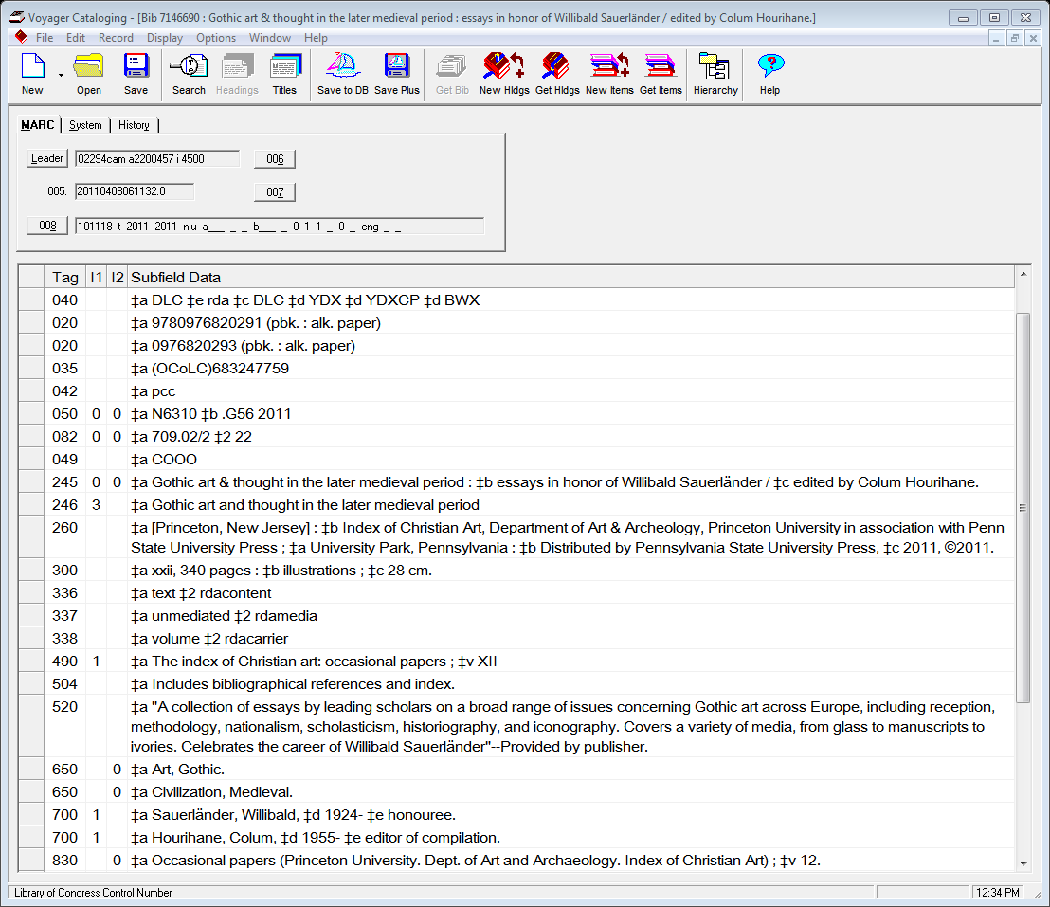
Cataloging form - ISBD
Content type
Media type
Carrier type
Notes:
Identifying an RDA record. As you know, it’s immediately identifiable by the ‡e (description conventions) rda and most often you will see an “i” in the Leader reflecting ISBD punctuation (International Standard Bibliographic Description) instead of the “a” for AACR2 (Anglo-American Cataloging Rules)
You also notice in the 260 field, both the publication and copyright dates, no longer simply the letter “c” but the copyright symbol. Both of these dates are added to the record if they appear in the book. Both dates are also reflected in the 008. The publication date is CORE and therefore required.
New Jersey and Pennsylvania are not abbreviated as they are with AACR2 . This is actually transcribing the places as they appeared in the book. And speaking of 260 fields, you will also start seeing more 264 fields.
You’ll notice, pages and illustrations are not abbreviated.
There are various new ‡e’s, the designators such as those used here in the 700 fields, honouree and editor of compilation. You may also notice that honouree is spelled using the European spelling. RDA is supposed to be more globally friendly than AACR2.
Lastly, you can’t miss the 33X fields which are physical descriptors.
The 336 or “Content type” field reflects the form of communication through which a work is expressed, in this case text because it is a book.
The 337 or “Media type” field reflects what type of device is required to view, play, run, etc., the content of a resource. This is a book, so it requires nothing and is therefore unmediated.
The 338 or “Carrier type” field indicates the format of the storage medium and the housing of a carrier; because this is a book its format is volume.

Slide 3
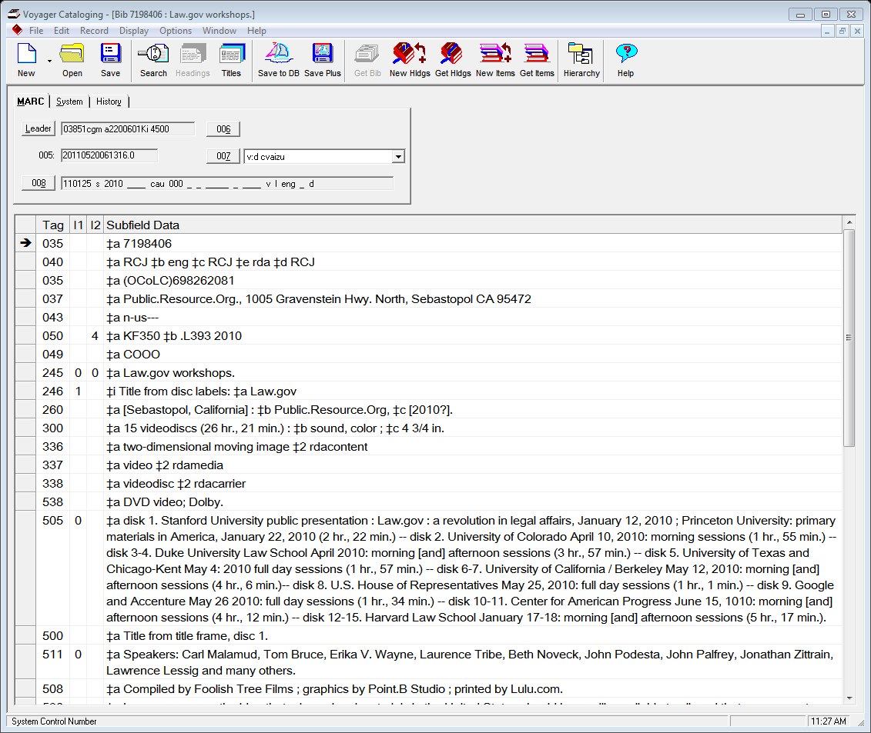
Notes:
And of course different materials will have different 33X’s. For example, this is a set of videodiscs.
The content is a “two-dimensional moving image”
The media is “video”
The carrier is “videodisc”

