Slide 1
AguaClara Advisory Council Meeting
April 15, 2011

Slide 2
Agenda
Quick update
Budget
  Expenses
  Revenue
Funding strategy for AguaClara

Slide 3
Millennium Water Alliance
$1,000,000 concept note submitted to USAID (design/capacity building/construction in Honduras and Guatemala)
Would fund a new truck and AguaClara Engineers
APP is the key implementing partner
By end of April will hear back from USAID Hope for invitation to write a full proposal

Slide 4
Grant Applications by AguaClara Engineers
Tech Awards application in process
Waterloo Foundation £85,000 submitted

Slide 5
Latin America
Guatemala – continued connections with a government ministry
Colombia
  Invitation to speak at Universidad Santo Tomas – Tunja (3 hours from Bogota in mid May)

Slide 6
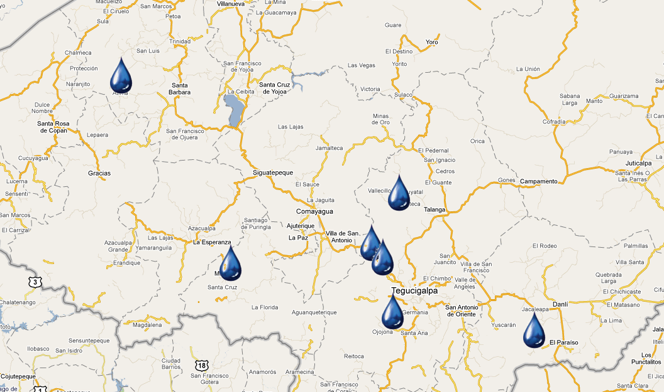
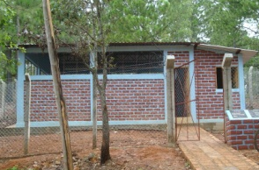
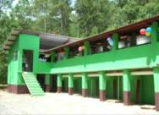
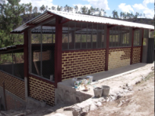
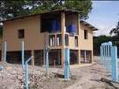

AguaClara in Honduras
Atima 2011
“Cuatro Comunidades” 2009
Agalteca 2010
Marcala 2008/2011
Alauca 2011
Tamara 2008
Ojojona 2007

Slide 7
Marcala (2) Honduras
A few details to complete
Plant Operator Training will continue
Good cooperation with the new ACRA director
ACRA willing to pay for a Stacked Rapid Sand Filter

Slide 8
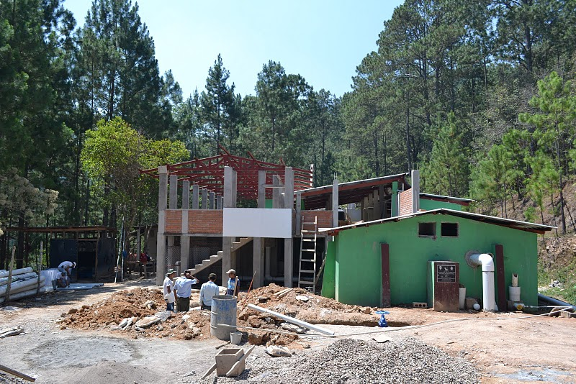

Slide 9
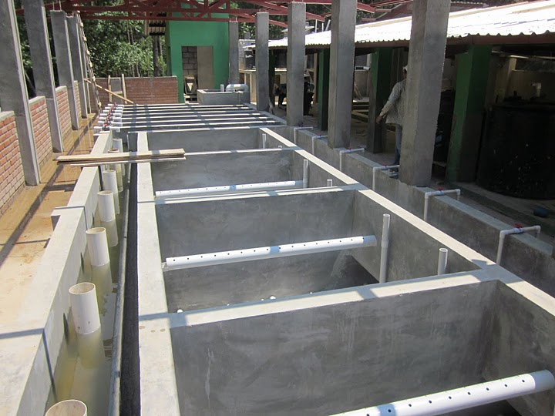

Slide 10
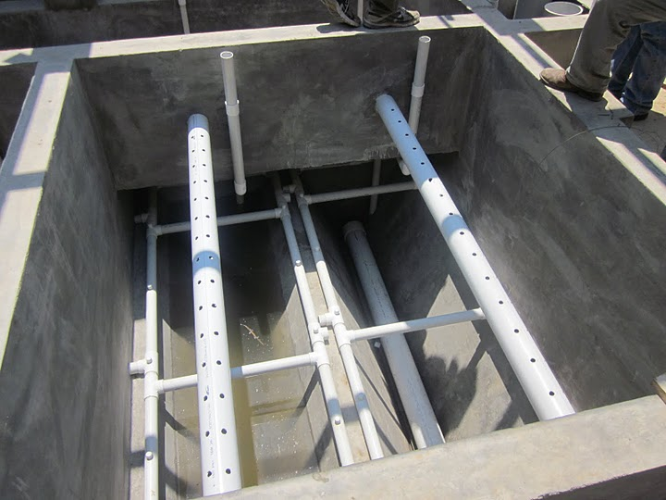

Slide 11
Alauca Honduras
Project is approved, Land is purchased
Waiting for funds to arrive from COSUDE (Swiss)
Antonio has been doing social work
Expecting to start construction after Semana Santa

Slide 12
Atima Honduras
No start date yet
Waiting for some final signatures of Honduran Rotarians
Then waiting for final approval from Rotary International
Still on track to start later this year

Slide 13
Water Meters
Tamara installing 60 water meters
Cuatro Comunidades is interested!
  Planning phase
  Idea is to install at water board homes first, then on new connections
Agalteca
  Antonio has begun talking about the possibility with the water board

Slide 14
Cornell Team: Peer-based learning
“I have been extremely impressed at how much responsibility I have been trusted with for my first semester in AguaClara. I already feel like I am contributing to this project in a meaningful way, and that respect from my peers and leaders holds me accountable in a way that most classes here at Cornell cannot.”
--Midterm feedback Spring 2011

Slide 15
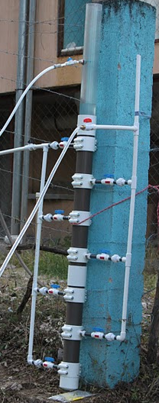
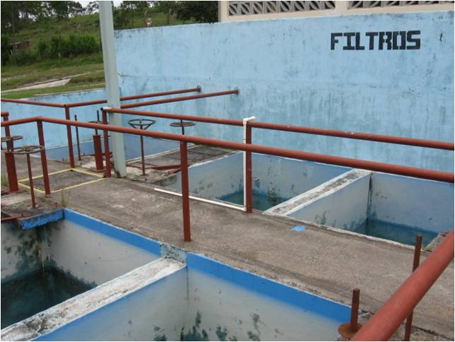
Stacked Rapid Sand Filtration
1/6 the plan view area of RSF
No backwash pump required
No requirement for 6 filter units
Preparing to take this technology full scale this summer (Tamara)

Slide 16
The Budget
Implementation funding is coming through other partners
AguaClara Engineers are working as consultants with hoped for funding through MWA – It would be good to have a contingency plan so we can hire someone this summer
This meeting’s focus is on AguaClara at Cornell

Slide 17
Funding Flexibility Multiplies Effectiveness
Opportunity to hire an M.Eng. graduate with advanced experience creating our automated design tool. There are many features that need to tested, debugged, and added to the design tool.
We need a few thousand dollars to take the SRSF technology to full scale. This technology will position AguaClara to be much more competitive.

Slide 18
Impressive ROI
We have highly skilled and motivated students and alumni who would be able to make substantial contributions to the project for “living” wages
The return on those investments is simply incredible
Our total R&D AND implementation expenditures to date cost less than what it would have cost to implement conventional technologies in 5 communities

Slide 19
Expenses
Each M.S./Ph.D. student $75k*
January trip for 21 students $30k
Research supplies $25k
Shop time $8k
Design and construction
of the first full scale filter $10k
Summer Internships
(Implementation sites or Cornell) $3.5k
*includes overhead. All other costs do not include overhead.

Slide 20
Revenue
EPA P3
  Great source for funding research supplies and CEE shop time
    $10k in 2007
    $10k in 2009
    $75k in 2010
    Applied for 3 $15k grants to be awarded? this summer
  Limited options for partial funding of a graduate student

Slide 21
Revenue
National Science Foundation
  Submitted proposal for $400k for 3 years
  Relatively low probability of success
Unrestricted Gifts
  Approximately $6,000 per year

Slide 22
Revenue
TA funding – The AguaClara program has now grown large enough that we now receive TA support for 1.5 semesters. (equivalent to about $50k)
Sanjuan Foundation - $50k

Slide 23
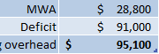
Funding summary
*
*
* These lines includes overhead. Other lines do not.
How can we generate $100k per year?

Slide 24
Strategies
College of Engineering Development Office (work with Cornell)
Form an NGO to make it easier for individuals to donate (go outside Cornell)
Identify individuals who may be interested in high impact donations
Create an endowment
Increase AguaClara visibility
Foundations and Organizations

Slide 25
College of Engineering development office
College Funding priorities – Faculty, Ph.D. fellowships, student teams
AguaClara could benefit from all three
Cornell’s fundraising strategy focuses on gifts for those broad categories
How could we connect with those who would like to support AguaClara but who won’t be energized by broad categories?

Slide 26
Form an NGO
I have individuals recommending this approach every year
Could a student team create and manage an NGO?
My preference is to empower existing organizations to realize their full potential rather than creating new organizations

Slide 27

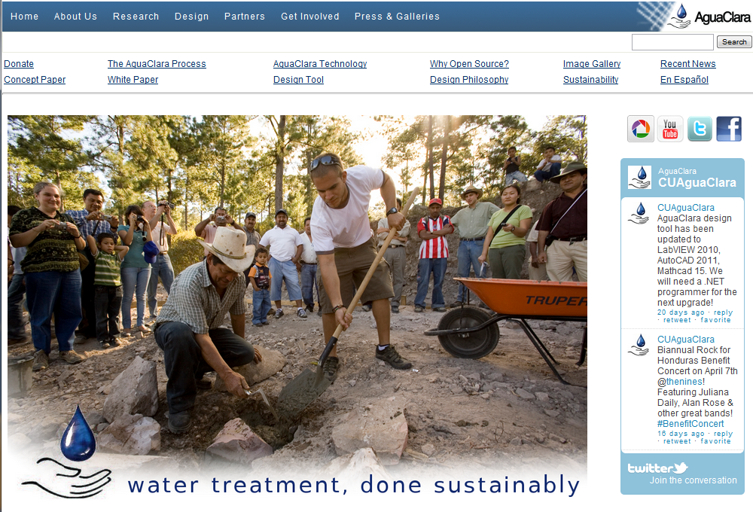
Increase Visibility: Our Long Term Strategy
TED talks (need nominations)
Ashoka fellowship (I nominated myself)
Popular press
Social media
Improved website
Fundraising event in NYC

Slide 28
Foundations, Organizations
UN, World Bank, InterAmerican Development Bank, USAID, USEPA, Peace Corps, NSF, Ford Foundation, Gates Foundation…
Little interest in sustainable water supply technologies
No interest (except perhaps NSF) in funding R&D

Slide 29
AguaClara in Washington: Like water in oil
Large institutions are…
  driven by global policies and priorities and have a top down approach
  slow in responding to new information (Institutional inertia)
  unwilling to adopt new ideas because they are highly risk adverse
We observe what works and what causes failures and respond quickly to data (bottom up approach)

Slide 30
Strategies
College of Engineering Development Office (work with Cornell)
Form an NGO to make it easier for individuals to donate (go outside Cornell)
Identify individuals who may be interested in high impact donations
Create an endowment
Increase AguaClara visibility
Foundations and Organizations

Slide 31
Review the Budget Assumptions
*
*
* These lines includes overhead. Other lines do not.

