Slide 1



High Flow Dose Controller

Slide 2
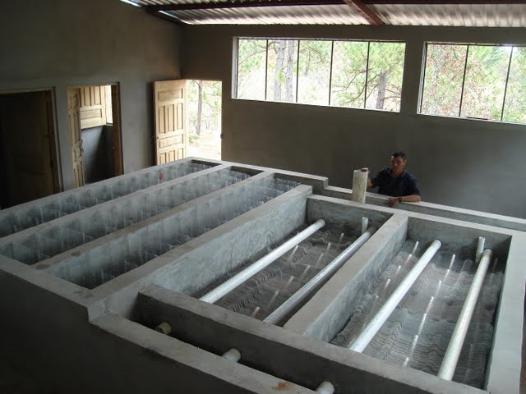
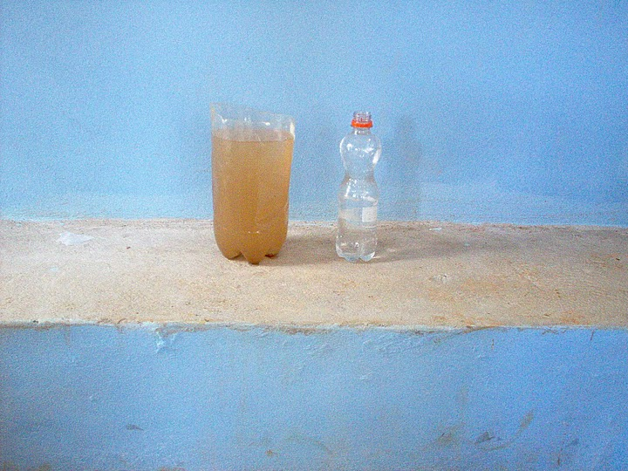
Getting Colloids to Settle
Notes:
There are a number of ways to clean water to make it suitable for drinking. Regardless of the process used, the ultimate goal is the removal of contaminants.
Small particles, referred to as colloids, that are suspended in water require lengthy settling times. To speed up the settling process, we need to make the colloids heavier. Colloids are negatively charged. If we mix in an aluminum salt, this negative charge is neutralized. This makes the colloids “electrically sticky” and if they were to collides, they would stick together and grow and would eventually become of sufficient size so they can settle out. The colliding takes place in the flocculator and the settling occurs in the sedimentation bays.

Slide 3
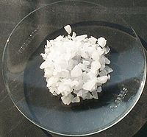
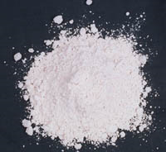


Aluminum Salt as a Coagulant
Alum
PAC
Photos courtesy of Wikipedia
Notes:
The two most common aluminum salts used for this process are Aluminum sulfate, referred to as Alum and Poly aluminum chloride or PAC. I want to note that this is NOT a unique process to AguaClara – many modern water treatment plants use this same method to clean the water we drink. The Cornell WTP uses PAC. And it is also believed that the Egyptians were using some kind of aluminum salt to clarify water as early as 1500 BC

Slide 4
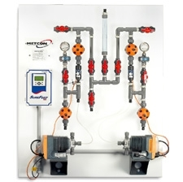
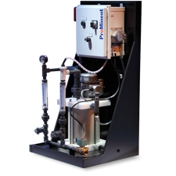
Modern Coagulant Metering
Photos courtesy of MetCon Engineering
Notes:
Normally, the amount of coagulant added to the plant is carefully metered and monitored with PLCs, regulating valves and specialized pumps. These methods require the use of electricity and consist of components that are not available in the remote areas we serve. These represent an inappropriate technology for Agua Clara.
The challenge for us is to produce this same level of precision without the level of complexity or the use of electricity.

Slide 5
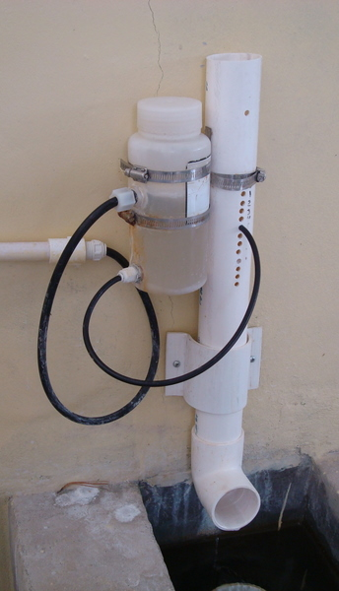
Simple Flow Control
Utilizes head loss through small tube for flow control
Perfect for low flow conditions
Well received by plant operators
Manually adjusted by operator
Photo courtesy of AguaClara
Notes:
Agua Clara engineers have developed a very simple and elegant solution to this problem. The two components to this simple flow controller are the constant head tank and a small diameter tube. Under laminar flow conditions, the head-loss through this small tube is predictable and can therefore be used to meter flow. The operator changes the height of the tube by putting it in different tubes and therefore changes the flow rate of the chemical.

Slide 6
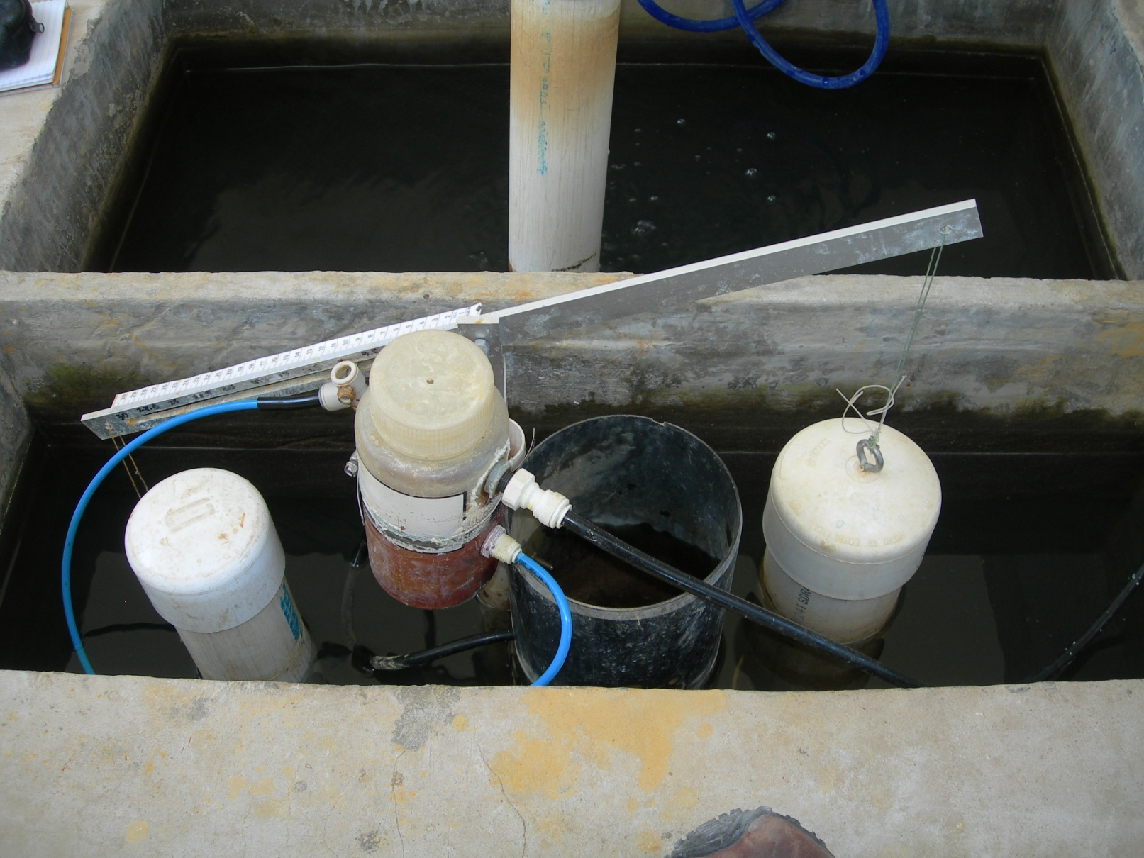
Coupling with Plant Flow
Notes:
This simple design was taken a step farther. The level in the entrance tank was coupled to the plant flow rate. The tube was attached to a slide on a lever arm which had a calibrated scale for dosing concentration. The float moves the lever arm, automatically adjusting the flow rate to maintain a desired concentration. Matt Higgins and his group will tell you more about this during their teach-in. But what I want to stress now is that at some point, plant flow rates will get high enough that the flow through the tube is no longer laminar so the flow will no long be predictable.

Slide 7
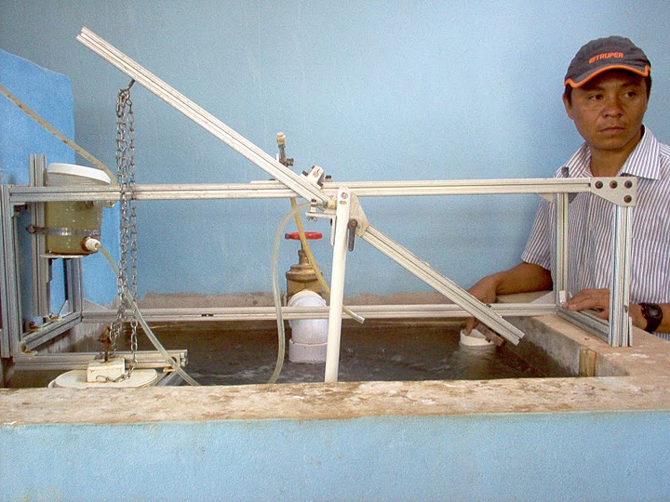
Non-Linear Dose Controller
Photos courtesy of AguaClara
Notes:
In 2009, I worked with a group of students to develop a new style of chemical dose controller that could work in all Agua Clara plants, regardless of flow rate. We increased the diameter of the tube to reduce head-loss and put an orifice at the end of the tube. The flow through an orifice is predictable regardless of flow rate, meaning as flow reaches the turbulent range the orifice equation holds true.
We installed our prototype at the AlgaTeca plant and worked with the engineers in Honduras to develop a chemical dose controller that the operators would find easy to operate and would provide the level of metering our plants require.
Unfortunately we ran in to a few problems with this design. Manufacturing of the orifice turned out to require a greater degree of precision than we expected so we weren’t getting repeatable flow rates from one orifice to another. Also, one orifice could provide sufficient flow for the entire dosing range which meant we needed two orifices and two scales. Surface tension had unexpected consequences and one suggested solution was yet another orifice. One further problem was the method we used to couple the entrance tank to the rest of the plant. Grit accumulation in the flocculator caused a rise in entrance tank level leading to incorrect dosing.
During this Januaries Honduras trip, our chemical doser was removed from service and the standard Agua Clara flow controller was installed.

Slide 8
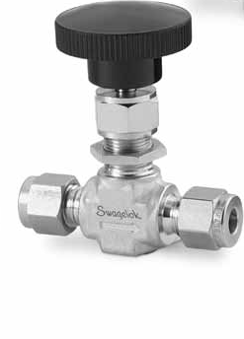
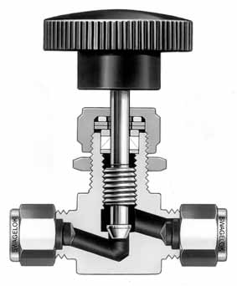
Variable Orifice – Needle Valve
Photos courtesy of Swagelock
Notes:
But, during the last year, I have been puzzling over how we can solve this problem. Eventually, we are going to need a method for dosing chemicals at high flow rates.
Many of the problems associated with this design were fixed with the addition of another orifice. I started thinking what we needed was a variable orifice, in other words, a needle valve. I played with this idea for a while and came up with this new concept for a high flow chemical dose controller.

Slide 9
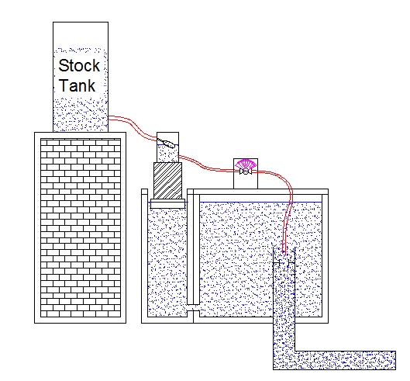
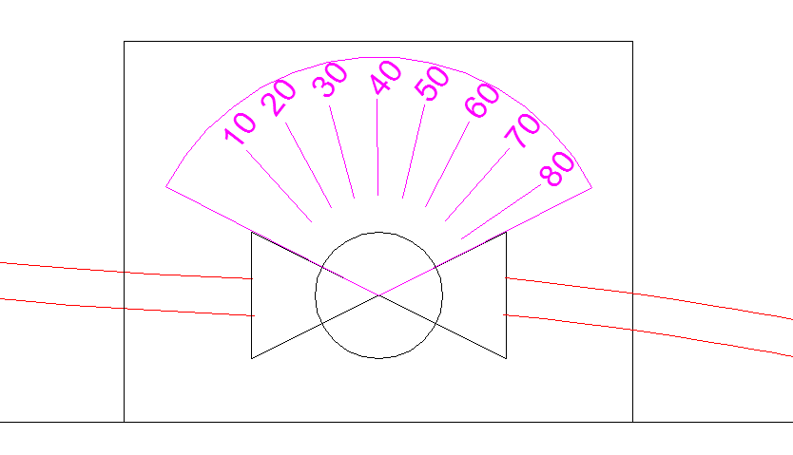
High Flow Dose Controller
To Flocculator
Notes:
This slide depicts the main components of the design. Its really quite simple. My plan is to take the constant head tank, mount in on a float, thereby eliminating levers and pivots. The tank will rest on an adjustable support that will allow for calibration. Then only other component in this design is the metering valve. The idea is to create a calibrated scale where the operator can dial in the concentration (not flow) and the opening in the valve coupled with the height here will determine the correct flow rate.

Slide 10
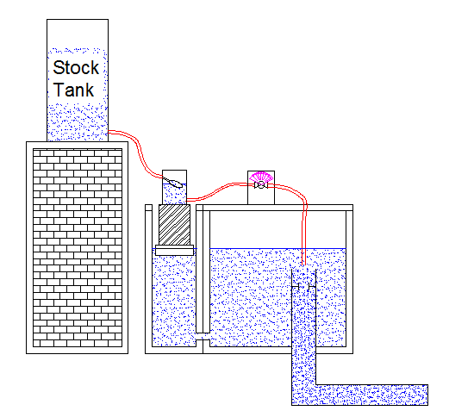
Low Plant Level
To Flocculator
Notes:
The operator will only need to make adjustments when inlet water quality changes, they will not need to make adjustments as flow rates through the plant changes. This adjustment is made automatically by changing the delta h between the constant head tank and the valve.

Slide 11
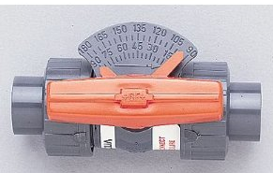
Metering Ball Valve
Photo courtesy of George Fischer Mfg.
Notes:
Now, a quick word about valves. Valves are generally categorized by whether they are designed for throttling or for shut-off. Because of different design constraints not all valves can be or should be throttled. I originally thought I would use the needle valve I mentioned earlier. This is the industry standard valve used when regulation is needed. It has a precisely machined orifice and a matching plug that provide very precise metering. My hope was to be able to find a valve series (by this I mean the exact same style of valve) that was available in different sizes that I could scale up or down depending on our plants size. Unfortunately, needle valves really NOT designed for such low pressure applications I and found it difficult to find orifice openings that were large enough for the flow rates we may require.
During my search, though, I found a new style of ball valve that has just been put on the market. As I stated earlier, not all valve are made for throttling. Historically, you can throttle a ball valve- it won’t really damage it but you can’t obtain fine control. This new ball valve I found is designed for metering and has what they are calling a characterized opening that allow for more precise control.
This valve should be arriving this week and I’ll be able to do some testing and see if it could be something we can use.

Slide 12
High Flow Dose Controller
To Flocculator
Notes:
Aside from finding the right valve for our application and designing a workable float, I’ll also need to come up with the right method to couple the entrance tank to the rest of the plant. It is necessary that there is free flow between the entrance-tank exit-orifice and the rest of the plant.

Slide 13

Notes:
Agua Clara – because girls have better things to do than carry water.

