Slide 1
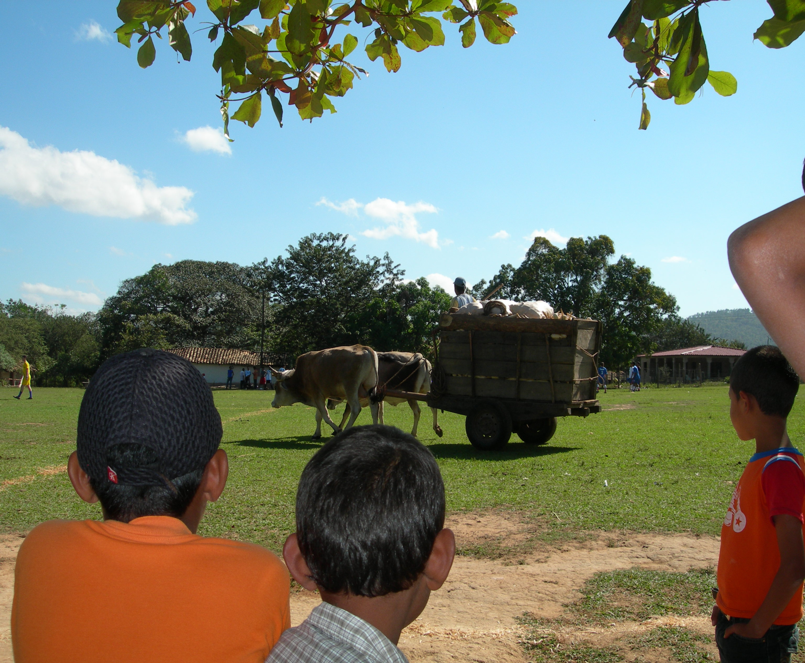


High Flow Dose Controller

Slide 2
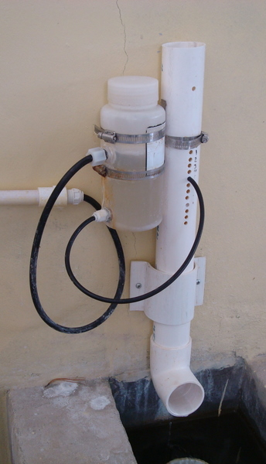
Linear Dose Controller
Photo courtesy
of AguaClara

Slide 3
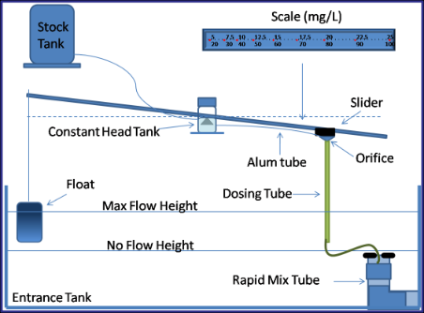
Non-Linear Dose Controller
Photo courtesy
of AguaClara

Slide 4
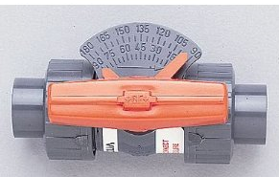
Metering Ball Valve
Photo courtesy of George Fischer Mfg.

Slide 5
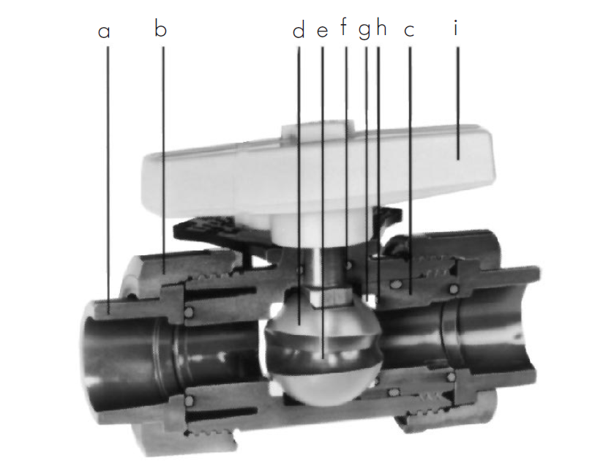
Characterized Opening
Photo courtesy of Georg Fischer
Piping Systems

Slide 6
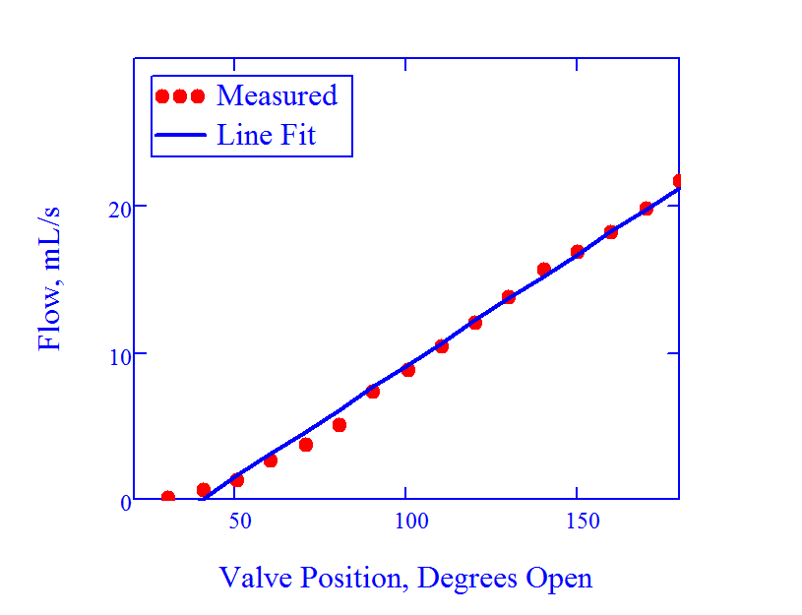
Cool Linear Action

Slide 7
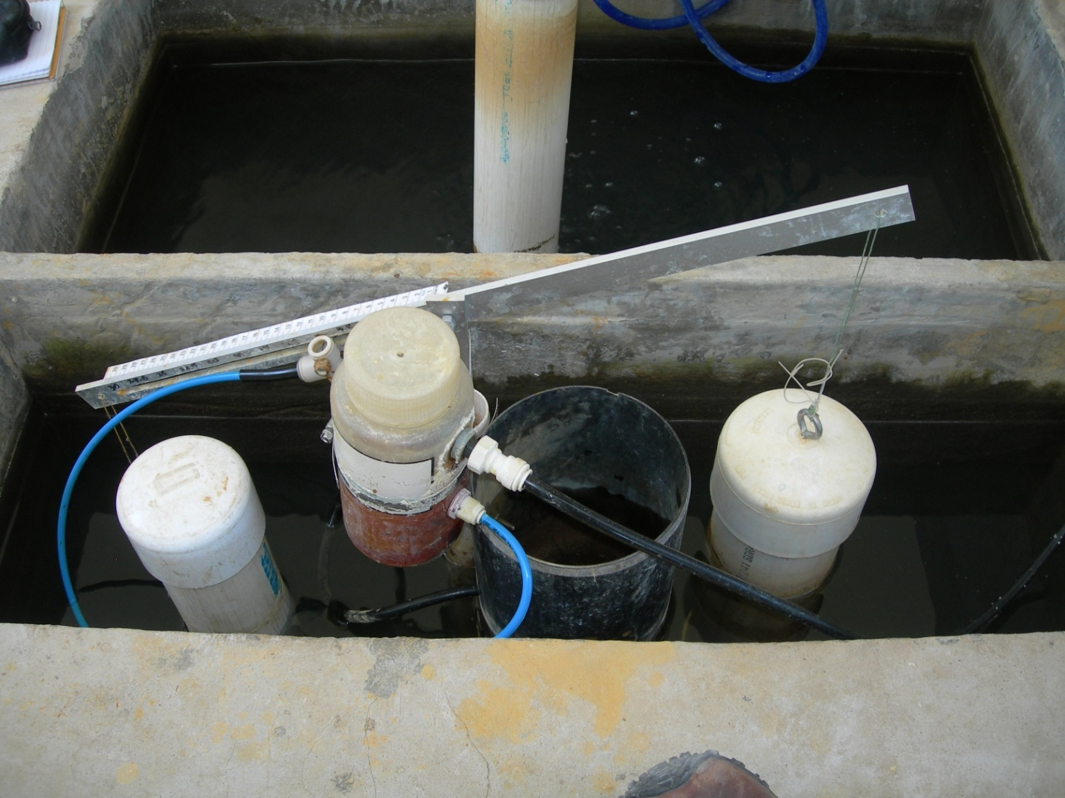


Coupling with Plant Flow

Slide 8
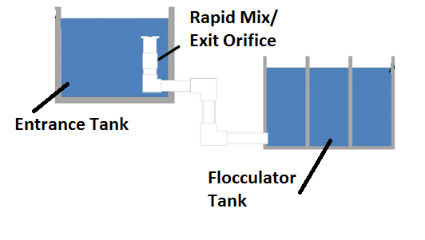
Flow Control Orifice

Slide 9
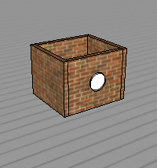
Free Flow Orifice
20 L/s Plant =
14.4 cm (5.67”)
100 L/s Plant =
32 cm (12.6”)

Slide 10
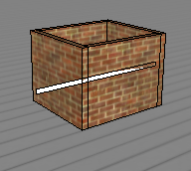
Free Flow Orifice
20 L/s Plant =
5 cm x 30 cm
100 L/s Plant =
5 cm x 160 cm

Slide 11
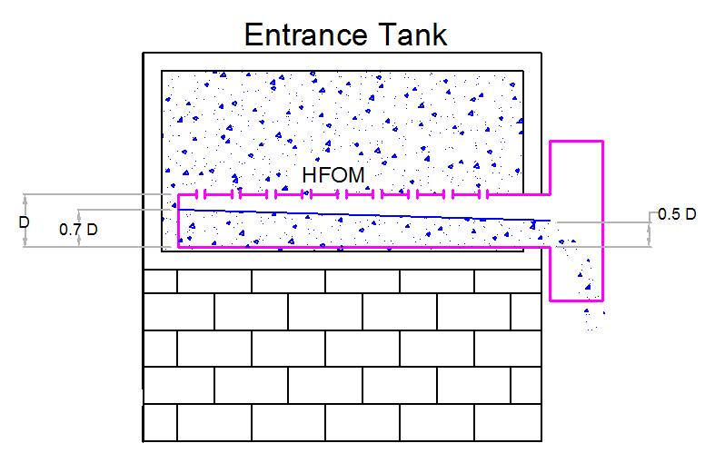
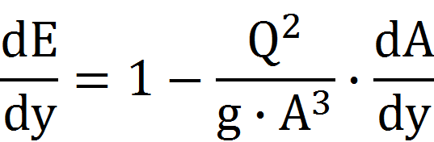
High Flow Orifice Meter

Slide 12
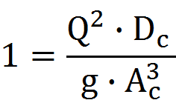
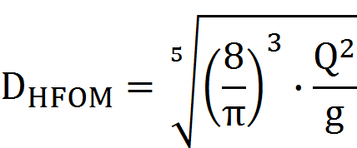
High Flow Orifice Meter

Slide 13
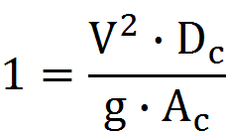
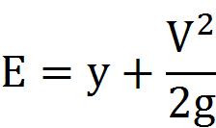
High Flow Orifice Meter

Slide 14

High Flow Orifice Meter

Slide 15
HFOM Diameter vs. Flow

Slide 16
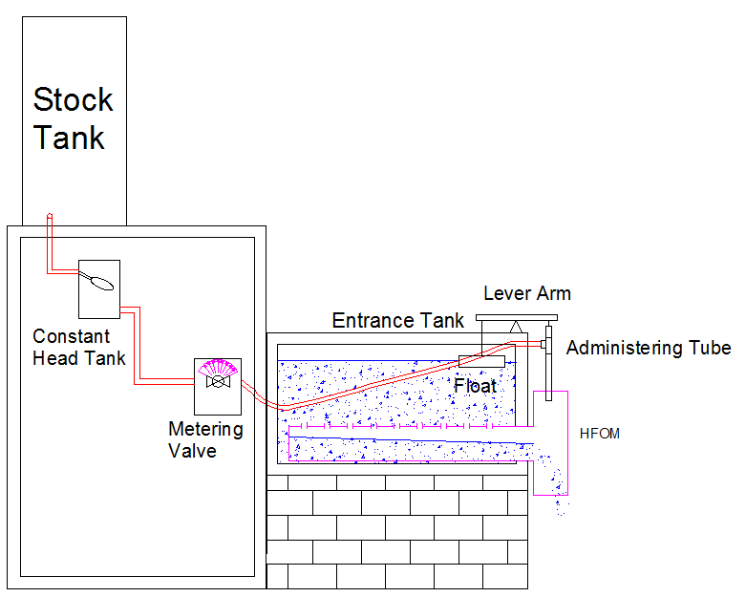
High Flow Dose Controller

Slide 17
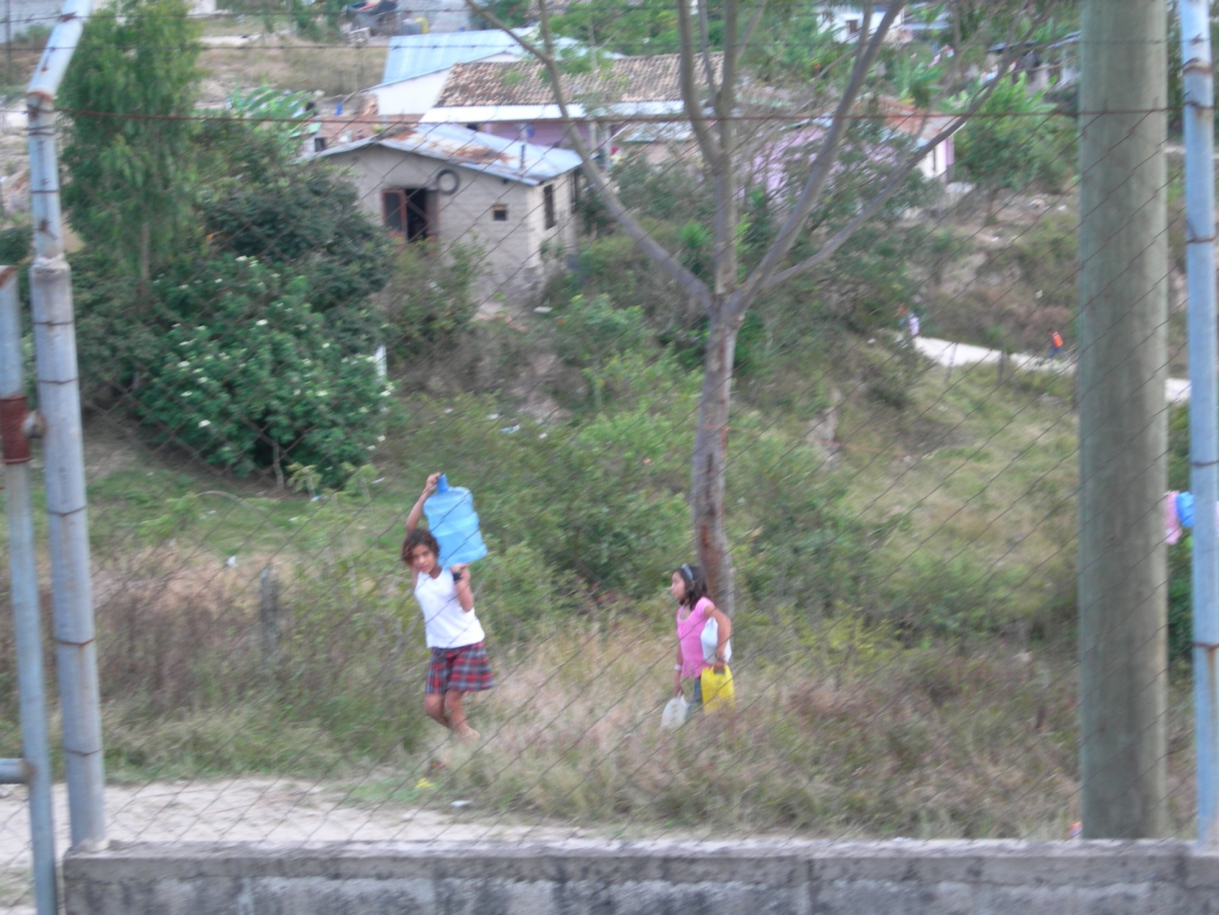
‘Cause girls have better things to do.......

