Slide 1

Stock Tank Mixing
Summer 2011
Aliya Adili, Christine Curtis, Justin Kim, Xuying Wang

Slide 2
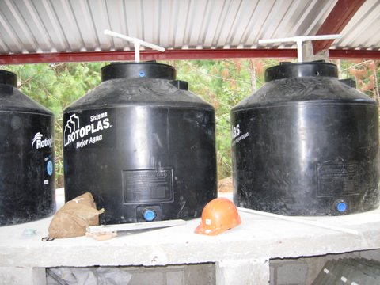
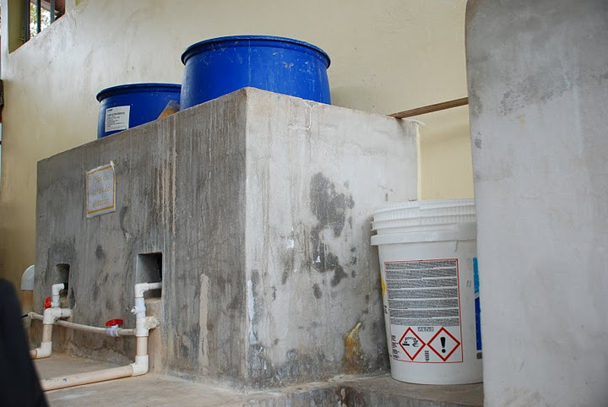

Introduction
  The team’s purpose: To improve stock tank mixing at AguaClara plants in Honduras.

Slide 3
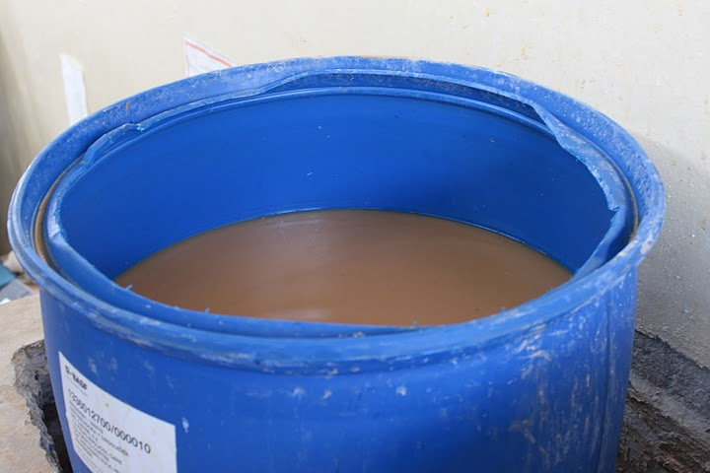
Introduction
Current mixing system (“stick mixing”) is inefficient
No way to tell when the solution is homogenized

Slide 4
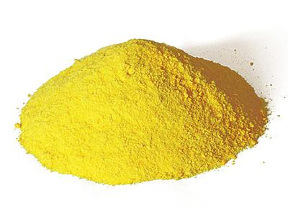
Why focus on PACl?
AguaClara plants are gradually switching to PACl.
More cost efficient than alum.
Notes:
Therefore, the team is experimenting with PACl.

Slide 5
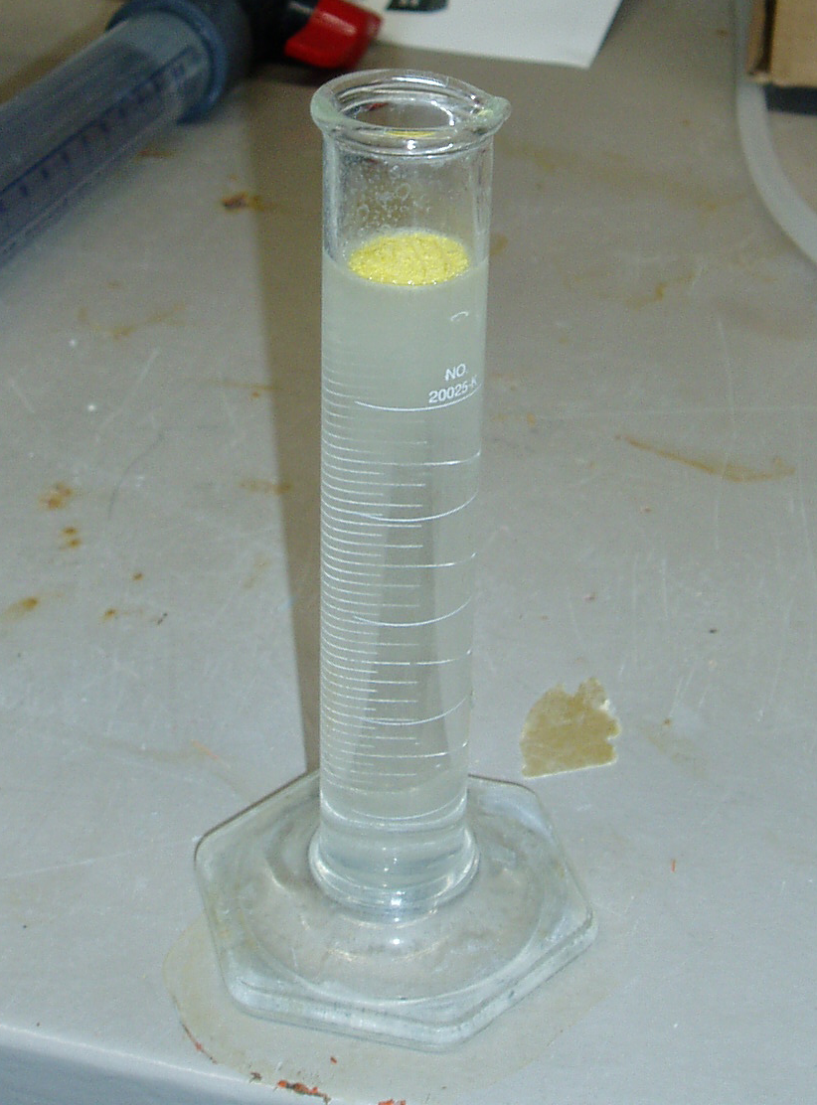
Why focus on PACl?
Mixes more readily than alum.
Less dense than water!

Slide 6
Two Phases to Mixing
1: The dissolution of the solid.
2: The elimination of the concentration gradient.
PACl dissolves readily, but the concentration gradient is a problem!
Notes:
PACl solution more dense than water.

Slide 7
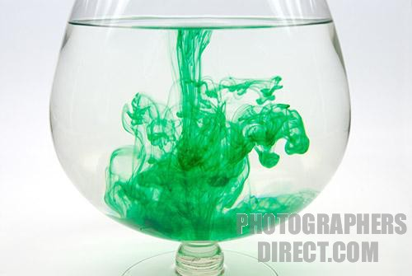
What is a Concentration Gradient?
Most of the dissolved PACl will settle down to the bottom of the tank and create a gradient.
Result: High concentration at bottom low concentration at the top.

Slide 8

How do we get rid of the Concentration Gradient?
Too big of a job for Molecular Diffusion
We need more energy!
We need a mixing device!
Notes:
When dumping PACl granules, only molecular diffusion, no concentration gradient yet.

Slide 9
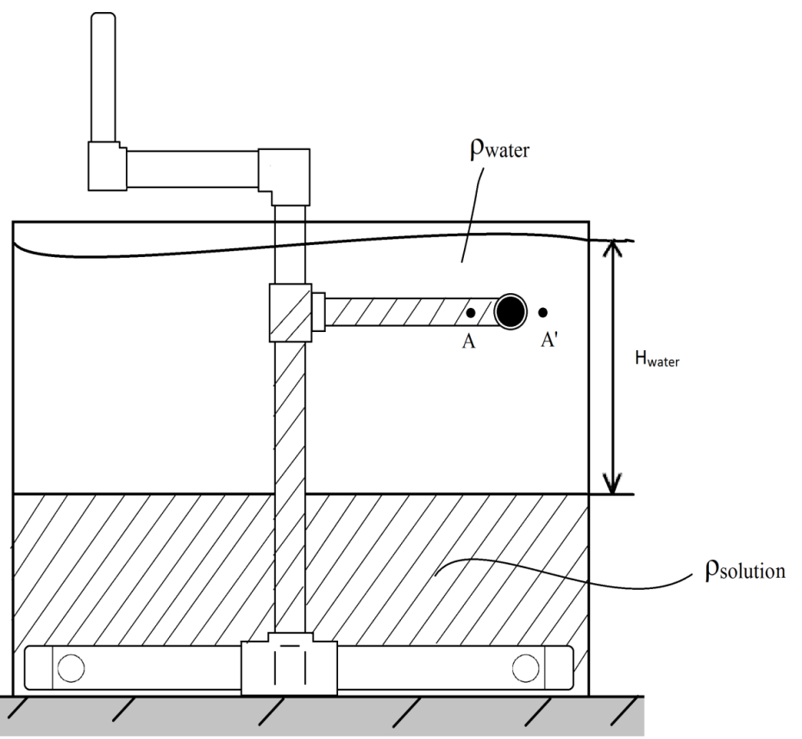
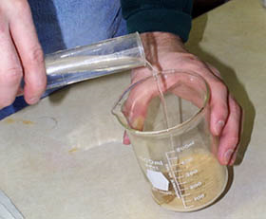
Mixing Systems
Injecting solution to the bottom of water
Centrifugal pump
Notes:
Pictures of each system

Slide 10

The Centrifugal Pump
Why a pump?
How does it work

Slide 11
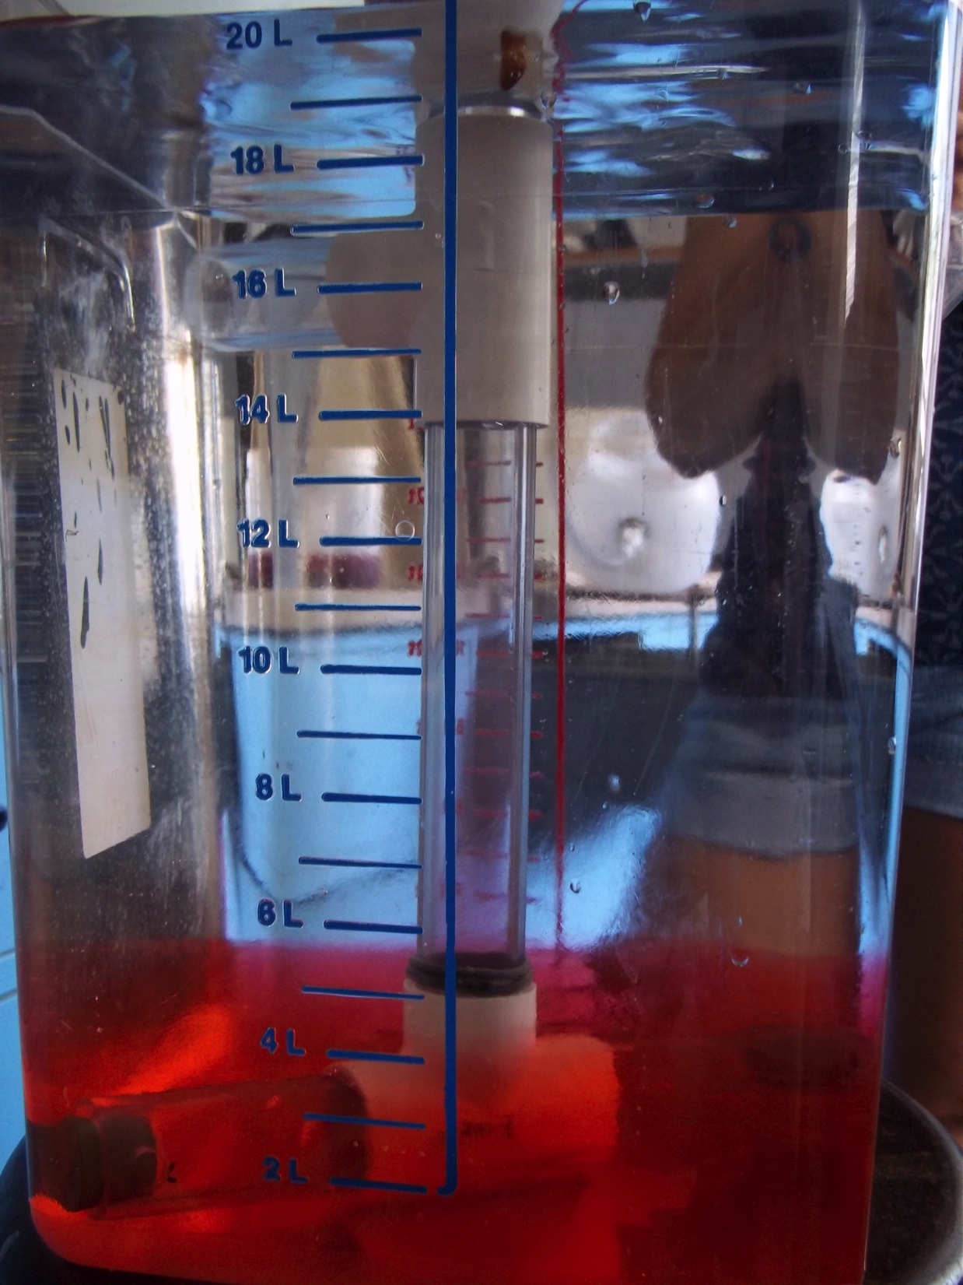
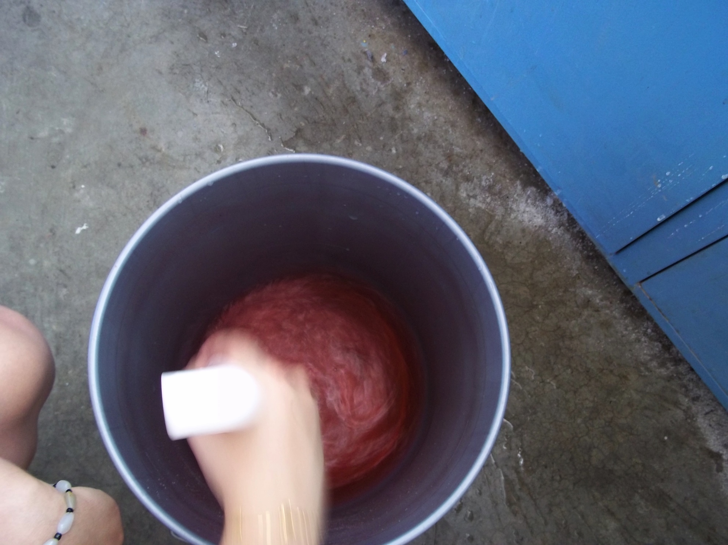
Experiment setup

Slide 12
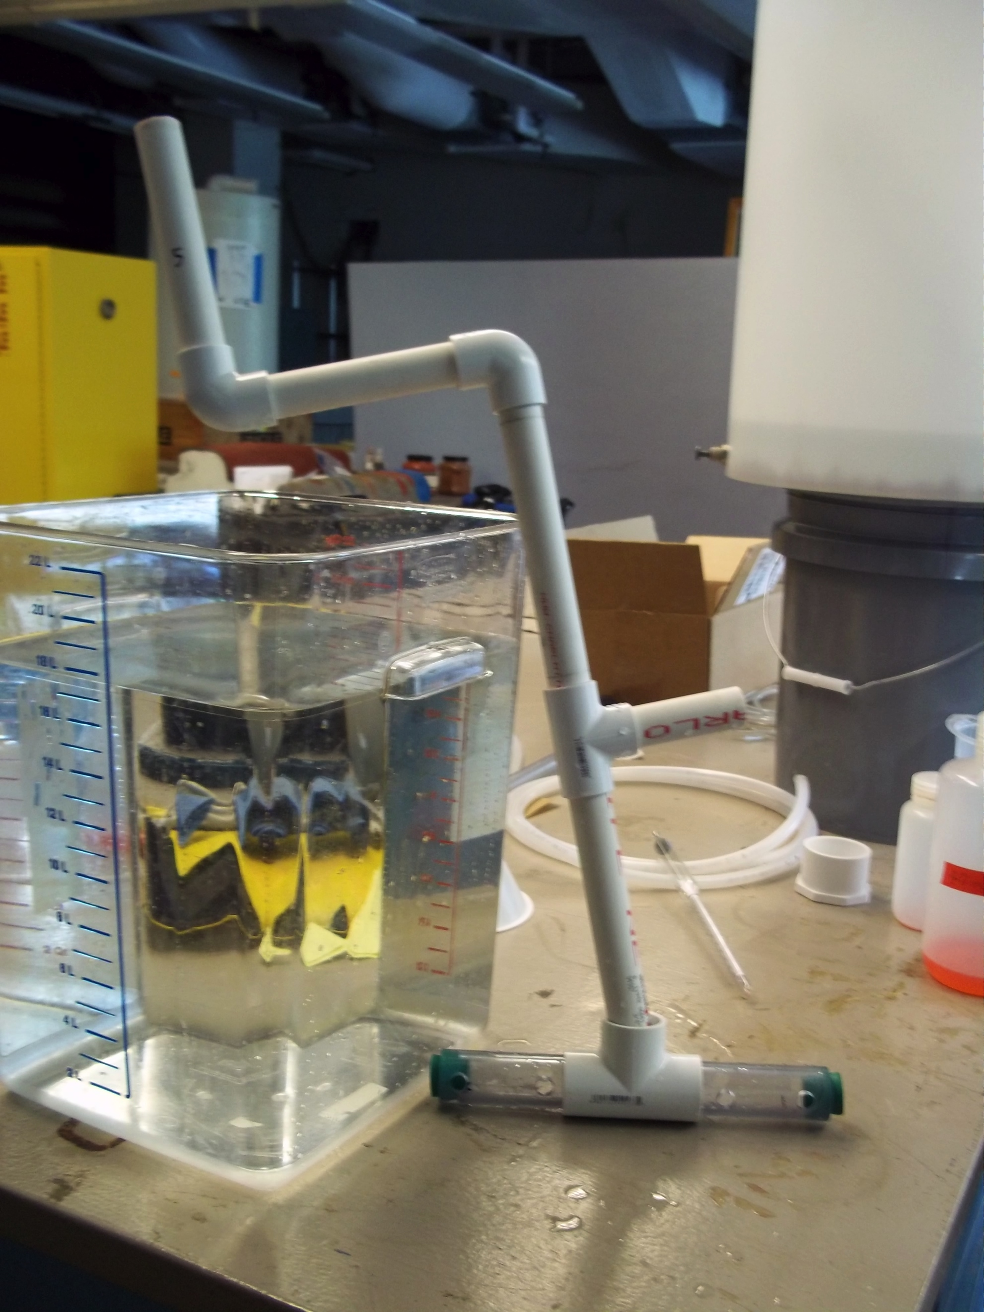
Previous Design
Badly sealed
Can’t measure the height of solution coming up during the experiment

Slide 13
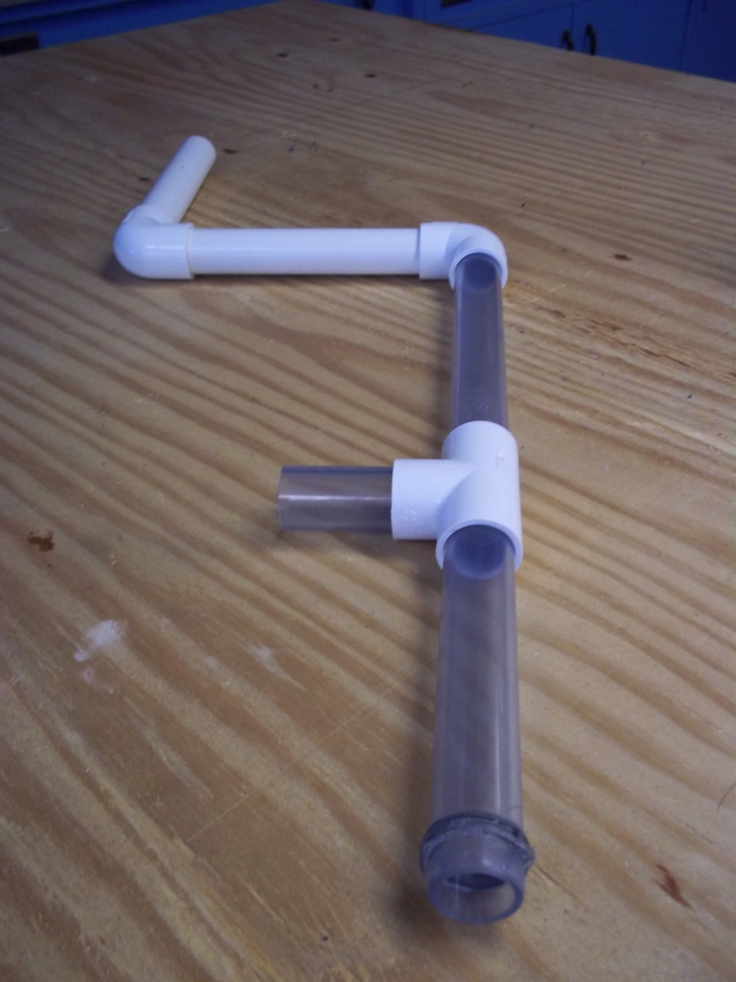
New Pump
Clear PVC
Sealed better than the old one

Slide 14
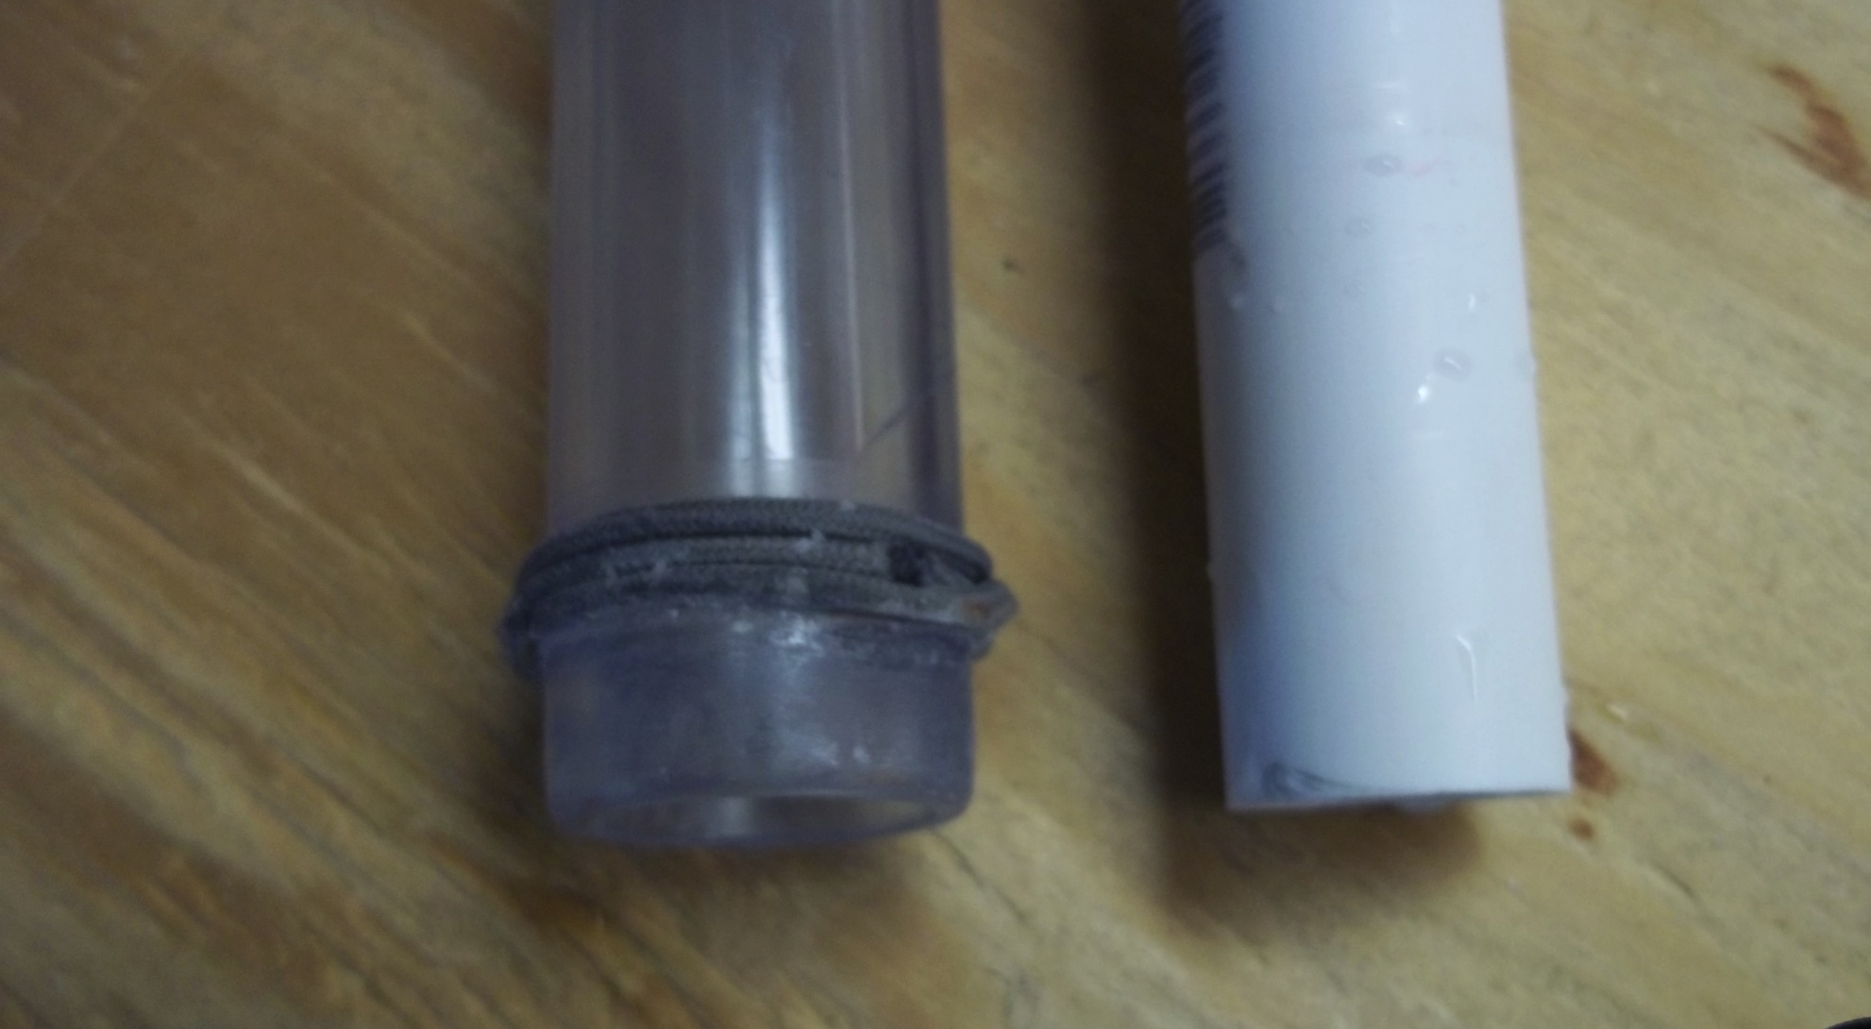
Detail of the seal parts

Slide 15
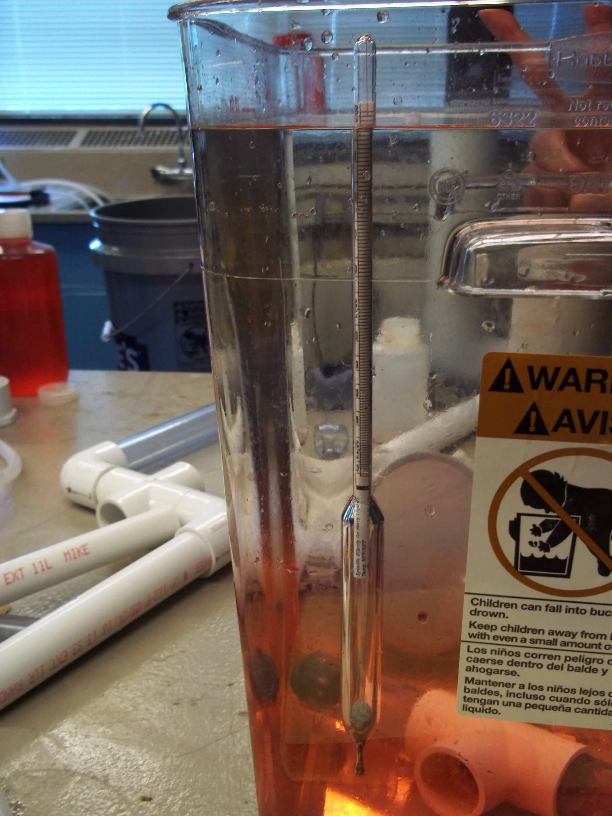
Tell the way when done mixing
Hydrometer
Density increases, measure the density of water to tell when done mixing

Slide 16
Results
The centrifugal pump is a good idea for mixing concentration gradient.
A satisfying flow rate could be obtained with relatively slow rotating speed.
Better sealed new pump can increase efficiency.

Slide 17
Future Work
Centrifugal Pump
Bicycle powered pump – May be efficient for larger tanks

Slide 18

Thank you!
Questions?

