Slide 1


Stock Tank Mixer
Julie Silva
Stephen Yoon

Slide 2
Chemistry
PACl, Alum, Ca(CIO)₃
  Dissolves easily
  Solution is more dense than water
Gradient
  High concentration at bottom
  Low concentration at the top
Once homogeneity is achieved, reactants will not separate
Notes:
It’s PACl (polyaluminum chloride)
This is also useful with alum (aluminum sulfate), the other coagulant that can be used, and with chlorine (calcium hypochlorite)

Slide 3
Team Goals
Design a mixing system that will:
  Improve operator use/ease
  Achieve a homogeneous mixture
  Be scalable to larger plants
Create operating guidelines
  Provide operator with verification of homogeneity
    Develop “optimal value” for log
Notes:
I would add – provide the operator with verification of homogeneity (or sufficient mixing). Remember that some students may be unfamiliar with the log kept by the operators

Slide 4
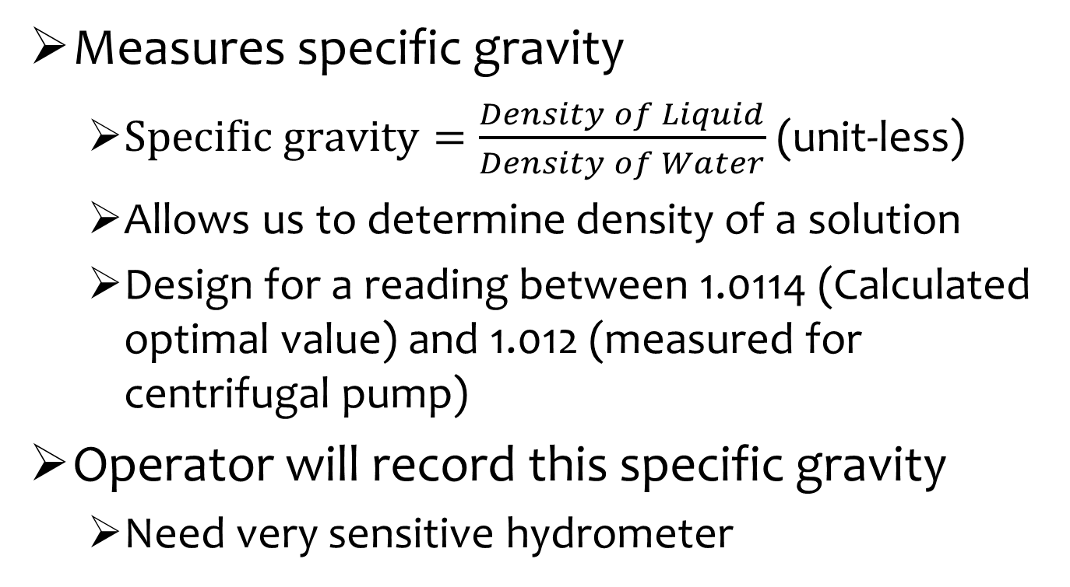
Hydrometer
Measures specific gravity
  $Specific gravity=\frac{Density of Liquid}{Density of Water}$ (unit-less)
  Allows us to determine density of a solution
  Design for a reading between 1.0114 (Calculated optimal value) and 1.012 (measured for centrifugal pump)
Operator will record this specific gravity
  Need very sensitive hydrometer
Notes:
I can tell that this slide is a picture, you should retype it to keep the presentation looking professional. Please describe what a hydrometer is/how it is used before this slide.

Slide 5
Video
Notes:
Videos are great in presentations!

Slide 6
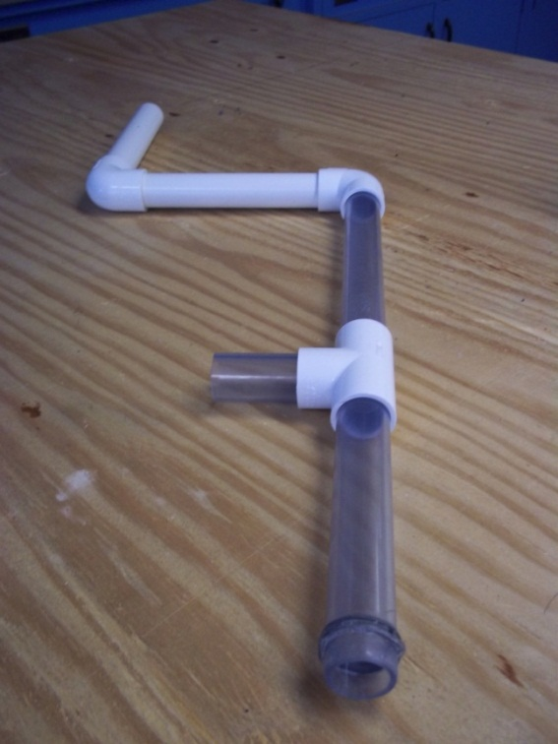
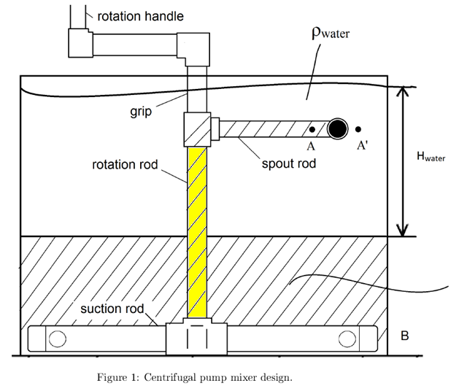
Past Apparatus
Clear pipes for increased visibility
Larger pipes
Rotation rod has tapered end for easier rotation
  Hair tie
Handle is difficult to use
Main problem: Stability/How to attach the apparatus into the tank

Slide 7
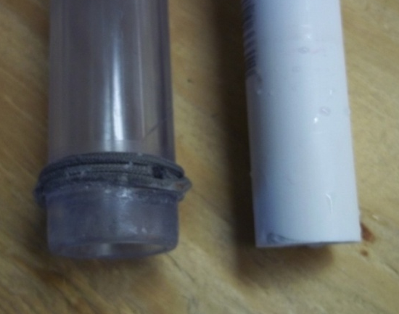
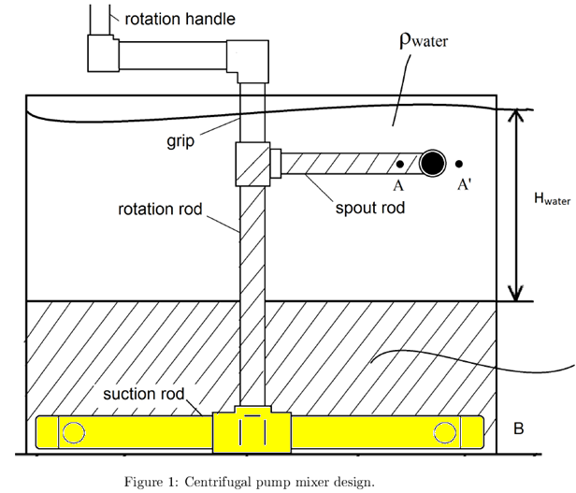
Hair Tie Improvement: “O-Ring”
Ridge to snap in place
  Must be taken out with force
“O-ring” or other material
  Friction
Notes:
I would just add an arrow to the point in the diagram where the rotation happens. Great animation! The top o ring is probably unnecessary if you have such a deep groove in the fitting.

Slide 8
Stability
Main Issue
Suction rod must be kept steady for centrifugal pump to work
Very difficult to attach suction rod to apparatus with no visibility
Notes:
Will demonstrate these difficulties with our prototype
^Great!

Slide 9
Future Work: “Stoppers”
Add stabilizing pipes to suction rod
  Pipes cut to fit snugly around suction rod
Once upright, has limited rotation
Suction rod attached to rotation rod
Side View
Suction Rod
Pipes have cut-out “u”
Top View
Notes:
The top view doesn’t show that one of the pipes is over the other (cut-out “u”). Make the center of the suction rod in the side view a different color or pattern, it is easy to confuse that with the stoppers you have next to the pipe in the top view (solid blue circle)

Slide 10
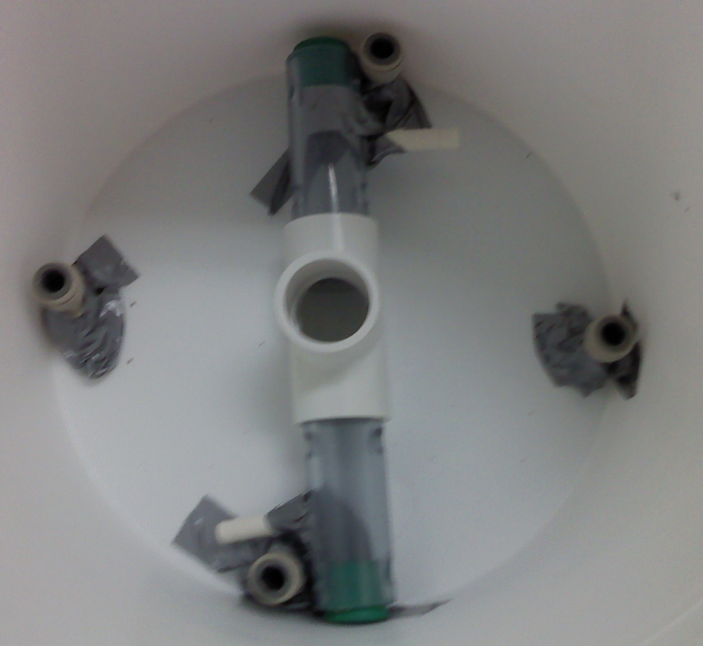
First Stoppers Experiment
Determine feasibility
  Suction Rod
  4 stoppers
  Rotated both ways
Observations
  All trials under 0.50 s
  Rod movement
Analysis
  Longer suction rod
  Make use of friction
Notes:
Before doing more experiments with adding stabilization pipes, we tried one experiment with a stabilized pipe. It was very difficult to get accurate readings for time loss for 2 reasons: 1. even though the rod was almost as long as the bucket, it wasn’t long enough… and kept moving… 2. The duck tape stopped much of the movement. Although we would not use duck tape in the Agua Clara plant, we could perhaps try to add friction to the bottom of the tank to stop movement. We also came up with the idea of adding a stabilizing “leg” to stick out of the rod that would hit into the stopper and decrease movement more.

Slide 11
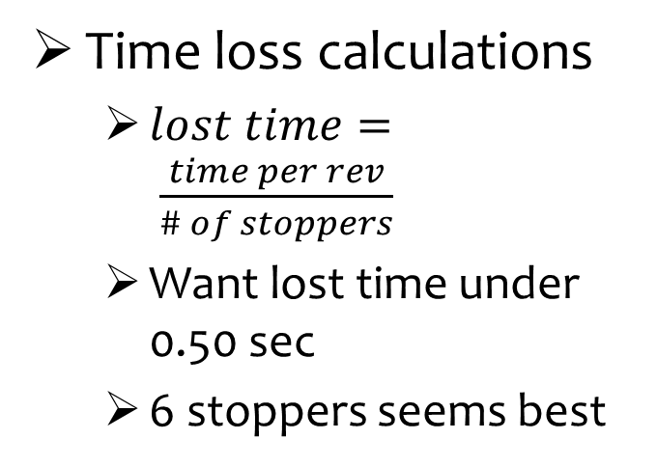
Stoppers Ctd.
Time loss calculations
  $lost time= \frac{time per rev}{\# of stoppers}$
  Want lost time under 0.50 sec
  6 stoppers seems best
Comments after experiment
  Will not have more than 0.50 sec of lost time
  Minimum suction rod length
  Make use of friction
Problems
  How will the stoppers be added to the tank?
Time per Rev | 1 sec | 2 sec | 3 sec
4 stoppers | 0.25 sec | 0.50 sec | 0.75 sec
6 stoppers | 0.17 sec | 0.33 sec | 0.50 sec
8 stoppers | 0.125 sec | 0.25 se | 0.375 sec
Notes:
Discuss possible solutions to adding the stopper to the tank… glue, cement… will continue this research.
-The pasted stuff is kind of obvious, I would retype it. Sounds like a good analysis though.

Slide 12
Future Research
Other stability ideas
  Permanently attach suction rod to tank
How do we make the rotation rod and suction rod attach easily?
  Guides: funnel, lid
Questions?

