Slide 1


Stock Tank Mixer
Julie Silva

Slide 2
Outline
Goals
Hydrometer
  Prototype
  Design and calibration method
Centrifugal Pump
  New design

Slide 3
Team Goals
Design a mixing system that will:
  Improve operator use/ease
  Achieve a homogeneous mixture
  Be scalable to larger plants
Create operating guidelines
  Provide operator with verification of homogeneity
    Develop “optimal value” for log
Notes:
I would add – provide the operator with verification of homogeneity (or sufficient mixing). Remember that some students may be unfamiliar with the log kept by the operators

Slide 4
First Hydrometer Design
Basic Hydrometer
  Cylinder and weight
  Must float in water without tipping
First Hydrometer
  Clear 3/16 in PVC pipe
  Screw for variable weight
    Washers
Balance could not be found
  Sunk with little weight (2 washers)

Slide 5
Modifications
Air chamber to increase buoyancy
Did not help

Slide 6
Working Hydrometer
0.115 in diameter Aluminum tubing
  Weight attached to the bottom, add washers
Floated in water with weight between 1.79 and 2.1g
Allowed me to develop method for creating simple hydrometers

Slide 7
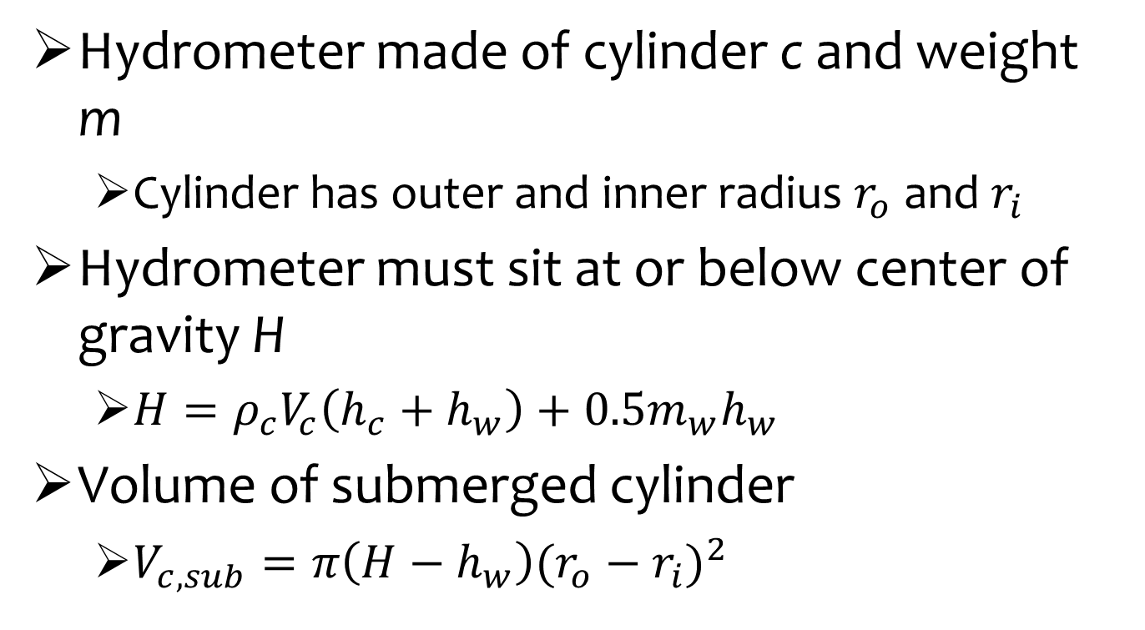
Calculations
Hydrometer made of cylinder c and weight m
  Cylinder has outer and inner radius $r_{o}$ and $r_{i}$
Hydrometer must sit at or below center of gravity H
  $H=ρ_{c}V_{c}\left(h_{c}+h_{w}\right)+0.5m_{w}h_{w}$
Volume of submerged cylinder
  $V_{c,sub}=π\left(H−h_{w}\right){(r_{o}−r_{i})}^{2}$

Slide 8

Calculations ctd.
Archimedes Principle
  Buoyant force = weight of fluid displaced
  $V_{c,sub}ρ_{c}m_{w}=ρ_{fluid}\left(\frac{m_{w}}{ρ_{w}}\right)$

Slide 9
Method
1. Choose rod material
  < 0.3 g/in and 1/8 to 3/16 in diameter
2. Calculate the approximate and reasonable height and weight needed to develop a hydrometer for given rod

Slide 10
Method ctd.
3. Build a prototype
  Start with a weight of 0.5 grams less than the calculated value, increase by 0.1 g to find range of values. Find this range for specific gravities of 1 and 1.0114.
4. Find attainable value within range.
  Safer to stay on the lighter side.

Slide 11
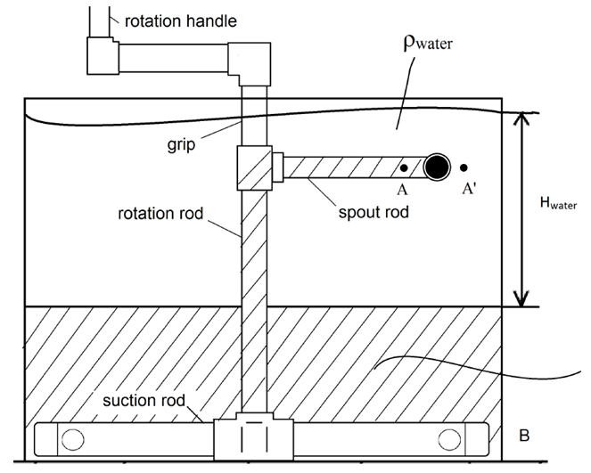
Previous Centrifugal Pump

Slide 12
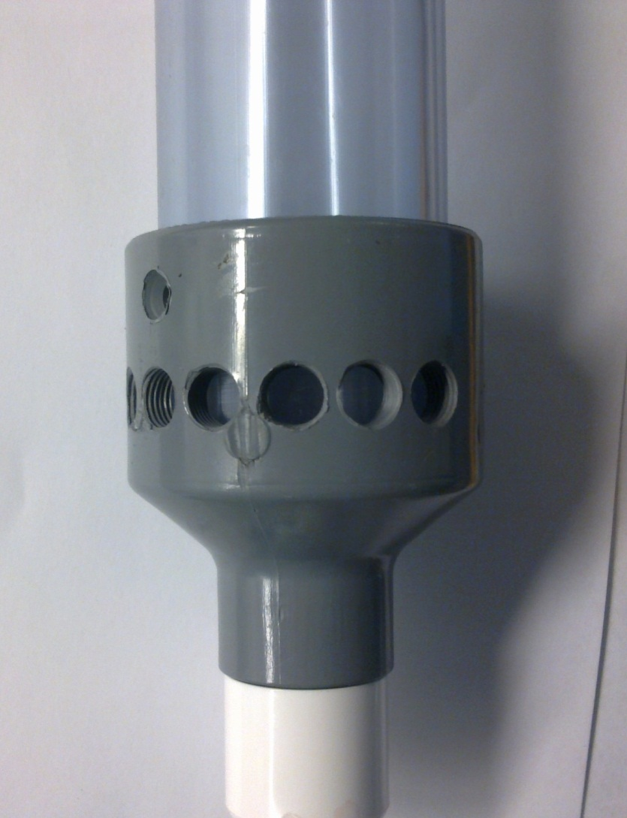
New Centrifugal Pump
Makes use of bulk head fitting in the bottom of the tank
Coupling with holes
Solution goes directly into suction rod

Slide 13
New Centrifugal Pump, ctd.
Stabilized at the top with a hole in the lid
Can be used with either tank
  Suction rod caused many problems
  Spout rod must fit within opening

Slide 14
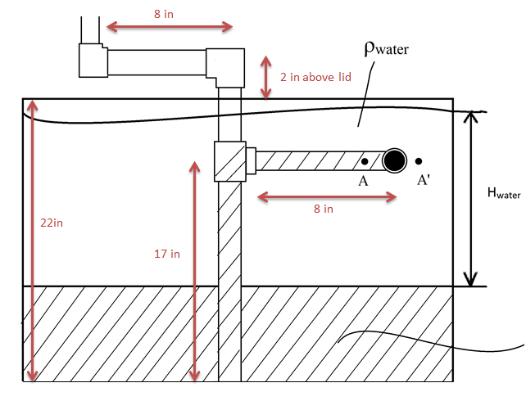
Approximate Specifications

