Slide 1

Stock Tank Mixing
Spring 2011
Jae Lim, Chris Inferrera, Boyang Mao

Slide 2
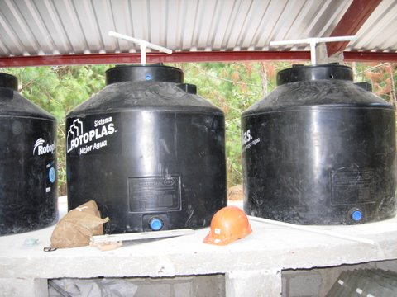
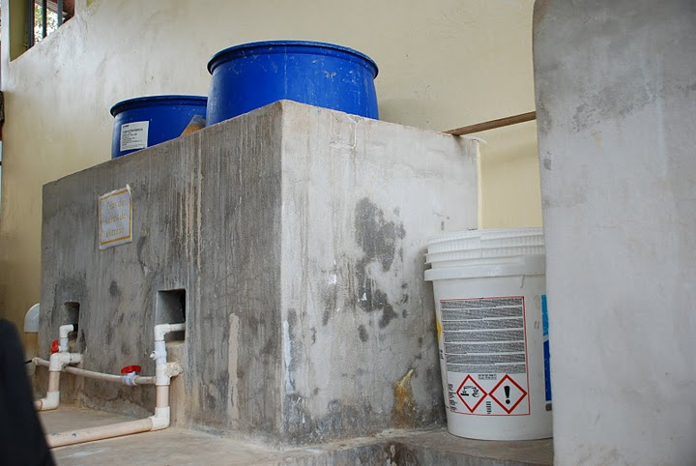

Introduction
  The team’s purpose: To improve stock tank mixing at AguaClara plants in Honduras.

Slide 3
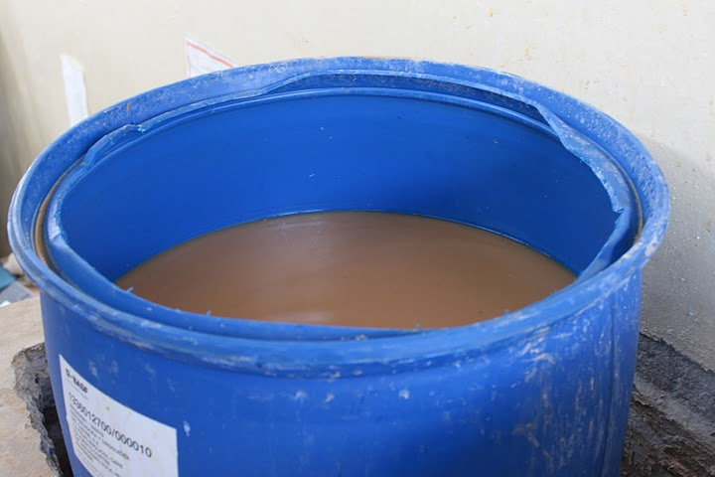
Introduction
Current mixing system (“stick mixing”) is inefficient
No way to tell when the solution is homogenized

Slide 4
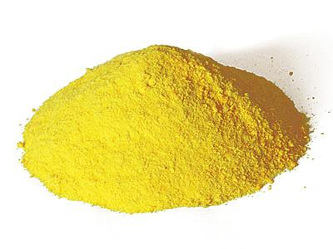
Why focus on PACl?
AguaClara plants are gradually switching to PACl.
More cost efficient than alum.
Notes:
Therefore, the team is experimenting with PACl.

Slide 5
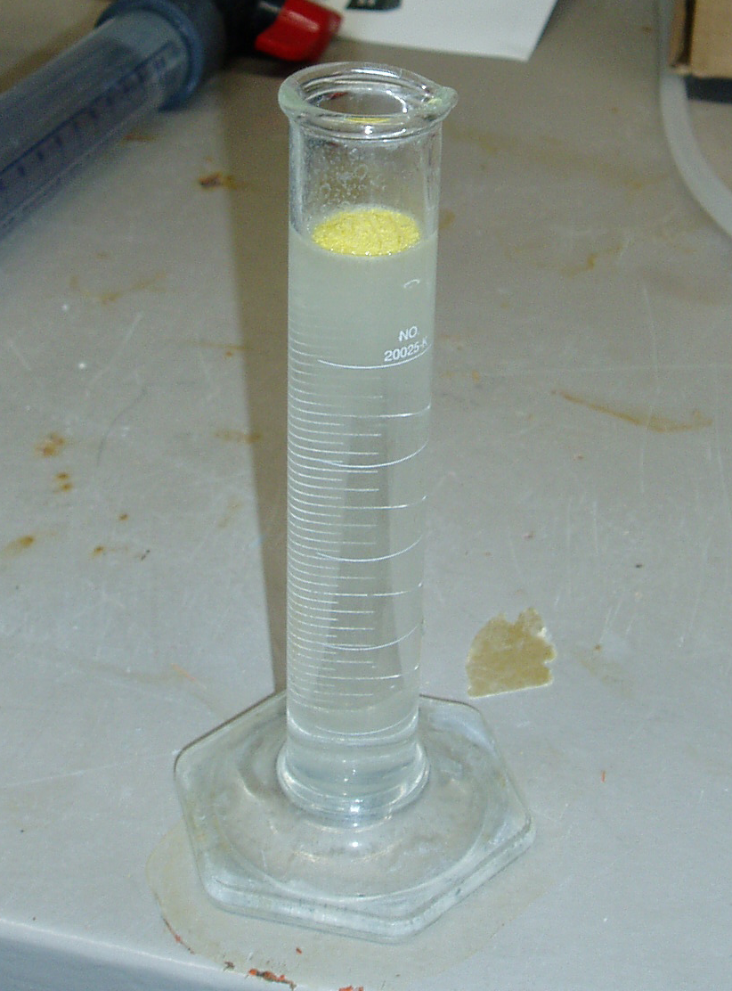
Why focus on PACl?
Mixes more readily than alum.
Less dense than water!

Slide 6
Two Phases to Mixing
1: The dissolution of the solid.
2: The elimination of the concentration gradient.
PACl dissolves readily, but the concentration gradient is a problem!
Notes:
PACl solution more dense than water.

Slide 7
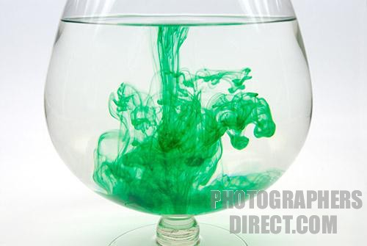
What is a Concentration Gradient?
Most of the dissolved PACl will settle down to the bottom of the tank and create a gradient.
Result: High concentration at bottom low concentration at the top.

Slide 8
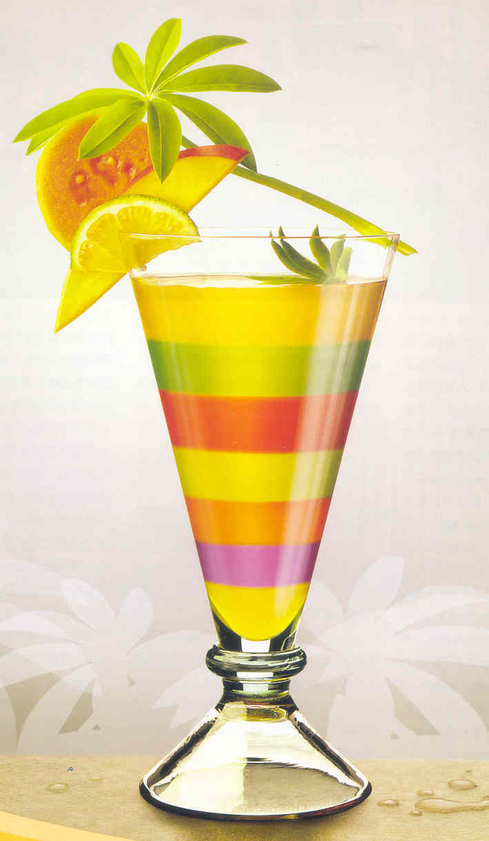
How do we get rid of the Concentration Gradient?
Too big of a job for Molecular Diffusion
We need more energy!
We need a mixing device!
Notes:
When dumping PACl granules, only molecular diffusion, no concentration gradient yet.

Slide 9
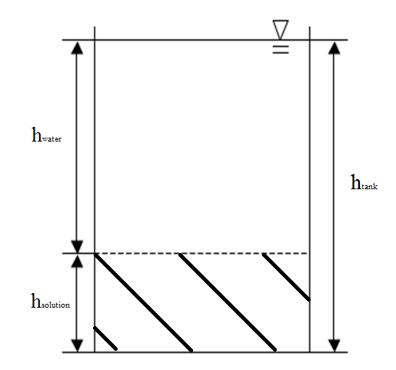
Worst Case Scenario Assumption
Purpose: To create the largest possible concentration gradient.
Assume highly concentrated solution on the bottom, pure water on the top, with no mixing in between.
Theoretical.
Notes:
Speed dumped pacl, two distinct concentrations.

Slide 10
How This Assumption Helps
Gives the worst situation for mixing.
Easy to calculate the potential energy difference, which is the threshold for mixing calculations.
Turbulence introduced to the solution is the key factor.
This allows us to focus on mixing introduced by the device (rather than diffusion).
Notes:
Two distinct layers. No energy dissipation (pure mixing) assuming density of soln will be determining factor in calculation of mixing process than diffusi
Turbulence matters instead of molecular diffusion.
So for gradient it is the turbulence that matters rather than molecular diffusion. The turbulence is determined by how much energy inputted and energy required is a fxn of density.
Therefore, we can use salt.

Slide 11
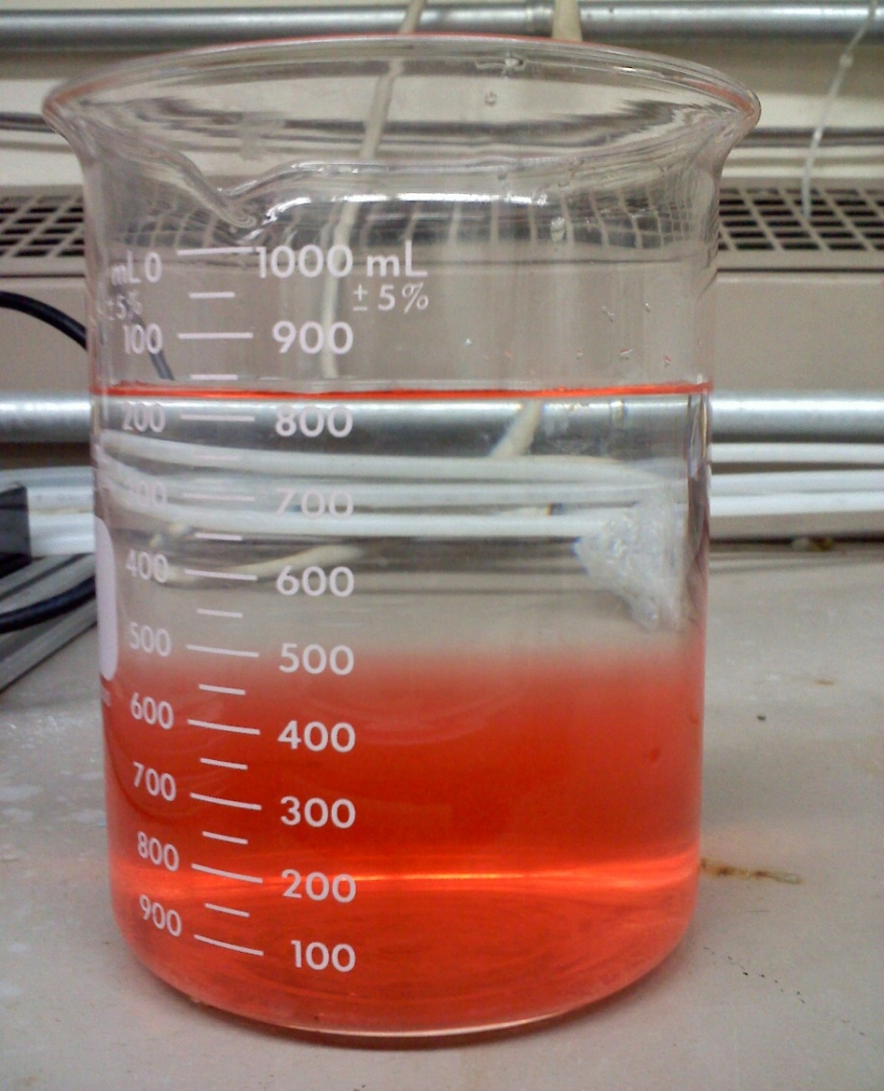
Practical Worst Case Scenario
Theoretical so it can only be used for calculations.
We made a practical worst case scenario that is used for experimentation.

Slide 12
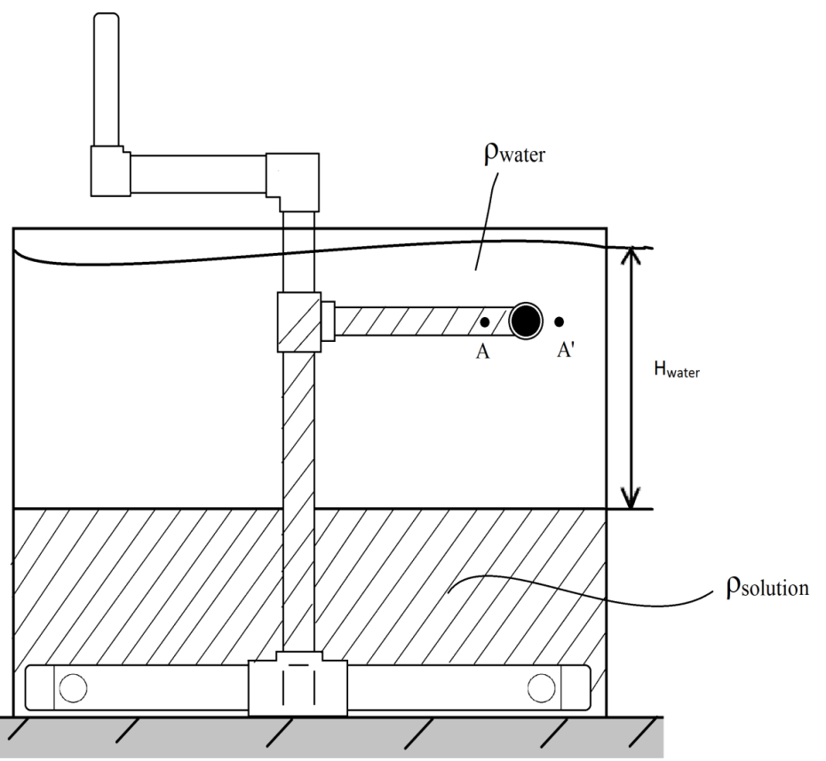
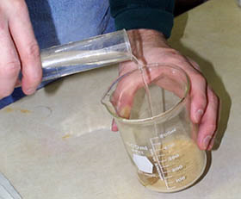
Mixing Systems
Pouring water on top of solution
Simple stirrer (“stick stirring”)
Centrifugal pump
Notes:
Pictures of each system

Slide 13
Pouring Water onto Solution
First, create a concentrated solution and fill the tank halfway with it.
Pour the pure water onto the concentrated solution.
This will create some mixing.

Slide 14
Dumping Water into Solution
Notes:
Note the different scale between Potential Energy Difference and Energy Input

Slide 15
Pouring Water Experiment
Theoretical density: 1084 g/L
Experiment density: 1038 g/L
<10% mixing efficiency!
Energy dissipation rate too low to enable complete molecular diffusion.
Notes:
The density of the surface layer solution was 1.038 kg/L while the target density should be 1.084 kg/L. The efficient of dumping water should be mush less than 10%.
The experiment showed that the solution taken up by the flow would settle down again at the bottom. Meaning that the energy dissipation rate of dumping water is not high enough to break the two liquid into smaller units and mix them up, so that molecular diffusion can finish the mixing process before the solution settle down again. Typically the energy dissipation rate should be greater than 1 W/kg for rapid mixing.

Slide 16
Simple Stirrer
Calculations are based on:
  a 55 gallon drum, 1.5” diameter stirrer
  Concentrated NaCl solution (~360 g/L).
  1 revolution per 2 seconds.
Energy input of the stirrer: drag force × moving distance.
Calculation results showed that 2 stirs would have a energy input greater than the potential energy difference.
Notes:
110 g/L???? Or 1100?
110 g/L concentration, NaCl solution (≈ 360 g/L solubility limit). Using a tube with 1.5 inch diameter and 1 revolution per 2 seconds.

Slide 17
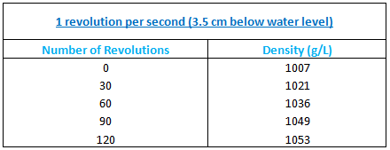
Tube Stirrer Experiment
Experimental setup:
  5 gallon bucket with a 1.25 cm tube stirrer.
  1 revolution per 1 second.
Final density: 1052.5 g/L
~120 revolutions needed!
Notes:
One stir per one second.

Slide 18
Results
This set of experiments yielded 1.2% efficiency.
For a larger scale, it is more likely to have a larger tank diameter to tube diameter ratio, making the efficiency would be even lower.
The simple stirrer is a highly inefficient mixer!
Notes:
Not possible to visually judge if mixing is complete.
Guidelines are needed.
Left these out.

Slide 19

The Centrifugal Pump
Why a pump?
How does it work

Slide 20
Centrifugal Pump Calculation

Slide 21
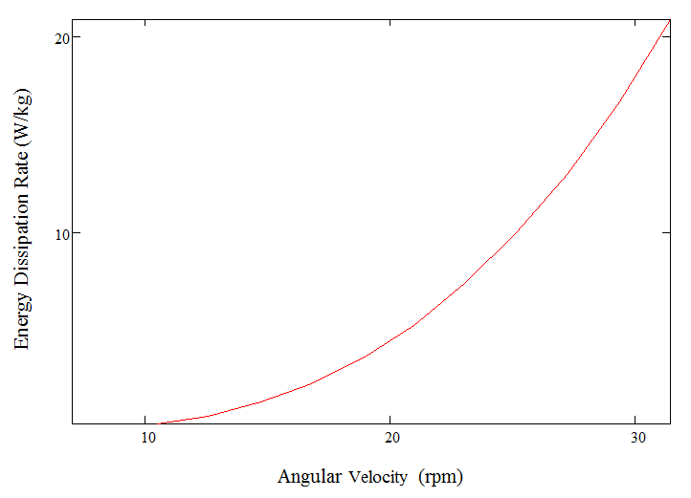
Centrifugal Pump Calculation

Slide 22
Results
The centrifugal pump is a good idea for mixing concentration gradient.
A satisfying flow rate could be obtained with relatively slow rotating speed.
A high energy dissipation rate could be obtained with the pump.

Slide 23

Remarks
Concentration gradient the major issue with mixing PACl solution
Current mixing system is not efficient for mixing the concentration gradient. Centrifugal Pump is a promising option.
It is important to enable the operator to know when the mixing is done.

Slide 24
Future Work
Centrifugal Pump
Find a way to tell when done mixing
  Test solution
  System design
  Mixing Guidelines
Impeller – May be efficient for larger tanks

Slide 25
Questions?

Slide 26
Concentration Gradient
Notes:
Source：http://www.tonglou.com.cn/space.php?uid=9356584&do=blog&id=578777
http://www.photographersdirect.com/buyers/stockphoto.asp?imageid=1198788

