Slide 1
Stock Tank Mixing
Alexandra Cheng
Apoorv Gupta

Slide 2
Semester Goals
Stock Tank Mixing Pump
  Design high efficiency device to uniformly mix stock solutions
  Perform small-scale testing and make design adjustments
  Provide design schematic for full-size pump
Hydrometer
  Chlorine density measurement

Slide 3
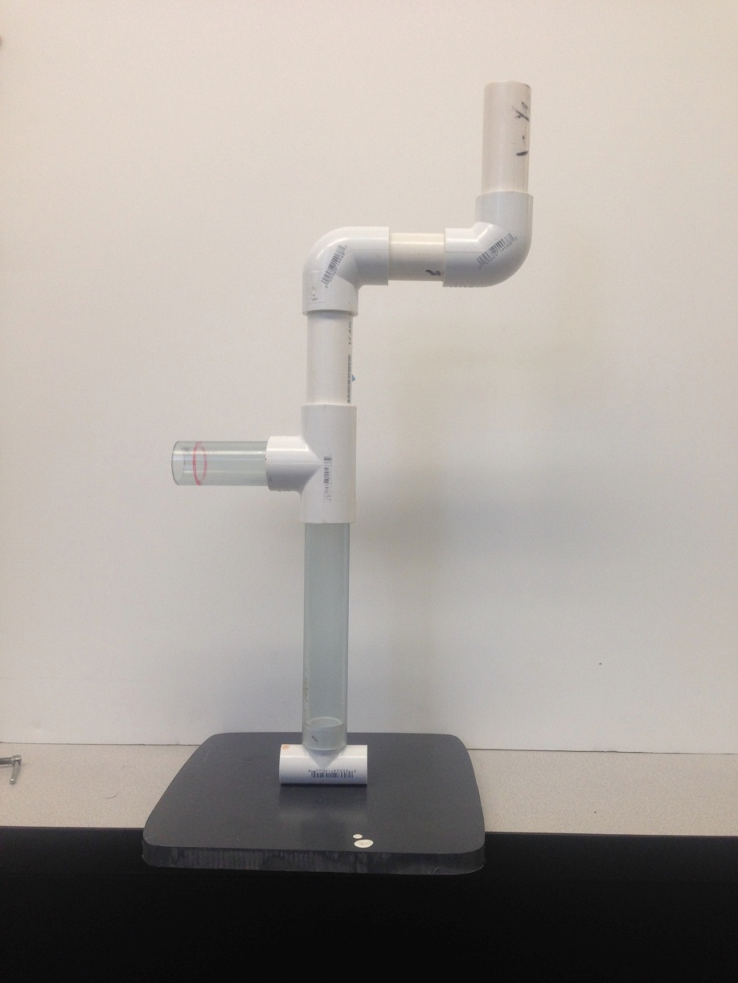
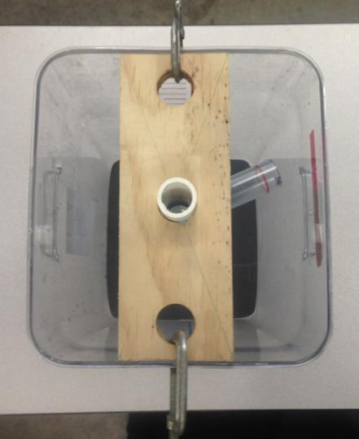
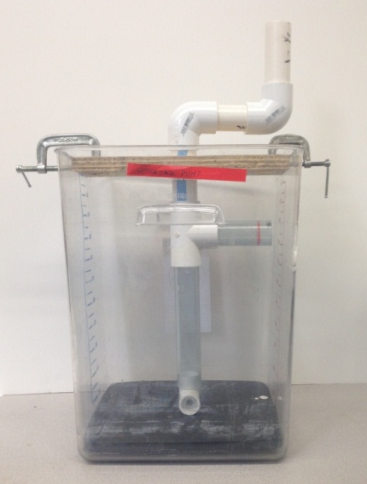
Fall 2013 Pump Design
Centrifugal pump
Raise dense solution to higher elevation using pressure gradient

Slide 4
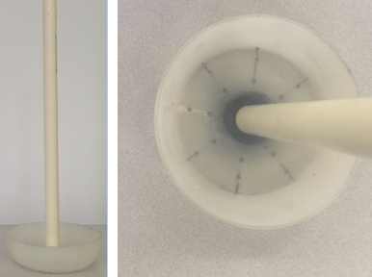
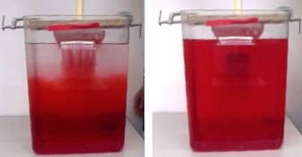
Bucket Mixer Design
Bucket with 16 0.156” diameter holes
Base projected area approximately 33% of tank base area
Designed to be 80% filled with dense solution at end of cycle
Raise bucket from bottom to top of tank in 5s, wait for bucket to empty and plunge back down

Slide 5
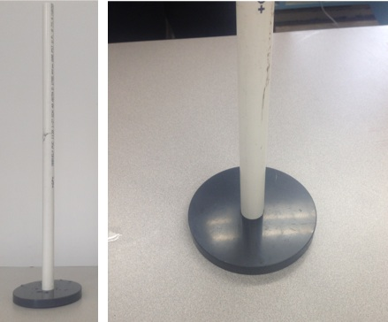
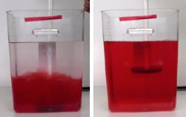
Plate Mixer Design
1” PVC plate, 33% of tank base area
Create jets and turbulence to encourage mixing
Lift mixer within the height of the dense solution and plunge up and down

Slide 6
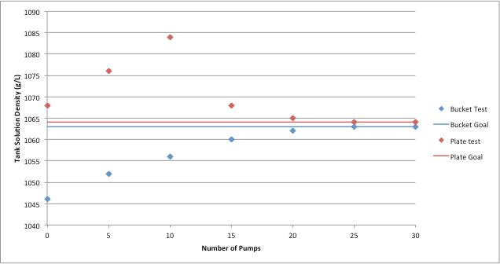
Result Comparison: Bucket vs. Plate

Slide 7
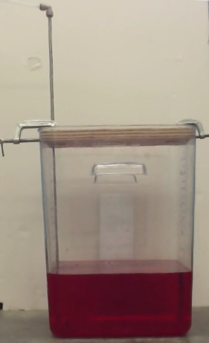
Base-Level Water Injection
Inject water into the bottom of the stock tank containing dense solution
HL = 2.1 cm due to injection, 31.9 cm due to water transport

Slide 8
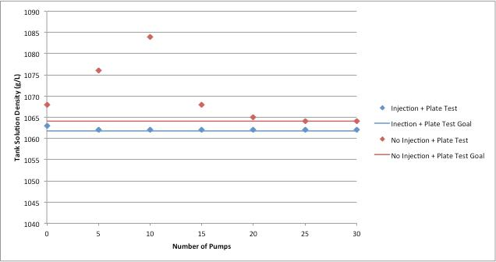
Water Injection Results

Slide 9
Water Injection Full-Scale Schematic
Head Loss due to injection set at 50 cm
Total Head Loss 1.332 m
Required orifice size = 2.143 mm diameter
Best procedure:
  30% of water + stirred in coagulant
  Remaining 70% of water injected at base level
  Complete mixing using the plate mixer

Slide 10
Future Work
Finalize design schematics for full-scale water injection system and plate mixer
Continue researching devices to be used for chlorine density measurement and test effectiveness and reliability

Slide 11

Questions

