Slide 1
Stock Tank Mixing
Alexandra Cheng
Apoorv Gupta

Slide 2
Semester Goals
Design a new stock solution mixing system
Perform small-scale testing and assess inefficiencies to make appropriate adjustments
Provide design blueprint for full-size system

Slide 3
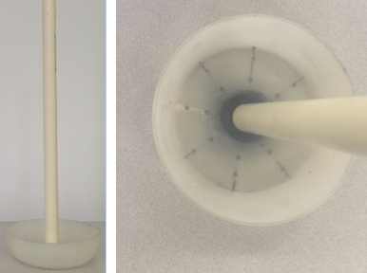
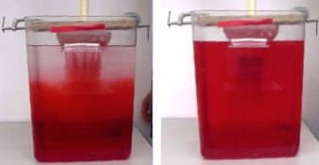
Bucket Mixer Design
Bucket with 16 0.156” diameter holes
Base projected area approximately 33% of tank base area
Drain dense solution at the top of the free surface

Slide 4
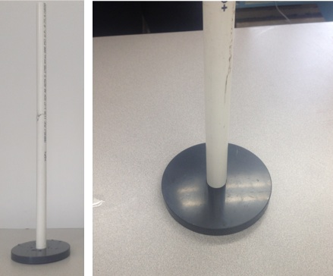
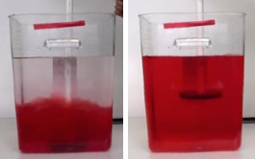
Plate Mixer Design
1” PVC plate, 33% of tank base area
Create jets and turbulence to encourage mixing
Lift mixer within the height of the dense solution and plunge up and down

Slide 5
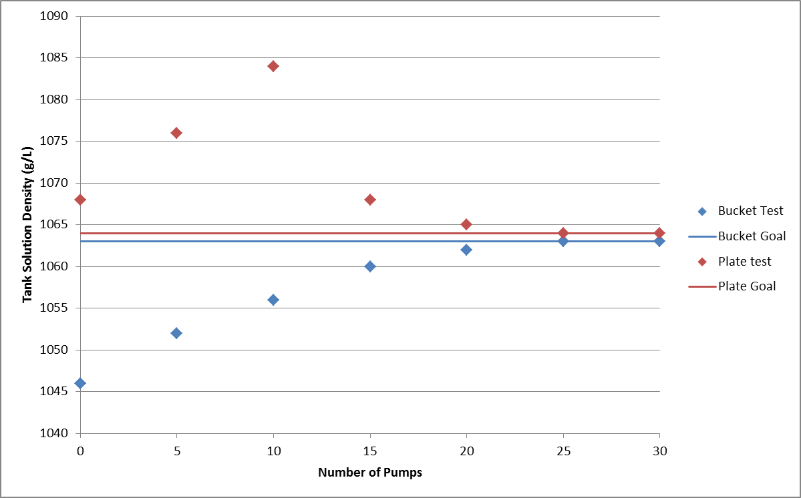
Result Comparison: Bucket vs. Plate

Slide 6
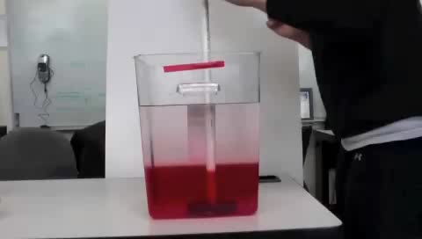
Plate Test Demo

Slide 7
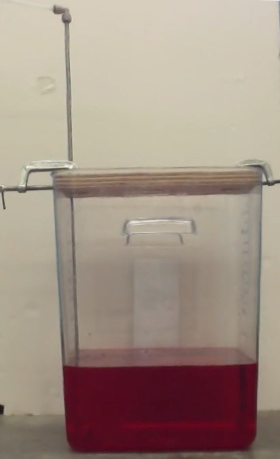
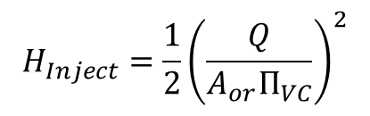
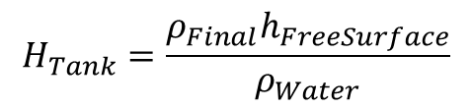
Base-Level Water Injection
Inject water into the bottom of the stock tank containing dense solution
H = 2.1 cm due to injection, 1.9 cm from water transport
$$H_{Inject}=\frac{1}{2}{\left(\frac{Q}{A_{or}Π_{VC}}\right)}^{2}$$
$$H_{Tank}=\frac{ρ_{Final}h_{FreeSurface}}{ρ_{Water}}$$

Slide 8
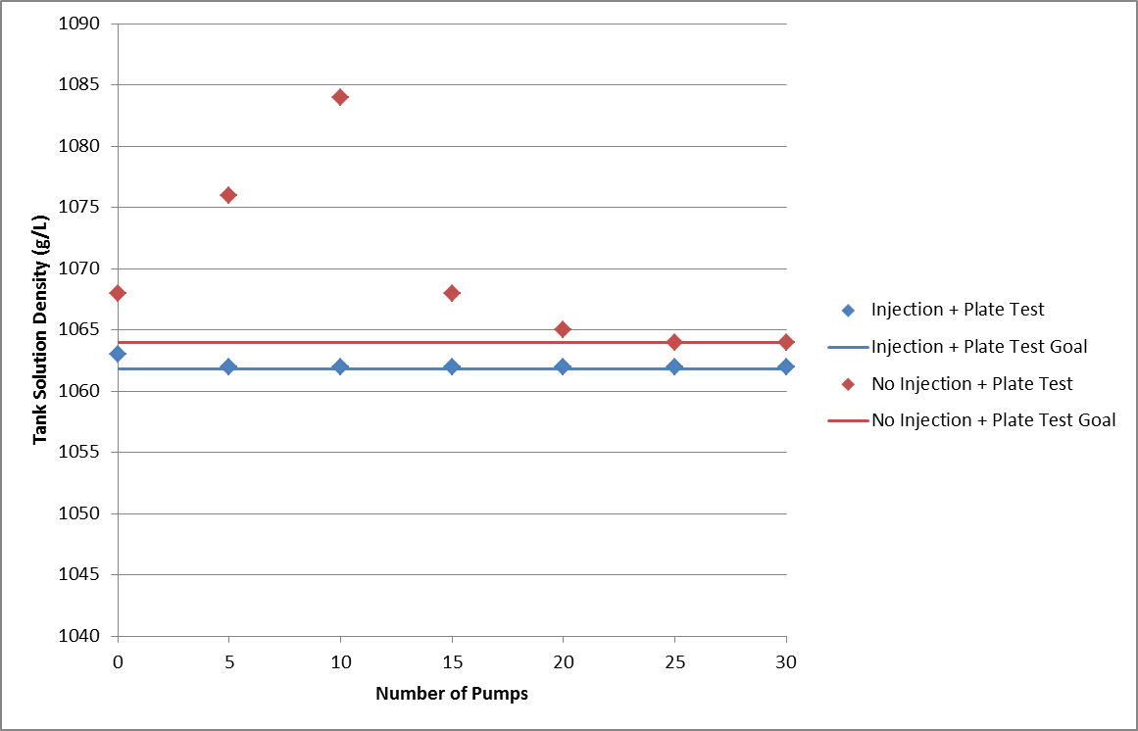
Water Injection Results

Slide 9
Water Injection Full-Scale Schematic
Head due to injection set at 50 cm
Total Head 54.3 cm (difference from original RAM pump setup)
Required orifice size = 2.1 mm diameter
Best procedure:
  30% of water + stirred in coagulant
  Remaining 70% of water injected at base level
  Complete mixing using the plate mixer

Slide 10
Future Work
Implement mixing system in San Nicolas and make necessary adjustments
Add mixer and injection process to the design code

Slide 11

Questions

