Slide 1
Stock Tank Mixing
Alexandra Cheng
Apoorv Gupta

Slide 2
Semester Goals
Hydrometer
  PACl
  Chlorine
Centrifugal Pump
  Small-scale testing
  Assess inefficiencies and adjust design
  Provide design blueprint for full-size pump

Slide 3
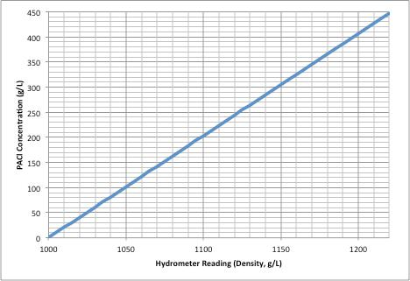
PACl Hydrometer
1.000-1.220 specific gravity range required
Krackeler Scientific Polycarbonate Model: $74

Slide 4
Chlorine Hydrometer
Calcium Hypochlorite:
0.013 kg/L solution concentration
1.012 kg/L < Density < 1.013 kg/L
Cole Parmer Glass Hydrometer
  1.000-1.050 SG Range
  0.0005 Divisions
  $33.50

Slide 5
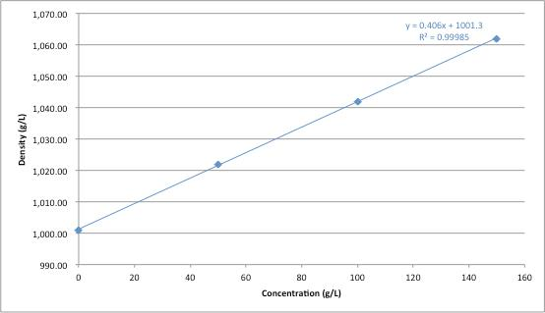
Sugar Tests
For pump tests ➔ reduced environmental impact

Slide 6
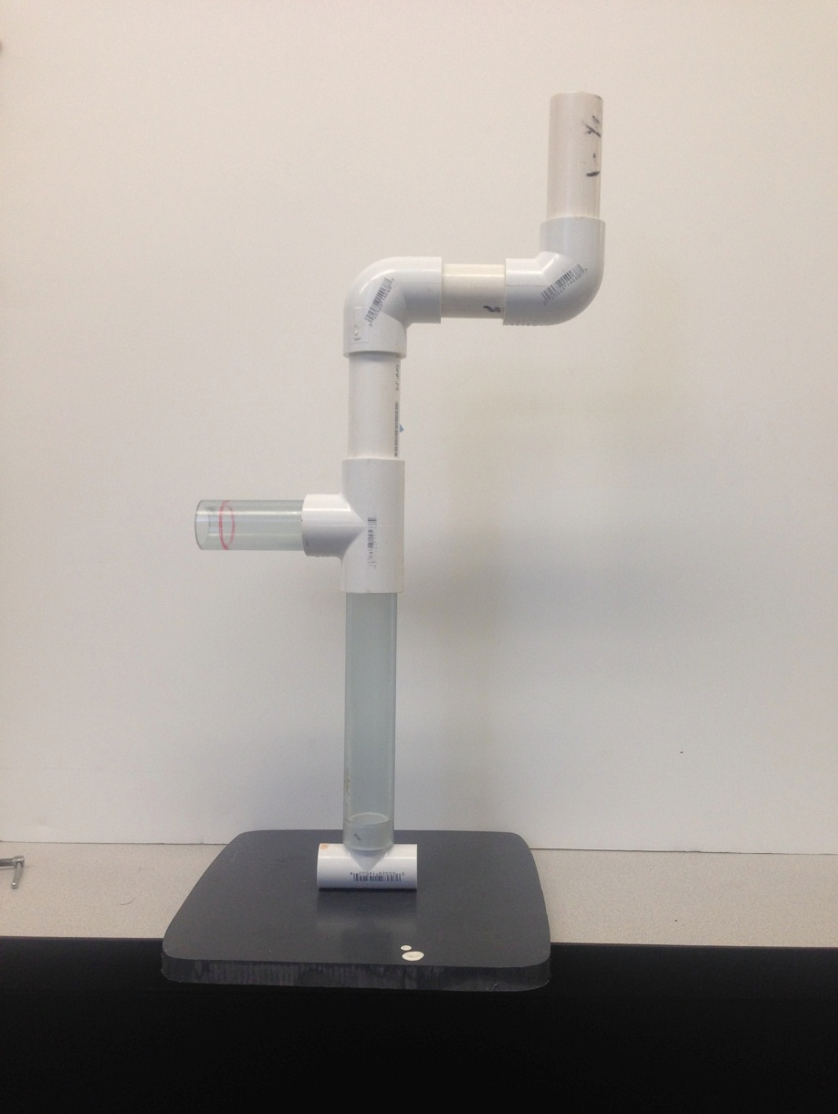
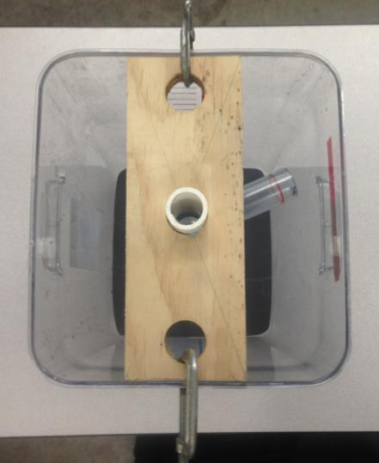
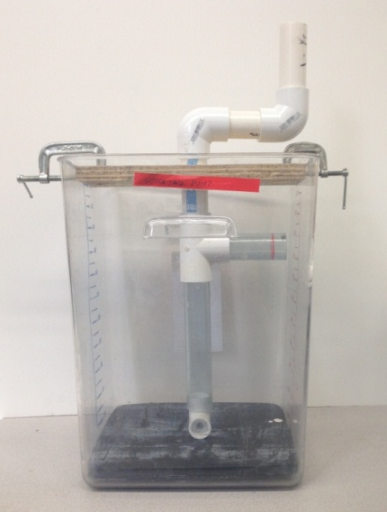
Pump Redesign
Small scale test tank
Stabilizing additions

Slide 7
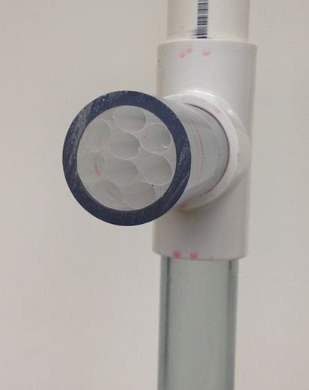
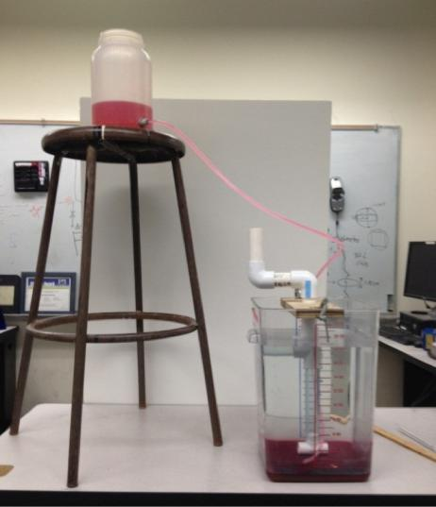
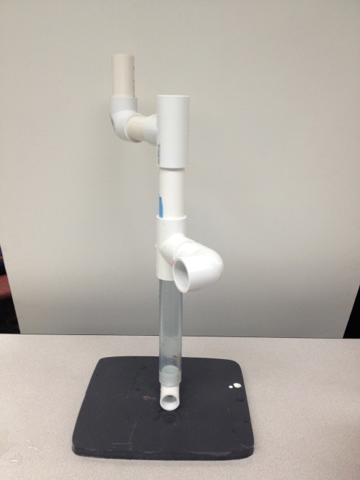
Lift vs. RPM: Procedure
Dense sugar solution with Red Dye #40
Stratified solution
Human operation with metronome
Notes:
Add picture of straw arm

Slide 8
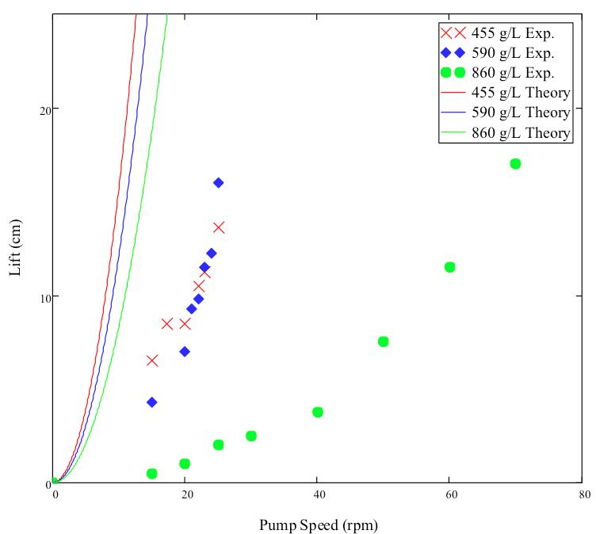
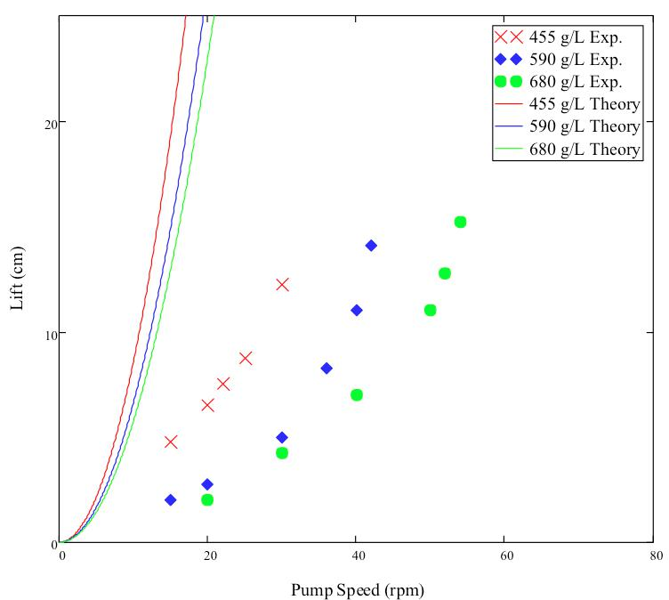
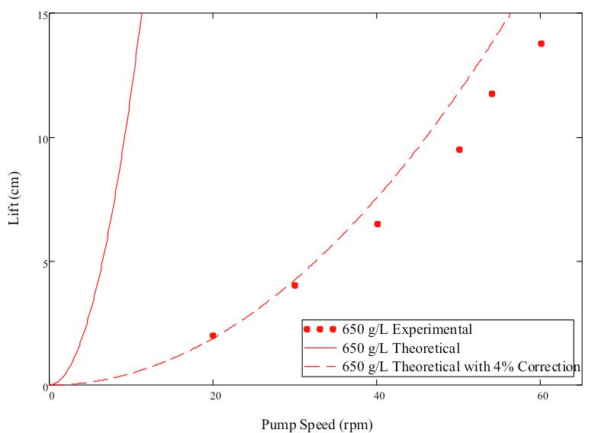
Lift vs. RPM: Results
Open Arm
Elbow Arm
Straw Arm
Notes:
Add illustrations/indications of what the pump geometry looked like?

Slide 9
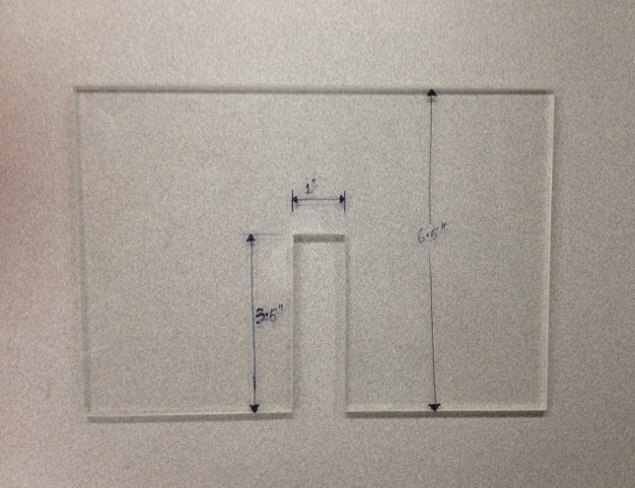
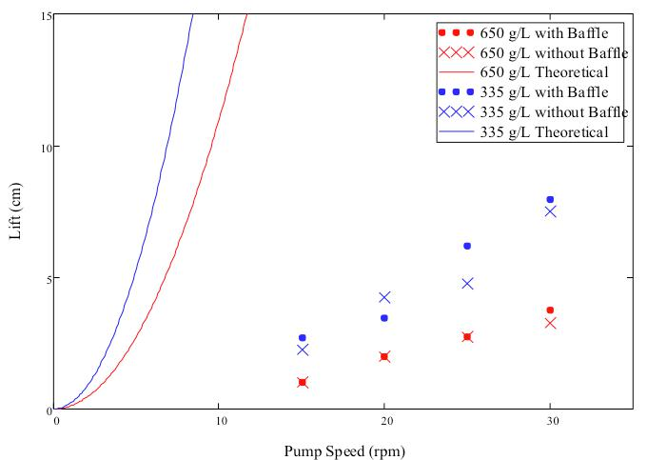
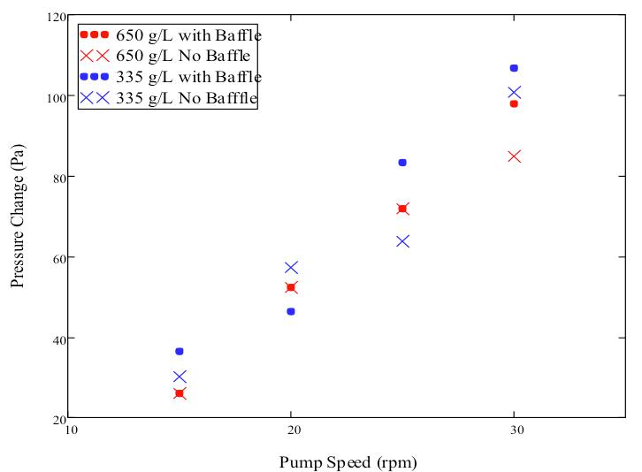
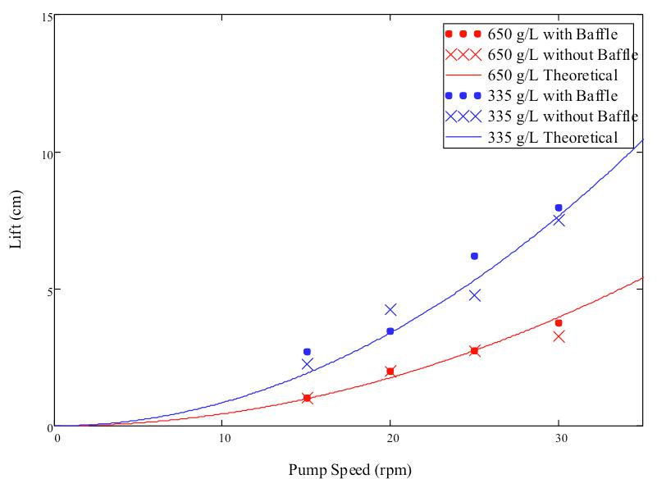
Lift vs. RPM: Efficiency
Sources of Error:
  Leaking rotating joint
  Leaking tee at rotating arm
  Fluid rotation

Slide 10
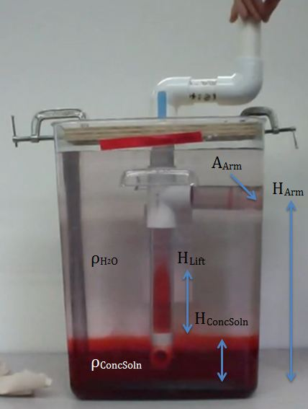
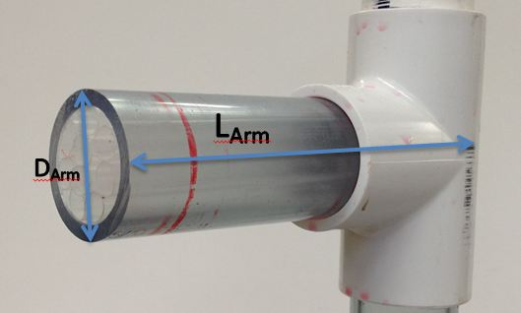
Flow & Torque Power Requirements
Flow
Torque
Notes:
Picture? Or adjust transition

Slide 11
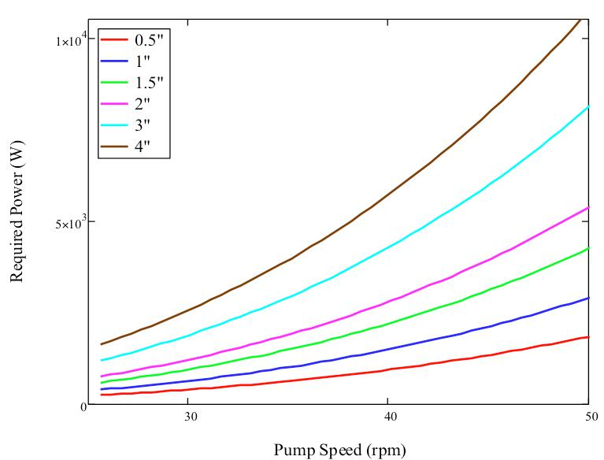
Flow & Torque Power:
Honduran Pipe Sizes

Slide 12
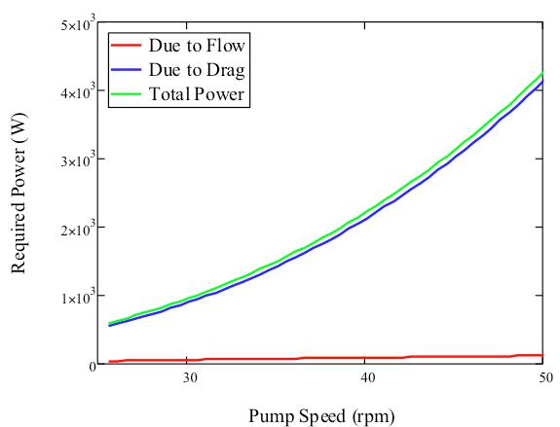
1.5” Pipe Analysis
Dominated by power lost to drag
Adjust drag coefficient (1.2)
75 W input: 27.5 rpm for 15 minutes with reduced drag coefficient (0.04)

Slide 13
Future Work
Polycarbonate hydrometer or other device for chlorine solution
Understand source of error in current pump design
Adjust current pump setup or completely redesign
  Reverse flow of water
  Rotating blades
  Baffles

Slide 14

Questions

