Slide 1

Fabrication
Harrison Gill, Julie Silva, Michael Walsh

Slide 2
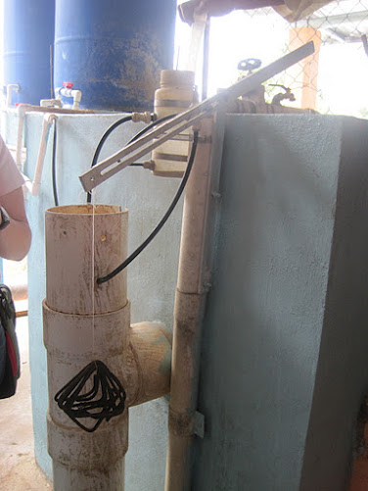
Alum
Dose Distribution
Revision for high flow dosing

Slide 3
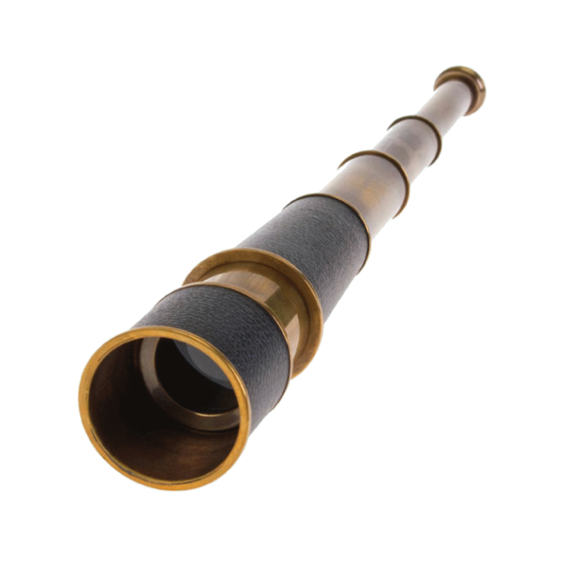
Scope of project
Critical in inducing efficient flocculation.
Dosage range: 10-60 mg/L
Proper portion of alum to influent
Manually adjustable flow through a lateral pipe.

Slide 4
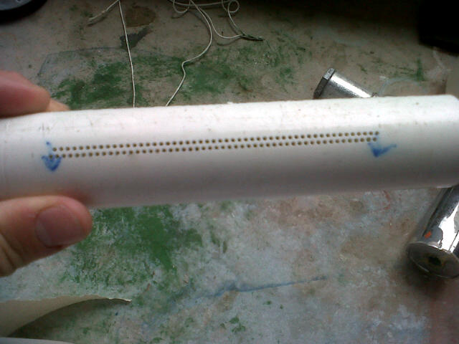
100 HOLES of UNIFORMITY

Slide 5
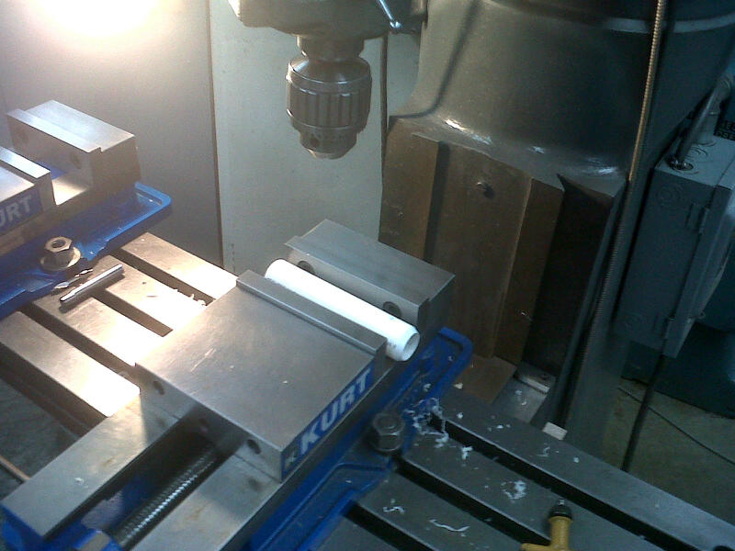
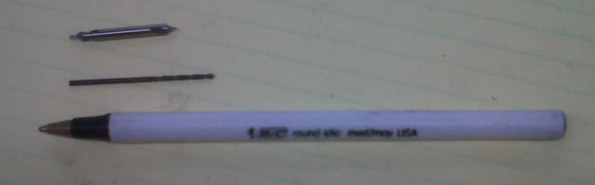
Machining…
Mill for precision
(2mm spacing)
3/64th inch drill bit
Starter drill bit required
to avoid wabble

Slide 6

With holes completed needed a way to adjust how many are open
IDEAS:
PVC disks
Tape PVC dowel
Rubber gasket
Lathe PVC rod to exact diameter
Obstacles:
Non-uniform inner diameter
Water tight seal needed

Slide 7
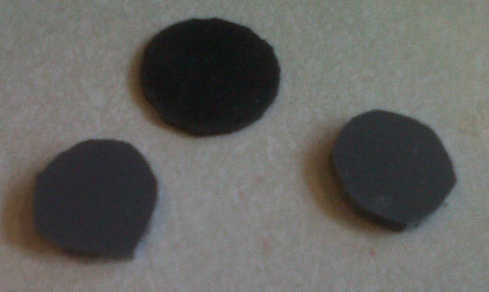
PVC disks compressing rubber gasket
Started machining… realized it was not as easy to make really small plates.
Moved on…

Slide 8
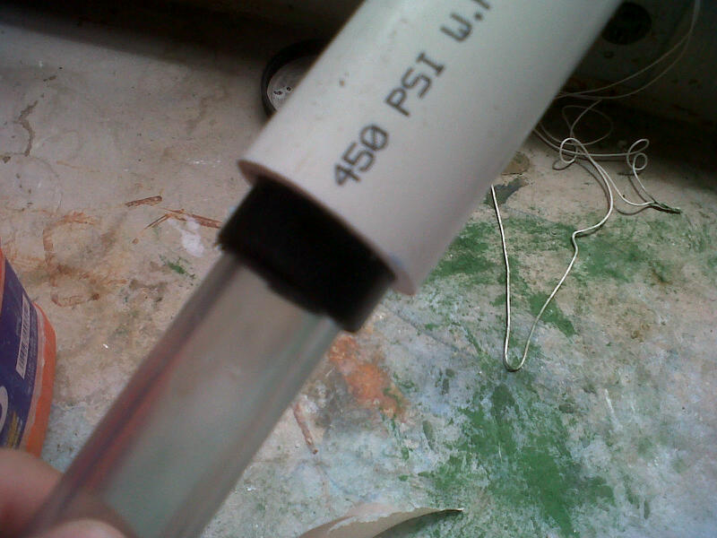
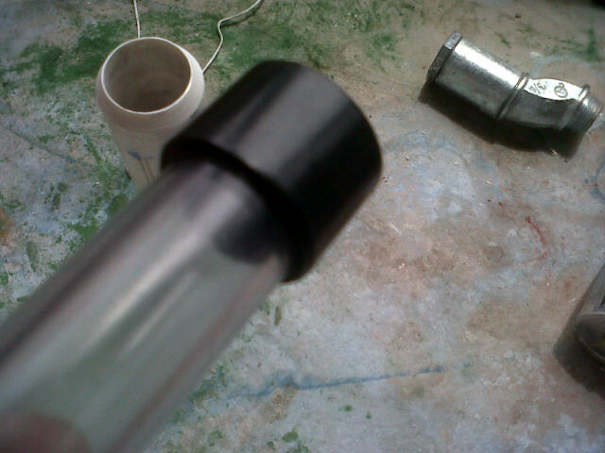
Electrical Tape to correct diameter
Simple design – Use PVC
rod and enlarge with tape
to fit inner diameter
df
Ran into issues:
Leaks through
Tape is easily deformed
Gets stuck / caught on holes

Slide 9
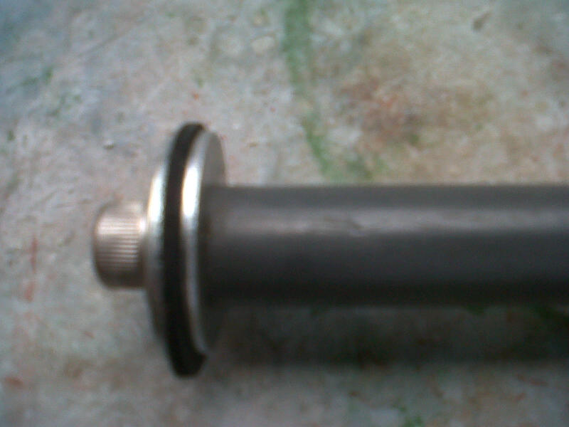
Washer Gasket Combination

Slide 10
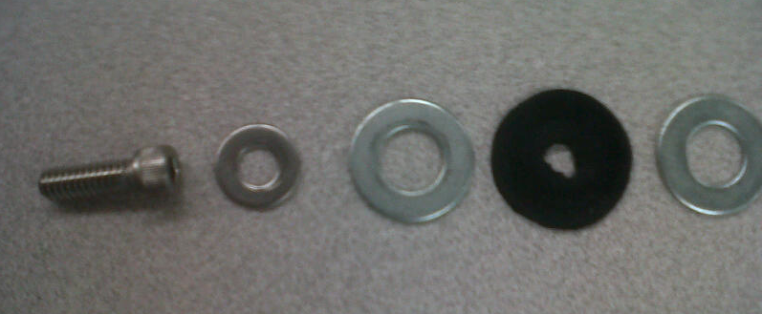
Bolt Assembly
Washers replace PVC disks with ease
Bolt conveniently tightens assembly into rod

Slide 11
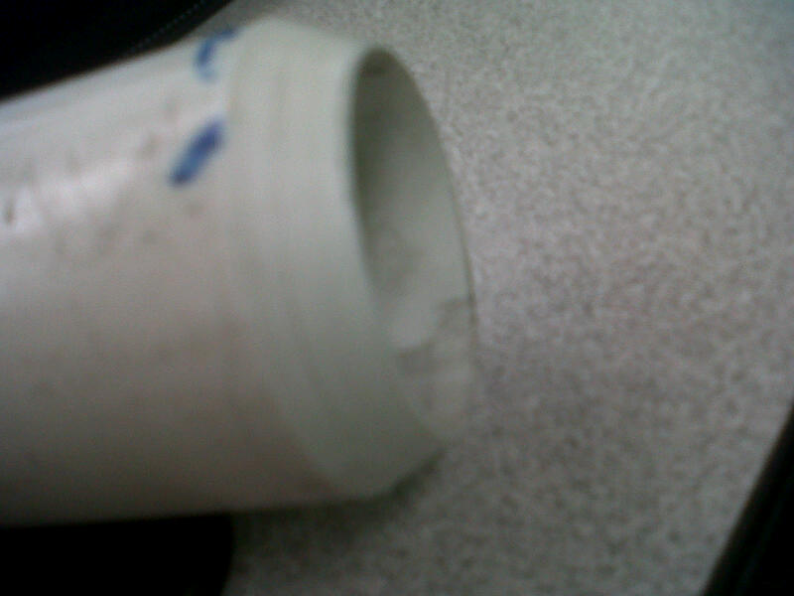
Creating the Gasket
Lathe PVC pipe of same inner diameter into “cookie cutter”
Apply pressure/spin into sheet rubber to create cut.
Cut out inner hole
to quarter inch
for bolt

Slide 12
Current Design
Rubber gasket and washers on PVC rod.
Essentially air tight
Easy to assemble
Toughest machining:
  Requires tapping PVC rod with 1/4th – 20 thread
Possibility of doubling gasket width for extra seal
Still a work in progress!

Slide 13
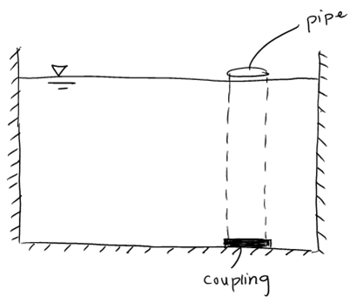
Pipe Stub Valve
Pipe stub valves

Slide 14
Finished Valve
The final designs incorporates elements from the flat plate design and pipe stub design.
  Includes a very short pipe stub to guide the valve
  Flat plate and gasket assembly to seal on the coupling

Slide 15
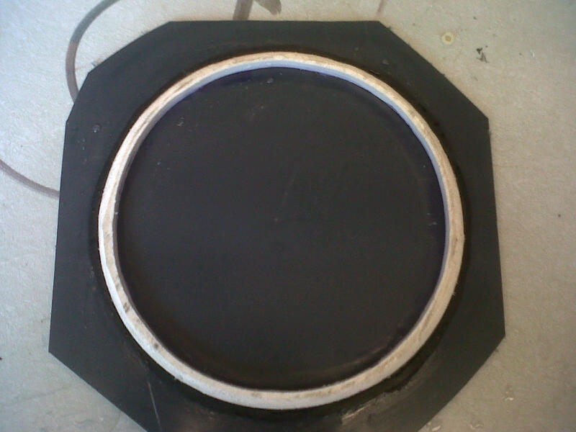
Plate Valve

Slide 16
Hydrometer
Hydrometer Fabrication Method
Find a container that will be bouyant even supporting weight.
Attach a thin rod to the cap, make watertight.
Create a solution with a 1.0114 specific gravity.
Add weights until the container/"chamber" is submerged.
Mark this line on the rod. This is optimal concentration.

Slide 17
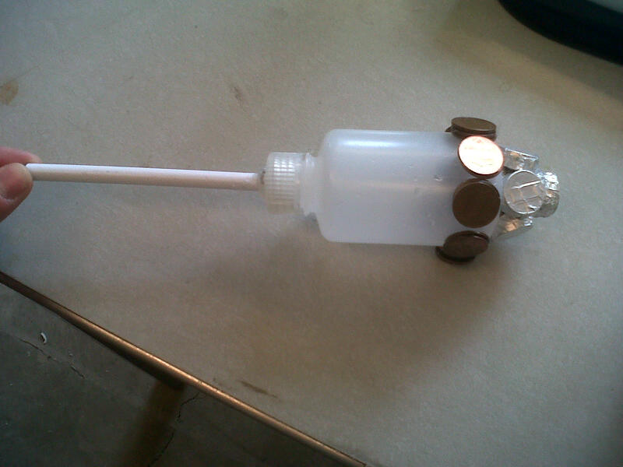
Hydrometer

Slide 18
Jet Reverser
Current designs use a drain channel and cover
Moving to a drain pipe which allows jet reverser to be integrated with the drain system
Methods to connect the jet reverser to the drain pipe.

Slide 19
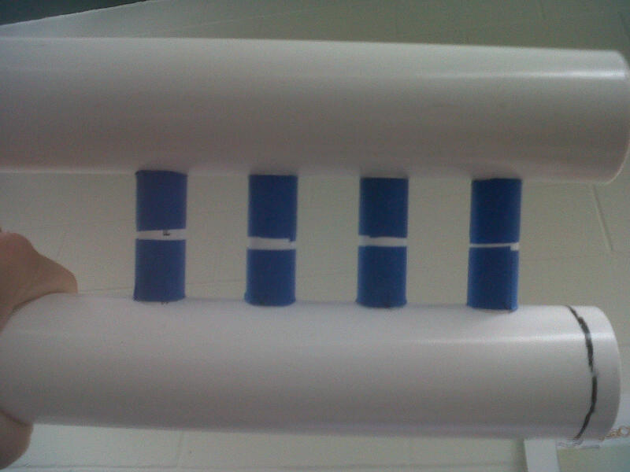
Jet Reverser

Slide 20


