Slide 1
Fabrication Fall 2014
Carl Talsma
Sara Sanz
Adrian Cobo

Slide 2
SRSF Weir System
Goal:
Make a hydraulic working scale model of the SRSF weir system for two filters to demonstrate how the weir system is used to set the flow to the filter during backwash. The hydraulics of this system are sufficiently complicated that explaining how it works is difficult and thus we need a working model for demonstration.

Slide 3
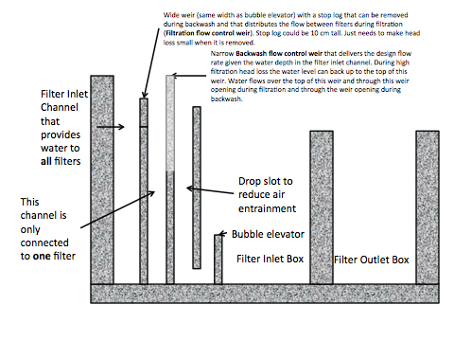
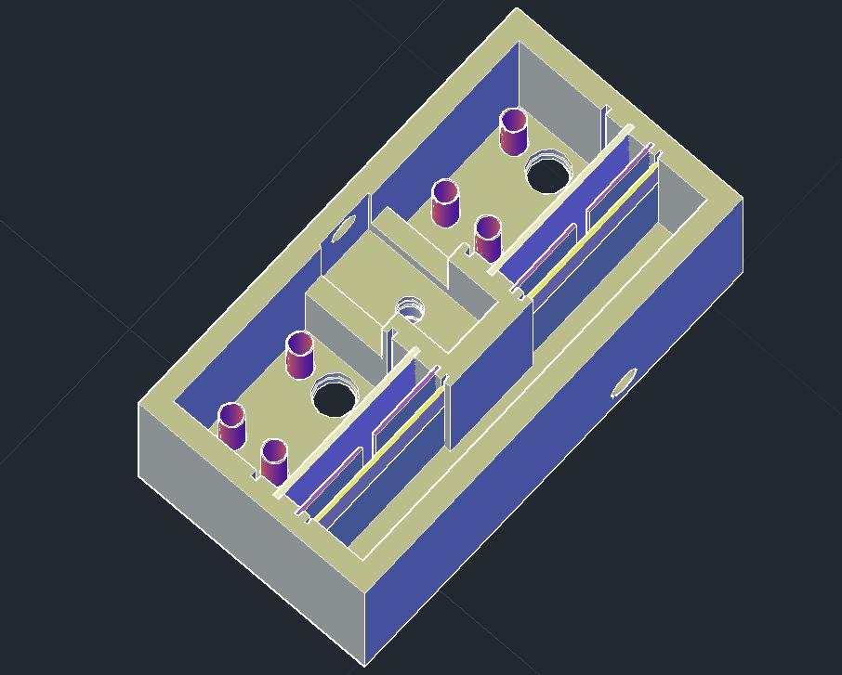
SRSF Weir System

Slide 4
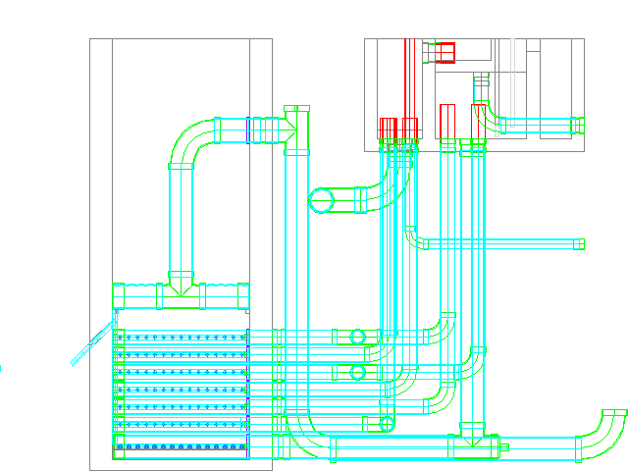
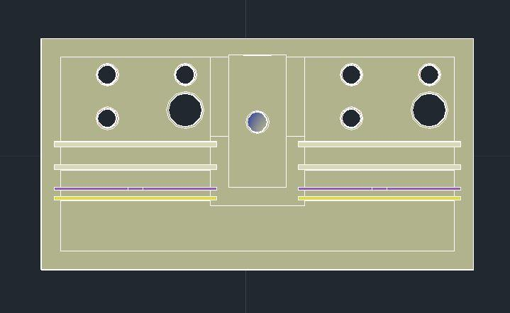
SRSF Weir System

Slide 5
Froude Number
Froude number is ratio between inertial forces to the weight of an element
Determines Hydraulic similarity, flow through model (.28 L/s)
Fr=V/sqrt(g*L)
Fr=Q/(L^2*sqrt(g*L))
Fr=Q/(L^5/2*sqrt(g))
Q.model=Q.plant*L^5/2

Slide 6
Pump
We need to use a centrifugal pump to provide the required flow rate and recycle water
We need to vary flow during backwash between the two filter channels.

Slide 7
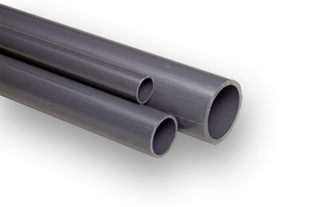
Scaled Model
¿ Grey PVC or Clear PVC ?

Slide 8
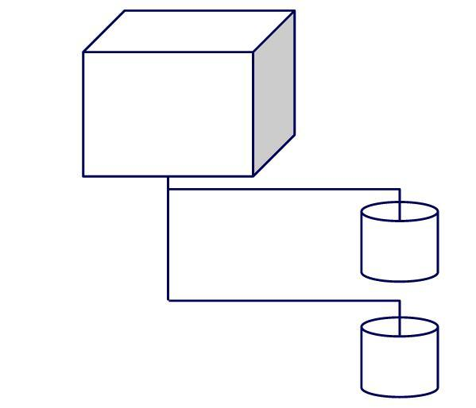
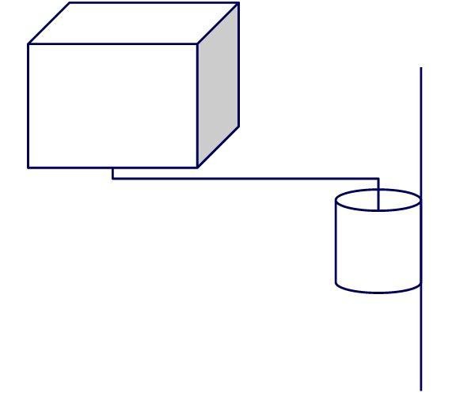
Backwash mode options
Two different buckets
One sliding bucket
Removable pipe

Slide 9
Next Steps
Order the material
Build the model
Test the model

