Slide 1
SRSF Weir Model Final Presentation
Fabrication Team:
Stephen Gadli & Natalie Mottl

Slide 2
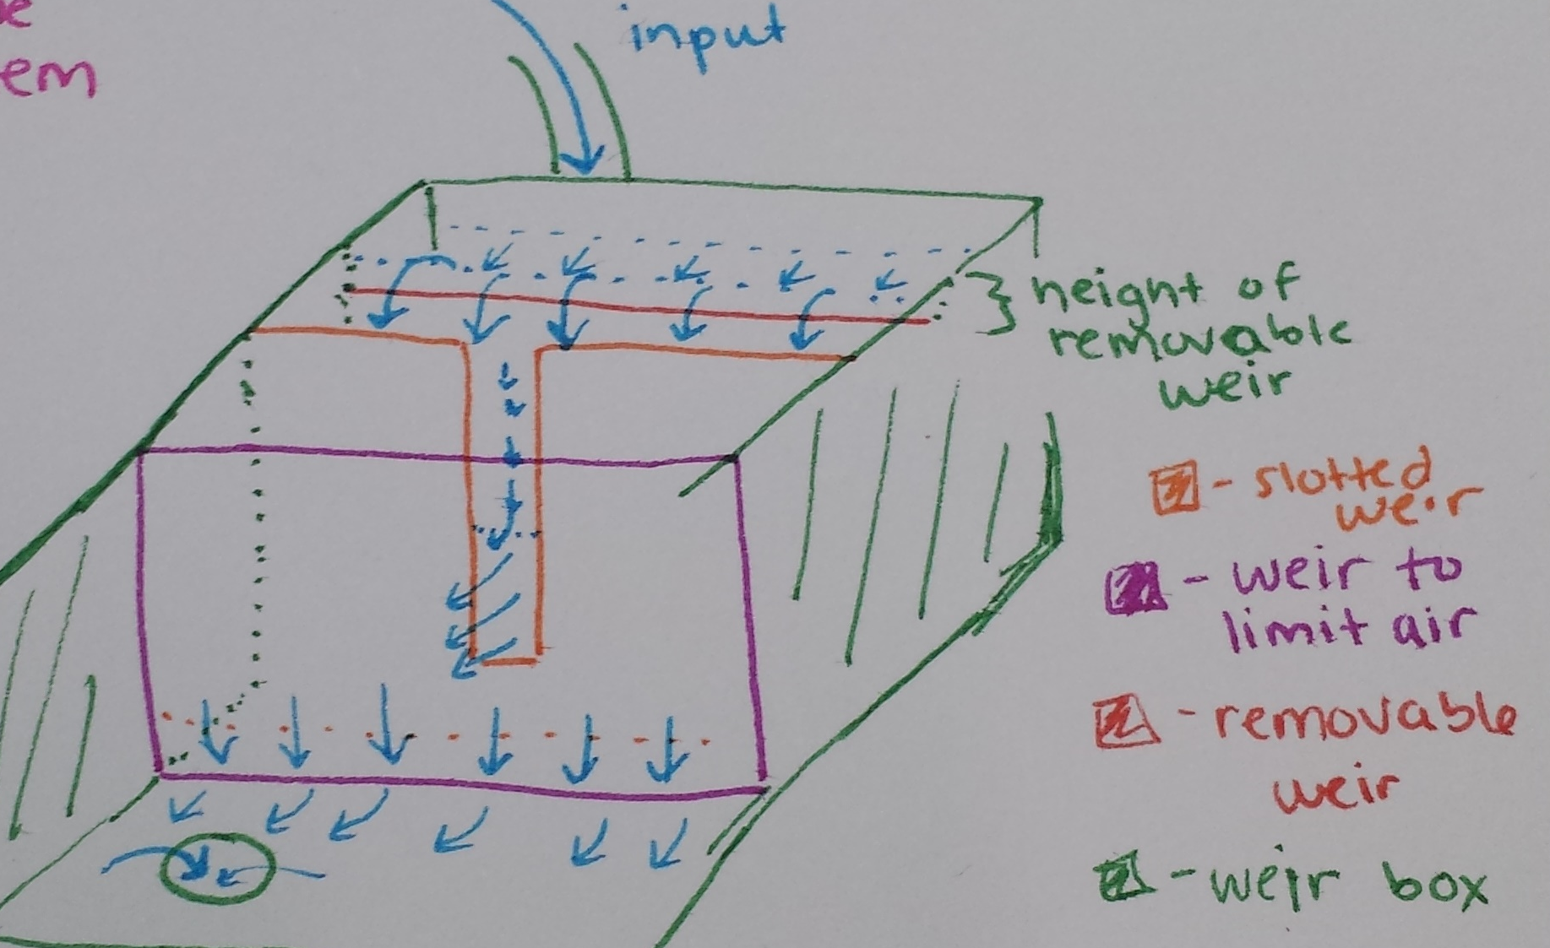
What is the Weir System?
Weir System in the Plant
Scale Model Purpose

Slide 3
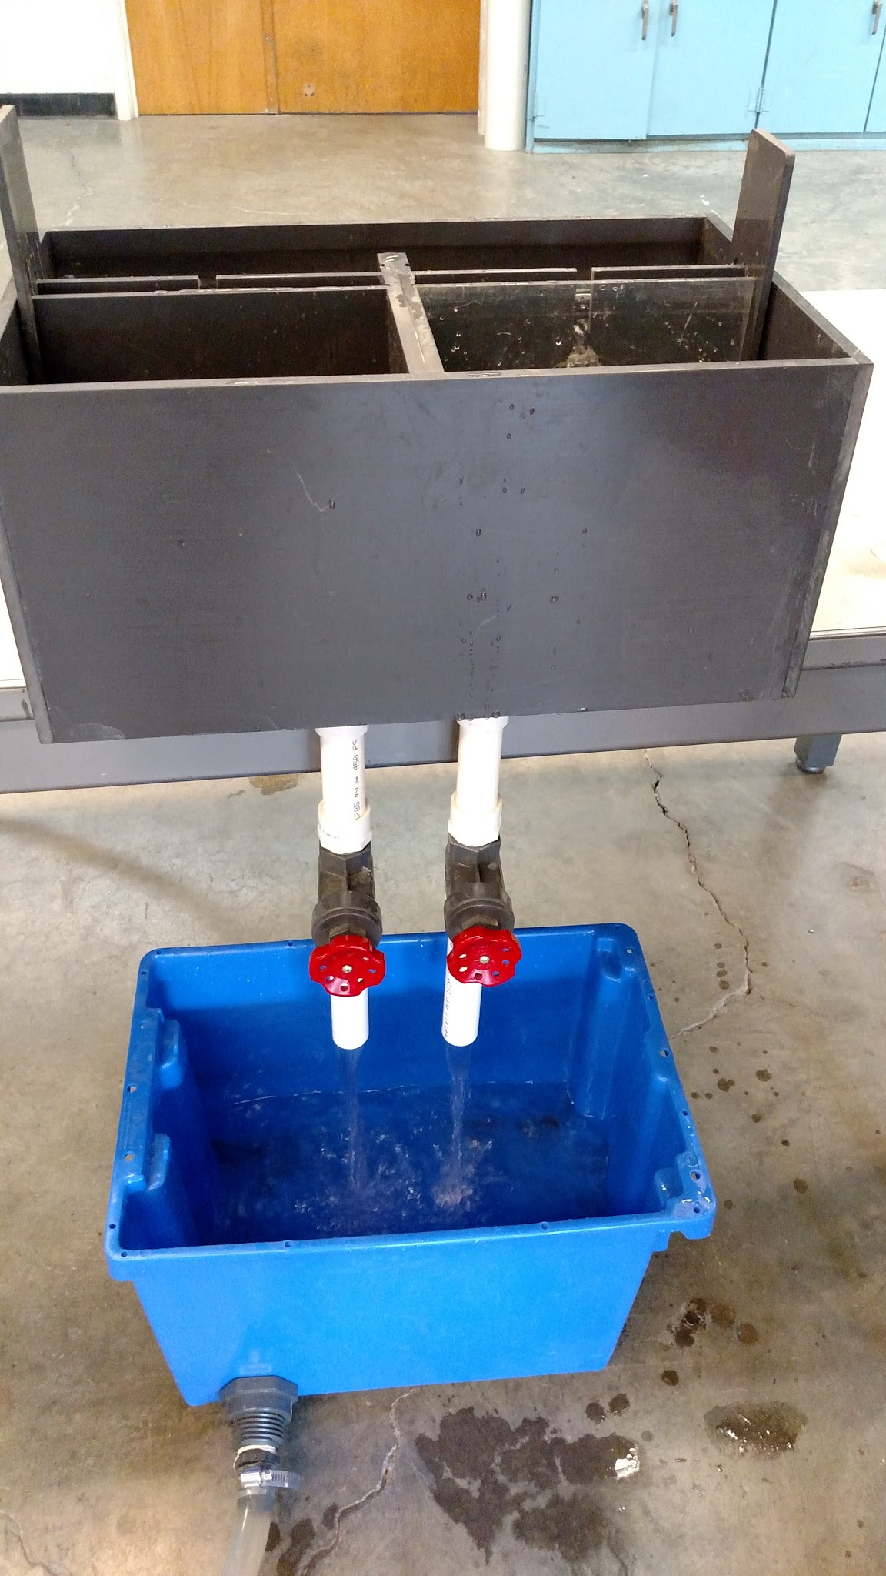
Objectives
Objectives:
Complete set-up
Test Model
Troubleshoot
Create Educational tools

Slide 4
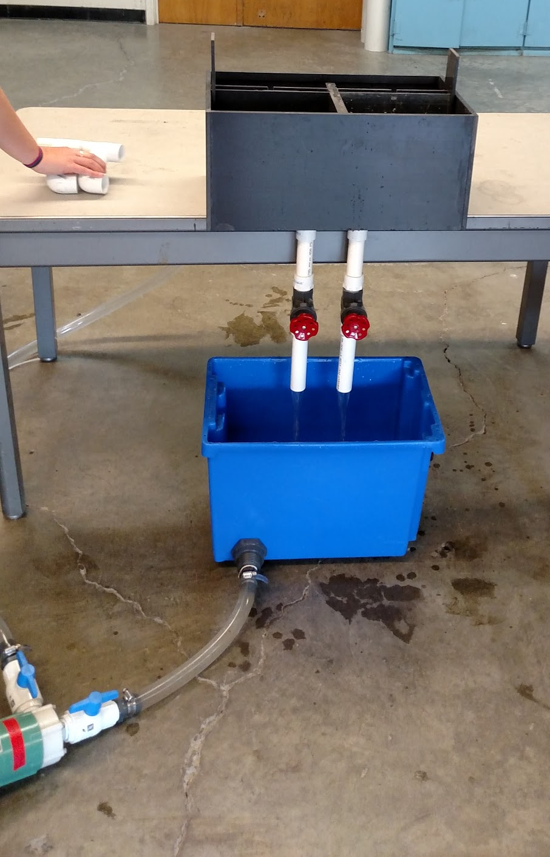
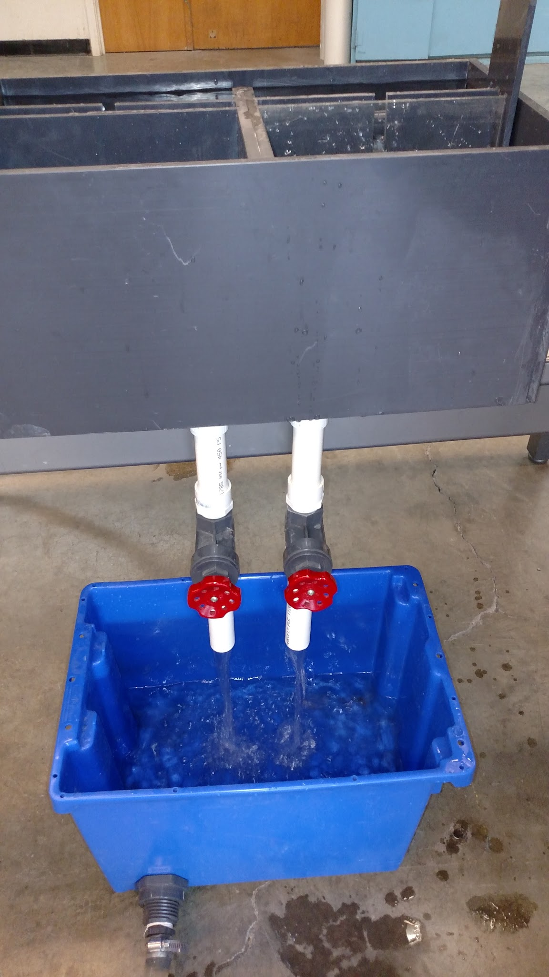
Weir Scale Model Set-Up
Pump
Tubing
Bucket

Slide 5
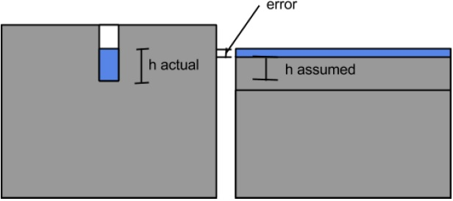
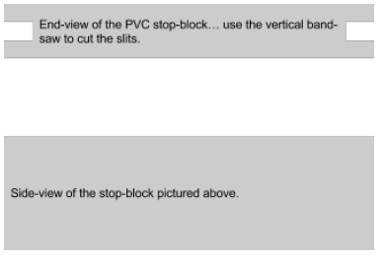
Challenges
Slotted Weir
Flow Rate Error
Re-sizing
  Stop Blocks
  Re-scale

Slide 6
Video
Found
Fabrication folder in google drive
SRSF Weir Model Final report
https://drive.google.com/file/d/0B0pSsNJYuZxrV0YxR2pjd1c3QVE/view?usp=sharing

Slide 7
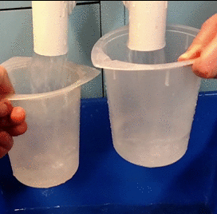
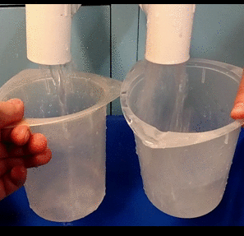
Final Outcomes
Both Weirs Closed
Right Weir Removed

Slide 8
Conclusions/Future Work
Functioning Weir Model
Acquire another, portable pump
Stop blocks
Work towards implementation

Slide 9
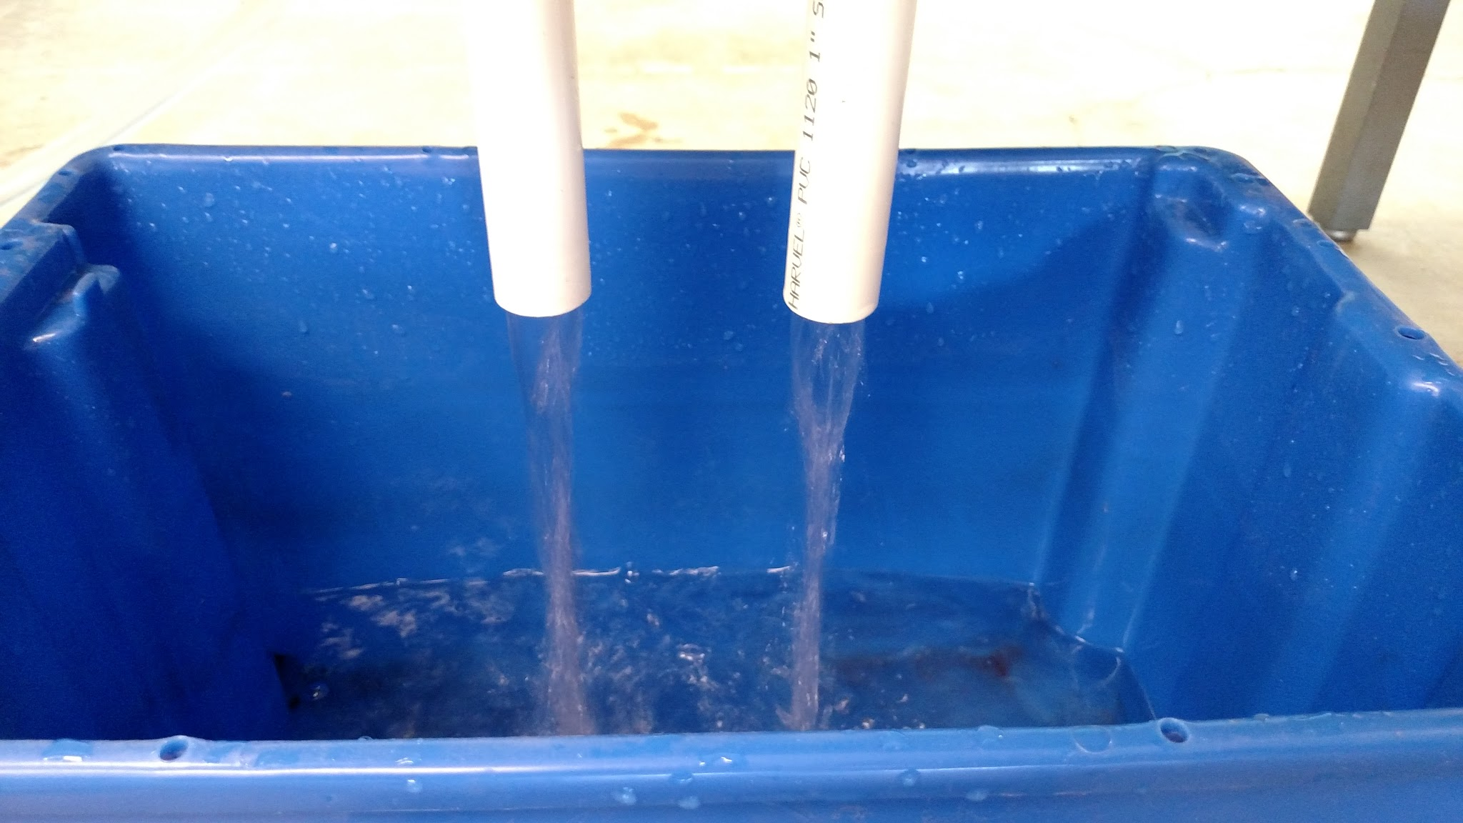
Questions?

