Slide 1
Floc Hopper Probe
The Spring 2016 floc hopper probe team tested different ways to improve the Fall 2015 probe design. This presentation will compare the results of three separate methods that were tested this semester. A detailed report of this research can be found on the Fabrication Team AguaClara wiki page.
Notes:
Abstract: The floc hopper probe is a device that is meant to locate the height of the sludge blanket in the floc hopper of AguaClara water treatment plants. Teams in the past have conducted research and eventually fabricated a working probe prototype that was transported down to Honduras on January 2016. The probe was tested at different treatment plants in Honduras and showed promising results with minor complications. This semester, one of the main objectives is to re-size the probe in order to ensure that it is able to enter the PVC pipe port that is in the sedimentation tank channel system. Furthermore, the team will look into making the design more professional while keeping it cost effective.
Link to full report: https://confluence.cornell.edu/display/AGUACLARA/Fabrication

Slide 2
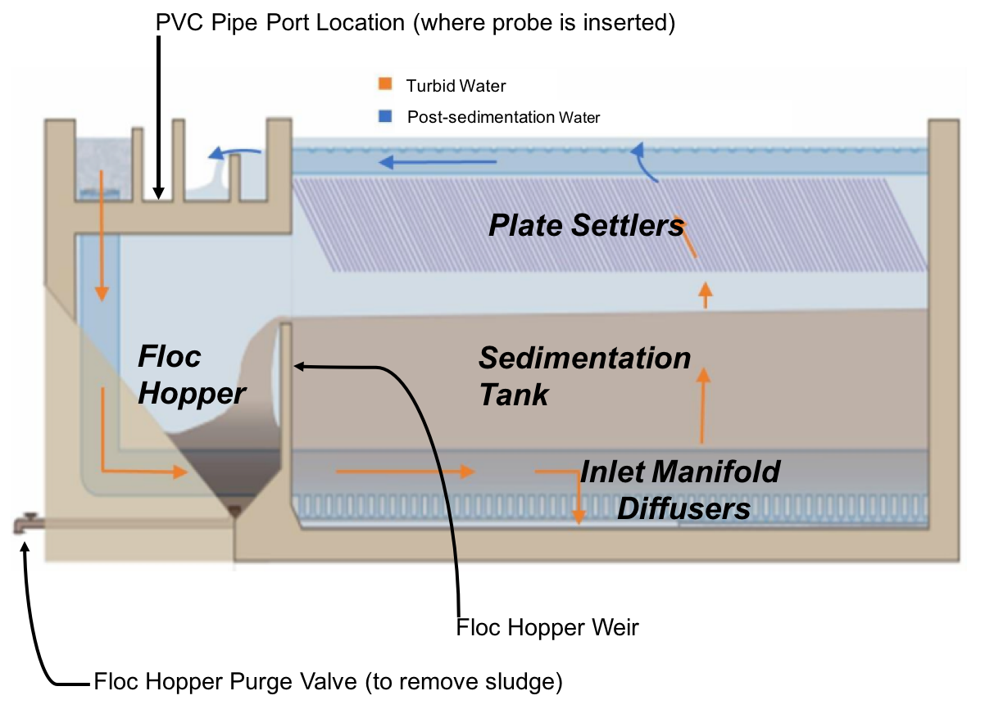
Sludge blanket should not reach the plate settlers
Fabrication | Floc Hopper Probe | Final Presentation Spring 2016
Notes:
Plant operators currently have no way of knowing exactly when or for how long to purge the floc hoppers that collect flocs from sedimentation. Consequently, this often leads to wasteful discharge of water that could have otherwise ended up in the distribution tank. The floc hopper team wishes to create a device that will let plant operators know when to purge floc hopper to prevent the hopper from becoming full, which can cause the floc blanket in the sed tank to reach the plate settlers.
The floc hopper probe is inserted into a 2-in PVC pipe port located just above the floc hopper (red arrow on the image above). As the probe is being pushed down the port the operator looks down the open end of the probe and keeps a close look on the light source below. Eventually the probe will encounter the sludge and the opaque sludge should then block out the light source, indicating to the operator that the he has struck the sludge blanket. The probe should then use some sort of method to reference the height of the sludge in the hopper and should indicate when the sludge is reaching a critical height; essentially if the hopper is getting too full that it will overflow over the weir and into the sed tank.
Image Caption: Profile view of sedimentation tank with red circle indicating the location of the floc hopper.

Slide 3
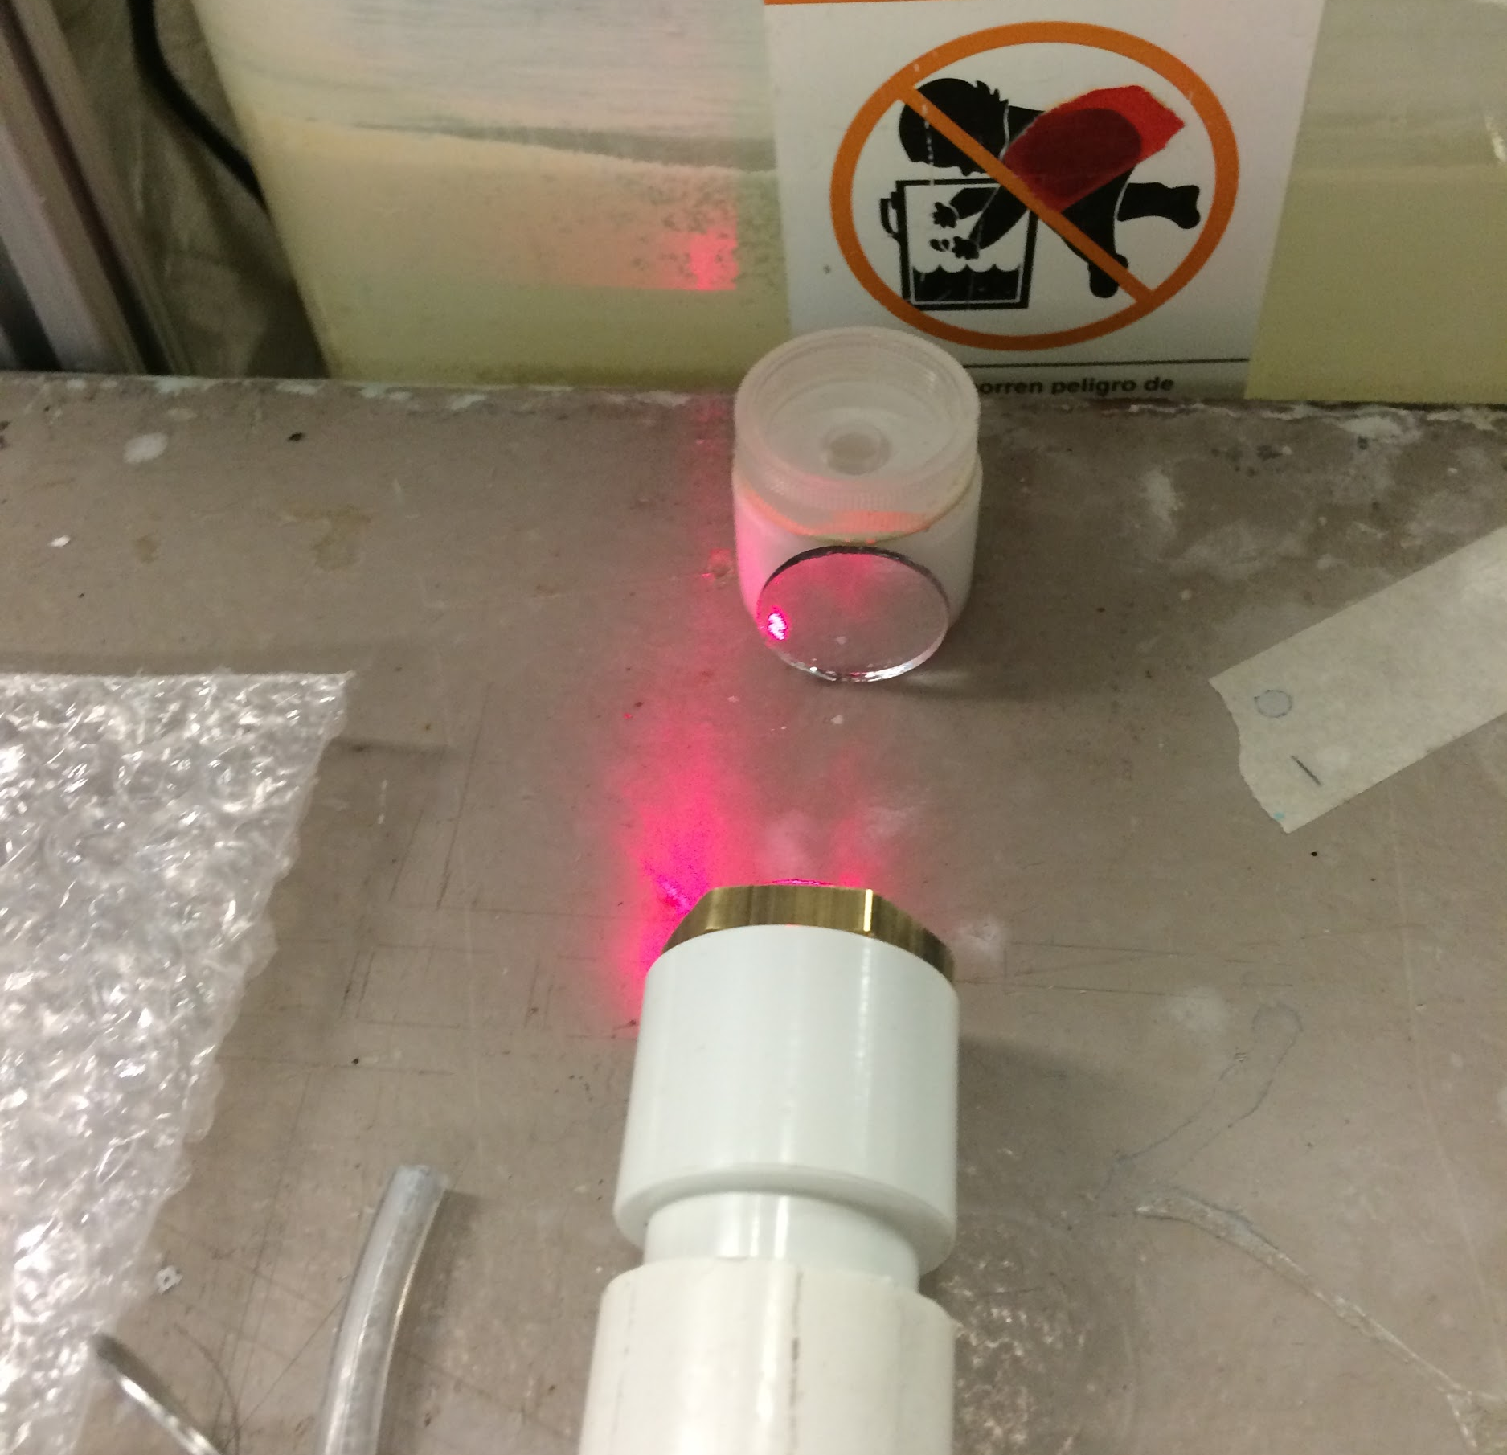
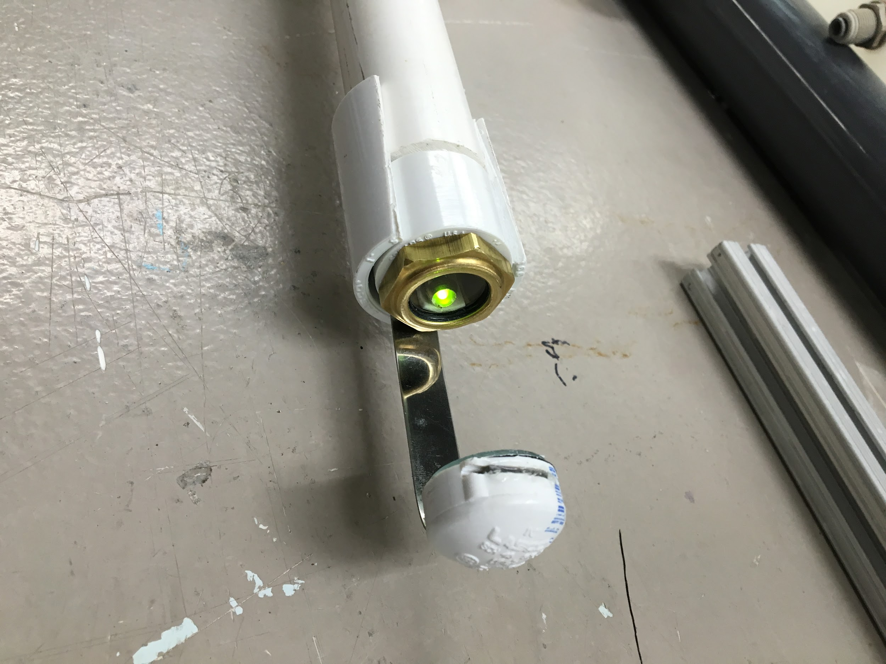
Using a laser will cause eye strain & LED light is hard to see
Fabrication | Floc Hopper Probe | Final Presentation Spring 2016
Notes:
The second iteration of the floc hopper probe explored the possibility of using a laser dot to indicate when the probe has reached the sludge blanket. Some key differences to note between this design from the Fall 2015 one, are that the light source in this design is pointing downwards as opposed to upwards. This opened a lot of possibilities to play around with the design given that the light source has now moved to being on the dry inside of the probe instead of being outside. This semester’s team devoted a lot of time into researching the properties of these light sources and the circuitry required for their functionality.
After running some experiments in the lab, it turned out that the laser was not the best choice. The would require the operator to look straight down the probe at the light created by the laser and this was strainful to the eye. Thus, an LED method was then tested. This iteration of the probe still required the operator to look down the pipe but there was less strain on the eye coming from the LED light. The probe wielder was meant to look down the probe, observe the LED’s reflection on the mirror, and check when the reflection would disappear as a result of the sludge blanket covering the mirror and obscuring the light’s reflection. During test trials the design functioned as it was supposed to, although it would require the user to have a keen eyesight. It was rather difficult, at least for me, to notice when the light’s reflection would vanish since I don’t have the best eye vision. Not to mention, the actual probe would need to be slightly longer
Image Caption: (LEFT) First iteration of floc hopper design that looked into having a laser as the light source. (RIGHT) Second iteration where the laser was substituted for a LED light.

Slide 4
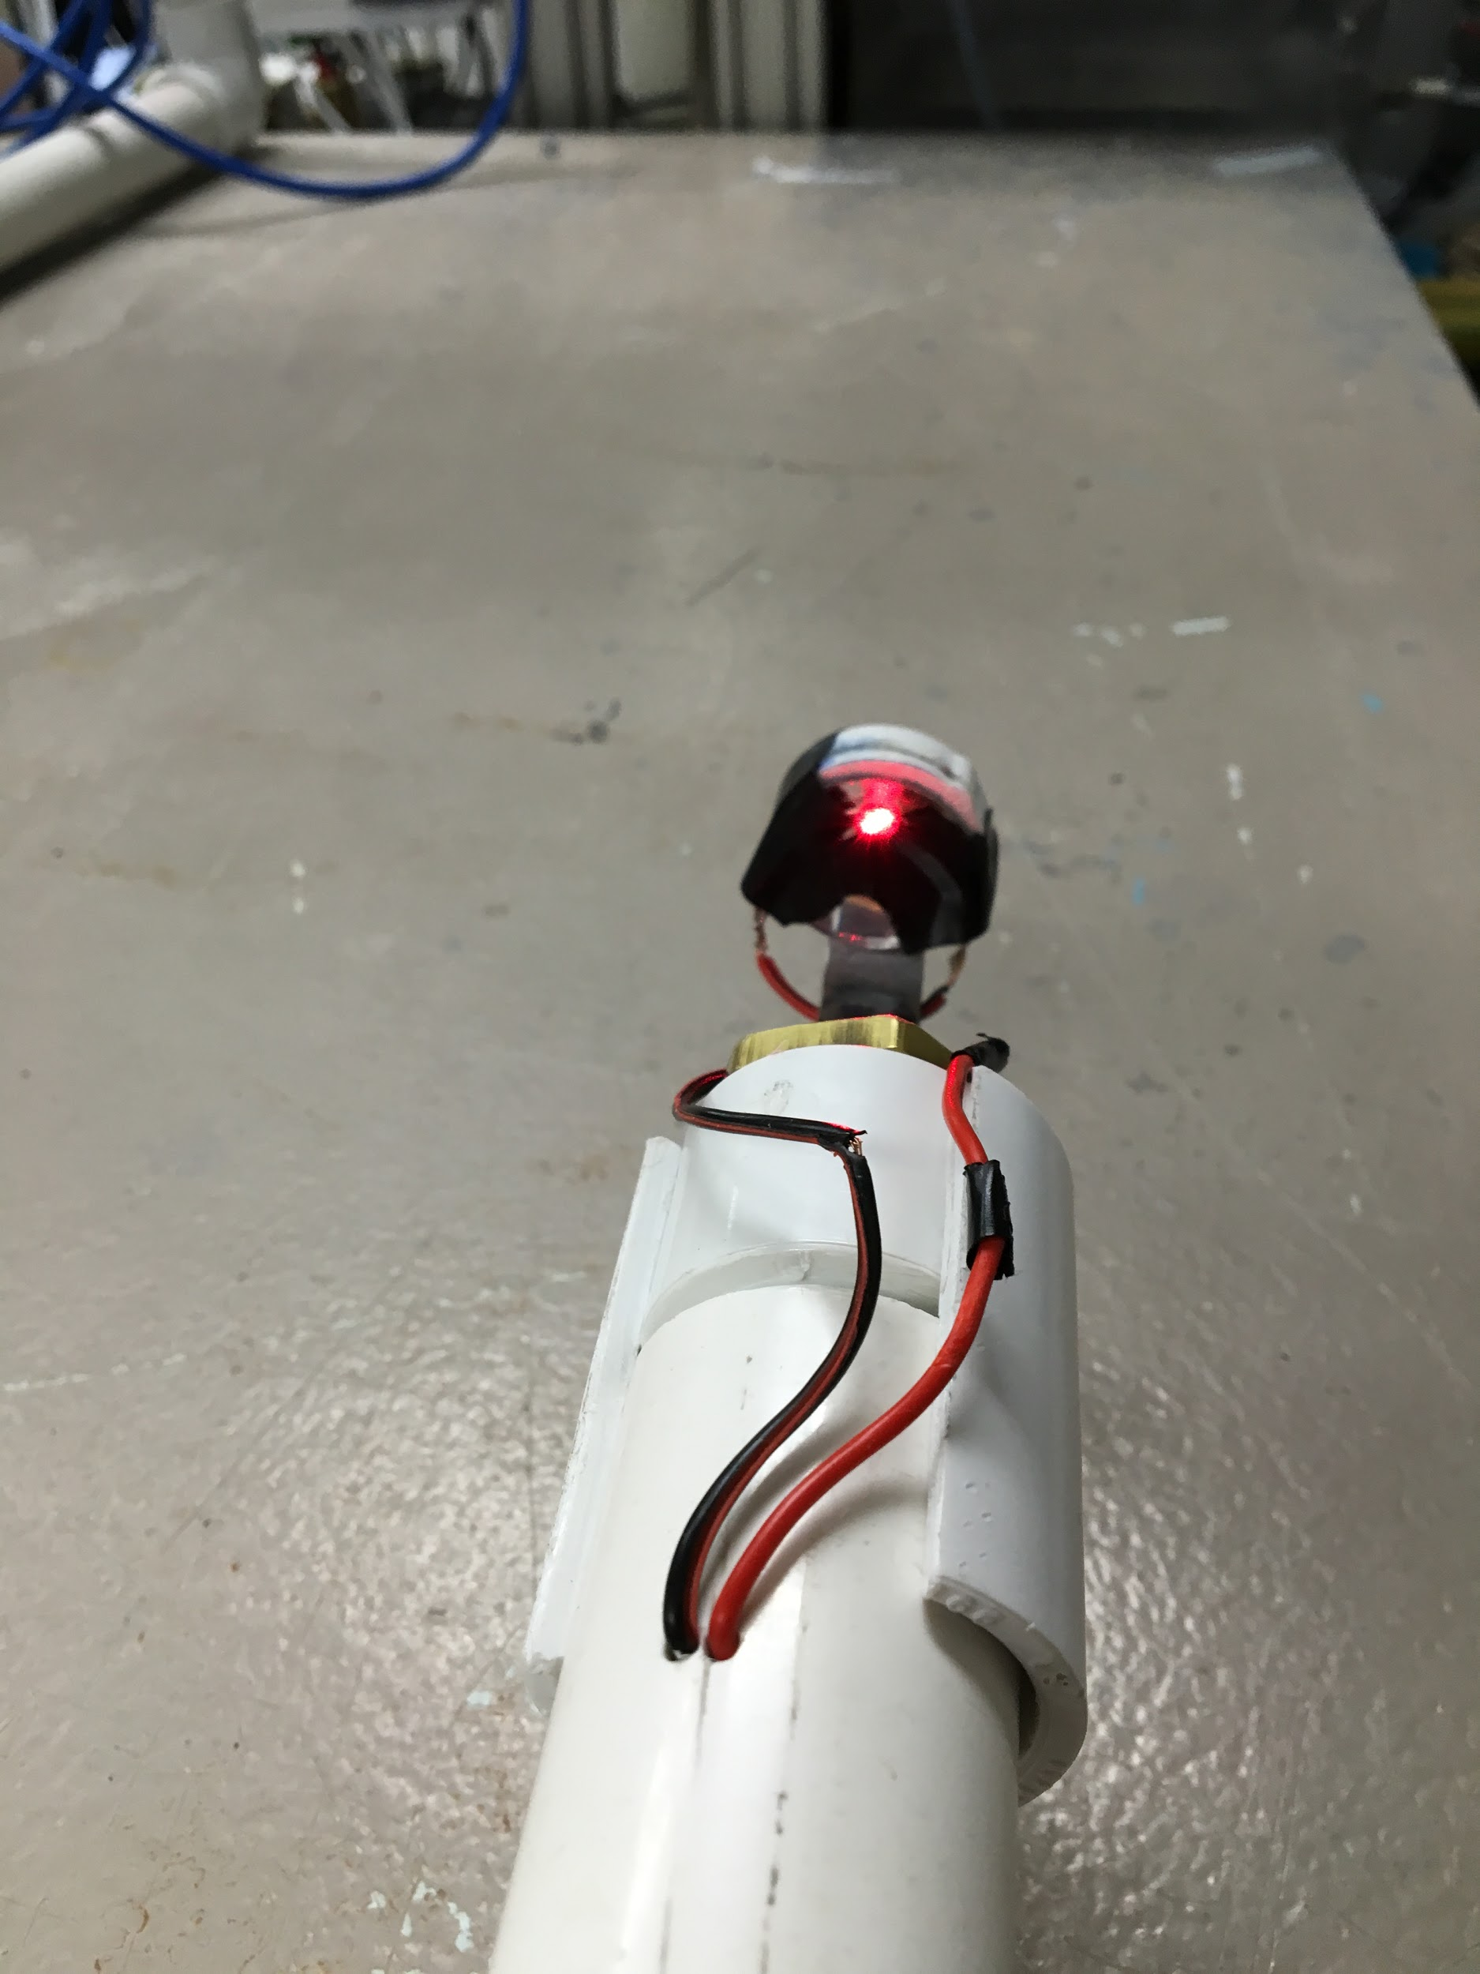
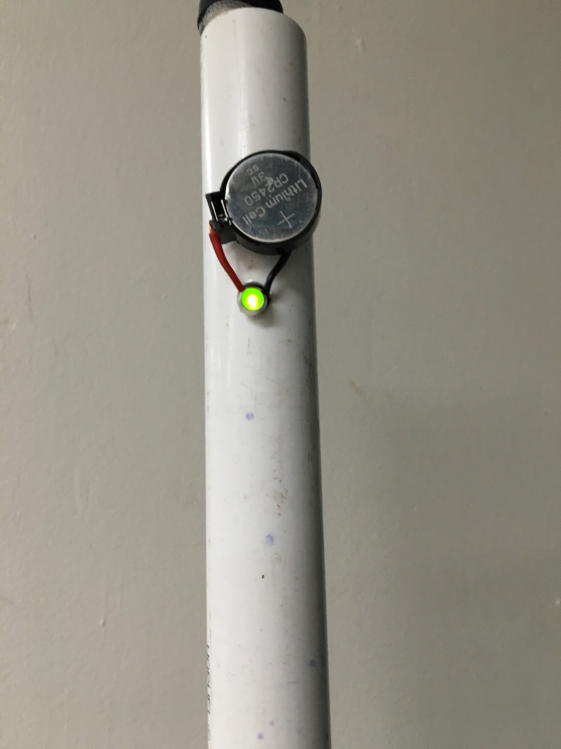
New design with photoresistor could work
Fabrication | Floc Hopper Probe | Final Presentation Spring 2016
Notes:
This design came from the idea that looking down the probe to notice the change in lighting might be problematic for some of the operators. The objective of this third iteration was to create an alternative that would eliminate this problem. From there some photoresistors were ordered and the wiring for the LED light was altered to incorporate one. The laser dot was placed back as it was in the first iteration but this time around it was pointing directly at the photoresistor. A photoresistor is light induced resistor that has high resistance when light strikes it and a low resistance in the dark. When the laser strikes the photoresistor, it prevents the current from the battery from passing and creating a full circuit, therefore not allowing the LED to turn on. If this light path between the the laser and the photoresistor is obscured, which the sludge blanket in the hopper is supposed to do, the LED light will turn on! This is the idea behind this method for the floc hopper probe. Unfortunately not trials were tested with this device.
Image Caption: (LEFT) Third iteration of probe with the red laser sight striking a photoresistor that has been taped to the mirror. (RIGHT) The LED light that will indicate when the sludge blanket in the floc hopper has covered the photoresistor.

Slide 5
Future work
Conduct test with third iteration of the probe and develop a waterproof model.
Explore ways to simplify electrical wiring.
Ship the probe to Honduras and test at the AguaClara plants.
Fabrication | Floc Hopper Probe | Final Presentation Spring 2016
Notes:
Future work should focus on testing this the probe that uses the photoresistor and its efficiency. The team should also look into making the wiring at the tip of the probe less messy and waterproof to avoid short circuiting. Also, future teams should look at incorporation a switch in the circuit to turn on the device as opposed to having to put on and take off the batteries during every use. Lastly, sending the finalized version of the probe to Honduras and testing it at the AguaClara treatment plants and innovate.

Slide 6
Questions and
Recommendations
Miguel Castellanos
Bachelor of Science
mc2326@cornell.edu

Slide 7
Appendix
Slides

Slide 8
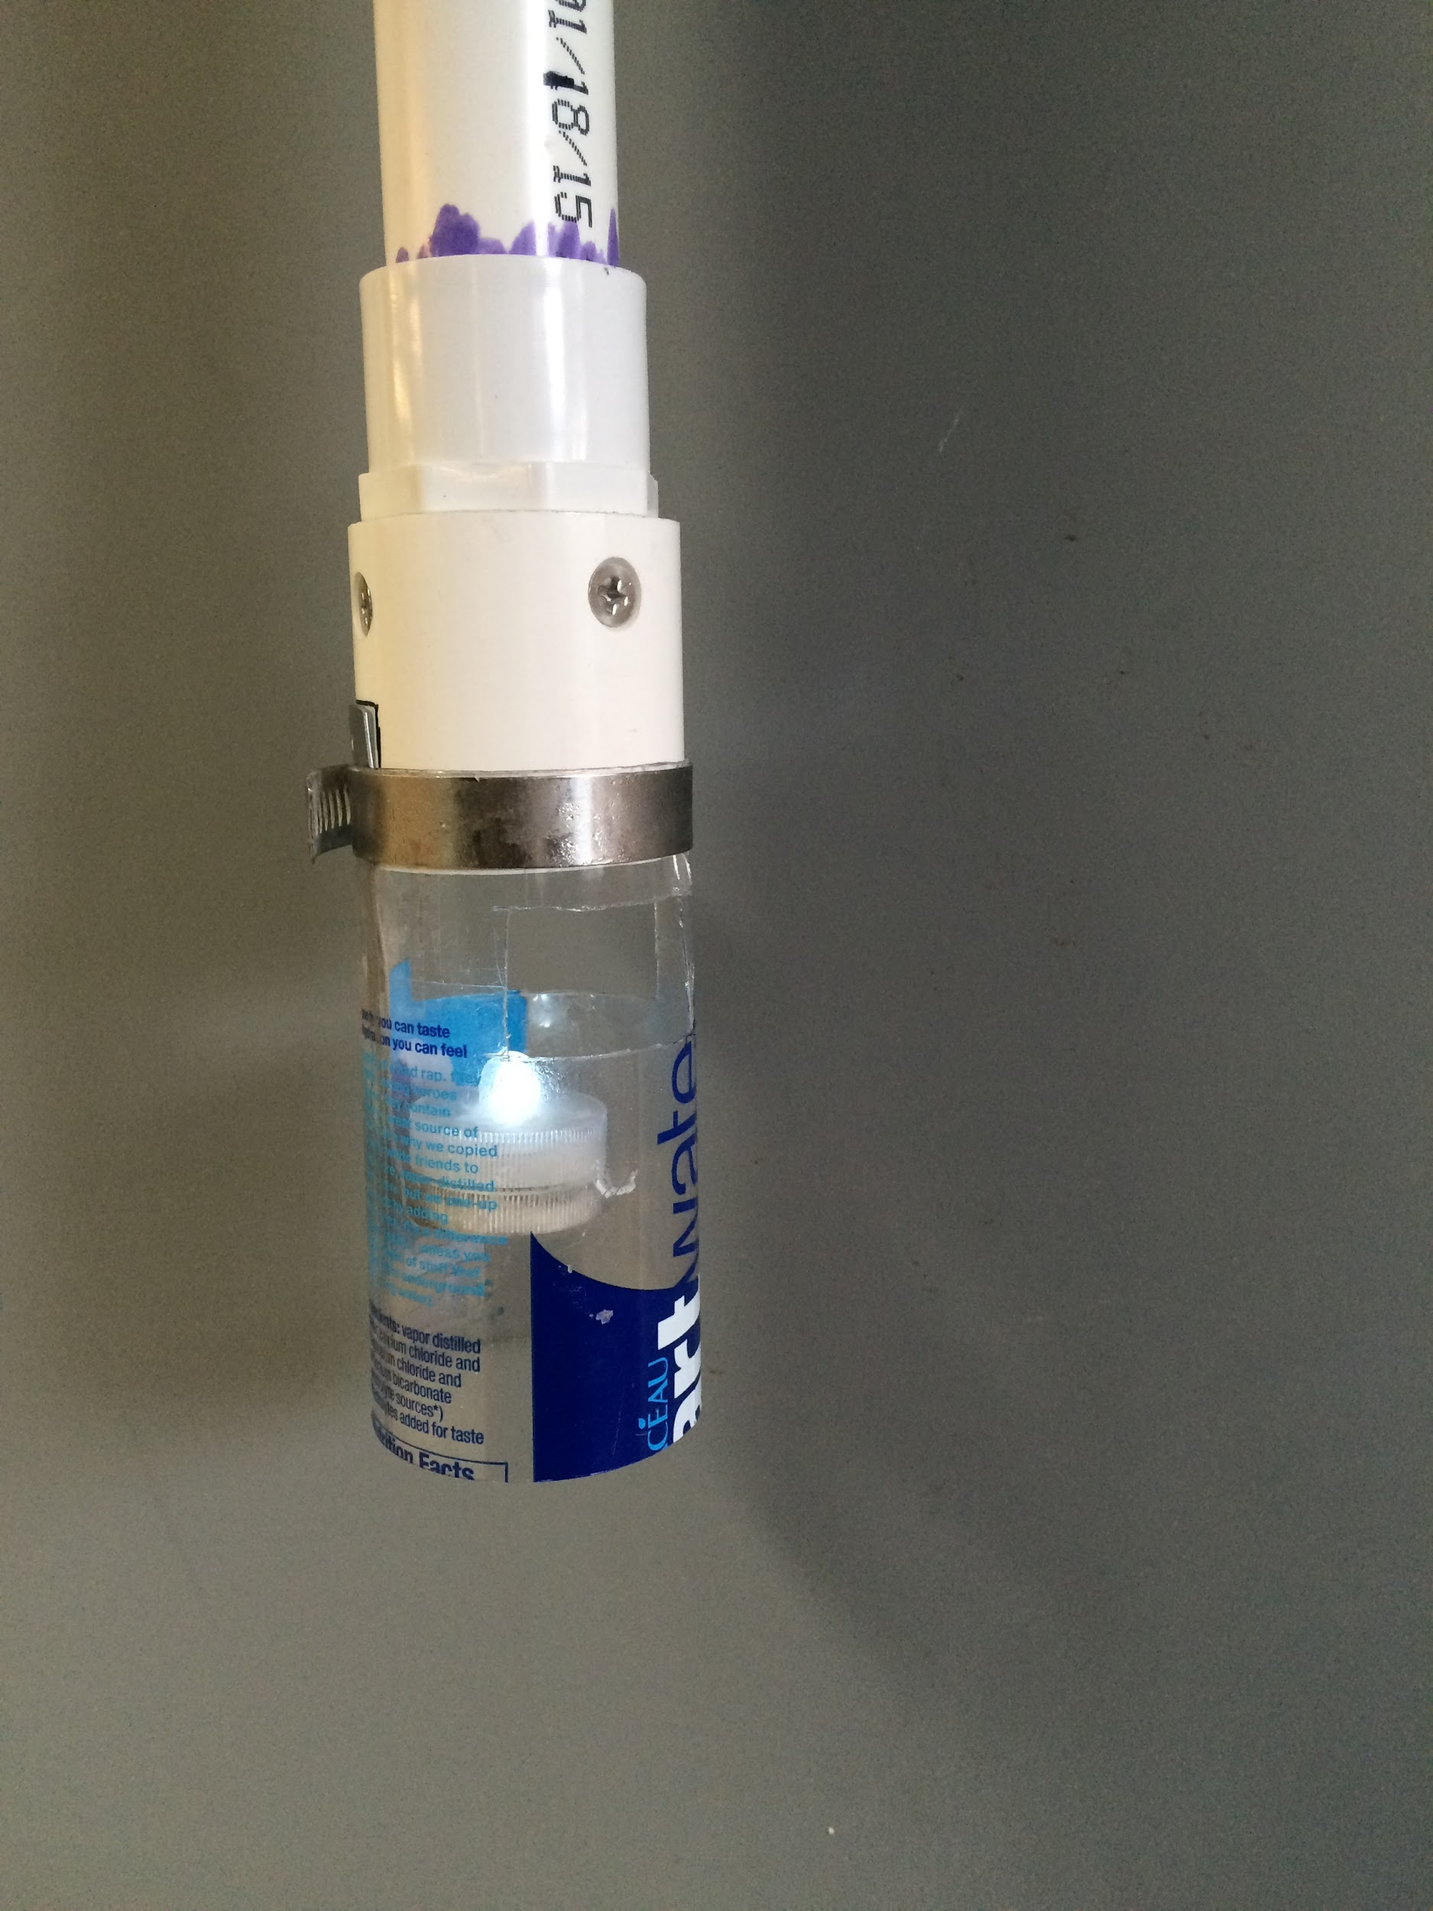
Floc hopper probe design from
fall 2015
Notes:
Appendix Slide 1: This image shows the previous floc hopper probe design that used a twist-on LED, and a floc “condenser” device to locate the sludge in the floc hopper. This design used a hose clamp to hold together the end components of the probe but when tested in Honduras it prevented the probe from entering the 2-in PVC pipe port to the floc hopper.

