Slide 1
Fabrication Fall 2014
Carl Talsma
Sara Sanz
Adrian Cobo

Slide 2
SRSF Weir System
Goal:
Make a hydraulic working scale model of the SRSF weir system for two filters to demonstrate how the weir system is used to set the flow to the filter during backwash. The hydraulics of this system are sufficiently complicated that explaining how it works is difficult and thus we need a working model for demonstration.

Slide 3
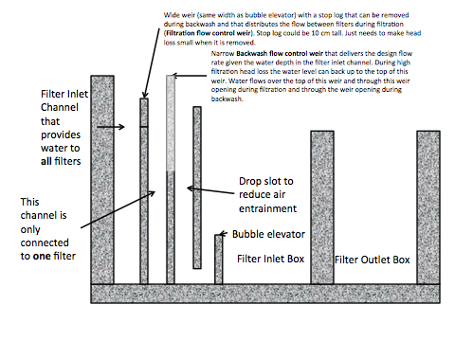
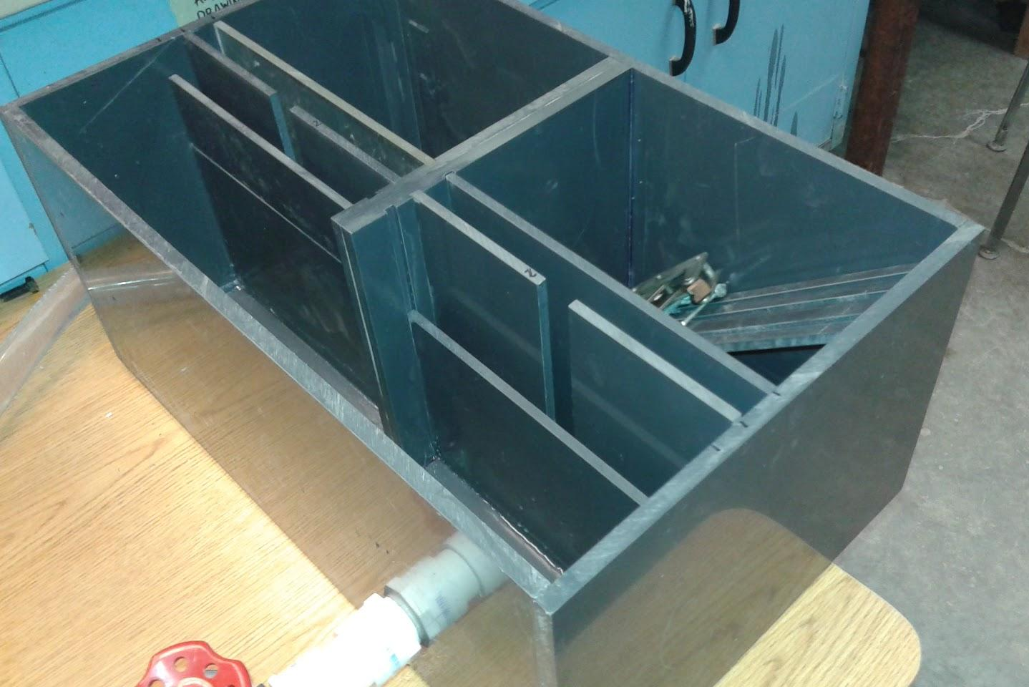
SRSF Weir System

Slide 4
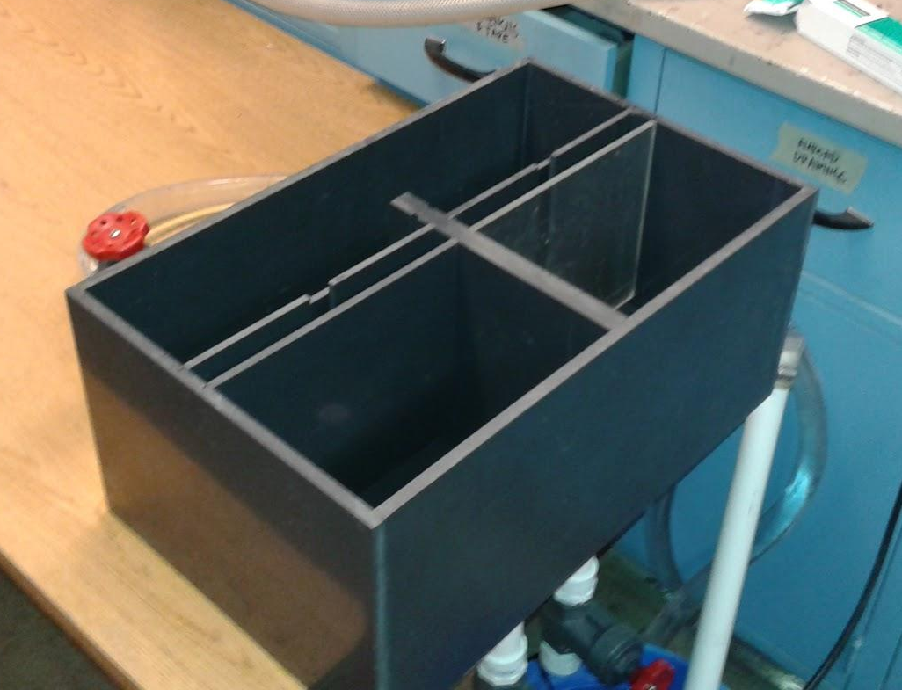
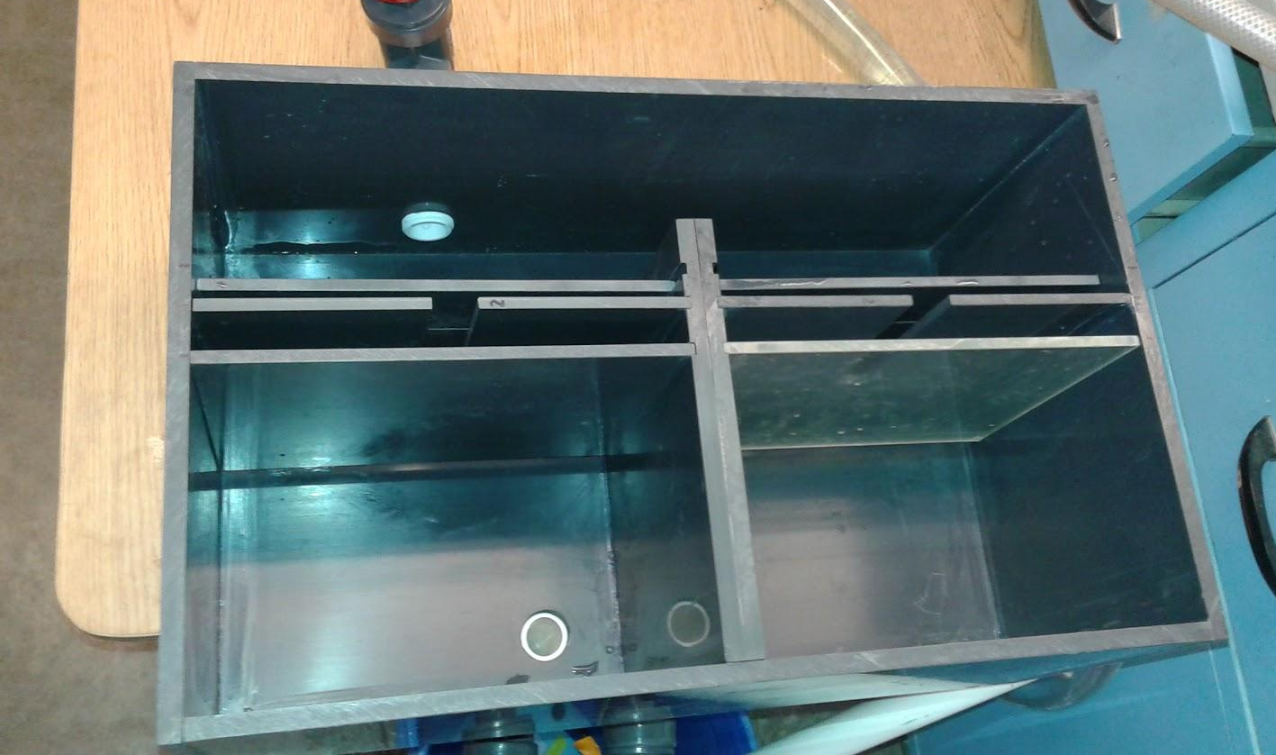
SRSF Weir System

Slide 5
Major Design Components
Weir Box/Tank
  Maintains Hydraulic Similarity
  Reasonable Size (portable)
Removable Weirs
  Maintains Hydraulic Similarity
  Easy to remove
Outflow system
  Easily change between backwash and filtration flow rate
  change in water depth (standpipes)
Inflow system
  recycles flow back into weir box
  constant design flow rate

Slide 6
Weir Box
Scaled from 50L/s agua clara plant CAD drawing
What is a reasonable scale
  ⅕? ⅛?
  Need to use Dimensionless analysis to match length scale to flow rate
  Froude Number
Break CAD drawing into individual components
  determine assemblage
  determine wall thickness

Slide 7
Froude Number
Froude number is ratio between inertial forces to the weight of an element
Determines Hydraulic similarity, flow through model (.28 L/s)
Fr=V/sqrt(g*L)
Fr=Q/(L^2*sqrt(g*L))
Fr=Q/(L^5/2*sqrt(g))
Q.model=Q.plant*L^5/2

Slide 8
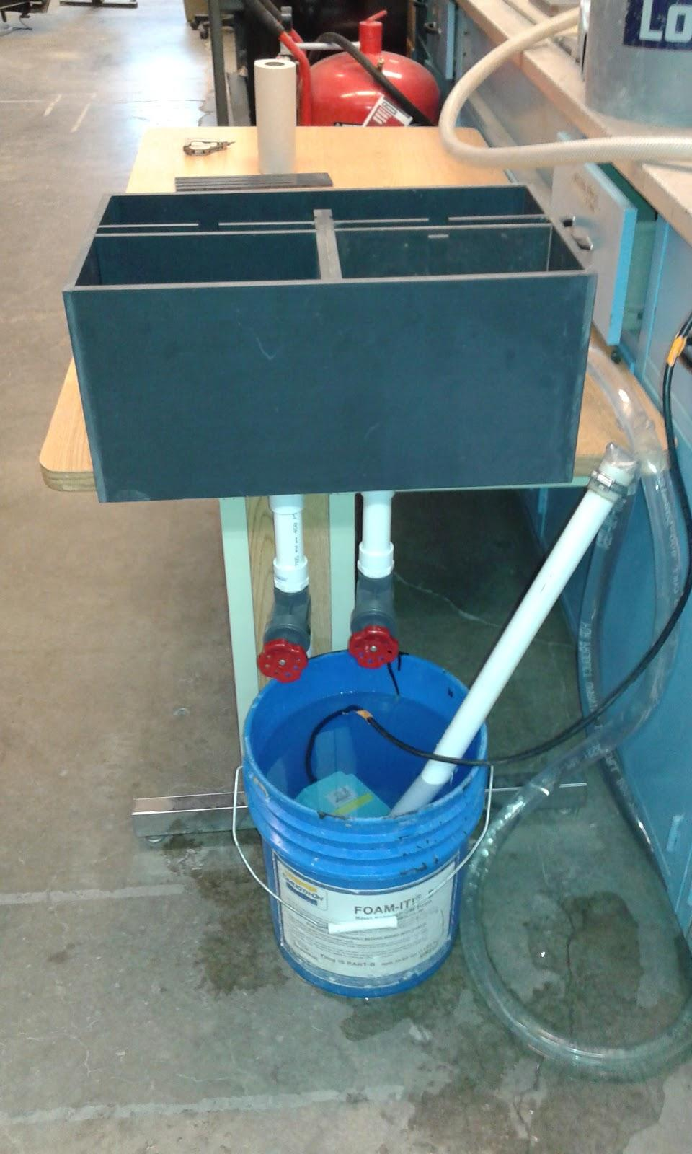
Outflow/Siphon System
Needs to achieve backwash flow rate
  0.28 L/s * 0.8= 0.224 L/s
  Determined by pipe diameter
How to Mimic Siphon for backwash
  Gate valves

Slide 9
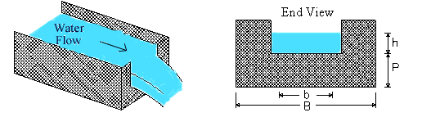
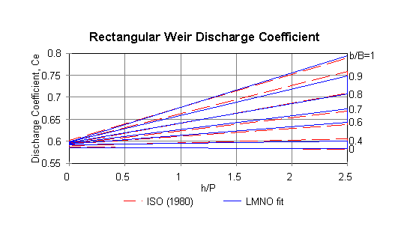
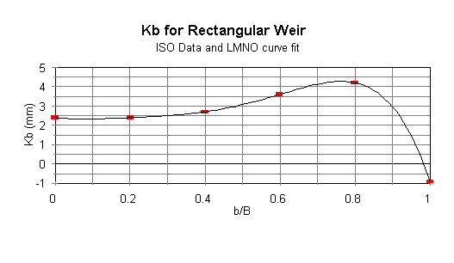
Weirs
Do the Weirs maintain hydraulic similarity?
  YES!
Rectangular Weir Equation:
Q=Ce*2/3*2*g*(b+Kb)*(h+Kh)3/2

Slide 10
Future Work
Continue testing the model
Refine the model
Determine new possible solutions to setting the backwash mode
Design how these weirs will be removed in a full scale plant or if a better alternative exists

Slide 11

LET’S SEE HOW THE MODEL WORKS!

