Slide 1
Fabrication Team
Julie Silva
Michael Walsh
Harrison Gill

Slide 2
Our Process
Understand problem and associated fundamental principles
Brainstorm solutions as a group
Evaluate possible solutions for feasibility and cost
Generate written designs/procedures
Evaluate with in country team
Test methodologies
Document procedures and designs
Evaluate with in country team
Revise
Complete

Slide 3
Ex. of Task and Constraints
With larger diameter inlet manifolds came the need for support.
  Must support weight of manifold (not water)
  Rests on sides of the sed tank
  Maintains proper height of diffusers above jet reverser.
Generate concepts!

Slide 4
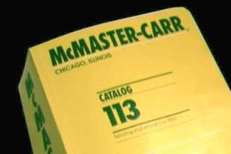
Large Diameter Inlet Manifold ctd
For this design we considered machining legs and fastening them to the manifold.
  Pros – specialized part, sturdy and doesn’t disrupt flocs
  Cons – availability in Honduras, cost, connection with manifold.
Generally we try to use parts we have and are cheap and easy to machine.
  This makes using 1.5 inch pipe a no brainer
  Had hose clamps laying around and tested out new method.

Slide 5
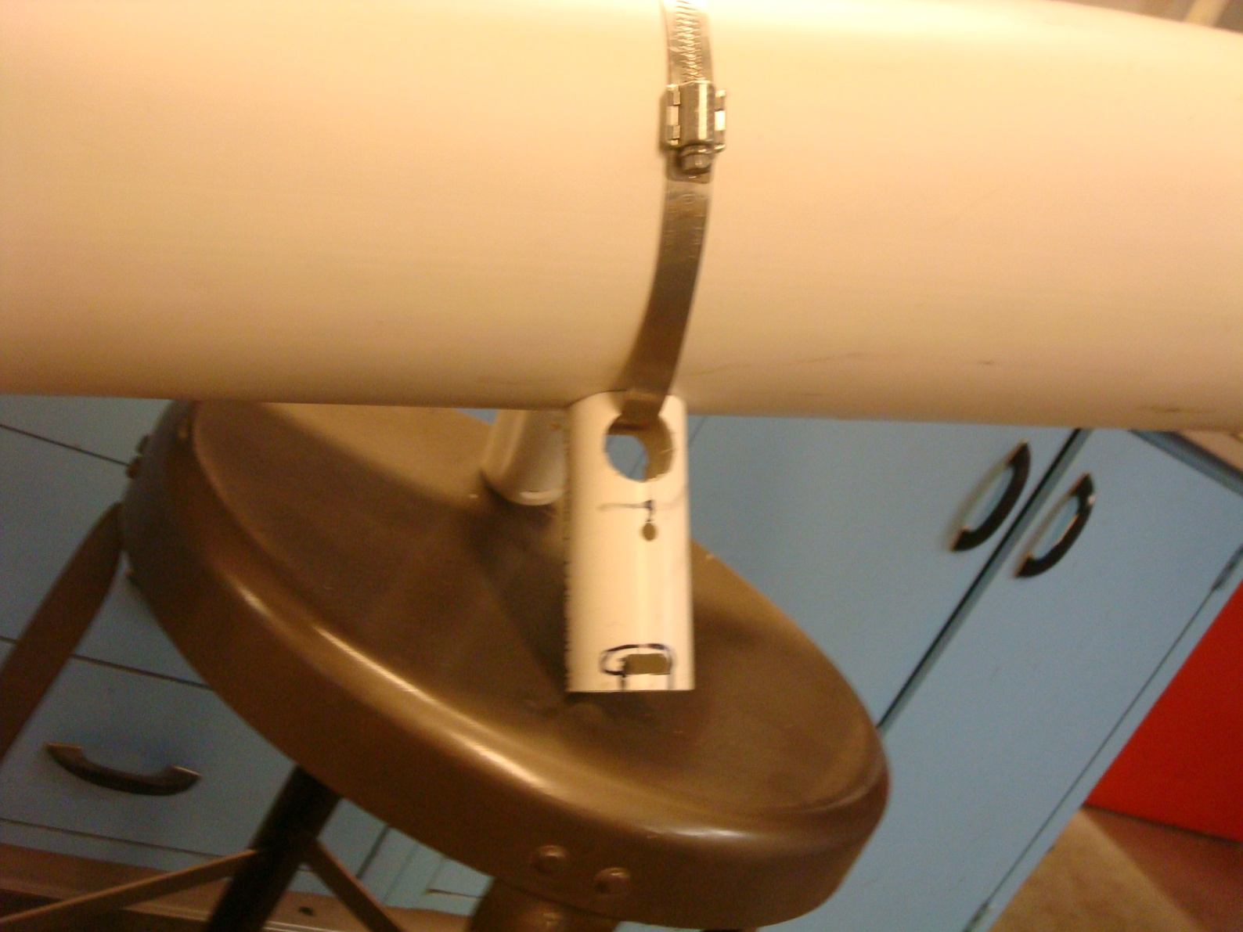
Basic Idea : Clamp through PVC leg

Slide 6
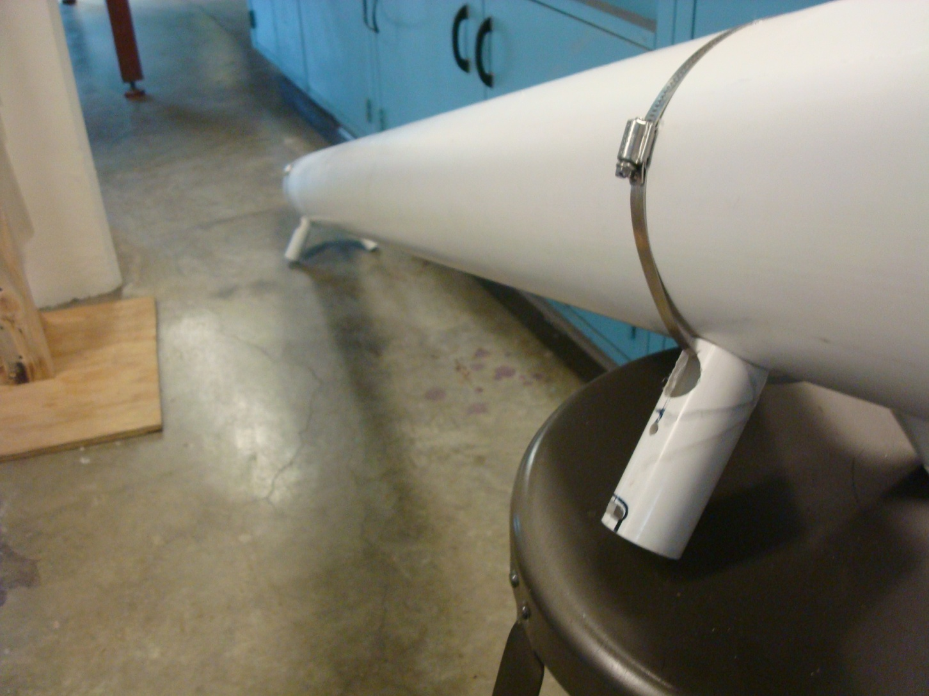
Inlet Manifold Feet

Slide 7
Orifice Plate
Controls head loss of flow into flocculator (10 cm head loss required).
Started out with a rubber end cap and decided it would deform.
  Switched to rubber sealed and supported with flat PVC enforced plate.

Slide 8
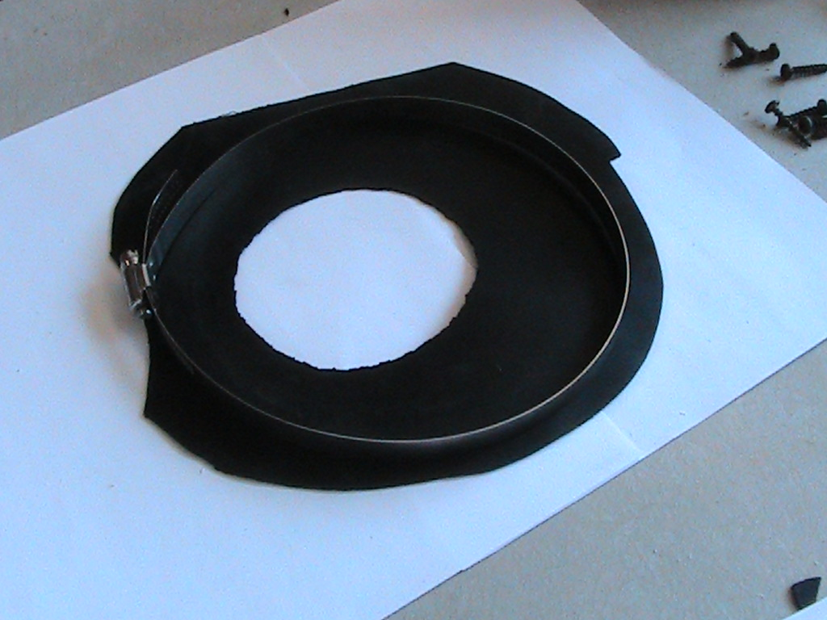
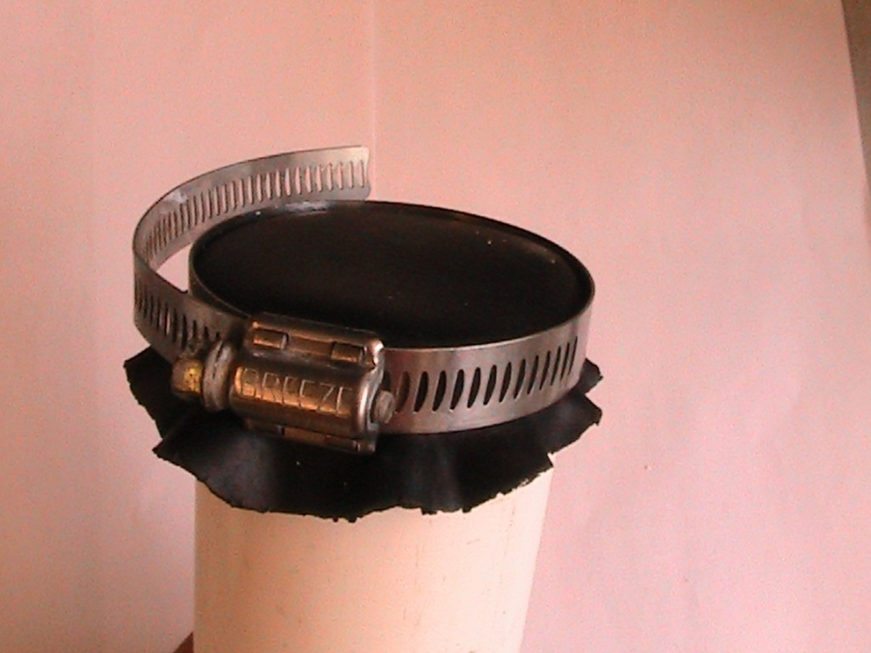
Orifice Plate Cover
(flat PVC plate not shown)
←Looks like this
Seals like this →

Slide 9
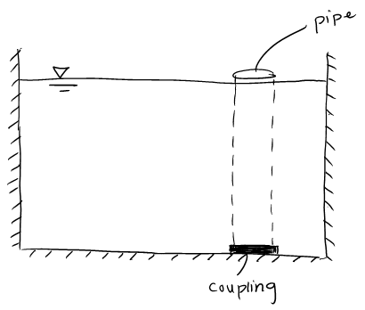
Pipe Stub Valves
AguaClara term for pipes to plug holes

Slide 10
Pipe Stub Valves ctd
Difficult when 6 in or larger
  Get stuck
  Heavy
Flat PVC plate to plug hole
  Difficult to replicate conditions in plants
    Large tank with an open pipe to plug

Slide 11
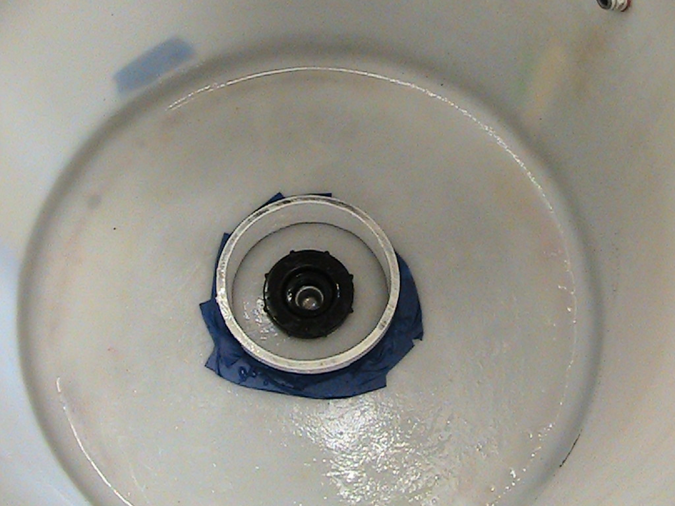
Experimentation Tank

Slide 12
Experimentation
Flat clear plate with rubber to create seal
  Leakage occurs between rubber and plate
Weight of water shifts plate
  Need to add sides onto plug
Difficult to determine whether or not the plate is properly in place
  Possibly larger plate with softer rubber

Slide 13
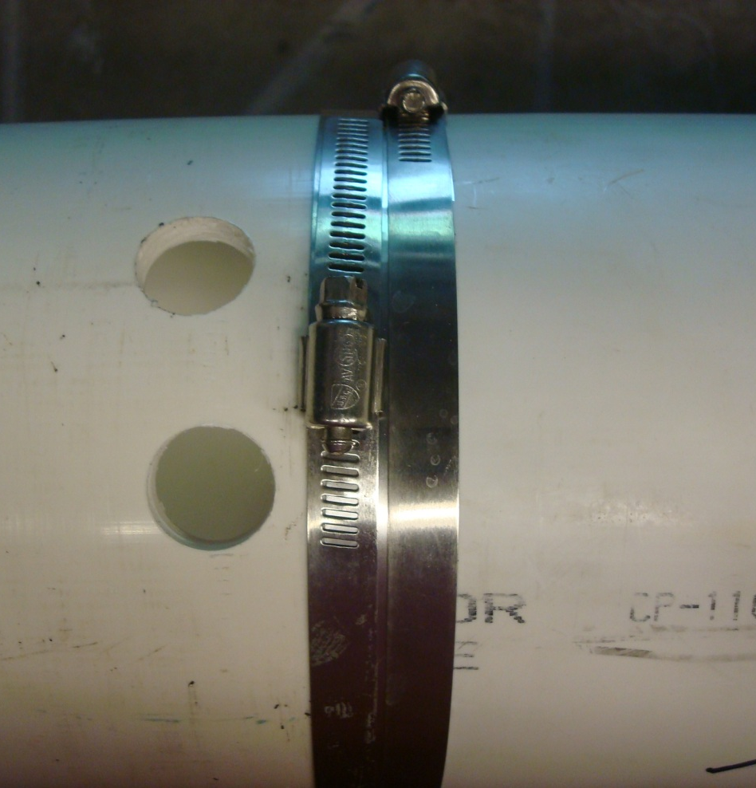
Low Profile Pipe Couplings
Inlet manifolds for the sed tanks in large plants need to be made out of multiple pipes
The diffusers only leave 1” gaps so couplings will not work
The solution is a low profile coupling made with a stainless steel band and hose clamp.

Slide 14
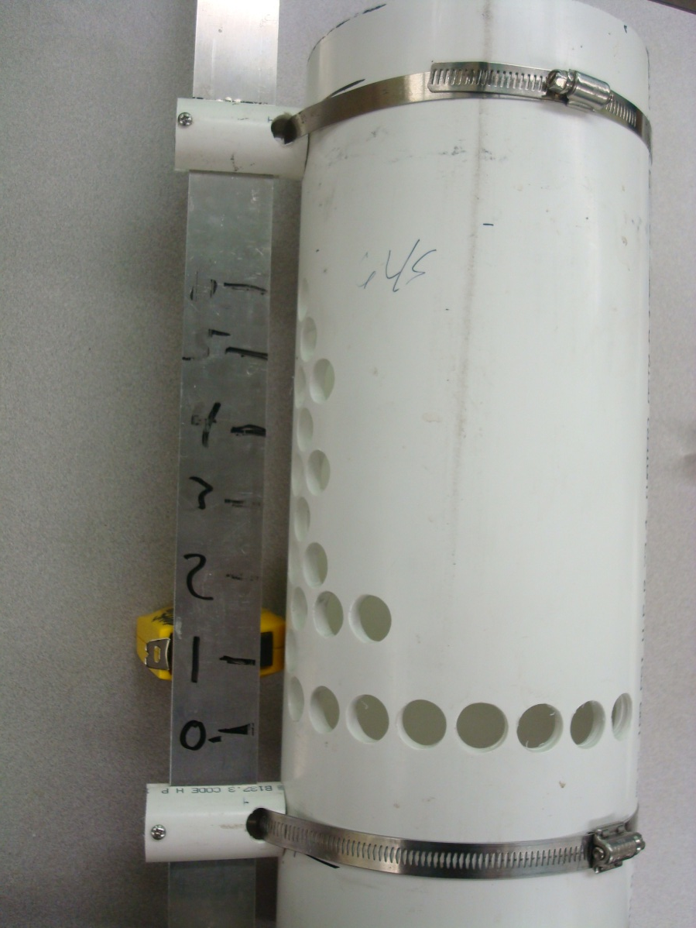
LFOM Scale Clamps
Design team has developed an algorithm to make a scale but it needs to be mounted in the entrance tank.
Mount and scale should be easy to make and easy to adjust.
Made of PVC, hose clamps, and Machine Screws.

Slide 15


