Slide 1
Fabrication
Juan Saavedra
Guo Jie Chin

Slide 2
Objectives
Extend battery life of cordless drill used on site
Improve hole saw cutting efficiency
Implement an efficient method to construct plate settler modules

Slide 3
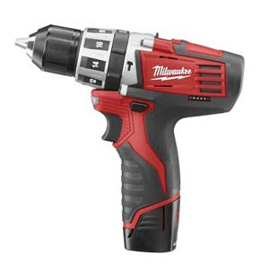
Drill Battery
Current situation
  New multipurpose drill acquired
  Limited usage
  Previous year’s team recommended utilizing the power of a car battery
Initial ideas
  Wire drill directly to a car battery
  Utilize DC power to charge the battery

Slide 4
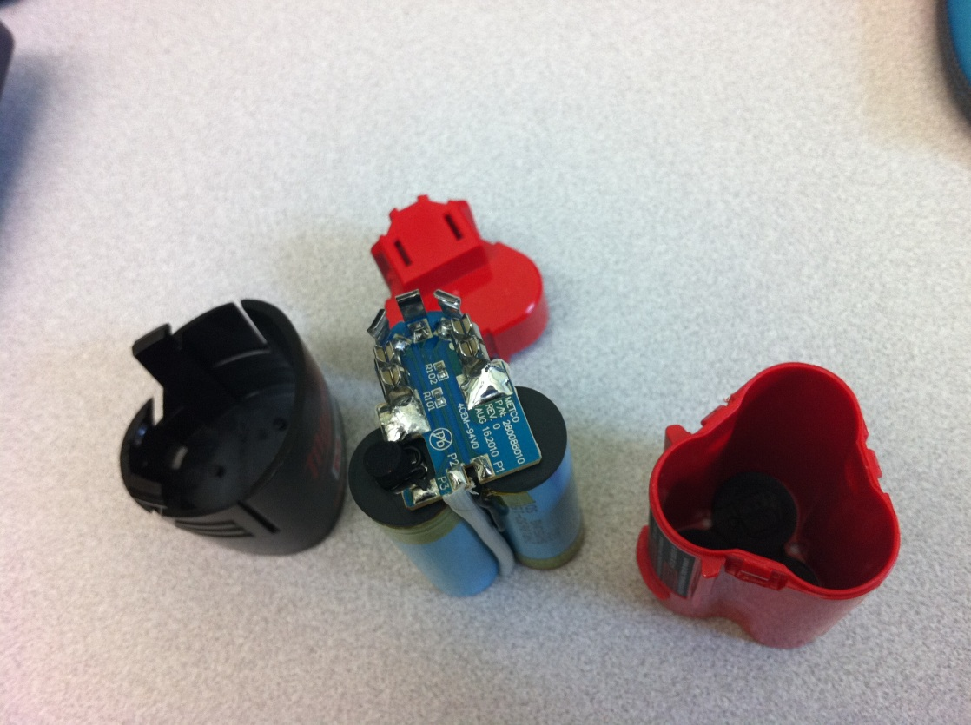
Drill Battery
Internal circuitry of the battery pack proved to be quite complex
We concluded that a direct connection is not a feasible route

Slide 5
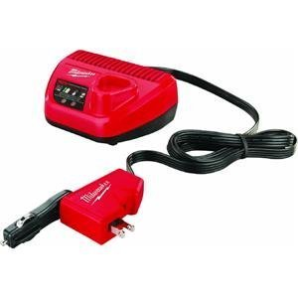
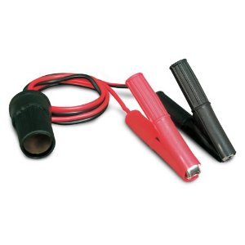
Drill Battery
Charging Battery with DC power
  The drill manufacturer produces a cigarette lighter DC battery charger
  Equipment arrived this week, and we will begin testing charge times and usability

Slide 6
Drill Battery
Benefits
  Versatile
  Causes no permanent damage or
  Safe
Drawbacks
  May result in down time if there are not enough batteries to cycle through
  Many connectors/adapters

Slide 7
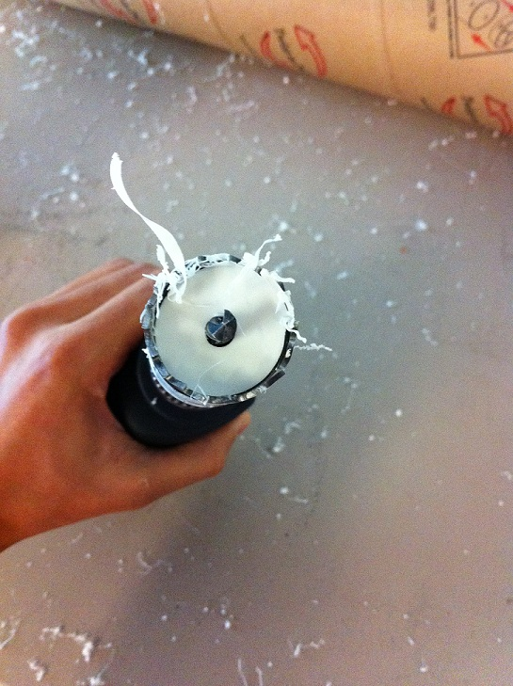
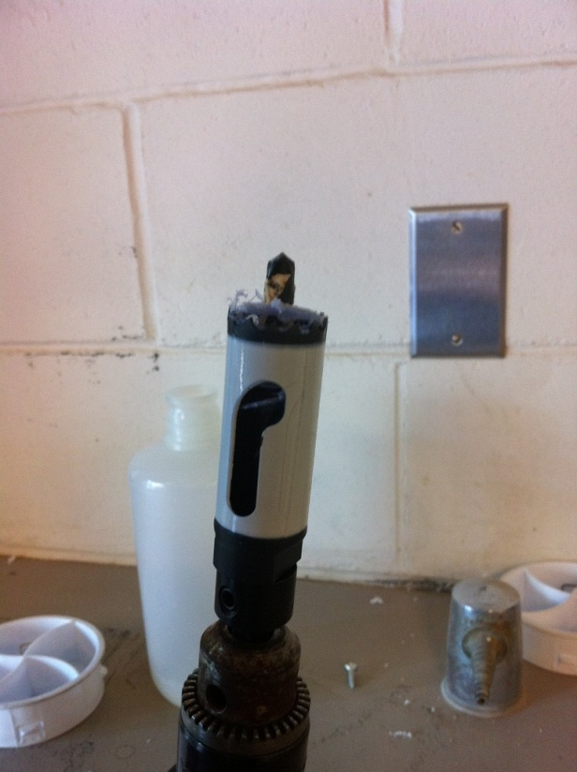
Hole Saw
Current issue
  Stuck plugs in the saw are difficult to remove

Slide 8
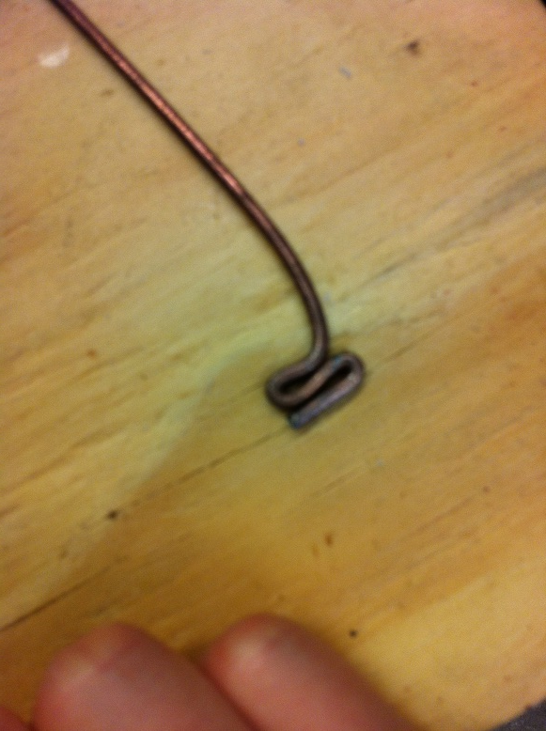
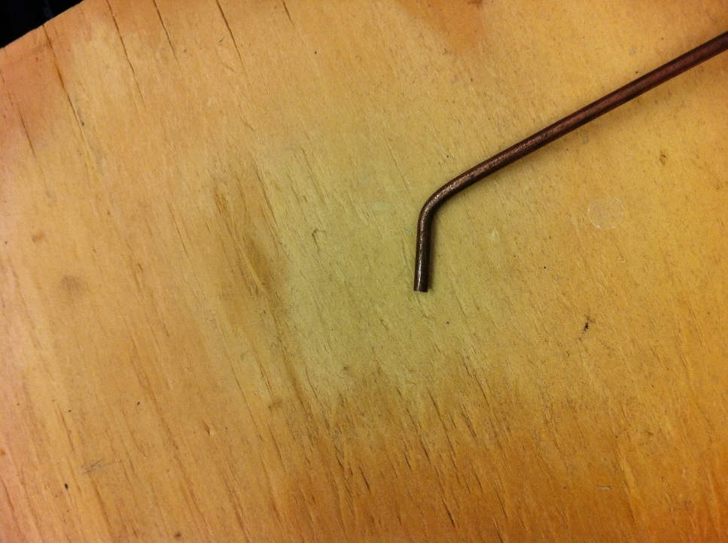
Hole Saw
Use a specialized tool
  One end is a step to use as a lever, the other end is to pry out the plug

Slide 9
Hole Saw
Tool was hard to stabilize and adjust
The prying end worked, but material was easily bent and rendered unusable
Not a viable method

Slide 10
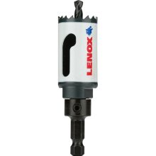
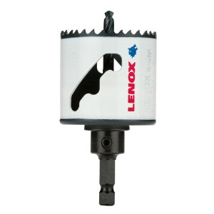
Hole Saw
Lenox Speed-Slot Hole Saw
  Designed to facilitate removal of hole plugs
  Uses a step system much like our tool to provide multiple lever points

Slide 11
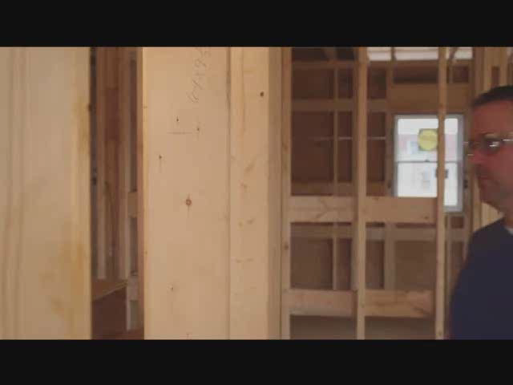
Hole Saw

Slide 12

Hole Saw
Advantages
  Worked effectively and more efficiently
  Not much more expensive ($10-15 more)
Disadvantages
  Very specialized & hard to find

Slide 13
Plate Settlers
Current issue
  Difficult to align and drill holes efficiently
  Previous year’s team proposed using a jig to align and stack plates
Our idea is to manufacture a jig that ensures a 2cm spacing between plates
Need to know height difference

Slide 14
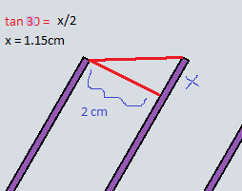
Plate Settlers
Since angle of inclination is 60 degrees, a height difference of 1.15cm gives 2cm separation between plates

Slide 15
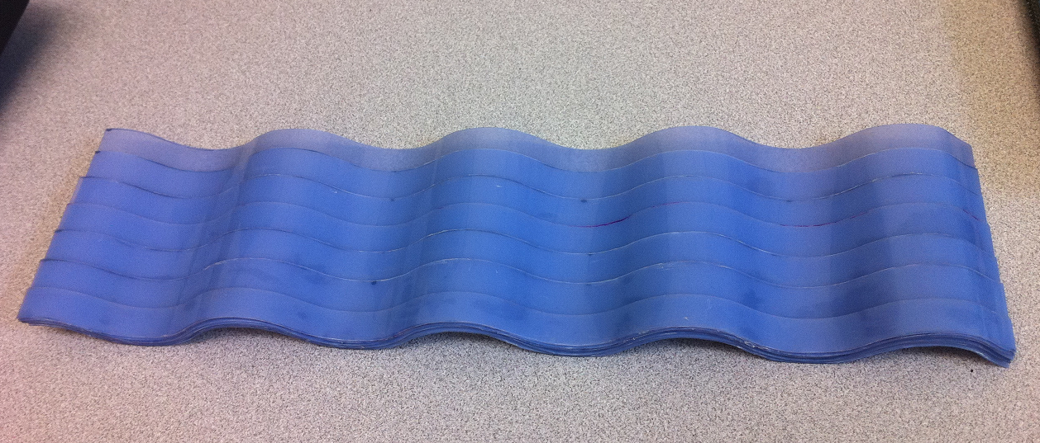
Plate Settlers
Built using seven 1.15cm long strips of successively layered lamina

Slide 16
Plate Settlers
Looking forward
  Evaluate the efficiency of the jig by constructing an entire plate module
  Extend the jig so it is able to handle more plates at a time for larger modules

Slide 17
