Slide 1
OStaRS Assembly
Mengqi Jiang and Subhani Katugampala

Slide 2
Overview of OStaRS Assembly
Open Stacked Rapid Sand Filters
  Constructed in plants > 8 L/s
  Three filters to be constructed in Las Vegas
Challenges
  Simplify assembly process
    Spacer
    Platform
    Holder
Figure 1: Flow of water through an inlet manifold in an OStaRS filter
Notes:
MENGQI

Slide 3
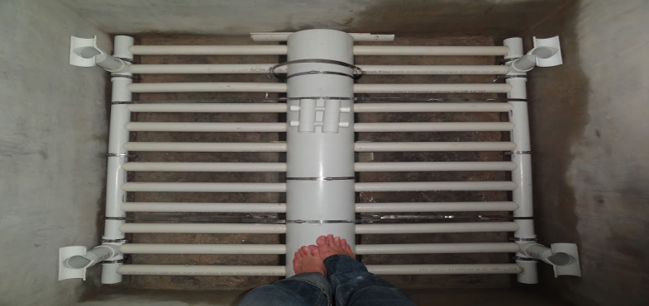
Problem Areas: Spacer
Stability of Modules
  Potential Solution: Spacers
Figure 2: Top view of a filter module including spacers in corners.
Notes:
MENGQI

Slide 4
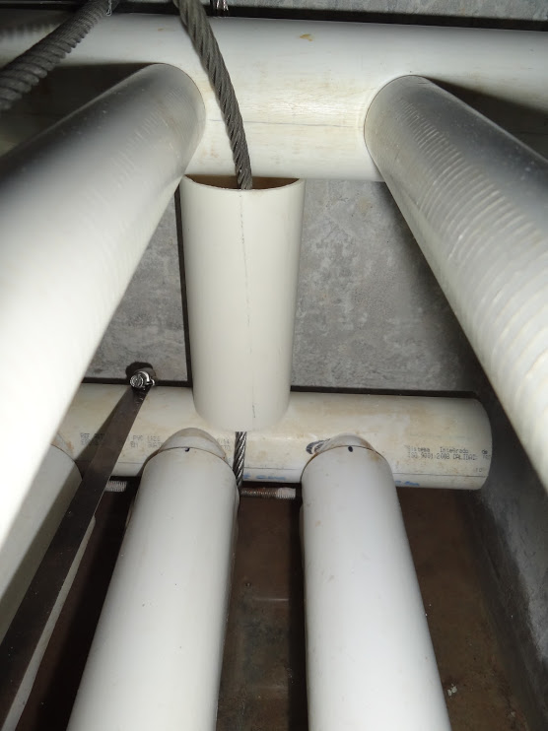
Problem Areas: Spacer
Figure 3: New spacer between filter modules consisting of a 2” pipe stub with cables to secure it in place.
Notes:
MENGQI

Slide 5
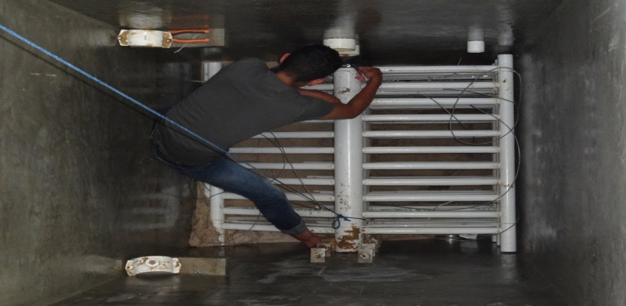
Problem Areas: Platform
Haphazard Assembly
  Potential Solution: Movable Platform
Figure 4: Top view of a filter module assembly without platform.
Notes:
MENGQI

Slide 6
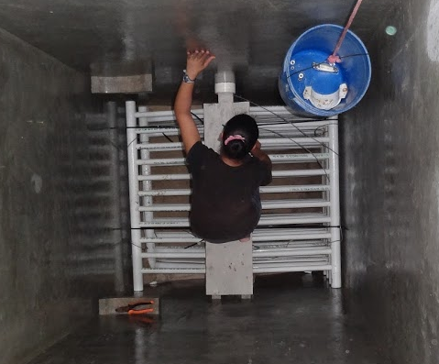
Problem Areas: Platform
Figure 5: Top view of a filter module assembly with a stagnant platform.
Notes:
MENGQI

Slide 7
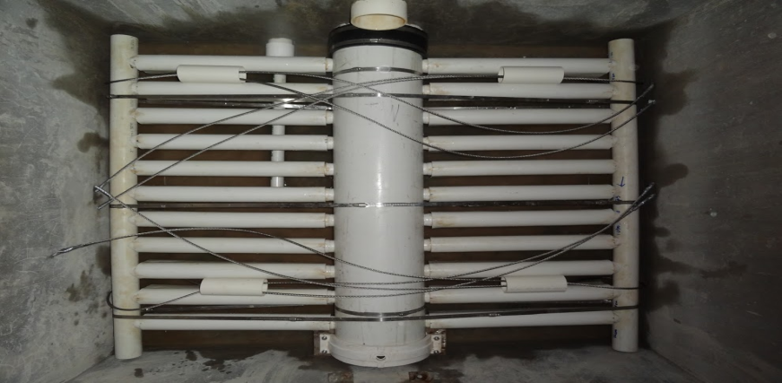
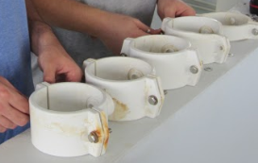
Problem Areas: Holder
Security of Trunk Line
  Potential Solution: Holders
Figure 6: Top view of a filter module with cable holder and truck line support
Notes:
MENGQI

Slide 8
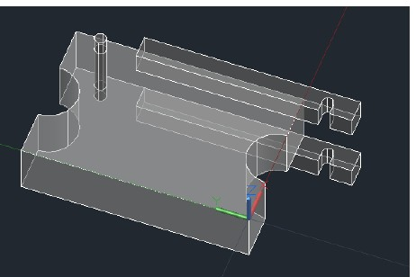
Modified Spacer: Design
Goal
  Minimize tools and components during assembly
Components
  PVC Spacer
  Straight latches instead of L-brackets
  PVC Rod
Figure 7: AutoCAD schematic of modified spacer design
Notes:
SUBHANI

Slide 9
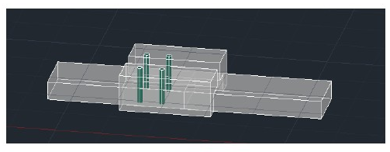
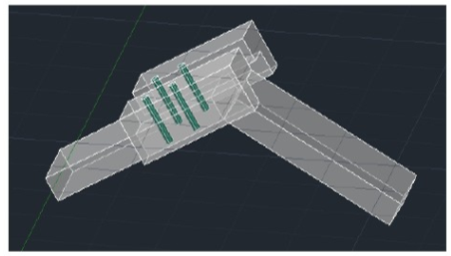
Initial Platform: Design
Goals
  Easier assembly
  Prevent bending pipes
Components
  Two wooden boards
  Two metal hinges
  Two angle brackets
  Metal Screws
Filter Modifications
  Slots into filter wall
Figure 8: AutoCAD schematic of platform
Notes:
SUBHANI

Slide 10
Moving Forward
Fabrication of platform and three spacers
  Design for top spacer to attach to the filter
Stress testing
Design alternative to current holder system (to support truck line)
Notes:
SUBHANI

Slide 11
Constant Head Tank
Anna Doyle, Valerie Shao, and Serena Takada

Slide 12
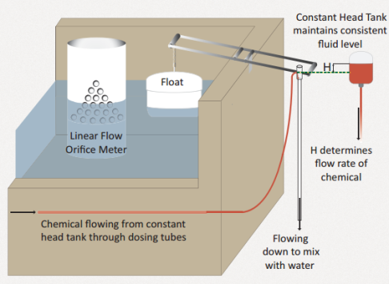
Constant Head Tank Overview
Constant Head Tank is part of Chemical Dose Controller
Regulates flow of chemicals from chemical stock tank to dosing tubes

Slide 13
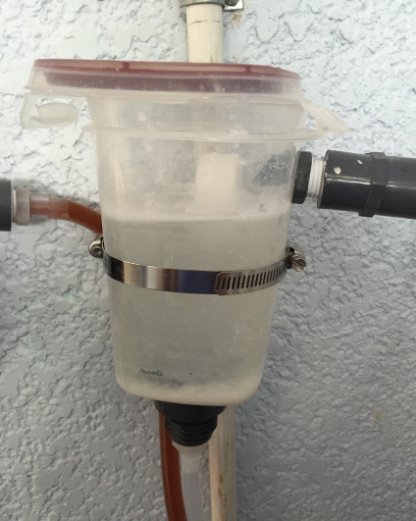
Current CHT Design using Plastic Tupperware
4 Problems:
Not chlorine resistant
Float valve requires modification
Stratification
No in-place cleaning

Slide 14
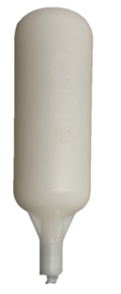
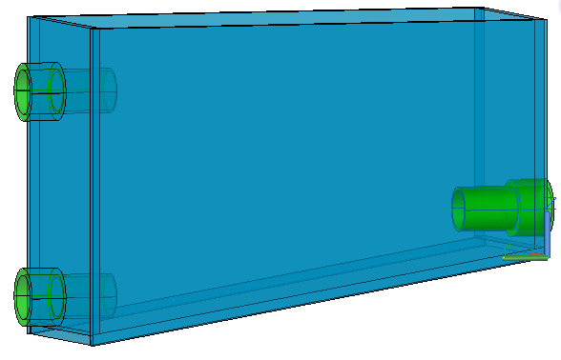
New CHT Design
Constant Free Surface
Influent from Stock Tank
Settling Calcium
Exit to Dosing Tubes
Closed Valve
Custom Clear PVC Tank
Sloped bottom to collect settled calcium

Slide 15

Cleaning In-Place
CLOSE Influent from Stock Tank
CLOSE Exit to Dosing Tubes
Drain settled Calcium

Slide 16
Clean CHT
Constant Free Surface
Influent from Stock Tank
Exit to Dosing Tubes
CLOSE Valve

Slide 17
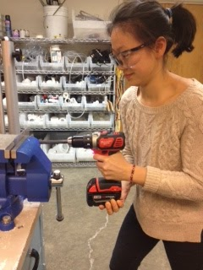
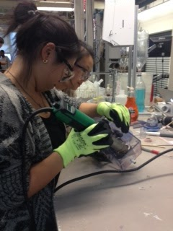
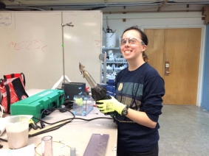
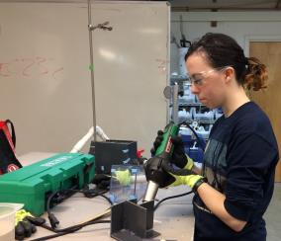
PVC Welding for Tank Construction

Slide 18
Future Work
Fabrication of first iteration of new CHT design
Testing of constructed CHT
Present design to Monroe/engineers in Honduras
Fabrication and testing of second iteration of design, if necessary

Slide 19
Flochopper Probe
Miguel Castellanos

Slide 20
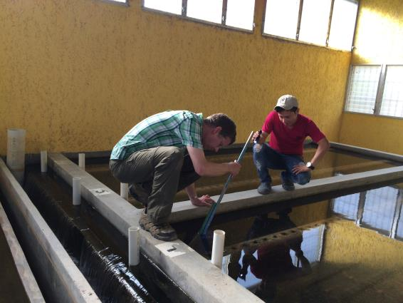
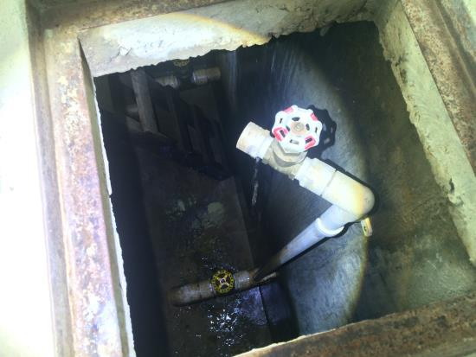
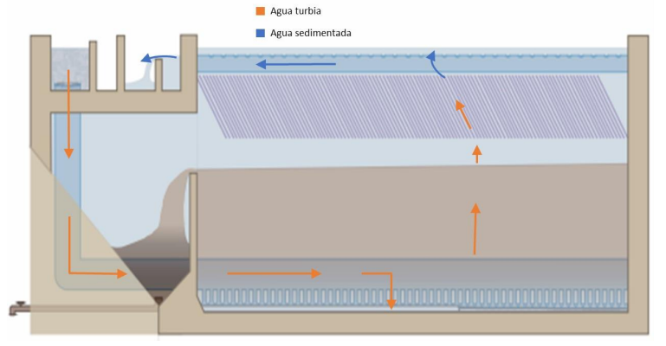
Challenge
Reduce the amount of water that is wasted due to purging floc hopper
Build a device to measure depth of sludge in floc hopper
Prevent floc hopper from becoming clogged with sludge, lowering plant performance

Slide 21


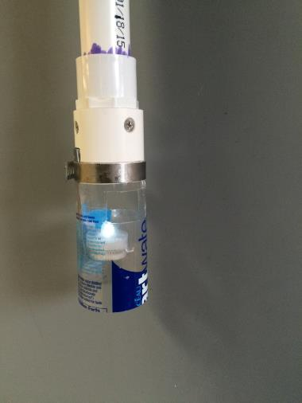
Fall 15 Methods
1” PVC
1” Hex brass glass sight
LED to indicate sludge blanket depth
Hose clamp to hold floc ‘condenser’ & LED light
Not to scale

Slide 22
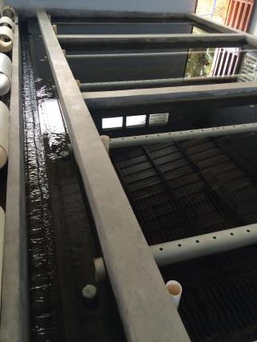
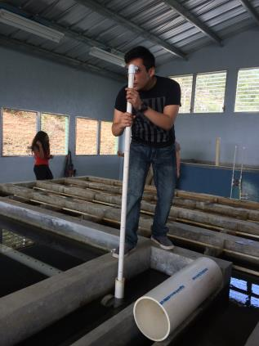
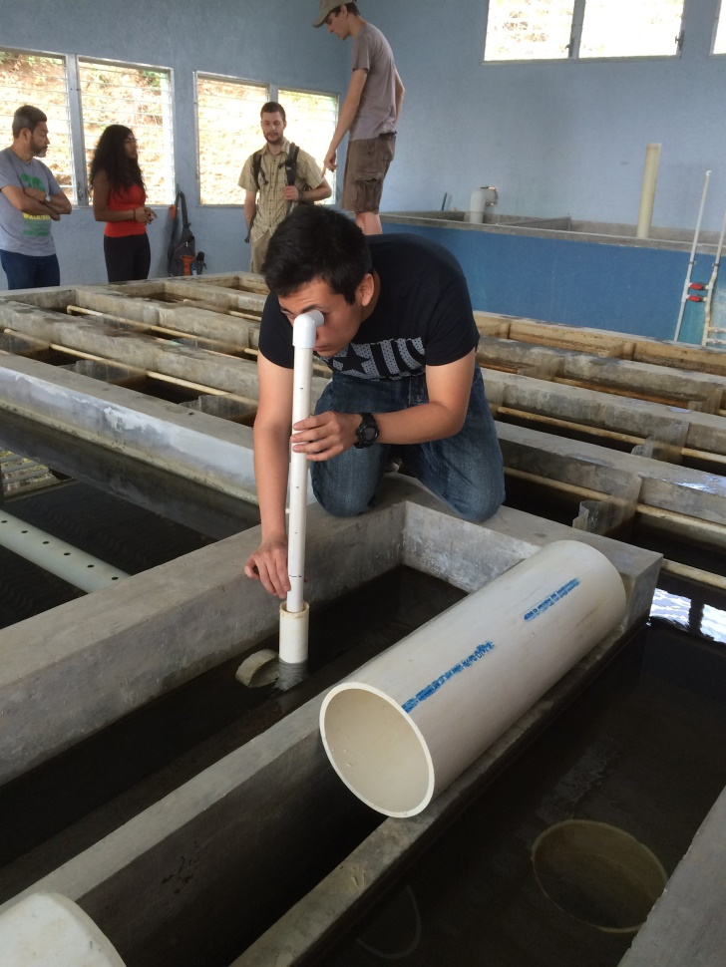
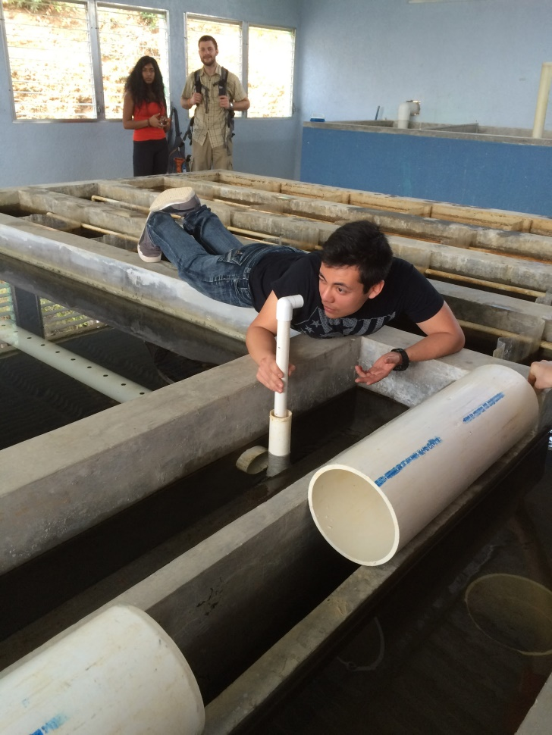
Honduras 2016 Results
Probe occasionally failed to enter 2” PVC pipe port in the sed tank channel
Delicate end components
Difficulty turning LED on/off
Floc hopper design varies with each plant

Slide 23
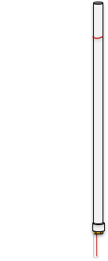
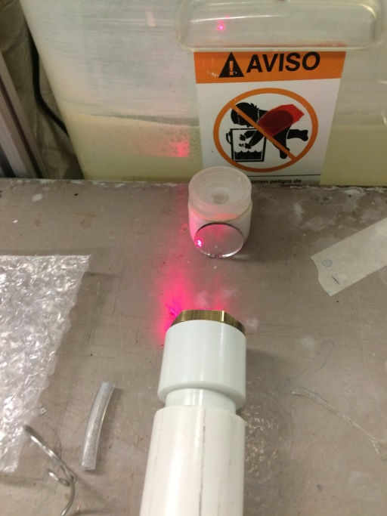
Spring 16 Goals
Entire apparatus made of 1” PVC pipe
Less external parts
From LED to red dot laser
Switch/button to turn laser dot on
Periscope to avoid eye damage
Functional prototype for Honduras 2017

Slide 24

Questions or Suggestions?

