Slide 1
Fabrication
Juan Saavedra
Guo Jie Chin

Slide 2
Introduction
Goal: to design and implement procedures to make the building process more efficient
Problems we approached
  Decrease time required to drill holes
  Improve battery life of cordless drill
  Design method to easily align plate settlers

Slide 3
Car Battery
Problem: Cordless drill used on site runs out of power frequently
Utilize a portable power source such as a car battery to drive it
  Direct power was not feasible due to complicated circuitry of battery

Slide 4
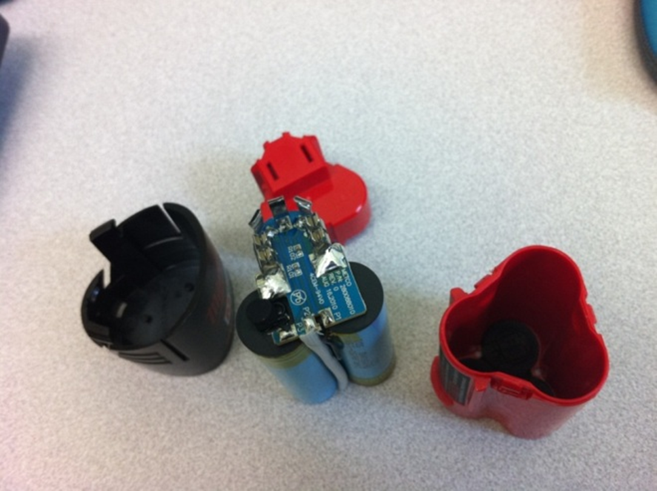

Slide 5
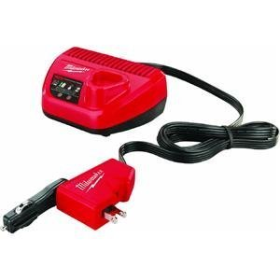
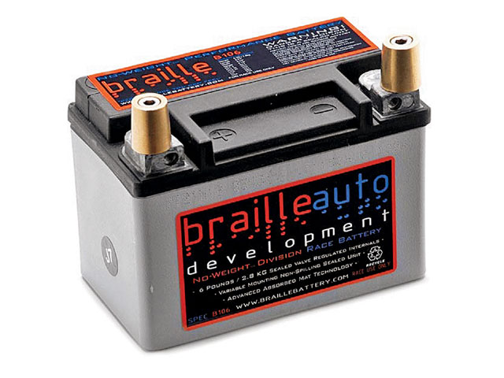
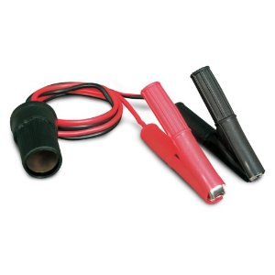
Car Battery
DC Battery Charger produced by Milwaukee

Slide 6
Car Battery
Promising results: Charge time of 42 minutes in our test
Advantages
  Safe, reliable
  Efficient, quick charge
Disadvantages
  Requires multiple swappable batteries

Slide 7
Car Battery
Future goals
  Research alternative sources of power
    Solar
    Mechanical Dynamo (e.g Bicycle)

Slide 8
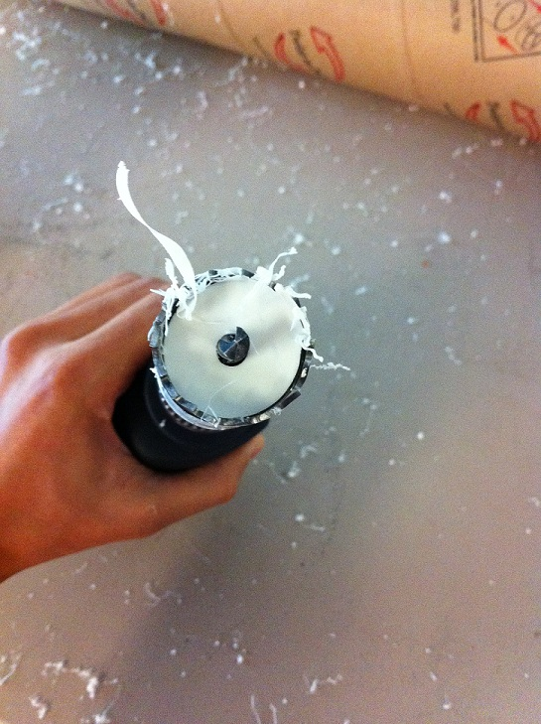
Hole Saw
Problem: hole saw plugs are difficult to remove
                Idea: use a different type of drill bit or saw

Slide 9



Hole Saw
Drill bits
Forstner Bit
Step Bit
Plastic Bit
Spade Bit

Slide 10
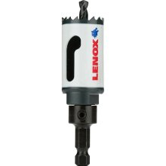
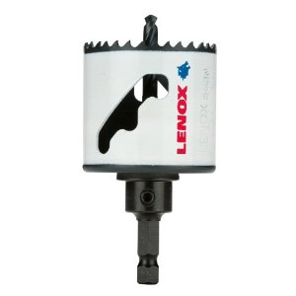
Hole Saw
Lenox speed-slot saw
  Uses a lever system to facilitate plug removal
  Worked much faster and more efficient in our tests

Slide 11
Hole Saw
Future goals
  Develop a specialized tool to pry out plug
  Design a tool to act as an elevated pivot for any general hole saw

Slide 12
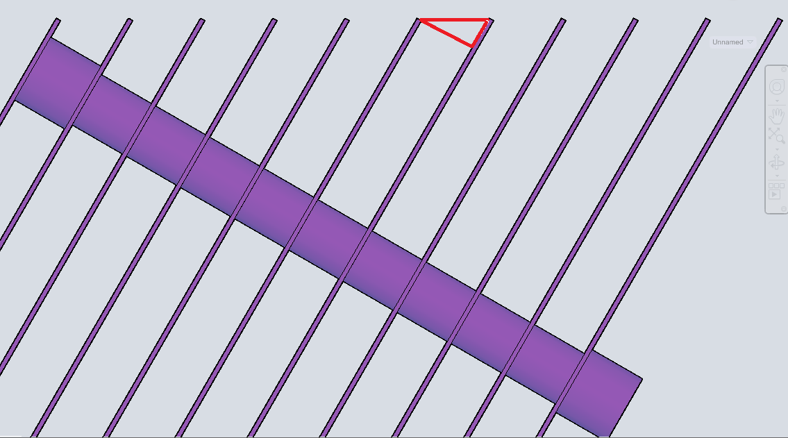
Plate Settlers
Current issue
  Difficult to align and drill holes effectively, since plates are to be placed at an angle

Slide 13
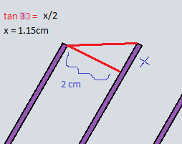
Plate Settlers
Our idea was to construct a jig that would allow workers to easily align plates
Knowing the angle of inclination, a geometric analysis gives us the necessary spacing

Slide 14
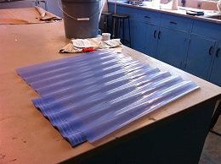
Plate Settlers
Initial jig: 1.15cm height difference results in 2cm plate separations

Slide 15
Plate Settlers
Issues
  Sacrifice accuracy for efficiency
    Hard to align since jig sheets were thin
    Hard to visually confirm if they were well aligned
Try building with a different material

Slide 16
Plate Settlers
Jig 2.0: Utilizing a thicker material
  Flatness does not matter – was actually easier to align
  Thicker material ensures accuracy

Slide 17
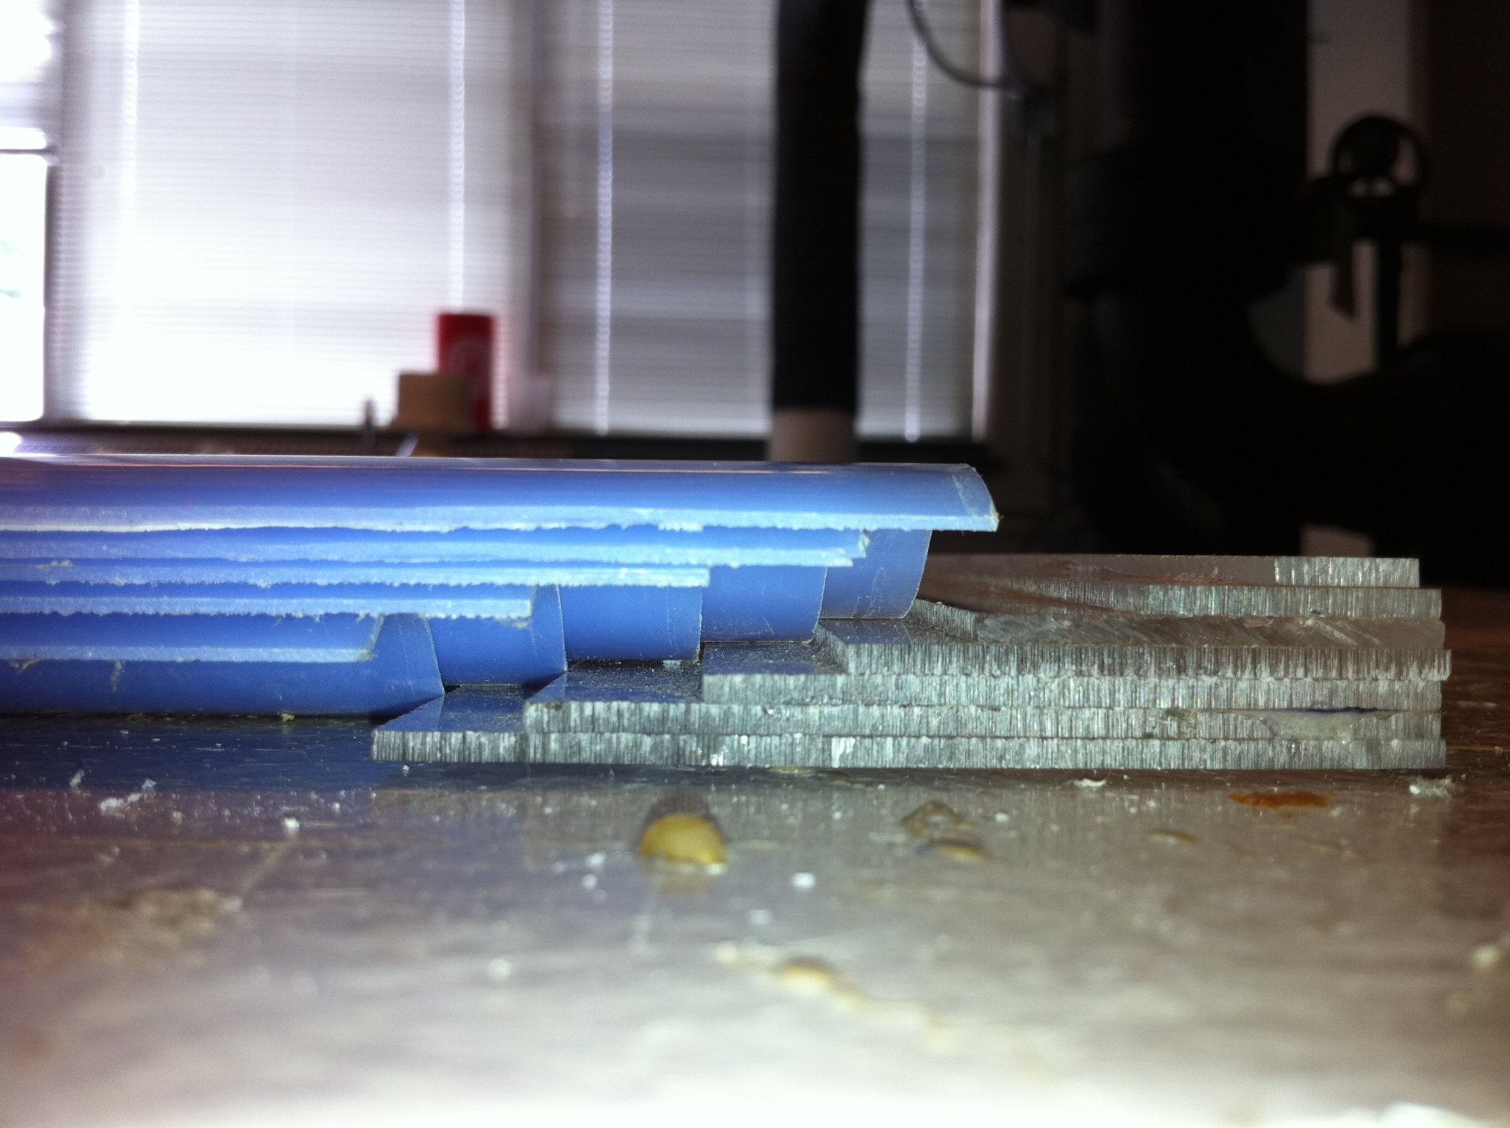

Slide 18
Plate Settlers
Jig 3.0
  Same material, but built using measurements of current designs being built
  Constructed slightly wider, and extended to fit up to 10 plates at a time
  Built with a 90 degree corner to nudge plates in

Slide 19
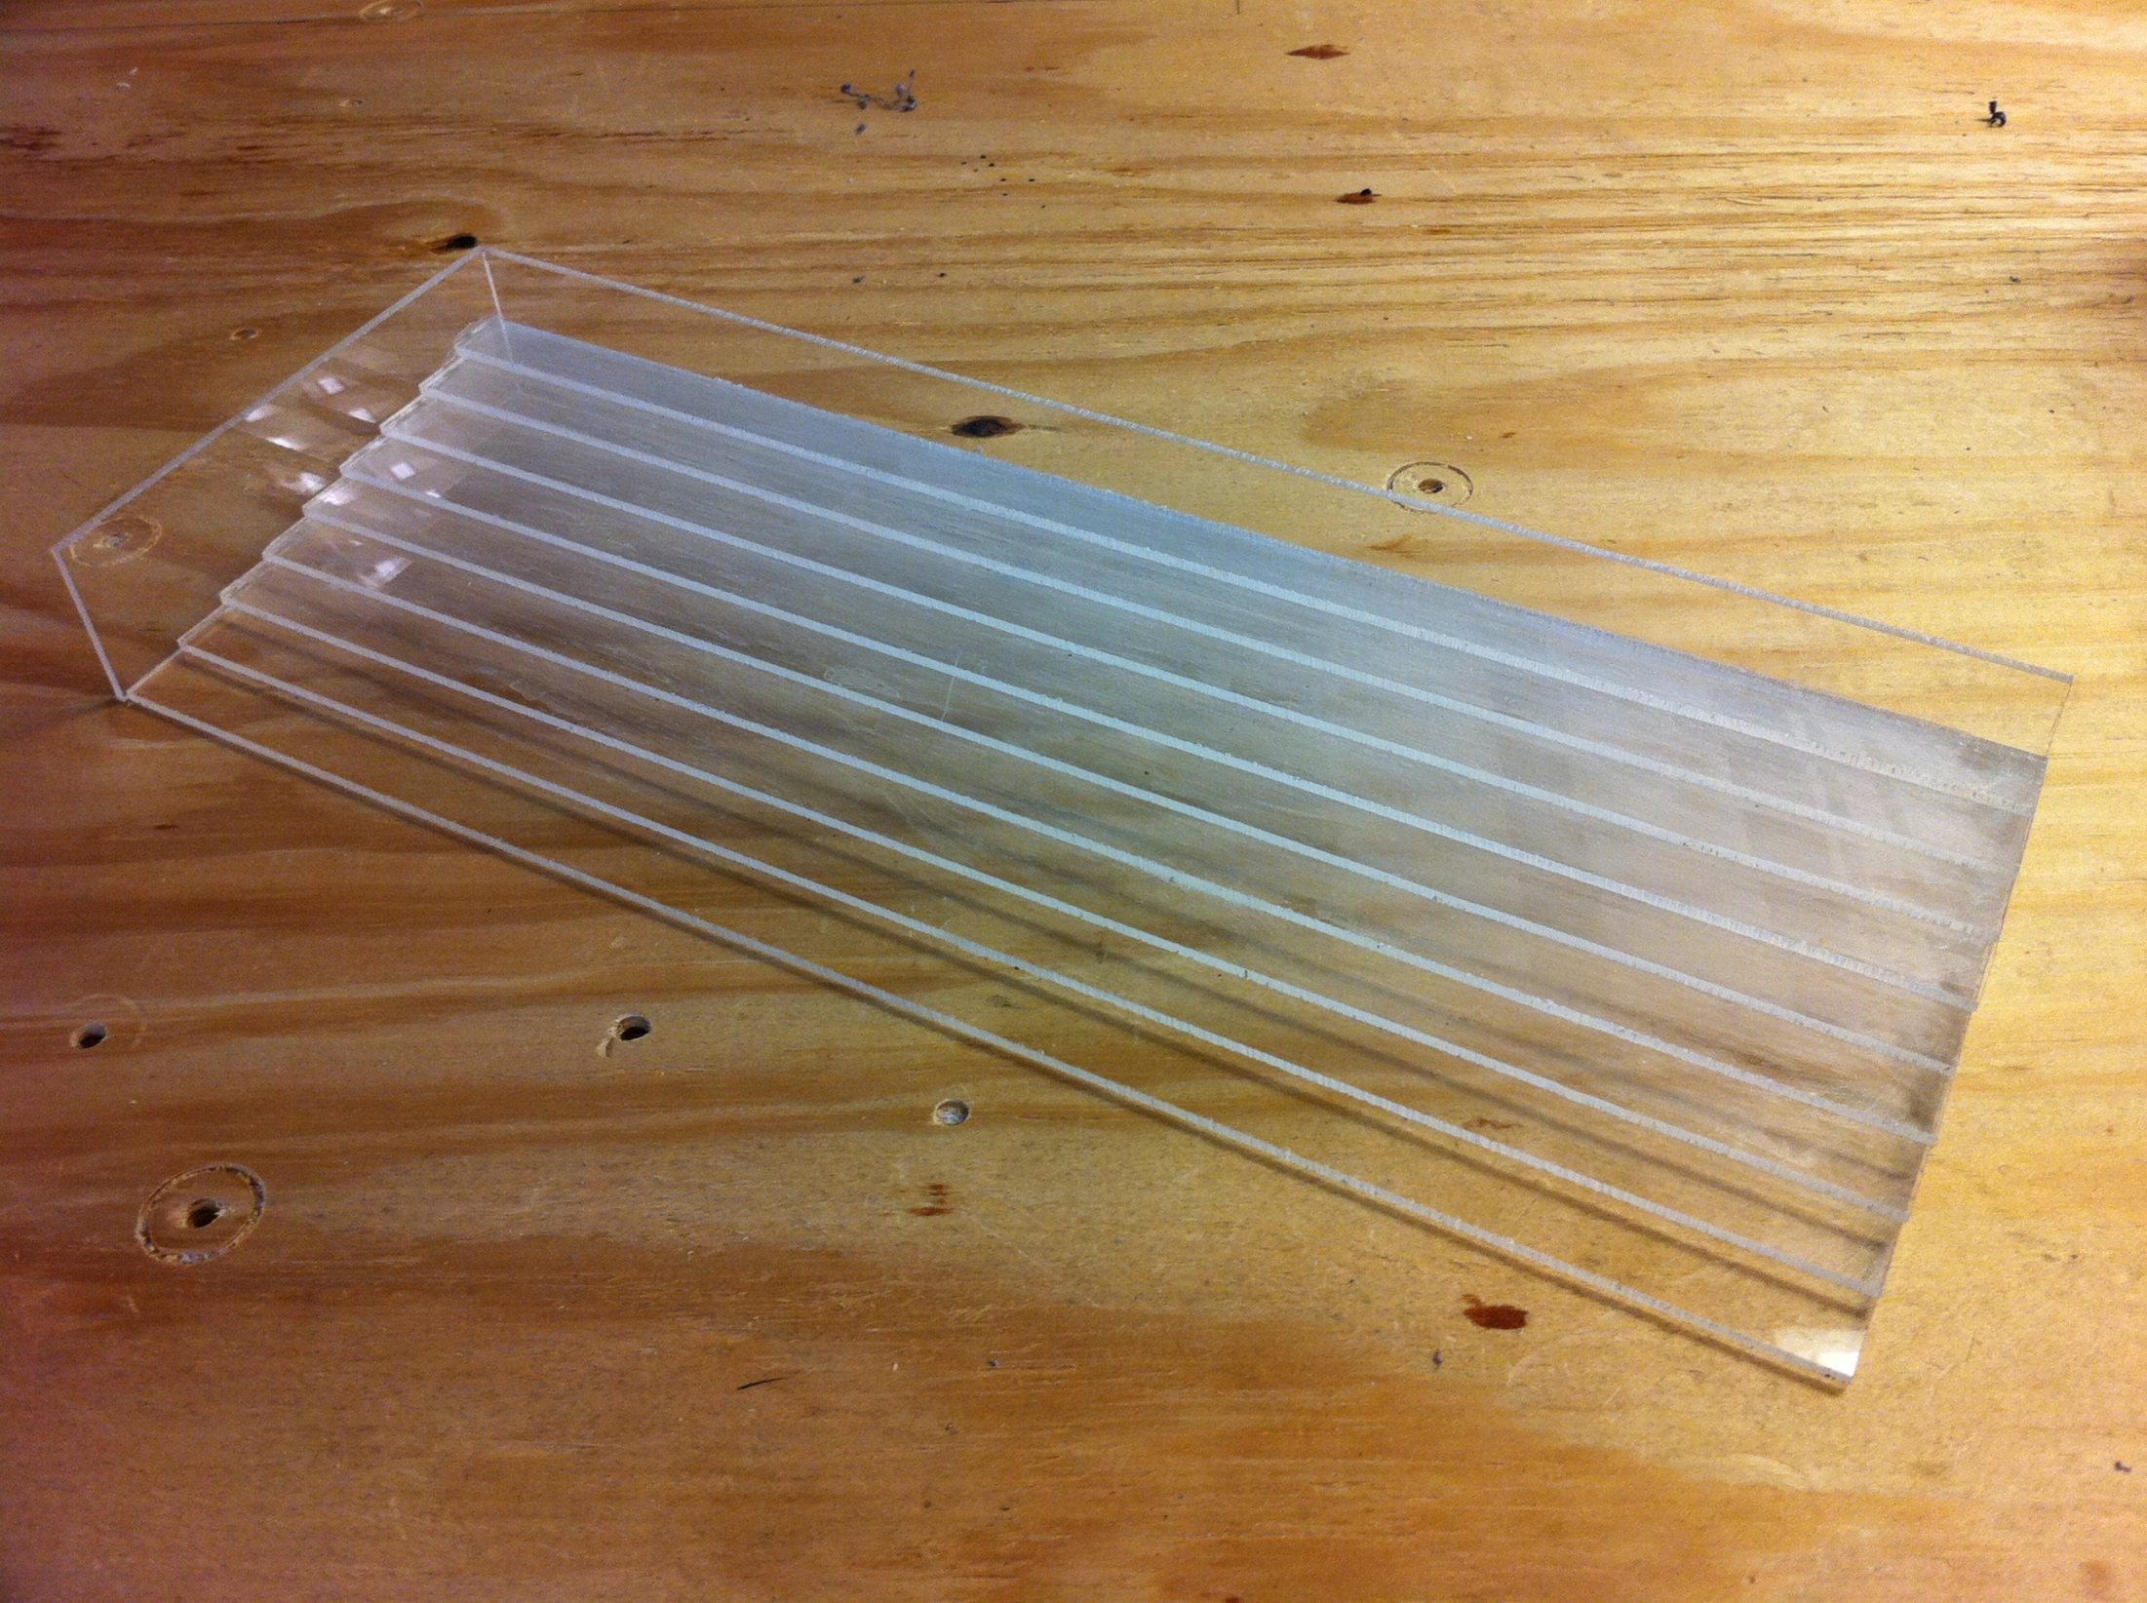
Plate Settlers

Slide 20
Plate Settlers
Future goals
  Find easier ways to measure initial holes
  Create different or multiple jigs to work for different plate spacings

Slide 21
Questions?

