Slide 1

Constant Head Tank
The Spring 2016 Constant Head Tank Sub-team developed two new CHT designs. This presentation will review and compare the new CHT designs in terms of ease of construction, functionality, and costs. A detailed report of this research is available on the Fabrication Team AguaClara wiki page.
Fabrication | Final Presentation Spring 2016
Notes:
The main problem with the plastic Tupperware Constant Head Tank (CHT) containers that are currently used in the AguaClara water treatment plants is that they are not chlorine resistant so they have to be replaced frequently. This issue was addressed by the fabrication team this semester. New CHTs were designed, fabricated, and evaluated to determine the best design to be implemented at AguaClara treatment plants. The first design was fabricated from clear PVC sheets and constructed using PVC welding; the second design was constructed out of a PVC pipe and cap. The two designs were then compared in terms of ease of construction, functionality, and costs. Based on this analysis and the recommendations from AguaClara engineers, the second design was determined best and will be implemented in future AguaClara water treatment plants.
Link: https://confluence.cornell.edu/display/AGUACLARA/Fabrication?preview=/137953871/335435240/fabrication-team-constant%20(9).pdf

Slide 2
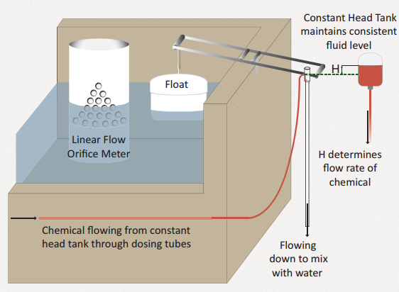
The CDC system regulates the flow of chemicals into the treatment train
CHT | Fabrication | Final Presentation Spring 2016
Notes:
The Chemical Dose Controller (CDC) system in AguaClara water treatment plants automatically controls the chemical dosage entering the treatment train. An integral part of the CDC system is the Constant Head Tank (CHT), which contains chemical solutions of either coagulant or chlorine which dose the raw water entering the plant. CHTs are designed such that the flow of chemicals leaving the CHT is controlled only by the elevation difference between the free surface in the CHT and the dosing tube exit that is open to the atmosphere.
This elevation difference can change in two ways: (1) The operator slides the end of the dosing tube along the lever arm to set the dose. (2) The plant flow rate changes, causing a corresponding change in the entrance tank water level that in turn lifts the float and changes the inclination of the lever arm. This system automatically controls the chemical flow rate based on the influent plant flow rate (Castro et al., 2013).
Figure Caption: A schematic of the Chemical Dose Control (CDC) system. The chemical flow rate into the treatment train is automatically controlled based on the elevation difference between the free surface in the CHT and the dosing tube level which is linearly correlated with water level in the Entrance Tank by a Linear Flow Orifice Meter

Slide 3
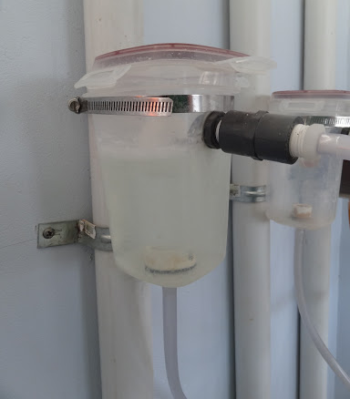
Existing CHTs are not chlorine resistant
CHT | Fabrication | Final Presentation Spring 2016
Notes:
The current CHT design uses a plastic Tupperware container that is available in Hondura. The outlet of the CHT is connected to a dosing tube which carries chemicals from the CHT to the lever arm. As mentioned above in the Constant Head Tank Theory section, the discharge flow of chemical leaving the CHT is determined by the elevation difference between the free surface in the CHT and the end of the drop tube that is open to the atmosphere. The main problem with the plastic Tupperware Constant Head Tank (CHT) containers currently being used in the plants is that they are not chlorine resistant and have to be replaced frequently.
Figure Caption::Current CHT design implemented in San Nicolás, Honduras. This CHT Design uses locally available plastic Tupperware as the tank with a custom float valve. There is evidence of chlorine stratification

Slide 4
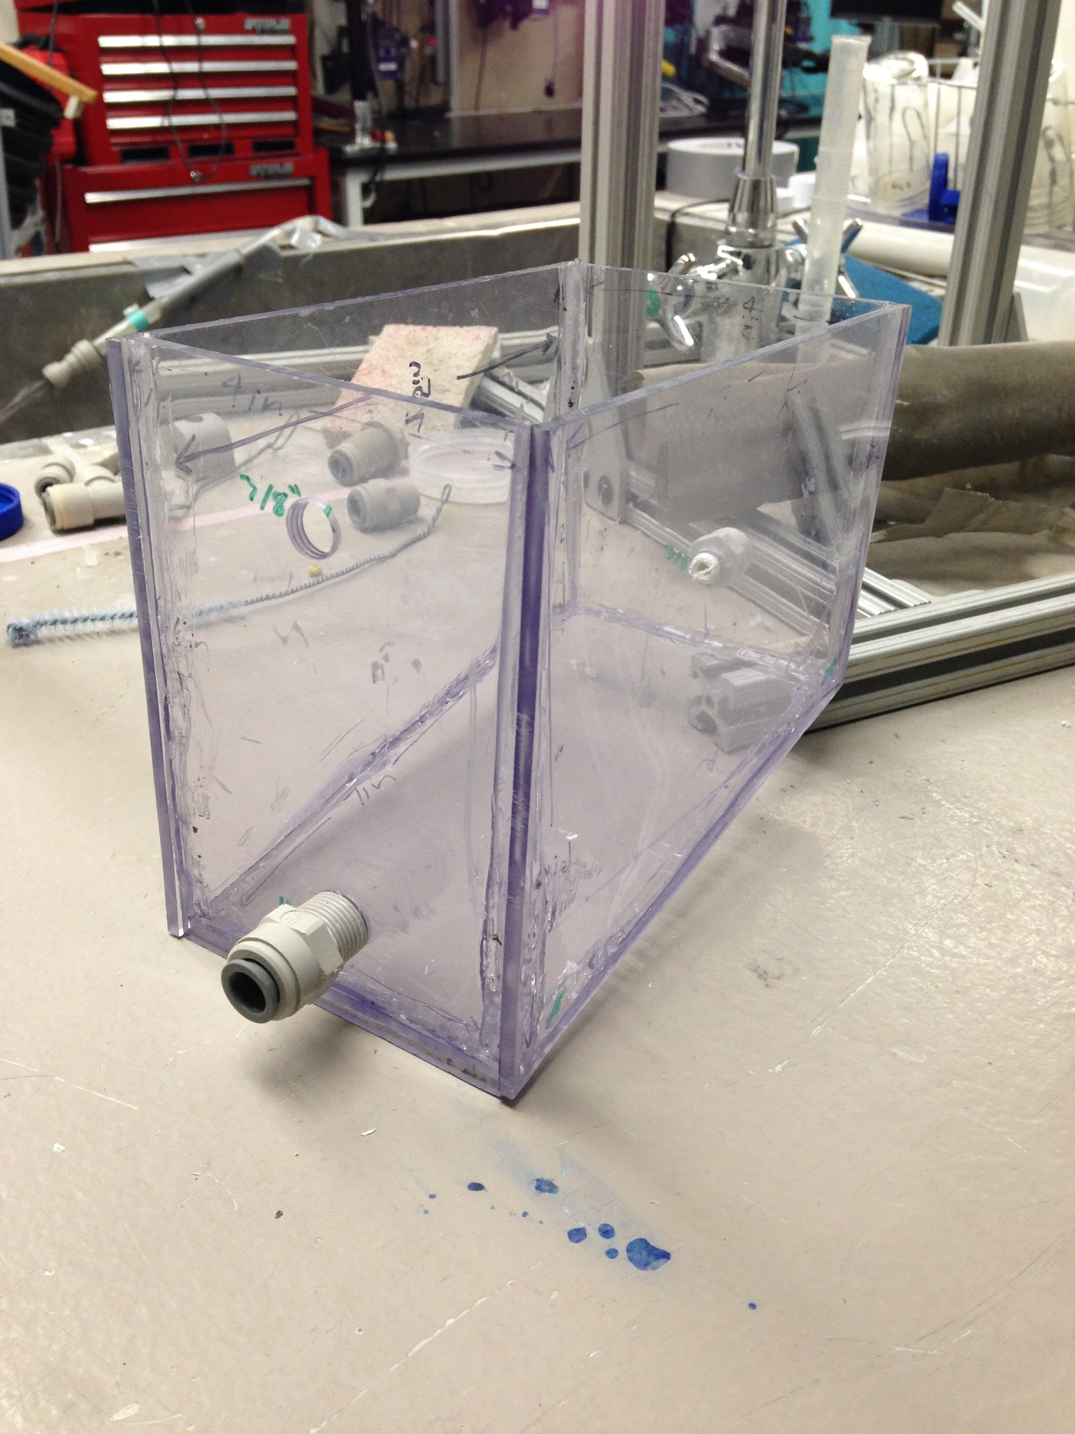
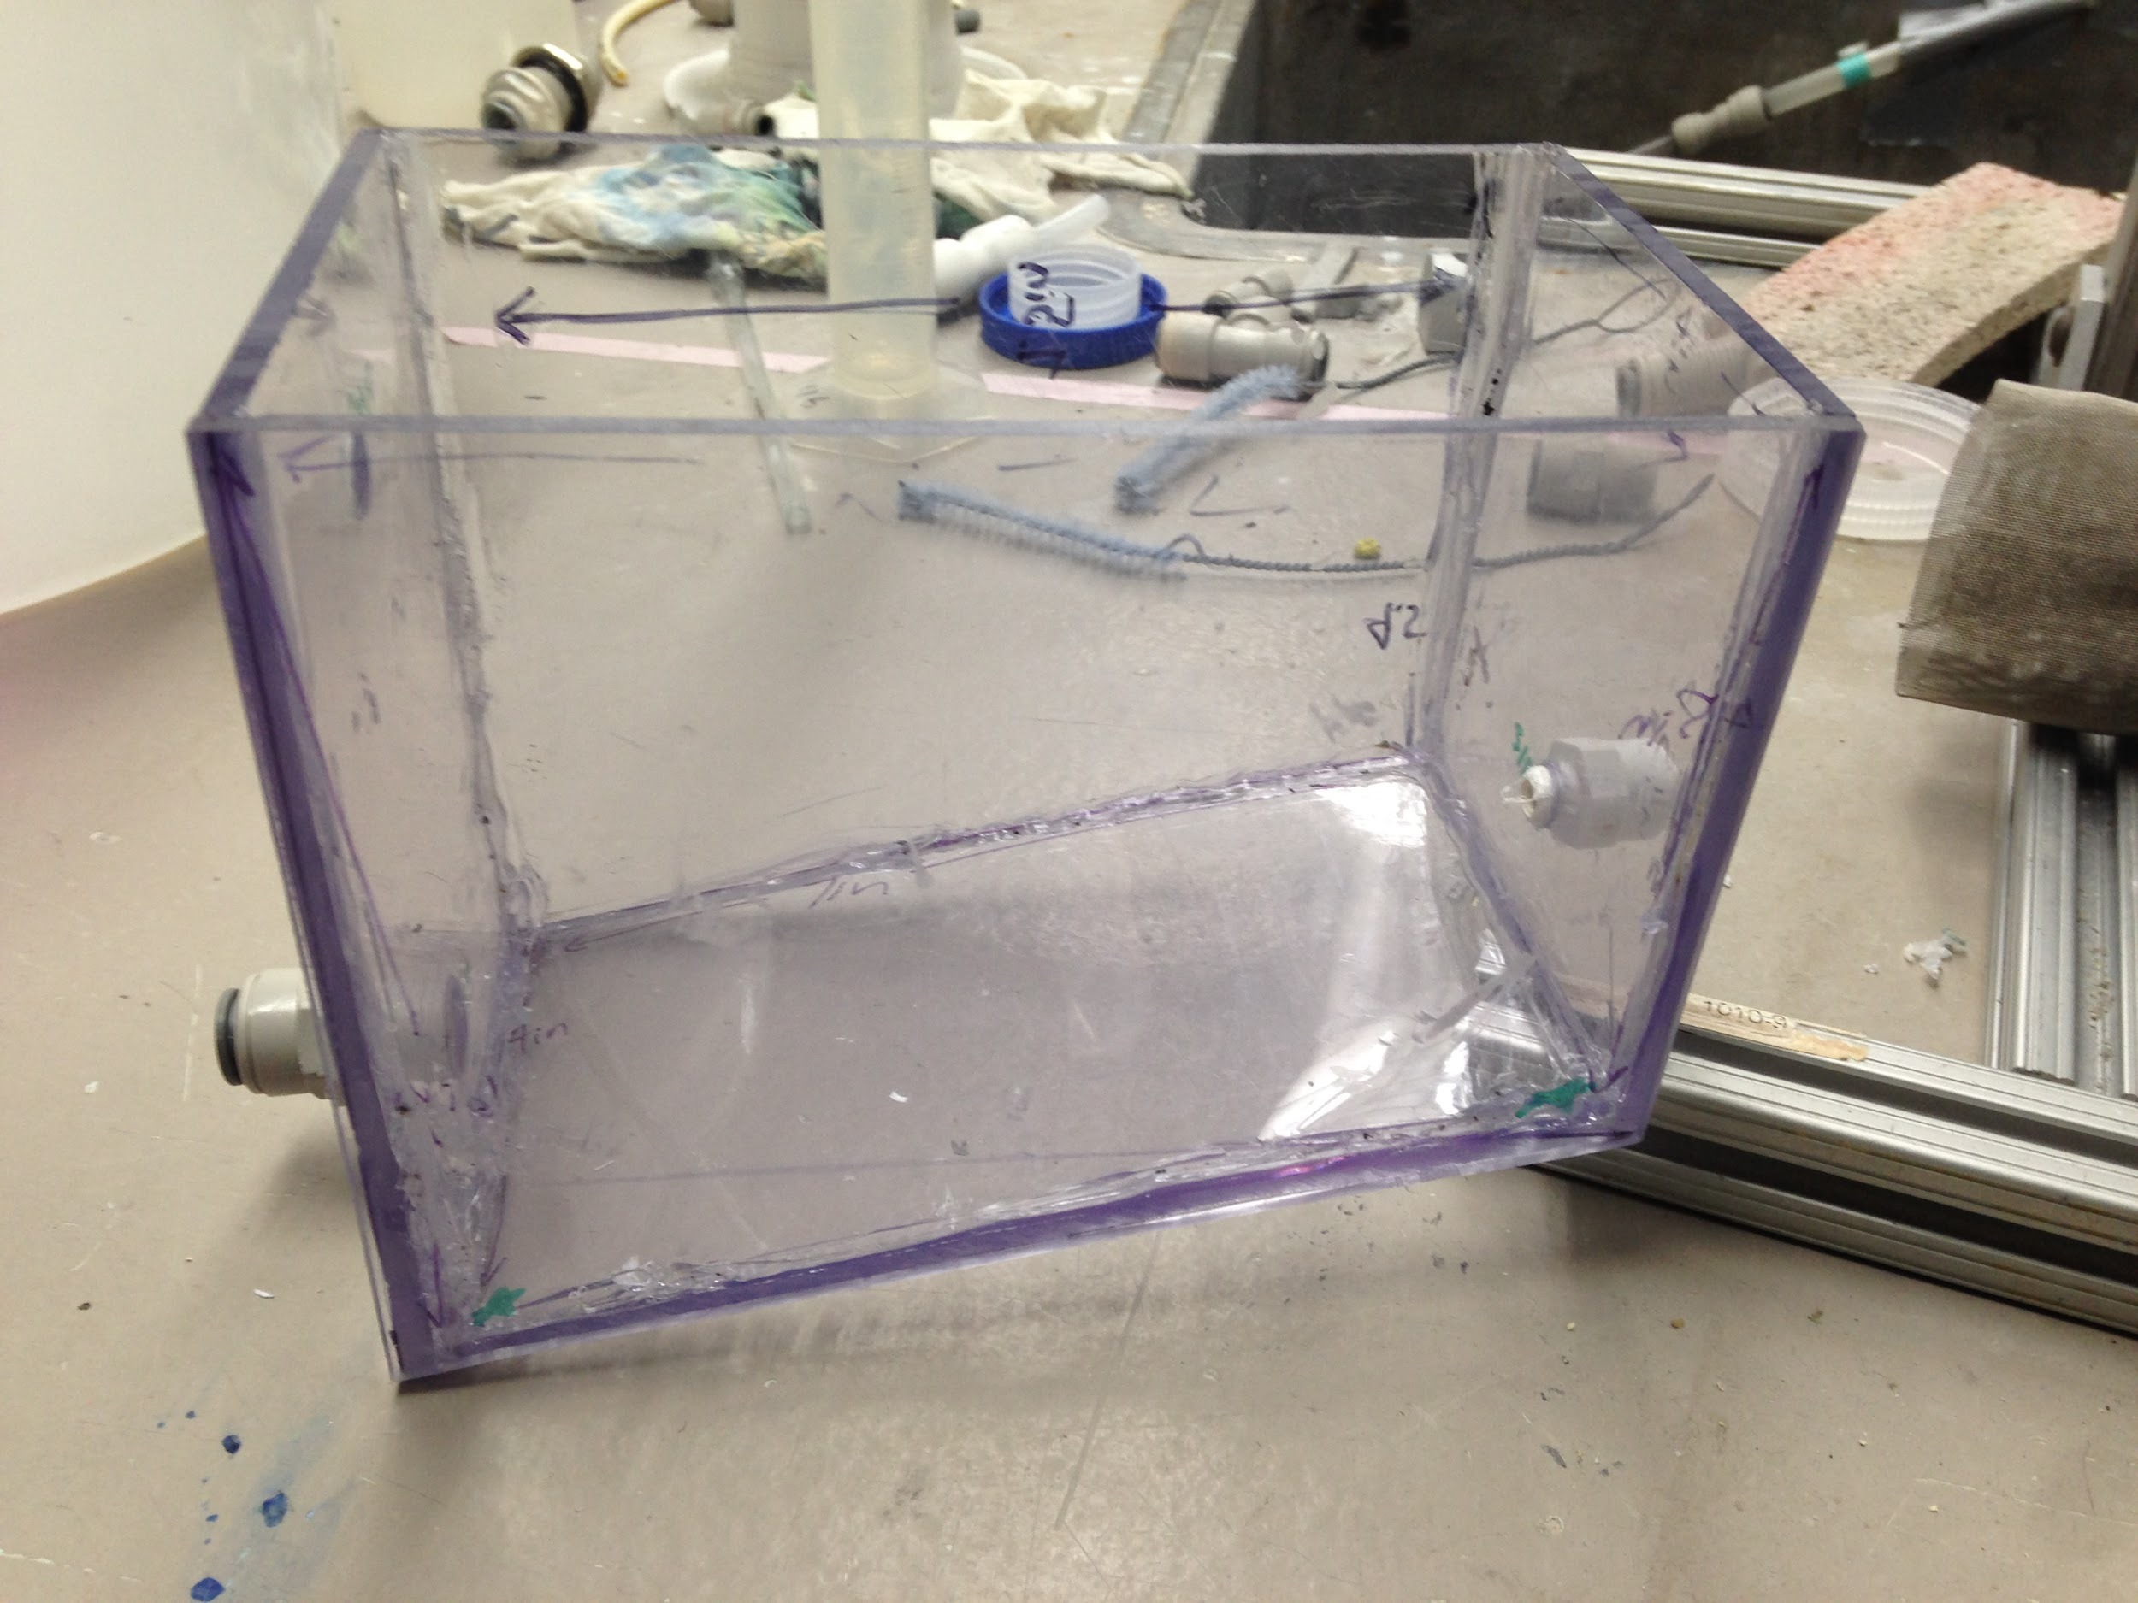
PVC welded tanks are chlorine resistant
CHT | Fabrication | Final Presentation Spring 2016
Notes:
The team designed a CHT and fabricated the system using PVC sheets and PVC welding techniques. The CHT was designed with the following design parameters in mind: ease of maintenance; life time and costs of the materials used; stratification of chemicals; using the original dimensions of the float valve and; locally sourced materials.
The dimensions of the PVC welded tank were based on the dimensions of the float valve as well as the size of a human hand and PVC welder. The size of the human hand and PVC welder were considered in order to ensure that they could fit inside the tank during construction and maintenance. The tank design was drawn in AutoCAD and the materials needed to construct the tank (PVC sheets, PVC rods, and ball valves) were purchased. The O-ring used to seal the inside of the tank wall surrounding the float valve is made out of aflas, a material resistant to calcium hypocrite.
The PVC welded tank was designed to be drained and cleaned without needing to disconnect or move the tank. This means that plant operators would no longer need to readjust the float valve to clean the CHT. This would ensure that the proper flow rate is being maintained in order to provide constant chemical dosage to the plant. Operators would clean the tank by closing the influent and effluent valves and opening the drain valve. Then, the operator would pour vinegar into the top of the tank in order to dissolve the scaling. After the scaling is removed, water is used to flush out the tank. Finally, the influent and effluent valves are once again opened, and the drain valve is closed in order to reconnect the CHT to the chemical dosing system.
Another design feature of the new CHT is that it has a sloped bottom so that solids that precipitate in the tank will settle out. This will keep the particles from flowing into the dosing tubes or causing blockages. A drain located on the vertical tank wall just above the sloped bottom will be used to clear the settled material. The angle of the slope was selected arbitrarily to 30 degrees to start with. Had this design been pursued further, the team would have performed experiments to evaluate the optimal slope angle for the precipitate to collect.
Left Figure Caption:This picture shows the prototype of the welded CHT. While the float valve was not in place, the sloped bottom feature can be seen by this picture. In addition, the drainage hole on the opposite vertical walls at the top and bottom of the slope are visible.
Right FIgure Caption:This picture shows an angled view of the tank. The biggest problem with this tank design was during the fabrication process, more specifically, welding the corners so that there would be a completely water tight seal

Slide 5
Problems Identified
Compared to the current CHT design,
Fabrication is more difficult, more time-consuming, and more costly
A water-tight seal is difficult to fabricate
PVC welding is difficult and expensive
CHT | Fabrication | Final Presentation Spring 2016
Notes:
The team deemed the first CHT design to be unfeasible. The primary concerns with this design surrounded the difficulty of using a PVC welder and the limited access to PVC welders in Honduras. In addition, the time and financial expenses required to master PVC welding and assemble a single CHT when compared to the existing and alternative design would be impractical.
The team also had a difficult time sealing the PVC welded CHT to be water-tight, a critical characteristic for a constant head tank. In particular, the seals in the corners were extremely difficult. Thus, PVC welding will be eliminated in the second CHT design developed in the Spring 2016 semester.

Slide 6
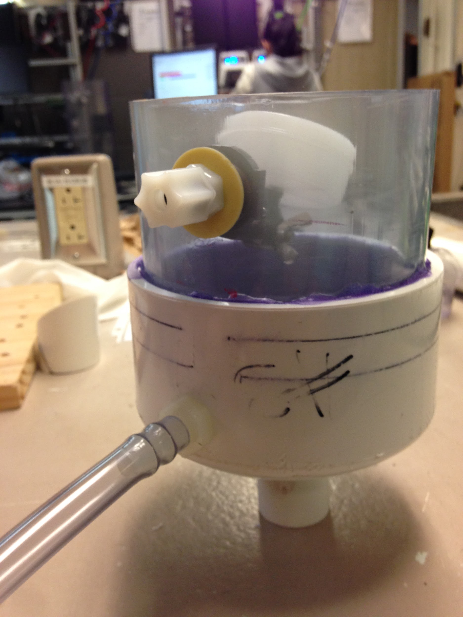
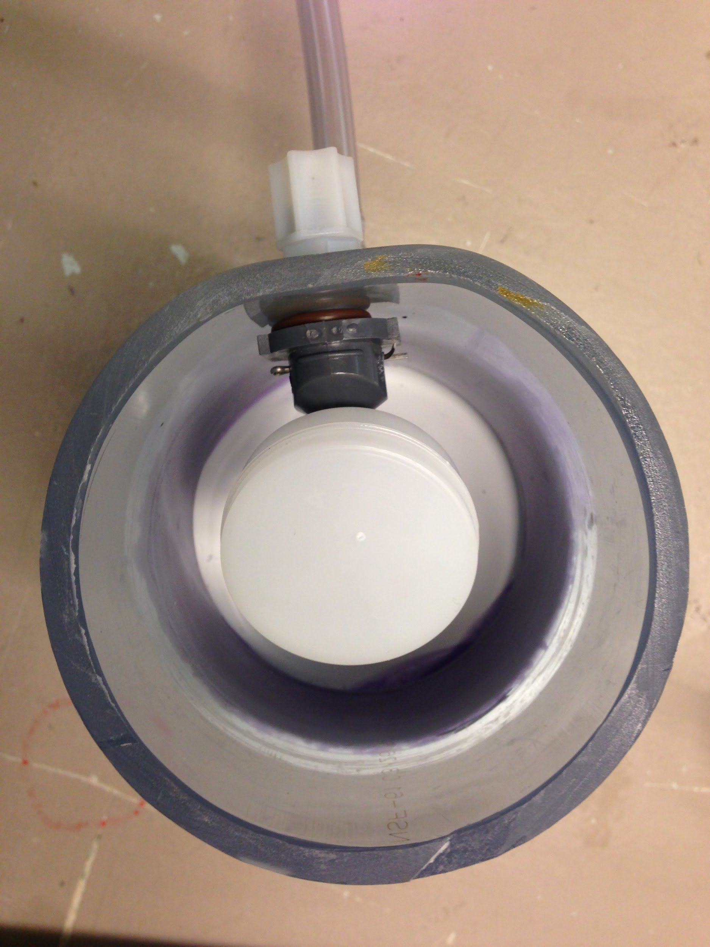
PVC pipes and caps are also chlorine resistant but easier to construct
CHT | Fabrication | Final Presentation Spring 2016
Notes:
The PVC Welded Tank was not feasible because the fabrication of the tank was too difficult and required the use of a plastic welder. The PVC Pipe Tank design addresses this problem because there is no PVC welding involved in the fabrication of this tank. All of the components can be purchased in Honduras and fabricated using PVC cement glue. If implemented abroad, this tank could be fabricated and repaired at the implementation site, because there are no additional tools necessary to fabricate the tank.
The PVC Pipe Tank was designed to be fabricated using ordinary tools such as screwdrivers, wrenches, and PVC cement. The tank was also designed to reduce the amount of time operators spend to maintain the CHT. This was ensured by applying the following design specifications: chlorine resistant material (PVC, nylon, aflas); sloped bottom for settled precipitate; a separate drain outlet used for in-place cleaning; easy elevation adjustment
In this design, the Fabrication Team decided not to focus on using the original float valve. Instead, the team decided to use the specially manufactured cylindrical 2" diameter by 3/4" long 6-32 unthreaded polypropylene floats.
The PVC Pipe Tank design was fabricated using PVC parts available in Honduras. The team fabricated the tank (shown in Figure \ref{BarbedPVCFVPipeTankSchematic}) using a clear PVC pipe (6" long and 4" inner diameter) and a 4" inner diameter schedule 40 white PVC pipe cap. The PVC pipe cap provided a sloped bottom where the precipitate would settle out over time. The pipe and cap were joined using PVC cement.
Three holes were drilled into the tank (One 7/16" diameter hole for the float valve and two 3/8" diameter threaded holes for fittings that lead to the exit to the Dosing Manifolds and to the Drain Channel). Nylon barbed fittings (3/8" outer diameter) were used to attach the flexible tubing that leads to the dosing manifolds and to the drain channel. An adjustable float valve with 1/4" barbed inlet (with the replaced float), in combination with a 1/4" to 3/8" outer diameter barbed reducer, bulkhead fitting and an o-ring, were used at the entrance to the tank.. The float valve is oriented upside-down in order to keep the float valve orifice submerged and not exposed to the atmosphere. The pipe wall around the float valve hole was flattened out (using the heat from a PVC welder) in order to have a straight surface that will ensure that the O-ring provides a watertight seal.
A Nylon Wye barbed fitting (3/8") and an appended piece of flexible tubing serve as a collection basin to capture any particles that precipitate before passing through the float valve. During regular operation, this appended piece of tubing will be clamped with a plastic tube clamp.
In-place cleaning will be performed in the same way as the PVC Welded Tank Design. However, the valves are replaced with plastic clamps and rather than pouring the vinegar directly into the tank, it will be poured into the appended piece of flexible tubing located before the float valve on the outside of the tank. When cleaning, the appended piece of tubing will be pointed towards the ceiling. Then, the clamp will be removed and vinegar will slowly be poured into the tube. This process will remove any scaling on the float valve orifice without the need to remove the float valve from the tank. When the float valve and the tank are clean, water is flushed down the same tubing and the clamp can be returned to its original position. There are plastic tube clamps on each piece of flexible tubing that are closed during cleaning in order to prevent contamination during cleaning.
Figure Caption:This photo shows the flattened portion of the outer tubing. This was done in order to increase the contact between the fitting and the wall. During the fabrication process, the team used a PVC welder to heat up the PVC pipe. However, this molding step can also be done without a PVC welder. PVC molding is currently done in Honduras by heating up the PVC in vegetable oil and the molding the shape.

Slide 7
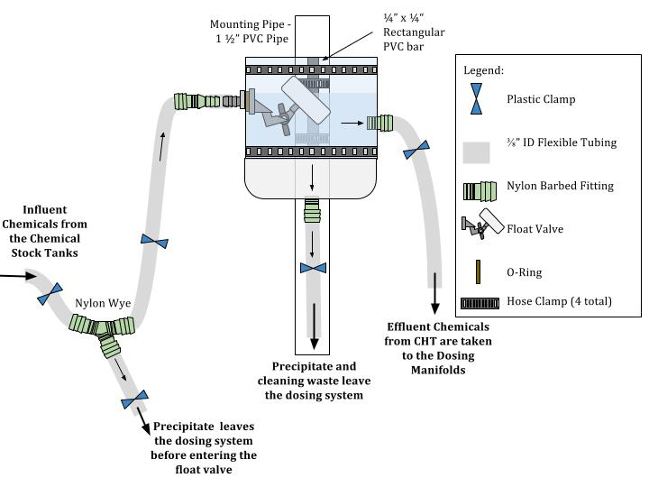
Schematic of the PVC Pipe CHT design
CHT | Fabrication | Final Presentation Spring 2016
Notes:
Figure Caption:Schematic of the PVC Pipe Tank Design showing the mounting system of an individual CHT. The CHT is attached to a rectangular PVC bar using two large hose clamps. This PVC bar is secured to the 1" mounting pipe .
See appendix 1 for a close up schematic of the connection used for the float valve.

Slide 8
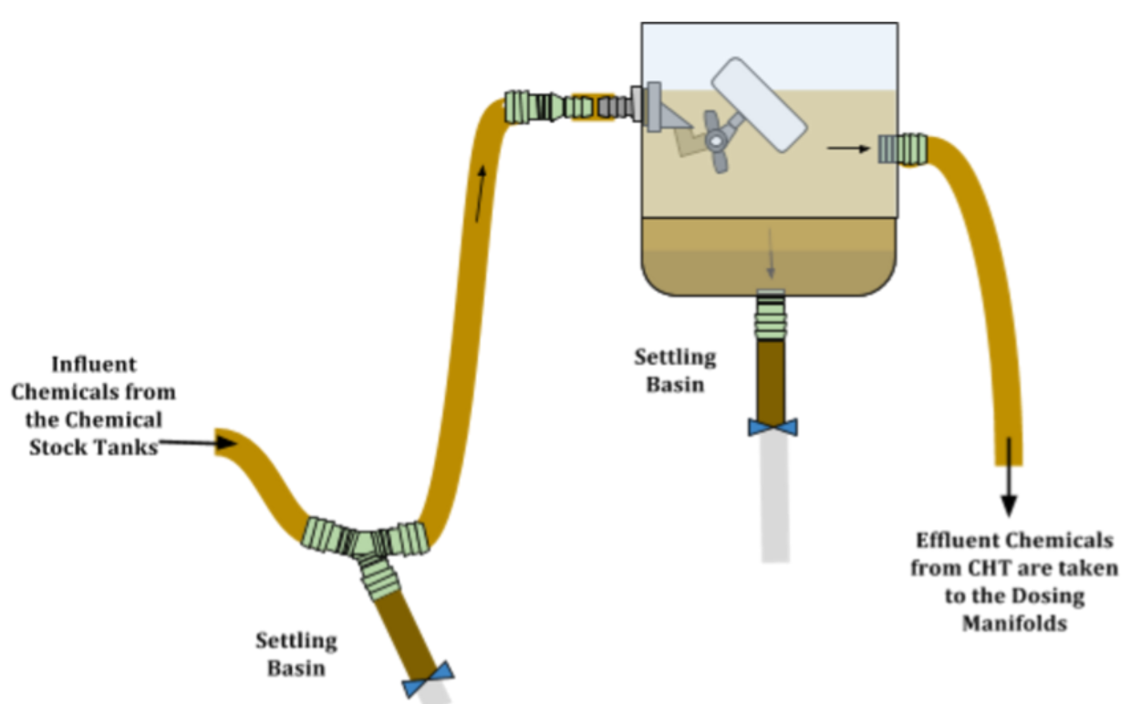
Regular Operation
CHT | Fabrication | Final Presentation Spring 2016
Notes:
During regular operation, Calcium Carbonate precipitate settles in the “Settling Basins.” When these basins are full, the operators will clean out the system.
Figure Caption:Schematic of the PVC Pipe Tank Design in Regular Operation

Slide 9
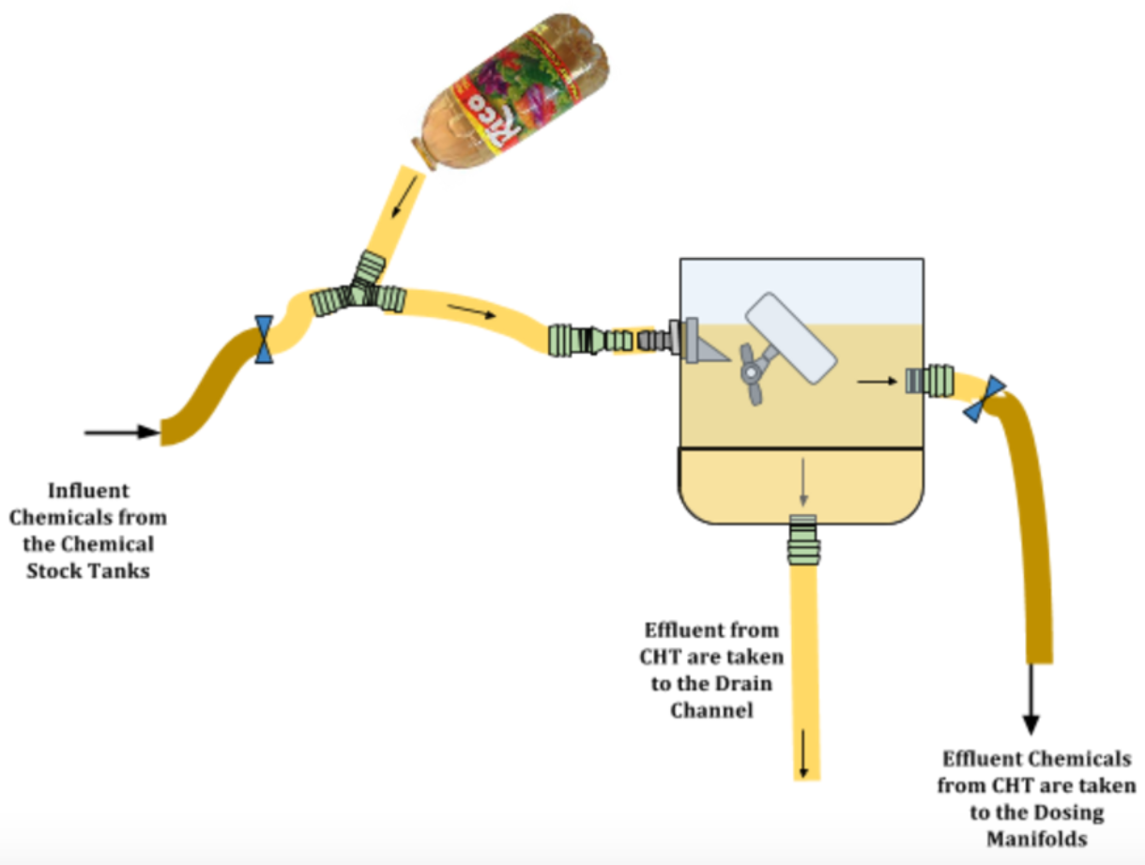
Operators Clean with Vinegar
CHT | Fabrication | Final Presentation Spring 2016
Notes:
When the settling basins are full, the operators will clamp the tubes from the Chemical Stock tanks and to the dosing tubes. This essentially cuts off the CHT from the rest of the CDC system. The clamps on the two settling basins are removed. The fluid in the tank now leaves through the drain tube. Any scaling (From the Calcium Carbonate) that exists on the system will be removed when the Operator pours vinegar into the short tube that served as a settling basin. Following the vinegar, water is flushed through the system.
Figure Caption:Schematic of the PVC Pipe Tank Design during cleaning

Slide 10
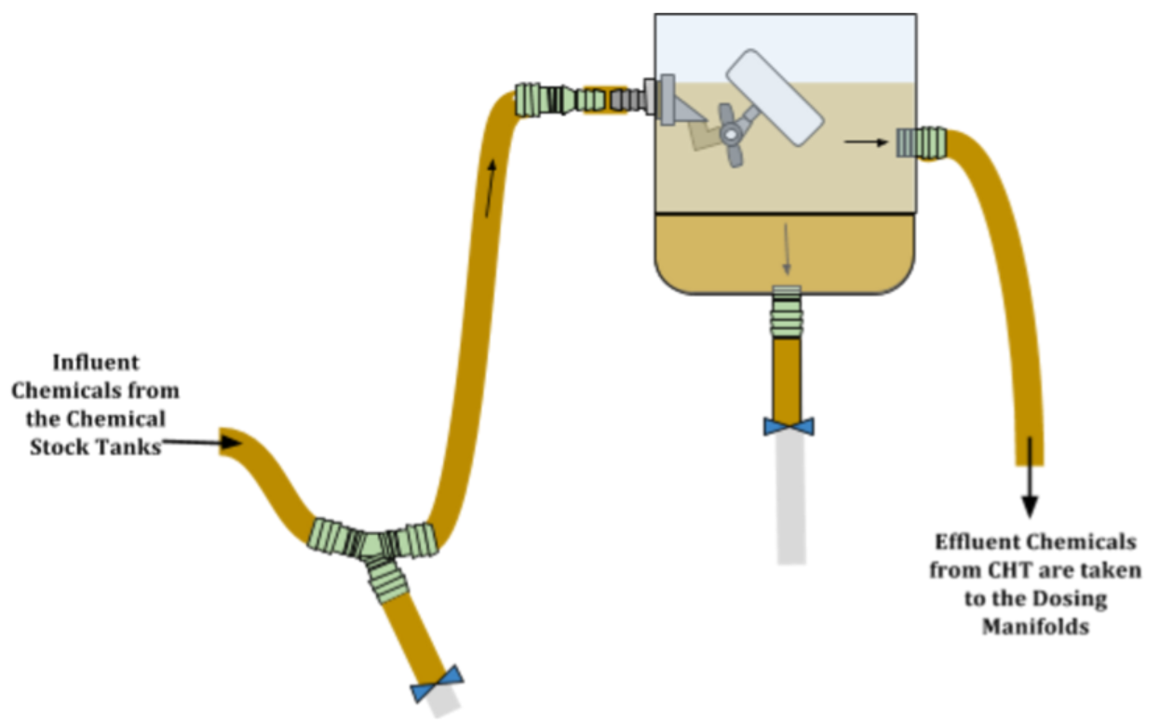
Clean Tank
CHT | Fabrication | Final Presentation Spring 2016
Notes:
Finally, the Settling basins are created by clamping the tube leading to the drain channel and the tube used to introduce vinegar.
Figure Caption: Schematic of the PVC Pipe Tank Design in Regular Operation

Slide 11
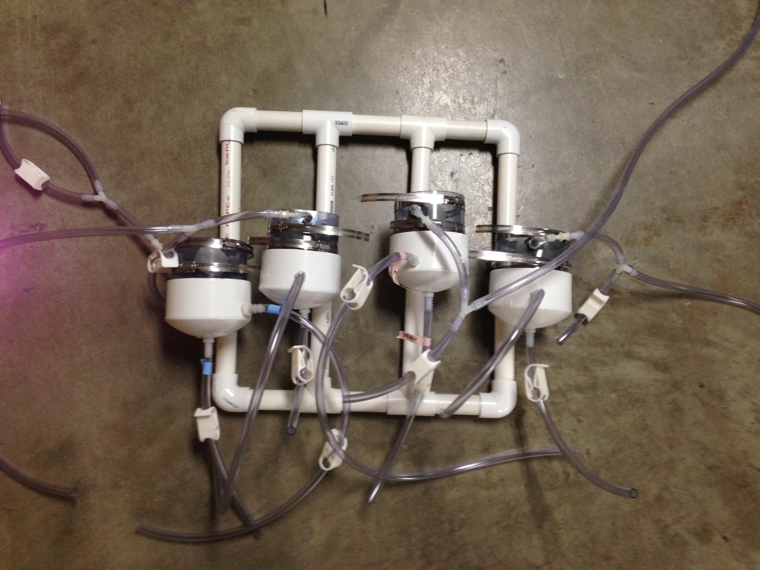
Modular mounting system can be retrofitted to existing plants
CHT | Fabrication | Final Presentation Spring 2016
Notes:
In an AguaClara water treatment plant, there are at least two sets of chlorine CHTs and coagulant CHTs. This is done so that at least one of each CHT will be connected to the system during the maintenance of the other set of CHTs. In this design, all of the CHTs will be attached to a frame made of 1" PVC pipes, elbows and tees. The complete system will be mounted to a wall using hooks.
To attach each CHT to the PVC frame, there is a 1/4" by 1/4" gray rectangular PVC bar between each individual tank and pipe. There are two small hose clamps that attach the PVC bar to the 1" mounting pipe and two large hose clamps that attach the PVC bar to the tank. This system reduces the spaces between the hose clamps and the system when the hose clamps are tightened. With this method, the tanks are well secured to the PVC frame.
See appendix 2 for a schematic of this mounting system.

Slide 12
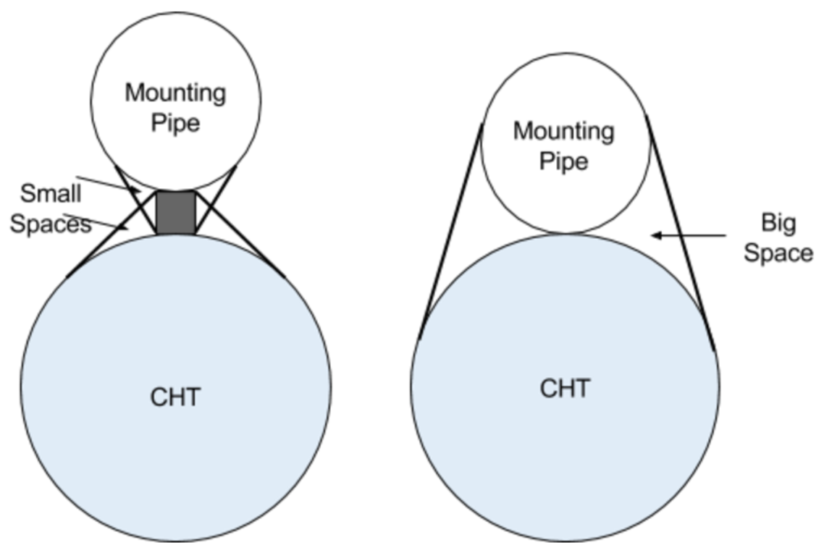
Achieve Stability by reducing spaces in hose clamps
CHT | Fabrication | Final Presentation Spring 2016
Notes:
Figure Caption: Adding a rectangular PVC bar between the mounting pipe and the CHT reduces the space created between the hose clamp and anything it is surrounding. The system on the left uses a small hose clamp around the white PVC mounting pipe and the gray rectangular bar. It also has a hose clamp around the gray rectangular bar and the CHT. The system on the right only uses a large hose clamp around both the mounting pipe and CHT, making the system looser and less secure.

Slide 13
Advantages/Comparison
Easy to fabricate
Easily attainable parts and tools
Less expensive
NO PVC WELDING
CHT | Fabrication | Final Presentation Spring 2016
Notes:
Compared to the PVC Welded Tanks Design, the PVC Pipe Tank Design is simpler to fabricate. It requires parts that are available in Honduras and uses tools that are already used at AguaClara water treatment plants.
The fabrication process of the tank takes no longer than 24 hours, and the majority of this time is to assure that the PVC cement has properly dried (connecting the PVC pipe cap to the pipe and when connecting the PVC frame). Using PVC cement is simple and requires no professional assistance. Thus, compared to the PVC Welded Tank design, the plant operators will be able to fabricate the tank themselves and repair the tanks independently.
Finally, this alternative is less expensive than the PVC Welded Tank design because there are no professionals being hired to fabricate the tank. Also, PVC plumbing parts are less expensive than clear PVC sheets. Otherwise, the same tubing and connections are used so there is no difference in price.

Slide 14
Future Work
NEW design challenge: PVC Pipe Tank design
Implementation in future AguaClara treatment plants
CHT | Fabrication | Final Presentation Spring 2016
Notes:
Next semester, the PVC Pipe Tank design will be coded into the AguaClara Design code as a Design Challenge. After discussing with Jon and Walker, current AguaClara engineers, the PVC Pipe Tank design will be implemented in future AguaClara water treatment plants. If the CHTs need to be replaced at any existing AguaClara water treatment plants, they will be retrofitted into these plants. This can be done by preparing the PVC Pipe CHTs along with the PVC framing and connecting the tubing to the existing CDC system.

Slide 15
Questions
and
Recommendations
Anna Doyle
Bachelor of Science
ard73@cornell.edu
Valerie Shao
Bachelor of Science
ves33@cornell.edu
Serena Takada
Bachelor of Science
st587@cornell.edu
CHT | Fabrication | Final Presentation Spring 2016

Slide 16
Appendix
Slides
CHT | Fabrication | Final Presentation Spring 2016
Notes:
From this point on, add any slides with figures that will help support your thesis. You might pull these figures from your Final Report.

Slide 17
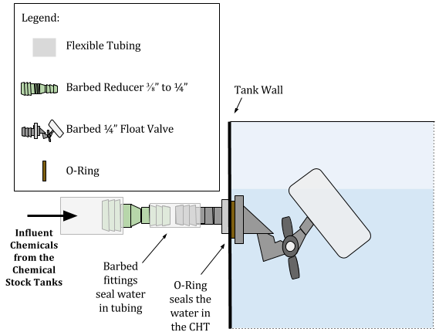
Schematic of the Float Valve Connection
CHT | Fabrication | Final Presentation Spring 2016
Notes:
Appendix 1
Figure Caption:This schematic shows the connection between the mini adjustable PVC float valve with 1/4" barbed inlet and the flexible tubing from the Chemical Stock Tanks. The barbed fittings and the O-Ring provide a water tight seal.}

Slide 18
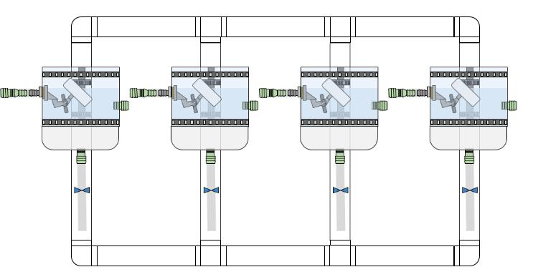
Schematic of Modular Mounting System
CHT | Fabrication | Final Presentation Spring 2016
Notes:
Appendix 2
Figure Caption: Schematic of the PVC Pipe Tank Design showing the entire mounting system of multiple CHT. The CHTs are attached to the frame which is mounted to the wall using hooks. For simplicity, the tubes attached the CHTs are not shown in this drawing.

