Slide 1
DOM Sensor
Final Presentation
Andres Larraza 5/15/2015

Slide 2
Basic Introduction
DOM: Dissolved Organic Matter, affects amount of coagulant needed in water treatment.
Long-Term Goal: create an affordable model that accurately measures DOM in water
Short-Term Goal: is this possible with an Arduino board

Slide 3
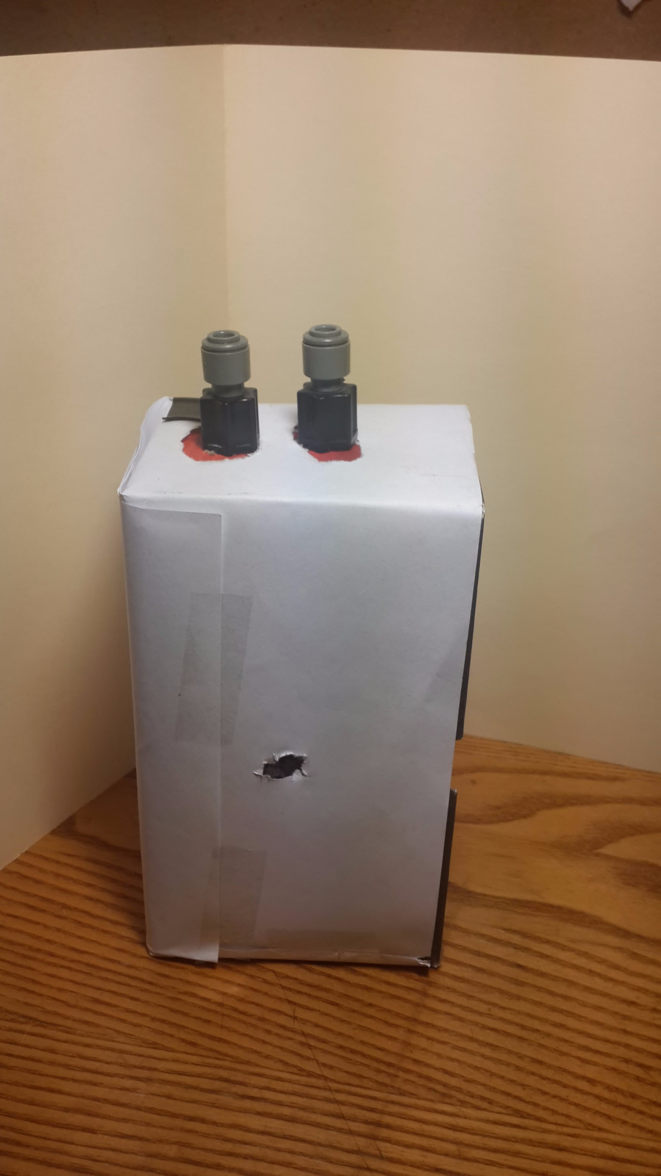
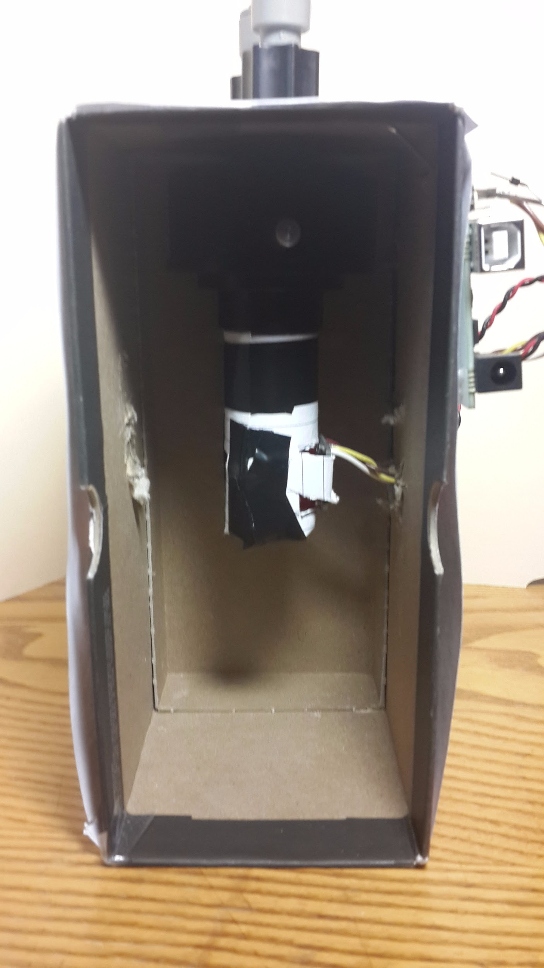
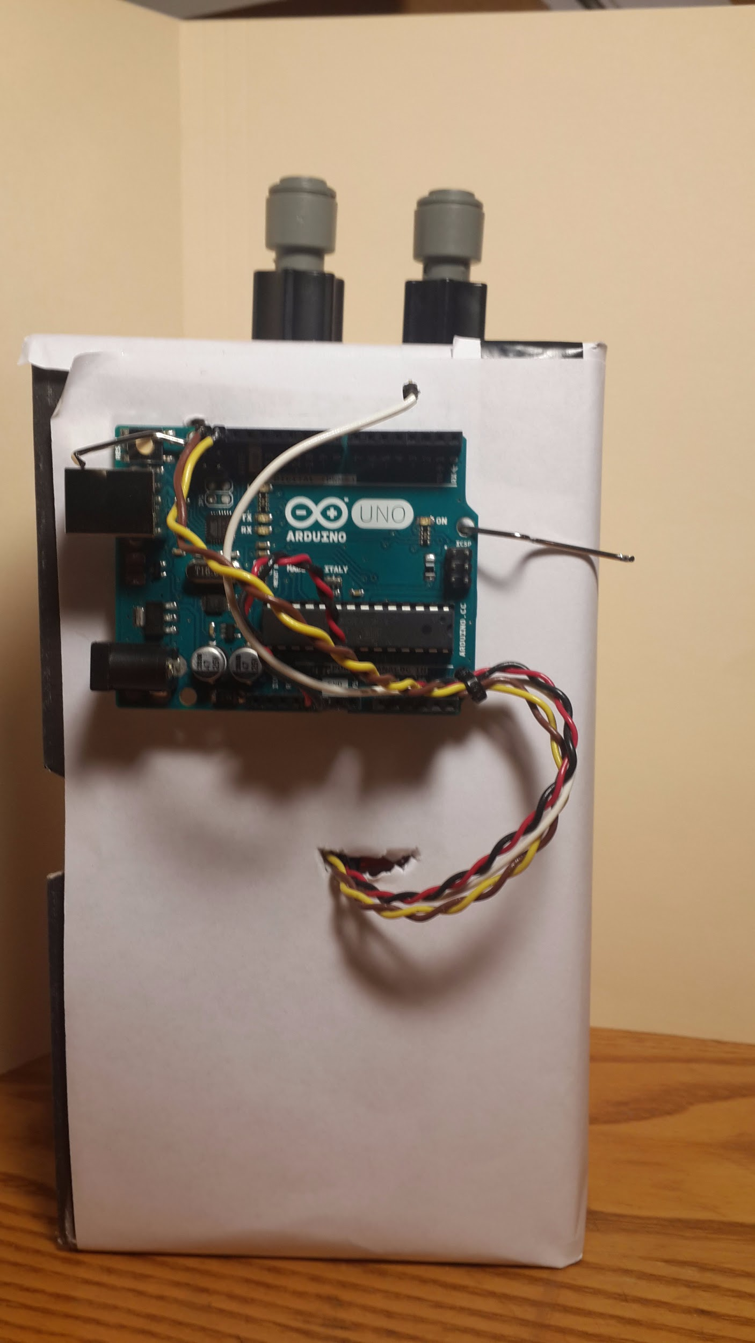
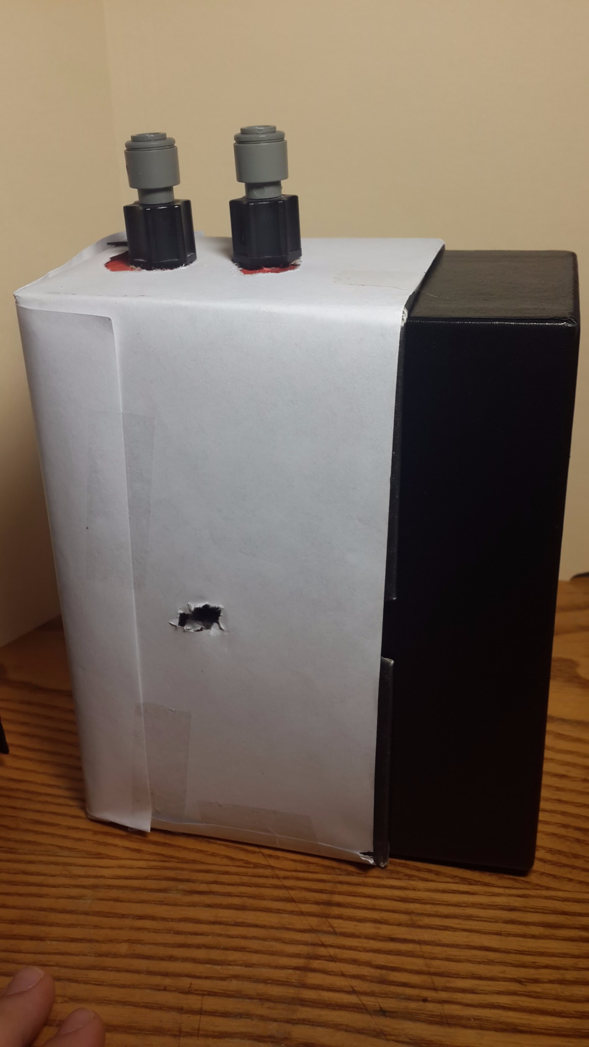
The set up

Slide 4
Data
Trial # | Color sensed 1 | Color sensed 2 | Color sensed 3 | Color sensed 4 | Color sensed 5 | Color sensed 6 | Color sensed 7 | Color sensed 8 | Color sensed 9 | Color sensed 10 | Photo color
1
2
3
4
5

