Slide 1
Floc Hopper Probe
Fabrication Subteam
Garret Janich
Steve Love

Slide 2
Initial Dilemma
Problem: Limited visibility into floc hopper at the end of sedimentation tanks. This is important to keep the sludge level regulated and minimize cleaning requirements.
Solution: Model a probe to peer through the 2” openings along the settled water channel. The waterproof tube is ideal for telescopic view as well as with a snake camera.

Slide 3
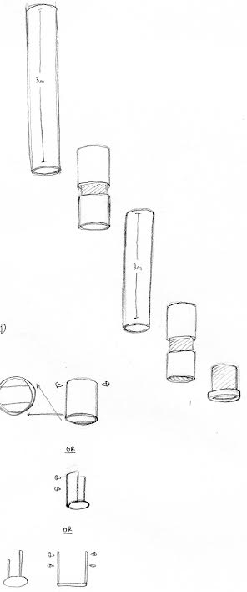
First Sketches
Pipe setup and camera reflector options

Slide 4
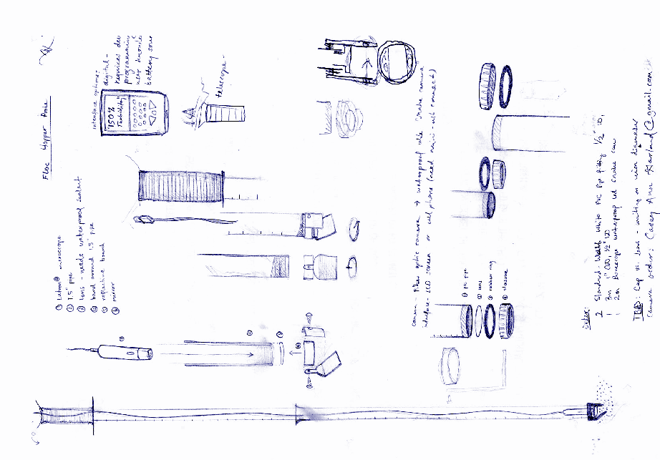
Sketches

Slide 5
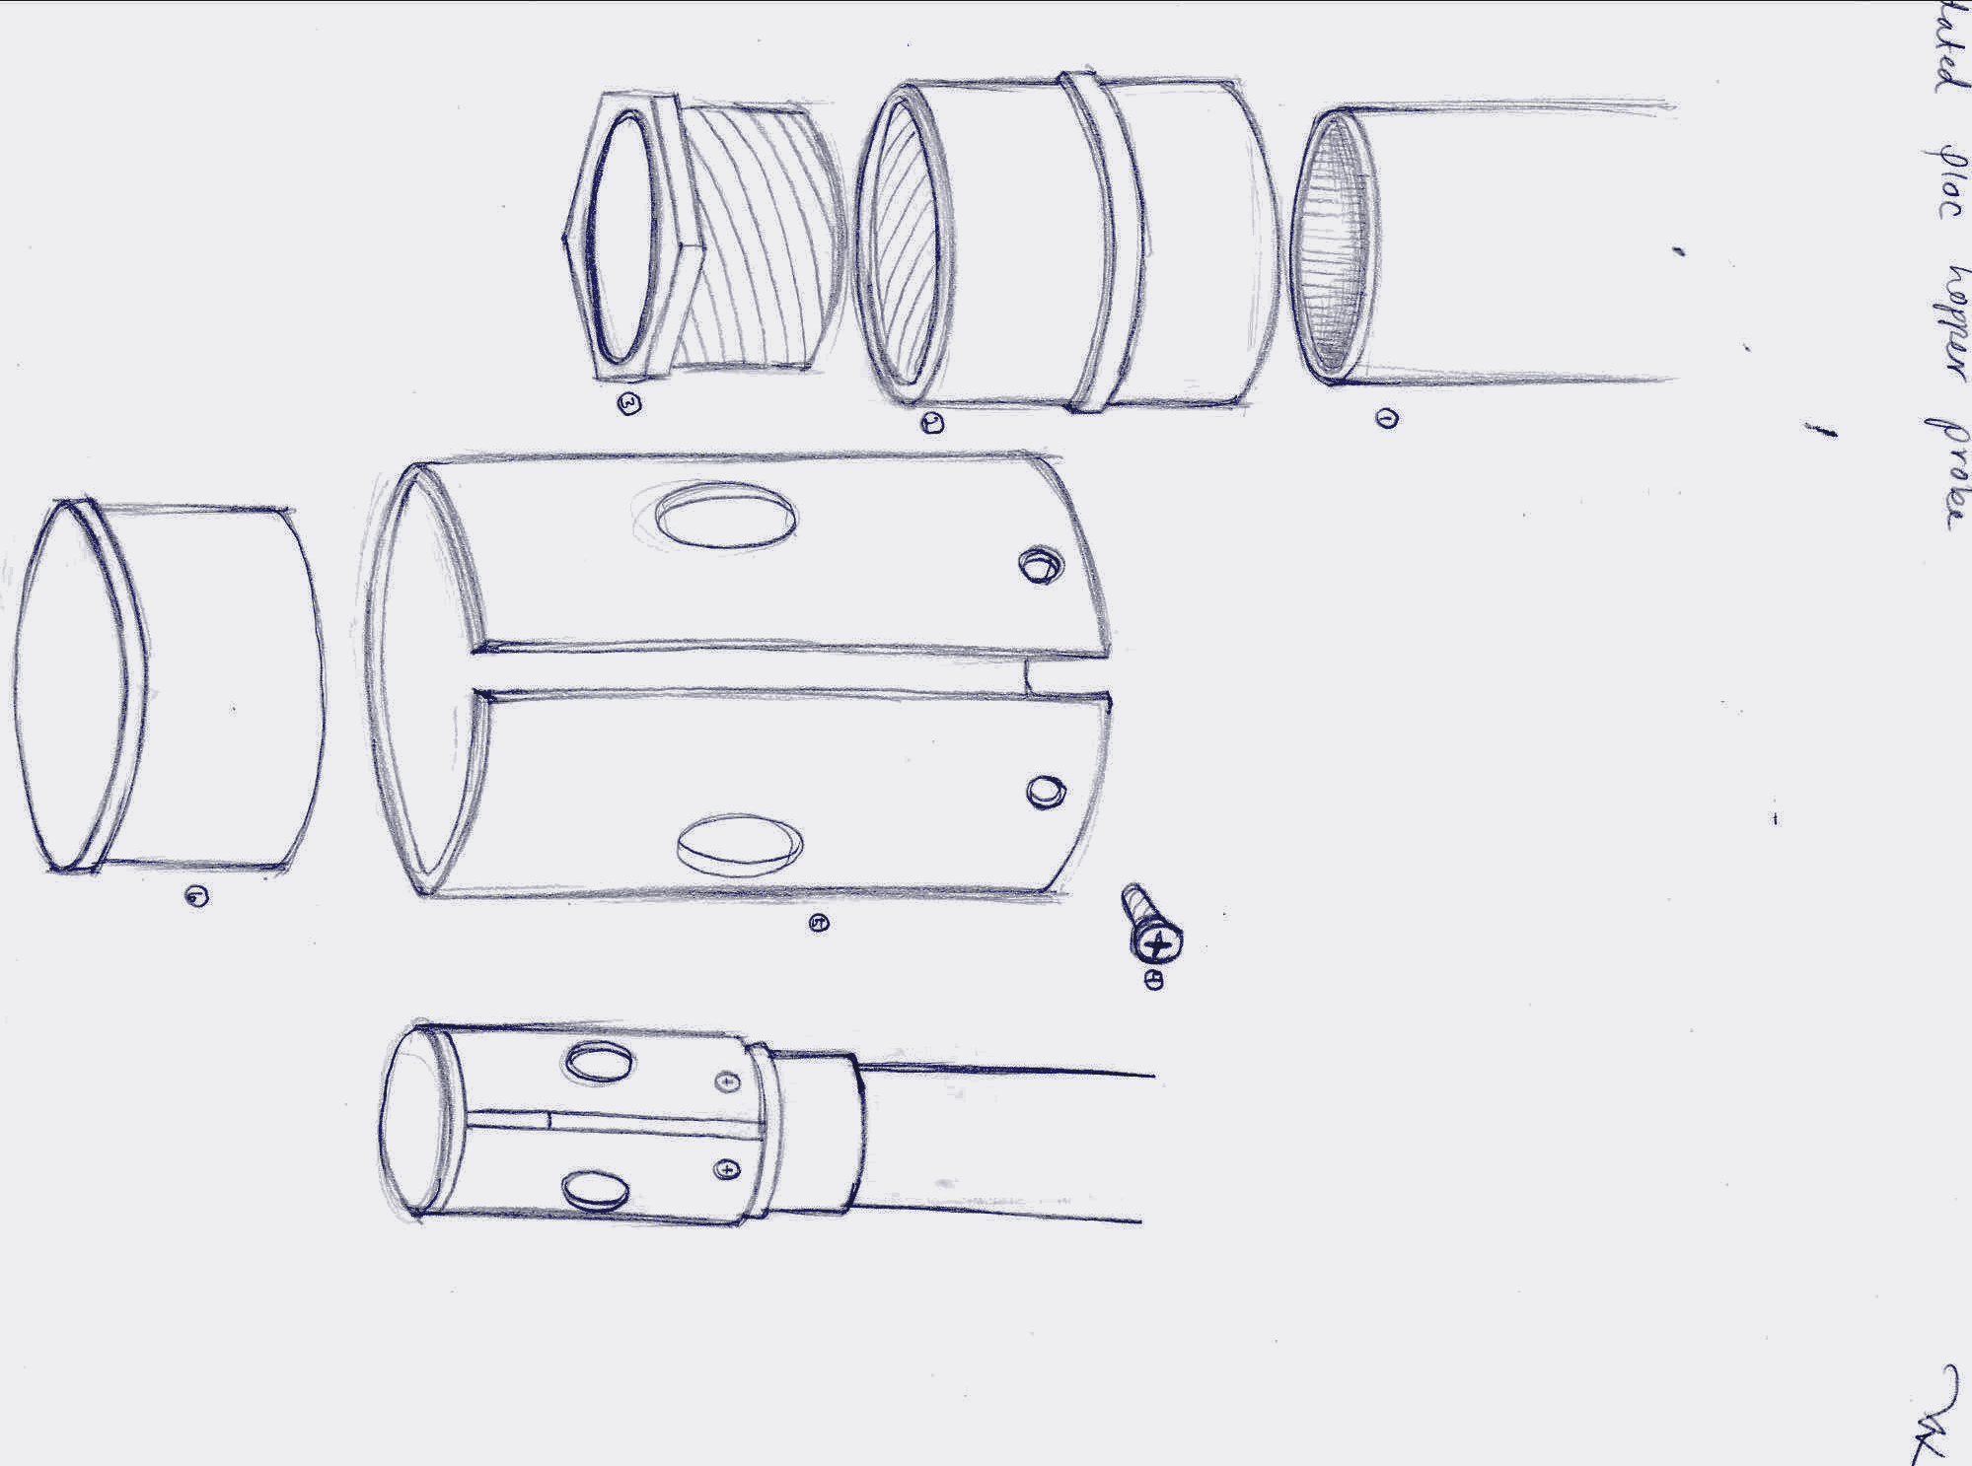
Prototype 1

Slide 6
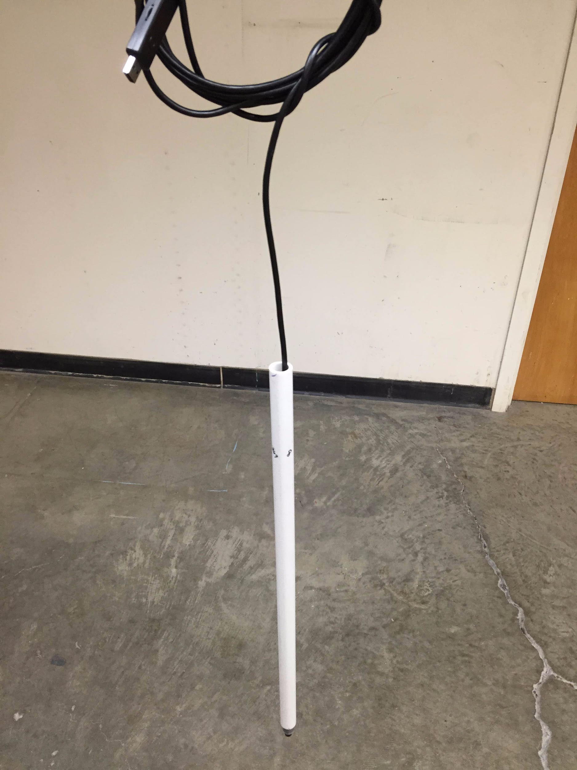
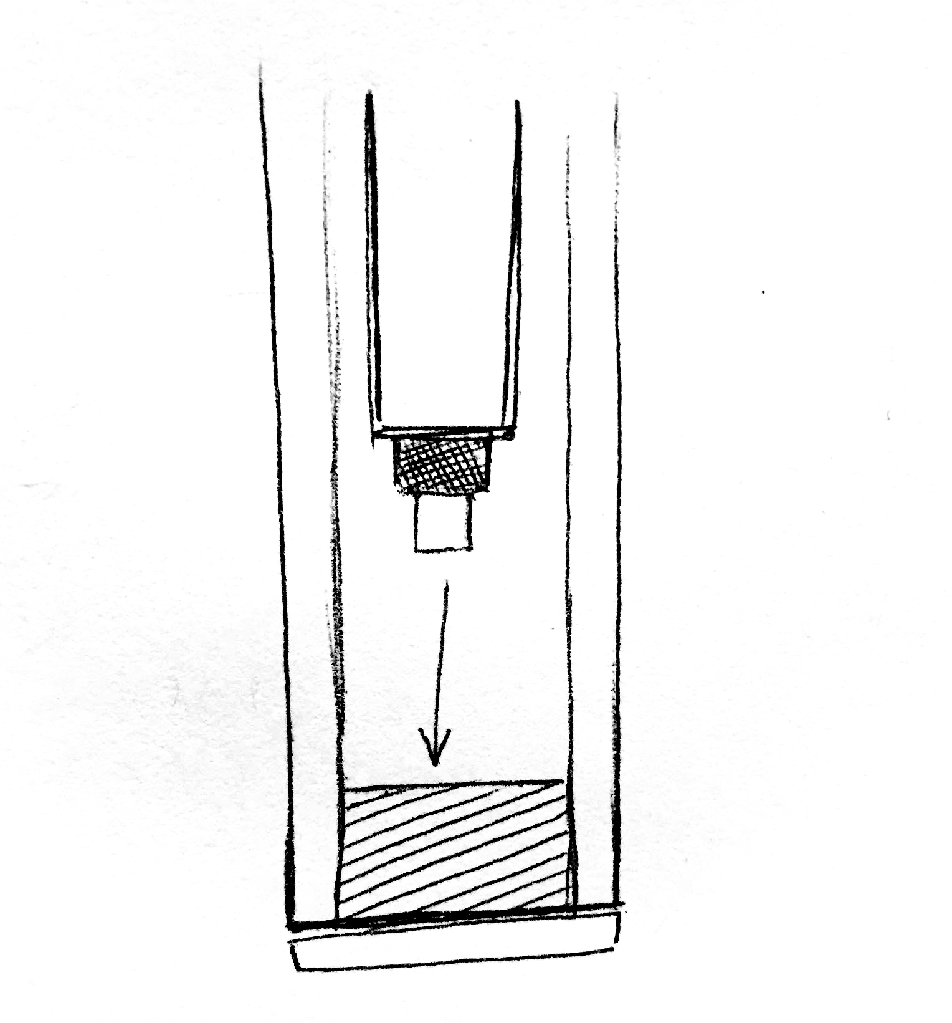
Camera Solution
Layers:
  Camera
  Duct tape collar
  Small flexible pipe

Slide 7
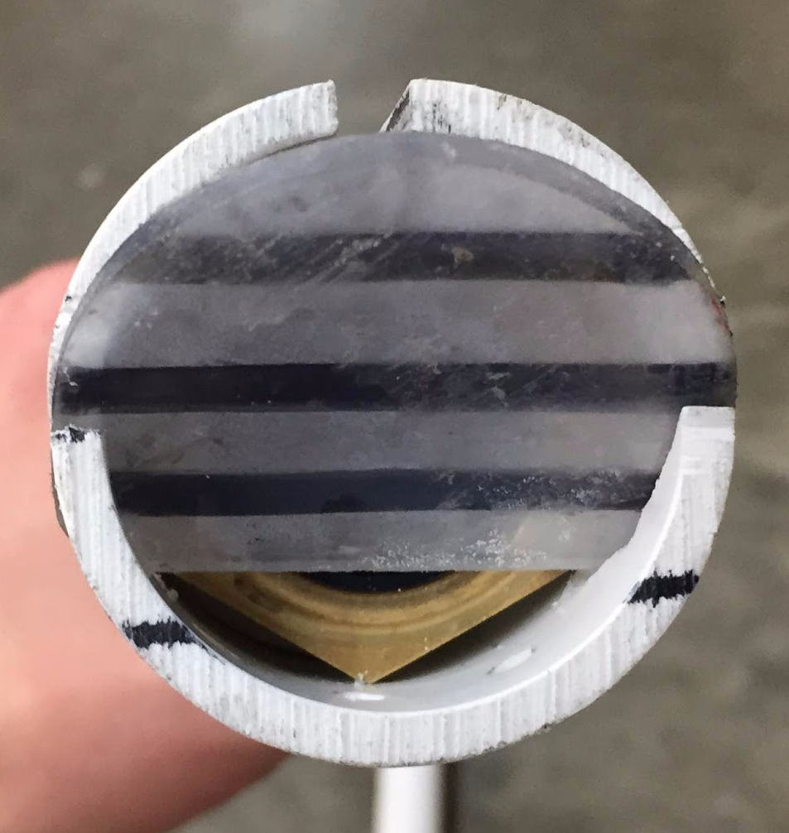
Challenges & Development
Challenges:
Distance between glass lens and plate should be at a ½”.
GLARE! The borescopic snake camera’s built-in LED causes disruptive reflection in glass lens.
Built up sludge may interfere with light - especially when located externally.
Development:
Borescopic camera fixated to a smaller internal tube for weight to concentrate direction.
Slanted removeable plate promotes sludge runoff.
Horizontal lines drawn on plate to determine depth.

Slide 8
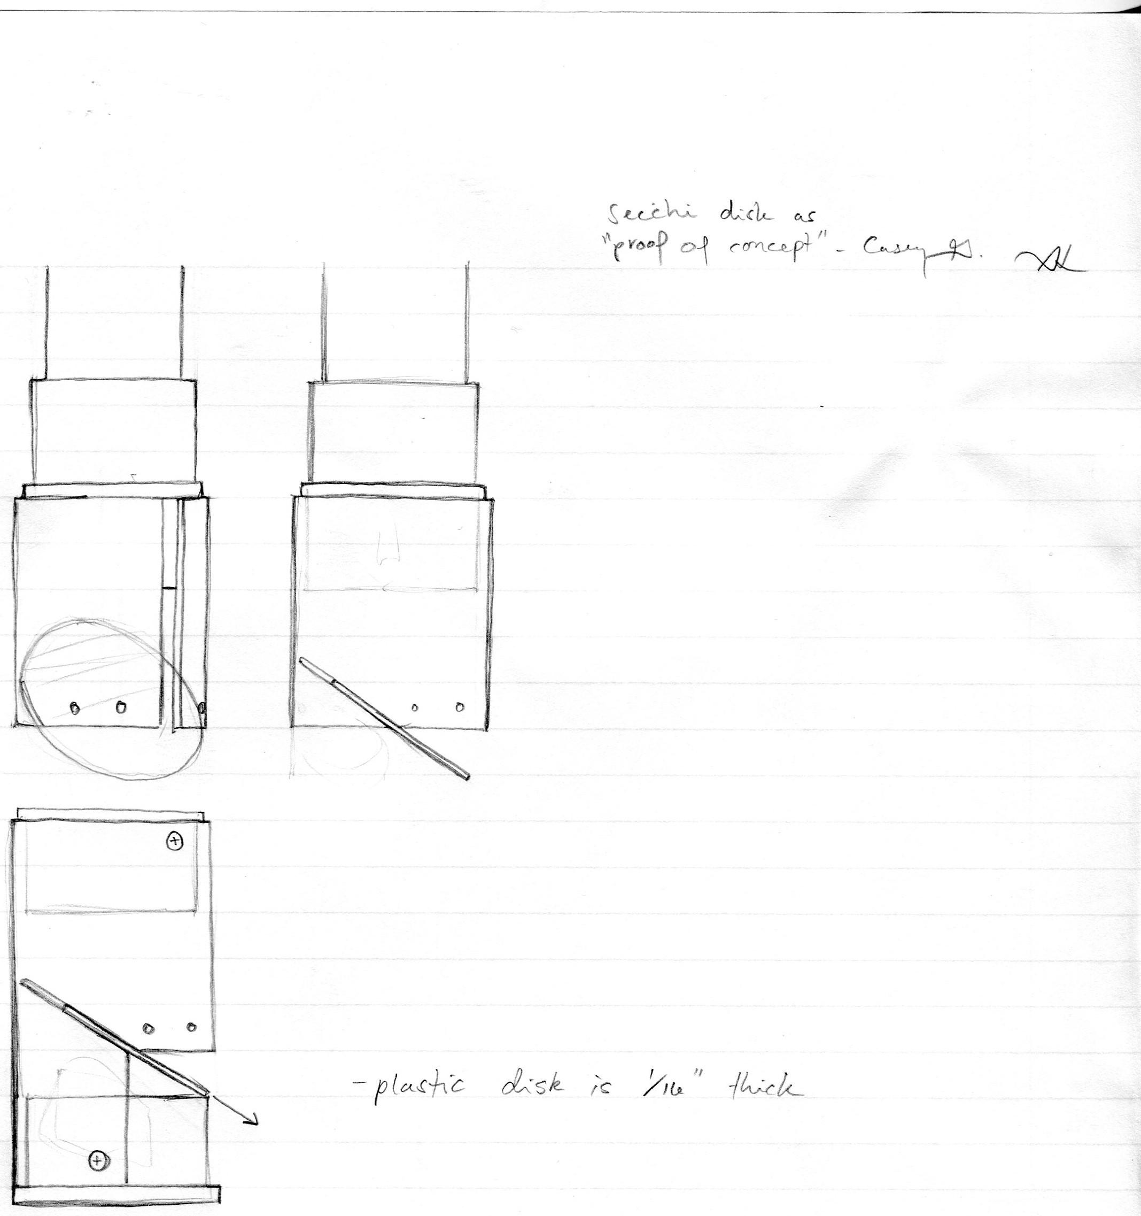
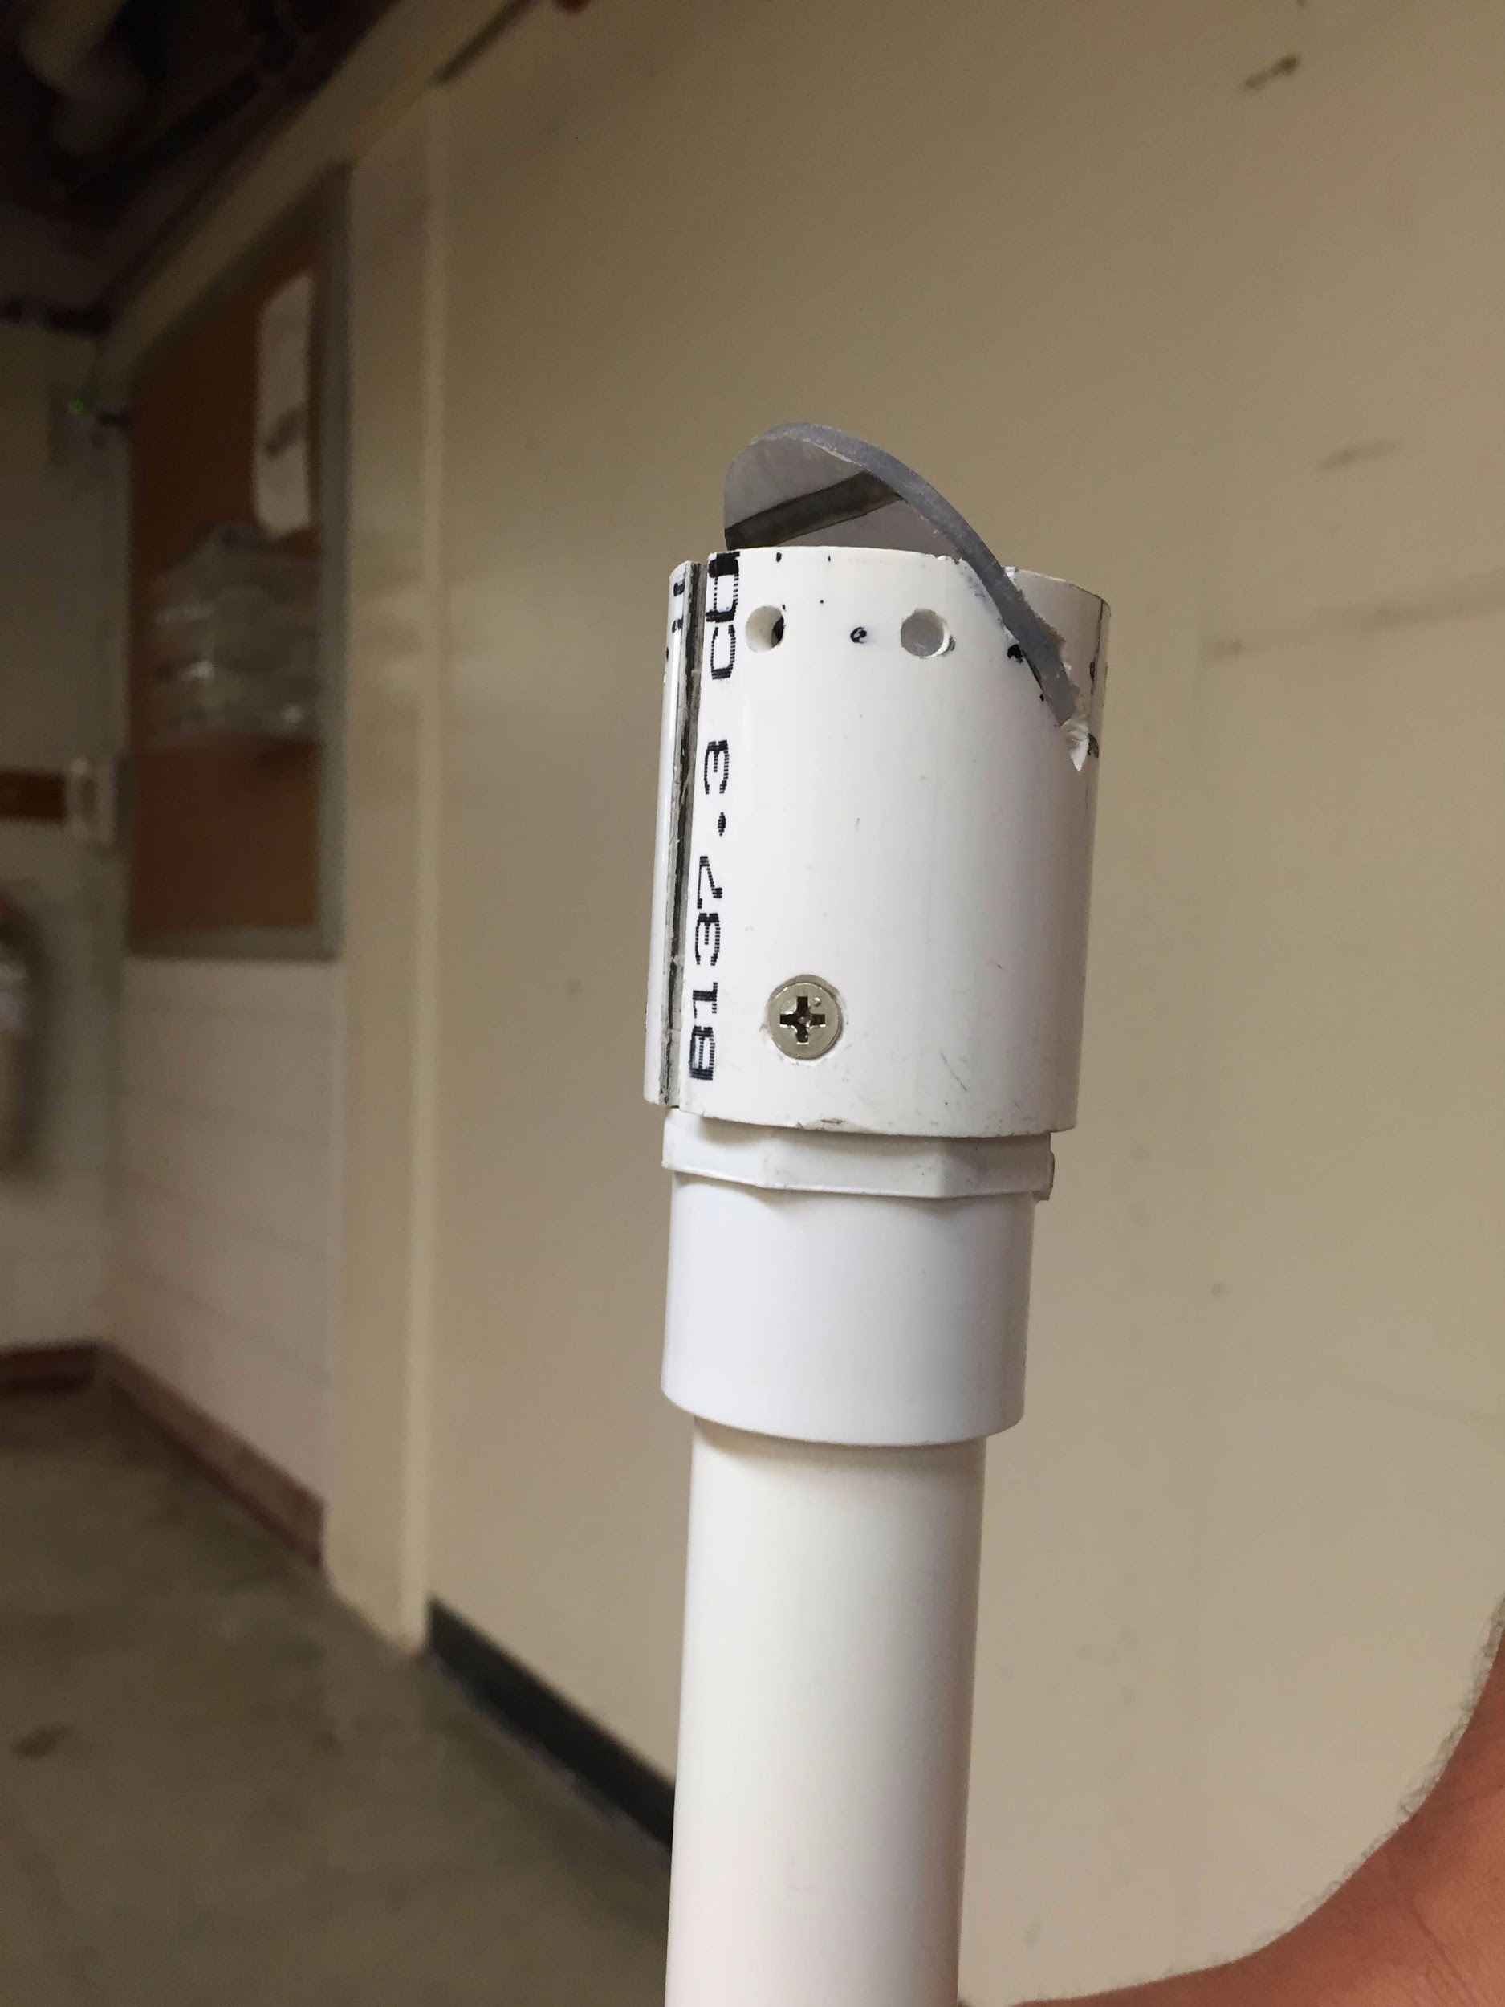
Current Design

Slide 9
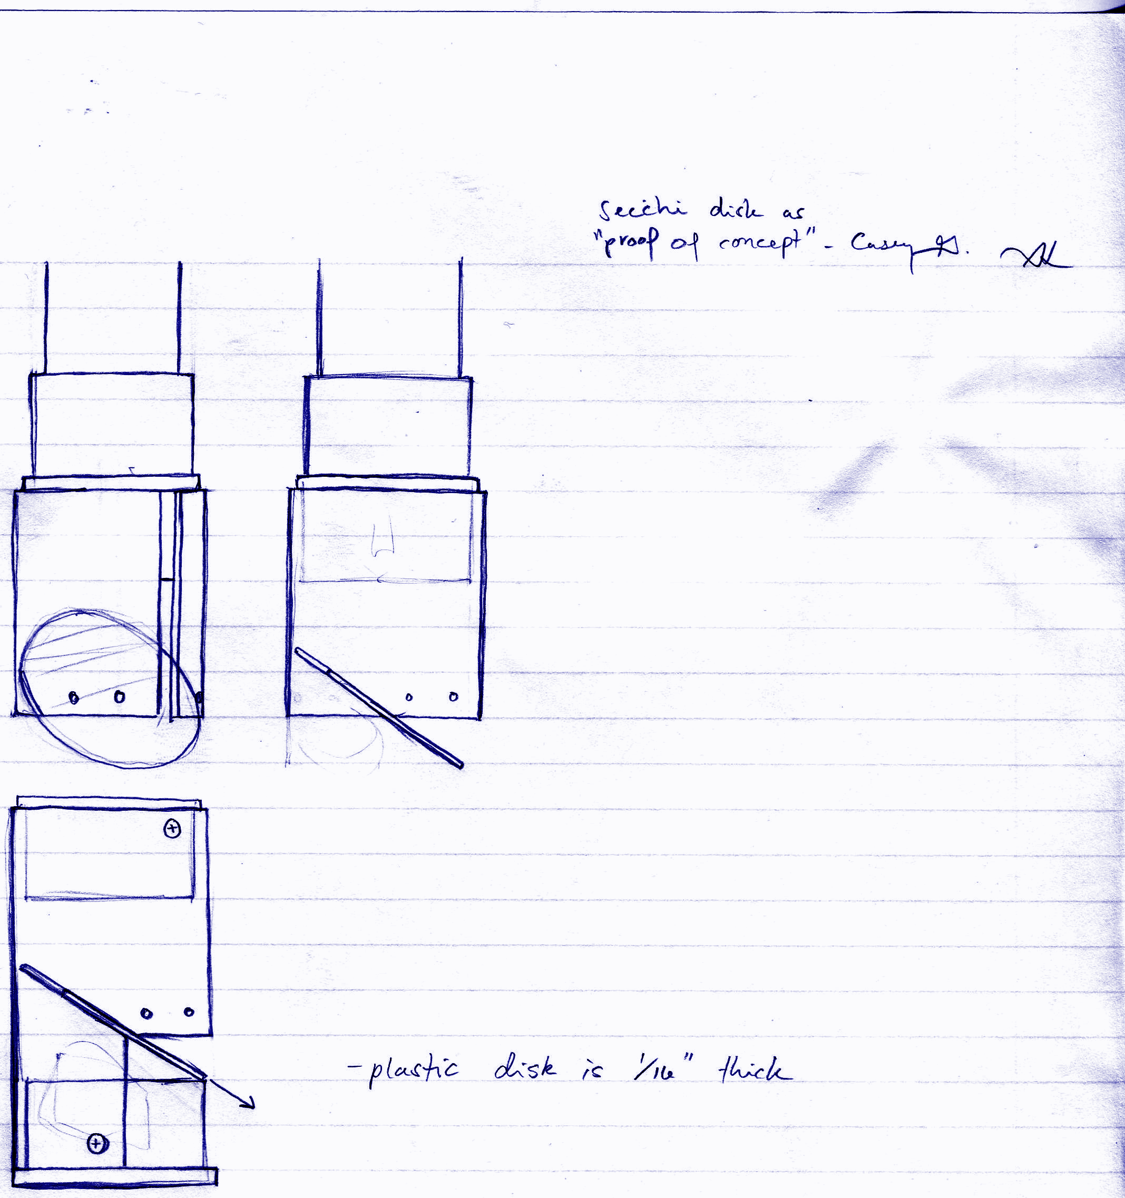
Next Steps in Design
Opaque plate allows for light visibility in the dark tank environment.
Choose optimal light type and fixture setup to illuminate plate.
Waterproof bulb options:
  LED “Candle”
    Pros: Remote control
    Cons: Single source of light
  Mini LED Balloon Lights
    Pros: Diverse points of light
    Cons: Undecided method of securing attachment

Slide 10

Next Steps in Imaging
Program camera to correspond images and image data to laptop.
Develop for use with a computer/smartphone interface.
Imaging methods should be expanded upon.
Explore probe head design to optimize even light transmittance for imaging quality.

Slide 11
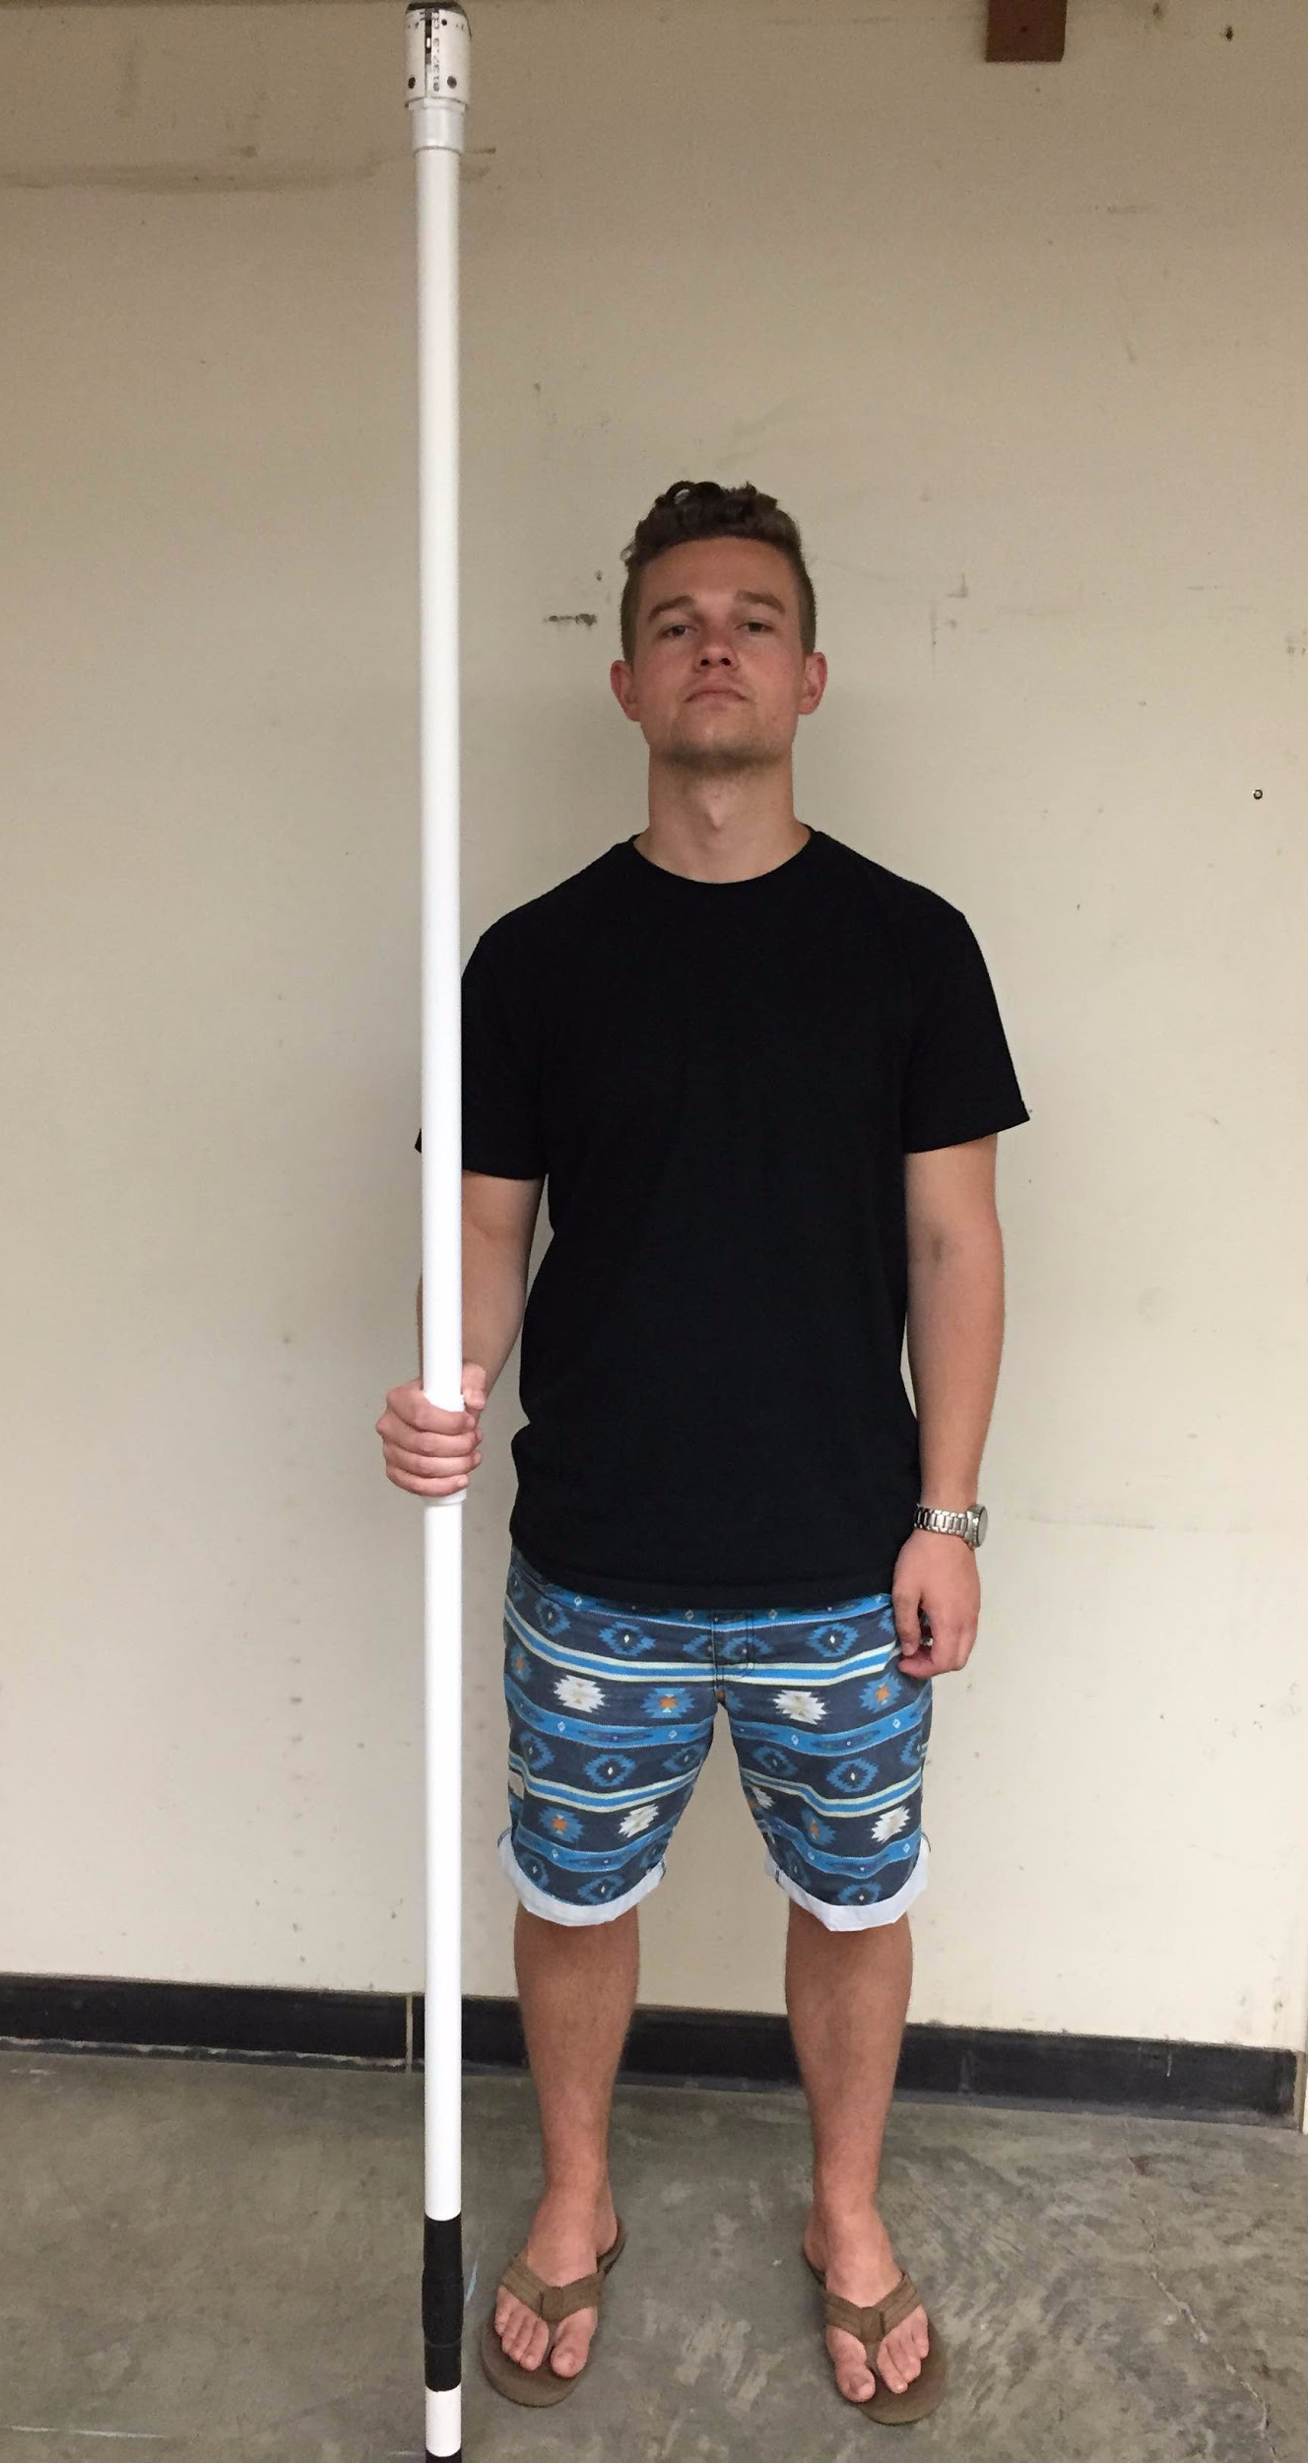
Shoutouts & Thanks
Ethan for sublime subteam leadership and consultancy.
Casey for deciphering part descriptions and ordering from many vague emails.
Monroe for an awesome experience and a great highlight to my resume.
All the fabrication subteam members for valuable suggestions and insights.
HAPPY SUMMER EVERYONE!!!
Sharkbait Ooh-HaHa

Slide 12

Questions
Questions?
Feedback:
  How can we improve our design?
  How else can the device be used?
  How does our research overlap?

