Slide 1

Turbidimeter/Inlet Manifold Team
Julia Morris
Andrew Gorodetsky
Heidi Rausch
TEACH-IN

Slide 2
Turbidimeter

Slide 3
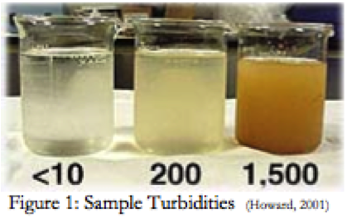

What is Turbidity?
Turbidity is caused by particles suspended in a water supply (sediment, phytoplankton, and pollutants)
Gives water a haziness or cloudiness
NTU = Nephelometric Turbidity Unit

Slide 4
Why measure it?
Gives a good approximation of how clean the water is
Drinking water <5 NTU
According to the WHO drinking water should be <1.0 NTU

Slide 5
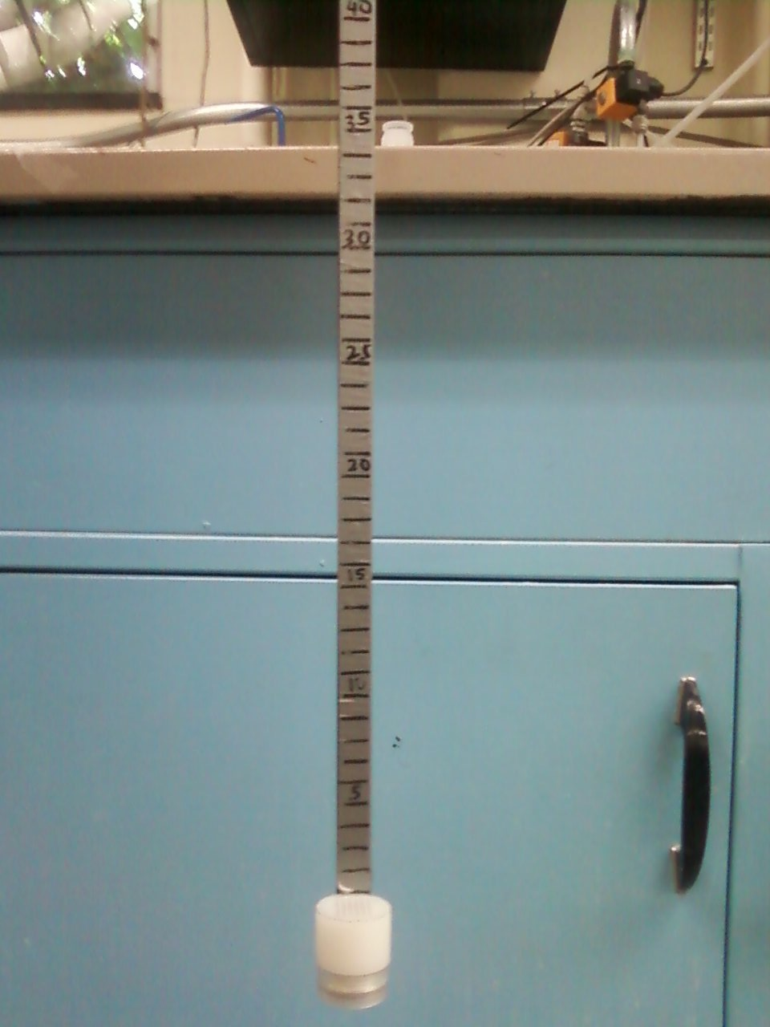
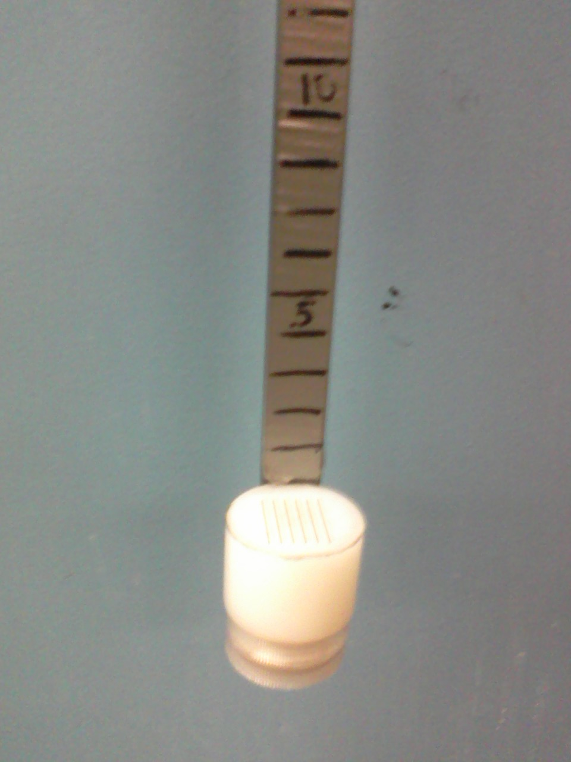
Measurement
Electronic Turbidimeters too expensive
Alternative handheld measurement
<$20 for materials
Notes:
During this slide we could have people come up and use the turbidimeter if they want to

Slide 6
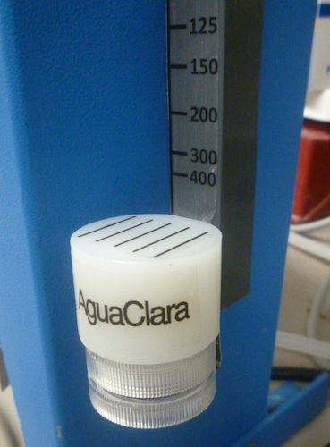
Turbidimeter Goals
Current Prototype only measures down to 15 NTU
Would like a low cost turbidimeter that can read down to 5 NTU or lower
Improve prototype by either lowering cost or improving reading accuracy

Slide 7
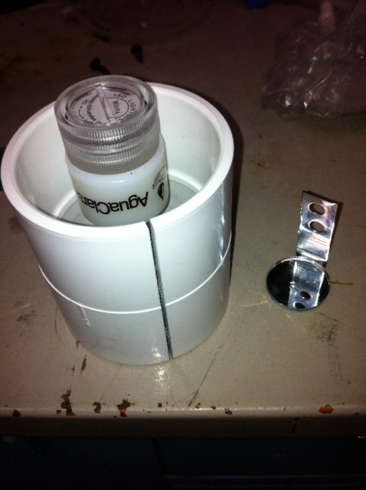
Mirror Design
Double the light path using a mirror
Light source at top
Mirror attached to the end of the lowering rod
Notes:
Extend range of turbidimeter by doubling the light path using a mirror

Slide 8
Problems with Mirror Design
Aligning mirror and LED pattern was difficult
Solutions cost too much
Focus on LED design

Slide 9
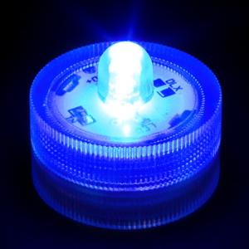
Colored LED design
Components
  Colored LED light (blue, green, and red)
  Diffuser with pattern
  Lowering rod

Slide 10
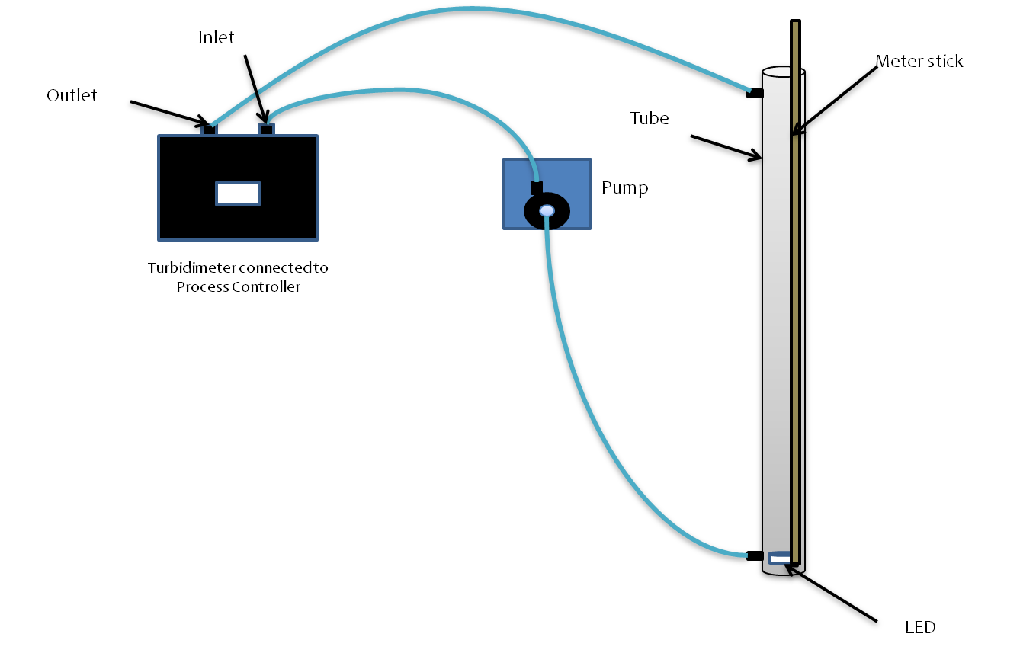
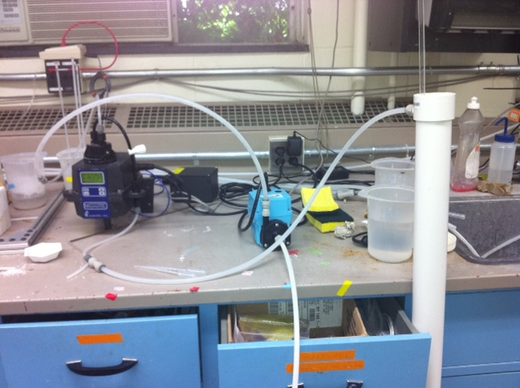
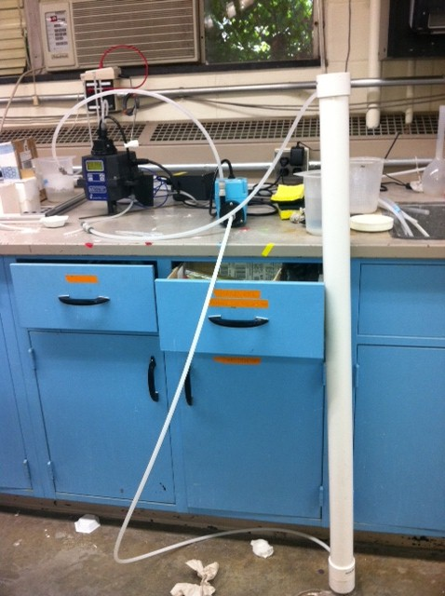
Experimental Setup

Slide 11
Experimental Methods
1. Add clay
2. Run pump system for 4 minutes
3. Turn off pump
4. Team member takes depth reading
5. Turn on pump
6. Wait 60 seconds
7. Repeat steps 3 – 6 for each team member
8. Repeat steps 1 – 7 for each addition of clay

Slide 12
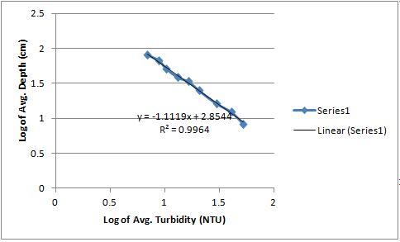
Blue LED Results

Slide 13
Blue LED Analysis
Relationship found
  Depth=715.2*(Turbidity)^{-1.1119}
5 NTU can be measured at 119 cm
Larger R-squared value

Slide 14
Turbidimeter Future Work
Revisiting the use of mirrors
Using lights other than LEDs
Changing the HDPE block
Using humic acid
Write paper to be submitted to the Journal of Environmental Engineering

Slide 15
Inlet Manifold

Slide 16
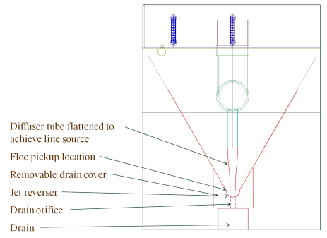
Inlet Manifold
What are we fabricating?

Slide 17
Diffusers
The diffusers are part of the Sedimentation tank
Need to create a line flow, instead of many point flows
Diffusers are made of 2” PVC pipe that is stretched into a thin rectangle

Slide 18
Inlet Manifold Goals
Finding an appropriate method for diffuser fabrication
Should be relatively simple
Must be able to recreate in Honduras

Slide 19
Methods
An easy and cheap method is needed to fabricate the new inlet manifold.
In order to do this, PVC pipe should be heated and then molded into a rectangle that is 1 cm wide with an undetermined length as of now.
It was determined that PVC pipe could be heated using boiling water, a heating blanket, or a heat gun.
So far, boiling water and a heat gun have been tested.

Slide 20
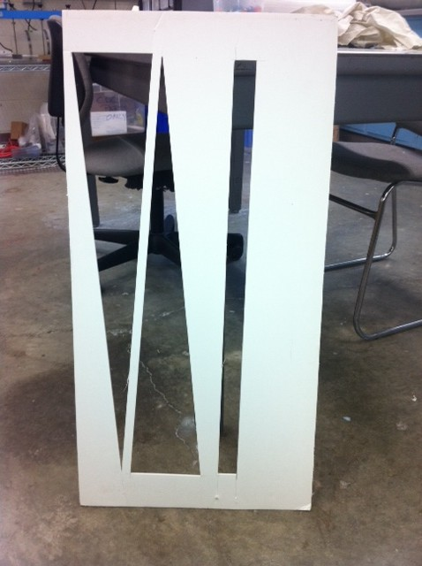
How to Shape the PVC Pipe?
We first decided that a mold would be best.
The hot PVC pipe would be pressed down onto it so that the end would be the rectangle of desired dimensions.

Slide 21
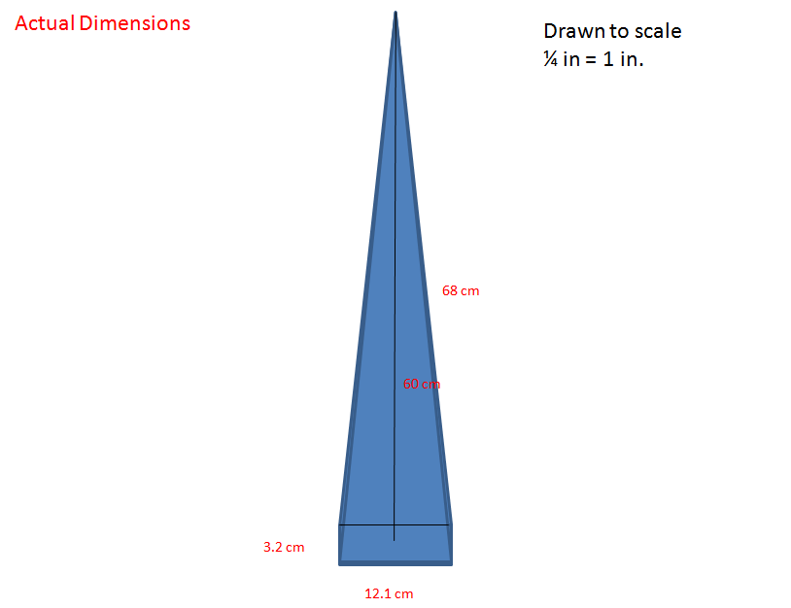

Slide 22
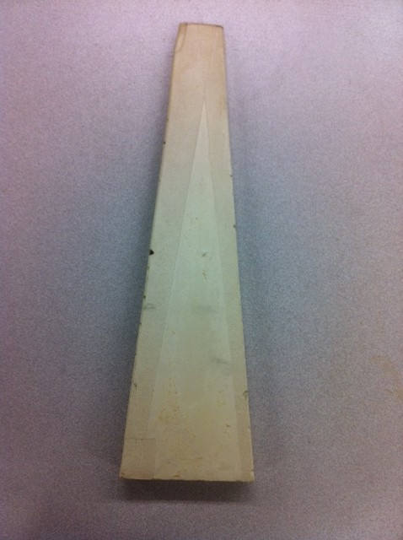
Original Mold
Our mold is made of plaster of paris and can withstand very high temperatures as well as water.

Slide 23
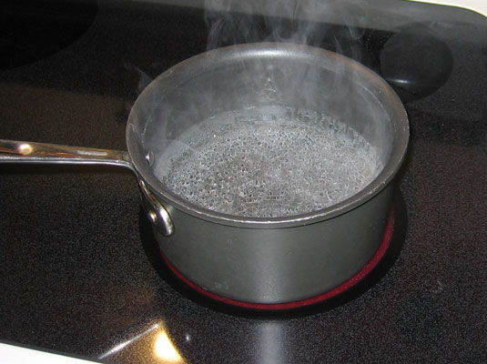
Boiling Water Method
Constantly heated water up in a microwave so that it boiled.
Soaked PVC pipe in the water and stretched it with gloved hands.

Slide 24
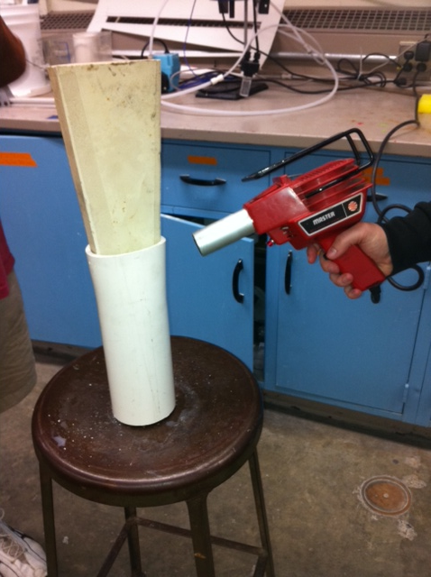
Heat Gun
Using the microwave was slow, so we decided to try heat guns.
Used two heat guns to warm the PVC pipe and slowly pressed it down the mold.

Slide 25
What Worked and What Didn’t?
The boiling water method was effective in heating the PVC pipe, but it was hard to keep the water constantly boiling which kept the PVC pipe hot.
The heat guns were very slow at heating the PVC pipe.
  Took about two hours to get the PVC pipe down the entirety of the mold

Slide 26
Analysis
While both methods got the PVC pipe to the desired temperature, neither of them were very efficient. The boiling water technique can be improved through the use of a hot plate.
The mold did work for the first dimensions given to us for the rectangle at the end of the PVC pipe, but the new dimensions are much smaller and the mold will be a lot more fragile. Another method will be tried out.

Slide 27
Inlet Manifold Future Work
Creating a lever system
Revisiting the use of boiling water
Use of a new type of mold
Use of a heating blanket

Slide 28
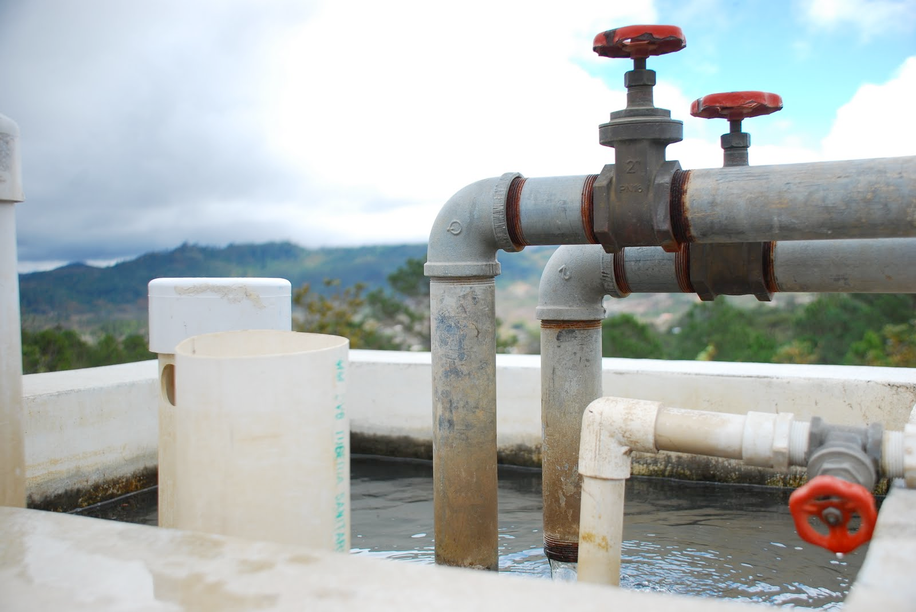
Questions?

