Slide 1

Turbidimeter
Final Presentation

Slide 2
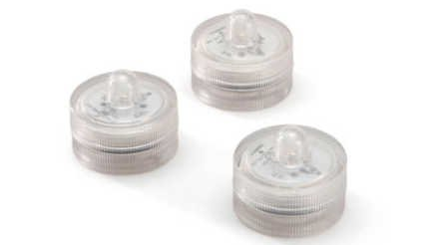
A novel approach to measure turbidity...

Slide 3
Basic Design Components
PVC pipe
LED light
depth testing pattern on LED
Lowering rod with LED attached

Slide 4
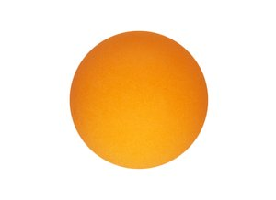
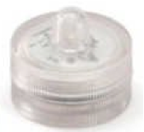

Prototype 1
+
+
LED light
source
Ping pong ball
Secchi disk
design

Slide 5
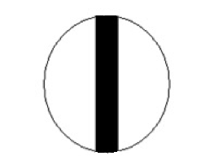
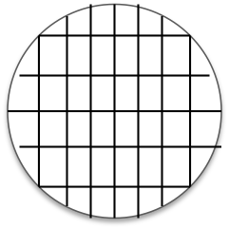
Prototype Designs Tested
# 1
# 4
Secchi disk pattern
“Agua Clara” words
Agua
Clara
# 2
Thick, black stripe
Fine, grid of lines
# 3

Slide 6
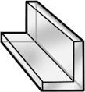
Final prototype
“Agua Clara” design
Light cylindrical diffuser
Stuctured rod with LED attached

Slide 7
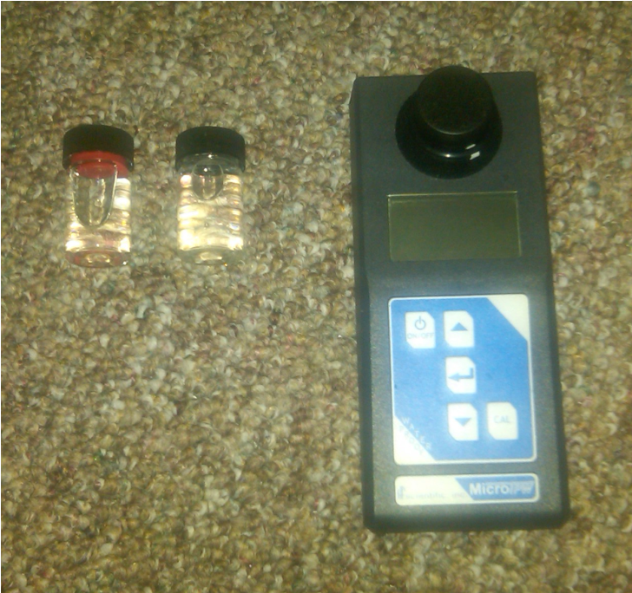

Experimental Methods
Testing using portable turbidimeter
  Clay added directly to tube
  Mixed by inverting tube

Slide 8
Experimental Methods
Problems with this method
  Portable turbidimeter unreliable
  Settling
Solution
  Constant Mix Experimental Setup

Slide 9
Experimental Methods
Constant Mix Schematic
Inlet
Lowering Rod
Outlet
Tube
1
Pump
Turbidimeter connected to Process Controller
LED

Slide 10
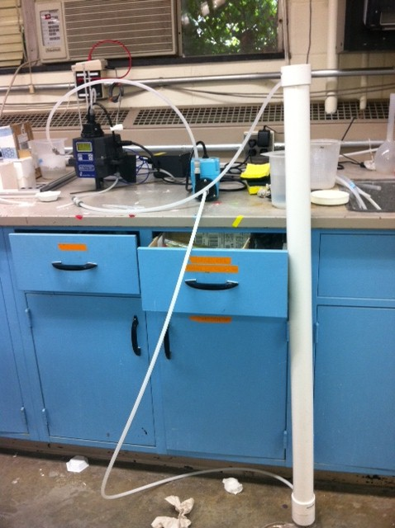
Experimental Methods
Measurement Procedure
  Turn pump on
  Add clay stock solution
  Once a steady NTU measurement is achieved, turn pump off
  Measure depth that “AguaClara” is not legible

Slide 11
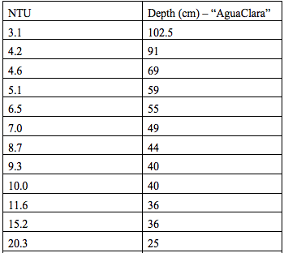
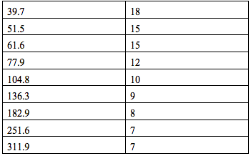
Results with Online Turbidimeter

Slide 12
Results with Online Turbidimeter

Slide 13
Results with Online Turbidimeter

Slide 14
Results with Online Turbidimeter

Slide 15
Results with Online Turbidimeter

Slide 16
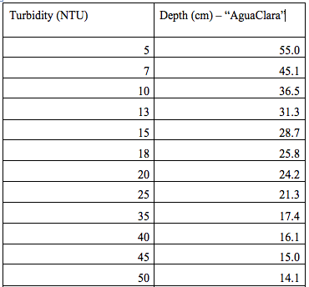
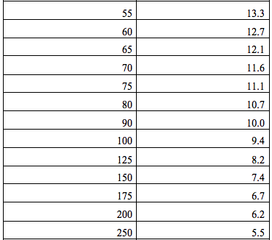
Final Turbidimeter Scale

Slide 17
Future Work
Test accuracy of our scale
Consider possible sources of operator error
Standardize materials for production

