Slide 1

Turbidimeter Team
Julia Morris
Andrew Gorodetsky
Heidi Rausch
TEACH-IN

Slide 2
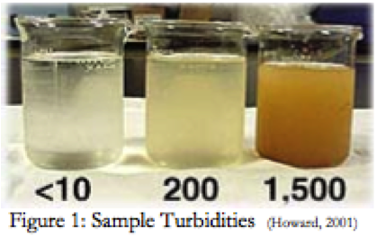

What is Turbidity?
Turbidity is caused by particles suspended in a water supply (sediment, phytoplankton, and pollutants)
Gives water a haziness or cloudiness
NTU = Nephelometric Turbidity Unit

Slide 3
Why measure it?
Gives a good approximation of how clean the water is
Drinking water <5 NTU
According to the WHO drinking water should be <1.0 NTU

Slide 4
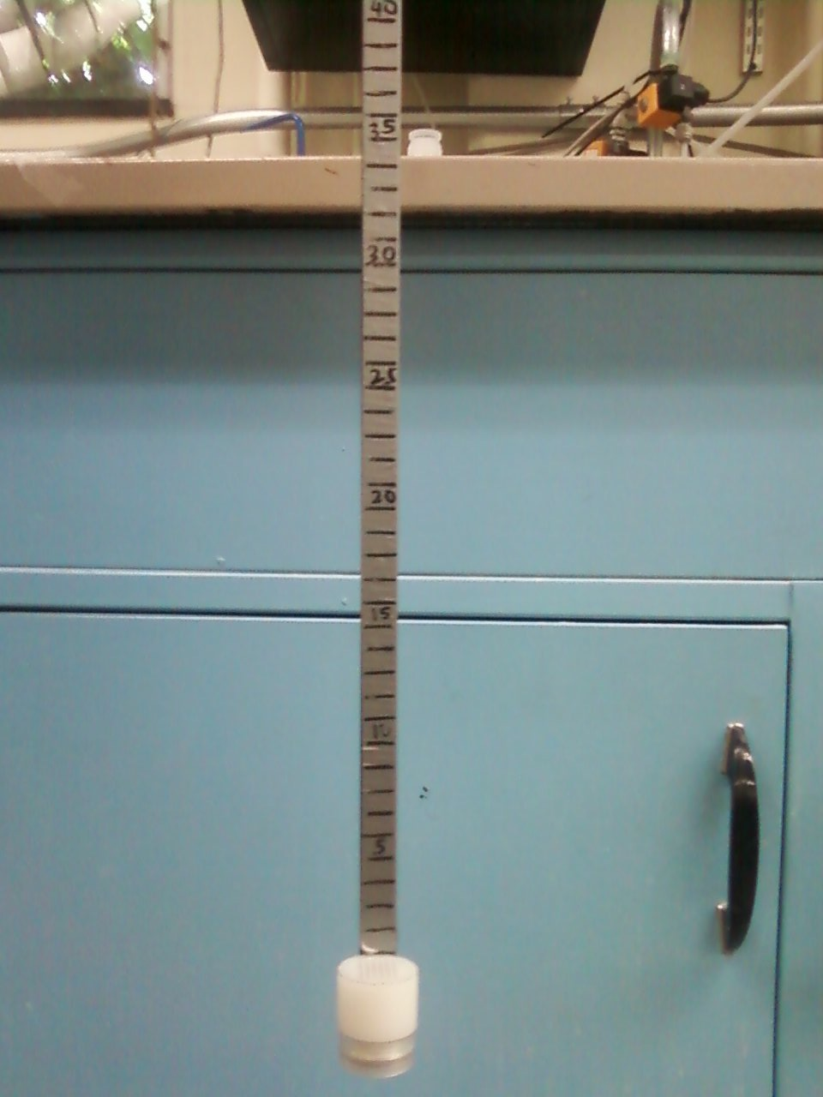
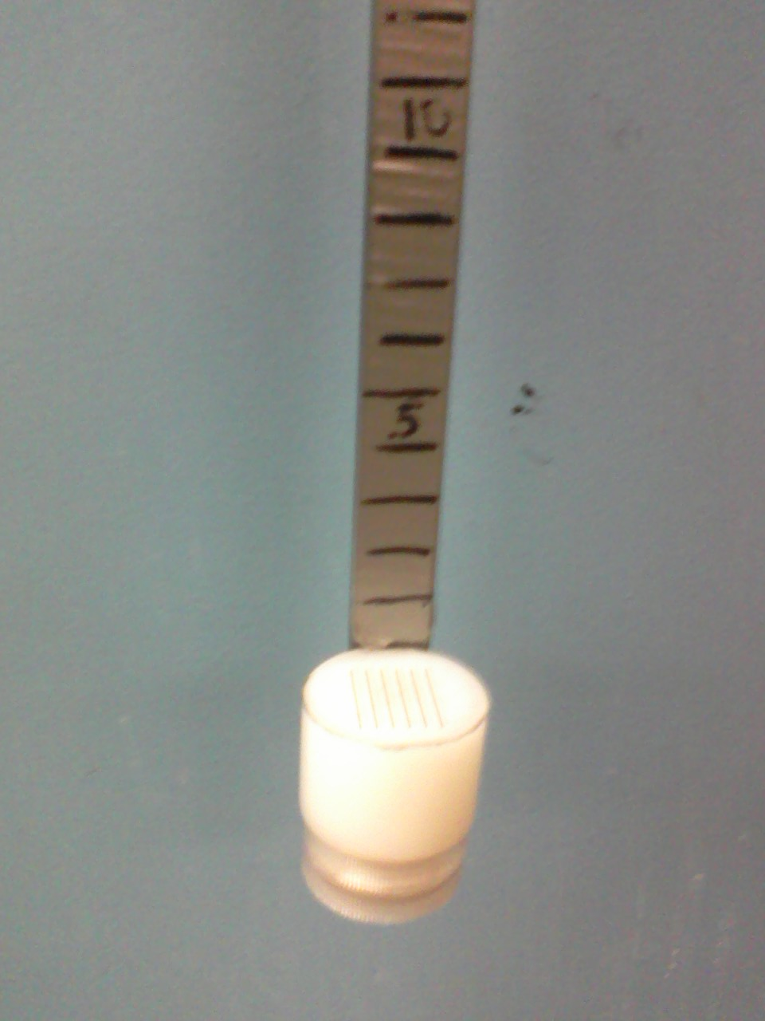
Measurement
Electronic Turbidimeters too expensive
Alternative handheld measurement
<$20 for materials
Notes:
During this slide we could have people come up and use the turbidimeter if they want to

Slide 5
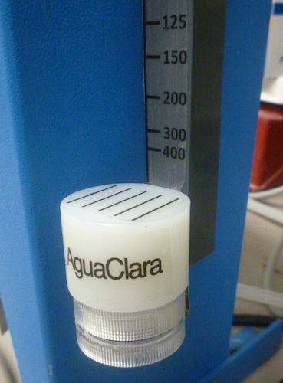
Turbidimeter Goals
Current Prototype only measures down to 15 NTU
Would like a low cost turbidimeter that can read down to 5 NTU or lower
Improve prototype by either lowering cost or improving reading accuracy

Slide 6
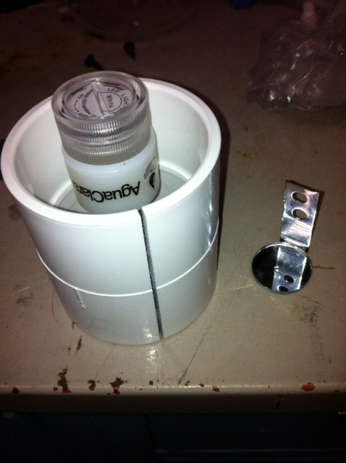
Mirror Design
Double the light path using a mirror
Light source at top
Mirror attached to the end of the lowering rod
Notes:
Extend range of turbidimeter by doubling the light path using a mirror

Slide 7
Problems with Mirror Design
Aligning mirror and LED pattern was difficult
Solutions cost too much
Focus on LED design

Slide 8
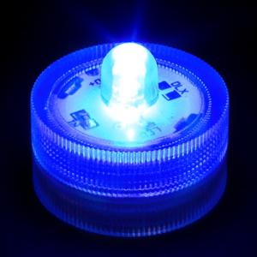
Colored LED design
Components
  Colored LED light (blue, green, and red)
  Diffuser with pattern
  Lowering rod

Slide 9
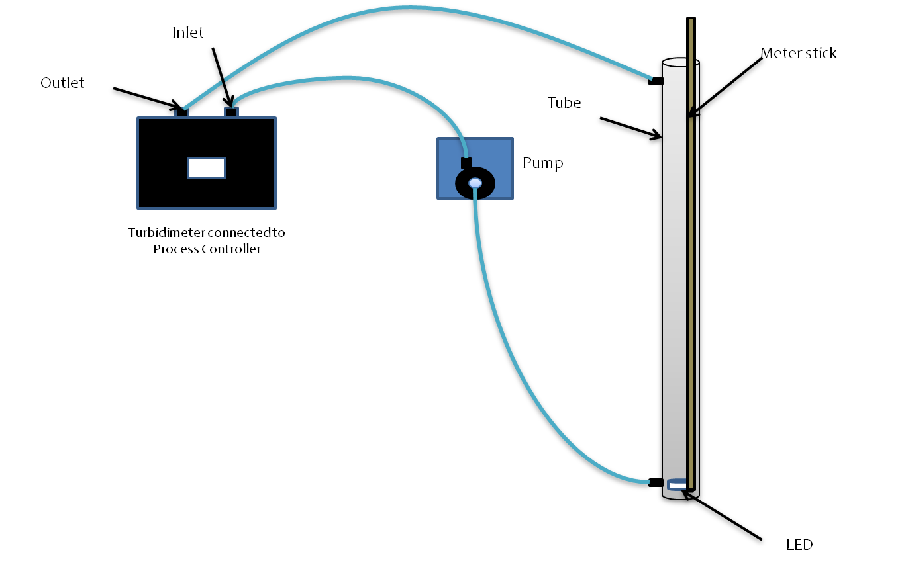
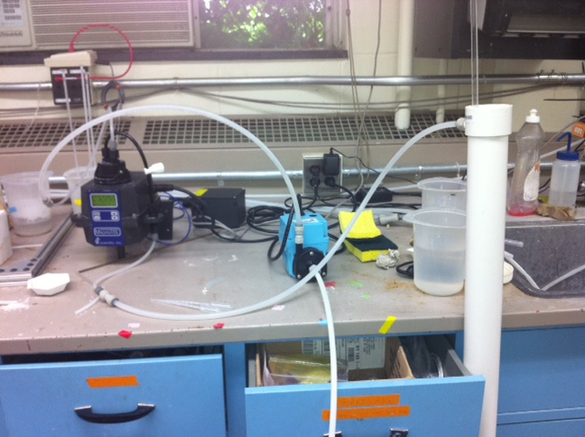
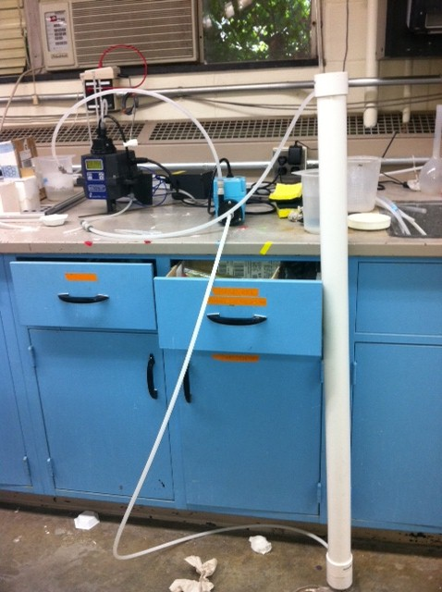
Experimental Setup

Slide 10
Experimental Methods
1. Add clay
2. Run pump system for 4 minutes
3. Turn off pump
4. Team member takes depth reading
5. Turn on pump
6. Wait 60 seconds
7. Repeat steps 3 – 6 for each team member
8. Repeat steps 1 – 7 for each addition of clay

Slide 11
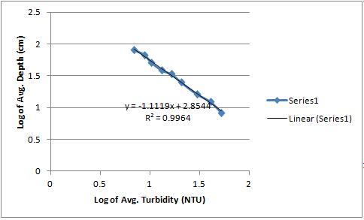
Blue LED Results

Slide 12
Blue LED Analysis
Relationship found
  Depth=715.2*(Turbidity)^{-1.1119}
5 NTU can be measured at 119 cm
Larger R-squared value

Slide 13
Turbidimeter Future Work
Revisiting the use of mirrors
Using lights other than LEDs
Changing the HDPE block
Using humic acid
Write paper to be submitted to the Journal of Environmental Engineering

