Slide 1

Turbidimeter
Julia Morris
Andrew Gorodetsky
Heidi Rausch
Final Presentation

Slide 2

Review: Why is there a turbidimeter team?
Turbidimeters for use in labs are very expensive
Need something that communities is Honduras can use
Need to determine whether or not communities need a plant built

Slide 3
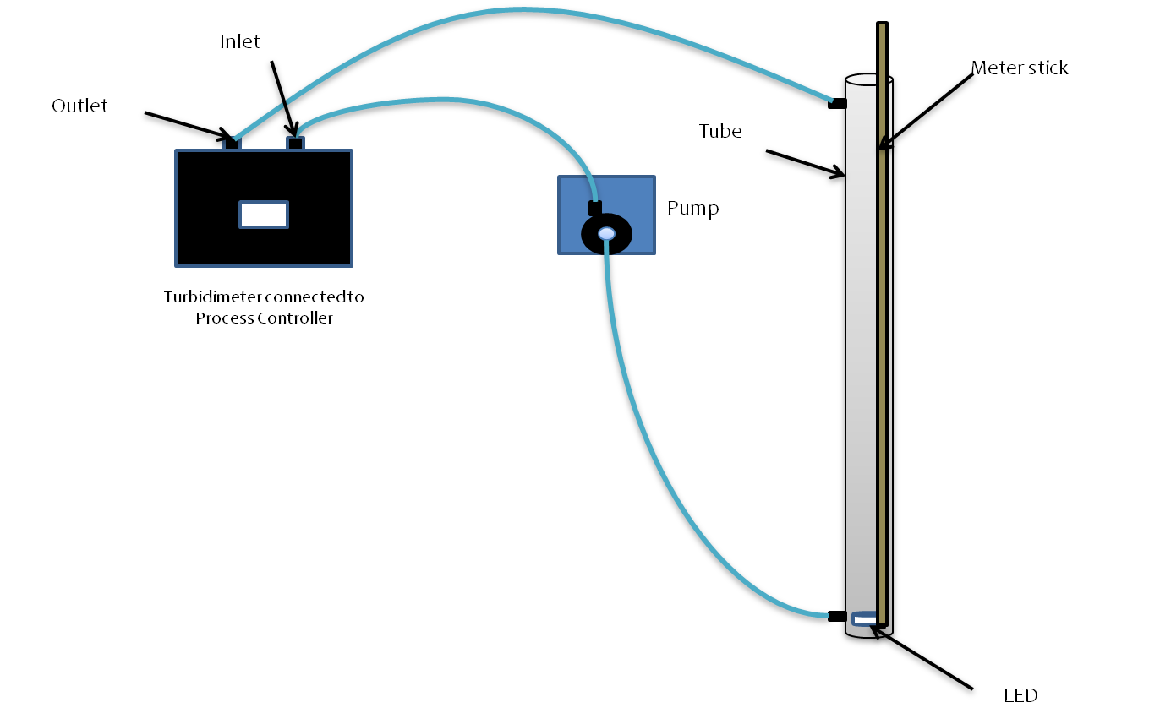
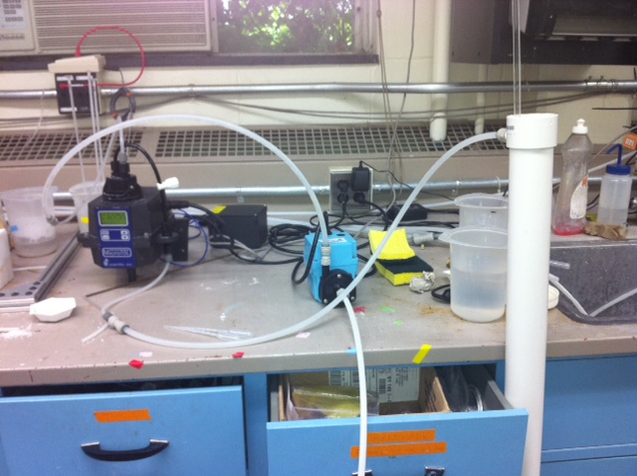
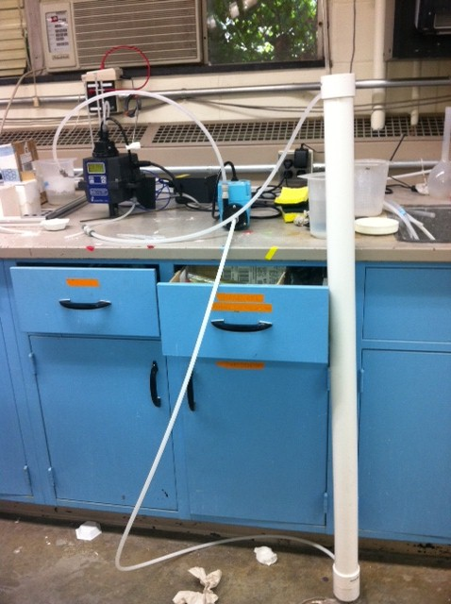
Experimental Setup

Slide 4
Experimental Methods
1. Add clay
2. Run pump system for 4 minutes
3. Turn off pump
4. Team member takes depth reading
5. Turn on pump
6. Wait 60 seconds
7. Repeat steps 3 – 6 for each team member
8. Repeat steps 1 – 7 for each addition of clay

Slide 5
Blue LED
5 NTU can be measured at 119 cm
Antonio stressed portability (~ 60 cm)
Needed new ideas

Slide 6
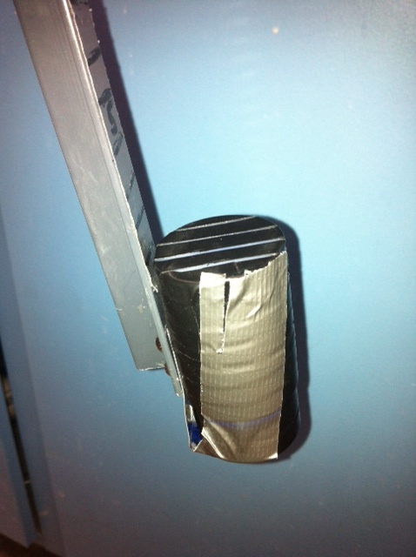
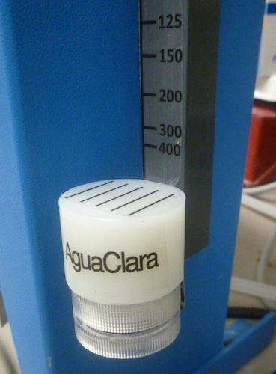
Double HDPE Block
Decided to try doubling the thickness of the HDPE block
Noticed a lot of light escaping out of the sides of the block
Taped up the sides with electrical tape

Slide 7
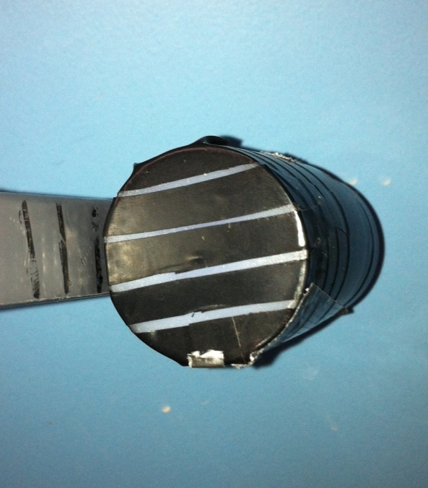
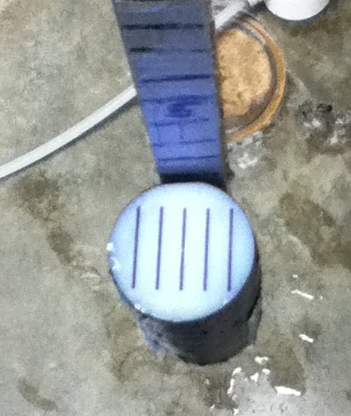
Double HDPE Block
Ran 3 different tests
Two different LED colors
  White and Blue
Two different pattern designs

Slide 8
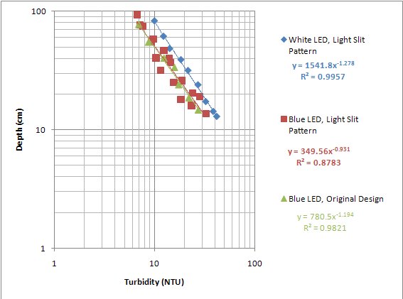
Results

Slide 9
Analysis
NTU value for length of 60 cm
White LED, light slit
  8.233 NTU
Blue LED, light slit
  7.73 NTU
Blue LED, original
  5.89 NTU

Slide 10
Turbidimeter Future Work
Revisiting the use of mirrors
Using lights other than LEDs
More tests with the Blue light, double HDPE design
Using humic acid
Complete paper to be submitted to the Journal of Environmental Engineering

