Slide 1
Focused on Engineering Excellence
But what facilitates the focus?
February 21, 2011
Monroe Weber-Shirk

Slide 2
Threads
Late breaking news – Market share for piped water is up
Economics of the AguaClara RIDE
AguaClara as a high performing team
Belonging to a community that supports your guiding principles leads to happiness!
A few thoughts on guiding principles
AguaClara: A shared dream that you are turning into reality

Slide 3
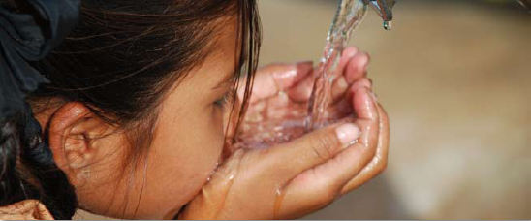
Piped water supplies dominate
Between 1990 and 2008, more than 1.2 billion people worldwide gained access to a piped connection on premises.
This is more than twice the population that gained access to all other improved drinking-water sources.
Notes:
http://www.wssinfo.org/fileadmin/user_upload/resources/1278061137-JMP_report_2010_en.pdf

Slide 4
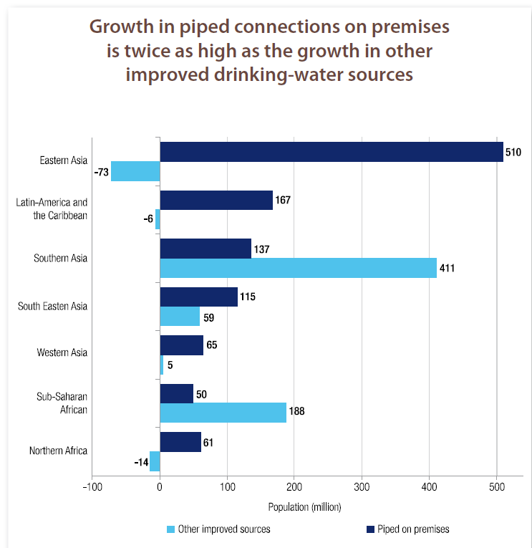
Increase in piped water service
Eastern Asia
Latin-America and the Caribbean
Southern Asia
South Eastern Asia
Western Asia
Sub-Saharan Africa
Northern Africa
u
Piped on premises
All other improved sources
Population (million)
Notes:
http://www.wssinfo.org/fileadmin/user_upload/resources/1278061137-JMP_report_2010_en.pdf

Slide 5
Installed capacity of AguaClara (L/s)
location | Partner | Construction begins | inauguration date | population served | design flow (L/s)
1. Ojojona | APP | June 2006 | January 2007 | 2000 | 6
2. Tamara | APP | January 2008 | June 15 2008 | 3500 | 12
3. Marcala | IRWA | Fall 2007 | July 2008 | 5500 | 30
4. Cuatro Comunidades | APP | October 2008 | March 2009 | 2000 | 6
5. Agalteca | APP | October 2009 | June 18, 2010 | 2160 | 6
 |  |  |  | total | 60

Slide 6
Problem-Based Research is cost effective
One conventional water treatment plant serving 15,000 people (60 L/s total installed capacity) would have cost $1.2 million ($20,000/(L/s)
Our partners built these facilities for about $0.3 million
At a savings of $0.9 million
Thus every $1 we invested in research has already saved $1.8 in Honduras!

Slide 7
More to come!
And we are just getting started with implementation
location | Partner | Construction begins | population served | design flow (L/s)
6. Marcala El Chiflador 2 | APP/ACRA | November 2010 | 3500 | 22
Alauca | APP | February 2011 |  | 12
[Atima] | APP | pending |  | 16
 |  |  | Total | 50

Slide 8
Types of Teams
High-Performing
Cooperative
members
team
Cooperative
Performance Level
Traditional
Pseudo
Types of Teams

Slide 9
Cooperative Learning Teams
Have a goal of maximizing all members’ learning
Hold themselves accountable for doing high quality work
Work face-to-face to produce joint work-products
Promote success through helping, sharing, assisting, explaining, and encouraging
Provide both academic and personal support based on a commitment to and caring about each other
Use teamwork skills to coordinate their efforts and achieve their goals
Share responsibility for providing leadership
Emphasize continual improvement (feedback) of the teamwork process

Slide 10
High-performance Cooperative Learning Team
Outperforms all reasonable expectations, given its membership
High level of commitment
Mutual concern for each other’s personal growth
Achieve high-performance and also have lots of fun
We are engineers. That means we use equations that capture the physics of the real world to predict behaviors and to provide design constraints. We explore possibilities by playing with equations.

Slide 11
Rank your Team
High-Performing
Cooperative
Our educational system has taught you to sit quietly, get in line, stand still, and wait for the teacher. You have been trained to be inefficient.
The planet needs your skills urgently. There is no time to sit around waiting.
members
team
Cooperative
Performance Level
Traditional
Pseudo
Types of Teams
How many times did you communicate with someone on your team about your project outside of class in the last week?
3 minutes… get into your teams. Discuss where you think your team is currently.
Create one or more strategies to move your team further up the curve.

Slide 12
AguaClara as a Community?
High performing teams create a strong sense of community
AguaClara lunches (one method)
  I’ve been eating lunch most days in the grad lounge with the goal of fostering informal interactions with students
  That doesn’t seem to work for undergrads
  Proposals?
We need to take deliberate steps to build community spirit (ice skating!!!)

Slide 13
Keys to happiness: Belief and the company of believers
To make sense of a complicated world and our place in it, humans need to construct meaning. We need to know what is expected of us, how to behave and how to function among other people. Otherwise, our sense of self is at risk.
But our protective systems of belief cannot work without the support of others.
Regardless of "what religious or belief system you accept, if you have a set of philosophical beliefs that you hold strongly, and you have others who support you in those beliefs, there's less likelihood you'll be unhappy."
Hanging out with friends who share your values can make you happy!
Keys to happiness: Belief and the company of believers
By George Lowery
Brashears
Notes:
http://www.news.cornell.edu/stories/Jan10/BrashearsHappy.html

Slide 14
Why talk about beliefs
(or guiding principles)?
Having the same guiding principles as the people you hang out with isn’t enough… (the guiding principles matter too)
If you can connect what you are doing to your guiding principles, then you won’t need to compartmentalize your life into “earning money”, leisure, family, friends, and faith.
Connecting your passion, your skills, and your guiding principles is very powerful (and empowering)
Notes:
I know this isn’t always possible…

Slide 15
What are guiding principles that influenced you to join AguaClara?
Make the world better
Do something that makes a lasting difference (legacy)
Tired of years of school that didn’t include contributing to society
Are you connecting with your passion?

Slide 16
Monroe’s Philosophy – a work in progress
Positive Energy – optimism - gratitude
  Surround yourself with people who can dream
  Dreaming makes it possible to create a new reality
If you feel boxed in, climb out of the box
Don’t burn bridges
You always have a choice – use it!
Exceed Expectations
Identify a need and then invent

Slide 17
An Optimist’s Perspective
What is the minimum annual budget required to sustain AguaClara as an educational program?
  Trip to Honduras (25k)
  Research supplies (15k)
  Software for computers (3k)
  AguaClara Engineers (20k each)
  Grad students (75k each)
Do you like this question?
Rephrased this question is: “When would you throw in the towel?”
An optimist always sees the opportunities for creative engagement. From an optimist’s perspective this question can’t be answered! So climb out of the box and then create an answer.

Slide 18
An optimist’s perspective
I will creatively use whatever resources AguaClara is able to acquire to make the world a better place.
Remember… we started this program with only a few thousands of dollars.

Slide 19
Monroe’s Philosophy
Positive Energy
  Surround yourself with people who can dream
  Dreaming creates a new reality
If you feel boxed in, climb out of the box
Don’t burn bridges
You always have a choice – use it!
Exceed Expectations
Identify a need and then invent

Slide 20
Don’t burn bridges
The individual who frustrates you today may be a powerful ally tomorrow
Everyone has the opportunity (and the right!) to mature and become a healthier person.

Slide 21
Monroe’s Philosophy
Positive Energy
  Surround yourself with people who can dream
  Dreaming creates a new reality
If you feel boxed in, climb out of the box
Don’t burn bridges
You always have a choice – use it!
Exceed Expectations
Identify a need and then invent

Slide 22
You always have a choice
There is a huge difference between not having much money and not having choices
Learn to live so that even if you don’t have lots of money, that you still have choices
Example… I wanted to be able to devote more time to AguaClara. I negotiated a reduction in my summer teaching load that included a 25% salary cut. I saw it as a choice because money isn’t my guiding principle.

Slide 23
A career goal: Connecting passion, skills, and guiding principles
This is my choice…
I want to maximize the amount of time that I am working on things that I am passionate about and that I can connect with my guiding principles

Slide 24
A Choice: How did AguaClara get started?
Complicated series of events, but I (and others) identified the need and proceeded to organize a team to address that need.
My job description does not include AguaClara!
No one at Cornell has ever asked me to lead the AguaClara program.
If you wait for your employer to ask you to take on a cool new initiative, it might never happen!

Slide 25
Use your choice: Empowerment
Maximize the amount of your time that you are doing what you want to do
Mold your career by creating your own opportunities

Slide 26
Monroe’s Philosophy
Positive Energy
  Surround yourself with people who can dream
  Dreaming creates a new reality
If you feel boxed in, climb out of the box
Don’t burn bridges
You always have a choice – use it!
Exceed Expectations
Identify a need and then invent

Slide 27
Exceed Expectations
When you are exceeding expectations you are doing it because you want to do it, not because someone told you what to do
Exceeding Expectations opens up doors for new opportunities
I like to maximize the amount of time that I am doing what I want to do… (efficiency matters)

Slide 28
Monroe’s Philosophy
Positive Energy
  Surround yourself with people who can dream
  Dreaming creates a new reality
If you feel boxed in, climb out of the box
Don’t burn bridges
You always have a choice – use it!
Exceed Expectations
Identify a need and then invent

Slide 29
Thomas A. Edison
I never did a day's work in my life. It was all fun.
I never pick up an item without thinking of how I might improve it.
I never perfected an invention that I did not think about in terms of the service it might give others.
I want to save and advance human life, not destroy it. I am proud of the fact that I never invented weapons to kill.

Slide 30
Monroe’s Philosophy
One more… Sharing is more fun
Life is a gift… my story…
Turn gratitude into action

Slide 31

guiding principles
Open Source
Free hydraulic designs
Empowerment of others
Collaborative work environment
Commitment to continual improvement
Careful matching of our strengths and weaknesses with the task
Distributed Intelligence!

Slide 32
Design Challenge
We are in a transitional stage where we have demonstrated that we can design plants that perform well.
The demand for our designs is increasing.
With that increased demand comes the need for better documentation
We need to be thinking now about the demands that we will have to meet in 5 years

Slide 33
Research Challenge
There is so much to learn about optimizing the design
There are new unit processes and design improvements that we need to invent
We need strategies for methodically testing, validating, and incorporating improvements into the design tool
We need to be thinking now about the demands that we will have to meet in 5 years

Slide 34
Outreach Challenges
Professional presence on the web (well underway!!!!)
Sustainable funding strategy for the program here at Cornell

Slide 35
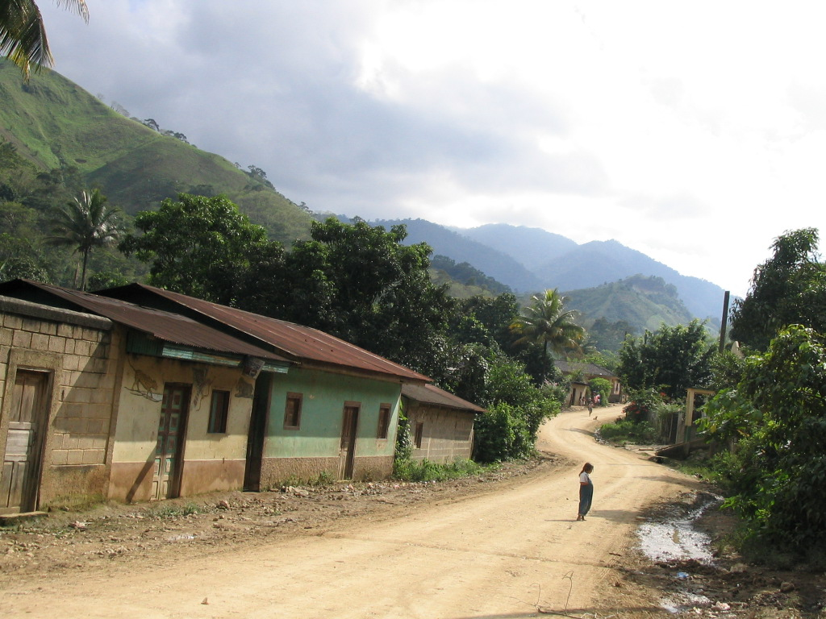
Where is AguaClara going?
Do you know why you are doing what you are doing and how it fits into the big picture?
Where are you taking AguaClara?
Where do you want AguaClara to be 5 years from now?
How many L/s will be
built in 2016?
What steps do we need
to take now to get
where we want to go?

Slide 36
challenge
Continue to be a VERY HIGH PERFORMING TEAM and DREAM

