Slide 1
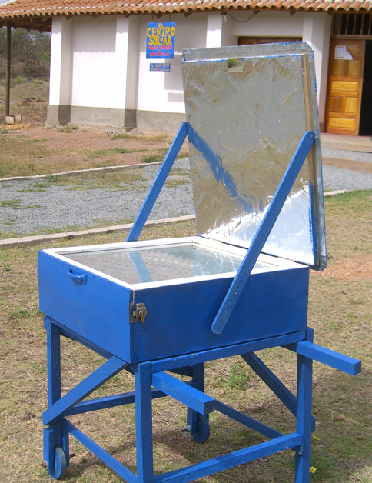
Solar Lovin'
Project Proposal
10/7/2010

Slide 2
Subteams for Fall 2010
Insulation
Concentrated Solar Cooker
Small Solar Cooker

Slide 3
Insulation
Problem
  Reduction of box cooker efficiency after one year of operation
  Box cookers have life expectancy of 10-12 years
Possible Cause
  Insulation settling
  Breakdown of resin (absorbs more water)
  No longer prevents convective heat transfer

Slide 4
Insulation: Criteria
Technical
Material must perform equal to or superior to the current material
Social
Must effectively explain the benefits of using new material to the Nicaraguan women
Economic
The materials used for the insulation must be both inexpensive and readily available in Nicaragua.
Environmental
Ensure all material and energy inputs and outputs are as inherently nonhazardous as possible
Attempt to design the products, processes, and systems to maximize mass, energy, space, and time efficiency.

Slide 5
Insulation: Tasks
Investigate the source of the problem
Investigate possible solutions
Identify alternate materials for insulation
Design and construct experiment
Conduct experimental testing
Data analysis
Communicate with Nicaraguan Community

Slide 6
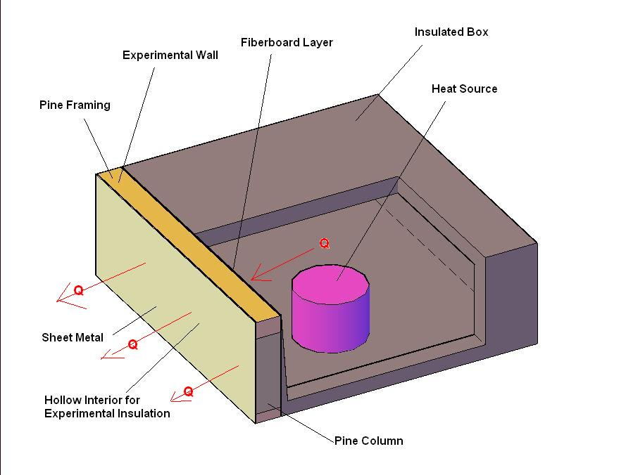
Insulation: Experimental Setup

Slide 7
Insulation: Gantt Chart

Slide 8
Criteria for Success!
Did we reach any conclusions?
Is the insulation effective?
Is the new method economical?
Is the new method sustainable?
Did we communicate with the community in Nicaragua?
Did we have fun?

Slide 9
Concentrated Cooker
Problem
Current solar box cookers do not reach high enough temperatures to fry foods (i.e. tortillas)
Approach
Research 3D parabolic cookers in order to create and execute an optimal design for the Nicaraguan women
Measure
Determine prototype’s ability to effectively fry food (temperature readings), as well as its buildability

Slide 10
Concentrated Cooker: Criteria
Technical
Design should be user-friendly such that components may be removed and/or replaced accordingly
Able to meet the temperature requirements for frying foods
Efficient, durable, and practical and should be relatively mobile in order to track the path of the sun.
Social
Allow women to reduce their use of wood-burning stoves in unsafe conditions
Lessen their time spent gathering wood
Economic
Materials in the final design must be available (in terms of location and cost) to residents in Nicaragua
Environmental
Resources used in the fabrication of the parabolic oven should be renewable and sustainable

Slide 11
Concentrated Cooker: Gantt Chart

Slide 12
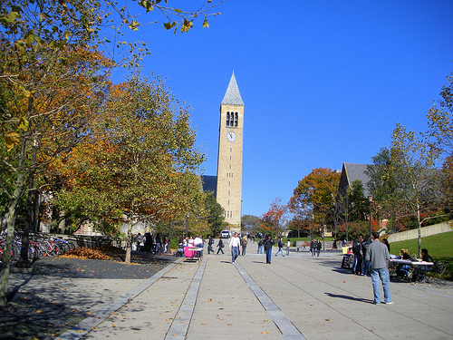
Small Solar Oven: Problem
Smaller, more portable ovens
Design for Ithaca climate
Promote and raise awareness

Slide 13
Small Solar Oven: Criteria
Technical
  Smaller than current design
  Must perform adequately
  Design for Ithaca
  Similar materials
Social
  Demonstrate cooking outside
  Raise awareness
  Reproducible in Nicaragua
Economic
  Minimize cost of materials
  Local materials
Environmental
  Minimize energy consumption
  Durable, not unbreakable

Slide 14
Small Solar Oven: Gantt Chart

Slide 15
Criteria for Success
Completion of stoves
Adherence to principles
Test stoves (FOOD!)
Staying within budget

Slide 16
Solar Oven Budget
Insulation
  Rice Hulls: $17
  Wood: $20
  Aluminum: $12
  Fiber board: $5
  Sheet metal: $15
  Other materials: $30
Concentrated Solar Cooker
  Online resources requiring viewing fee: n/a
  Potential material costs: n/a
  Trip to Nicaragua over Spring Break: n/a
Small Solar Oven
  Small sheets of glass: $20
  Wood/fiberboard: $20
  Sheet metal and paint: $10
  Rice hulls/wood shavings: free
  Mineral wool: up to $10
  Hinges, screws/bolts: available at lab
Total Solar Oven Budget for Fall 2010 = $149

