Slide 1
Inlet Manifold :: Fall 2010
Steve Beyers
Anna Lee
Ju Khuan Pan
Katie Weible

Slide 2

Team Goal!
Deliver water uniformly into the bottom of the sedimentation tank without breaking up the flocs.

Slide 3
Problems
Lack of settling floc in one area of the tank
Circular Flow motion in the Sedimentation tank
  Indicates non-uniform flow distribution in the sedimentation tank.

Slide 4
Initial Hypotheses
Pressure Recovery
  The kinetic energy in the flow through the manifold is converted to pressure, a form of potential energy.
EGL
HGL
1
2
n-1
n
Major head loss

Slide 5
Pressure Recovery

Slide 6
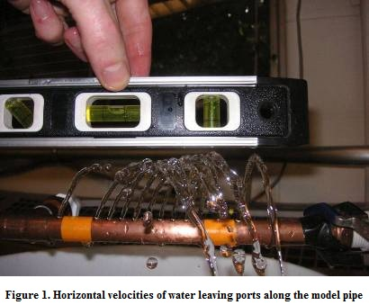
New discovery!
(Horizontal Component of Velocity)
The presence of horizontal velocity forces the water jet out of the orifice to be slanted.
Vertical Velocity
Resulting
Vector Sum
Horizontal Velocity

Slide 7
Circular Flow

Slide 8
Revised Hypotheses
Dual contribution of pressure recovery and horizontal driving forces causes unbalanced and circular flow in the sedimentation tank.

Slide 9
Modeling Goals
Verify whether pressure recovery occurs
Quantify the behavior – does it match mathematical predictions? – so that we can improve design
Observe to see if OTHER factors contribute – understand the cumulative behavior
Use the model to explain rationale and educate
Overall Goal: Better sedimentation performance in Agua Clara plants!

Slide 10
Models and Designs
  Sequential Model Development...
    Pipe with drilled holes- visual observation only!
    Pipe with drilled holes to measure pressures
      In air (maintain level)
      In water (after proving in air)
      First step – measure at first hole and last
        Tee and end of pipe
    Direct measurement of water out of pipe
      First step – measure at first hole and last
    Scale model of entire sediment tank to look at other hypotheses, using dye tests.

Slide 11
Model/Experiment Challenges
  How do we measure pressure in a flowing manifold without disturbing flow?
  Pressures are very small – too small for many conventional measurement devices.
  How can we measure flow from tiny ports placed less than 1 cm apart (in scaled model)?
  Dampening pressure pulsations of the pump
  Eliminating noise in the pressure signal

Slide 12
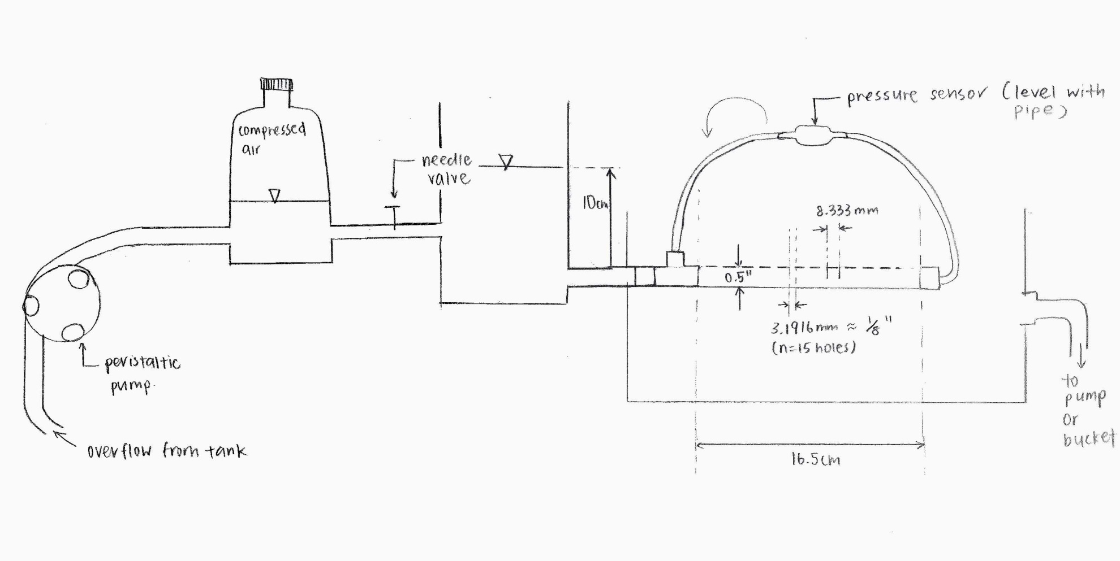
Pressure Measurement Model Sketch

Slide 13
Modeling Challenges
Impracticality of keeping Reynolds Number Constant
  Are we really modeling the conditions we want?
Scaling
  Scaling can distort some elements
    ½” PVC pipe has much thicker wall section than 6”
    Launders can’t handle the high flowrate (relative to size)
  Scaling can really help too!
    Very low detention time means we see behavior easily and readily, not over many hours
    We can build multiple models with less spare $$$

Slide 14
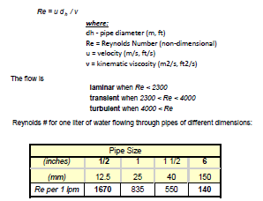
Reynolds Number

Slide 15
Reynolds Number
For Agua Clara Plants, with inflow of 3 liters/second, Re = 140*3*60 = 25,200 (>4000 = turbulent)
  But velocity slows – after 14 of 15 orifices, Re is about 1/15th of that – or about 1680 (less than 2300) = laminar
For our model, max pumping rate is about 3 liters/min; Re = 1670*3 = 5,010 (turbulent)
  But velocity slows – after 5 orifices, Re = 3340 (transitional); after 10, Re = 1670 (<2300) = laminar
Will our model still replicate the full size situation?

Slide 16
Modeling Challenges
We would like clear PVC pipe – but not available with the thin enough walls to mimic the large-scale condition.
Limited time, resources, and modeling expertise limits the number of models and design solutions we can attempt. For example, pump not quite large enough; no rotometer large enough, limited fittings...
Just like real life!

Slide 17
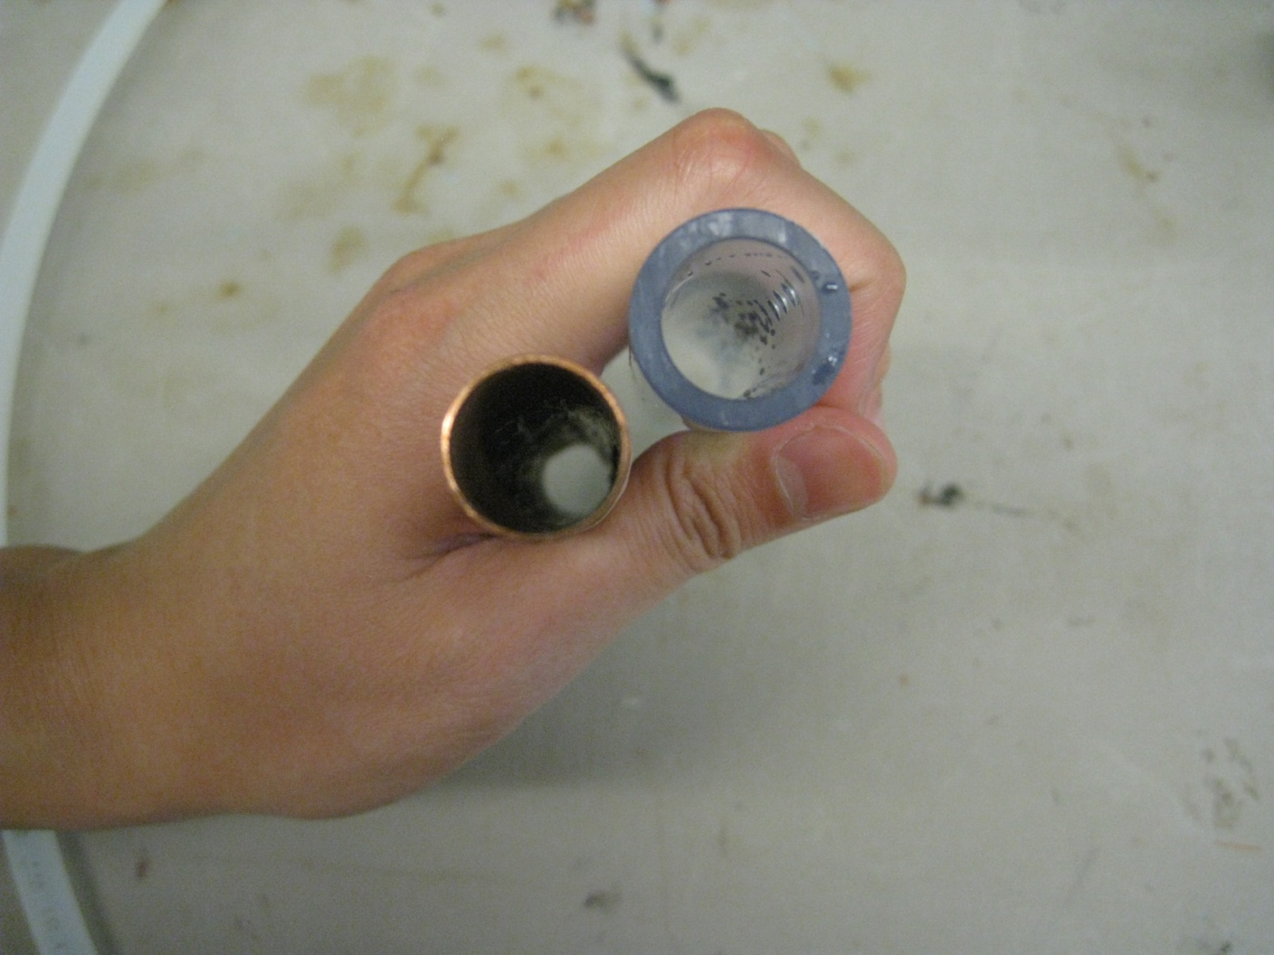
Wall thickness was critical!

Slide 18
Models and Designs
The first model (1-1/2” diameter) needed the full flow of a bathtub spigot to provide adequate flow!
We then built a 3/4 “ diameter pipe model – now we just needed the kitchen sink!
We settled on a ½” diameter modeling size. Why?
  It was the only one we could support with our lab pump
  Smaller models are cheaper and allow multiple setups

Slide 19
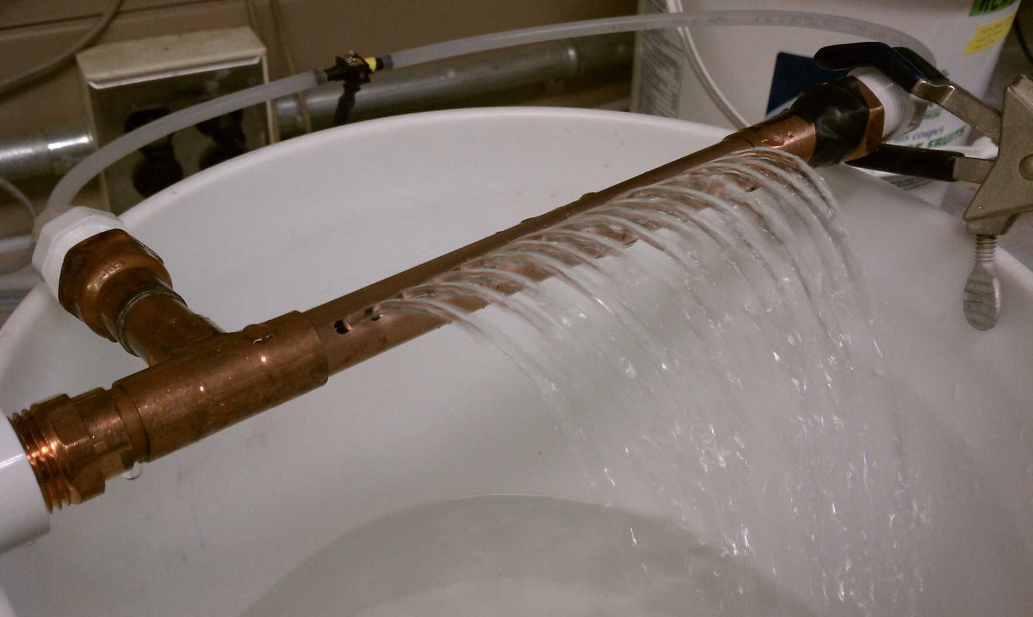
Physical Model (1/2” copper)

Slide 20
Full tank Models
We then built full-tank models for dye testing
  Wanted to confirm cumulative effect of horizontal flow
  Better way to communicate the overall effects
  Wanted to check for other effects
  Wanted way to “prove” alternative solutions
Goals:
  Flexible – to try out different designs
  Simple – to allow clear visualization of issues and solutions

Slide 21
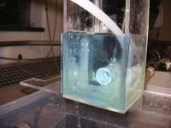
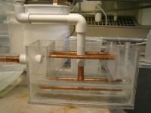
Full Tank Model for Dye Test

Slide 22
CAUTIONS!
Don’t want this solution to create other issues!
Baffles must not reduce ability to remove sludge
Flow patterns should support desire for sludge blanket
Changes in baffle spacing could affect tank circulation?
Re-design of inlet could affect launder design?

Slide 23
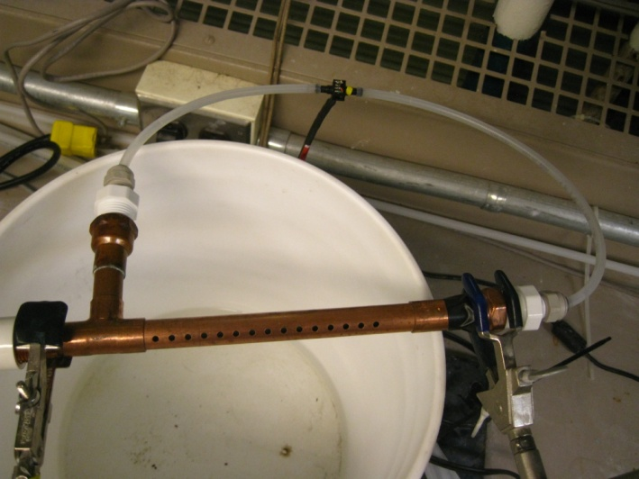
Pressure Sensor Experiment
Objective
  To measure the pressure difference between the first and last port on the model manifold
Set-up
  Pressure sensor was attached to the beginning and end of the model manifold
Pressure Sensor

Slide 24
Pressure Sensor Experiment
Experimental Methodology:
  Ensure that pipe is level with the pressure sensor
  Run the pump to get rid of air bubbles
  Zero the reading on Process Controller
  Run the pump
  Log the pressure readings from the sensor

Slide 25
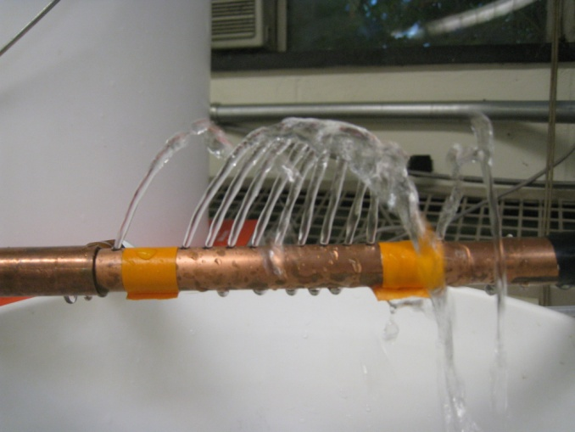
Flow Capture Experiment
Objective
  To measure the difference in flow between the first and last port on the model manifold
  More flow = more pressure
Set-up
  Ports #2,3,13 and 14 were sealed off to isolate the flow from the first and last port

Slide 26
Flow Capture Experiment
Experimental Methodology
  Run the pump to get rid of air bubbles
  For a set period of time, collect the flow from the first and last ports in separate graduated cylinders
  Record the flow collected for each port

Slide 27
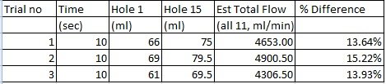
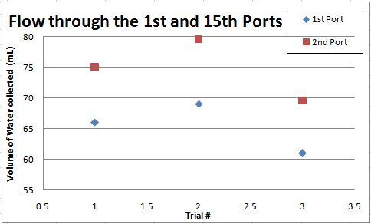
Results
Pressure Sensor:
  Data was too noisy for any meaningful analysis
Flow Collection:
  Flow from the last port was consistently higher (about 13 to 15% higher)
  Expected increase in flow from the last port was 18%
15th Port

Slide 28
Conclusion
Pressure recovery is occurring at the end of the inlet manifold
  As expected, more flow is collected at the end of the manifold
  Since more flow = greater pressure, pressure recovery must have occurred

Slide 29
Dye Testing
Objective
  To visualize the effect of the horizontal flow component from a model manifold submerged in a model of a sedimentation tank
Set-up and Methodology
  The model manifolds were removable, so the dye test experiments were repeated with:
    A scaled down model of the design manifold (Original)
    The original model manifold with baffles
    A model manifold with tapered spacing with baffles
    A center-fed manifold with baffles

Slide 30
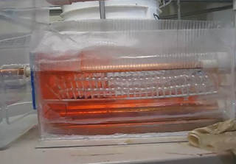
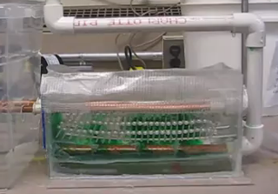
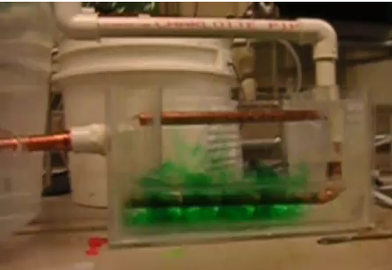
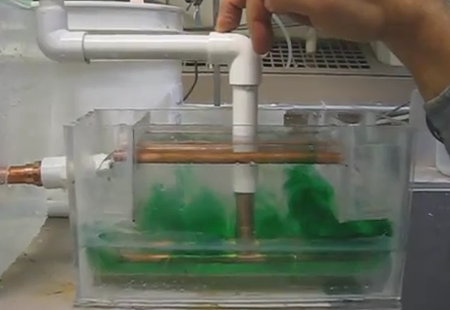
Results
ORIGINAL PIPE
ORIGINAL PIPE W/ BAFFLES
TAPERED SPACING PIPE W/ BAFFLES
CENTER-FED PIPE W/ BAFFLES

Slide 31
Results: Original Pipe
http://www.youtube.com/user/happywaterdroplet#p/u/3/I3dmUofYeuc

Slide 32
Conclusion
The circular flow in the tank is obvious
The high concentration of dye at the end of the model manifold is indicative of a strong horizontal velocity of the water exiting from the ports

Slide 33
Results: Original Pipe with Baffles
http://www.youtube.com/user/happywaterdroplet#p/a/u/2/qd0OhYshVYA

Slide 34
Conclusion
The baffles have helped to distribute the flow more evenly

Slide 35
Results: Tapered Spacing with Baffles
http://www.youtube.com/user/happywaterdroplet

Slide 36
Conclusion
Still more concentration of dye at the end
Experimental problem?
Problem with our calculations for hole spacing?

Slide 37
Results: Center-Fed Pipe with Baffles
http://www.youtube.com/user/happywaterdroplet#p/a/u/1/T3kD9CgT9zc

Slide 38
Conclusion
The dye is still more concentrated at the ends
Dye more concentrated on the right side
  Experimental problem?

Slide 39
Improvements to our experiments
Mostly preliminary testing of our proposed solutions
Reliability of results
  For example, ensuring level set up
  Repeatability
Improvements to models
  Tighter baffles
  Better launders

Slide 40
Next Steps?
Retrofit existing plants
  Specifically Agalteca that suffers from the “floating floc” problem
Real world application considerations:
  Cost
  Constructability
  Material availability
Agua Clara Design Tool considerations:
  Could someone code this design?

Slide 41
Things to consider as we redesign:
Baffles to impede the horizontal flow and cause smaller sections of the sed tank to have uniform rise of flocculated water
  After each port? Grouping multiple ports?
  Built into the plant itself or separate?
Tapered spacing of ports
Tapered sizing of the ports
Flow
Flow

Slide 42
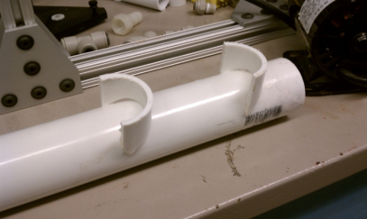
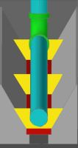
Baffles
Baffles after each port?
Baffles after several ports?

Slide 43
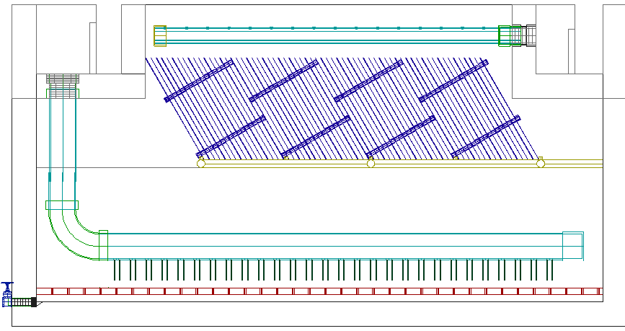
Jets (same size as original ports)
Jets!
Notes:
CON: it does nothing for pressure recovery
PRO: It gets rid of horizontal.
The smaller the orifice, the more it is directed downward. Smaller holes, but will this break up floc.

Slide 44
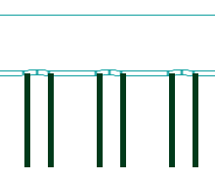
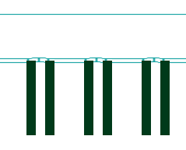
Jets (smaller sized ports)
This design results in the head loss through the orifice dominating → little difference in pressure from first to last port
Jets to match the original size of ports
Jets that are smaller than the original ports
Notes:
*more head loss through the orifice, very little pressure differential from first to last (b/c horizontal negligible)
Same size would allow straightening, smaller would help with pressure recovery

Slide 45
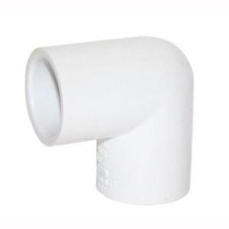
Elbows
Flow
Flow
Notes:
PRO: All the velocity is going into the tube instead of across the top of the hole. It creates a pitot tube, this relates the water to the EGL instead of the HGL, which is more constant.
CON: vena contracta effects, you still have an energy created by forcing the flow to turn the corner. Eliminated pressure recovery but energy dissipation issue. Manufacturing and cost.

Slide 46
Baffle before the port
Flow
\
\
\
\
\
\
\
Notes:
PRO: somewhat easy to manufacture, breaks up flow so it goes over and down. The flow is no longer seeing the horizontal component of flow b/c it wraps around.
CON: unknown flow patters (?) If these are big compared to the pipe, the velocity will have to increase (same Q, smaller A) → so is there energy dissipation?

Slide 47
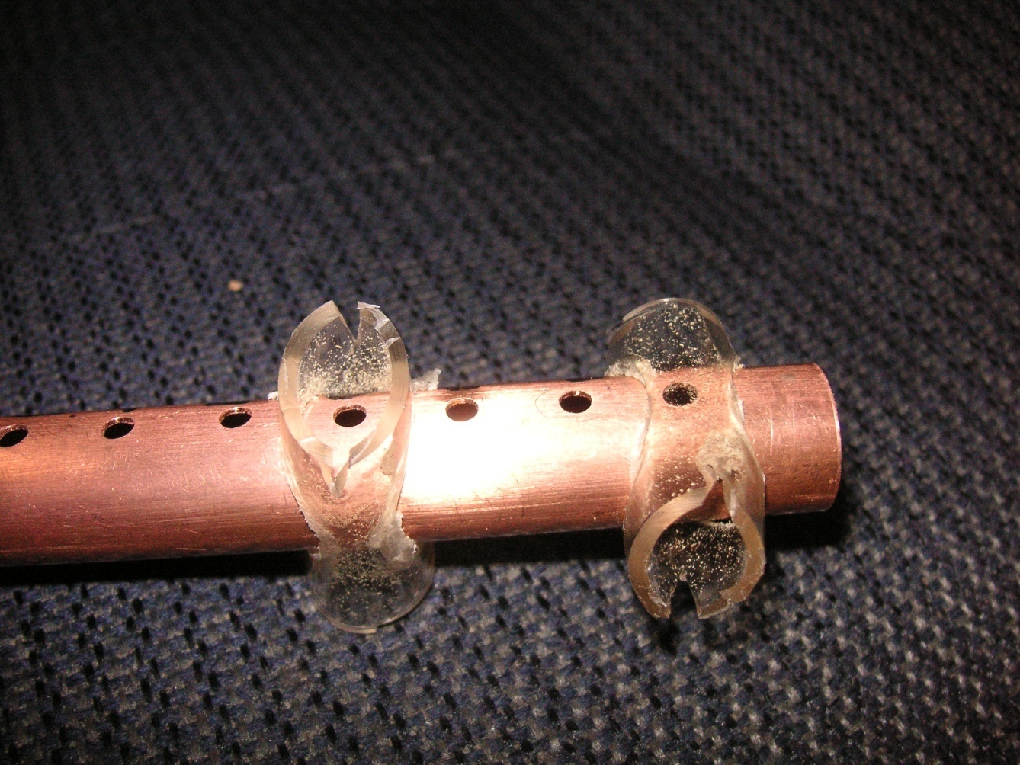
Splitting the flow at every port
(1)
(2)
Fabricated by Steve!
TWO OPTIONS:
The “sleeve” serves as a support and baffle
The sleeve redirects the water to flow down and out
Notes:
PRO: straightening the direction of the flow, Manifold can rest on the pipes beneath it as they rest on the “V” of the sed tank bottom
CON: by itself, it doesn’t do anything for pressure recovery, energy dissipation b/c it’s still taking a 90 turn ☹

Slide 48
Splitting the flow into 2
Q
½ Q
Q
½ Q
½ Q
½ Q
Notes:
PRO: less velocity, less pressure recovery, RIGHT: single channel, get sludge out more easily, reduce launder effect, build channel with less material
CON: have to redesign agua clara (one on left is easier to implement → retrofit existing)

Slide 49
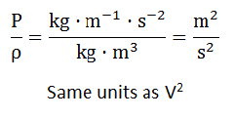

Why halve the flow?
P_{final} & P_{o} = “pressure term” = P/ρ
½ Q → ½ V₀
  Using Bernoulli’s, we know that
  By halving V_{o}, we reduce the velocity term by ¼ (½²)
An example:
V₀ = 2 m/s, V₀² = 4 m²/s²
P will vary by V² as: V = 2 → V = 0
P_{final} = P₀ + 4
V_{o} = 1 m/s, V_{o}² = 1 m²/s²
P will vary by V² as: V = 1 → V = 0
P_{final} = P₀ + 1
Notes:
We will still have pressure recovery but it will be much less of a differential between the first and last port

Slide 50
Energy Dissipation Rate, ε
Cost
Constructability
Codability
Pressure Recovery
SOLUTION
Horizontal Velocity Component
Notes:
Remember that Monroe wants a velocity less than 0.17 m/s

Slide 51
Questions?

Slide 52
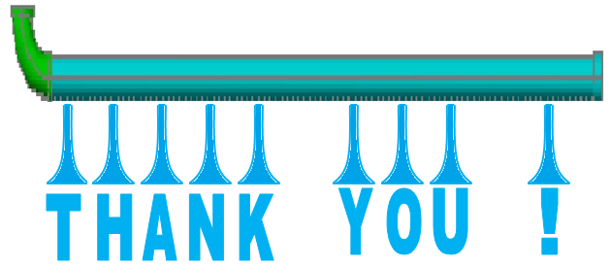

Slide 53
Appendix

Slide 54
Why Model the Tee Solution?
Three problems to solve:
  Stop undesirable circulation flows
  Reduce total velocity (V_{x}² + V_{y}² = V_{T}²) to minimize floc build-up
  Produce more even distribution
As opposed to other single-pipe solutions considered, only the Tee model reduces V_{x} at first hole --- so only the tee model can keep V_{T} below the critical velocity used to select the manifold pipe size

Slide 55
Is the TEE the only solution?
Other solutions:
Two inlet branches
Larger (8” or greater) manifold
Other design solutions?
How to decide?
Lowest cost/simplest fabrication
Retrofit or new?
  For retrofit, not easy to re-orient
  For new, more opportunities
Other benefits to Center Feed?
  Reduce sludge draw length (but two drains)
  Single channel (but need center support)
  More balanced launder flow?

