Slide 1
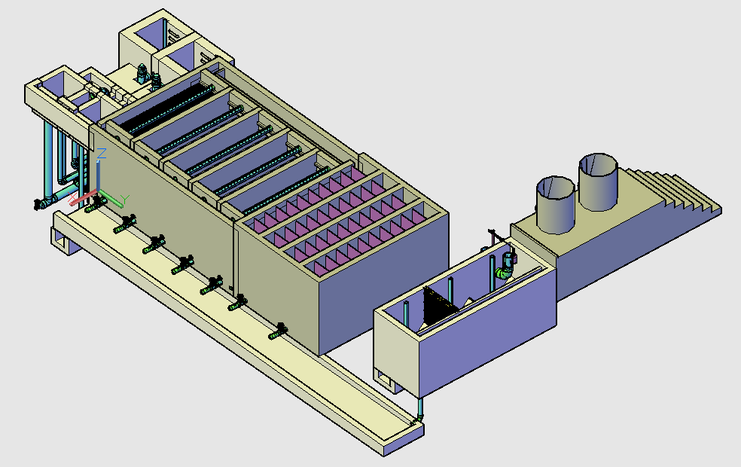
Sedimentation Tank: Tank where flocs settle out of the water
Flocculator: Tank with a series of 180° turns that generate turbulence that causes collisions between suspended particles. The particles stick together to form flocs if the chemical coagulant dose is correct.
Entrance Channel: The means by which clarified water goes to the filters
Chemical Storage Tanks
Stacked Rapid Sand Filtration: Process that uses sand filtration to remove small flocs that were not captured by the sedimentation tank. The filter contains several inlet and outlet manifolds to maximize the amount the amount of water filtered per area.
Entrance Tank: Water enters the plant here
Exit Channel: The means by which the clarified water goes to the filters
Sludge Drain: Allows the operator to remove settled particles from the entrance and sedimentation tanks

Slide 2
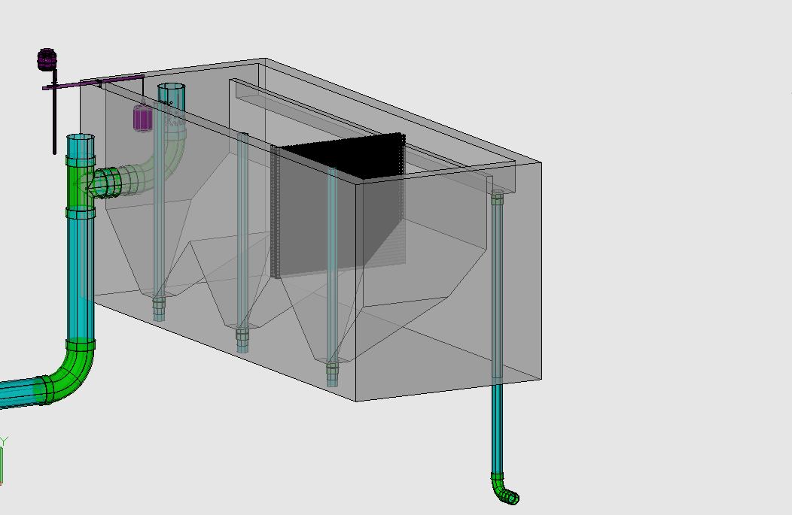
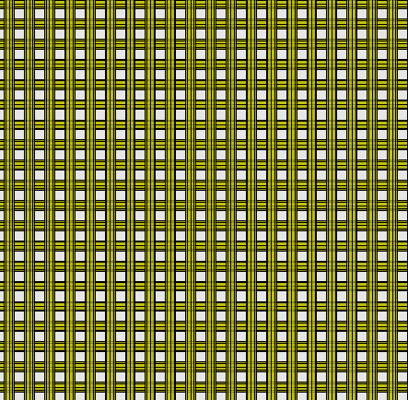
Linear Flow Orifice Meter: Maintains a linear relationship between water height in the entrance tank and flow in the plant
Overflow Weir
Water enters the plant
Trash Rack: Prevents debris from coming into the plant.
To Flocculator
Chemical Dose Controller: Regulates the amount of alum (aluminum sulfate) that mixes with the raw water to ensure proper floc formation
Hopper: Collects debris and grit to prevent it from entering the plant (primary sedimentation)

Slide 3
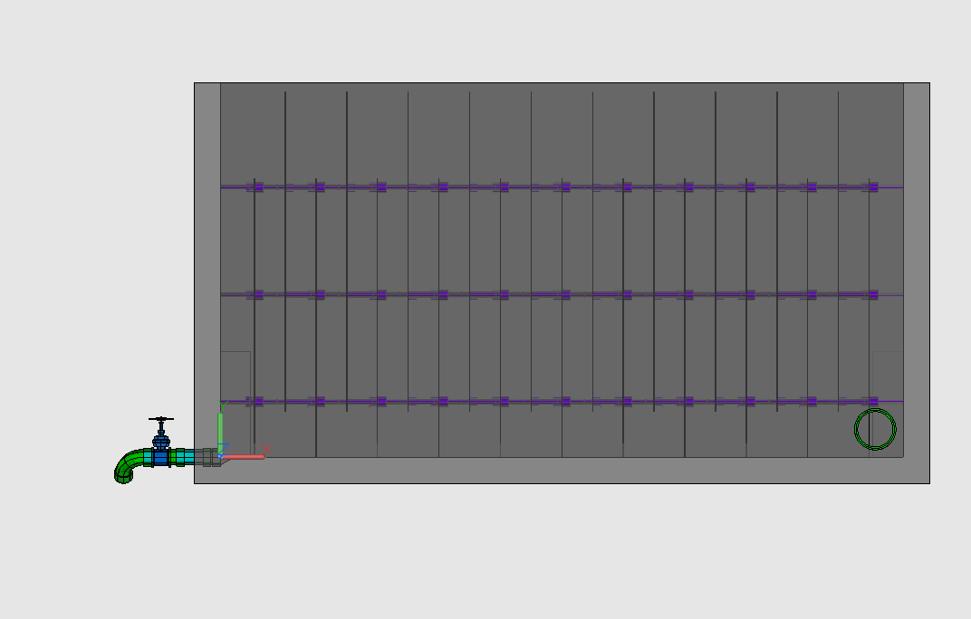
Water Flowing through Flocculator
Drain Valve
Rapid Mix Pipe: Ensures chemical coagulant is distributed evenly throughout water. Brings water from Entrance Tank to Flocculator

Slide 4
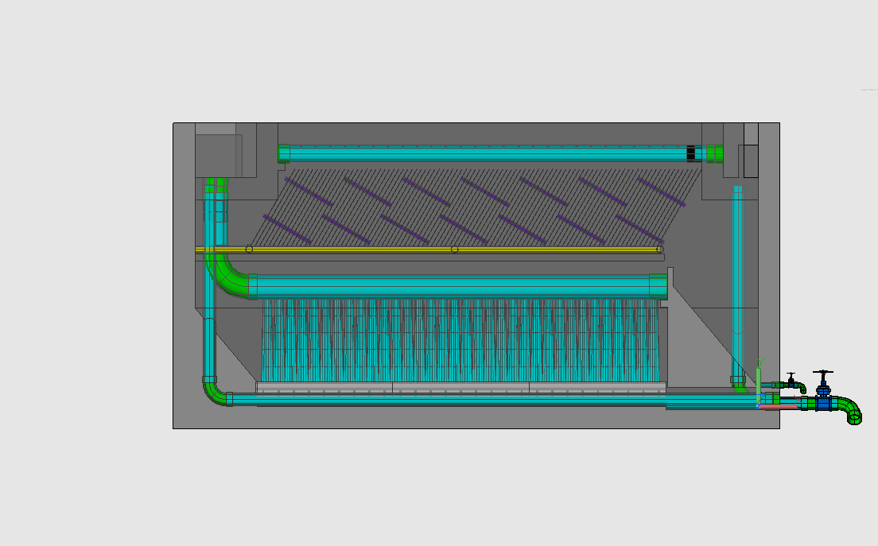
Entrance Channel: Transfers flocculated water from the floc tank to the sedimentation tank inlet manifold
Launder: A pipe with many holes that removes clarified water from the top of the sedimentation tank. The launder empties into the sedimentation tank exit channel.
Exit Channel: The means by which clarified water goes to the filters
Water from Flocculator
To Filter
Sedimentation Inlet Manifold: Distributes flocculated water evenly throughout the sedimentation tank.
Plate Settlers: Reduces the distance a particle has to fall before it is ‘captured,’ or has to fall before it hits a solid surface
Diffusers: Prevents horizontal velocities in sedimentation tank
Sludge Drain: Allows operator to remove settled flocs from the tank. Semi-circular trough shape allows for floc re-suspension from diffuser jet velocity
Floc Weir/Hopper: Controls the height of the floc blanket

Slide 5
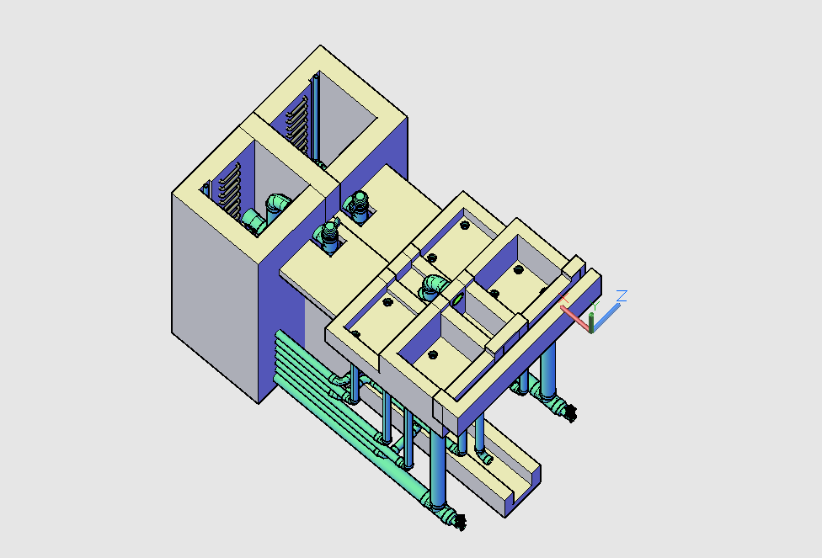
Stacked Rapid Sand Filtration: Process that uses sand filtration to remove small flocs that were not captured by the sedimentation tank. The filter contains several inlet and outlet manifolds to maximize the amount of water filtered per area
Filter Entrance Tank: Water flows from here into a series of pipes that distributes clarified water evenly into the stacked sand bed
From Sedimentation Tanks
Water flows out of the filter
Filtration Exit Tank: Filtered water is removed by a series of pipes from the filter and is sent to disinfection and distribution
Water flows into the filter

