Slide 1
Kuali Coeus Workflow
Dan Dwyer Cornell University, Lisa Oliva Michigan State University , Chris Denne Colorado State University

Slide 2
Agenda
KC Routing Requirements
KC Proposal Routing Implementation
KC Workflow Technical Overview

Slide 3
KC ROUTING REQUIREMENTS

Slide 4
Workflow and Routing
Workflow - The movement of a document around an organization for purposes including sign-off, notification and execution of actions.
Routing – The path by which a document will travel to its destination.
Research administration processes involve researchers, departments, central administration offices and review committees.

Slide 5
Proposal Routing Requirements
Proposals are routed for:
Researcher certifications
Department and college approvals
Special reviews
Delivery to sponsored programs office

Slide 6
Proposal Routing Challenges
Multiple department approval due to collaboration or joint appointment
Variability in rules by unit, sponsor or type
Time constraints due to hard deadlines
Who does rejected proposal return to?
What data can change without re-routing?
Workgroup coverage and proxy approvals at many steps

Slide 7
Award Routing Requirements
Ability to route different parts of the Award independently – Award, Time & Money, Award Budget – while still sequencing the Award as a combined entity
Ability to allow unit administrators/PIs to create and/or modify budget and route to central office for approval
Ability to blanket approve Award documents for internal actions

Slide 8
Award Routing Challenges
Generally simpler routing rules than proposal routing
An award may be routed many times during its lifecycle (e.g. changes to PI or CoPI, rebudgeting between budget categories; new funding for subsequent periods, changes in award terms & conditions or reporting requirements.)

Slide 9
Protocol Routing Requirements
Ability to route from researcher to IRB administrator with different rules for initial protocol verses revisions, amendments and renewals
Ability to route from IRB Administrator to Reviewer and back
Ability to route many correspondence types from IRB administrator to researcher

Slide 10
Protocol Routing Challenges
Generally simpler routing rules the proposal routing
However, a protocol may be routed many times during its lifecycle from researcher to IRB administrator to reviewer.
Interest in routing for some special reviews prior to or in parallel to routing to compliance office
Routing for review may involve some confidentiality issues not found with proposals

Slide 11
KC Workflow Analysis
Develop use case that represents most common scenarios
Check use case among partner institutions
Test multiple scenarios during quality assurance testing
Recognition that implementing institutions will modify according to local needs – configurability is critical

Slide 12
KC ROUTING IMPLEMENTATION

Slide 13
Demonstrating Workflow
Workflow use case – where it all began
Proposal search – initiating a detailed search
Opening a proposal
Submitting a proposal into workflow
Approval process– normal case
Approval process – submission to sponsor before workflow has completed
Disapproving a proposal

Slide 14
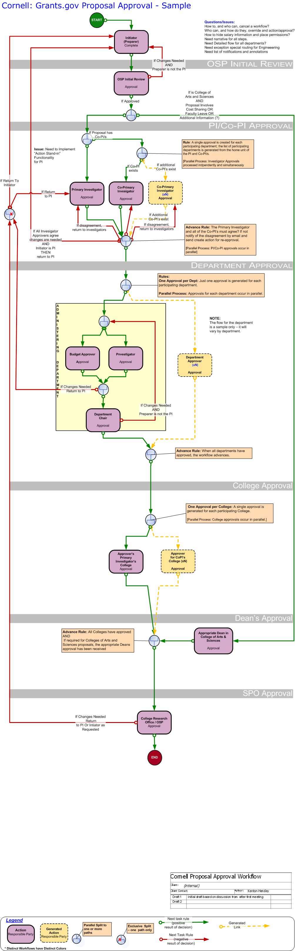
Workflow Use Case - Proposal

Slide 15
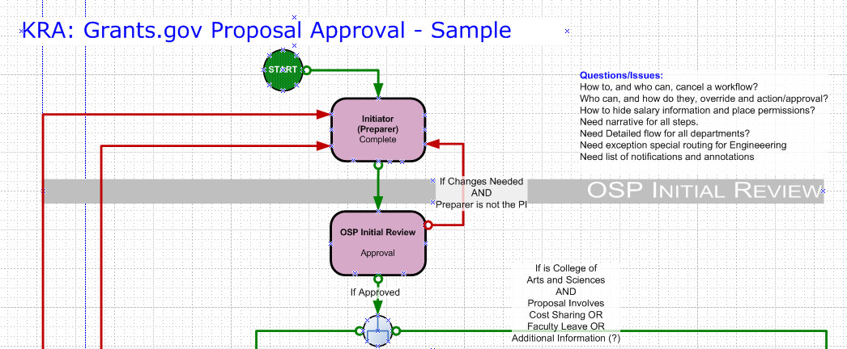
Workflow Use Case - Initiation

Slide 16
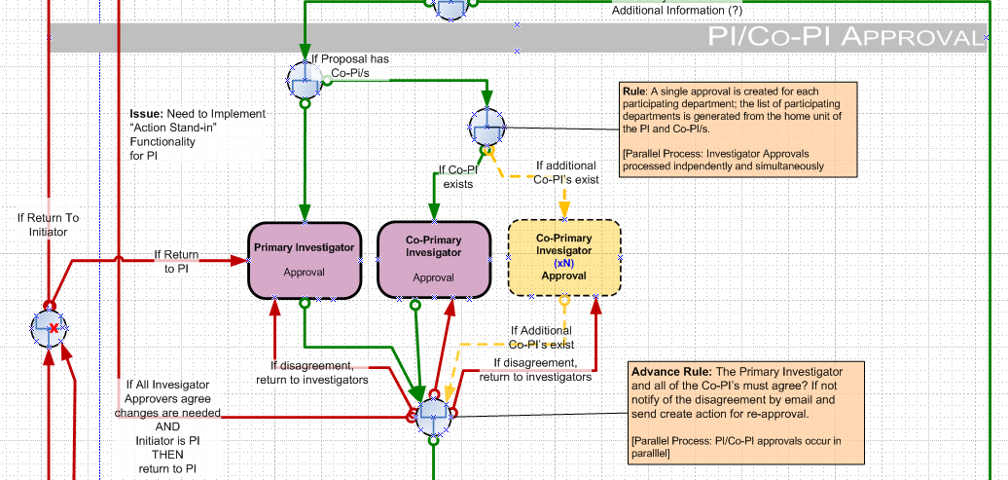
Workflow Use Case - Researcher

Slide 17
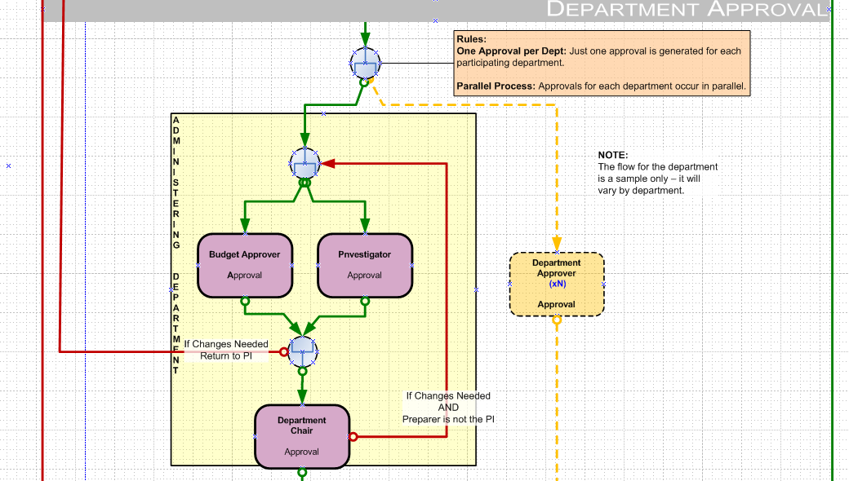
Workflow Use Case - Department

Slide 18
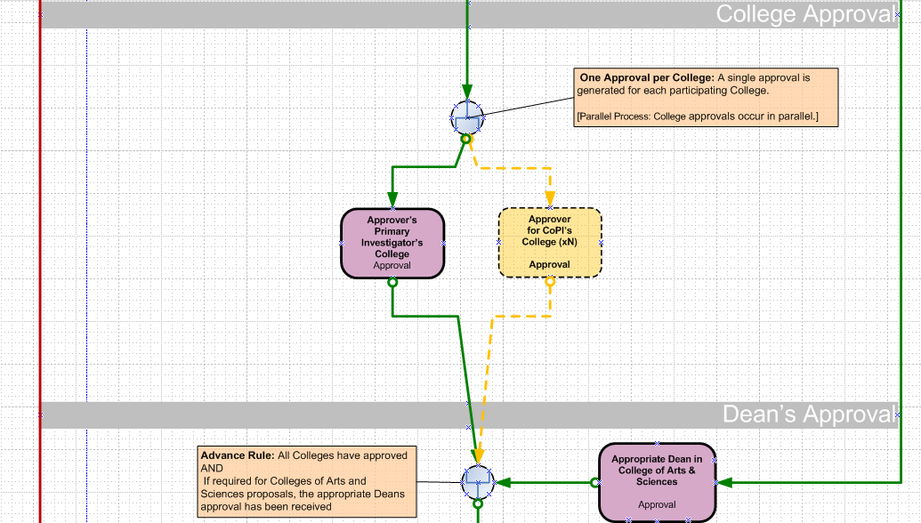
Workflow Use Case - College

Slide 19
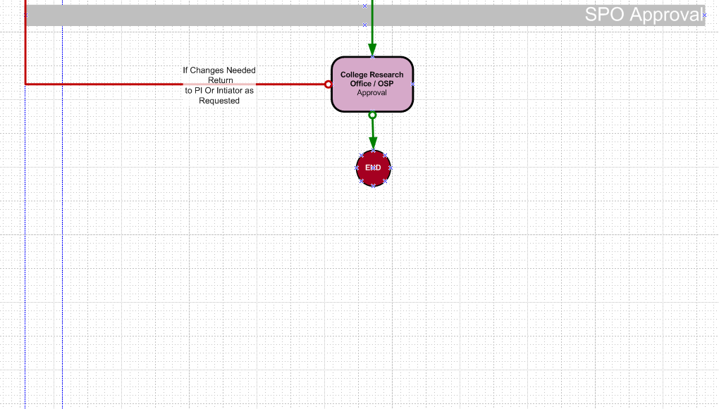
Workflow Use Case - Completion

Slide 20
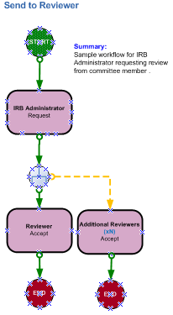
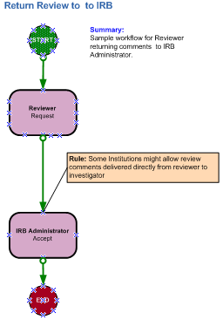
Workflow Use Case – IRB Review

Slide 21
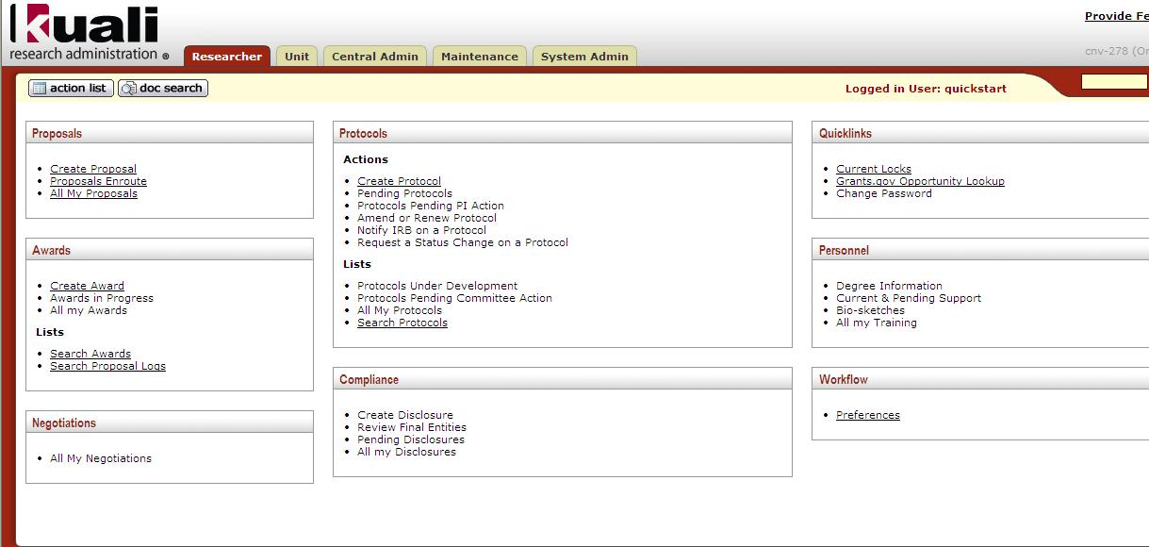
Searching for an existing Proposal

Slide 22
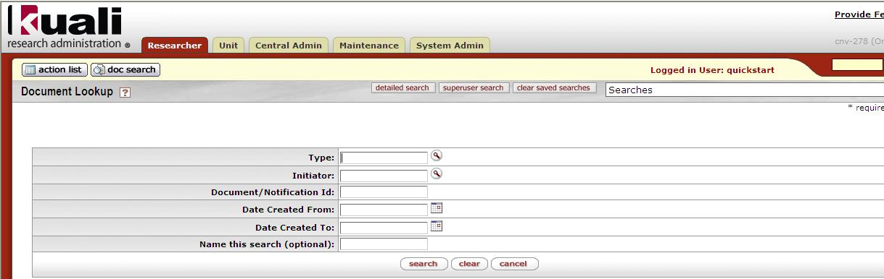
Initiating a detailed search

Slide 23
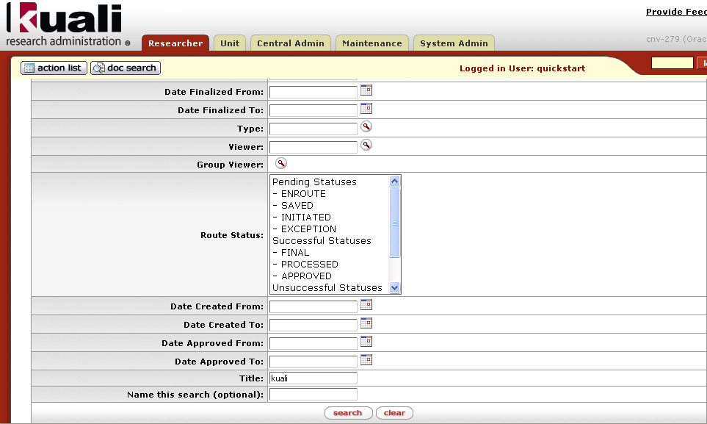
Detailed search

Slide 24
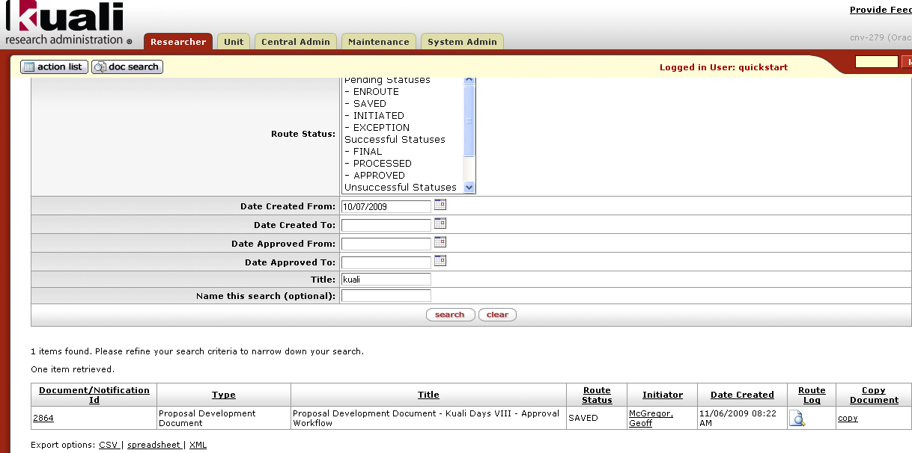
Detailed search results

Slide 25
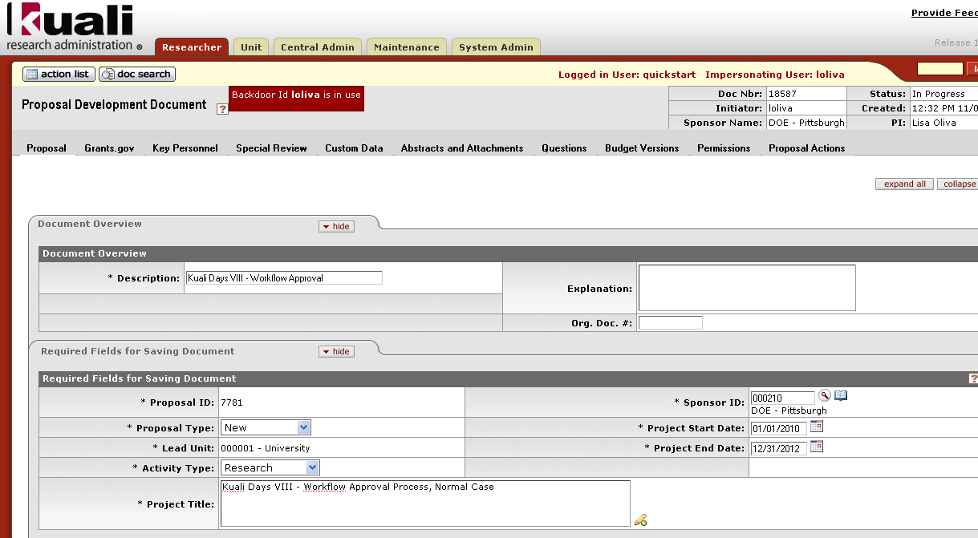
Opening the Proposal

Slide 26
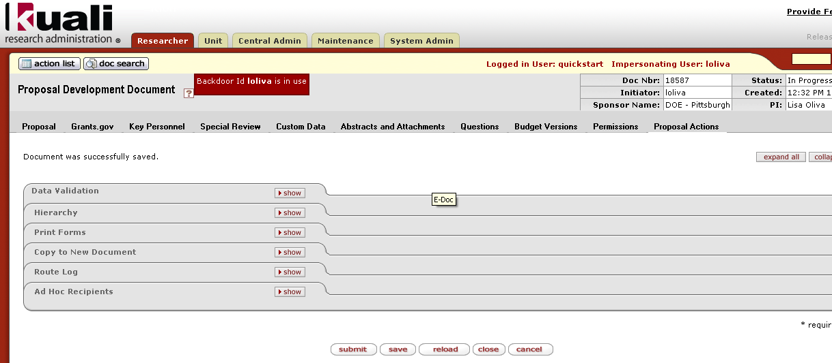
Submitting a proposal into Workflow

Slide 27
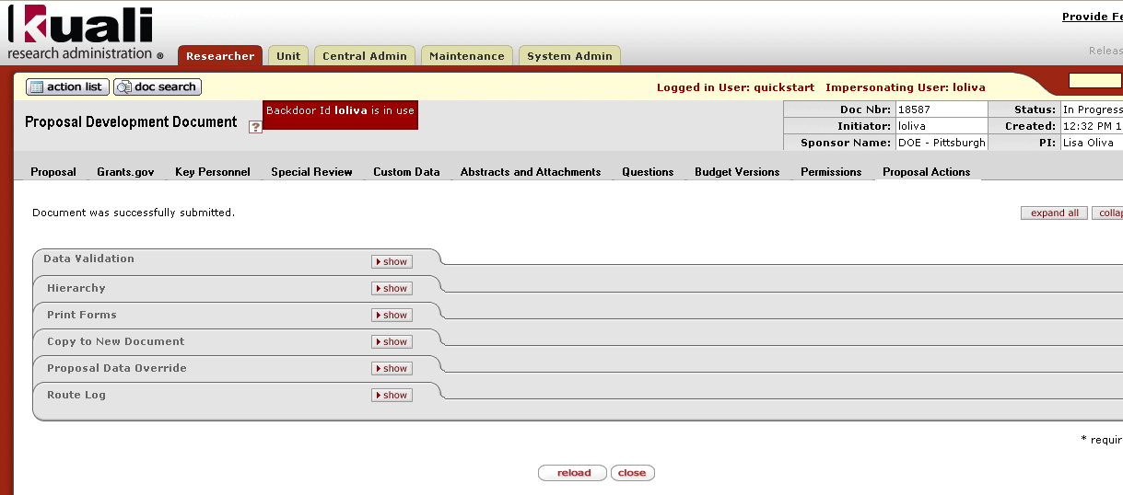
Proposal – submitted into Workflow

Slide 28
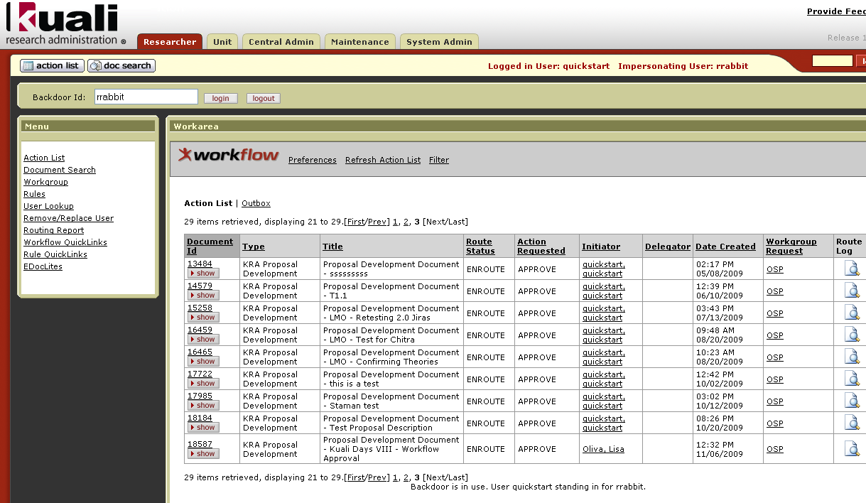
First approver – action list

Slide 29
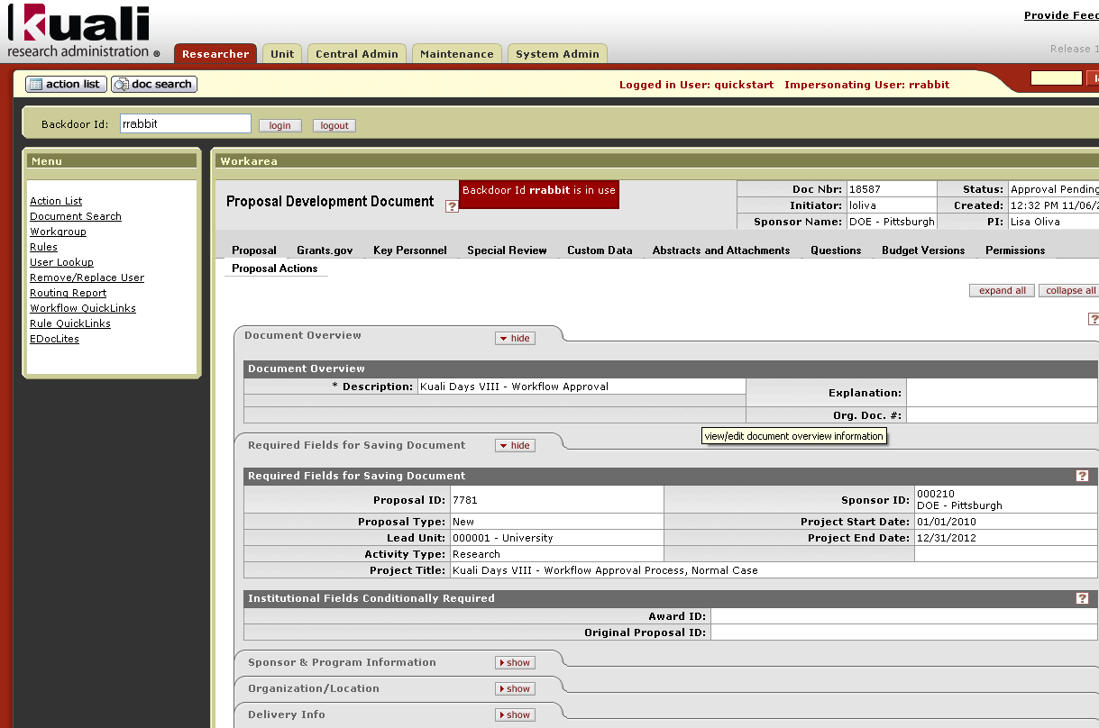
First approver – open proposal to review

Slide 30
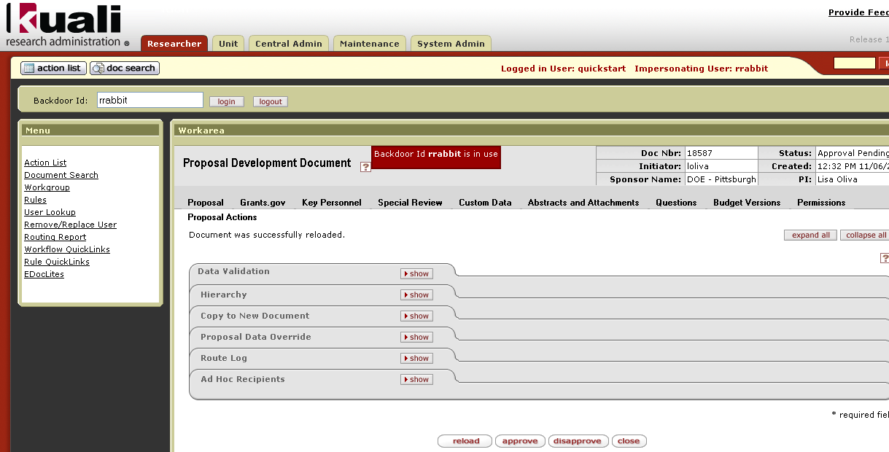
First Approval

Slide 31
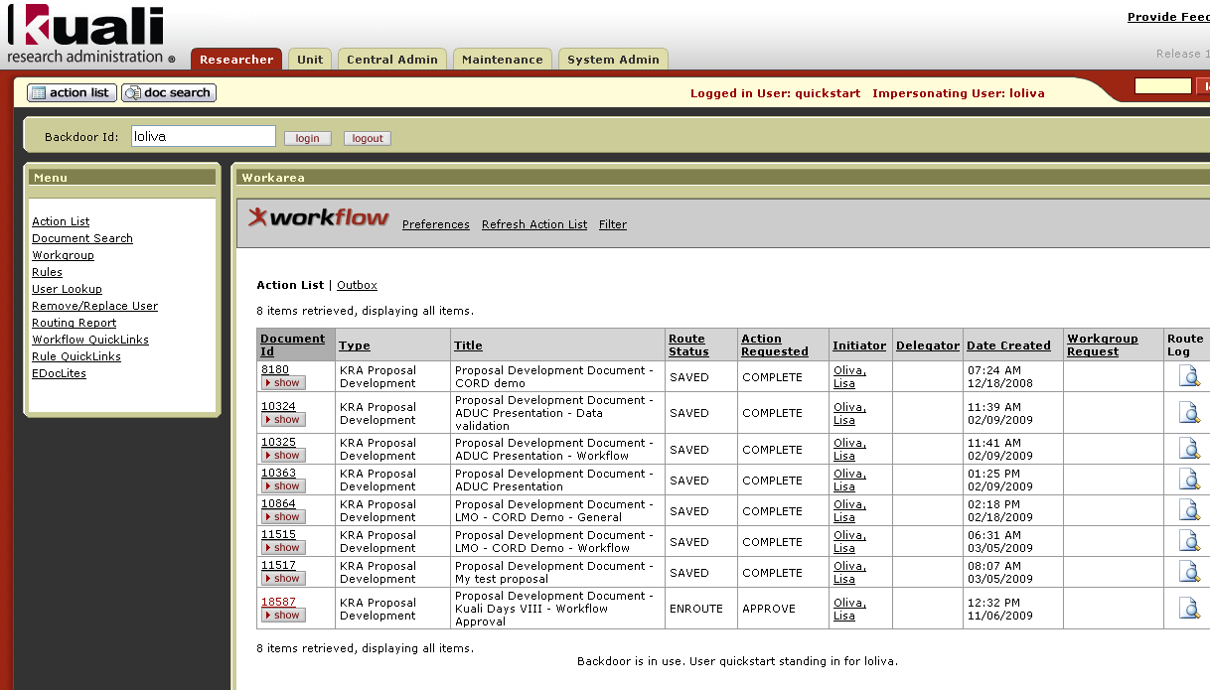
Second Approver – Principal Investigator

Slide 32
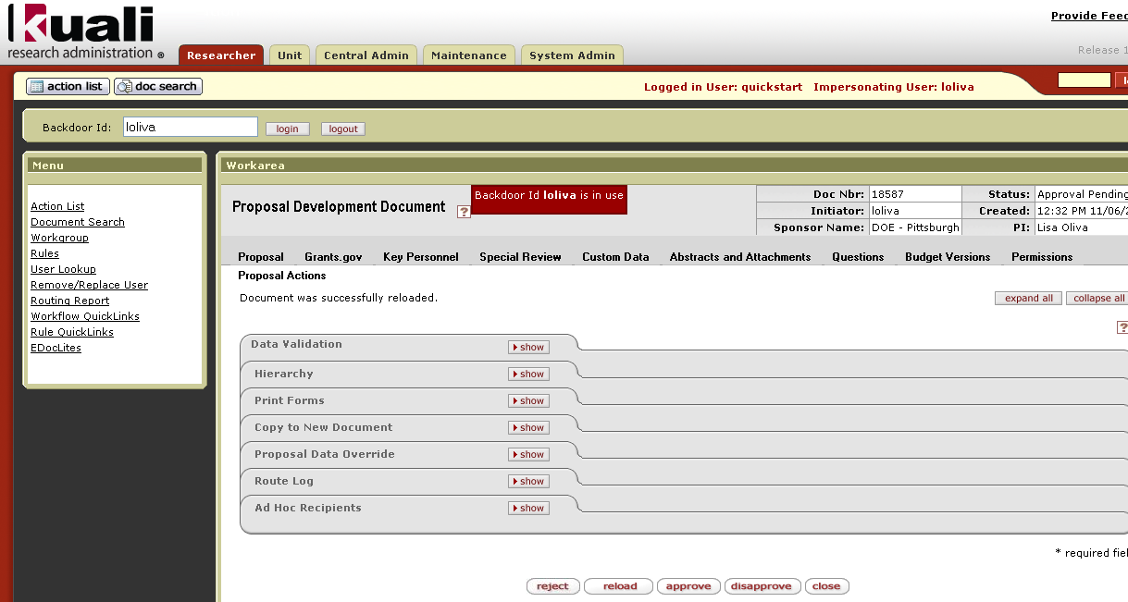
Second Approval Enacted

Slide 33
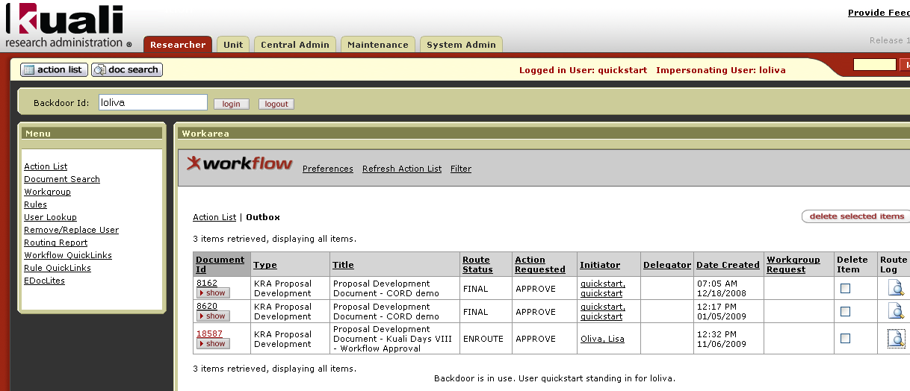
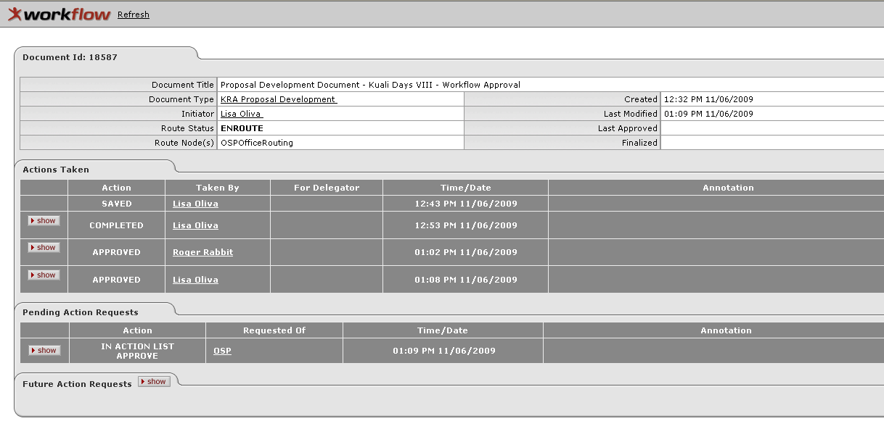
Outbox & Route Log

Slide 34
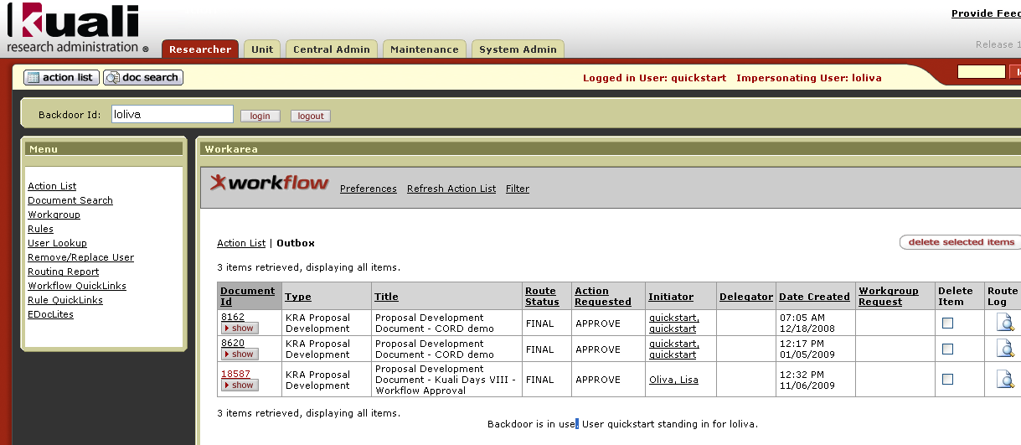
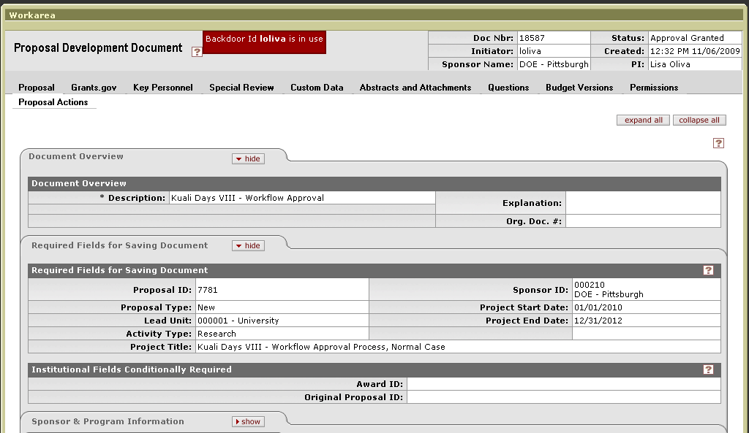
Fully Approved

Slide 35
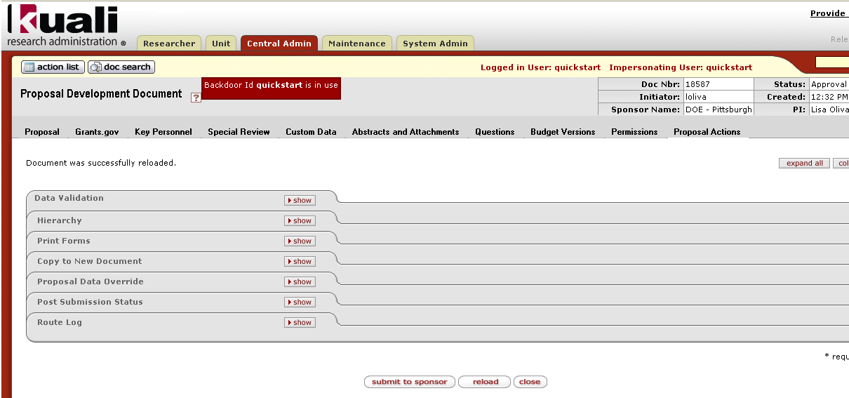
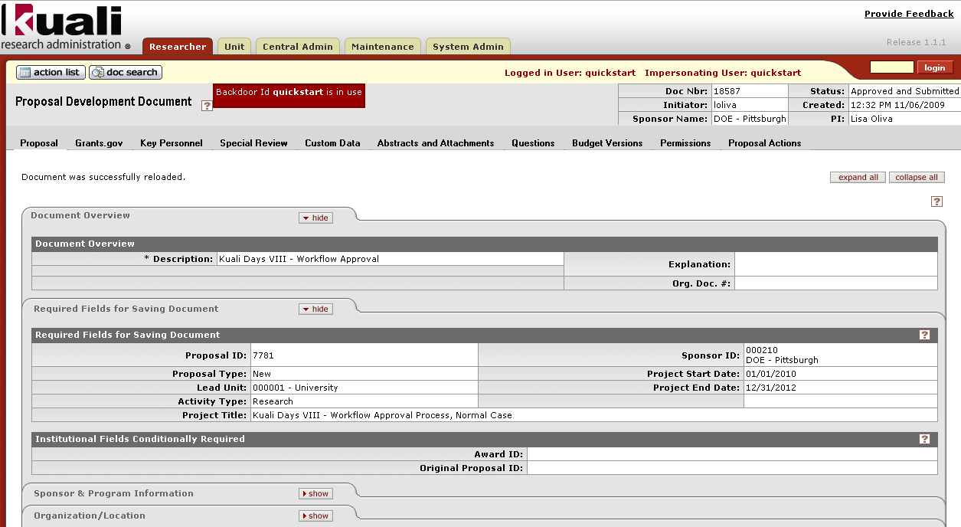
Submit to Sponsor

Slide 36
Approval – submitting to sponsor before workflow completes
Proposals can be submitted to the Sponsor before Workflow has completed
Proposal must have entered workflow before it can be submitted to the sponsor
Workflow continues even after submission to the sponsor (approvals are still necessary!) ☺

Slide 37
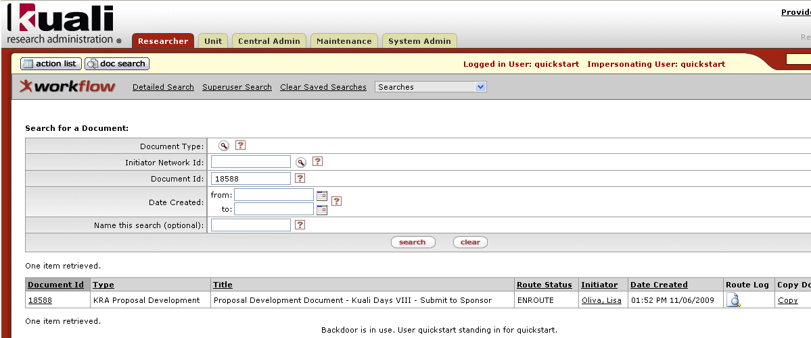
Approval – submitting to sponsor before workflow completes

Slide 38
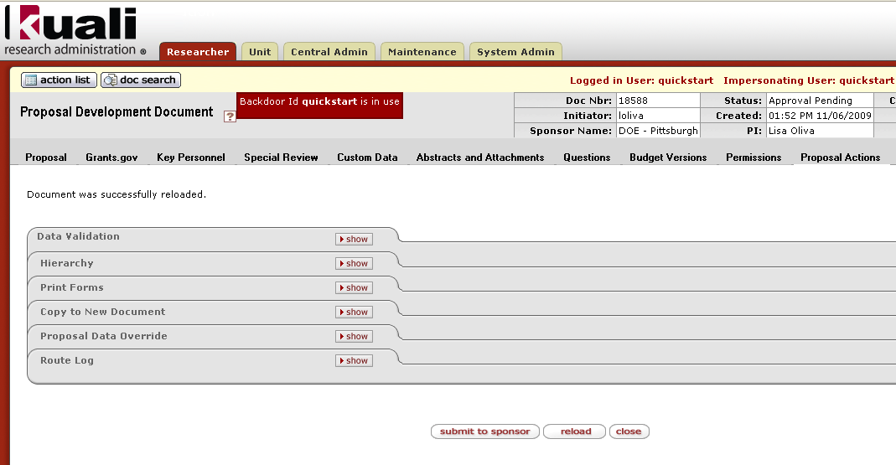
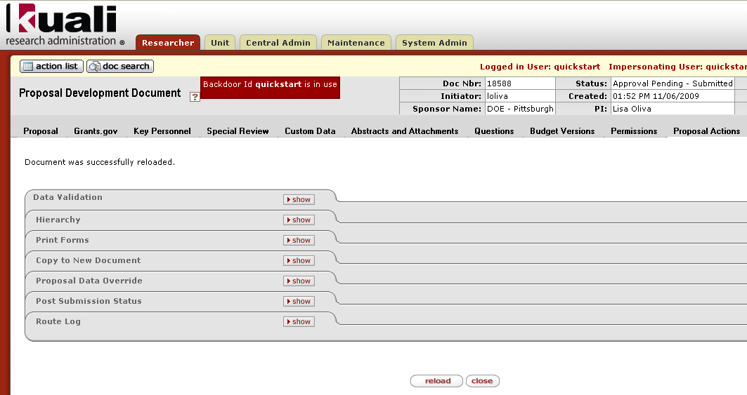
Submit to Sponsor action

Slide 39
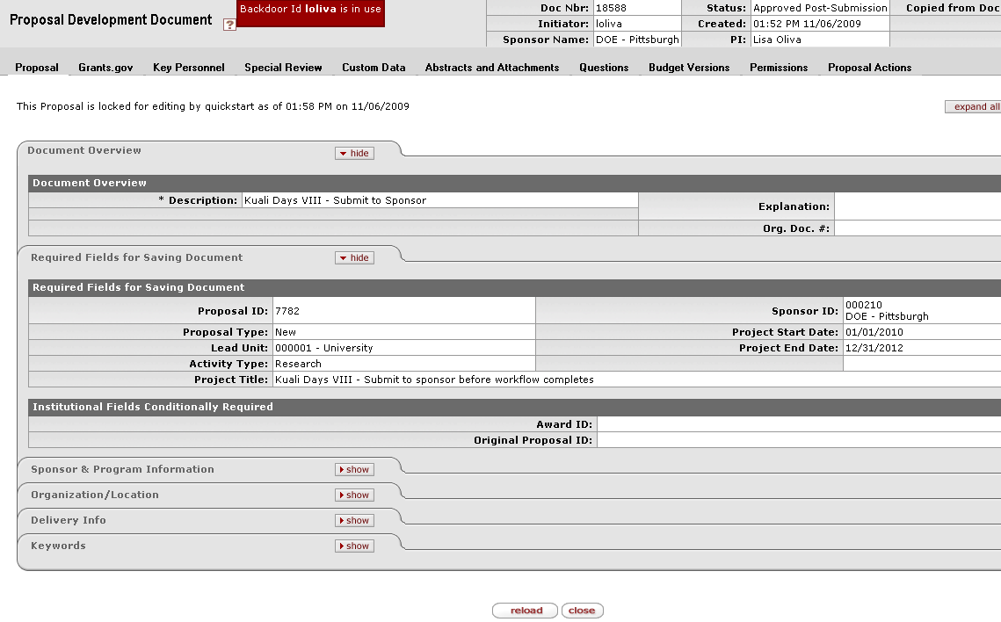
Approved Post-Submission

Slide 40
Disapproving a proposal
User disapproving the document must provide a comment
Principal Investigator receives a acknowledgement request
All individuals who have previously approved the proposal receive a notification that the proposal was disapproved
Cancels the document

Slide 41
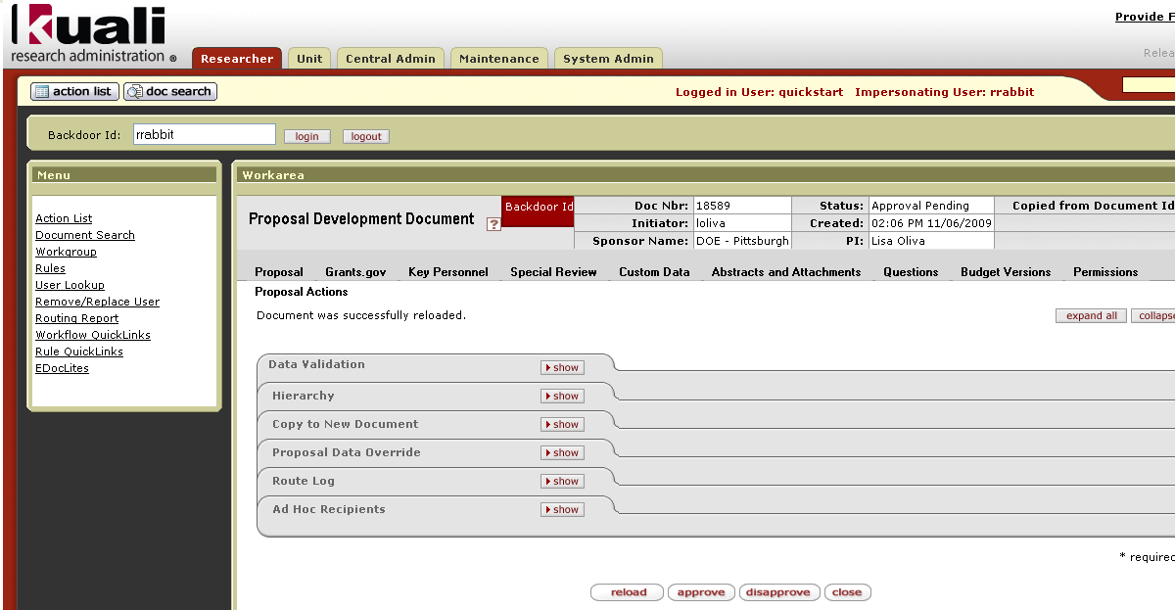
Disapproving a Proposal

Slide 42
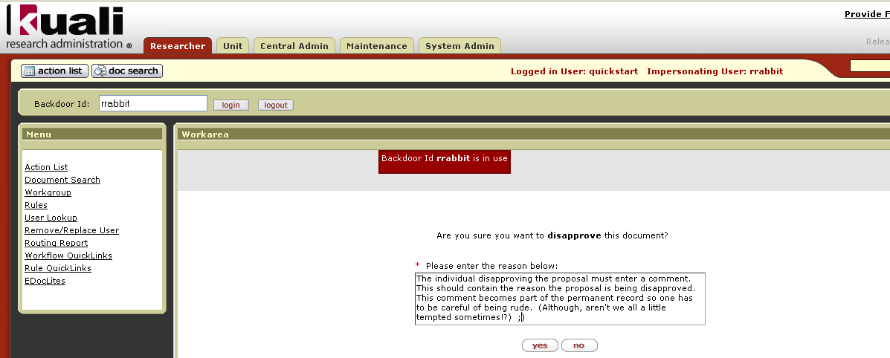
Disapproving a Proposal

Slide 43

Action List shows Disapproval

Slide 44
Returning the proposal to the initiator
Being developed in this release (e.g. unable to demonstrate it today)
Allows the initiator to correct any errors and resubmit the document into Workflow
Records entire route log - initial path, return, through completion

Slide 45
KC WORKFLOW TECHNICAL OVERVIEW

Slide 46
KC Workflow Technical Overview
Kuali Enterprise Workflow (KEW) Overview
KEW Configuration
Coeus/KC Workflow Functional Parity

Slide 47
Kuali Enterprise Workflow Overview
KEW is a component of Kuali Rice
Rice is Kuali based enterprise class middleware for Rapid Application Development
Provides consistent Workflow API & functionality across applications

Slide 48
Kuali Enterprise Workflow Overview
Workflow as a Service
Embedded/External
Configurable Elements of a Workflow in KEW
  Route Nodes
  Rules
  Roles
  Actions (Approval, Acknowledgement, FYI)
Integrated into KNS Documents & KIM
Accessible from existing applications
UI
  Action List
  Document Search
  Route Log
Notes:
Will start with UI – blaze through since they’ve seen this earlier in the presentation

Slide 49
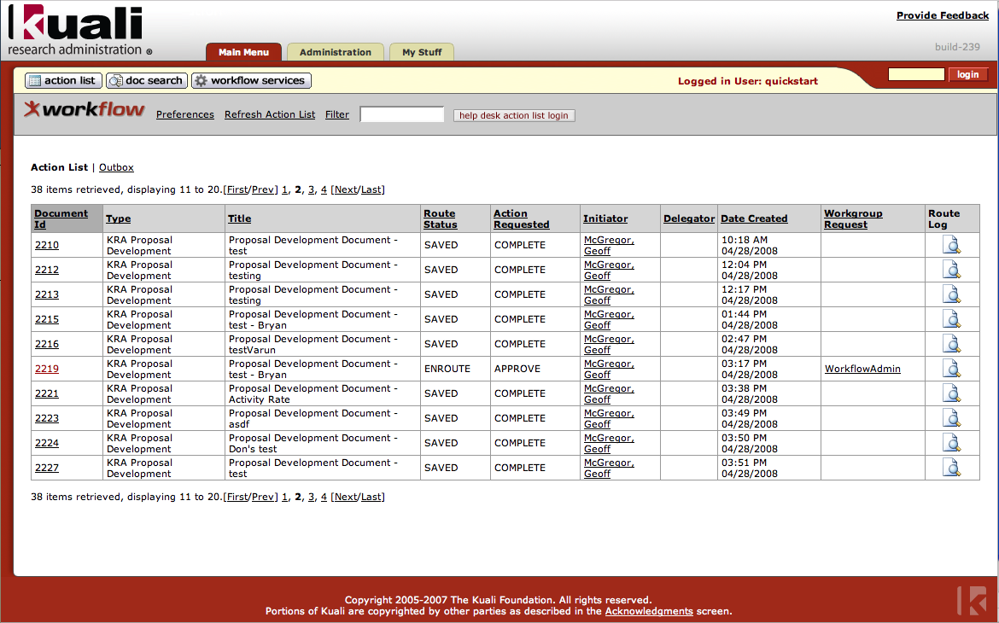
Action List

Slide 50
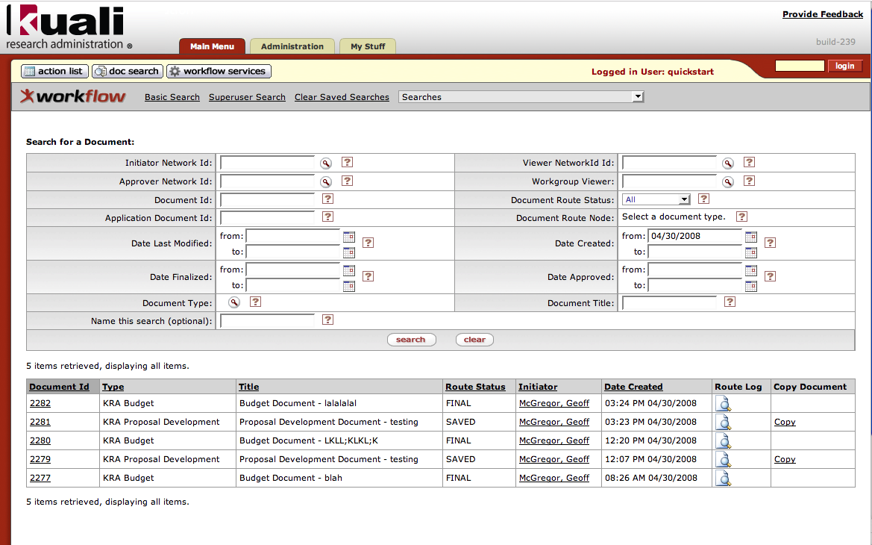
Document Search

Slide 51
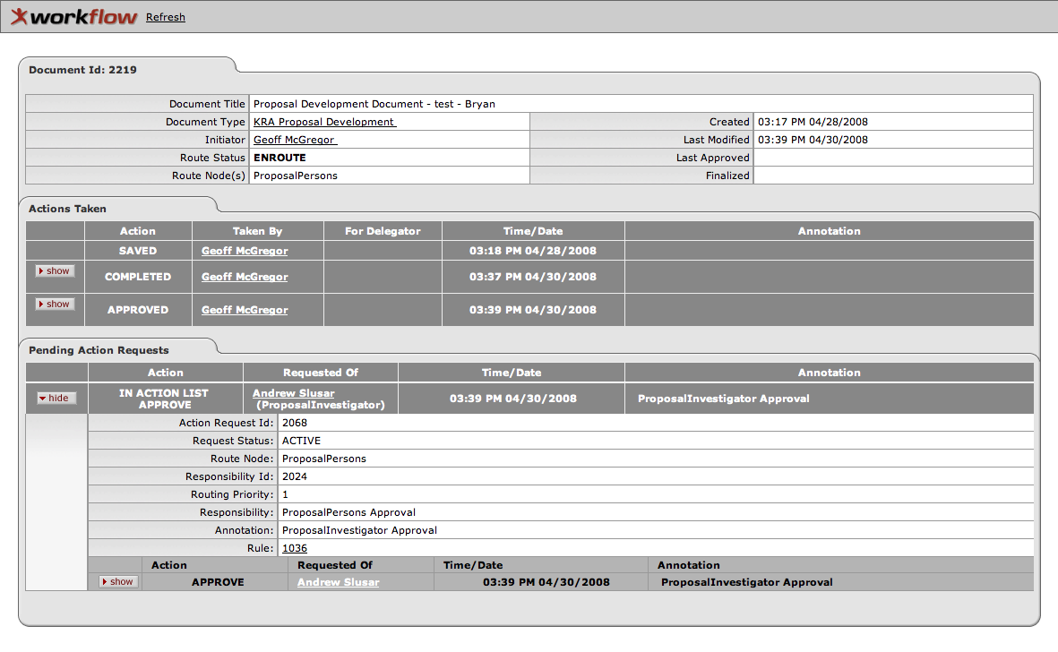
Route Log

Slide 52
Kuali Enterprise Workflow Overview
KEW Allows KC to:
  Submit a Document to a group of users for approval
  Give approvers the ability to route the Document to users for approval on an ad-hoc basis
  Track where a Document is in the approval process
  Give Administrators the ability to approve or disapprove a Document, or return it to the PI for modification
  Return a document to a previous Workflow Status
  Notify users for either FYI or required actions

Slide 53
KEW Configuration
Primarily XML
  Rules can be maintained through the KEW web UI
Requires technical expertise
Defines KEW Configuration Components: Document Type, Route Nodes, Route Templates, Routing Attributes, Searchable Attributes, Rules

Slide 54
Document Type
Defines and name the document including Workgroups, PostProcessor, docHandler, attributes, and route Path & Nodes.
<documentType>
<name>ProposalDevelopmentDocument</name>
<description>Create an Awesome Development Proposal</description>
<label>KC Proposal Development</label>
<postProcessorName>org.kuali.workflow.postprocessor.KualiPostProcessor</postProcessorName>
<superUserWorkgroupName>WorkflowAdmin</superUserWorkgroupName>
<blanketApproveWorkgroupName>WorkflowAdmin</blanketApproveWorkgroupName>
<defaultExceptionWorkgroupName>WorkflowAdmin</defaultExceptionWorkgroupName>
<docHandler>${kuali.docHandler.url.prefix}/proposalDevelopmentProposal.do?methodToCall=docHandler</docHandler>
<active>true</active>
<attributes>
<attribute>
<name>AggregatorSearchAttribute</name>
</attribute>
…
</attributes>
<routingVersion>2</routingVersion>
<routePaths>
<routePath>
<start name="Initiated" nextNode="OSPInitial" />
<requests name="OSPInitial" nextNode="ProposalPersons" />
<requests name="ProposalPersons" nextNode="UnitRouting" />
<requests name="UnitRouting" nextNode="OSPOfficeRouting" />
<requests name="OSPOfficeRouting" />
</routePath>
</routePaths>

Slide 55
Rule Attribute
Attributes and expressions for rule evaluation to conditionally require a node
<ruleAttribute>
<name>ProtocolWorkflowTypeAttribute</name>
<className>org.kuali.rice.kew.rule.xmlrouting.StandardGenericXMLRuleAttribute</className>
<label>ProtocolWorkflowTypeAttribute</label>
<description>ProtocolWorkflowTypeAttribute</description>
<type>RuleXmlAttribute</type>
<routingConfig>
<fieldDef name="protocolWorkflowType" title="protocolWorkflowType" workflowType="RULE">
<display>
<type>text</type>
</display>
<validation required="false" />
<fieldEvaluation>
<!-- expectation: this is run and evaluates to true -->
<xpathexpression>
wf:xstreamsafe('//document/protocolWorkflowType') = wf:ruledata('protocolWorkflowType')
</xpathexpression>
</fieldEvaluation>
</fieldDef>
</routingConfig>
</ruleAttribute>

Slide 56
Search Attribute
Defines searchable Document attributes
<ruleAttribute>
<name>BudgetCreatorSearchAttribute</name>
<className>edu.iu.uis.eden.docsearch.xml.StandardGenericXMLSearchableAttribute</className>
<label>BudgetCreatorSearchAttribute</label>
<description>BudgetCreatorSearchAttribute</description>
<type>SearchableXmlAttribute</type>
<searchingConfig>
<fieldDef name="budgetCreator" title="Budget Creator">
<display>
<type>text</type>
</display>
<quickfinder service="UserLookupableImplService" appliesTo="networkId" draw="true" />
<fieldEvaluation>
<xpathexpression>//users/budgetCreator/value</xpathexpression>
</fieldEvaluation>
</fieldDef>
<xmlSearchContent>
<users>
<budgetCreator>
<value>%budgetCreator%</value>
</budgetCreator>
</users>
</xmlSearchContent>
</searchingConfig>
</ruleAttribute>

Slide 57
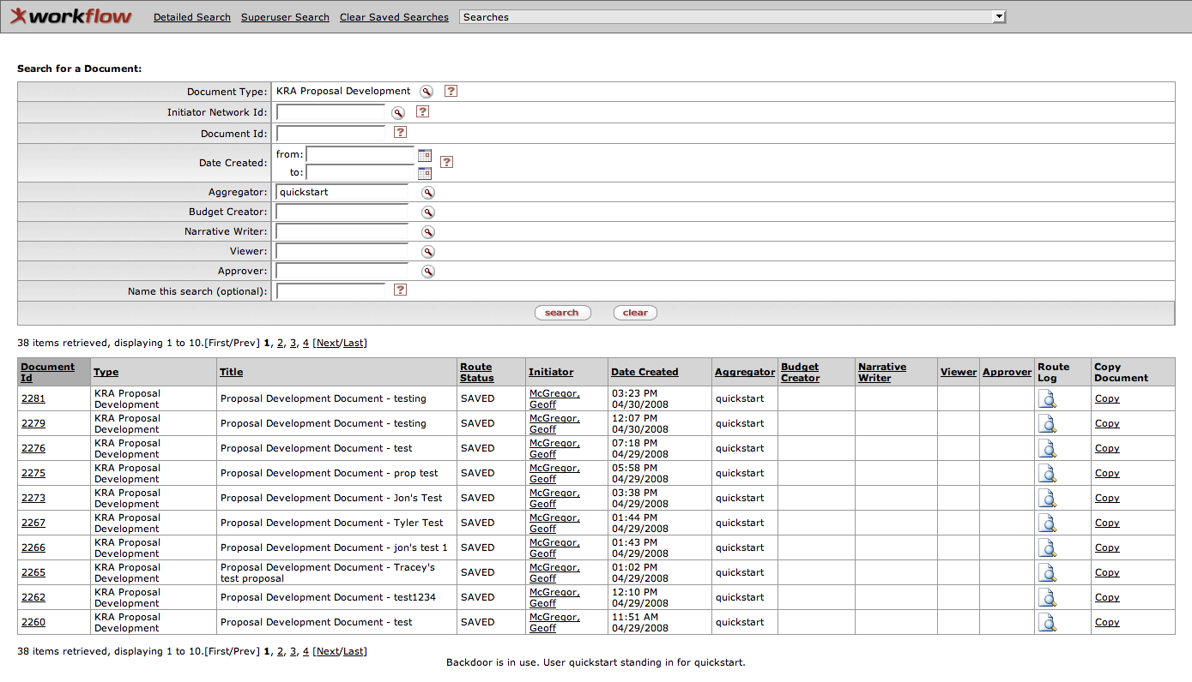
Document Search with Search Attributes

Slide 58
Rule Template
Aggregates rule attributes for a particular rule
<ruleTemplate allowOverwrite="true">
<name>OSPInitialApproval</name>
<description>OSP Initial Approval Routing Rule</description>
</ruleTemplate>
<ruleTemplate allowOverwrite="true">
<name>ProposalPersonsApproval</name>
<description>ProposalPersons Approval Routing Rule</description>
<attributes>
<attribute>
<name>ProposalPersonRoleAttribute</name>
<required>false</required>
</attribute>
</attributes>
</ruleTemplate>

Slide 59
User & Role Rules
Defines entities for routing approval
<rule>
<documentType>ProposalDevelopmentDocument</documentType>
<ruleTemplate>OSPInitialApproval</ruleTemplate>
<description>OSP Initial Approval</description>
<ignorePrevious>true</ignorePrevious>
<responsibilities>
<responsibility>
<user>quickstart</user>
<approvePolicy>A</approvePolicy>
<actionRequested>A</actionRequested>
<priority>1</priority>
</responsibility>
</responsibilities>
</rule>
<rule>
<documentType>ProposalDevelopmentDocument</documentType>
<ruleTemplate>ProposalPersonsApproval</ruleTemplate>
<description>ProposalPersons Approval</description>
<ignorePrevious>true</ignorePrevious>
<responsibilities>
<responsibility>
<role>org.kuali.kra.workflow.ProposalPersonRoleAttribute!PROPOSALINVESTIGATOR</role>
<approvePolicy>A</approvePolicy>
<actionRequested>A</actionRequested>
<priority>1</priority>
</responsibility>
</responsibilities>
</rule>

Slide 60
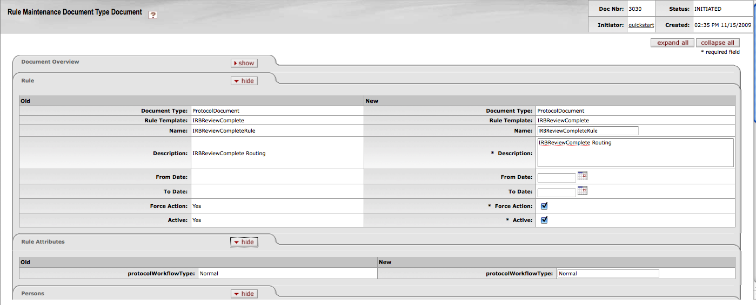
Workflow Rule - GUI

Slide 61
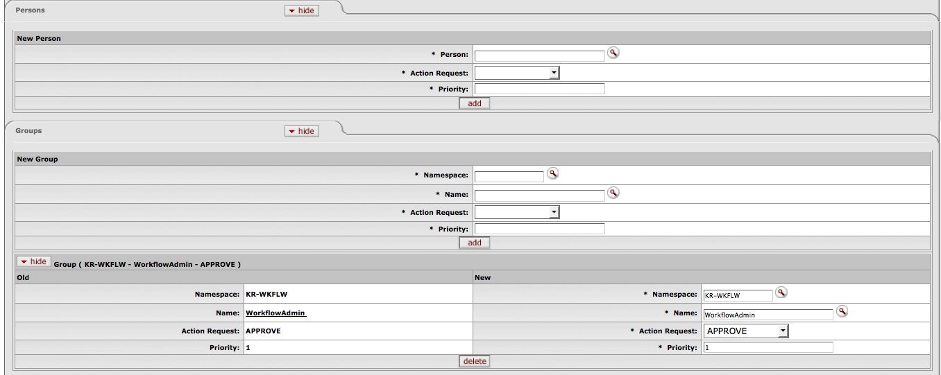
Workflow Rule - GUI

Slide 62
Coeus/KC Workflow Functional Parity
Filled Gaps
  Configuration - Meta-Rules, Rules and Conditions
  Multiple Approvals
  Inbox (Action List) - View Resolved
  Return to initiator
Gaps for KC Release 2.0
  Workflow Configuration through GUI
  Other potential Workflow Use Cases
    More dynamic Actions/Statuses
    Multiple documents tied together
Other expansion for KC Release 2.0
  Workflow used in Awards and IRB modules
Notes:
Removed prev slide notes:
Initial KC/Coeus Gap Analysis Spring 2007
Functional and Technical
Coeus Workflow configuration is significantly different than the KEW configuration we were starting with
There were also some areas of Coeus Workflow functionality that KEW couldn’t provide

Slide 63
Questions?

