Slide 1
Kuali Coeus IRB

Slide 2
Session Agenda
Coeus IRB
KC IRB Development Process
KC IRB User Interface
Questionnaire
Protocol Actions
Coeus & KC – Continuing Collaboration

Slide 3
Coeus IRB

Slide 4
Coeus IRB
Planning for Coeus IRB started in 2003
First roll out was in 2005 for administrative support (back office operations)
Kuali Coeus port began in 2007
First implementation of protocol submission (Coeus Lite) by Yale in February 2009
Initial support for electronic review in November 2009

Slide 5
Coeus IRB Components
  Submission of protocols to the IRB administrative office
  Assignment of protocols to an IRB and specific reviewers
  Development of IRB agenda
  Review of the protocols by IRB reviewers
  Creation and logging of correspondence to researcher
  Electronic creation of minutes
  Request actions from researcher
  Protocol management actions by IRB administrator

Slide 6
KC IRB Development Process

Slide 7
Kuali Coeus Goals
Maintain all functionality from the Coeus product
Apply development infrastructure & user interface consistent with Kuali
Identify critical enhancements for consideration in Kuali product

Slide 8
KC IRB Timeline
Functional requirements development began summer 2007
Mock screen development began spring 2008
Code development began fall 2008
Development work is expected to be completed in January 2010
Post Kuali Days planning will inform the delivery date

Slide 9
Process: Module Development Steps
Subject Matter Experts (SMEs) review current product (Coeus) functionality
SMEs write specification documents
  Enhancements to FC for review/vote
  FC keeps tabs on scope throughout
Usability group build screen mockups
SMEs review screen mockups
Developers build code
Testers do quality assurance and report issues

Slide 10
The User Interface

Slide 11
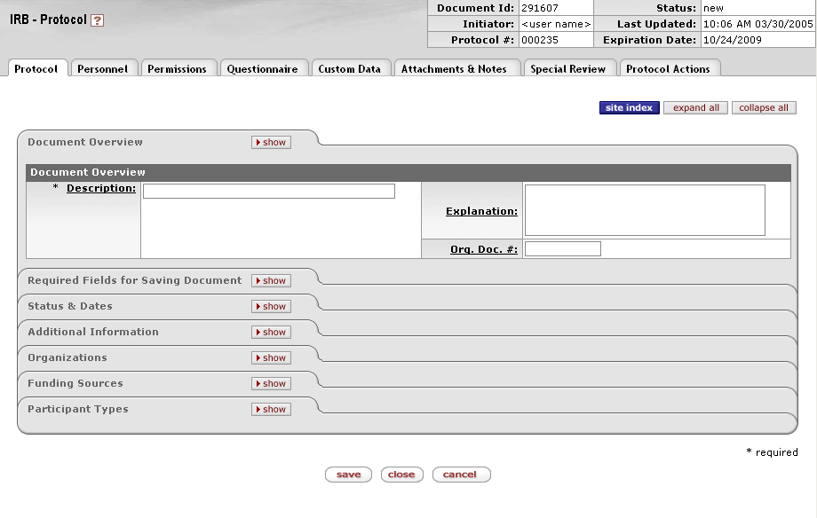
Navigation Elements

Slide 12
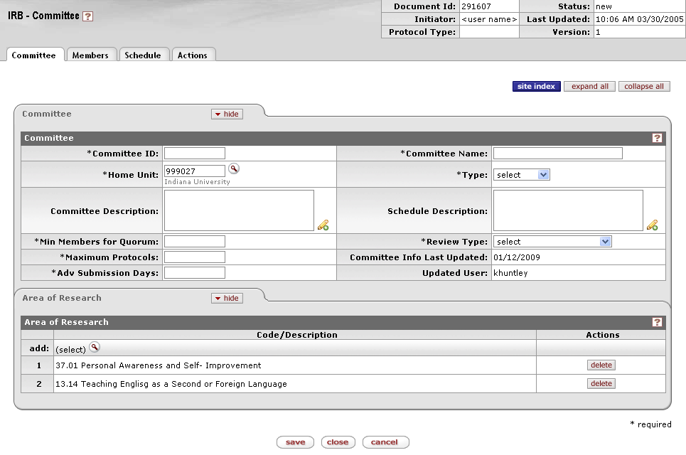
Committee Management

Slide 13
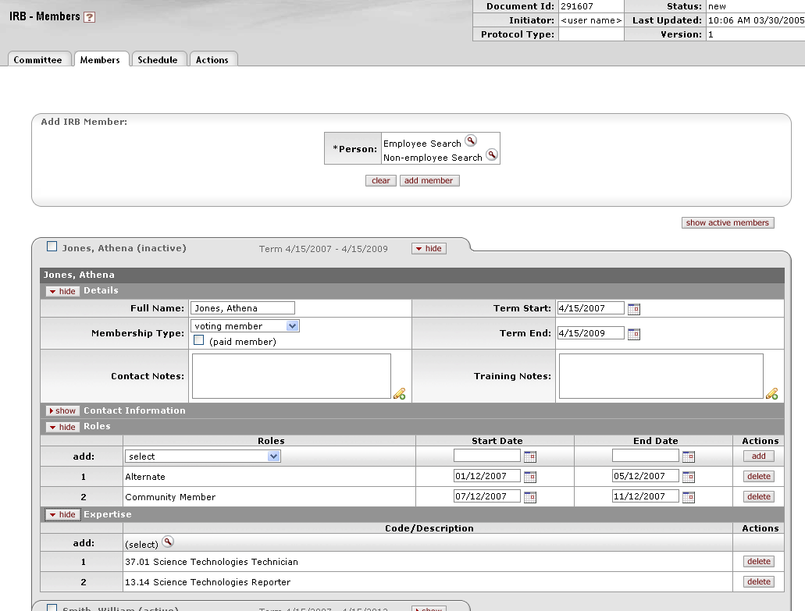
Member Management

Slide 14
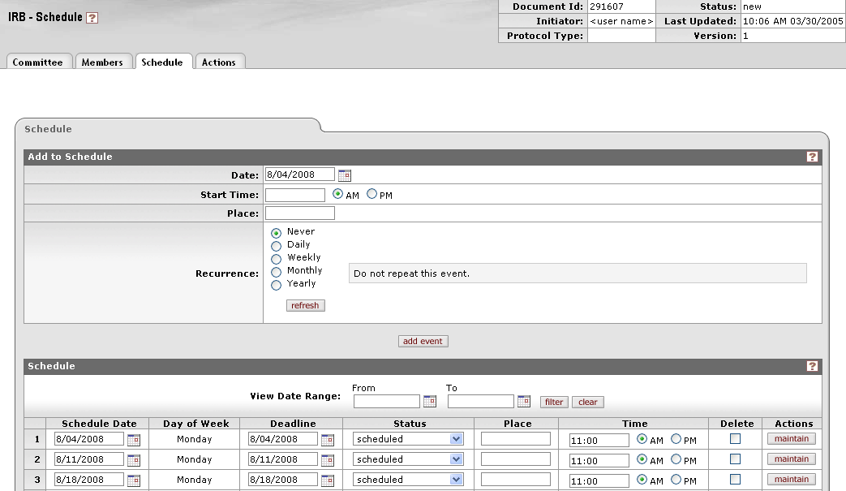
Schedule Maintenance

Slide 15
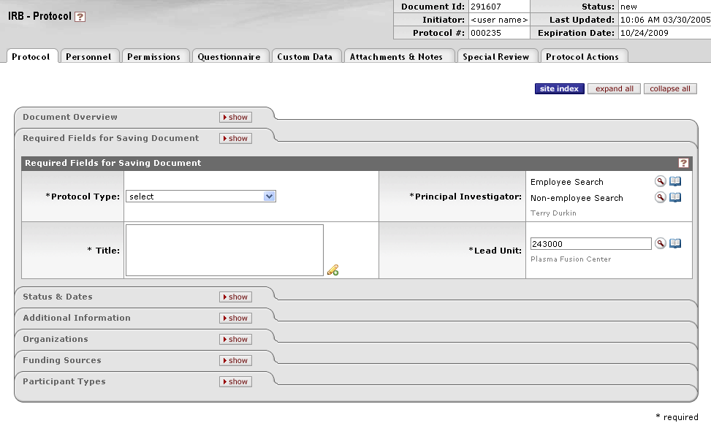
Required Fields

Slide 16
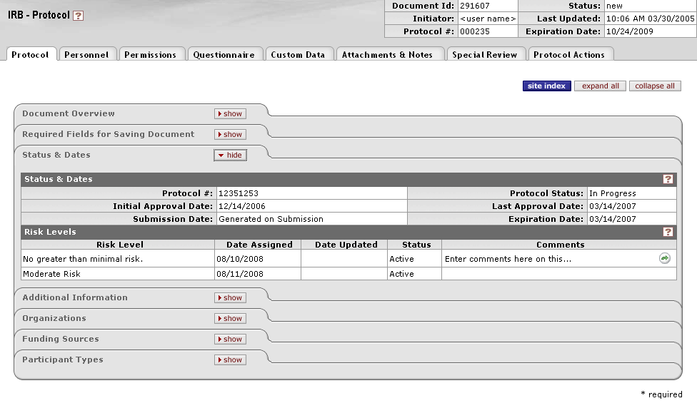
Status & Dates

Slide 17
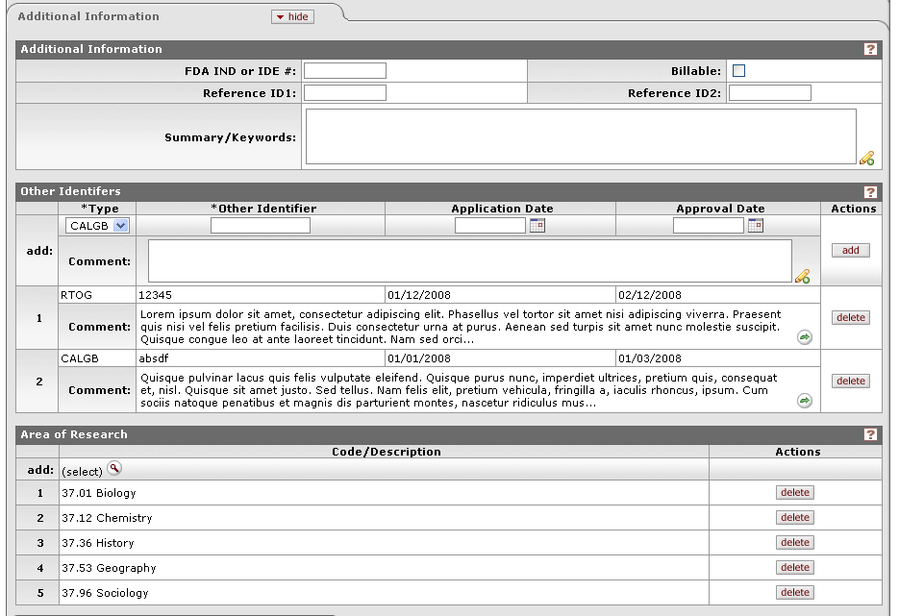
Additional Information

Slide 18
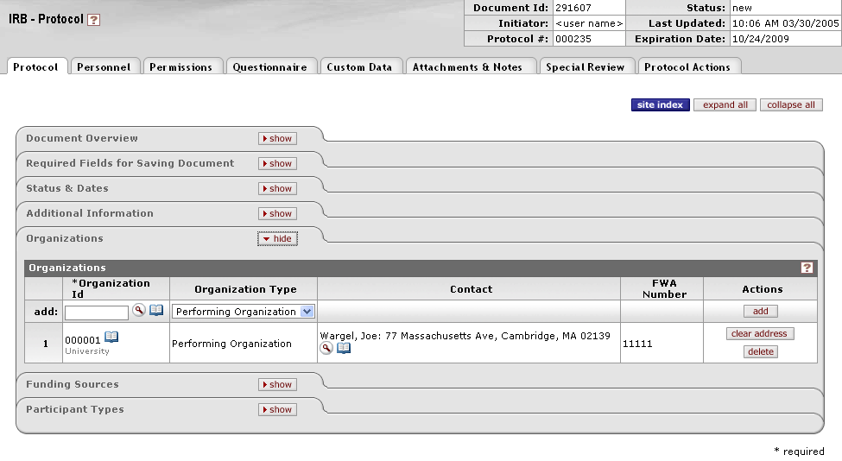
Organization

Slide 19
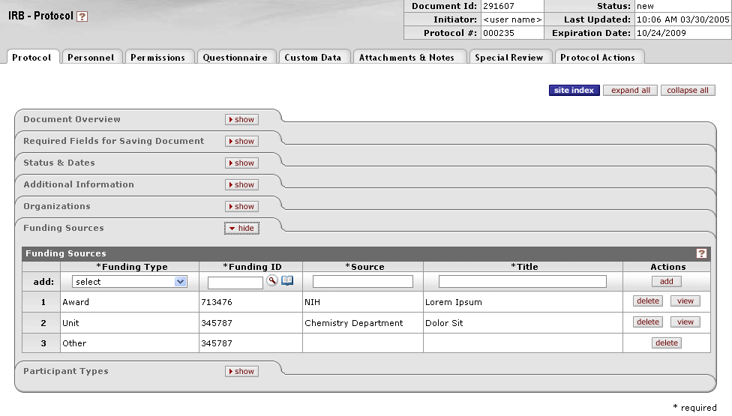
Funding Sources

Slide 20
Participant Types

Slide 21
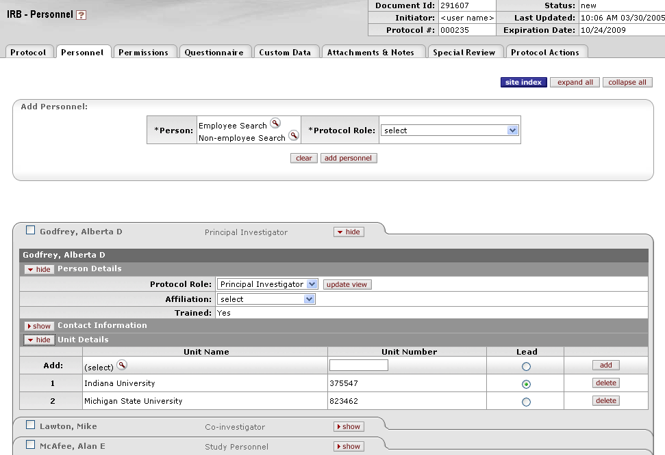
Personnel

Slide 22
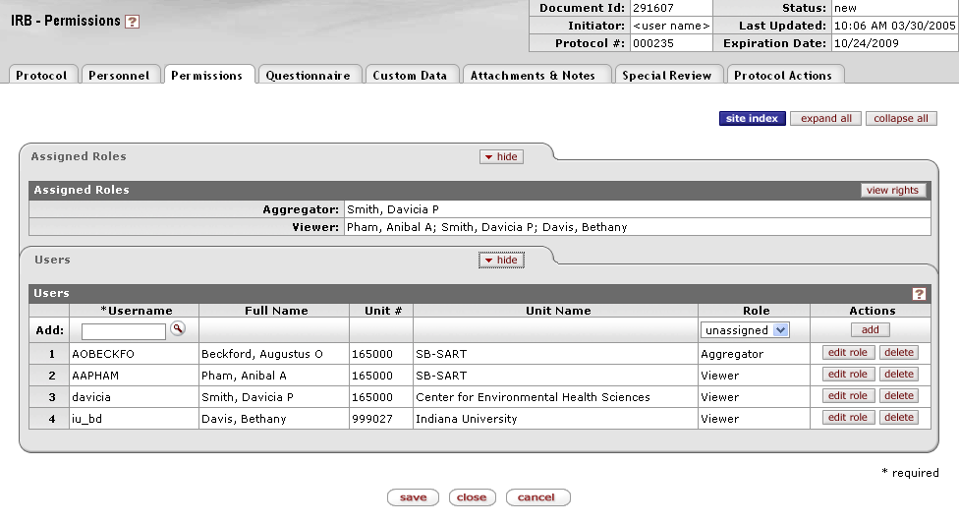
Permissions

Slide 23
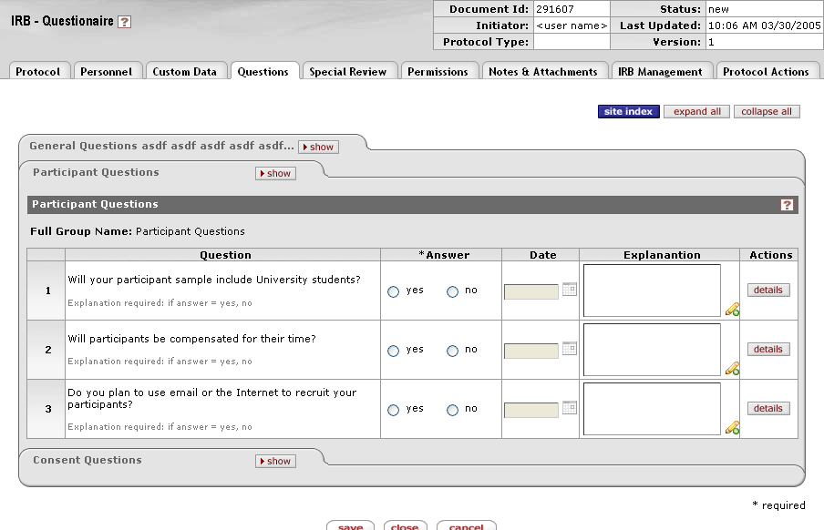
Questionnaire

Slide 24
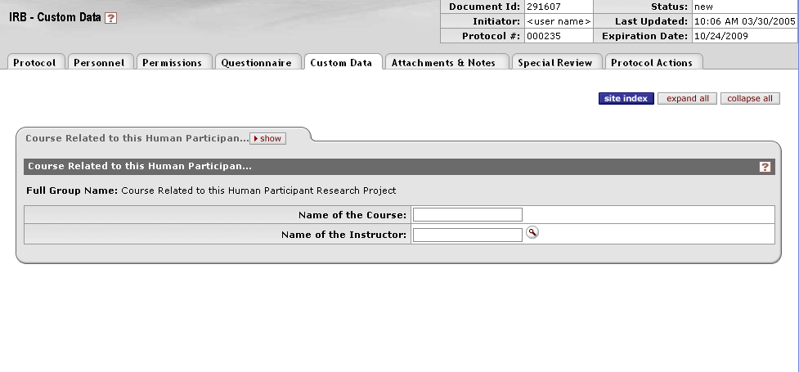
Custom Data

Slide 25
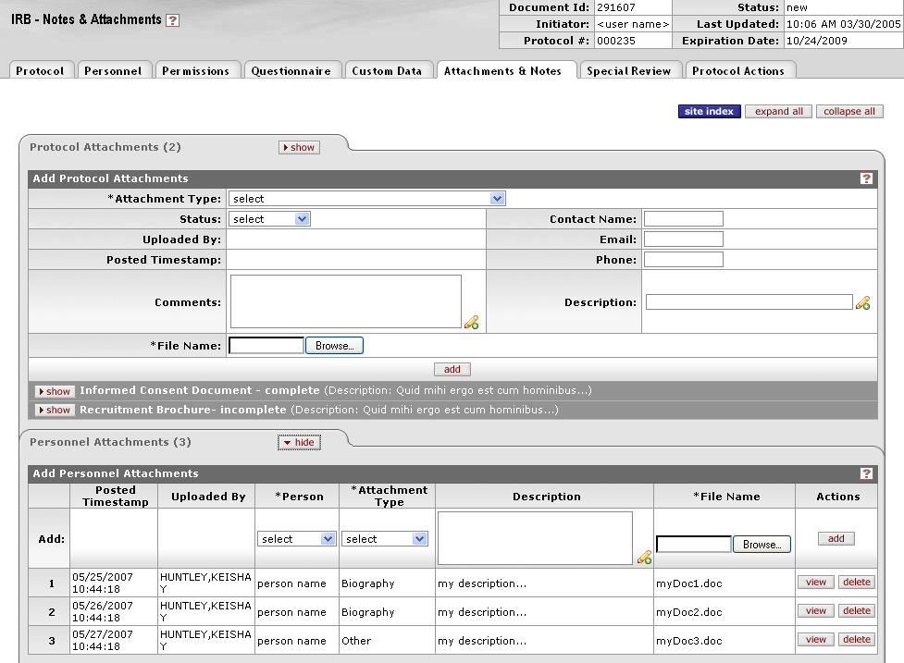
Attachments

Slide 26
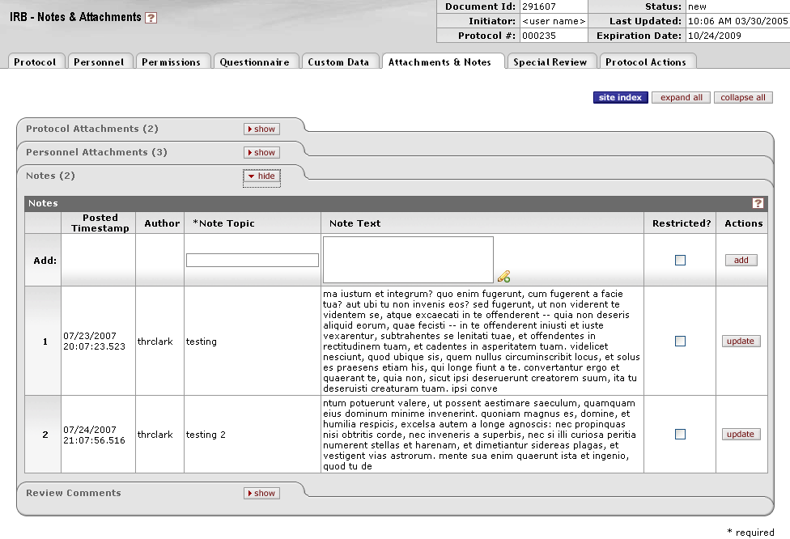
Notes

Slide 27
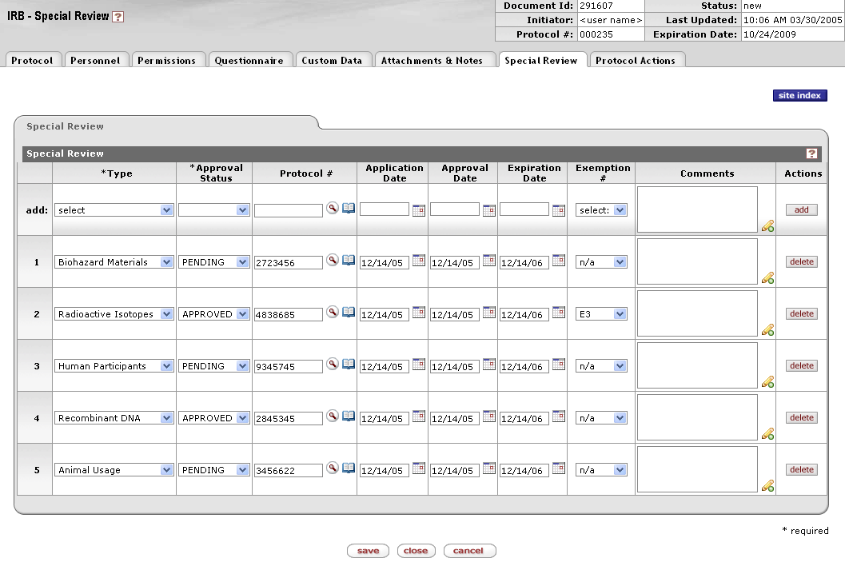
Special Review

Slide 28
Questionnaire

Slide 29
Questionnaire
Method for collection of institutionally defined data within IRB protocol document
Questions can be of many standard types (Yes/No, Date, Text, Checkbox, Pulldown)
Questions can be conditional or hierarchical
Questions and questionnaires are versioned

Slide 30
Questionnaire Structure
Create individual questions
Accumulate questions into a questionnaire
Associate a questionnaire with a specific Kuali Coeus Module (e.g. IRB)

Slide 31
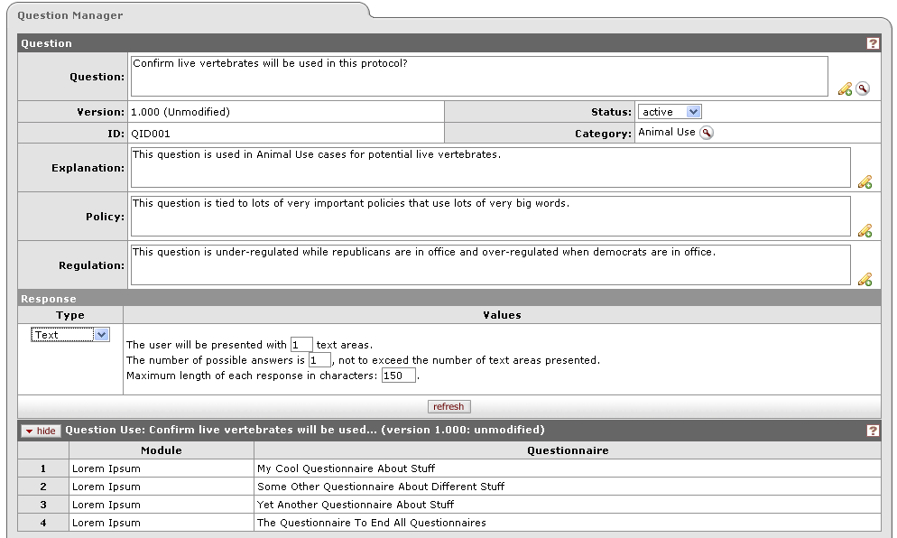
Question Manager

Slide 32
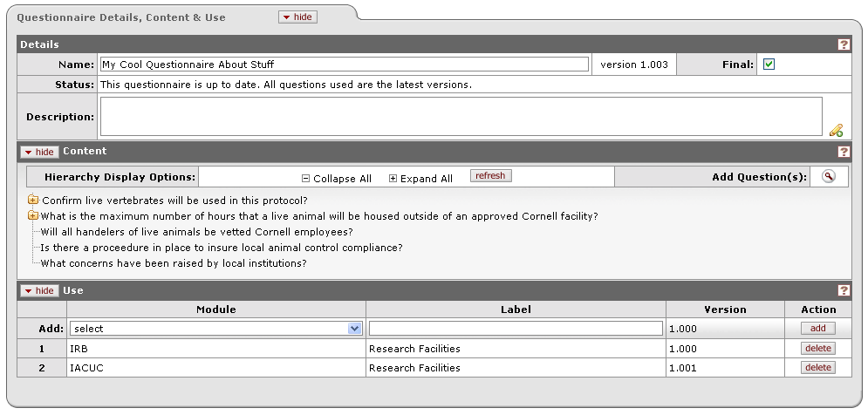
Questionnaire Editor

Slide 33
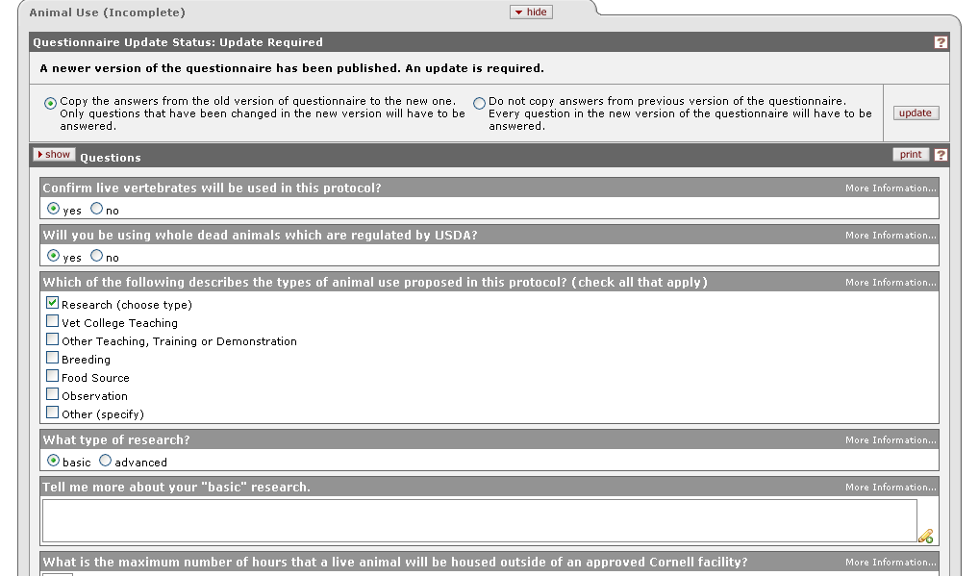
Questionnaire Example

Slide 34
Protocol Actions

Slide 35
Actions
Many actions will be taken against a protocol during its normal lifecyle
Available actions are dependent on current state of protocol plus the role & rights of user
Data may be collected at time of action
Multiple actions may be required serially
User interface design is critical to user experience

Slide 36
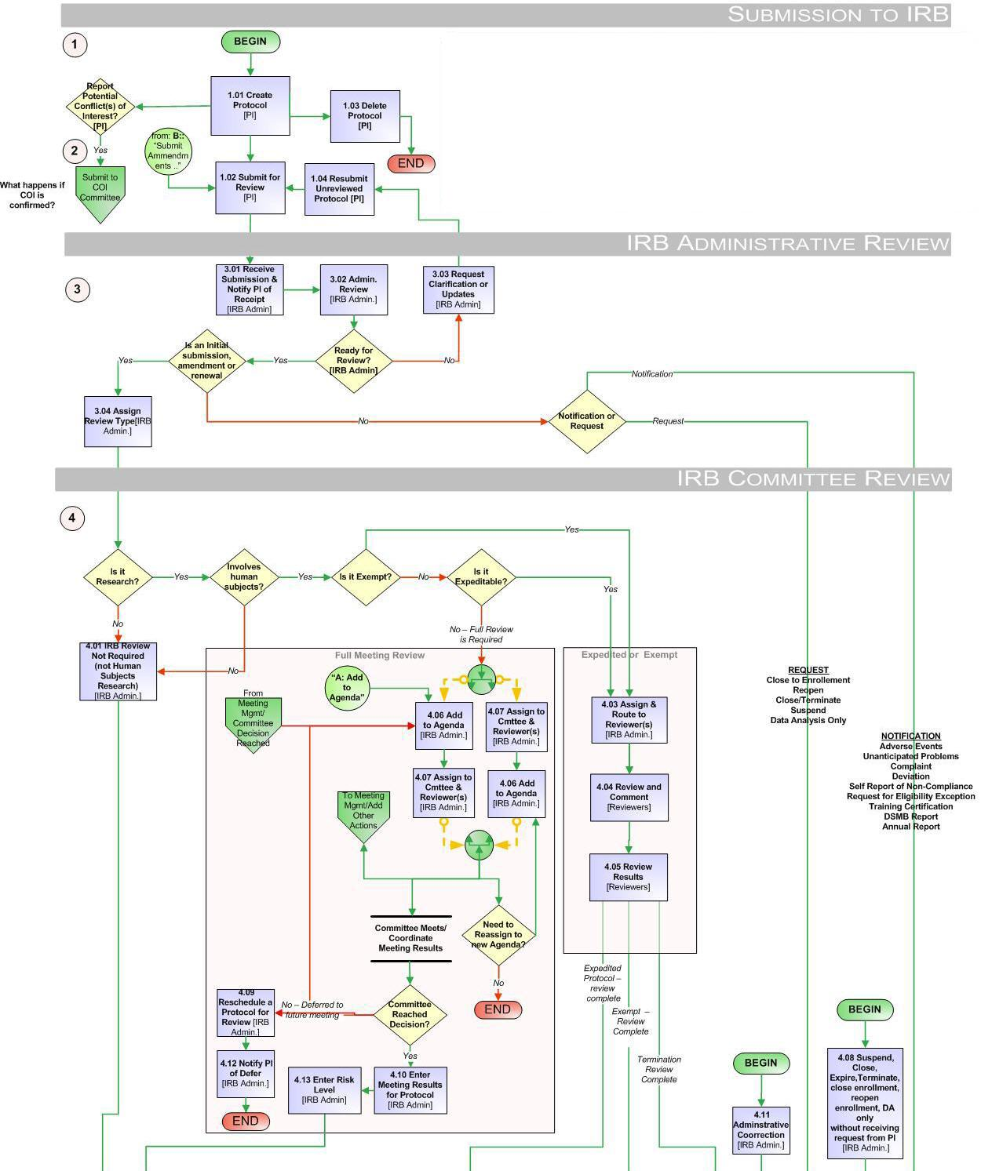
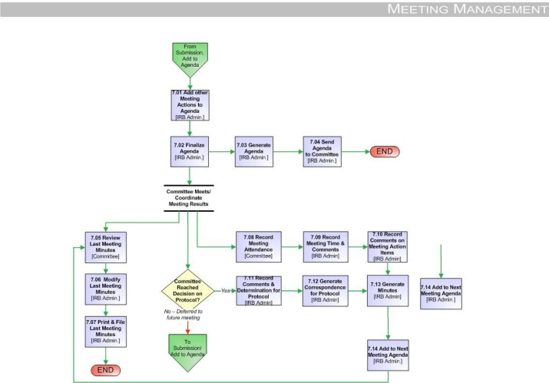
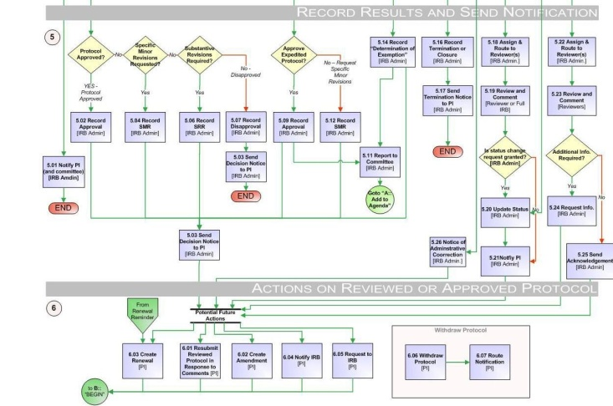
IRB Process Map

Slide 37
Sample Protocol Actions
Protocol Created
Submitted to IRB
Withdrawn
Notify IRB
Request to Close Enrollment
Request to Re-open Enrollment
Request to Close
Request for Suspension
Amendment Created
Renewal Created
Assign to Committee, Assign to Agenda, Assign to Reviewers, Defer
IRB Review Not Required, Expedited Approval, Exemption Granted, Approved, Disapproved, Substantive/Specific Minor Revisions Required
Closed for Enrollment, Re-Open Enrollment, Data Analysis Only
Closed (Administratively Closed), Expired, Suspended, Terminated
Administrative Correction
Undo Last Action
Renewal Reminder Generated

Slide 38
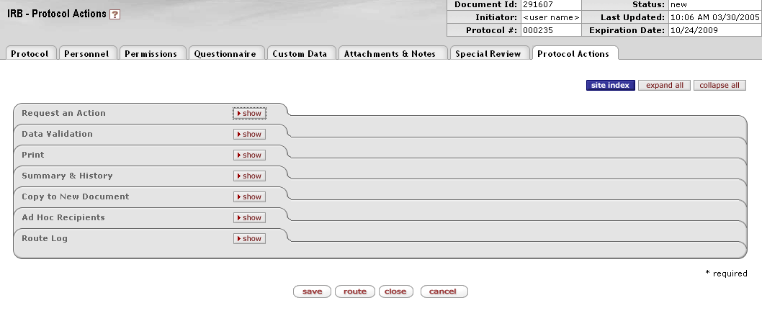
Protocol Actions

Slide 39
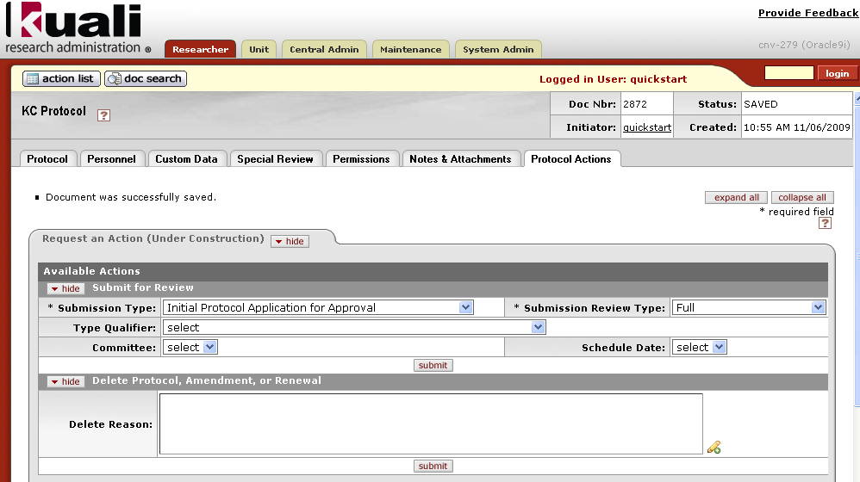
Researcher Actions - Submit

Slide 40
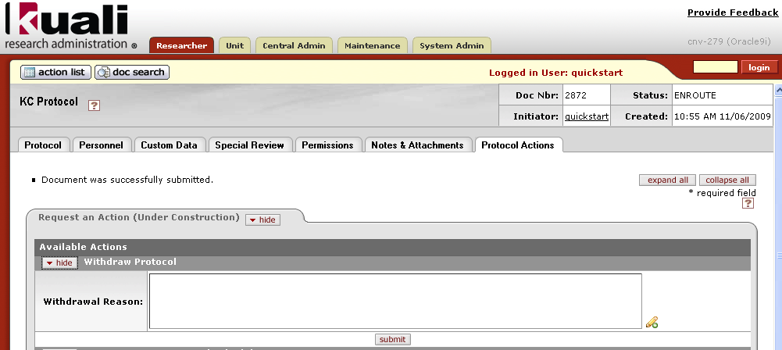
Researcher Actions - Withdraw

Slide 41
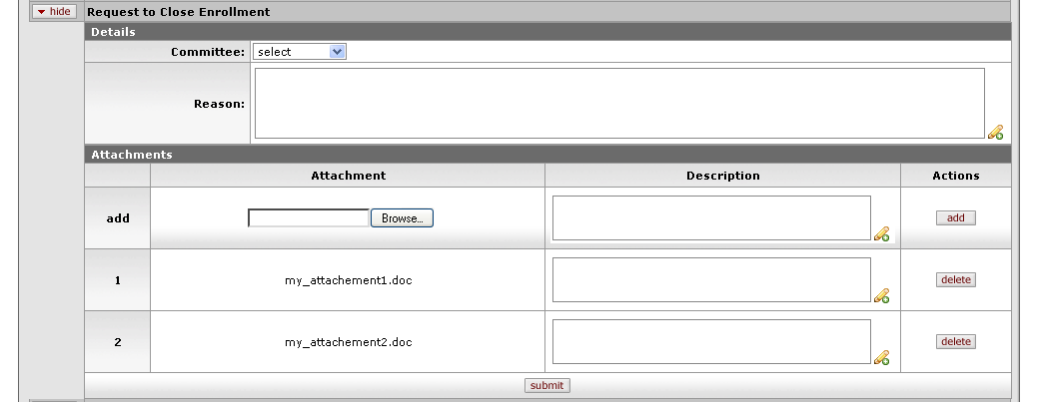
Researcher Actions - Request

Slide 42
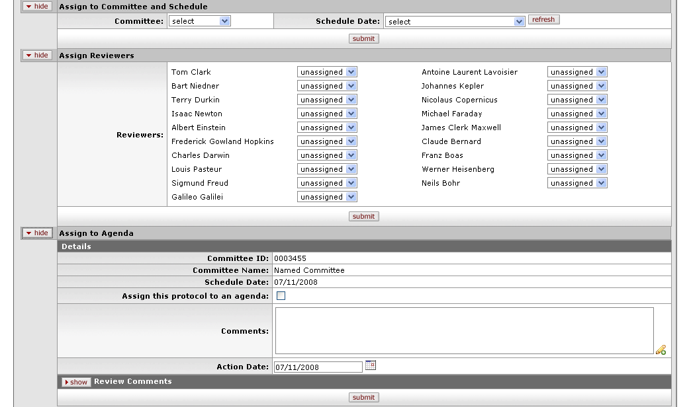
IRB Administrator Actions

Slide 43
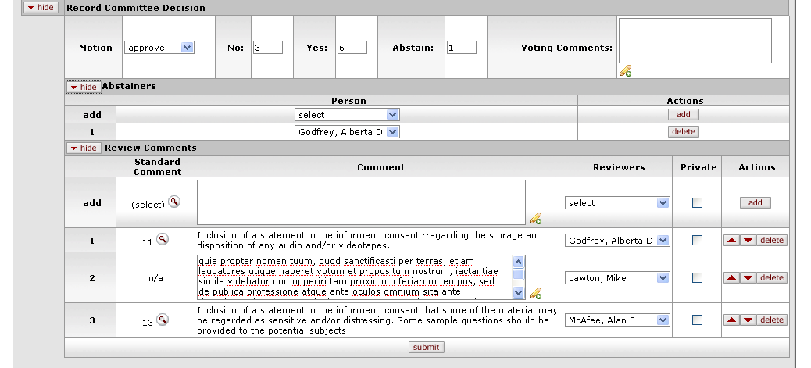
IRB Administrator Actions

Slide 44
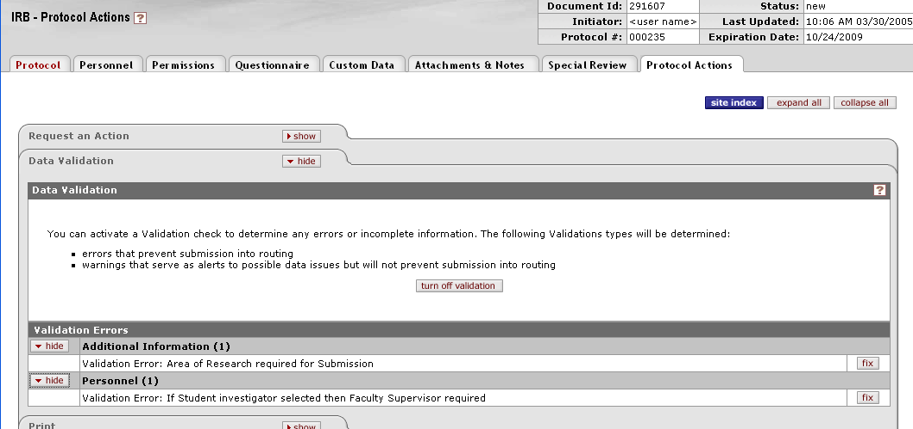
Data Validation

Slide 45
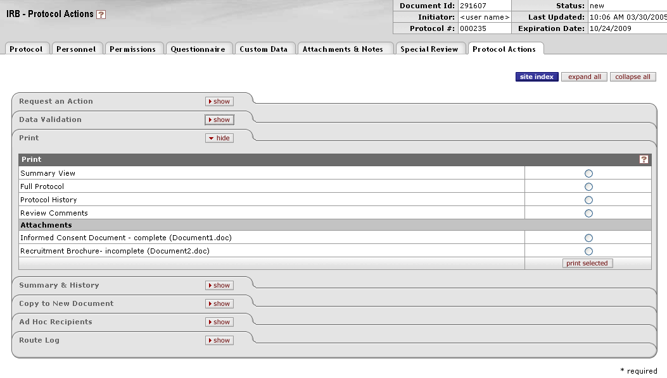
Print

Slide 46
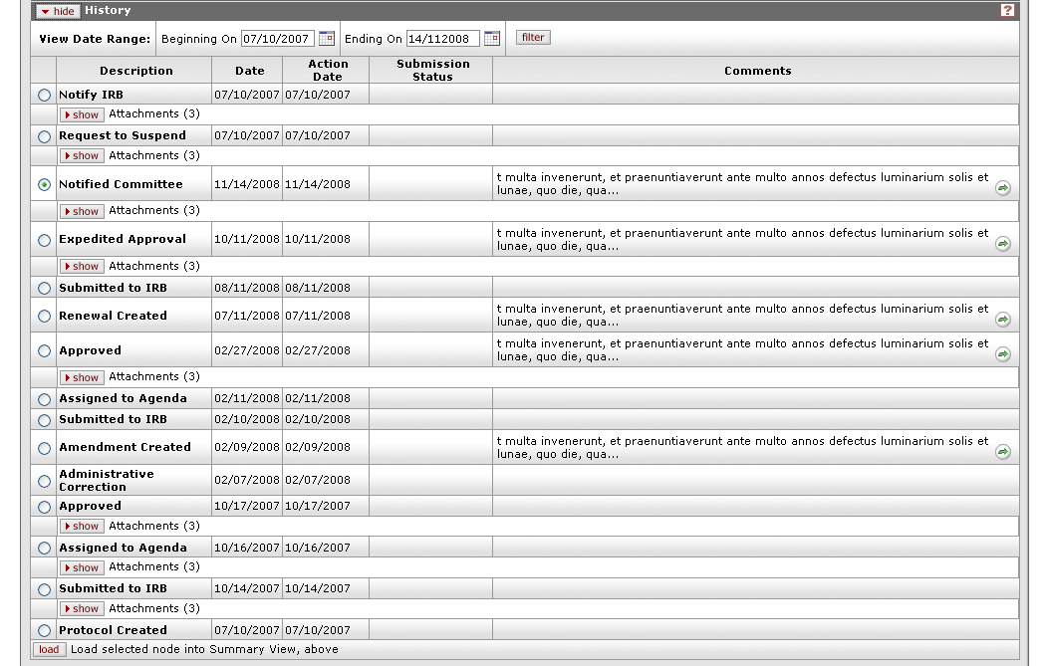
History

Slide 47
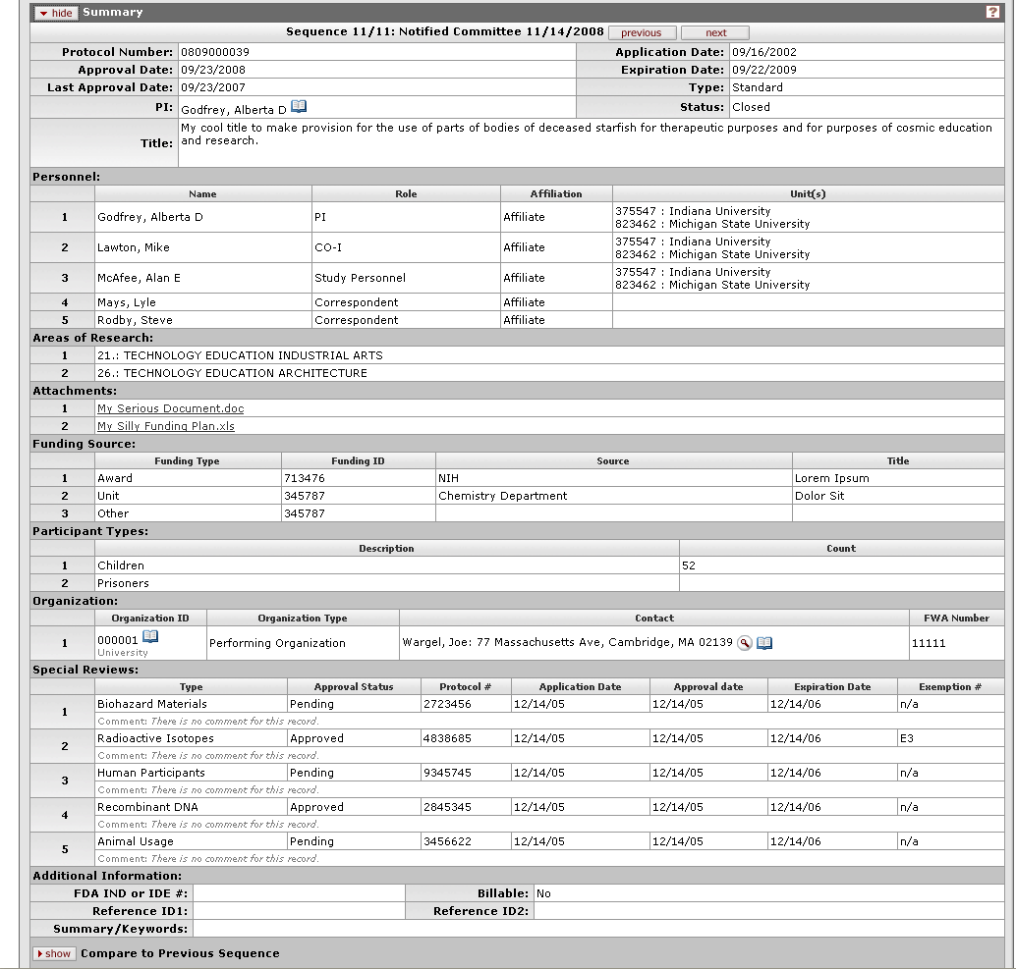
Summary

Slide 48
Coeus & KC – Continuing Collaboration

Slide 49
Coeus/KC Collaboration
New development in Coeus IRB is ongoing with significant enhancements in recent releases
Coeus consortium members participate in KC SME group
KC SME members attend Coeus Compliance Committee meetings
Two KC partners have implemented Coeus IRB

Slide 50
Keys to Success
A solid Coeus IRB base to build on
Structured Kuali process
Involvement of functional experts (SMEs)
A quality flexible product is critical to successful implementations
Migration path for Coeus IRB users
Good working relationship between Kuali and Coeus

Slide 51
Kuali Coeus IRB
Questions?
KC IRB Lab, 3:30 in Conf 1+2

