Slide 1
Research and Design Options
AguaClara Spring 2010 Design and Research Teams

Slide 2
Our Objectives
Cultivate an environment that is supportive and facilitates learning
Enable students to become self-learners
Understand and design processes that:
  Aid in the removal of colloidal (very small) particles from water
  Can be utilized in a gravity driven plant
  Are cost-effective for small towns in the Global South
  Can be effectively utilized by an operator with minimal “traditional” educational training

Slide 3
Tips on Choosing a Team
Choose teams that:
  Interest you
  Complement your skills and coursework
Do not be afraid to learn or make mistakes

Slide 4
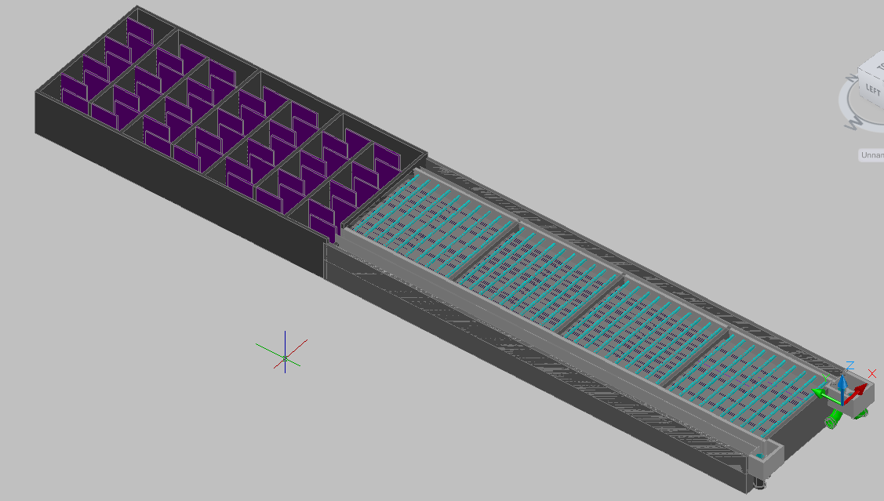
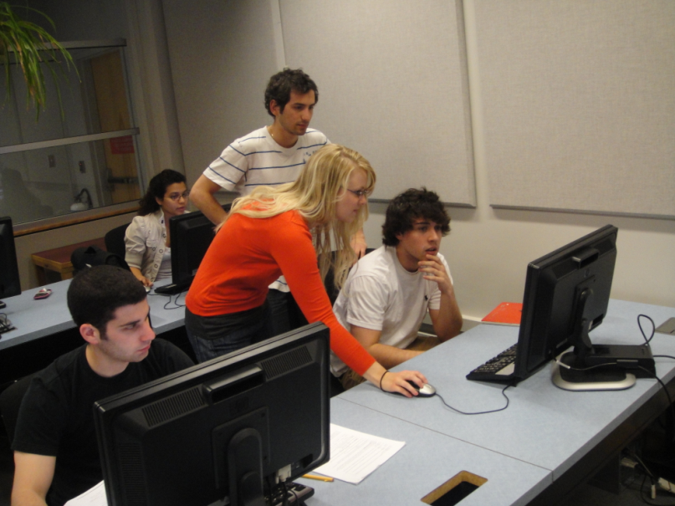
Design Team
Overview

Slide 5
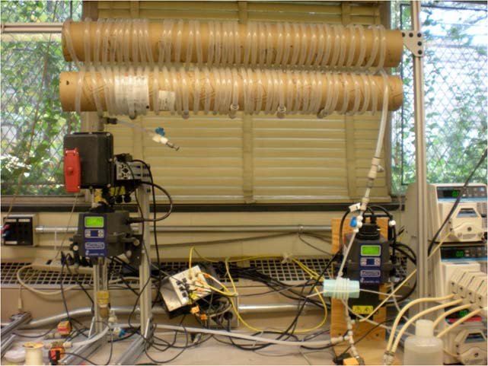
What do we do?
Translate lessons learned from research and previous plants into actual plant designs!

Slide 6
How do we do this?
Automated Design Tool
  Accessible for free to users on the web
  Users enter a few parameters (i.e. water flow rate, materials limitations) and receive a plant design automatically via email in just a few minutes!
  Uses computer code that the design team developed to do this
  We hope that it will greatly expand the implementation of AguaClara plants one day!

Slide 7
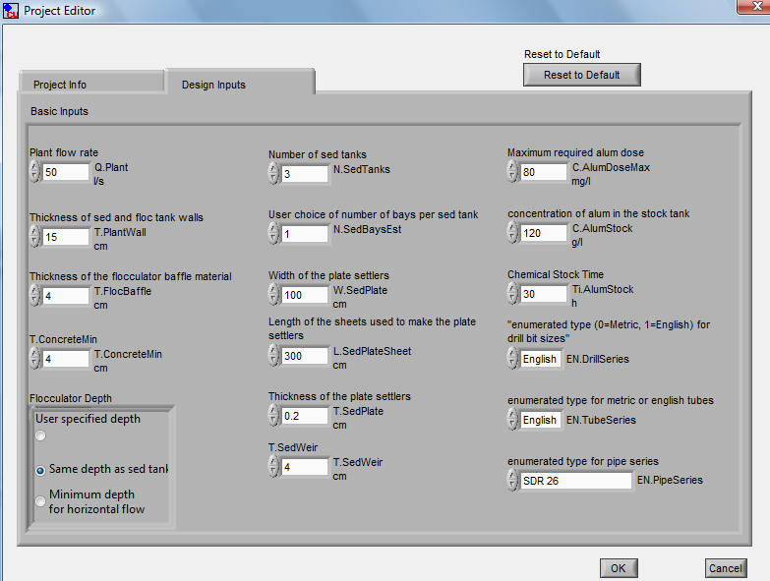

Slide 8
How does the Automated Design Tool Work?
Students developed MathCAD code to calculate the important dimensions of the plant (based on fluid mechanics, materials, etc.)
Students also developed code for AutoCAD that then draws the plants based on these dimensions

Slide 9
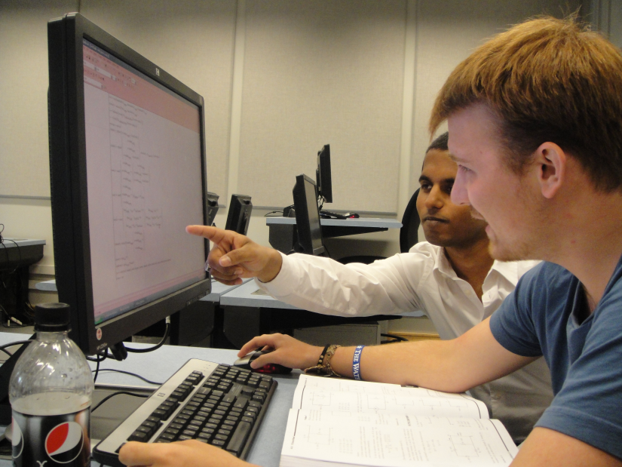
What will you do?
Work alone or in small
teams (depending on your
preference)
Update the code for one component of the plant based on new things we learn, errors we find, etc.
Other potential tasks include:
  Documentation manual describing design
  Materials List including dimensions of all materials used

Slide 10
Design Team Skills
Must love coding and computers since this is all you will use! (No “traditional” lab research with experiments, etc.)
Basic coding experience helpful (CS100 counts!)
  Familiarity with MathCAD helpful but not necessary, it’s an easy program to use
AutoCAD or similar drawing experience a plus but not necessary
  Some tasks don’t use this skill, but you can certainly use it if you want to use it

Slide 11
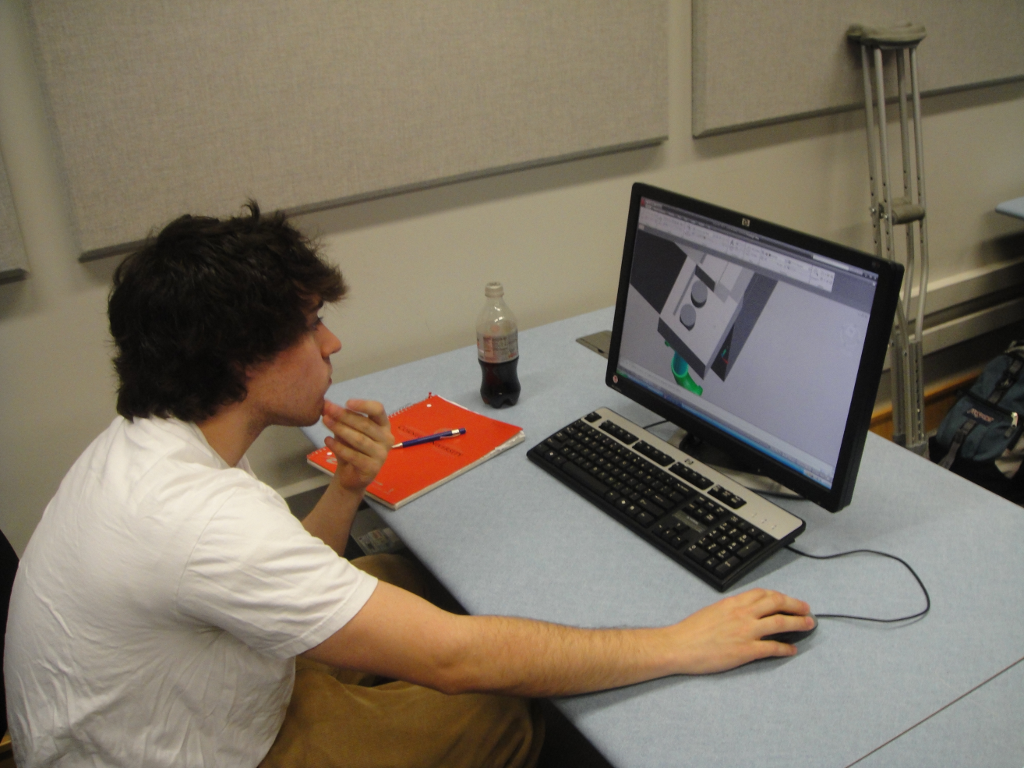
Conclusions
Design Team is awesome! You should join it!

Slide 12
Research Teams
Chemical Dose Controller
Acid Neutralizing Capacity Doser
Inlet Manifold
Plate Settler Spacing
Filtration
  Sand Filter
  Foam Filter

Slide 13
Make
Problem Solve
Experiment
Program
Chemical Dose Controller Team

Slide 14
Dose Controller
5
7.5
10
12.5
15
17.5
20
22.5
25
20
30
40
50
60
70
80
90
100
Notes:
Akta

Slide 15

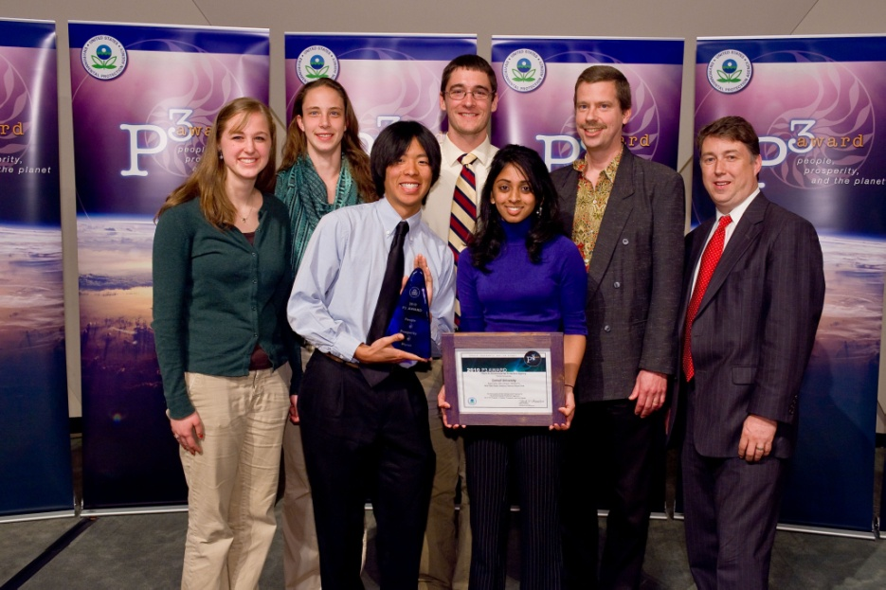
EPA P3 Competition: People, Prosperity and the Planet
Phase I (Spring 2009): $10,000 for research and development
Phase II (Spring 2010): $75,000 for Phase II activities!
Project presentation at the annual National Sustainable Design Expo in Washington, DC
Notes:
Kayti

Slide 16
Phase I Activities
Research potential nonlinear doser designs
Write algorithms that calculate relevant parameters
Design a prototype nonlinear dose controller and rapid mix tube
Replicate the prototype doser for installation at the new plant in Agalteca
Document all research and design for the EPA P3 competition
Perform validation testing on the doser
Develop a display and poster for the EPA P3 competition
Make
Problem Solve
Experiment
Program
Phase II Activities
Continue validation testing on the doser
Analyze performance data from the plant at Agalteca
Research and fix failure modes to increase reliability
Document final replicable doser design
Convert doser to locally available materials
Incorporate doser into Automated Design Tool (ADT)

Slide 17
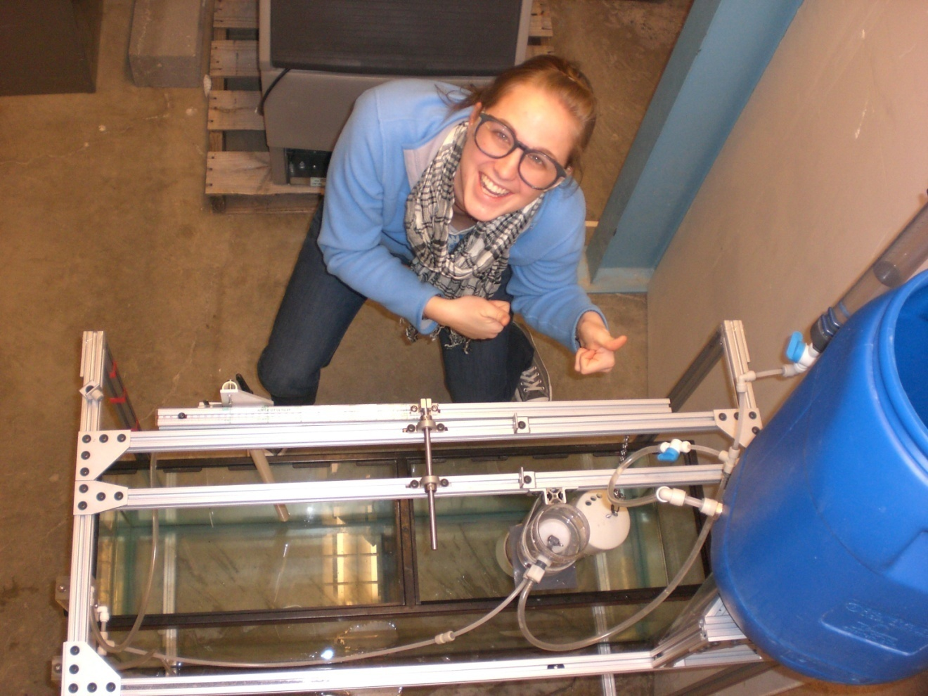
And…
IT’S FUN!

Slide 18
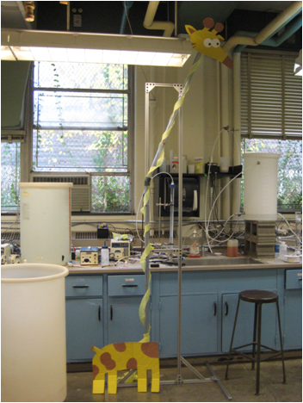
ANC CONTROL TEAM
Katie Weible
Ximena Aristizabal
Chengfeng Wu
Drew Hart

Slide 19
Alkalinity
Alkalinity is the ability of a water to neutralize acid
The higher the alkalinity, the higher the capacity to neutralize water
Acidity can be neutralized by base ions such as carbonates or hydroxides

Slide 20
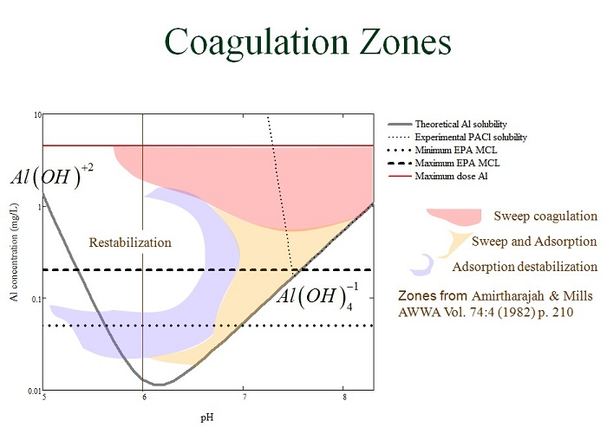
ANC Problem Overview
Lack of alkalinity in source waters in Honduras
AguaClara utilizes aluminum hydroxide flocs to remove small particles in the water
Formation of aluminum hydroxides after alum dosing lowers pH
Ideal pH range for aluminum hydroxide precipitation is 6.5-7.5

Slide 21
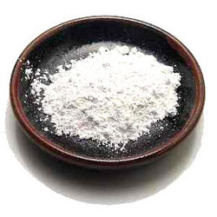
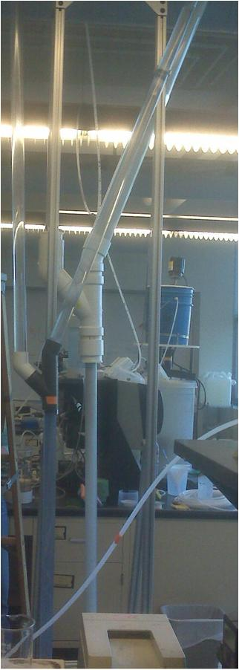
Objective
Design a lime (Ca(OH)₂) feeder which:
  Is simple and easy to construct
  Delivers clean effluent at pH ~ 12.6 (saturated lime)
  Is easy for the operator to use:
    Easy place to feed lime
    Lime only added every 24 hours

Slide 22
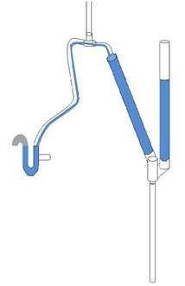
Experimental Apparatus
Lime addition
Path of effluent
Effluent; pH monitoring
Fluidized bed of lime
Flow rate

Slide 23
CHALLENGES
Improve the design to achieve continuous operation.
Determine the causes of failure. (probing hypothesis: carbonates, kinetics, residence time, particle size).
Scale the design to the actual flow rate in Honduras.
Simulate conditions in Honduras (water temperature, lime characteristics).

Slide 24
SKILLS FOR FUTURE TEAM MEMBERS
Interest in combining good, general chemistry background with basic understanding of fluids
Willingness to learn new software – Process Controller and MathCAD

Slide 25
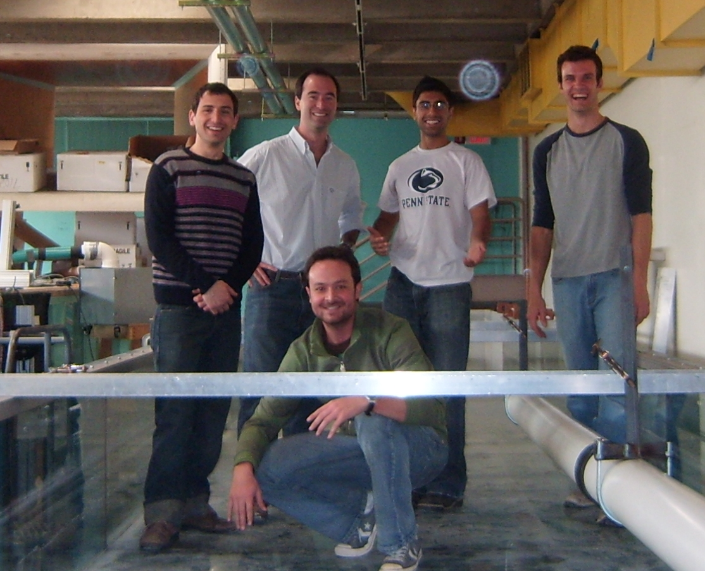
Inlet Manifold Research
Rami Bechara
Gonzalo Caprario
Vanish Grover
Nicolas Pautassi
Julia Schoen
Arthur Shull
Inlet Manifold Research and PIV Team
Spring 2010

Slide 26
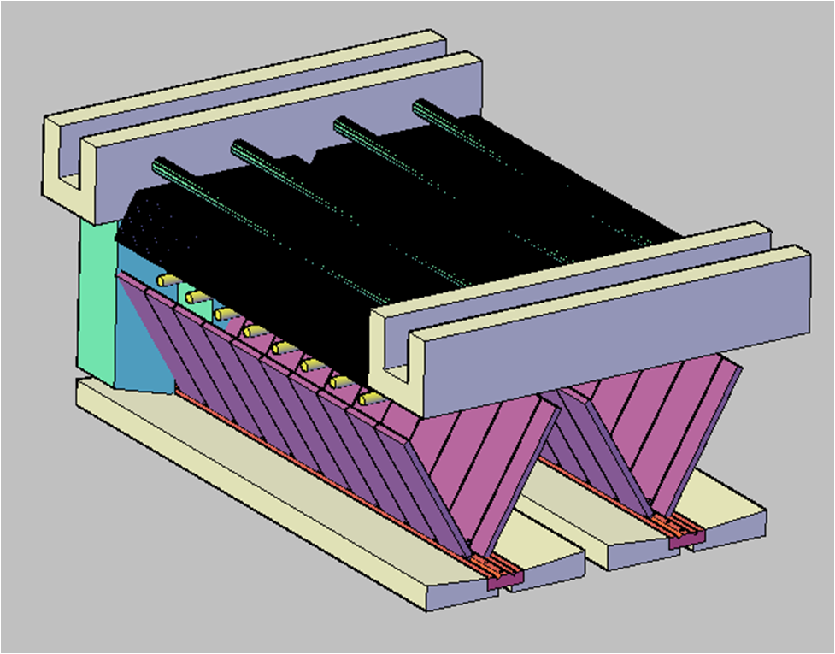
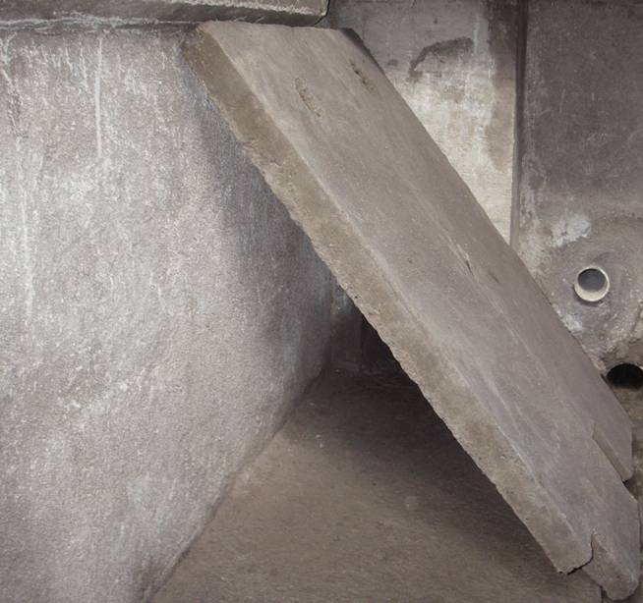
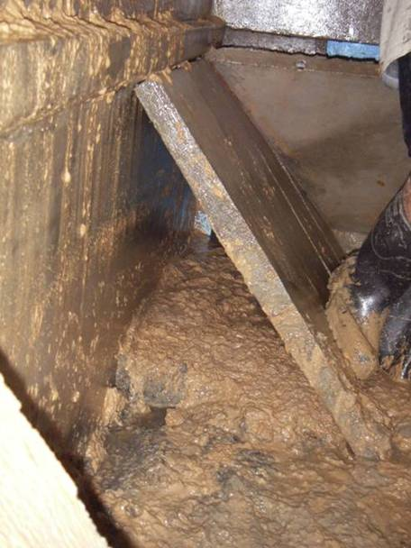
Reasons to start this research
Previous Design
Inlet Channel
Chimney
Plate Settlers
Exit Channel
Sedimentation Tank Cuatro Comunidades
Problem
Ports
Distribution Channel

Slide 27
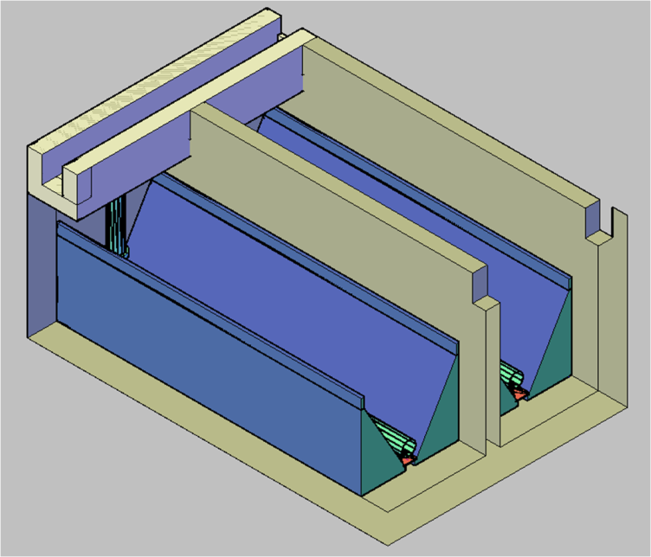
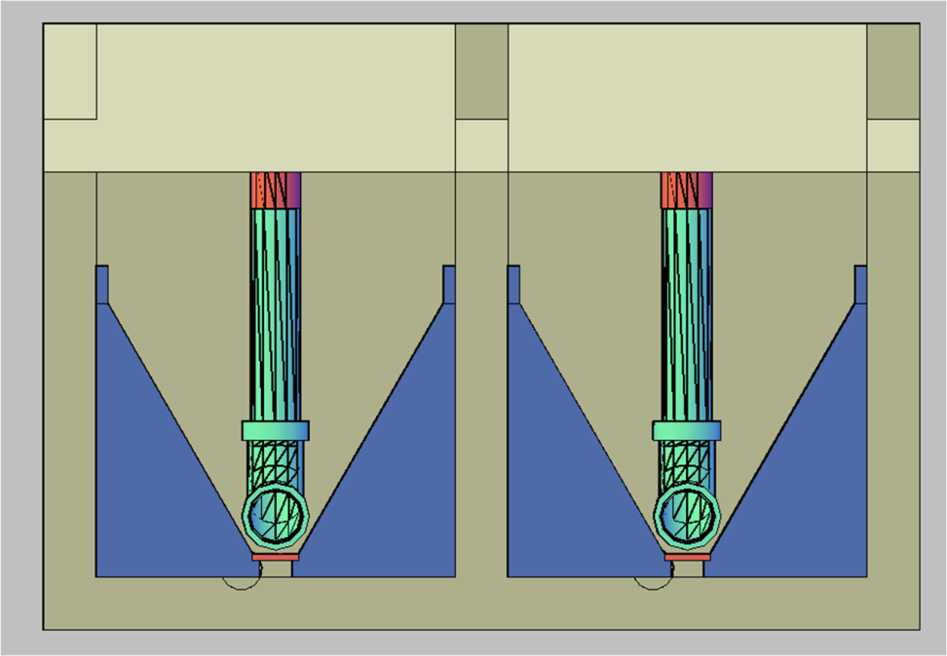
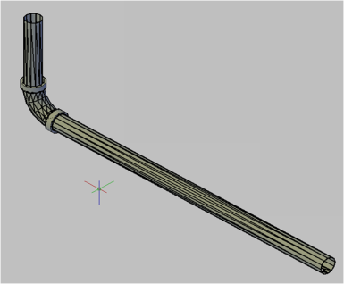
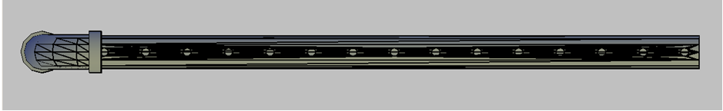
Current Design
Inlet Manifold
Ports

Slide 28
Objectives
Maintain the same fluid velocity along the ports of the manifold
Maintain a high enough fluid velocity to prevent flocs from settling inside the manifold
Avoid floc breakup
Make construction easy and repeatable
Use cost-effective and commonplace materials

Slide 29
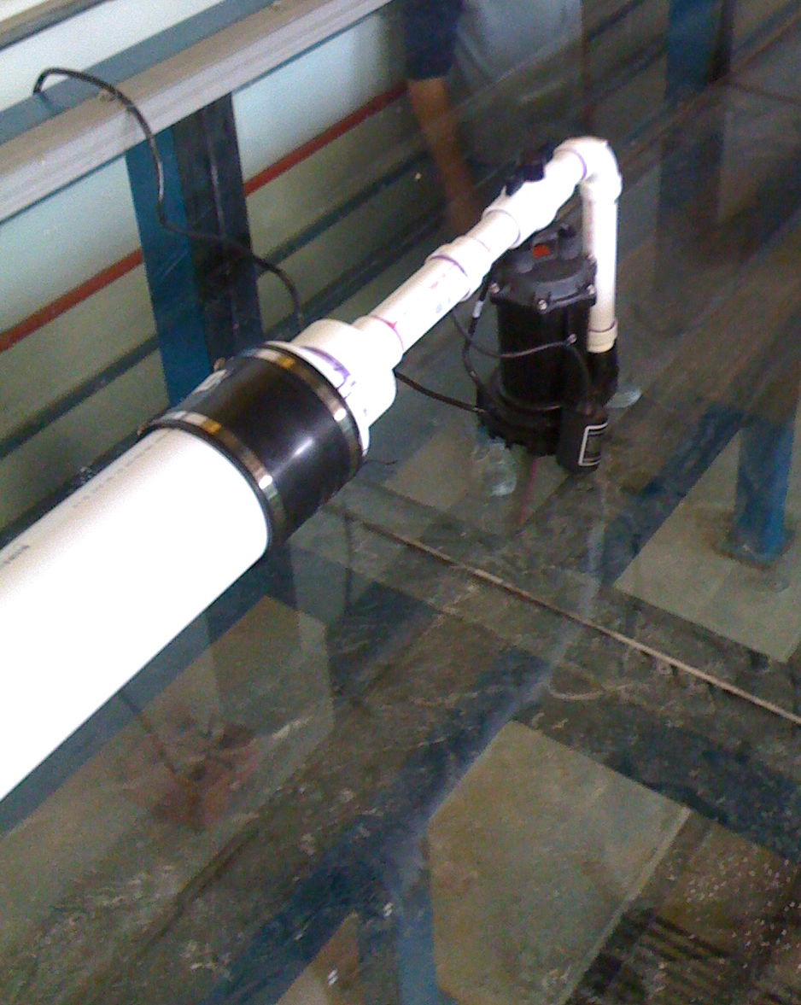
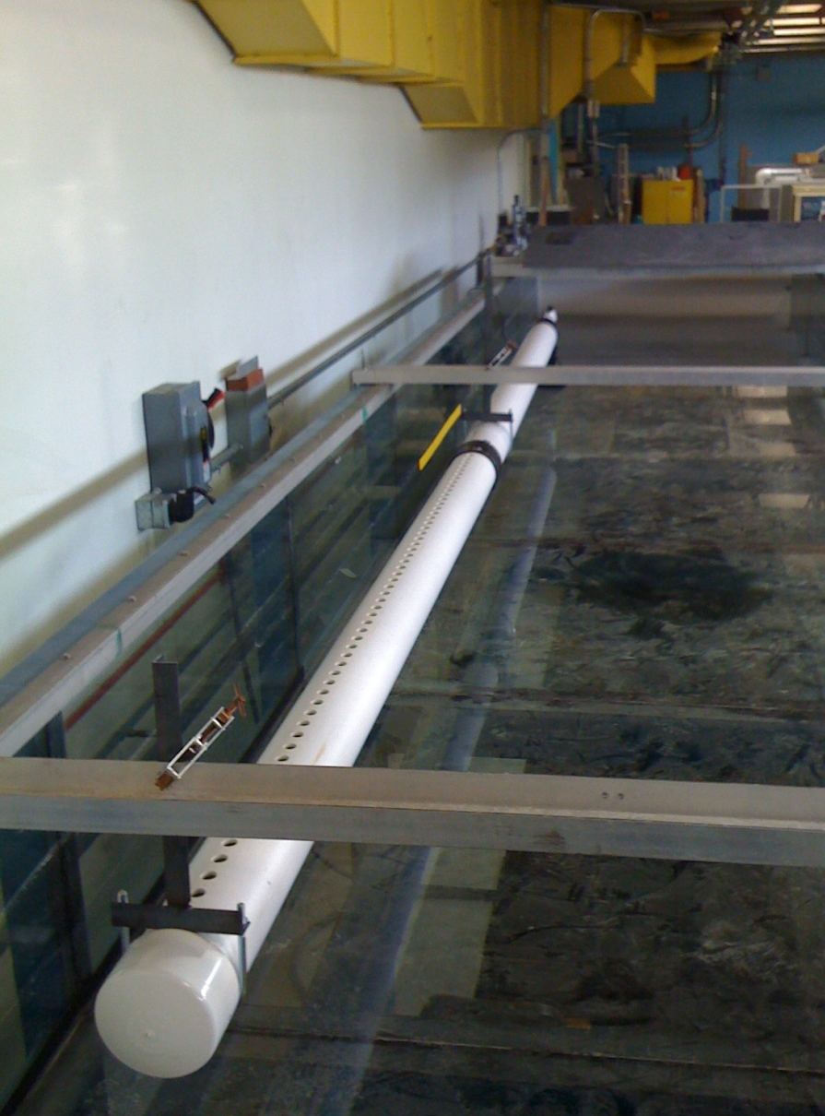
Lab configuration

Slide 30
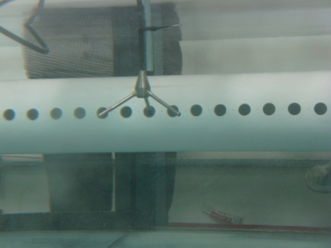
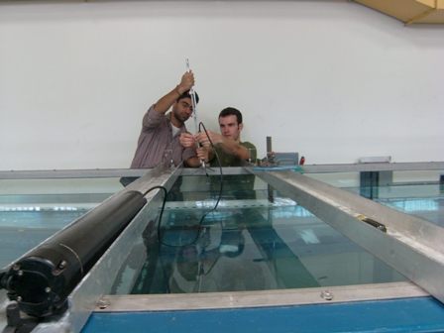
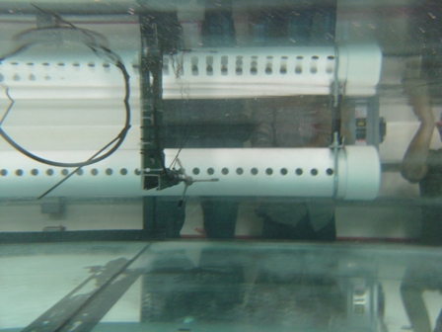
Acoustic Doppler Velocimetry Set up

Slide 31
Example Results
Velocity sample at port by ADV
Velocity profile along manifold

Slide 32
Suggested background
Willingness to learn ADV and MathCAD software
Willingness to be flexible with scheduling and sharing equipment
Good at understanding relatively complex mathematical procedures and solving relatively complex mathematical equations

Slide 33
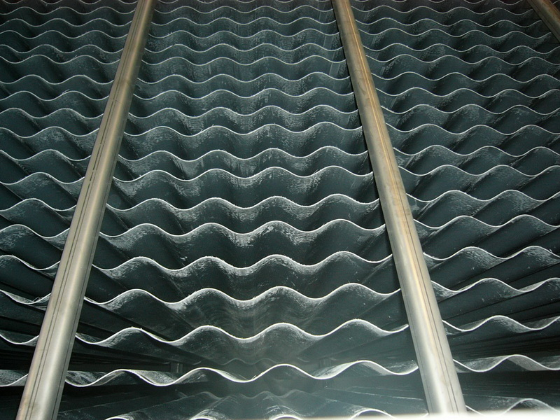
PLATE SETTLER SPACING
May 4th, 2010
ZACHARY ROMEO
&
TANYA CABRITO

Slide 34
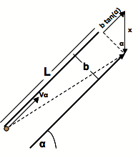
What are Plate Settlers?
At the top of the sedimentation tank, lamella are a network of stacked, sloped plates with narrow channels between them.
As water flows through these channels gravity pulls out coagulated dirt particles, resulting in a clean effluent.
A model of how plate settlers work – dependent on plate geometry and fluid velocity

Slide 35
What we do:
Our Goal
Minimize the spacing of plate settlers in AguaClara plants. Closer plate settlers saves AguaClara money by allowing for smaller sedimentation tanks.
How?
In lab, we test the effects of plate settler spacing using tubes. Currently, we are investigating a possible failure mechanism of closely spaced plates, termed floc rollup.

Slide 36
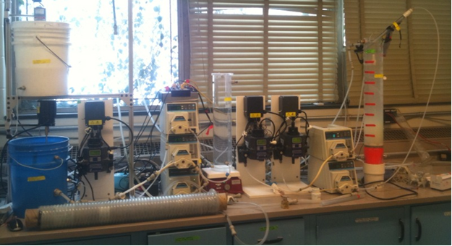
The setup:
Clay Stock
Floc Blanket
Alum Stock
Pinch Valve
100
Rapid Mix Tube
Settling Column
Flocculator
Raw Water Line
Raw Water Tank

Slide 37
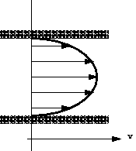
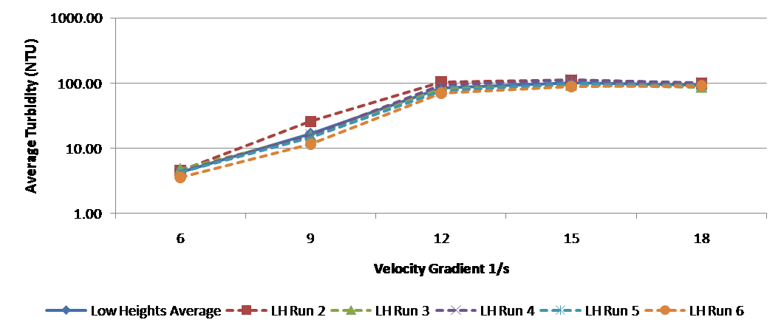
A Peek at What we do
Model fluid wall shear on floc particles and determine conditions which cause failure in plate settlers (when particles are pushed up the plate settlers)
Sample results

Slide 38
Interested?
Why Join?
PSS experimental setup is like a full miniature AguaClara plant. Good way to generally see how the plant processes fit together.
PSS research is heavily based on fluid dynamic concepts, providing an excellent way to apply what you’ve learned.
Requirements
Fluid dynamics – strongly recommended
    - Current research is heavily based on basic fluid dynamic concepts
Willingness to learn new software - Process Controller, MathCAD

Slide 39
Filtration Team

Slide 40
What is Filtration?
Removal of particles by passage through layers of porous media.
How does it happen?
Surface removal - Mechanical straining caused by build up of suspended solids layer on top of the filter
Depth removal – Occurs below the surface of the filter and can be accomplished via
-Attachment
-Interstitial straining

Slide 41
Surface Removal
Flow
Suspended solids
Top of filter
media
Filter media

Slide 42
Depth Removal
Flow
Suspended solid
Filter media

Slide 43
Why do we want filtration for AguaClara?
Turbidity (NTU) = Cloudiness/Dirtiness of water caused by suspended particles in the water
1000s NTU
Surface Water Range
Cleaner Water
10 NTU
World Health Organization Standards
5 NTU
AguaClara sedimentation tank
performance range
1 NTU
EPA Standards
0.3 NTU
Filtration technology

Slide 44
Central Tenets of Research
Do not use electricity.
Make minimal use of specialized components that would be difficult to acquire in remote communities.
Make the system open to the atmosphere
Make it easy for an operator to observe and operate

Slide 45
What is a major challenge for filtration?
Once the filters are full of dirt, how do you clean them?
  Sand filtration will utilize backwashing
  Foam filtration will utilize some sort of pressure system to squeeze dirt and water out of foam

Slide 46
Clear Well Backwashing
Legend
Open Valve
Closed Valve
Backwash
Water:
Confirmed
Quantity
And
Quality
Clear Well
Sludge
Filter Bed
Distribution
2nd Filter

Slide 47
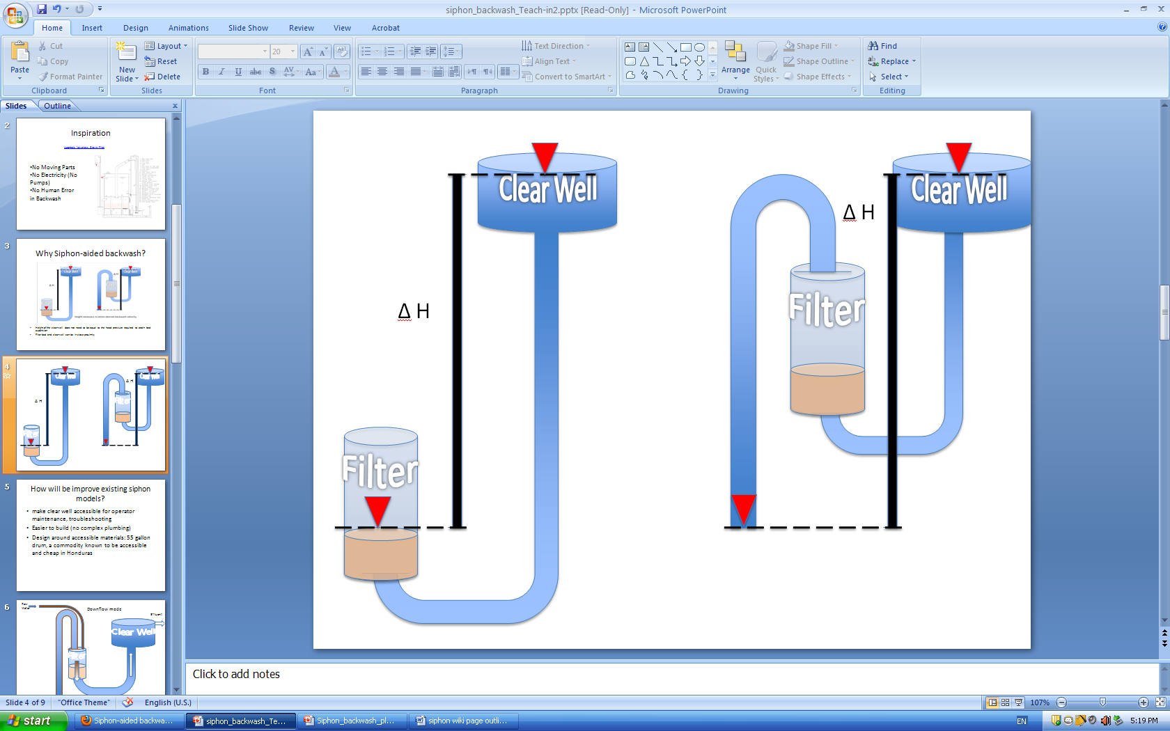
Siphon-aided backwash
The siphon allows for less height clearance between the clear well and filter

Slide 48
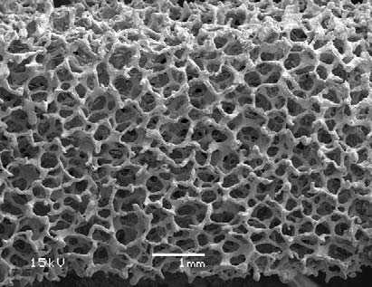
Foam Filtration: Why use foam instead of sand?
Reduce the amount of water that is wasted during a cleaning cycle.
Could be more efficient per unit area in filtration, saving space and ultimately construction costs to implement filtration
Magnification of foam

Slide 49
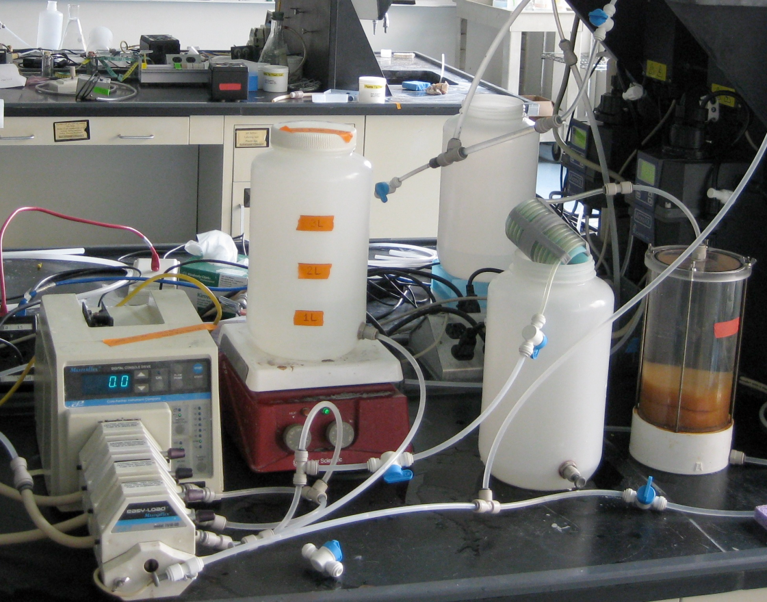
Foam Filtration Subteam
Current laboratory experiments test the ability of foam to filter under a variety of conditions

Slide 50
Suggested background
Willingness to learn new software: MathCAD and Process Controller
Willingness to have flexibility to try new designs and ways of thinking about filtration
Willingness to brainstorm and try new things weekly in the laboratory

Slide 51
Questions?

