Slide 1
Tube Floc Experiments
Sophie Bernat
Team : Laura Floyd Alex O’Connell
Tami Chung Dali Sun

Slide 2
Table of Contents
Introduction
Data analysis
Results
Conclusion

Slide 3
Introduction
Goal:
  Understand flocculation in AguaClara plants
  Study the parameters that influence the results of flocculation.
    Residual turbidity
    Settling velocities

Slide 4
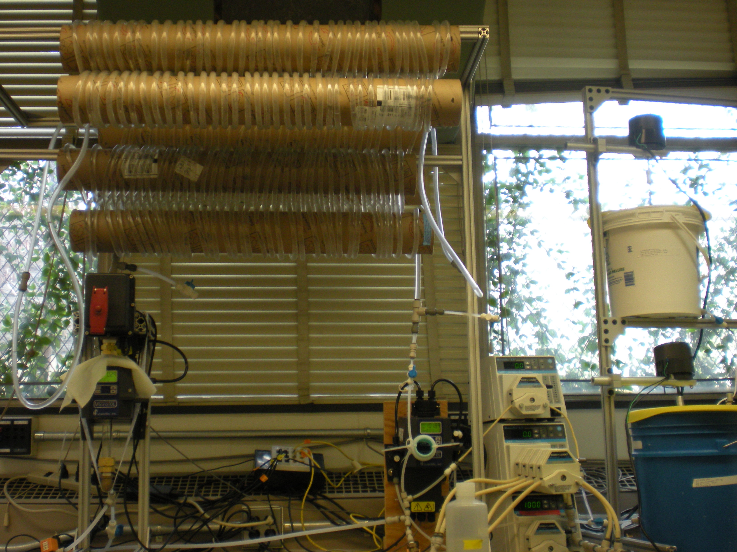
FReTA Experimental Setup:

Slide 5
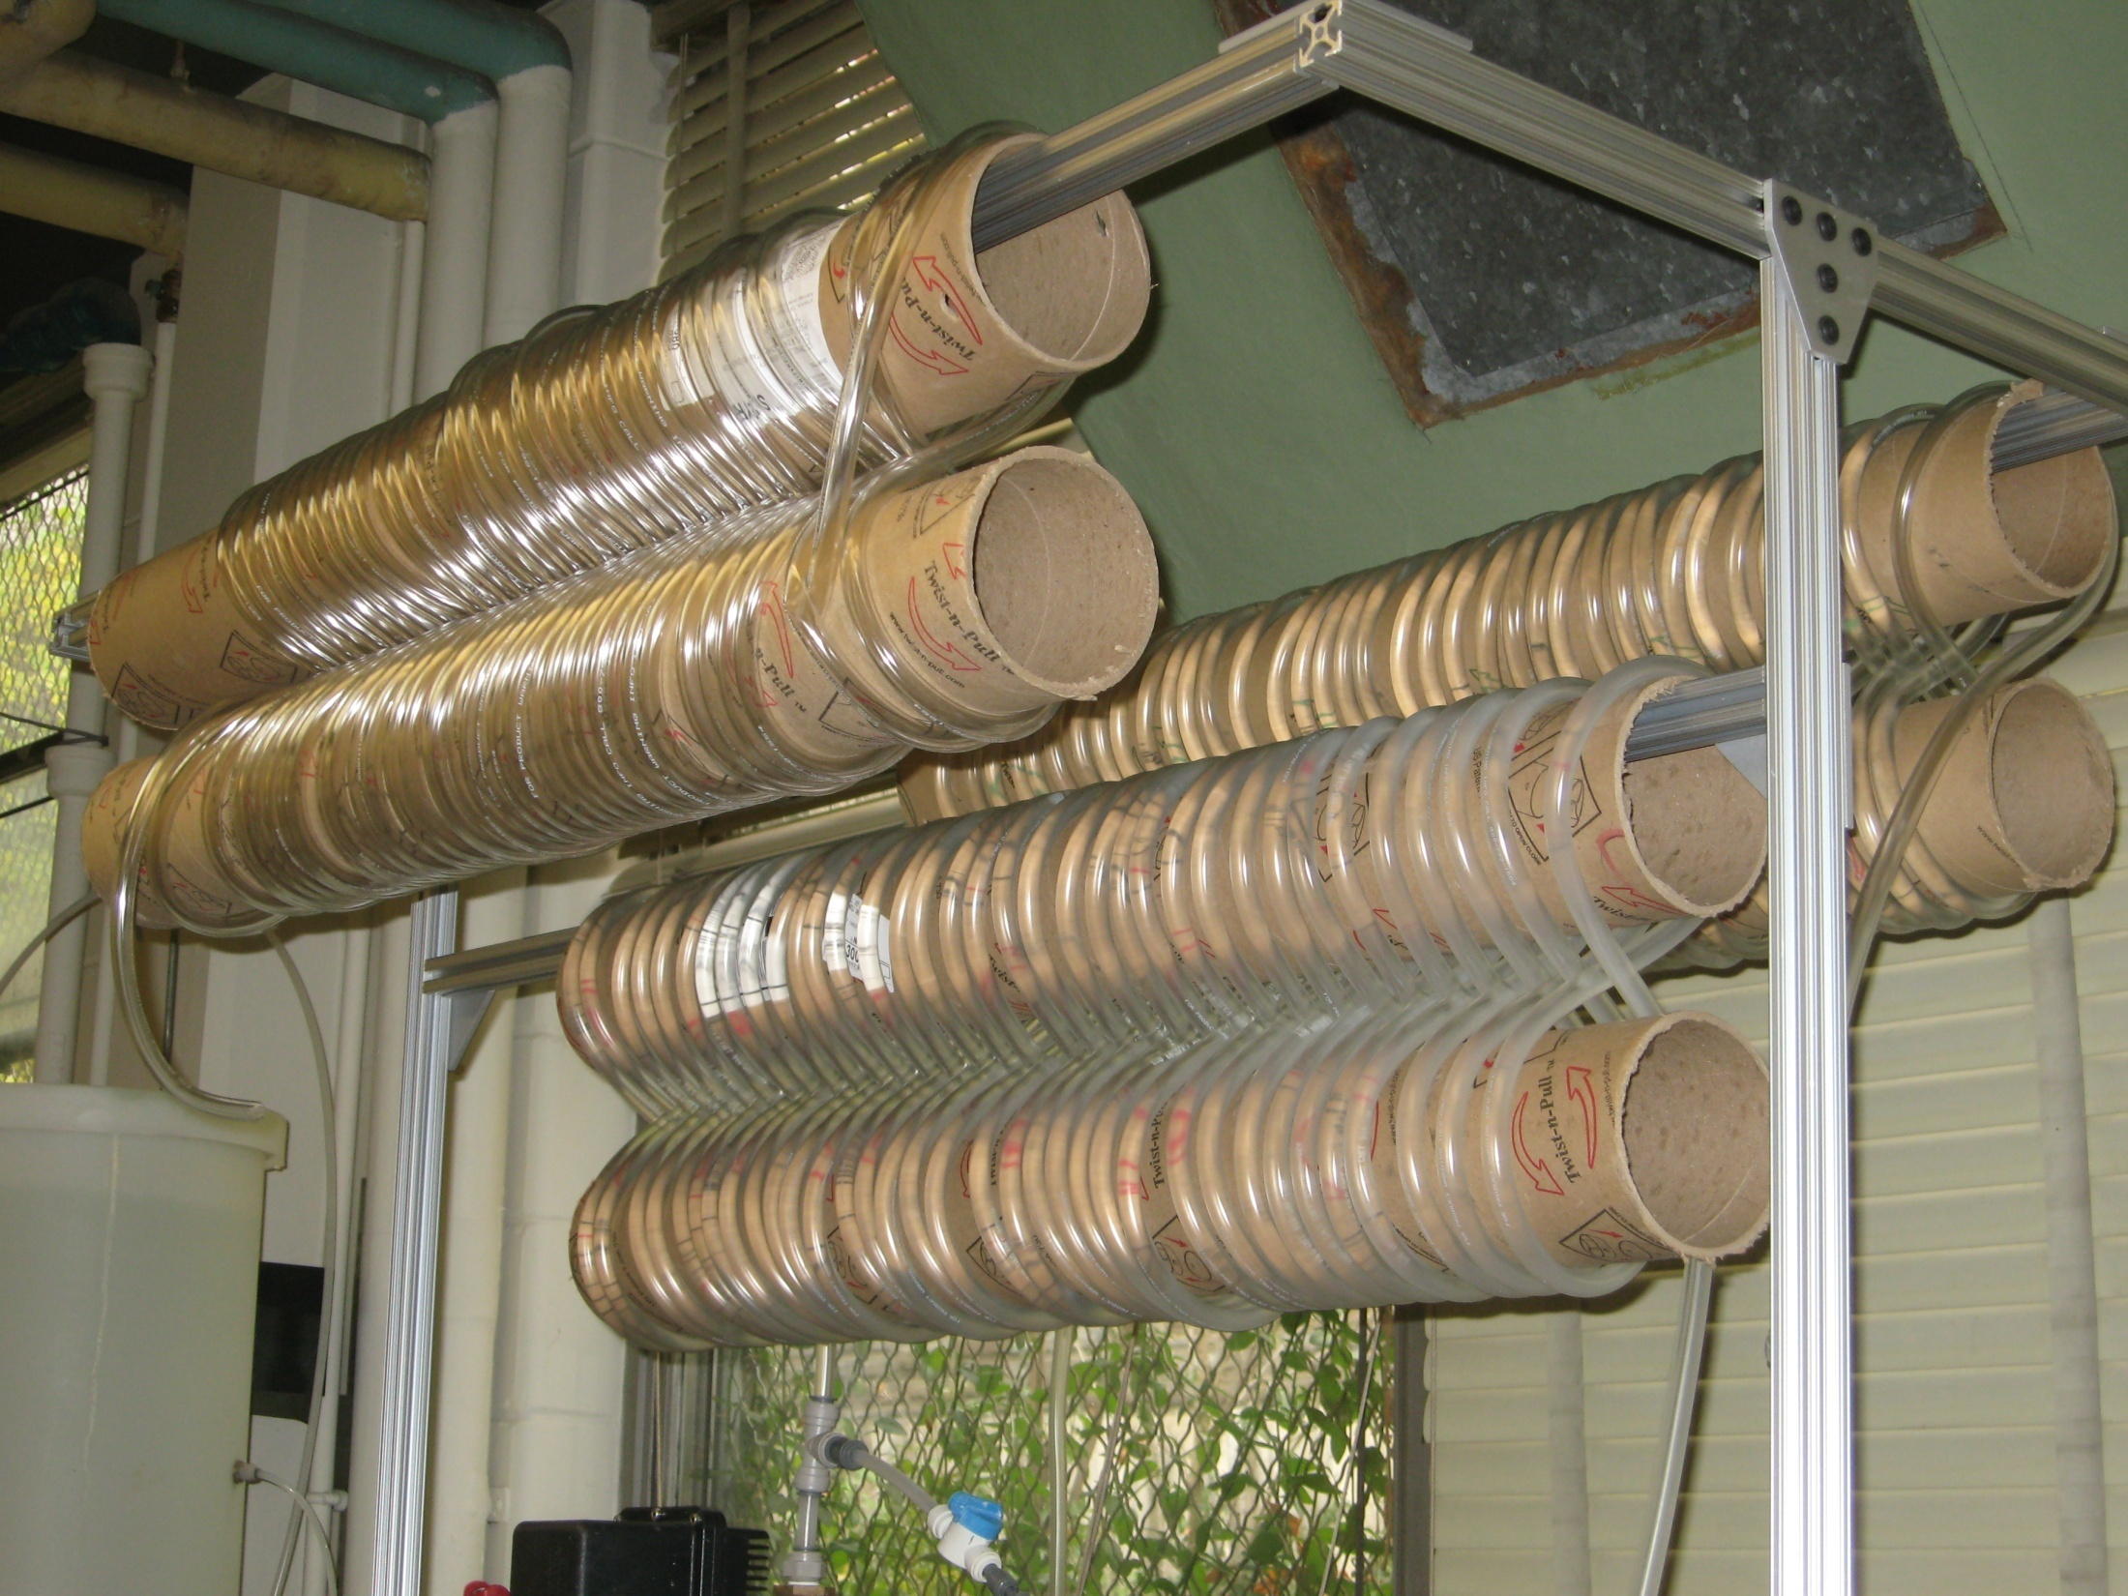
Tube Flocculator

Slide 6
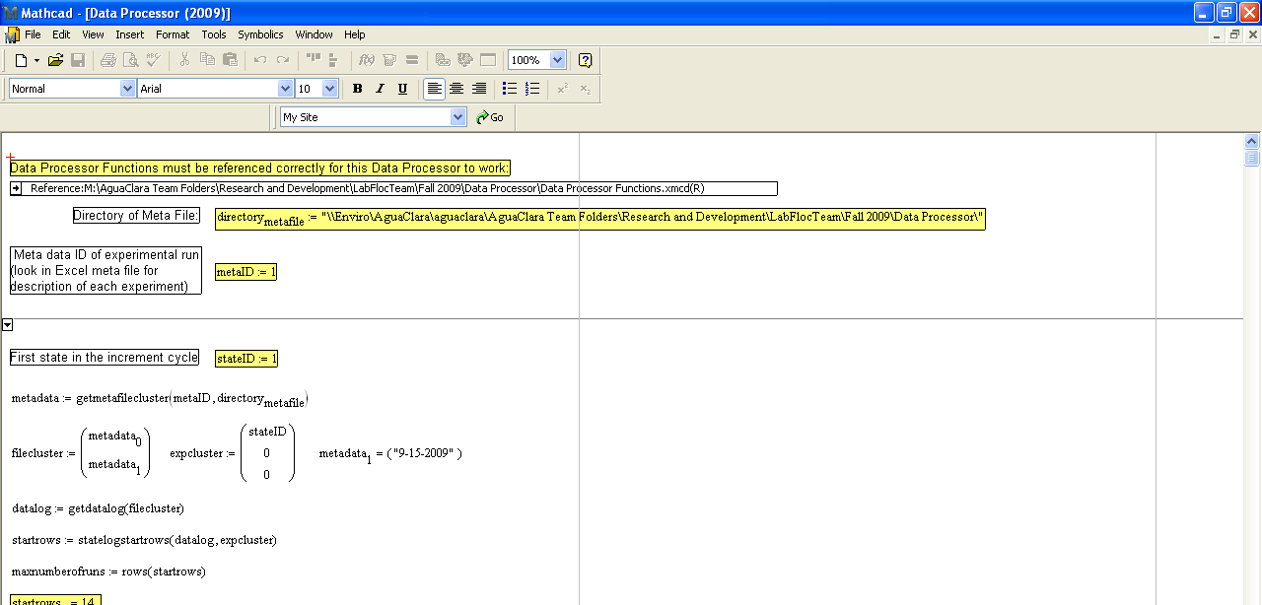
Data Analysis
Essential tool used for analyzing data
    MathCad

Slide 7
Data Analysis
MathCad
  Processes data and presents graphs plotting important information needed for data analysis
Main graphs we used for our experiment:
  Residual Turbidity Graph

Slide 8
Residual Turbidity
Raw data: Turbidity vs. Sedimentation Velocity
Focusing on Residual Turbidity: Residual Turbidity vs. Sedimentation Velocity

Slide 9
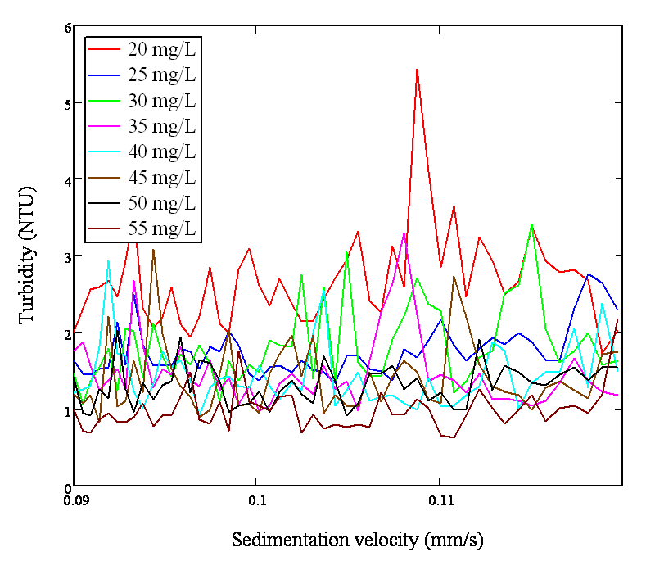
Residual Turbidity vs. Sedimentation Velocity
Alum Dose | Residual Turbidity
20 | 2.663
25 | 1.755
30 | 1.81
35 | 1.497
40 | 1.437
45 | 1.413
50 | 1.325
55 | 0.984
Notes:
100 NTU experiement @ 1st flocculator length.

Slide 10
Varying Alum Dose and Flocculator Length
Goal: To determine the effect of alum dosage and flocculator length on tube flocculation.
Varied alum dosage (increasing by constant increments)
Applied the set alum dosages to three different flocculator lengths.

Slide 11
Results
Effect of the alum dose on flocculation:

Slide 12
Results
Effect of length of the flocculator on residual turbidity:

Slide 13


Results
Effect of length of the flocculator on residual turbidity:
Break up flocs
Steady state
  Floc size disribution constant

Slide 14
Conclusions
Increasing alum dose improves flocculation initially but with diminishing returns as dose increases beyond a certain level

Slide 15
In the Future
Complete our investigation of alum dose and flocculator length by collecting more data to fill in optimal alum dosages for the different influent turbidities
Run a test for FReTA
Begin investigating how pH affects flocculation

Slide 16
Thank you
Question ?

