Slide 1
Tube Floc Final Presentation
12.11.2010
Karen Swetland Alex O’Connell Tami Chung

Slide 2
Agenda
Introduction
  Theory behind Flocculation
  Goals and Objectives
Experiments
  Improvements and changes made to the apparatus
  Study of minimum coagulant dose required to induce rapid flocculation
Results

Slide 3
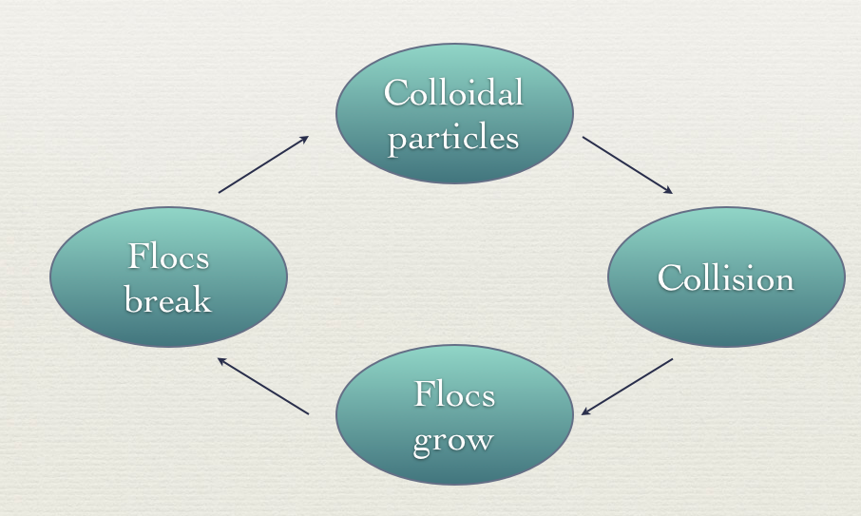
Flocculation

Slide 4
Flocculation
Sedimentation

Slide 5
Goals/Objectives
Fix and improve apparatus setup
Study relationship between coagulant agent and flocculation
Study the effects of floc breakup on flocculation performance
Study how differential settling influences flocculation performance
How addition of organic matter in water affects flocculation

Slide 6
Goals/Objectives
Fix and improve apparatus setup ✓
Study relationship between coagulant agent and flocculation ✓
Study the effects of floc breakup on flocculation performance
Study how differential settling influences flocculation performance
How addition of organic matter in water affects flocculation

Slide 7
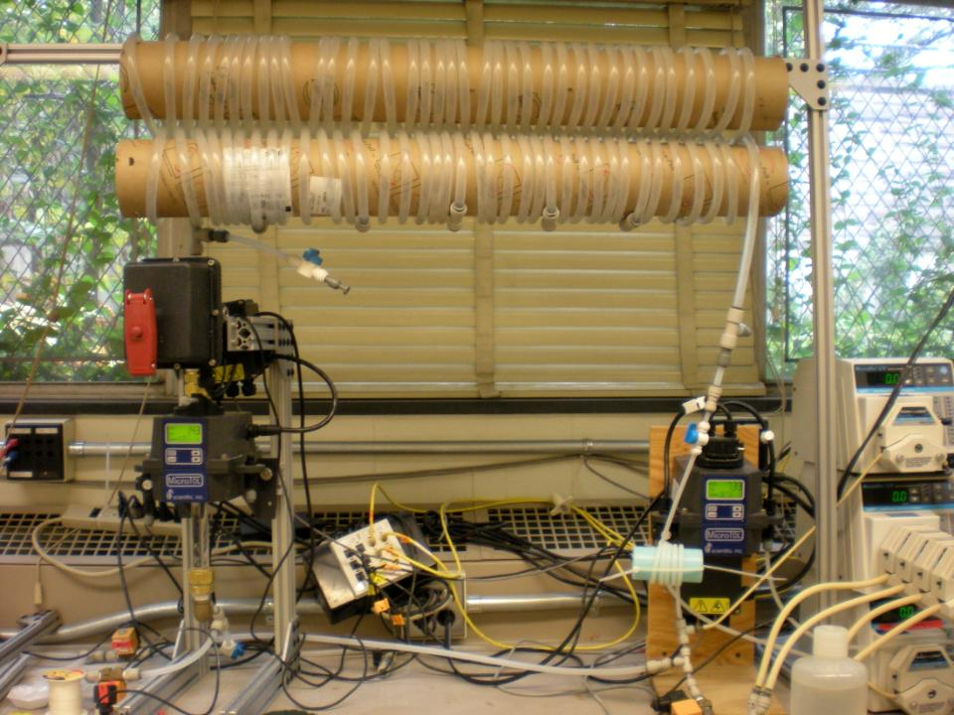
FReTA Experimental Setup
Notes:
A general view of FReTA and the tube flocculator

Slide 8
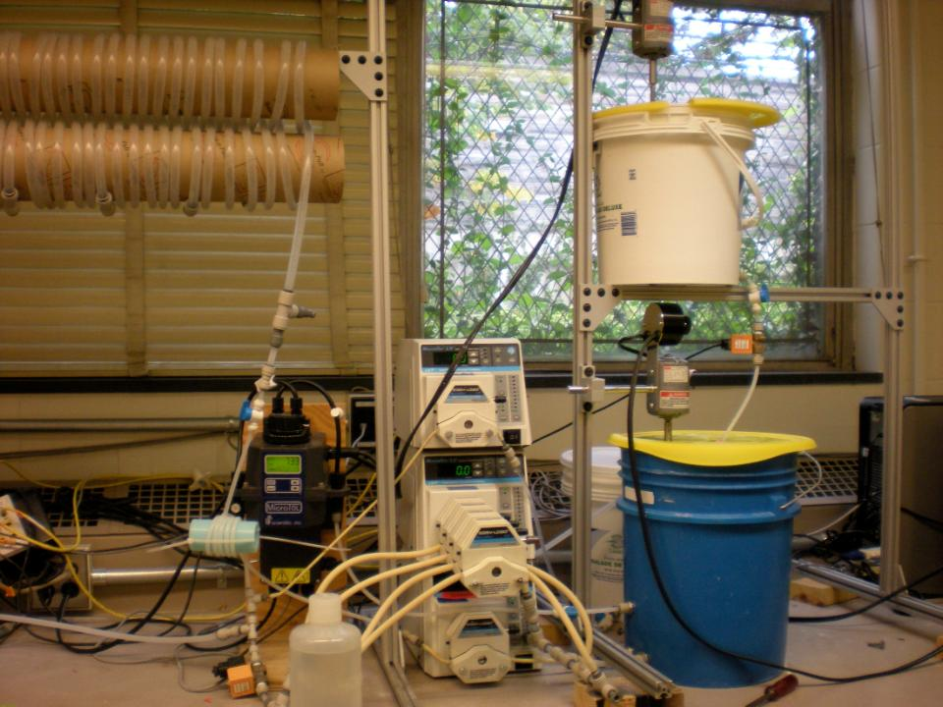


Clay Stock Bucket
Raw Water Bucket

Slide 9
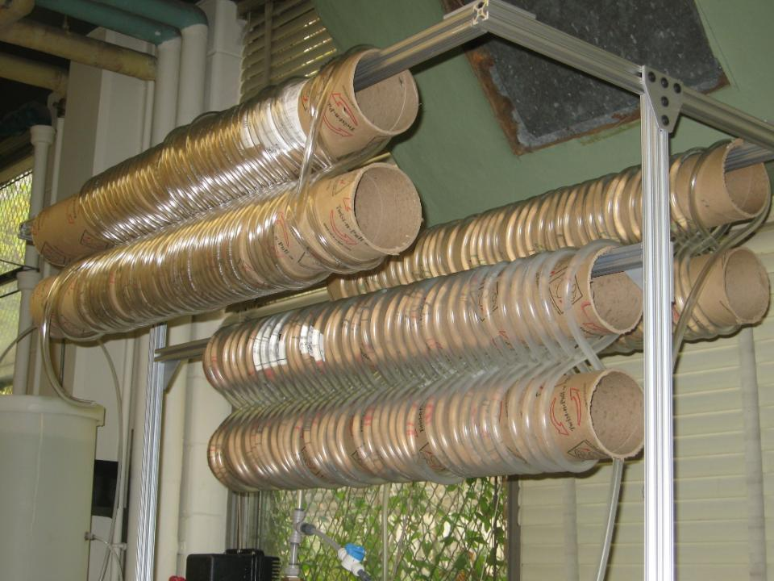
Tube Flocculator

Slide 10
Experimental Setup: Adjustments to Apparatus

Slide 11
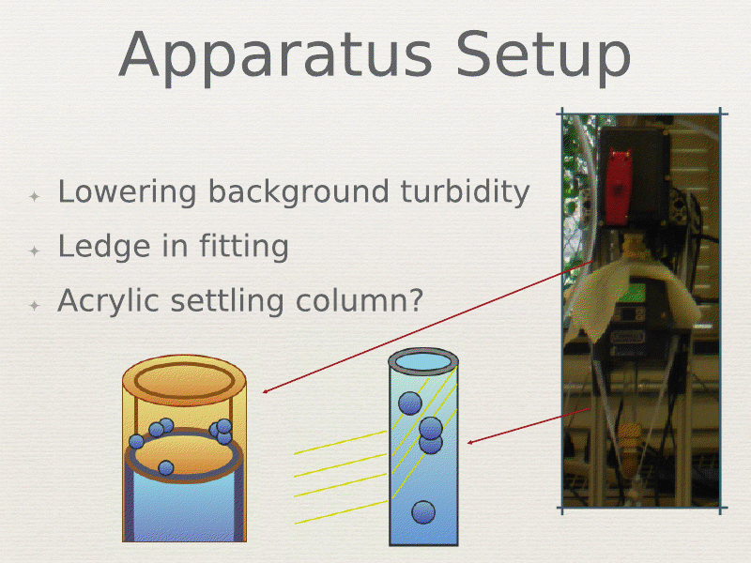

Slide 12
Pressure Sensor Test
Pressure

Slide 13
Pressure Sensor Test
Ramp down duration ∝ length of flocculator
m = Proportionality constant (8 sec)
X = Flocculator length parameter (1,2,3)
b = Time required for pump to decelerate to 0 mL/s (4 sec)
Ramp down duration = mX +b

Slide 14
Coagulant Dose
&
Rapid Flocculation

Slide 15
Experimental Design
Turbidity-> Chemical | 5 NTU | 15 NTU | 50 NTU | 150 NTU | 500 NTU
Alum, 56m | 0.187-1.67 | 0.187-1.67 | 0.187-1.67 | 0.187-1.67 | 0.187-1.67
Alum, 82m | 0.187-1.67 | 0.187-1.67 | 0.187-1.67 | 0.187-1.67 | 0.187-1.67
PAC, 56m | 0.131-0.813 | 0.131-0.813 | 0.131-0.813 | X | X
PAC, 82m | 0.131-0.813 | 0.131-0.813 | 0.131-0.813 | X | X

Slide 16
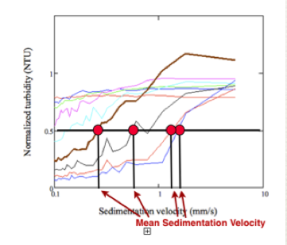
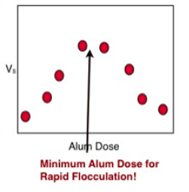
Data Analysis
1. Find mean sedimentation velocity at 0.5 NTU
2. Find the maximum point of ∆Vsed/∆(Coagulant dose) vs Coagulant dose

Slide 17
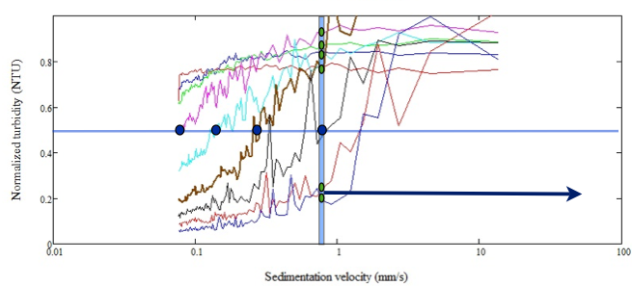
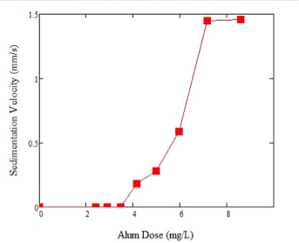
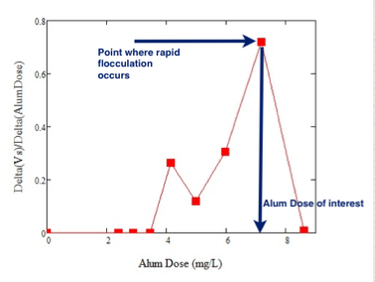
Data Analysis

Slide 18
50 NTU Results
50 NTU PAC, 56m- the blue line was chosen

Slide 19
Results
Turbidity-> Chemical | 5 NTU | 15 NTU | 50 NTU | 150 NTU | 500 NTU
Alum- 56m | 0.967 | 0.805 | 0.671 | X | X
Alum- 82m | 0.466 | 0.559 | 0.466
PAC – 56m | 0.813 | 0.47 | 0.279 | X | X
PAC – 82m | 0.564 | 0.47 | 0.279 | X | X
Al(NO3)3 | X |  |  | X

Slide 20
Rapid Mix: Does it matter?
FReTA should be able to tell us!
Identical experiments were performed with the exception of the rapid mix unit
  In one experiment, rapid mix remained
  In another, rapid mix was removed and replace by a straight section of tubing

Slide 21
Alum, 50 NTU, 84 m
With rapid mix
Without rapid mix

Slide 22
Alum, 50 NTU, 84m
Red is No Rapid Mix Blue is With Rapid Mix

Slide 23
PAC, 50 NTU, 56m
With Rapid Mix
No Rapid Mix

Slide 24
PAC, 50 NTU, 56m
Blue is With Rapid Mix
Red is No Rapid Mix

Slide 25
Future Goals
Complete study on rapid flocculation
Continue studying how rapid mix effects the development of flocculation
Add in organic matter (humic acid)

Slide 26
Questions?

