Slide 1
Tube Floc Team
Teach-In Fall 2010
Karen swetland
Alex O’Connell
Tami Chung
10/19/10

Slide 2
Agenda
Theory on Flocculation
Experimental Setup
Fall Research Initiatives

Slide 3
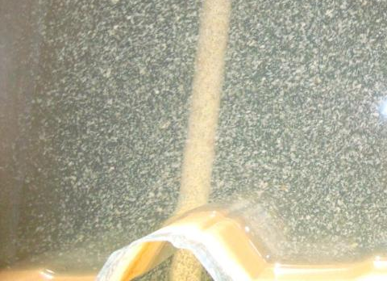
Theory on Flocculation

Slide 4
Theory on Flocculation
What causes the turbidity of the water?
  Colloidal particles
Electrostatic barrier
As the colloid moves to the right, the electrostatic barrier (repulsion) increases

Slide 5
Flocculation Theory
Flocculation decreases the electrostatic barrier in a process called charge neutralization
  Changes the charge of the particles
  Introduces positively charged particles
Coagulant
  Alum [Al₂(SO₄)₃*14.3H₂O]
  Poly Aluminum Chloride (PACl) [(AlO₄Al₁₂(OH)₂₄(H₂O)₁₂)⁷⁺]
+
+
+
+
+

Slide 6
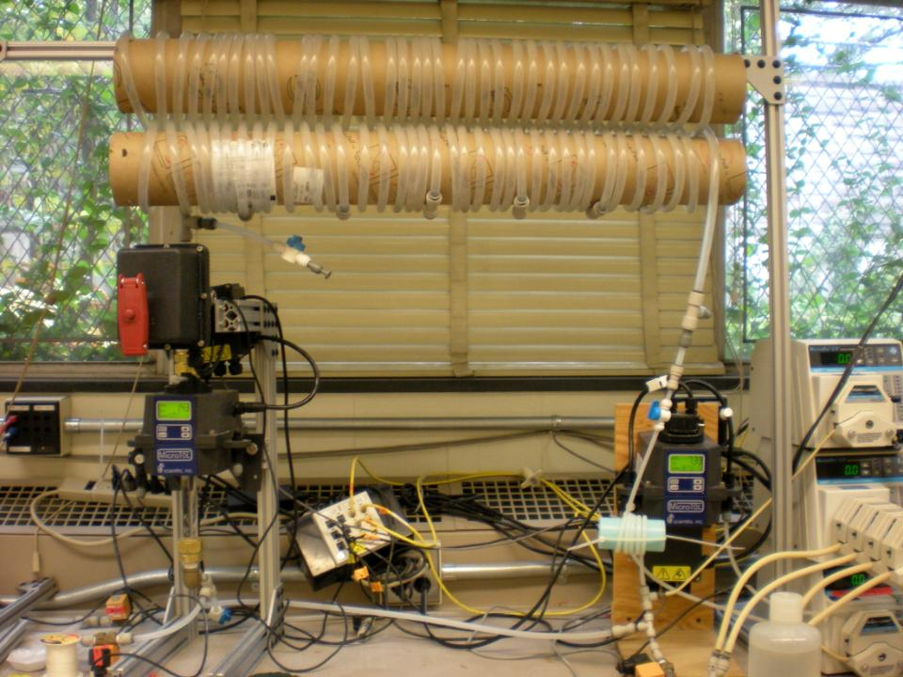
FReTA Experimental Setup:
Used to analyze flocculation
Notes:
A general view of FReTA and the tube flocculator

Slide 7
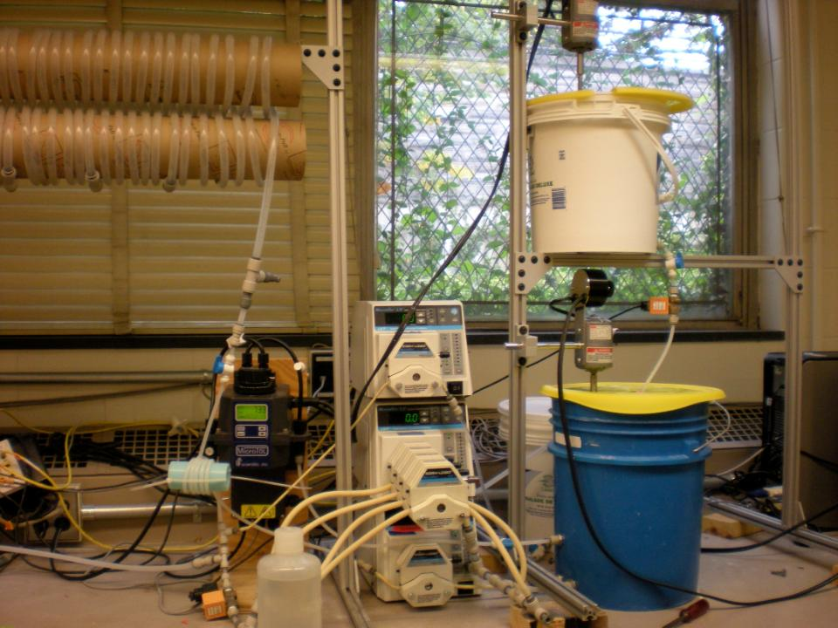


Clay Stock Bucket
Raw Water Bucket

Slide 8
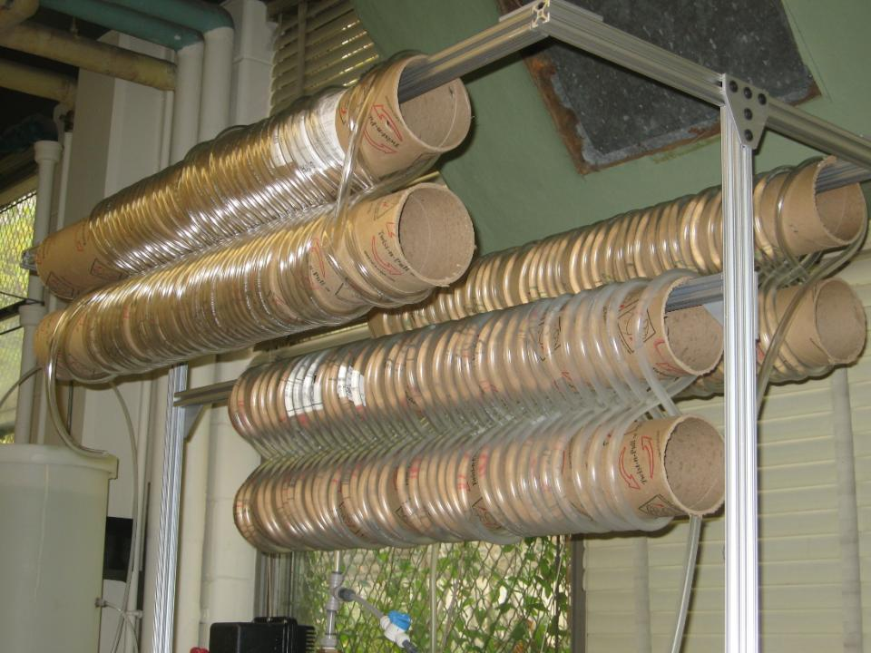
Tube Flocculator

Slide 9
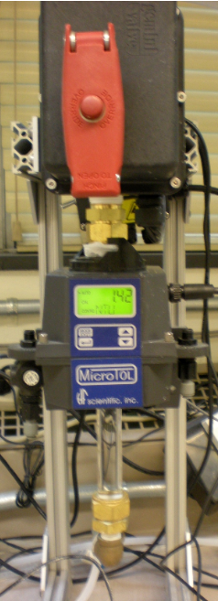
Ball Valve
Effluent Turbidimeter
Settling Column
Notes:
Final portion of the apparatus: FReTA! ☺

Slide 10
Data Processing in MathCAD
As reported in “method for quantitative analysis of flocculation performance”

Slide 11
Data Processing in MathCAD
Retrieve data from files
Assign to variables
Transform to V_{s}
Smooth based on the average of 36 points
Normalize based on the average loading state turbidity
Raw and smoothed/normalized turbidity data plotted against sedimentation velocity at alum dose of 5.06 mg/L and 30 NTU influent turbidity in a 56m flocculator.

Slide 12
Data Processing in MathCAD
Calculate standard deviation for each point
Plot as error bars to show the accuracy of smoothing
Smoothed data with error bars representing one standard deviation above and below the average. Standard deviations are calculated from the 36 data points that are averaged to create each smoothed point.

Slide 13
Data Processing in MathCAD
Estimate the mean and variance of the normalized data
Use pgamma and genfit to fit a cumulative distribution function (CDF) to the data
Take the derivative of the CDF to get the probability distribution function (PDF)
Smoothed/normalized data, fitted CDF and fitted PDF plotted against sedimentation velocity.

Slide 14
Data Processing in MathCAD
Perform experiments at differing coagulant doses
Compare smoothed data to determine the minimum dose required for rapid flocculation
  Why?
Smoothed data sets with varying alum doses.

Slide 15
Fall 2010 Research

Slide 16
Role of Alum in Flocculation
Past experiments: Right combination of flocculator length and alum dose
  More questions
    Floc breakup
    Differential Settling
What we need: a more focused research on a single parameter

Slide 17
Experimental Design
Rapid Flocculation
  Sensitive range where changes in apparatus can be detected easily
Test a small range of alum doses to locate the transition to flocculation
Smoothed data sets with varying alum doses.

Slide 18
Obstacles and Progress
Apparatus
  Ledge on fitting
  Slipping Settling Column
Data Accuracy
  Background NTU
  Pressure Sensor Experiments
Raw and smoothed/normalized turbidity data plotted against sedimentation velocity at alum dose of 5.06 mg/L and 30 NTU influent turbidity in a 56m flocculator.

Slide 19
Future Experiments
Test the new acrylic settling column
Find right time duration for fluid flow transition
Begin experiments investigating minimum alum dose required for rapid flocculation
Compare minimum alum dose to minimum PACl dose
Conduct experiments on rapid mix at minimum alum dose

Slide 20
Thanks for listening!
Any questions?

