Slide 1
Tube Floc
Final Presentation Summer 2010
Karen Swetland
Craig Bullington
Rami Bechara
Tami Chung

Slide 2
Agenda
Purpose of the Tube Floc team
Summer work
  Replicating Spring 2010 experiments
  Responding to comments from the reviewers of Ian Tse’s “Method for Quantitative Analysis of Flocculation Performance”
    Test suspension experiment
    Data processing revamped

Slide 3
Purpose of tube floc team

Slide 4
Flocculation
Colloidal Particles
Collisions!
Flocs grow
Flocs break

Slide 5
Flocculation
Colloidal Particles
Collisions!
Flocs grow
Flocs break
Sedimentation

Slide 6
Summer work

Slide 7
Questions to answer:
Can we validate settling column in FReTA with standard particles?
Is data being processed in the most accurate and efficient manner?
How does floc breakup affect the residual turbidity? Can we manipulate floc breakup to increase performance?
How does differential settling affect performance and should it be reported?
How does the addition of organic matter to synthetic raw water affect performance?

Slide 8
Questions to answer:
Can we validate settling column in FReTA with standard particles?
Is data being processed in the most accurate and efficient manner?
How does floc breakup affect the residual turbidity? Can we manipulate floc breakup to increase performance?
How does differential settling affect performance and should it be reported?
How does the addition of organic matter to synthetic raw water affect performance?

Slide 9
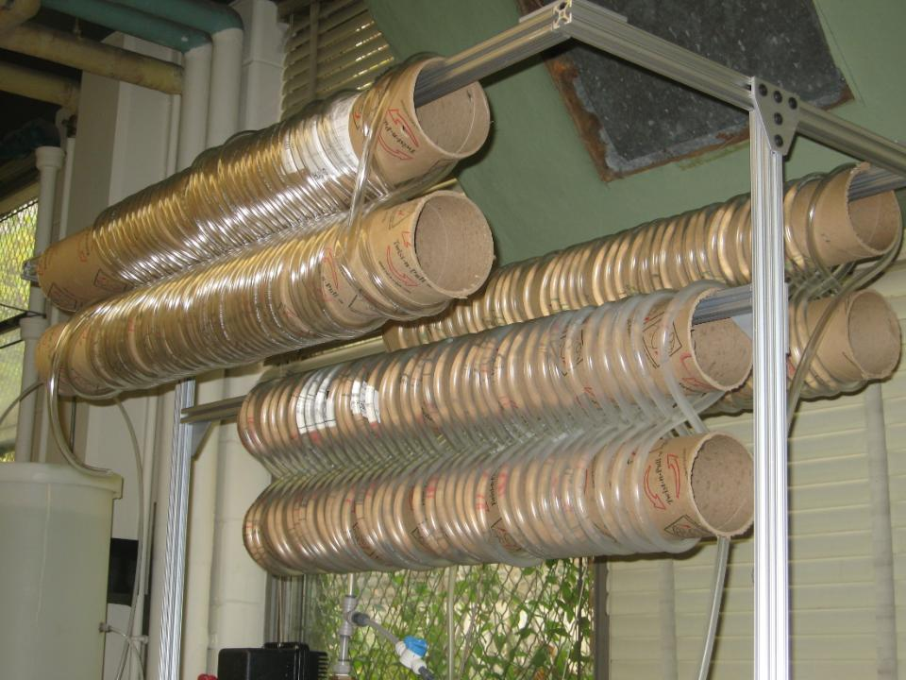
Replicating spring 2010 experiments
  Varying the alum dose and flocculator length for various influent turbidities
Alum: 0-100 mg/L
Length: 28m, 56m, 84m
Gθ: 20405, 40810, 61210
Influent Turbidity: 5, 100, 500 NTU

Slide 10
Experimental data
Mean Residual Turbidity vs. Alum Dose (500 NTU; Length 1)
Mean Residual Turbidity vs. Alum Dose (Length 1; All Turbidities)

Slide 11
Experimental data
Mean Residual Turbidity vs. Alum Dose (500 NTU; All Lengths)
Mean Residual Turbidity vs. Alum Dose (5 NTU; Lengths 1 &3)

Slide 12
Responding to reviewer comments

Slide 13
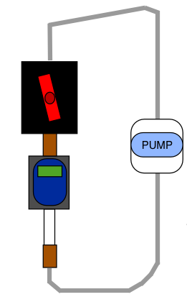
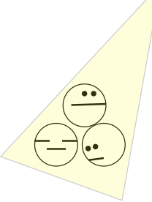
Test suspension
Validation of FReTA’s settling column
Input known mixture of distilled water and particle beads
Compare experimental settling velocities of the control and FReTA experiments to
theoretical settling velocities.
Experimental Set-up:
  Closed Circuit with FReTA
  Settling Column and Turbidimeter

Slide 14
Test suspension
Stokes settling velocities were calculated for the particles
A similar design was used in Adachi et al. (1997)
Confirmed by the sedimentation of standard latex spheres.
No physical reason to expect performance differences between FReTA and the Adachi apparatus.
Table 1: Mean sedimentation velocity averaged over all trials
Predicted | Control | FReTA Suspension
0.153 mm/s | 0.193 mm/s | 0.254 mm/s

Slide 15
Other comments
Influence of narrow tubing
  In all cases, error < 1%
Limiting factors on particle size/settling velocity
  Turbidimeter response time, duration of settle state, and smoothing technique
  In all cases, data is able to characterize the relevant flocs
Documenting laminar flow conditions
  Flow rates > 15.75 mL/s represent turbulent flow, data to be eliminated
Replicating the system
  Resources were provided online

Slide 16
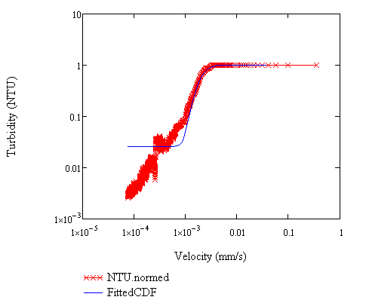
Comments on data processing
Response to bimodal particle size distribution
  Current gamma distribution does not accurately characterize the tail section of most datasets

Slide 17
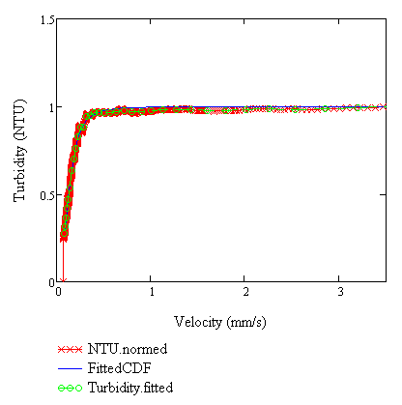
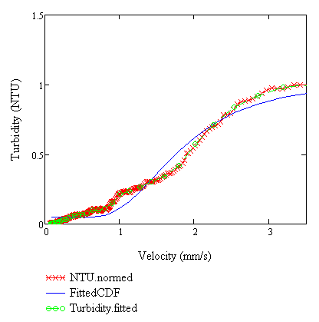
Bimodal distribution
We are currently working on an algorithm that chooses between uni- and bi-modal distributions
“Fitness” of the distribution is determined by mean squared error
Unimodal Distribution
Bimodal Distribution

Slide 18
Smoothing Techniques
Ian’s technique
  Averaging over nine points
  Median of five points
  Essentially smoothing over 45 points (seconds)
Claimed that smoothing was necessary for the gamma fit to work
  Not true! Some data can be fit with no smoothing
  Most data can be fit with only 2-point averaging
How should we smooth?

Slide 19
Smoothing techniques
Tolerance/average-based smoothing
Weighted average smoothing
Tolerance: controls iterations on numerical methods
  0.01 to 0.1
Smoothing: averages over several points
  2 to 10
Ian used a tolerance of 0.25
Divides possible settling velocities into uniform intervals
Creates a weighted average of points within each interval
Currently reduces 1800 data points to 55 points

Slide 20
Future work
Experiments
Data Processing
Adjusting the energy dissipation rate to induce/reduce floc break up
Monitoring the effects of pH and NOM on flocculation
Controlling and characterizing differential settling
Ensure the accuracy of bimodal fit
Streamline the code to minimize memory usage
Add comments on the most recently added/modified sections

Slide 21
QUESTIONS?

