Slide 1
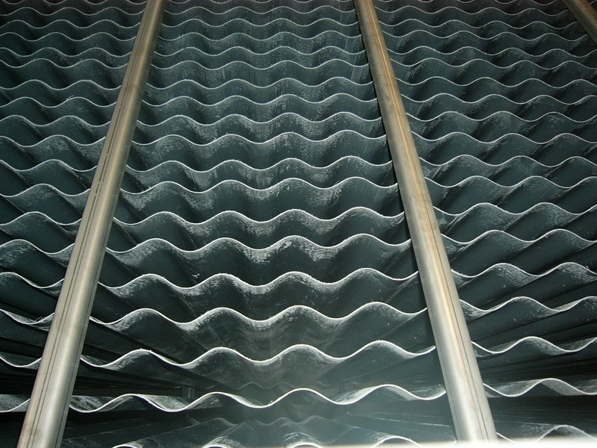
Plate Settler Spacing
Zachary Romeo
Tanya Cabrito
Alexander Duncan
Richard Pampuro
tiara Marshall

Slide 2
Outline
Brief Overview (problem and system)
Previous Results and System Alterations
Theory
Planned Experiments
  Related Calculations/Logic
  Required Materials
  Expected Results
  Literature Search Summary
  Floc Formation Model

Slide 3
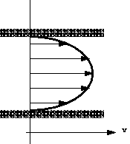
Brief Overview – The Problem
Investigating floc rollup – failure due to velocity gradients at capture velocities expected to achieve turbidity of < 1NTU
Cause – High velocity gradients due
to small spacing

Slide 4
Where we left off – Previous results
Previous experiments failed to separate performance deterioration due to capture velocity from velocity gradients
    Mainly because capture velocities were too high (9-27 times higher than AguaClara capture velocity of 10 m/day)

Slide 5
Turbidimeter Settling
Problem Recap:
Clay Test Results:
Solutions:
- Manifolds
- Reservoir

Slide 6
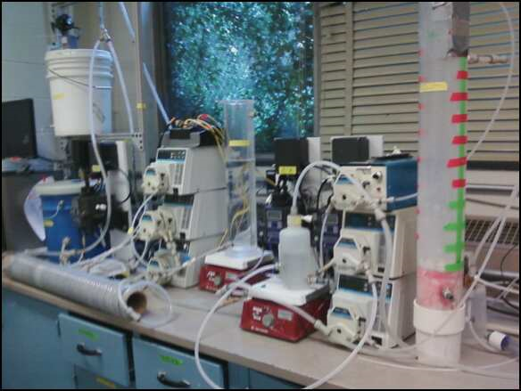
The setup:
Characteristics
  100 NTU water influent
  100 m/day column upflow velocity
  Alum dosage – 45 mg/L
Alum Stock
Bundled Tubes and Manifold
Reservoir
Clay Stock
Tube Settler Effluent
Floc Blanket Effluent
Floc Blanket
Pinch Valve
Raw Water Turbidity
Flocculator
100
Settling Column
Rapid Mix Tube
Raw Water Line
Raw Water Tank

Slide 7
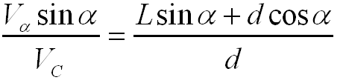
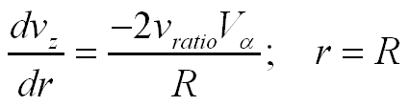
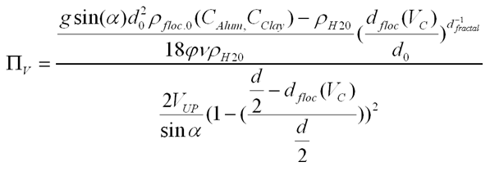
Theory
Equations
    Where v_{ratio} reflects geometric considerations
    = 1.5 for plates and 2 for tubes
Π_{V} failure criterion = (Terminal Velocity of floc/Experienced Velocity due to velocity gradient)

Slide 8
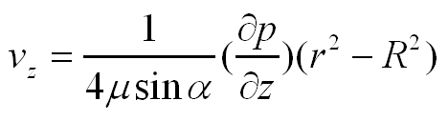
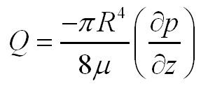
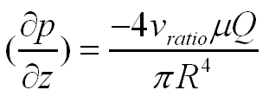
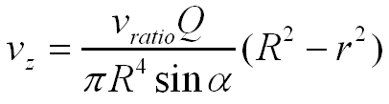
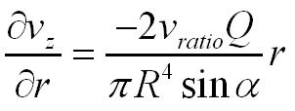
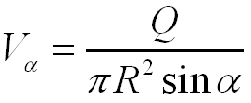
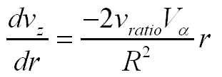
Linearized Velocity Gradient Derivation
Starting with: [Eq. 1]
Knowing rearranges to [Eq. 2]
Substitute [Eq. 2] into [Eq. 1] to get: [Eq. 3]
δ/δr([Eq. 3]) to get [Eq. 4]
Substitute into [Eq. 4] to get
Evaluate the gradient at the wall to get

Slide 9
List of Planned Experiments
Clay Experiments
Failure Due to Velocity Gradient Experiment
Floc Settling Velocity Distribution Experiment
Natural Organic Matter Experiments
Repeat above experiments using NOM stock instead of clay stock

Slide 10
Velocity Gradient Experiment (Clay)
Goal: Investigate settler failure by velocity gradients while holding capture velocity constant at 10 m/day (0.12 mm/s, AguaClara value)
Diameters chosen represent a good range to test for AguaClara plants (5/8”,1/2”,3/8”,1/4”)
Adjust length to get a range of Vup and velocity gradients.
Vup range to show failure: 1 mm/s no failure – control
2 and 5 mm/s are used as failure cases
Check Failure by Π_{V} term

Slide 11
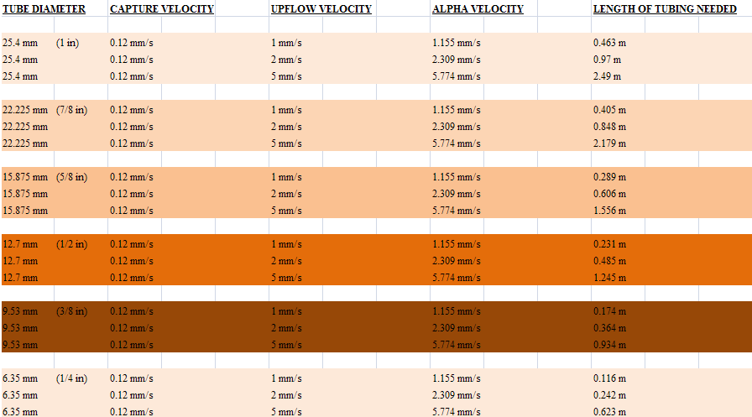
Velocity Gradient Experiment (Clay)

Slide 12
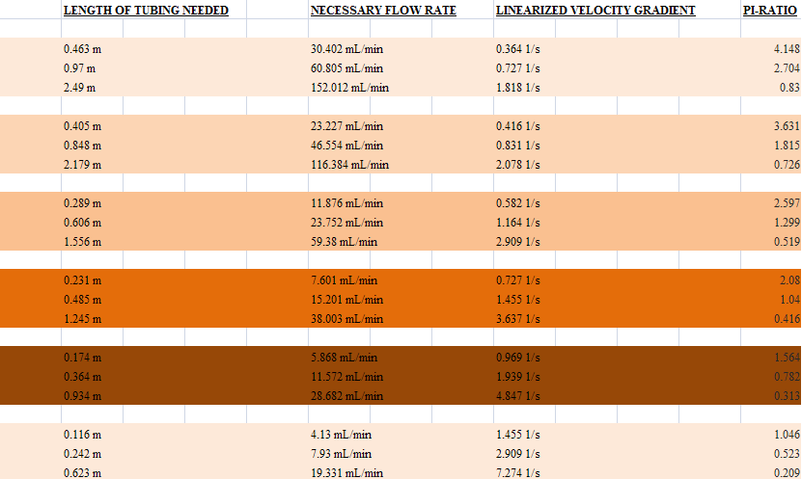
Velocity Gradient Experiment (Clay)
Pi values less than one indicate expected failure.

Slide 13
Expected Results for Clay
What conditions does these value correspond to?
We expect failure to occur at a certain velocity gradient corresponding V_{c} and that threshold exists such that increasing the velocity gradient provides no further worsening of performance.
Turbidity (NTU)
1 NTU
velocity gradient (1/s)
How does the failure point move with varying capture
velocities?
v_{capture1} < v_{capture2}
Turbidity (NTU)
1 NTU
vcapture2
vcapture1
diameter

Slide 14
Premise for NOM Experiments
Switch out clay for NOM to form less dense flocs.
Hypothesize that less dense flocs will roll up at lower velocity gradients (larger diameters)
Expected results relative to clay
Hope that this may provide more insight into the 5 cm rule for plate settler spacing
1 NTU
vcapture2 (NOM)
vcapture2 (clay)
diameter

Slide 15
Settling Velocity Distribution Experiments
Ramp down Vc while ensuring that Π_{V} >> 1 in order to get a general picture of settling velocity profile.
Be able to better quantify and predict the magnitude of failure for velocity gradient experiments
Assess the consistency of floc blanket properties

Slide 16
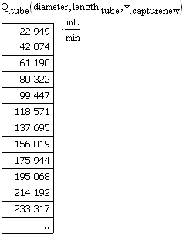
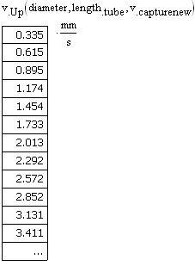
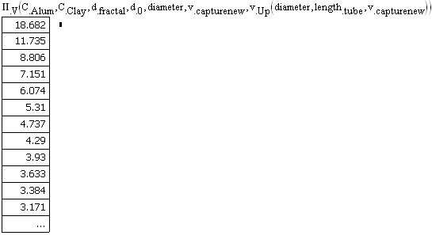
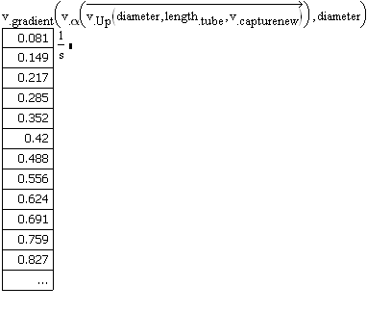
Calculation and Tube Dimensions
Tube length: 18 cm
Tube diameter: 3.81 cm (1.5 in)

Slide 17
Literature Search Summary
Most rigorous modeling of tube and plate settlers available (Fong Leung & Probstein, Lamella and Tube Settlers: Model and Operation, 1982) is empirical; it explains performance in terms of a two-layer model.
  Key parameters in characterizing a clarification systems based on this model are the different densities of the two layers (clarified and sludge) and the ratio of clarified effluent height to the height of the settler channel.
  The article recommends a lamella spacing of 4 cm and a tube diameter of 2.5 cm but does not explain the rationale for these values.
  AguaClara has already seen this article and would prefer to find guidelines that have been more rigorously tested for performance.
The following articles have superior models, but it would take a rigorous analysis to apply those models to our system’s operating conditions:
  Okoth, Centikaya, and Briiggemann, On hydrodynamic optimisation of multi-channel counter-flow lamella settlers and separation efficiency of cohesive particles, Chemical Engineering and Processing, 2008, 47 (1) : 90-100.
  J. Ziolo, Influence of the system geometry on the sedimentation effectiveness of lamella settlers, Chem. Eng. Sci. 51 (1) (1996) 149-153.
One source not easily available that may have clear-cut guidelines on spacing:
  Chen, Y. R. (1979). Design criteria for inclined tube settlers. AIT master’s thesis, Asian Institute of Technology, Bangkok.

Slide 18
A New Approach to Floc Modeling
Integration of collision theory with KMC
  Computationally inexpensive fine grain model
  Allows for diverse length scales
  Framework for stochastic processes
Model allows for examining population dynamics of floc size and collision outcomes
Improves upon current models by simulating systems with no analytic solution
  Permits incorporation of potentially complex flow geometries
  Complex particle geometries to more accurately capture physics.

Slide 19
Stochastic Modeling with KMC
Transition probability
State probability
(concentration)
Probability density
Transition probabilities from collision theory, for example:

Slide 20
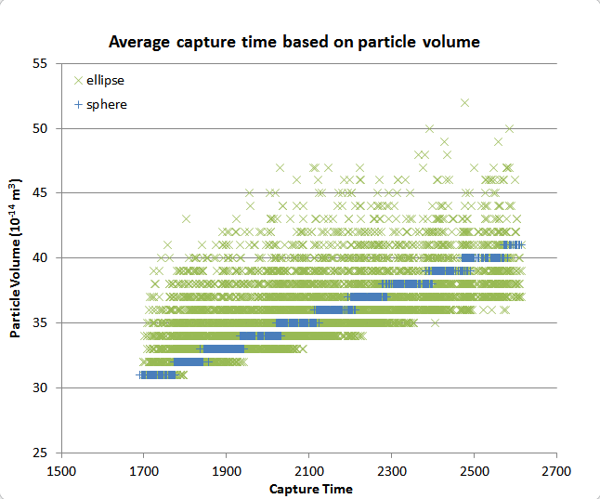
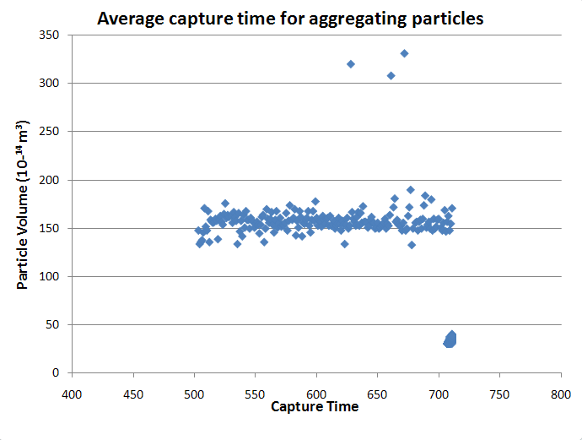
Model Data Generation

Slide 21
Questions?

