Slide 1
Outreach Team Teach-In
Fall 2010: AguaClara
Eun Gi Chung
Karah Conklin
Will Maher
Alexander Matthews
Rob Solaski

Slide 2

This Semester’s Projects
On campus Presentations
Fundraising
  Viamericas
  Wegmans/
  Pepsico Grant
  Benefit Concert – Earth Day
Media
  NYTIMES
  National Geographic
  Blue Legacy
Revised website
AguaClara Video

Slide 3
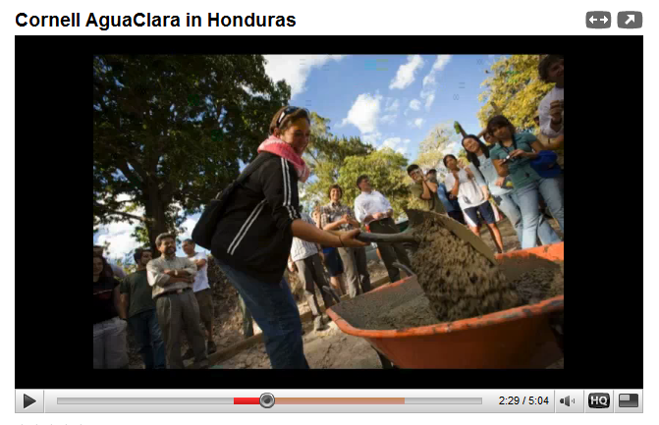
Presentations
Requested by faculty and peer advisors
HS Class
PowerPoint Presentation
Demo Plant
YouTube slide-show

Slide 4

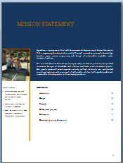
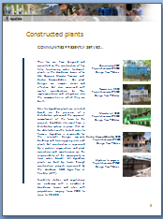
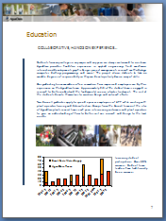
Sponsorship Package
Organized summary of AguaClara’s purpose, past work, and future developments
Intended to gain financial support from corporate and non-profit sponsorships

Slide 5
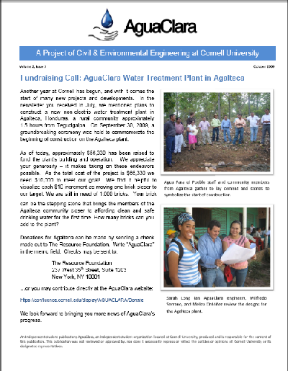
Alumni NewsLetter
Announced groundbreaking of Agalteca Plant
Effort to raise remaining $10,000
Newsletter layout template created

Slide 6
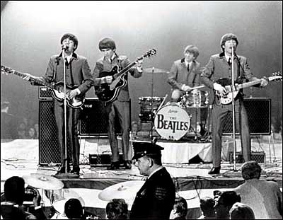
Benefit Concert
The Nines, College Town
Dinner starting at 6:30pm
  10% of proceeds go to AguaClara
Concert tickets

