Slide 1

Low Flow SRSF
Christian Compton, Alli Hill, Amanda Rodriguez, and Sam Taube

Slide 2

Summer Challenge
To design a Low Flow Stacked Rapid Sand Filter
Implement technology implemented in the full scale filter in Tamara and the pilot scale model in B60B
Modify:
  Inlet & Outlet systems
  Manifold system – constructability
  Backwash & Siphon systems
  Consider filter shape, size, material, open vs. closed

Slide 3
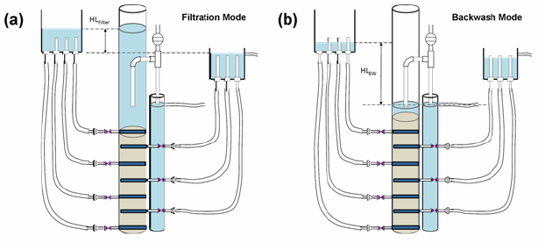
Diagram of the pilot-scale apparatus
Pilot Scale Stacked Rapid Sand Filter
Ultra Low Flow
Basic premise = this system allows for the flow of filtration to be equal to the flow of backwash so that normal plant flow can be used to backwash the filter
Shows the water levels during (a) the filtration cycle and (b) the backwash cycle along with important head losses.

Slide 4
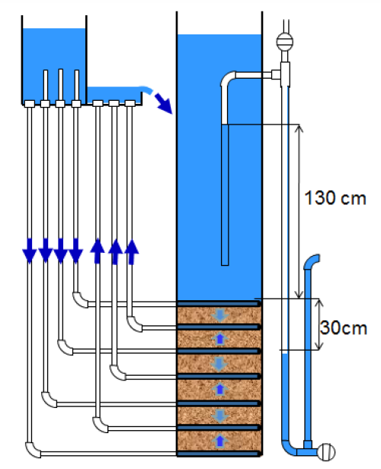
Updated Pilot Scale

Slide 5
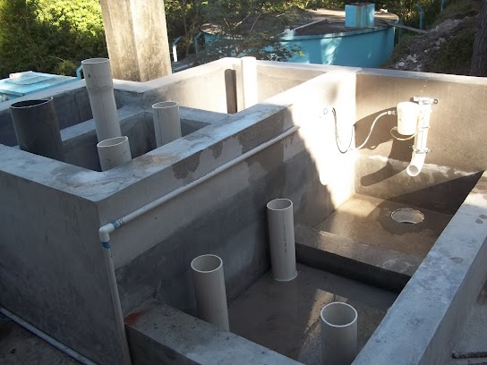
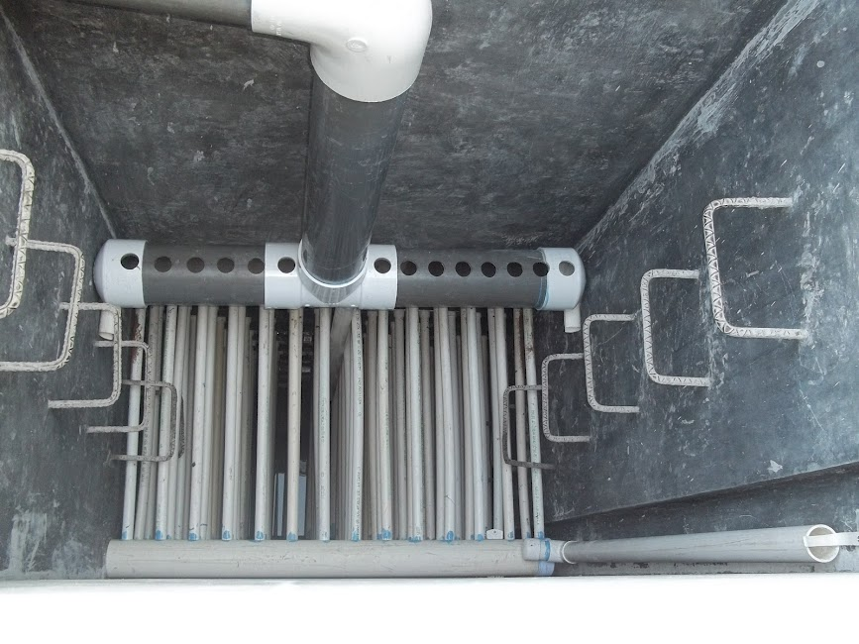
Full Scale in Tamara

Slide 6
Filter Geometry
Square Filter
Circular Filter
implemented at the full scale level
evenly distributes water throughout the filter
easy to construct – at large scale
  filter we are aiming to design would be too small to construct using concrete.
  explored the option of purchasing plastic tanks
implemented in our pilot scale model in B60B
Pipes are available in necessary sizes
This model is an ultra low-flow filter
  our model will need to be larger
Difficulty of designing a new manifold system which would optimize the circular geometry
  Considering cutting slotted pipes at an angle and capping with rubber stoppers

Slide 7
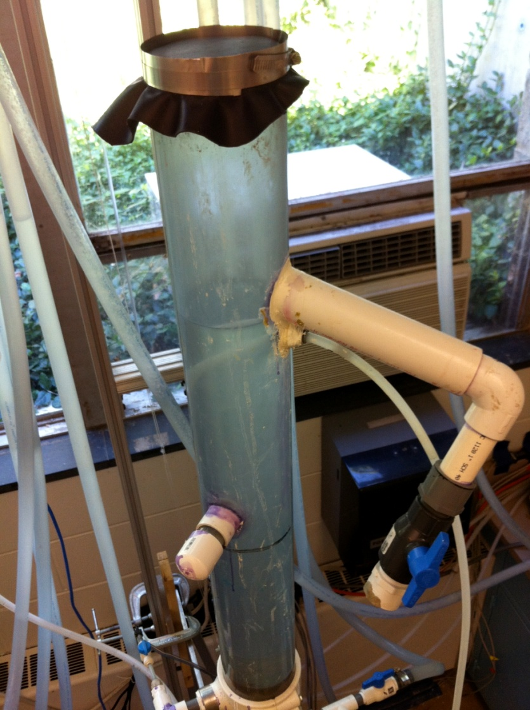
Pressurized Filter
Pressurized filter yields negative pressure during backwash; thus the filter and controls can be at similar elevations
  Can achieve 1.2 m backwash head without the filter bed having to be significantly lower than the sedimentation tanks
Eliminate need for a siphon
Must be air and water tight
We’ve modified the pilot scale filter to test the Pressurized system

Slide 8
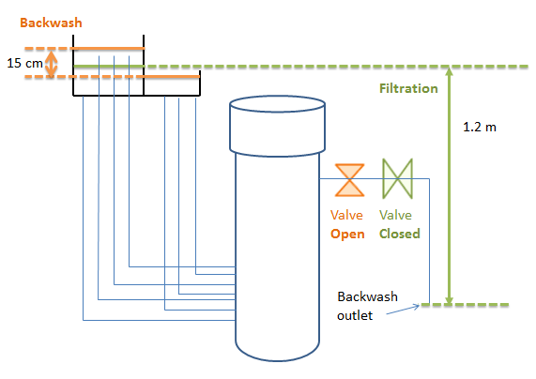
Potential Design

Slide 9
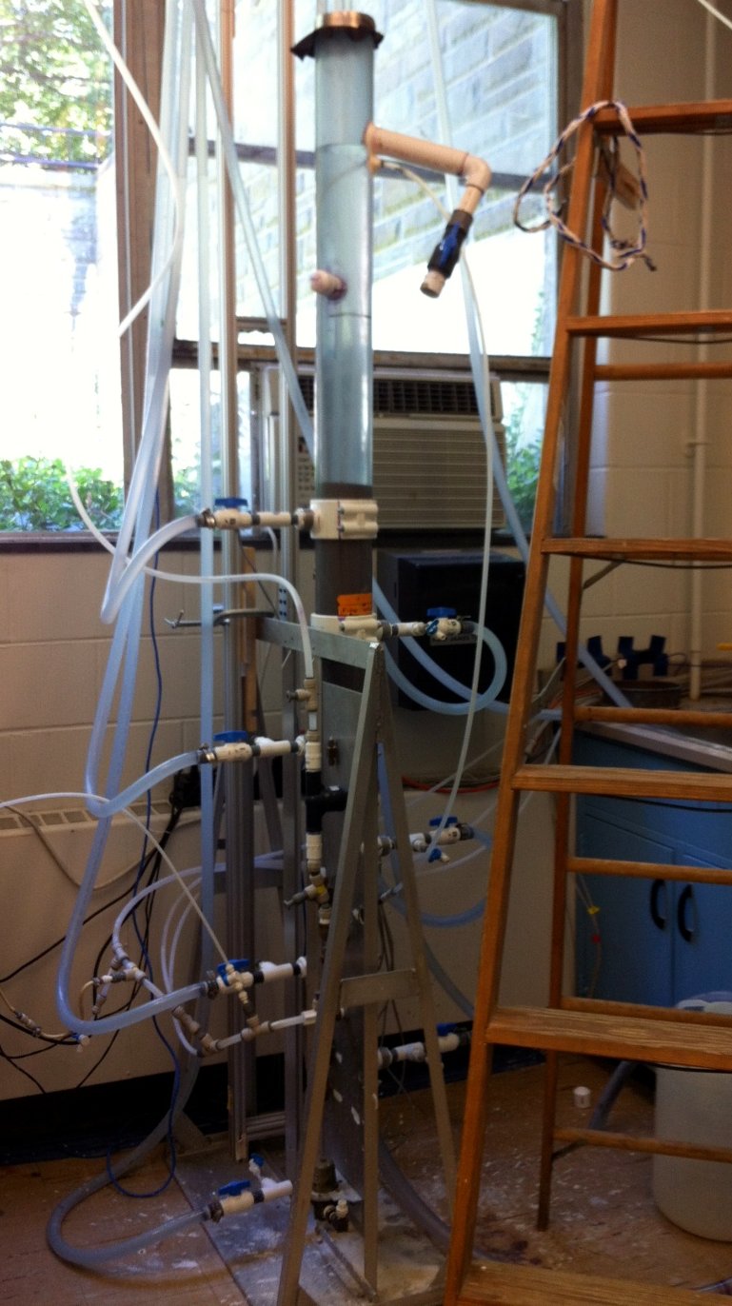
Modified Pilot Model

Slide 10
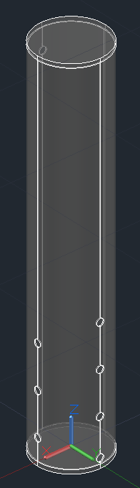
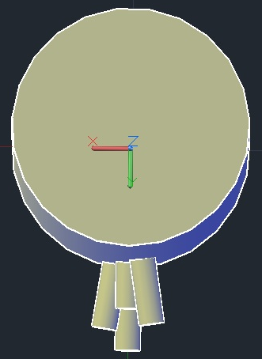
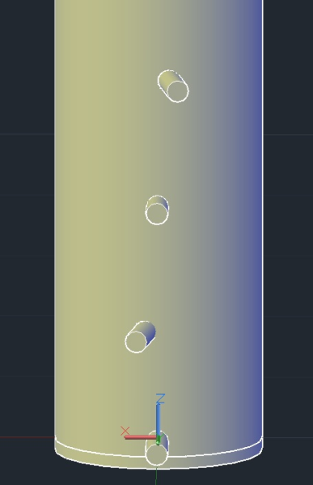
Flexible Tubing vs. Rigid PVC
Different designs necessary for different options
  Flexible tubing is most effective because it allows for a simple arrangement of inlet and outlet pipes
  Rigid PVC requires connections to be offset so as not to bump into other pipes

Slide 11
Future Work
Design, Experimentation, and Calculations
  Work with Fabrication team to build a full scale filter using 12” PVC
    Test using Hydraulic Testing Facility – add modifications so that we can provide and measure flow of 1 L/s
    Explore the idea of adding a “sight tube” to insure that all sand is fluidized during backwash
  Write code to implement filter into design tool
  Calculate optimal positions of inlet and outlet boxes based on head loss

