Slide 1

Stacked Rapid Sand Filtration Teach-In
Spring 2011
Stacked Filtration Team
Anderson Cordero
Mickey Adelman
Sara Coffey
William Maher

Slide 2
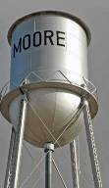
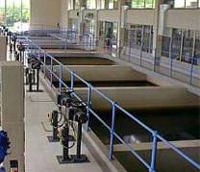
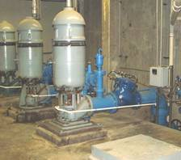


Project Rationale
Traditional rapid-sand filters: completely impractical
  Backwash requires high velocity.
  The options are ridiculous ....
Making a new kind of filter
  Save water during backwashing.
  Reduce cost of infrastructure.
  Eliminate requirement for pumps.
  Make filtration accessible in more places around the world.

Slide 3
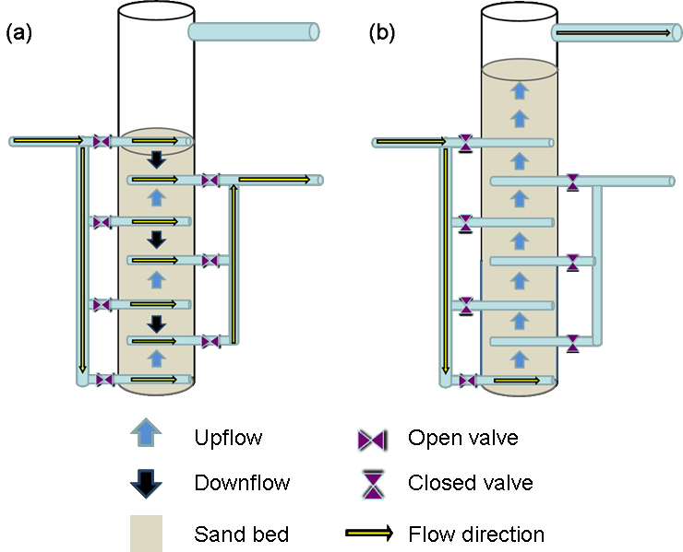
The Stacked Filtration Concept
With the same flow rate ...
Filter in parallel
Backwash in series
Notes:
Jeff

Slide 4
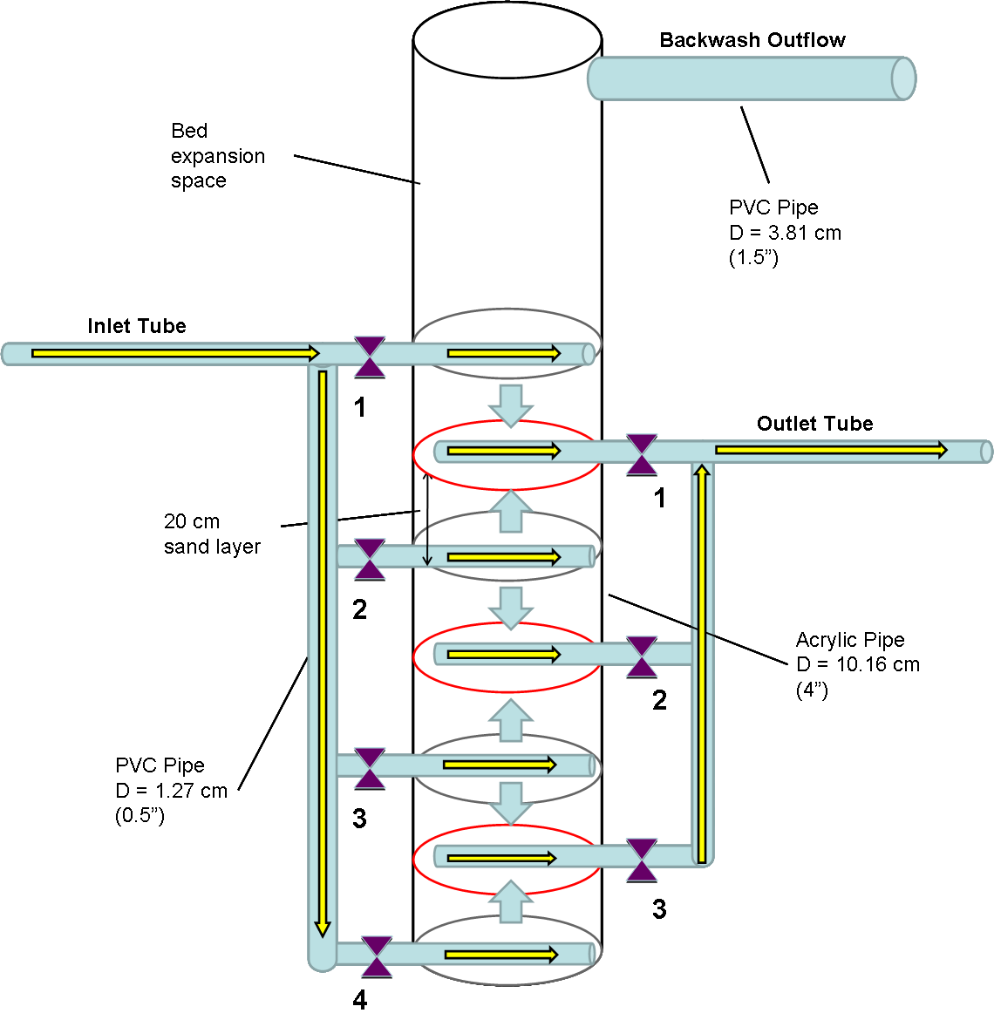
Experimental Apparatus
Filter geometry:
Total height: 1.8 m
20 cm layer depth
6 plane areas for filtration and 1 for backwash
4” PVC/Acrylic column
Flow conditions:
Q_{Total} = 4.86 L/min
V_{Filtration} = 1.67 mm/s
V_{Backwash} = 10 mm/s
This is within range of typical
RSF values.
Notes:
Jeff

Slide 5
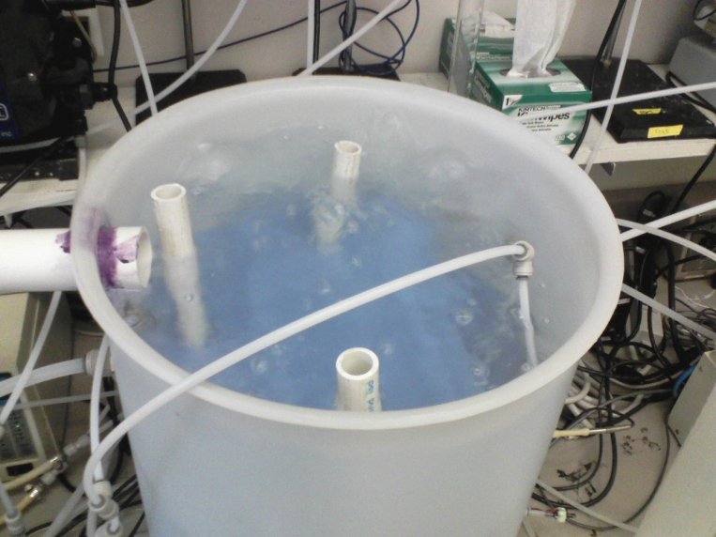
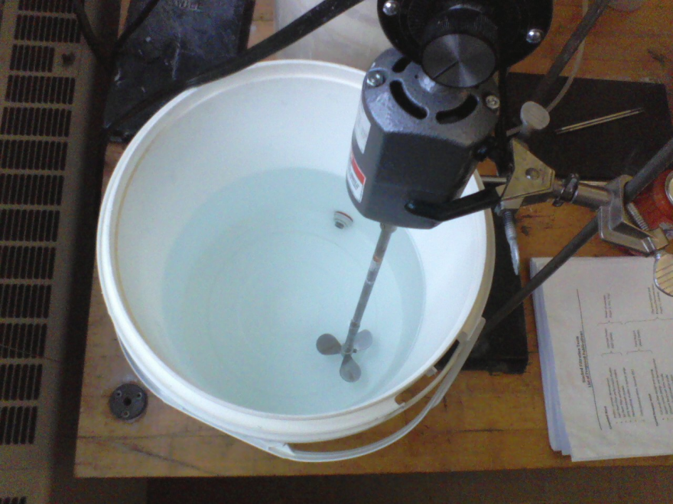
Experimental Apparatus
Adjustments:
Aerator
Baffling
Upgraded alum mixer
Flow control valve
Reduced head loss through tubing
Backwash effluent turbidimeter
Notes:
Jeff

Slide 6
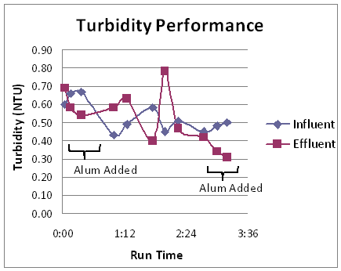
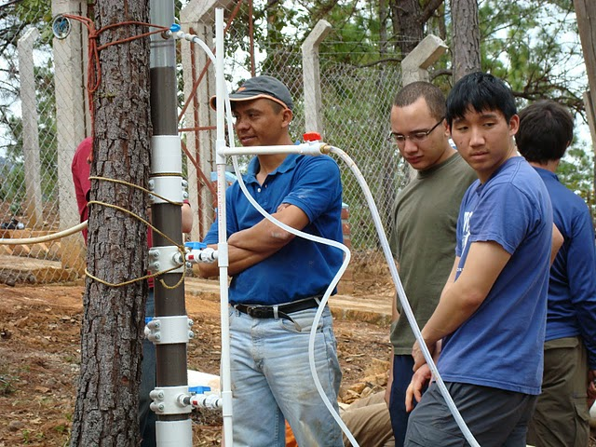
Agalteca: SRSF Demonstration
Learned important lessons about stacked filtration
  Hard to filter CLEAN water!!!
  Importance of alum for filter performance
Antonio from APP learned how to set up and explain the SRSF.
Notes:
6

Slide 7
Siphon Study
Objectives:
Demonstrate an air valve/trap siphon system.
Determine system’s ability to control the level of water in a container.
Seek laboratory evidence that this system could control the modes of filter operation.

Slide 8
Siphon Study
Experimental Diagram: Calculated Variables
“Filtration”
A
C
“Backwash”
B
Table
Sink

Slide 9
Siphon Study
Design Implications:
Excess height failure: the air trap fails when A reaches about 60-70% of B. Therefore, to reach a 30 cm height increase during filtration requires a backwash channel about 42 cm deep.
Siphon failures: the siphon would not break with the backwash water level just below the siphon pipe (C = 1.25 cm). More negative pressure is required.
Water level in backwash channel: as the level of water changes in the siphon outlet tube, some water is forced out and the water level in the backwash channel rises.

Slide 10
Backwash Time Study
Objectives:
Observe the removal of contaminants from the filter bed during backwashing.
Identify a “point of diminishing returns.”
Determine an efficient backwash time that will clean the filter bed and minimize water usage.
Procedures:
Place a sampling port to connect a line through a pump and to a turbidimeter.
Run the SRSF in backwashing mode, and monitor backwash effluent turbidity over time.

Slide 11
Backwash Time Study
Results:
Curve shape meets expectations.
Effluent turbidity exceeded maximum turbidimeter reading.
92.3% turbidity removal in the first five minutes? (Couldn’t find maximum turbidity value)

Slide 12
Backwash Velocity Study
Objective:
Observe the velocity and head required to fluidize the stacked filter.
  Clean bed conditions
  Loaded bed conditions
Procedures:
Add a calibrated pressure sensor to monitor flow.
Set the process controller and water level to backwash mode.
Slowly increase the flow rate using the flow control valve, and monitor pressure and sand response at each flow to determine when fluidization begins.

Slide 13
Backwash Velocity Study
5.0
Results:
Head loss increases as flow increases, up until fluidization occurs.
Observations indicate that fluidization occurs at or around 4.8 mm/s.
3.5 mm/s

Slide 14
Future Work
Practical Experiments
  Alum Dose Study
  Sand Grain Size Analysis
Process Fundamentals
  Upflow vs. Downflow Removal Mechanisms
  Flow Distribution – Tracer Dye Studies
  Filter Media Variation

Slide 15
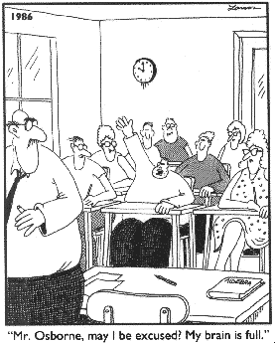
Questions?

