Slide 1


Stacked Rapid Sand Filtration
Final Presentation, Spring 2011
Stacked Filtration Team
Anderson Cordero
Mickey Adelman
Sara Coffey
William Maher

Slide 2
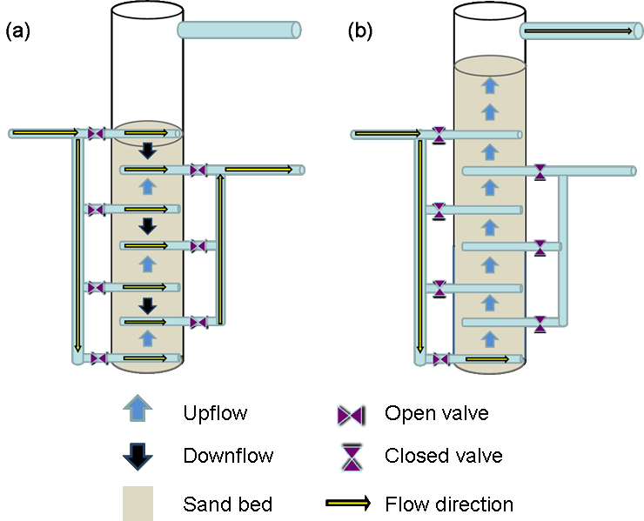

The Stacked Filtration Concept
With the same flow rate ...
Filter in parallel.
Backwash in series.
Notes:
Jeff

Slide 3
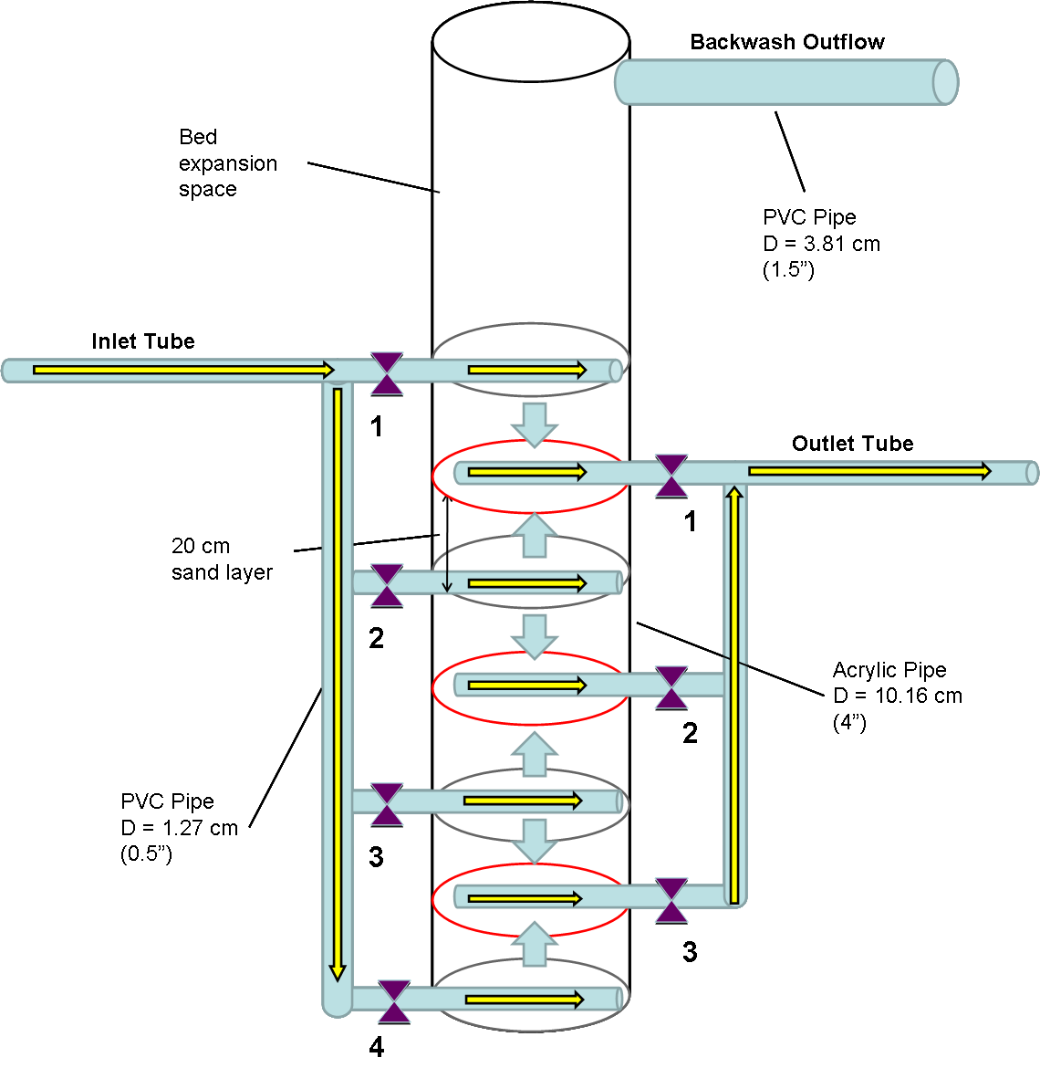
Experimental Apparatus
Making a new kind of filter:
  Save water during backwashing.
  Reduce cost of infrastructure.
  Eliminate requirement for pumps.
  Make filtration accessible in more places around the world.
Flow conditions:
Q_{Total} = 4.86 L/min
V_{Filtration} = 1.67 mm/s
V_{Backwash} = 10 mm/s
Notes:
Jeff

Slide 4
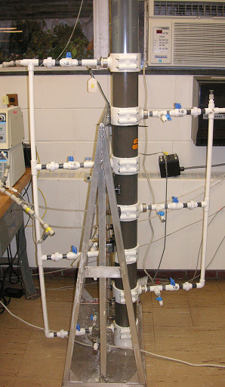
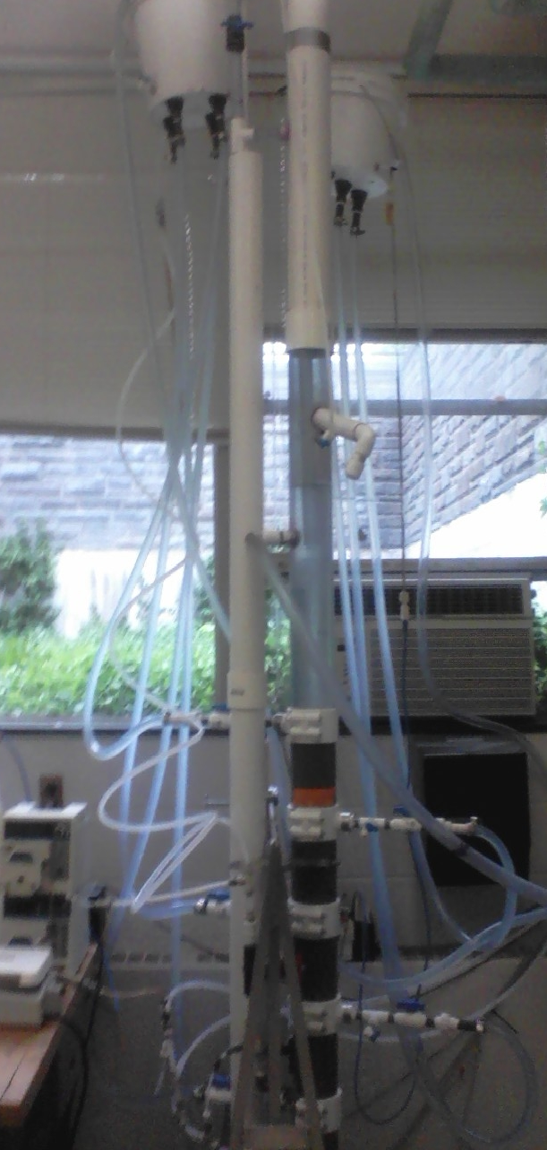
Experimental Apparatus
Notes:
Jeff

Slide 5
Backwash Time Study
Objectives:
Observe the removal of contaminants from the filter bed during backwashing.
Determine an efficient backwash time that will clean the filter bed and minimize wasted water.
Procedures:
Place a sampling port to connect a pumped line to a turbidimeter to monitor the turbidity of backwashing waste.
Use water similar to AguaClara sedimentation tank effluent to backwash: ~5 NTU.
Run the SRSF in backwashing mode, and monitor backwashing waste turbidity over time.

Slide 6
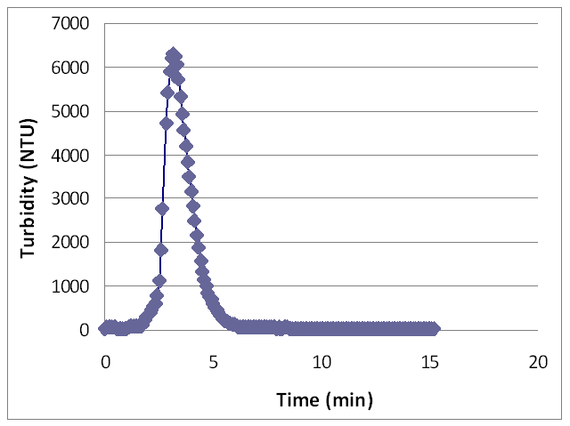
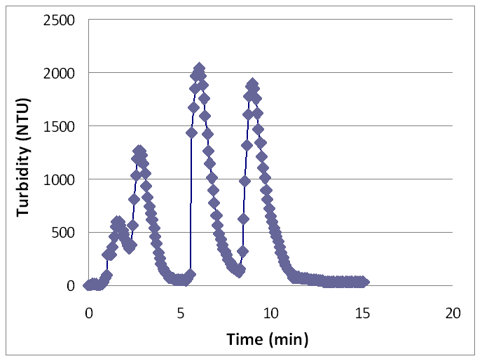
Backwash Time Study
Results:
The high turbidity of backwash waste necessitated a dilution system for measurement. The results you see here are scaled from the diluted observations.
One shot vs. several layers at a time

Slide 7
Backwash Time Study
Interpretation:
A consistent amount of clay in the range of 35,000 NTU-L was loaded into and subsequently recovered from the bed during each trial.
For “one-shot” backwashing, at least 99% of contaminants are removed in the first 6 minutes.
                ; Δt = 5 s

Slide 8
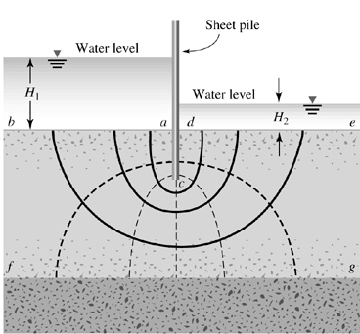
Backwash Velocity Study
Starting backwash is a key design constraint.
  Enough total head has to be available to fluidize the sand.
  Full-scale filters can’t just be dug deeper.
Analogy: effective stress concept from geotech
  Critical hydraulic gradient may lead to “piping” (fluidization).
  Effective stress goes to zero.
  Predicted to happen around 5.3 mm/s for filter sand
Piping risk

Slide 9
Backwash Velocity Study
Objective:
Observe the velocity and head required to fluidize the stacked filter sand bed.
  Clean bed conditions
  Loaded bed conditions
Procedures:
Add a calibrated pressure sensor to monitor flow.
Set the process controller and water level to backwash mode.
Slowly increase the flow rate using the flow control valve, and monitor pressure and sand response at each flow to determine when fluidization begins.

Slide 10
Backwash Velocity Study
Results:
Velocity “ramped up” in discrete steps.
Head loss increases with velocity until fluidization occurs.
Fluidization starts around 4.8 mm/s.
The initiation velocity appears to be the same for clean or loaded bed.

Slide 11
Backwash Velocity Study
The design challenge: spike in head loss
  Sometimes much larger for a loaded bed
  Head required to achieve 4.8 mm/s velocity in the sand?
  Perhaps can be reduced by fluidizing two layers at a time
“One shot” loaded-bed test
Slower fluidization loaded-bed test

Slide 12
Full Control System
Objectives:
Collect data with the control system simulation ,and look for failure modes.
Come up with the correct design constraints for trough placement and siphon system.
Determine the important physical parameters governing the performance of this system and which dimensions must be selected and scaled for a full-scale design.
Understand the “transition period” between backwash and filtration and how the inlet and outlet pipes must be configured.

Slide 13
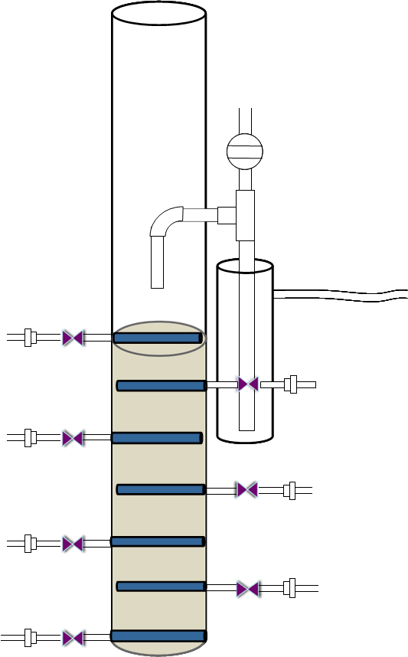
Full Control System
Inlet Pipes
Siphon
Filter Column
Inlet Box
Outlet Box
Backwash Outlet
Hoses
General Setup
Notes:
Experimental Setup
Construct a support frame for the inlet and outlet vessels, allowing for adjustment their heights
Construct an inlet vessel with pipes at different elevations, with the vessel itself high enough to provide the head
required for filtration and backwashing, containing an emergency weir and a pressure sensor to track water levels
Connect the new inlet tubes to the filter to the current inlet pipes, using ½” hoses, hose clamps, and slip adaptors
for the existing unions.
Drill a hole in the filter column to install the siphon system that was used for the siphon study at the beginning of
the semester
Tie a vertical piece of 3” PVC pipe to the side of the filter to serve as the backwash trough, and add a weir and
hose to drain the backwash water to the sink
Construct an outlet vessel connected to the current outlet pipes using ½” hoses, hose clamps, and slip adaptors
for the existing unions, containing a weir and hose to drain the filtered water to the sink and a pressure sensor to
track water levels. It should be placed so that the filtration cycle water level is maintained above the siphon.

Slide 14
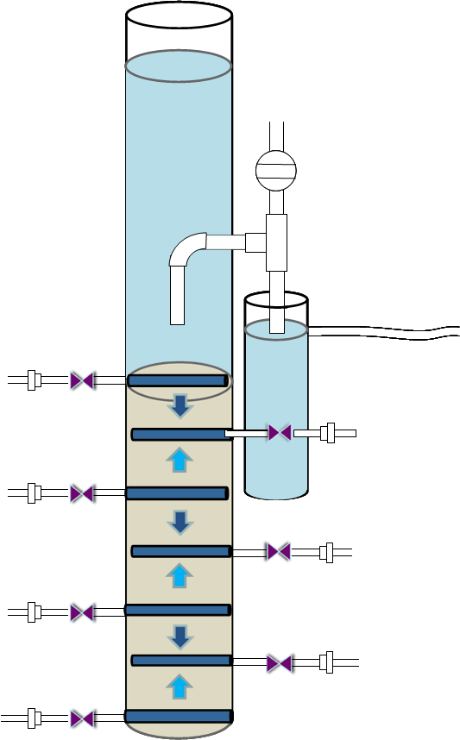
Full Control System
Air Trap
Flow Exit
HL_{Filtration}
No Flow
Filtration Mode

Slide 15
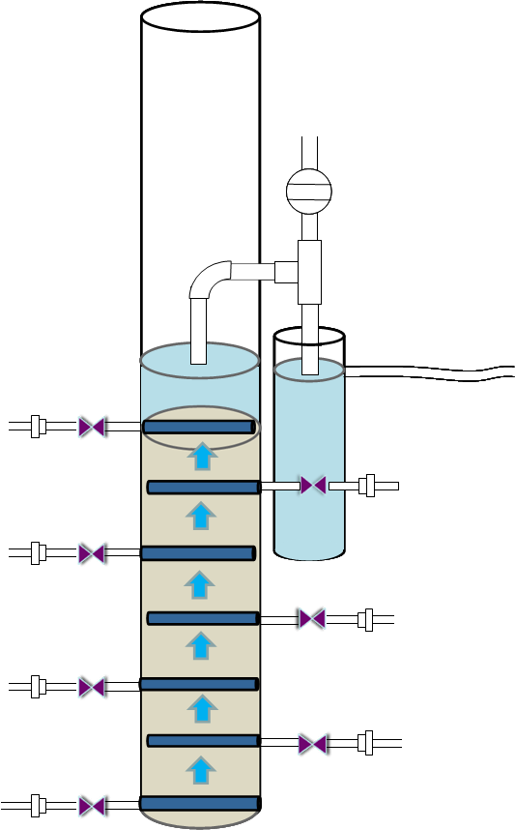
Full Control System
No Flow
Siphon Flow
Flow Exit
HL_{Backwash}
Backwash Mode

Slide 16
Discovered Failure Mode
Problem:
Whole layer of sand engulfed by siphon system during
backwash initiation due to excess bed expansion.
Hypothesis:
Great volume of water from inlet box entering the filter
in a short time interval causing a flow rate and velocity too high through the bed.
Plan of action:
Short circuit a great percentage of water through the top
filter inlet by making height of first three inlet pipes constant.

Slide 17
Important Design Constraint
Assuming Air
Incompressibility:
h₂ = h₃
h₁
Assuming Constant
Air Pressure:
h₁ = h₃
h₂
weir
weir
L₃
h₃
Therefore:
h₁ = h₂
End of Backwash
During Filtration

Slide 18
Summer Implementation
Current plans
  One full-size SRSF unit at Tamara WTP
  Start around June
Sand media sourcing
  Results of sand grain size analysis

Slide 19
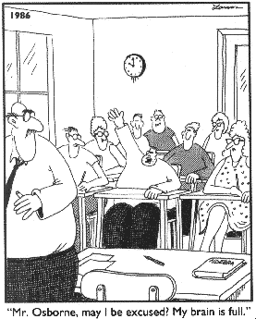
Questions?

