Slide 1
Stacked Rapid Sand Filtration
Final Presentation, Fall 2011
Ziyao Xu ∙ Alli Hill ∙ William Maher Min Pang ∙ Michael Adelman

Slide 2
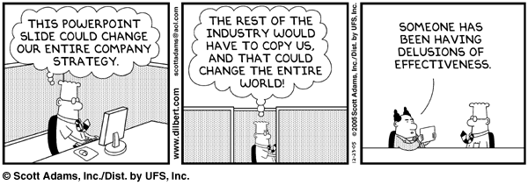
Outline
Introduction
Pilot-scale research
  Control system
  Water seal siphon
  Sand removal system
  Flow distribution
Bench-scale research
  Upflow/downflow
  Self-healing test
Progress in the field
Future work

Slide 3
Introduction:
SRSF Concept and Hydraulics
Flow Exit
No Flow
Air Trap
Flow Exit
No Flow
Siphon Flow
Filtration cycle
Backwash cycle

Slide 4

Pilot Scale:
Control System Study
Siphon leaked during filtration.
Collect data to find source of leak and quantity of water lost to leakage.
Pursue methods of redesigning the siphon system.
56 cm
85 cm
Filtration cycle

Slide 5
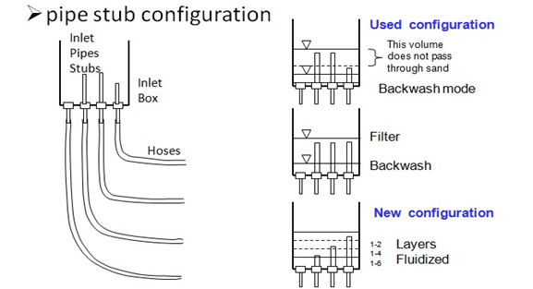
Pilot Scale:
Control System Study

Slide 6

Pilot Scale:
Control System Study
Filtration
Backwash
Transition
Pipe Stubs: 38 cm, 43 cm, 48 cm

Slide 7
Pilot Scale:
Control System Study
Filtration
Backwash
Transition
Pipe Stubs: 3 at 45 cm

Slide 8

Pilot Scale:
Water Seal Siphon Study
The U-shaped pipe configuration will replace the backwash basin.
Observed water levels are consistent with theoretical hydrostatics.
This is a typical implementation in plumbing.
130 cm
30cm
Notes:
Min will present.

Slide 9

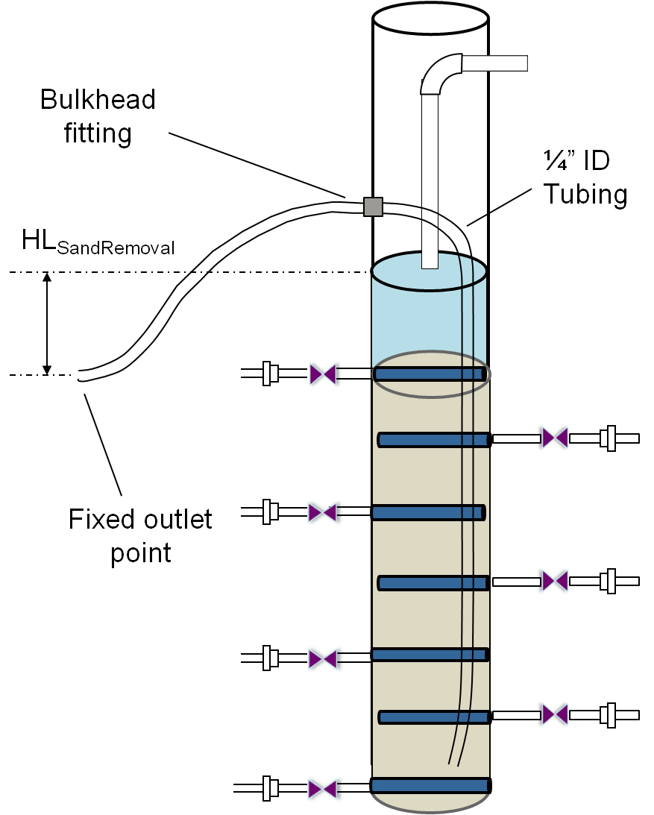
Pilot Scale:
Sand Removal System Study
Design concept
  Purpose: facilitate filter maintenance
  Removing sand through the pipe while maintaining a fluidized bed in the filter column
  Sand removal pipe velocity 0.67 m/s
  Filter upflow velocity 7.36mm/s
Notes:
Two velocities are predicted velocities. Min will present.

Slide 10
Pilot Scale:
Sand Removal System Study
Two effects:
Density differences decrease the sand flow rate.
Air trapped in the siphon increases head loss, thus increases the sand flow rate.
Notes:
Min will present.

Slide 11
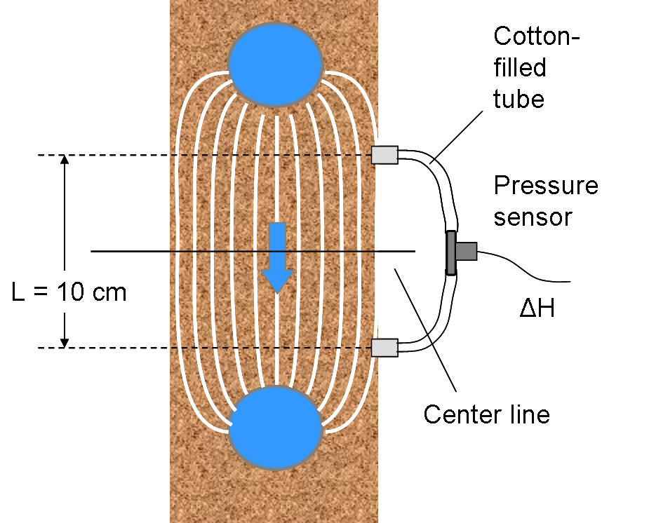
Pilot Scale:
Flow Distribution Study
Experimental setup – sensor design, Darcy’s Law
10 cm elevation spacing between
the holes
Sensors were calibrated
so they reported positive flow
during filtration mode.
Apply Darcy’s Law:
Notes:
Min may present this.

Slide 12
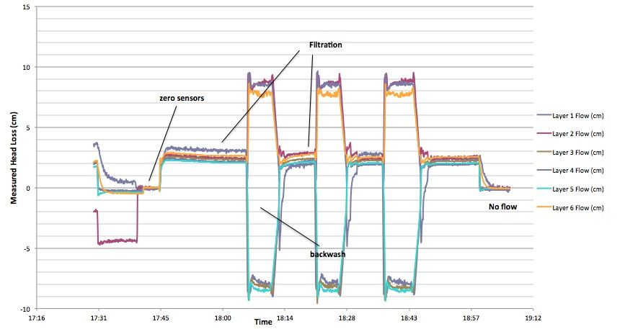
Pilot Scale:
Flow Distribution Study
Clean-bed results
Pressure drop
about 3.4 cm
during filtration
Pressure drop
less than 10 cm
during backwash

Slide 13
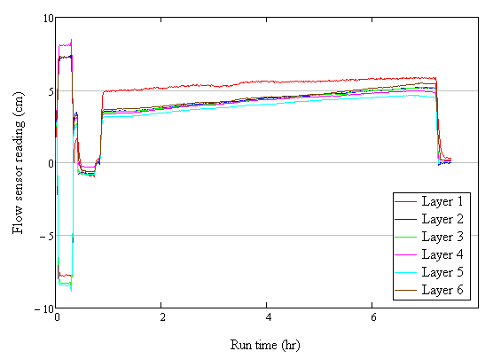
Pilot Scale:
Flow Distribution Study
Loaded-bed results
7 hours run time
Initially non-uniformly
distributed
A trend of increasing
uniformity
Good turbidity removal
performance

Slide 14
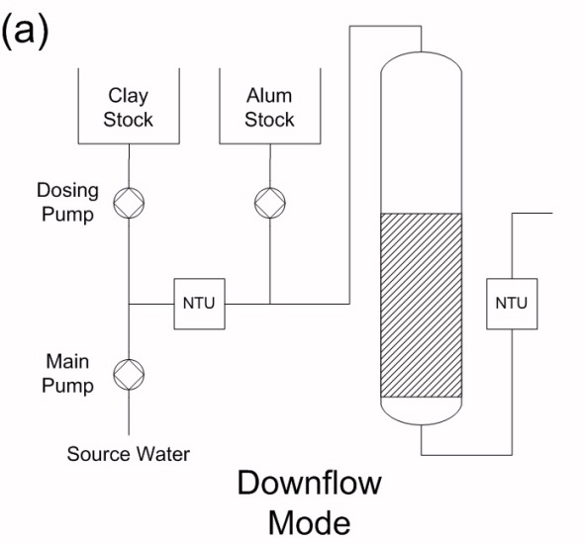
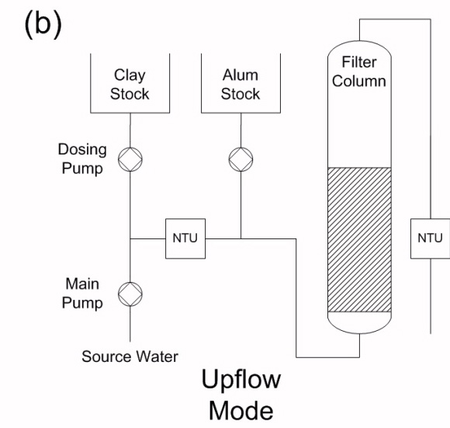
Bench Scale:
Upflow/Downflow Study
Setup for upflow-downflow comparison

Slide 15
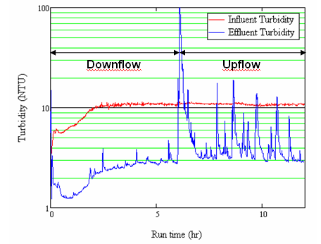
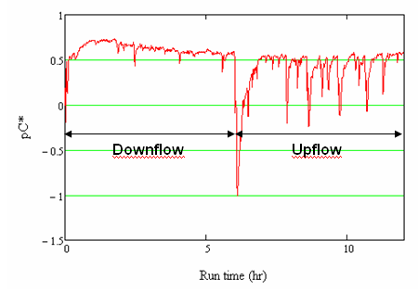
Bench Scale:
Upflow/Downflow Study
Initial results – upflow/downflow comparison
  Many turbidity spikes during the upflow cycle
  No backwash between runs

Slide 16
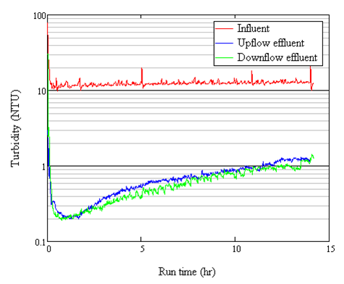
Bench Scale:
Upflow/Downflow Study
Final results – upflow vs. downflow performance
  14-hour filter cycle
  Backwash cycle in between runs to clean the bed
Performance does not significantly differ
  Important for the viability of the SRSF

Slide 17
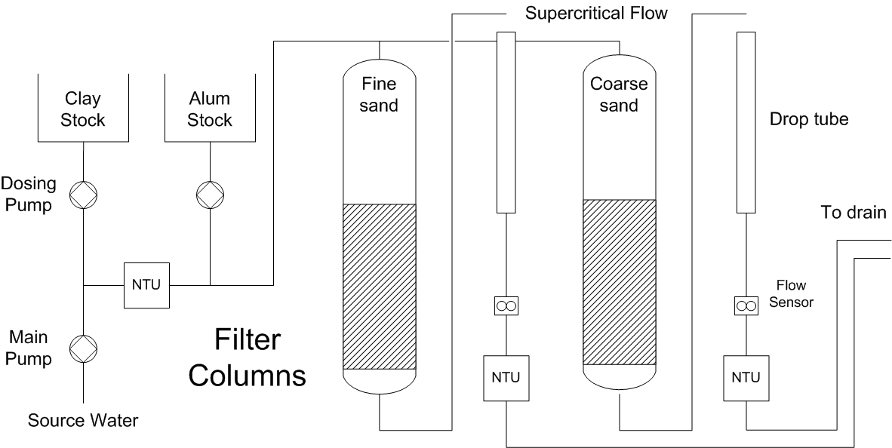
Bench Scale:
Self-Healing Study
Sand grains may stratify by size during backwash.
Is it possible for parallel filter beds of differing grain size to perform well together?

Slide 18
Bench Scale:
Self-Healing Study
Flow is distributed unevenly, filter 2 in which we loaded the fine grain receives most of the flow.
Bizarre turbidity diagram.
Same performance of the two grains while one receives more flow.
More tests are expected
Fine
Coarse

Slide 19
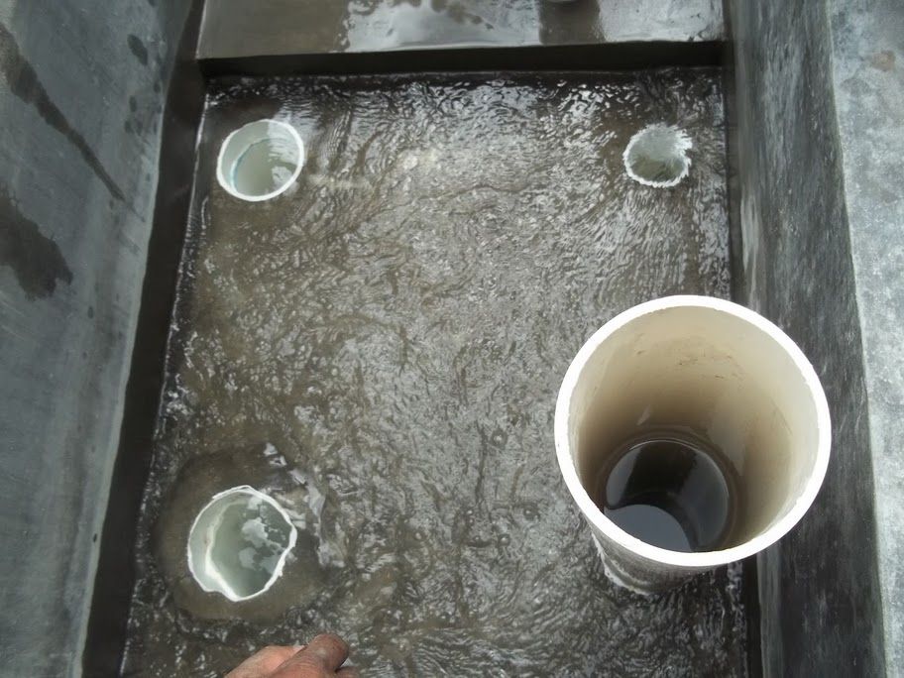
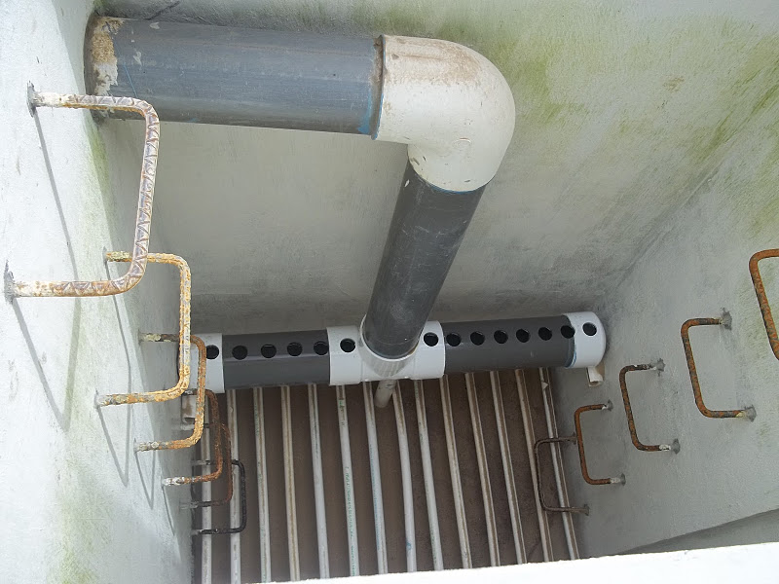
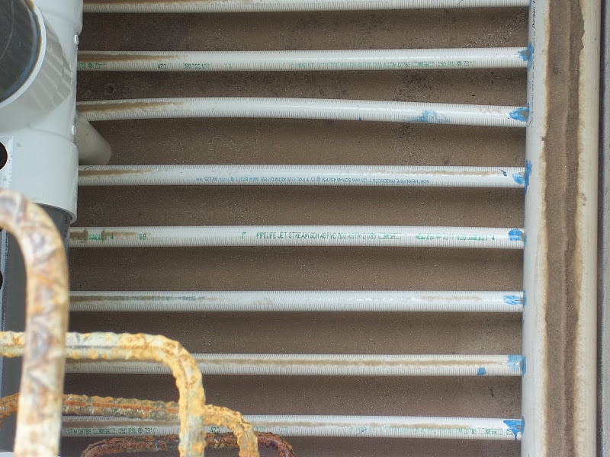
Field Scale:
Progress in Támara, Honduras

Slide 20
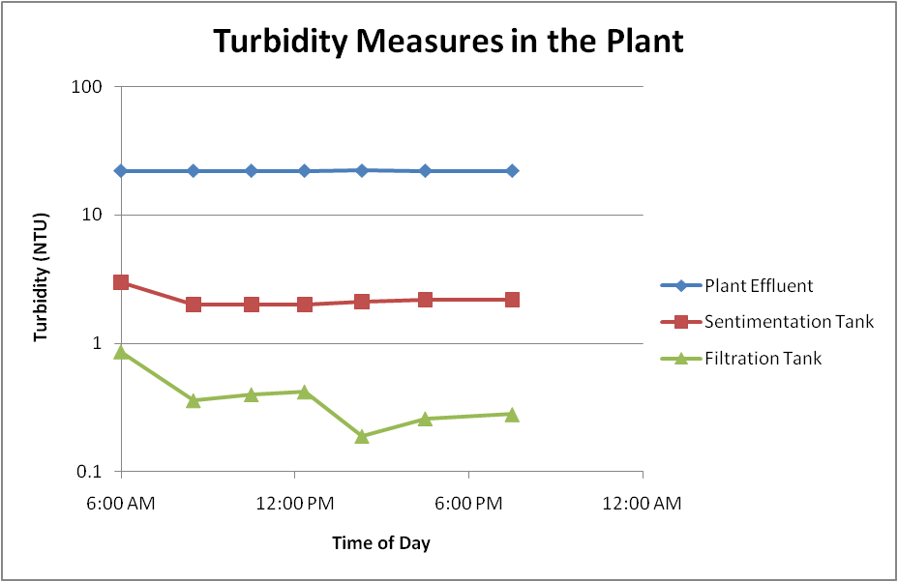
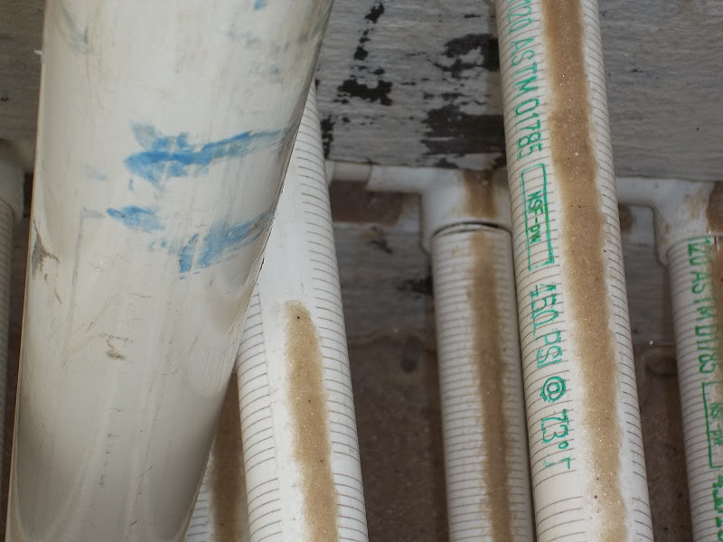
Field Scale:
Progress in Támara, Honduras
Filter performance results
  SRSF can meet EPA standard.
Challenges and problems
  Air entrainment due to the entrance weir
  Breaks and sand leaks in the slotted pipe
Plant Influent

Slide 21
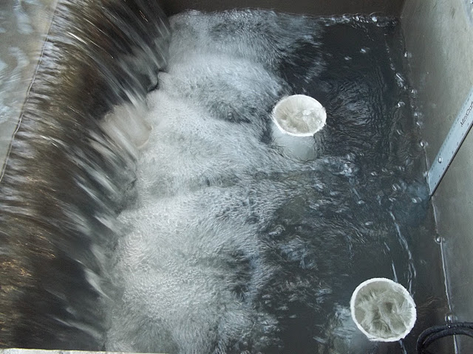
Future Work
January trip tasks
  Saw and slotted pipe fabrication
  Data collection in Tamara
  Future filter sites
Further research
  Alter sand grain size to test efficiency
  Prevent air entrainment in filter
  Long-run performance
21

Slide 22
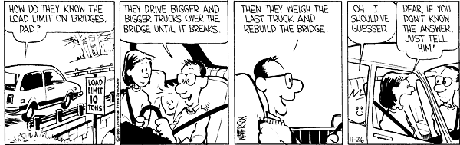
Questions?

