Slide 1
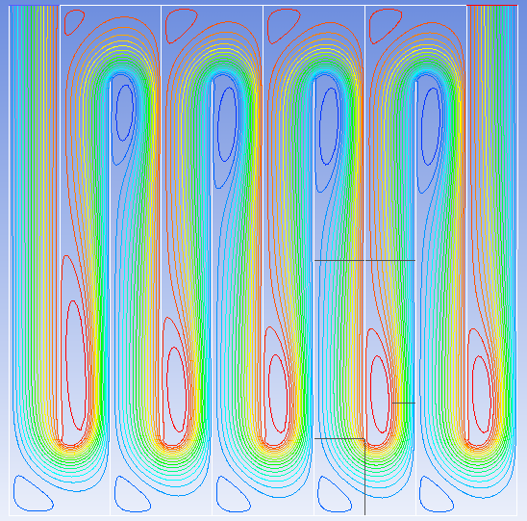
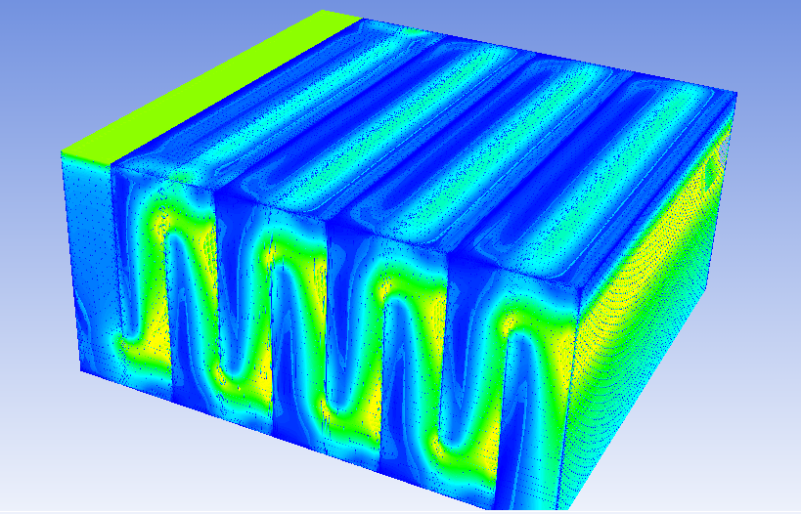
CFD Simulation
Travis Stanislaus & Steve Southern
Spring 2010

Slide 2
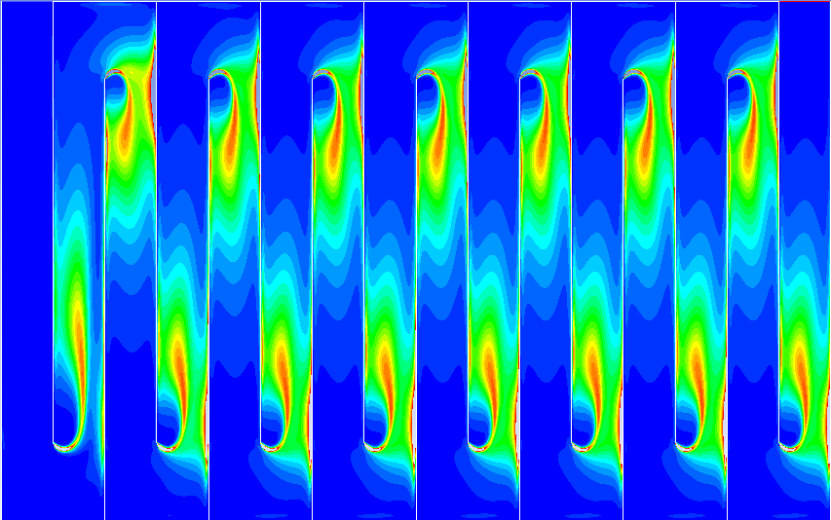
Goals
Primary
Obtain an accurate Turbulent Energy Dissipation Map throughout the Flocculator
Issue
CFD has many sources of error that prevent an accurate solution
Secondary
Mitigate the effects of all sources of error
  Discretization Error
    Grid Size
    Solver Order
  Linearization Error
  Wall Treatment
  Turbulence Model
    3D Effects

Slide 3
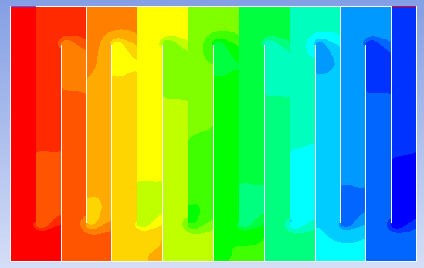
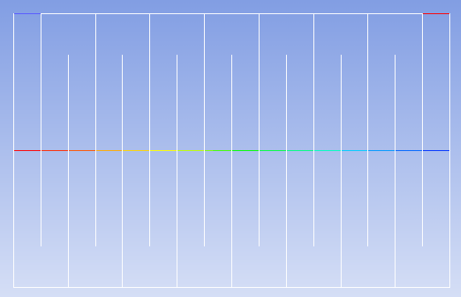
Analyzing K - CFD
Extract Cp data at half the flocculator height for all baffle spaces

Slide 4
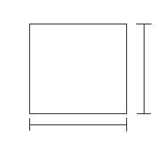
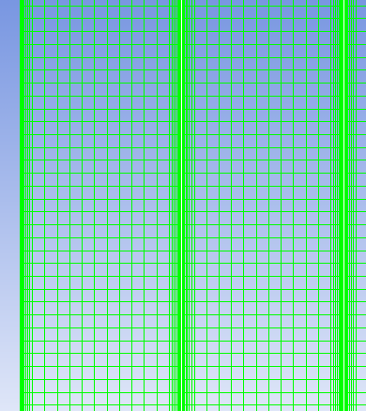
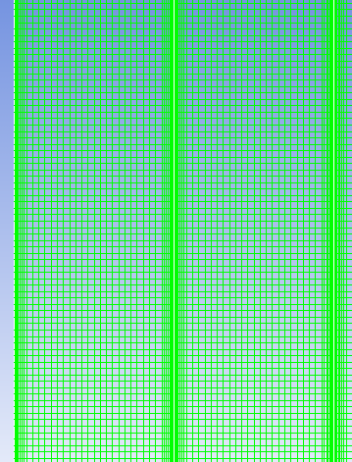
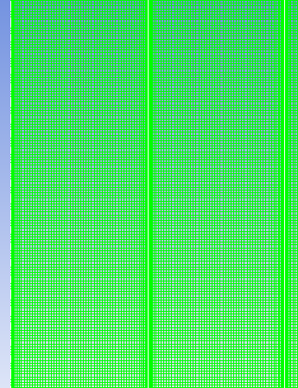
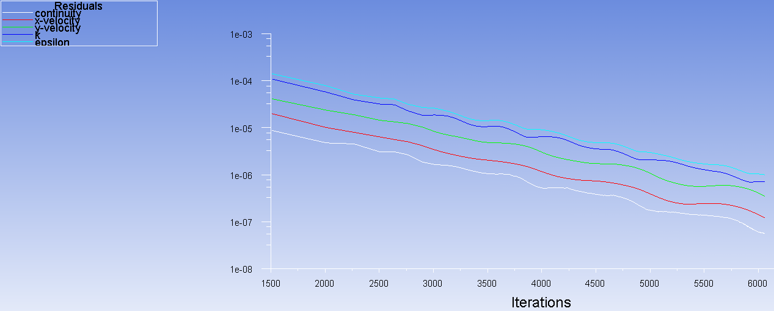
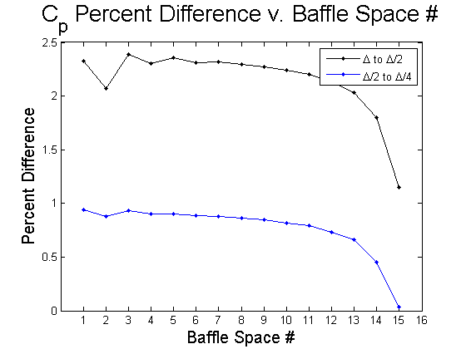
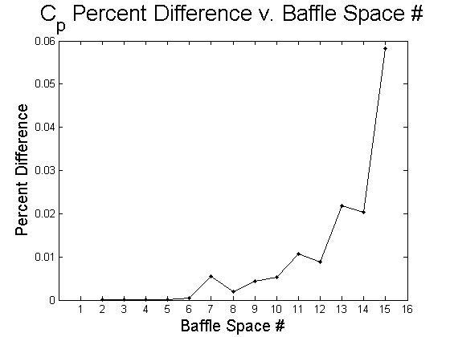
Quick Summary
Grid Convergence (Discretization Error)
∆
Iterative Convergence
(Linearization Error)
∆

Slide 5

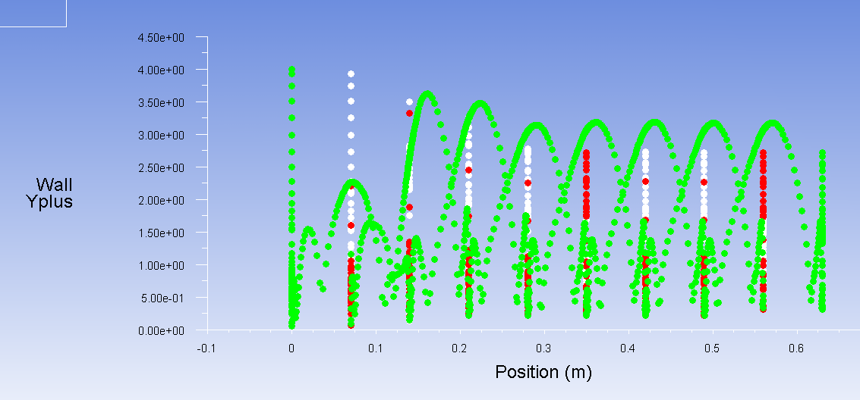
Wall Treatment (Verification)
Resolve the viscous sublayer y⁺ < 5
Avoid the buffer layer 5 < y⁺ < 30

Slide 6
Turbulence Model Validation

Slide 7
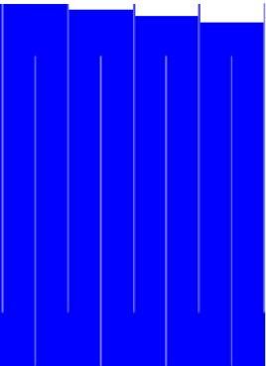
Analyzing K - Experiment

Slide 8
Turbulence Model Validation

Slide 9
Discretization Order

Slide 10
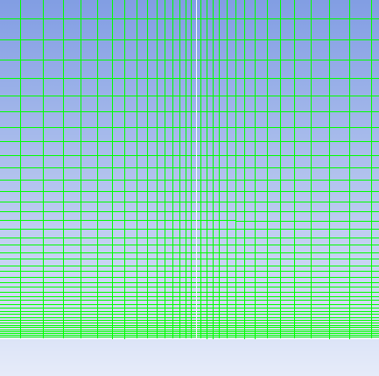
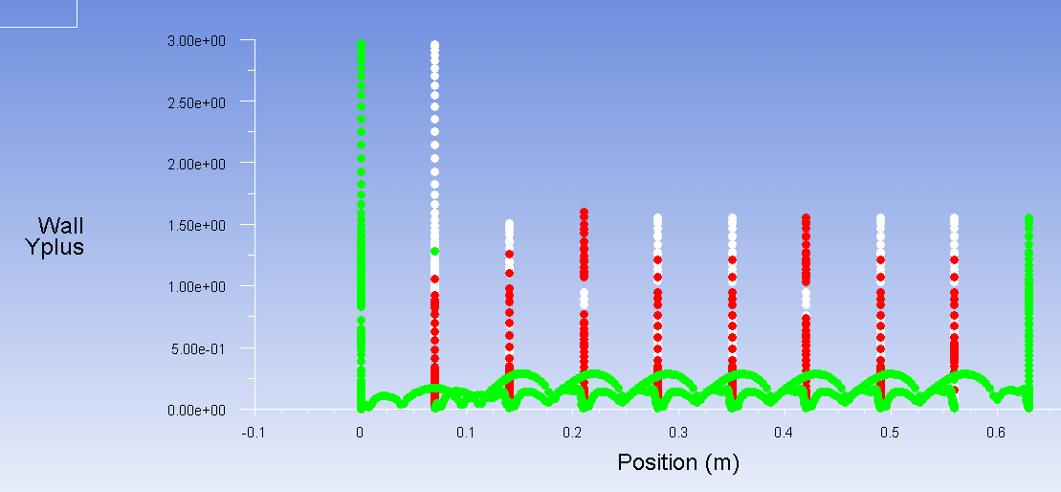
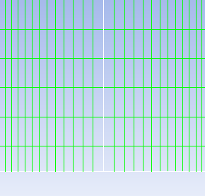
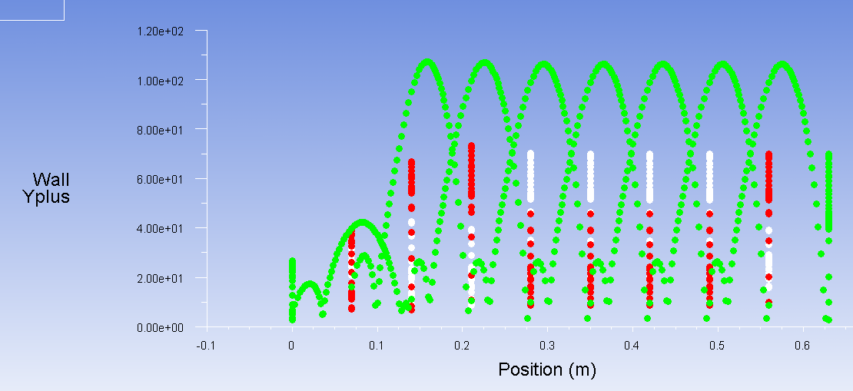
Wall Treatment (Validation)
Enhanced Wall Treatment (y⁺ < 5)
Standard Wall Functions (y⁺ > 30)

Slide 11
Wall Treatment (Validation)

Slide 12
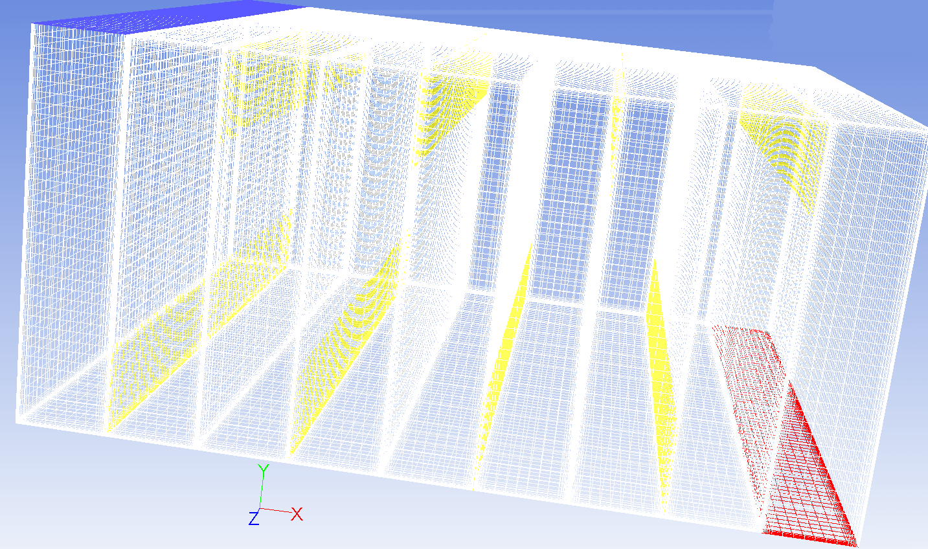
3D Case

Slide 13
3D Results

Slide 14
Verification/Validation Summary
Discretization Error (Grid Size) < 1%
Linearization Error (Iteration) << 1%
Wall Treatment y⁺ < 5 or y⁺ > 30
  Not necessary that y+ << 5
Anisotropic Reynolds stresses call into question eddy-viscosity models (k-ε, k-ω)
Results show eddy-viscosity models over predict experimental K by a factor of 2
RSM over predicts by a factor of 1.5
No significant difference between:
  1st and 2nd order discretization
  Standard and enhanced wall functions
  2D and 3D

Slide 15
Orifice (Validation Study)
Compare the Discharge Coefficient, C_{d}, calculated in Fluent with measured values of C_{d}.
Discharge Coefficient of Orifice
Re | C_{d} calculated from Fluent | C_{d} from “Fluid Mechanics” by Frank White
10⁴ | 0.6285 | 0.633
10⁵ | 0.6087 | 0.611
10⁶ | 0.606 | 0.6

Slide 16
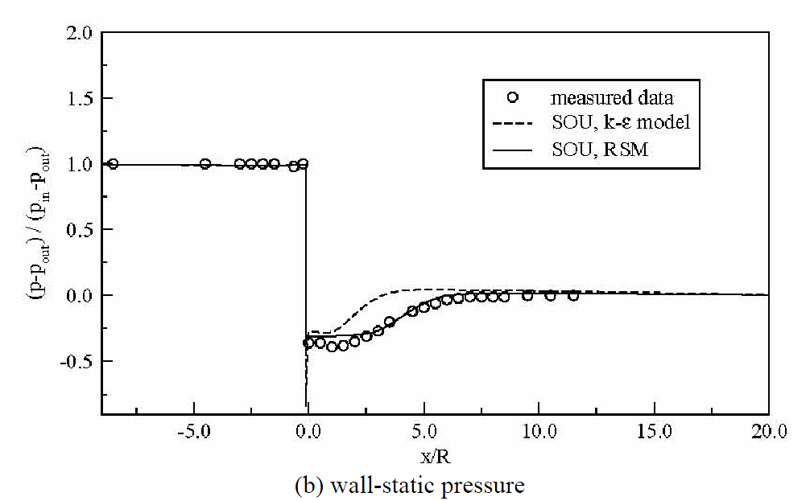
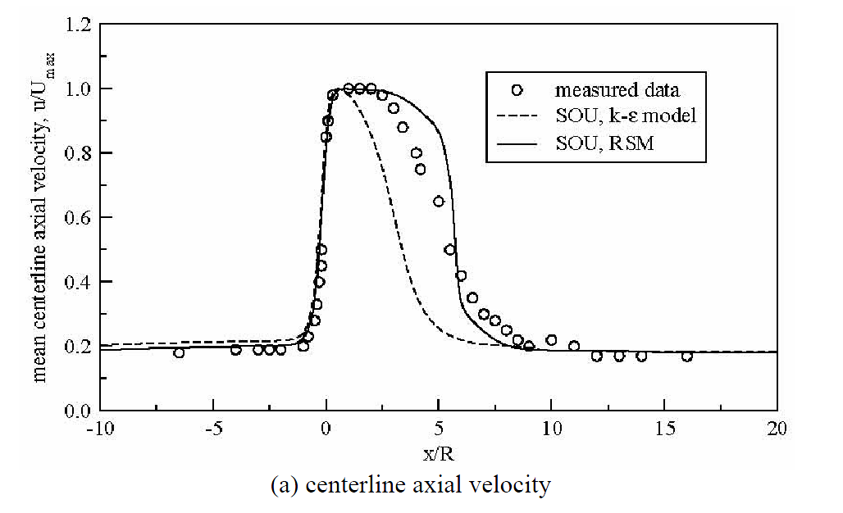
Orifice (Validation Study)
Compare plots of dimensionless wall-static pressure and centerline velocity of orifice simulation in Fluent with experimental measurements.

Slide 19
Final Words on the Orifice
Recirculation zone length from orifice
Experiment: 0.13161 m
k-ε realizable: 0.2 m
RSM: 0.185 m
K from measurements and Fluent
K_{measurement}= 31.04
K_{fluent}= 27.76

Slide 20
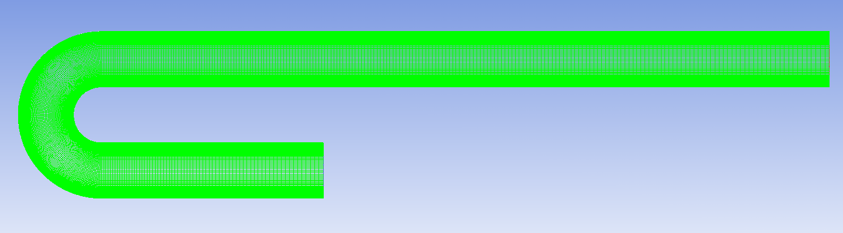
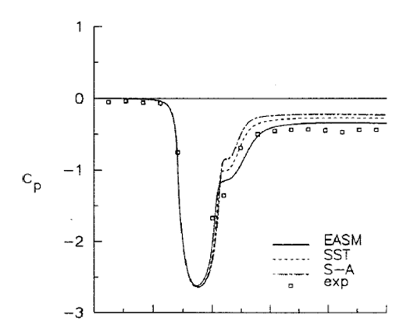
U-Duct (Benchmark)

Slide 21
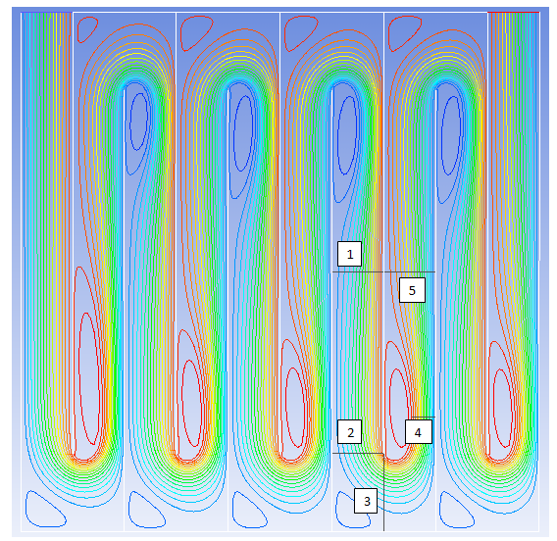
A Problem in the other Validation Studies
K obtained from the energy is not time averaged therefore it does not include the turbulent kinetic energy.

Slide 22
Future Challenges
Understand K for both CFD and experiment
Understand the differences between turbulence models
Perform a large eddy simulation (LES)
Create a rapid mix model

Slide 23
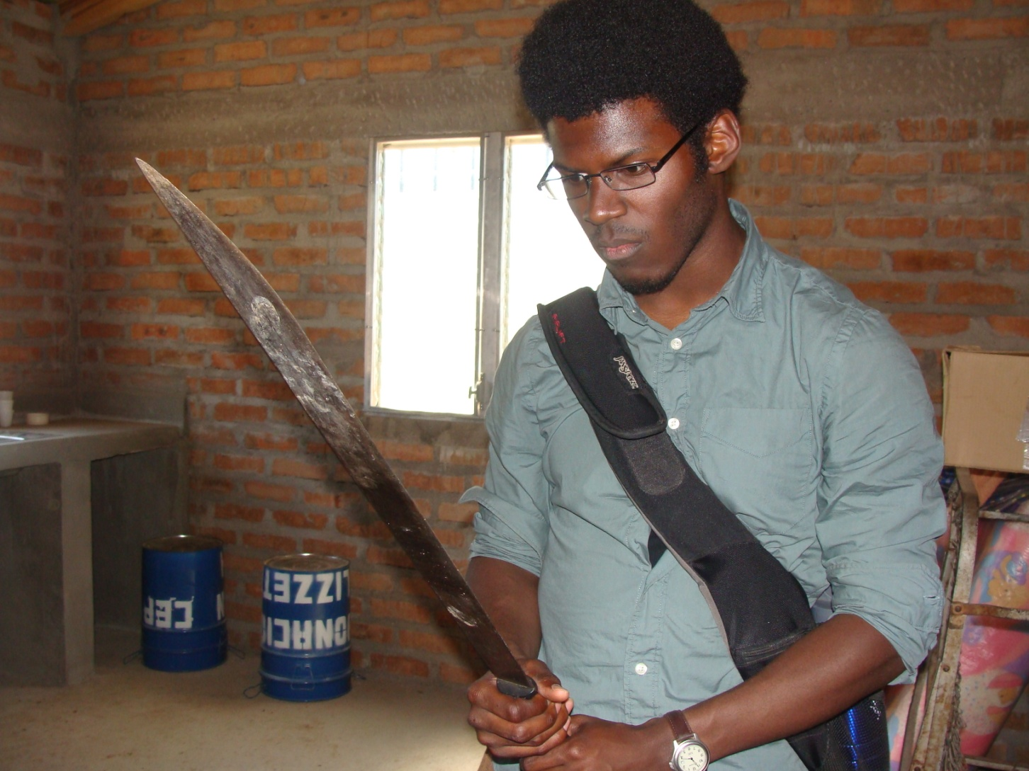
Questions?

