Slide 1
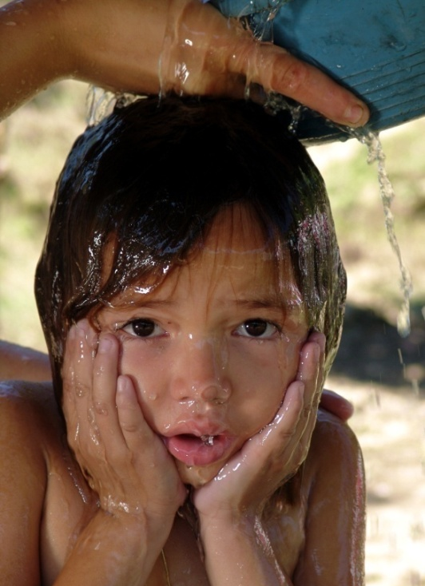
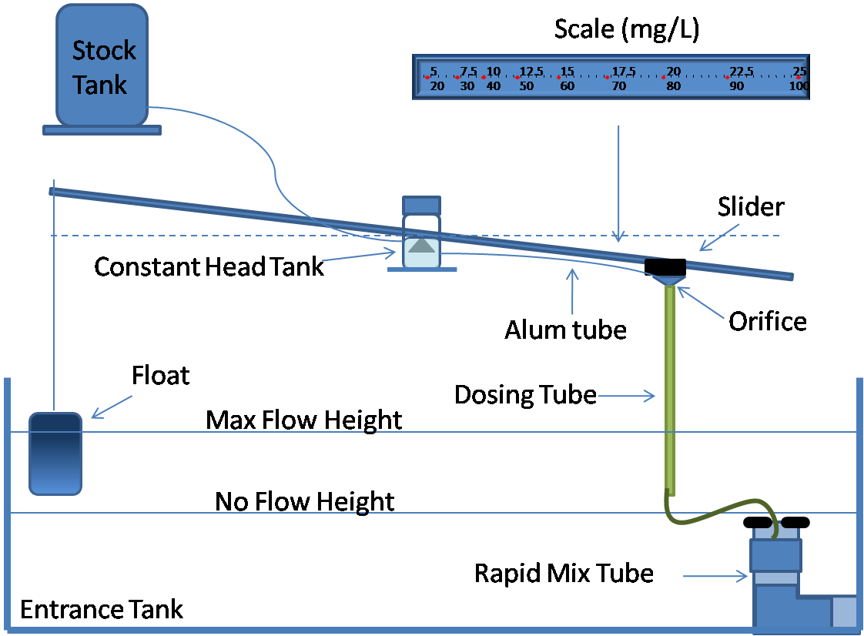
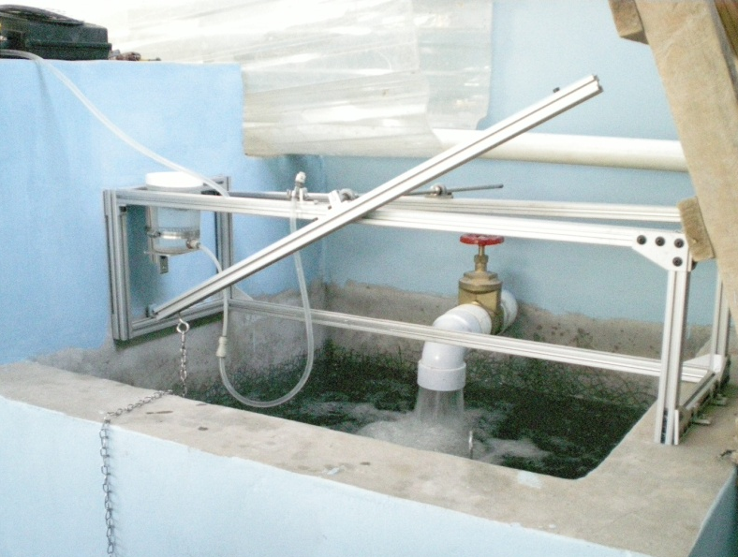
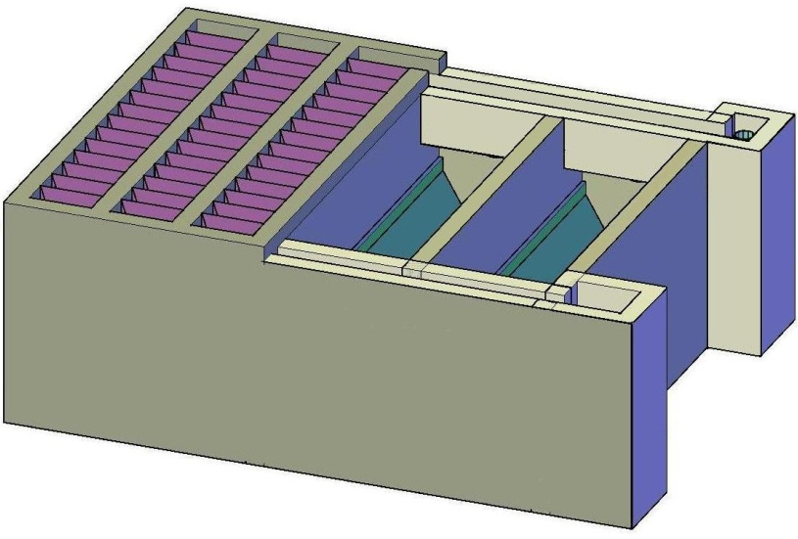
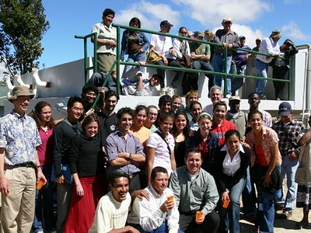
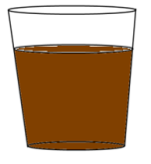
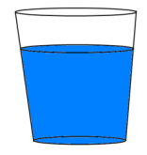
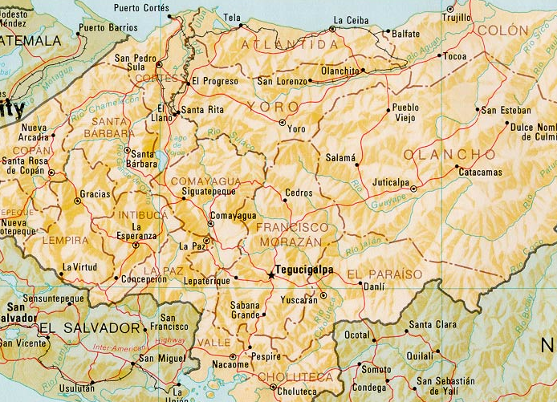
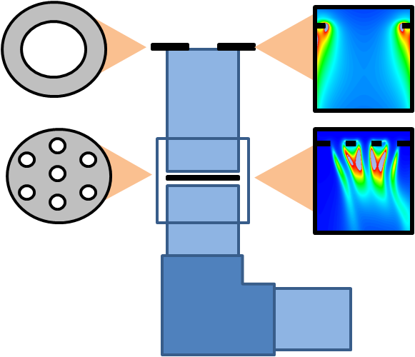


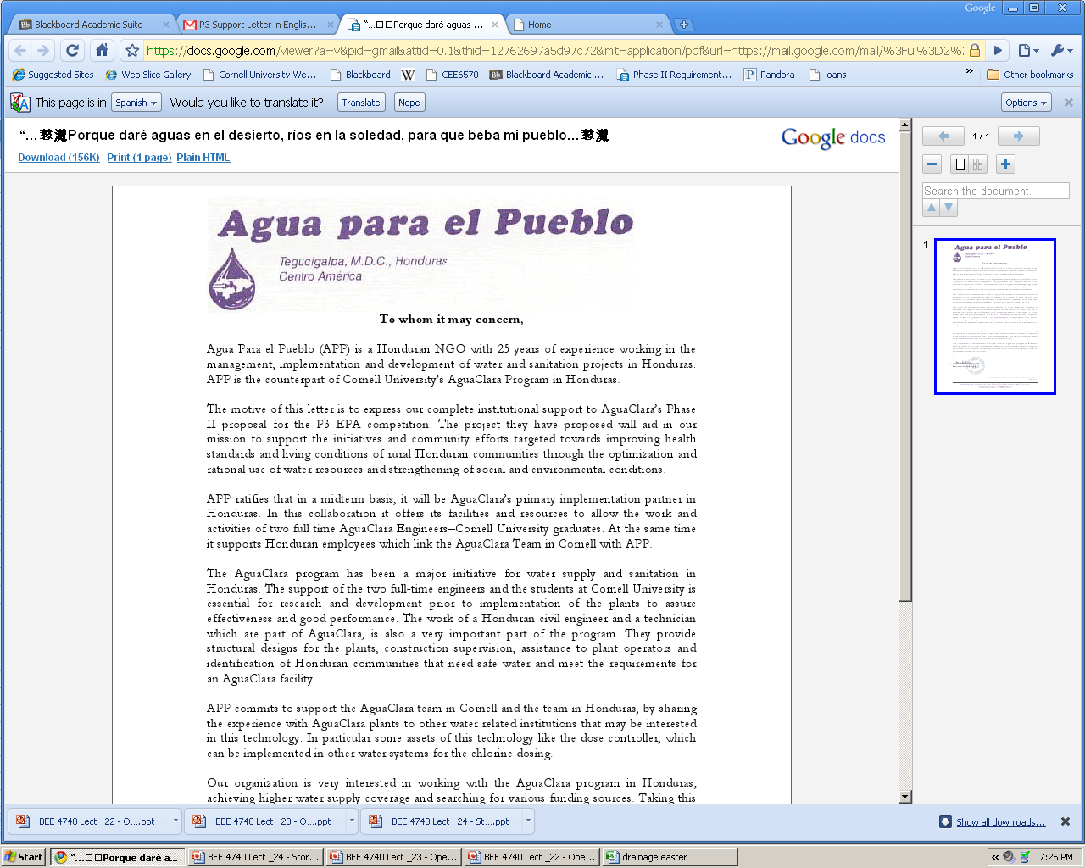
J-1
Nonlinear Chemical Dose Controller for AguaClara Plants
Background & Problem Definition
Cornell University
Kayti Curtis, Dale Johnson, Harrison Ko, Akta Patel, Karen Swetland, Monroe Weber-Shirk
Discussion and Conclusions
AguaClara is a program at Cornell University that is improving drinking water quality through innovative research, knowledge transfer, open source engineering and design of sustainable, replicable water treatment systems. The AguaClara team formed in the fall of 2005 in response to the need of hundreds of Honduran communities that rely on contaminated surface water sources for their drinking water supply. As the AguaClara project grows, water treatment plants are being designed to serve larger communities. A chemical dose controller must be designed to dose chemicals accurately over a wide range of flow rates. The dose controller is used with the newly designed Rapid Mix Tube. Accurate alum dosing impacts the effectiveness of the subsequent processes: flocculation and sedimentation.
Purpose and Objectives
Research potential nonlinear doser designs
Write algorithms that calculate relevant hydraulic constraints for the doser and rapid mix tube
Design a prototype nonlinear dose controller and rapid mix tube for preliminary testing
Replicate the prototype doser with appropriate modifications for installation in the new plant in Agalteca, Honduras
Perform validation testing on the doser
Data and Findings
A gravity-powered dosing system was designed for both laminar and turbulent flows
The design is being coded into AguaClara’s Design Tool to be readily available for use by anyone in the world
There are currently five AguaClara plants in Honduras. The plant designs are robust and can be easily transferred to other countries
With the new dosing system, AguaClara designed plants will operate more efficiently. successfully reduces turbidity below 5NTU and coliform counts to zero
The design has the potential to bring clean water in an affordable, sustainable way to about 100 million people
The nonlinear doser adjusts the alum flow rate to maintain a specific alum concentration as the plant flow rate changes. The apparatus has been de-signed with two different dosing orifice sizes which correspond to two different scales on the lever arm for more accurate alum do-sing. The operator will decide, based on the tur-bidity of the raw water which of the two scales to use.
P3 Phase II Proposal
Our Goal
Every year there are 1.6 million diarrheal deaths related to unsafe water, sanitation, and hygiene- the vast majority among children under five. - World Health Organization
Continue validation testing on the doser
Analyze performance data from the plant at Agalteca
Research and analyze failure modes to increase doser reliability
Convert doser to locally available materials
Document final replicable doser design
Incorporate doser into Automated Design Tool (ADT)
Design and construct scaled process components to optimize flocculator and sedimentation designs
dirty water
clean water
“The single biggest thing we can do to improve plant performance is to make the dosing (by technology and good operation) as accurate, precise, and consistent as possible.”
-Dan Smith, AguaClara Engineer in Honduras
Chemical doser & entrance tank at Agalteca, Honduras
AguaClara plant
Rapid Mix Tube
Benefits
References
Connection to the Global South
The Rapid Mix Tube provides adequate macro and micro scale mixing of the alum with the raw water. This ensures homogeneous mixing to the molecular scale and optimizes the formation and aggregation of flocs in the flocculator.
The AguaClara technology is uniquely capable of producing safe drinking water from turbid surface waters without using electricity. Proper dosing of coagulant leads to clean drinking water, which in turn improves the quality of life of all the people in the community. With clean water available in their homes, community members are able to spend more time and money on educational, social, and income-generating activities.
AguaClara. aguaclara.cee.cornell.edu .
Schulz, Christopher R and Okun, Daniel A. Surface Water Treatment for Communities in Developing Countries. United Kingdom : Wiley Interscience, 1984.
Honduras
Acknowledgements
The AguaClara technology is simple to manage, and is sustainable even by resource poor communities. Agua-Clara empowers implementation partners in the Global South by providing them with training and designs that require no electricity and use locally available materials. Non-profit implementation partners build, operate, train, and transfer water treatment plants to the communities. AguaClara technology has been successfully implemented in five communities, serving over 15,000 people in Honduras. The team plans to expand to other countries in the very near future.
We would like to give a special thanks to Yoon Choi and Monica Hill, team members in Fall 2009. We would also like to thank Monroe Weber-Shirk for guidance and instruction. Lastly, we would like to acknowledge the EPA for the P3 Phase I grant (Award 834338).
Macro/micro mixing plates
Model velocity gradients
Turbidity data from AguaClara plants in Fall 2009. In general AguaClara plants meet or exceed the WHO standard of five NTU about 80% of the time. These plants reduced the number of coliforms (indicators of disease-causing bacteria) to zero in every sample.

