Slide 1
Karen Swetland
Chemical Dose Controller
Research Team!
Experiments
Presentations
Competitions
Kayti Curtis
Dale Johnson
Harrison Ko
Akta Patel
Notes:
Karen

Slide 2
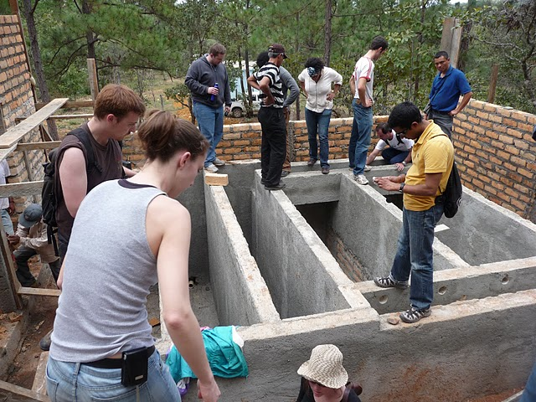
Agalteca
Notes:
Karen

Slide 3
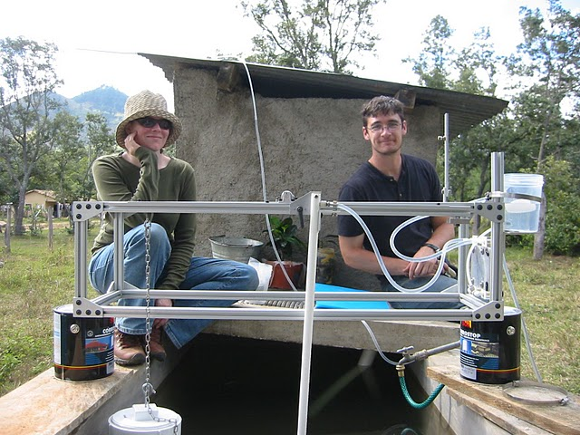
Agalteca
Notes:
Karen

Slide 4
Dose Controller
Stock Tank
Stock Tank
Constant Head Tank
Constant Head Tank
Dosing arm
Dosing arm
Counterweight
--
Range of motion
Varies dosage with varying flow rates not just turbidity
More precise
dosage
--
Counterweight
Float
Plant head loss
max plant flow
max plant flow
Float
min plant flow
min plant flow
Rapid Mix Tube
Entrance Tank
Rapid Mix Tube
Entrance Tank

Slide 5
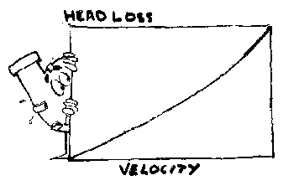
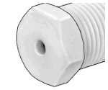
Non-Linear?
The new design for the dose controller is considered “non-linear” because of the dominant equation
where
is the chemical flow rate
is the orifice coefficient
is the available head
Notes:
Harri

Slide 6
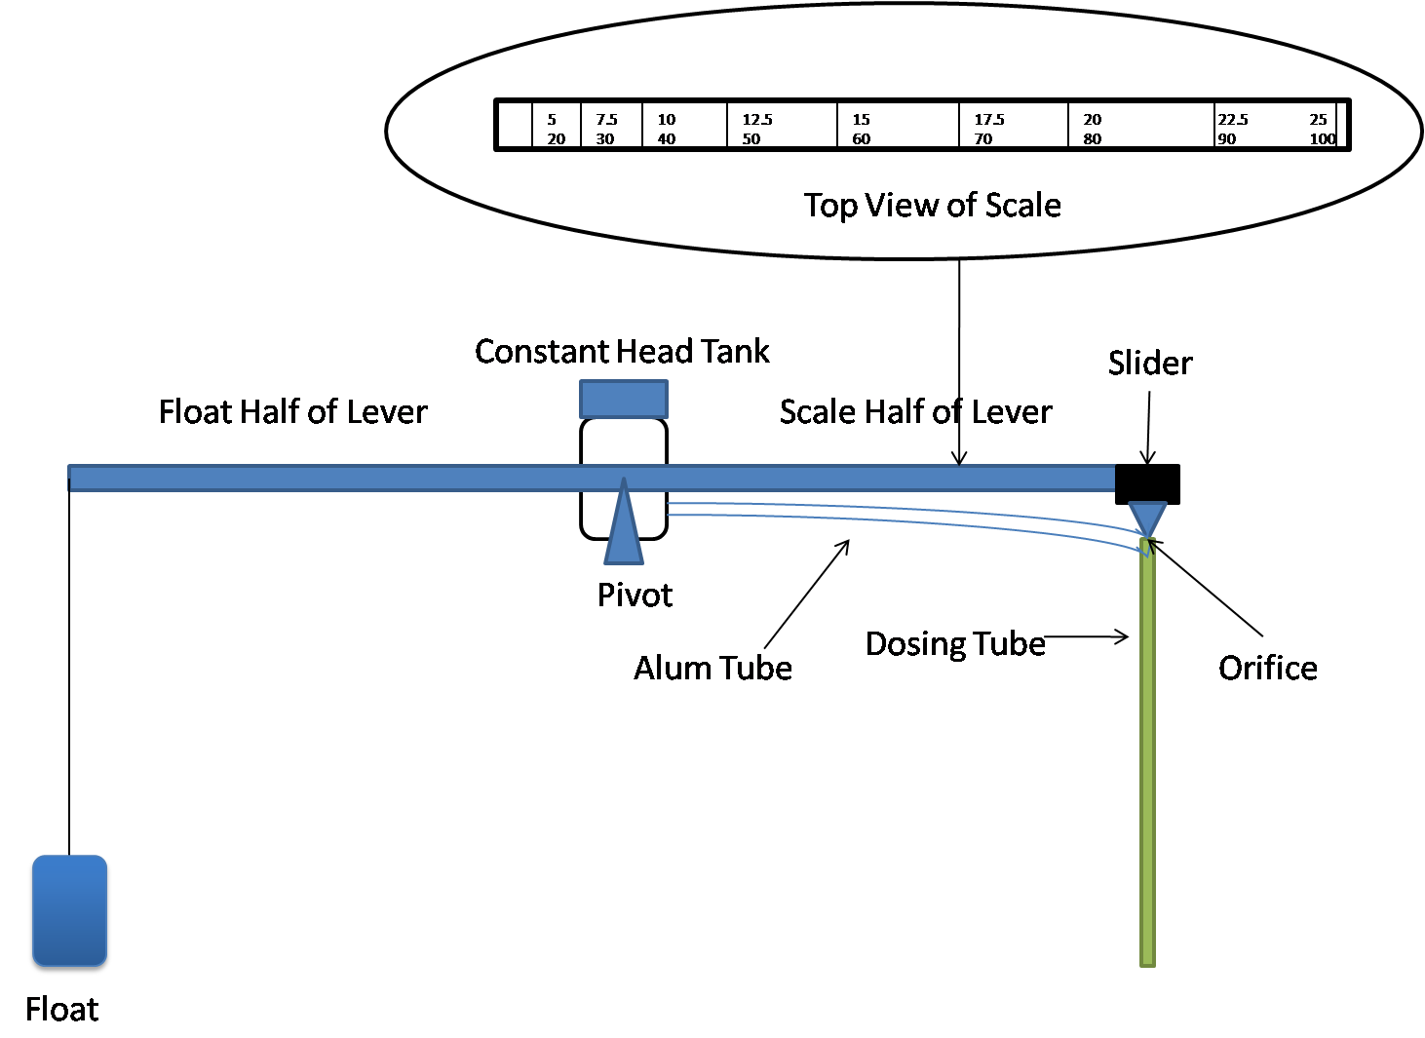
Lever Arm: Dual Scales
Benefits of Dual Scale
Top view of scale
Possible to dose at wider range (5-100mg/L)
More precision at lower doses leads to higher quality effluent
Reduces wasted alum from overdosing
5 7.5 10 12.5 15 17.5 20 22.5 25
20 30 40 50 60 70 80 90 100
mg/l
Notes:
Daleford

Slide 7
Linking Dosage to the Non-linear Scale
Alum
Dosage
Alum
Flow
X 2 =
Increase Diameter of Orifice
Decrease Length Scale
Point
on
Scale
Pivot Point
20
30
40
50
60
70
80
90
100
5
7.5
10
12.5
15
17.5
20
22.5
25
Notes:
Dale

Slide 8
Calculation of Max Angle and Length
Process | Headloss
Rapid Mix Tube | 10 cm
Flocculator | 13.5 cm
Launder | 5 cm
Weir | 5 cm
Total | 33.5 cm
Dosing arm
--
Range of motion
Plant head loss
Max Plant flow
Float
Min Plant flow
Entrance Tank
Rapid Mix Tube
Notes:
Dale - With the new max delta H of 33.5 cm, with a 80 cm equal length lever we get a max angle of 57 degrees

Slide 9
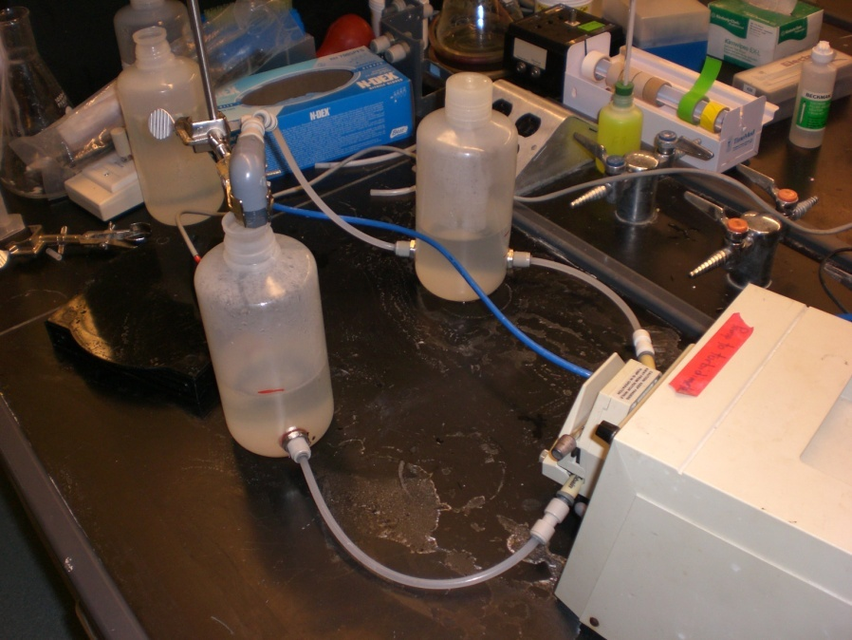
Clogging Experiment
Results
  Inconclusive evidence of a clog
  Change orifice size: 1.01, 2.28 mm diameter to 1.587, 3.175 mm
  Recommend lower dose of alum: 125 g/L to 51 g/L
  Stock tank will have to be refilled more often
Notes:
Akta

Slide 10
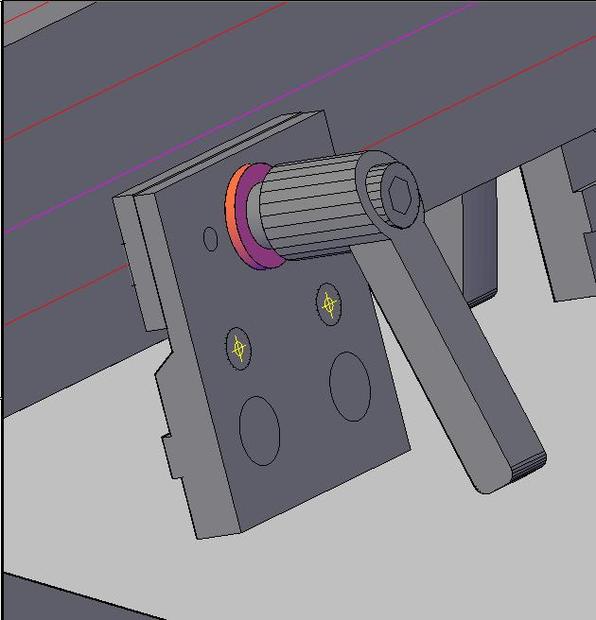
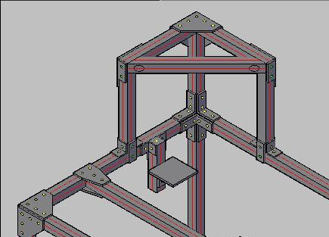
Prototype Design
Slide Brake
Stock Tank Platform
Notes:
Harri

Slide 11
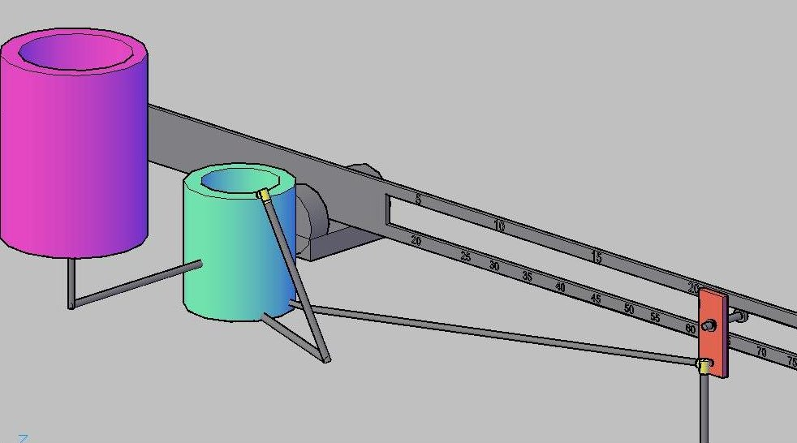
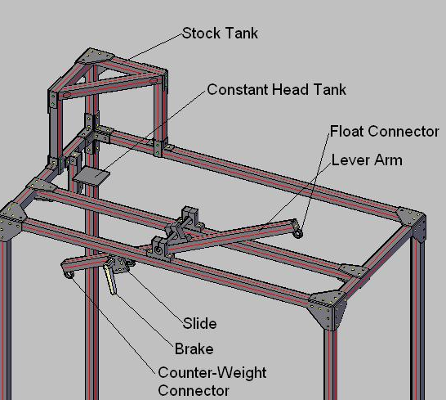
Conceptual & Actual Designs
AutoCAD Model
Full-Scale Prototype
Notes:
Harri

Slide 12
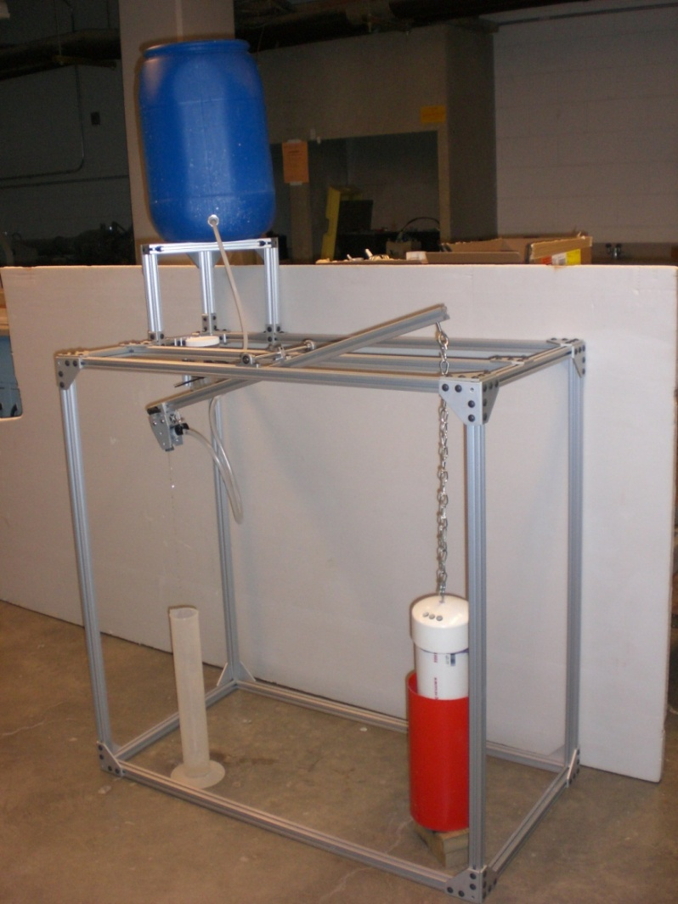
Assembled Doser with Hydraulic Components Attached
Notes:
Harri

Slide 13
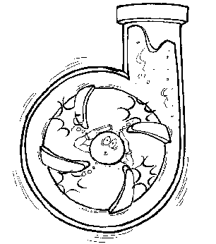
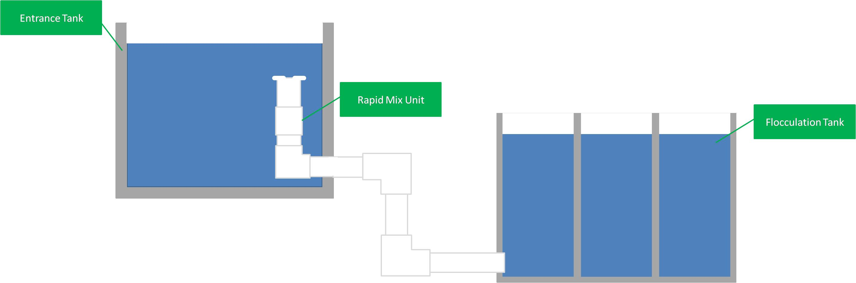
Rapid Mix Tube Design
Notes:
Kayti

Slide 14
Mixing Orifices
Need: 1< K <2 (exit loss coefficient)
Ain here is based off of the area of the large scale mixing orifice that causes the constricted flow area
Large scale mixing will take place in the first section of the tubing
The small scale mixing orifice is designed with a target head loss, Δh
Using the following equation, we calculate the maximum length of the smallest dimension of a rectangular orifice
Ain
Notes:
Kayti

Slide 15
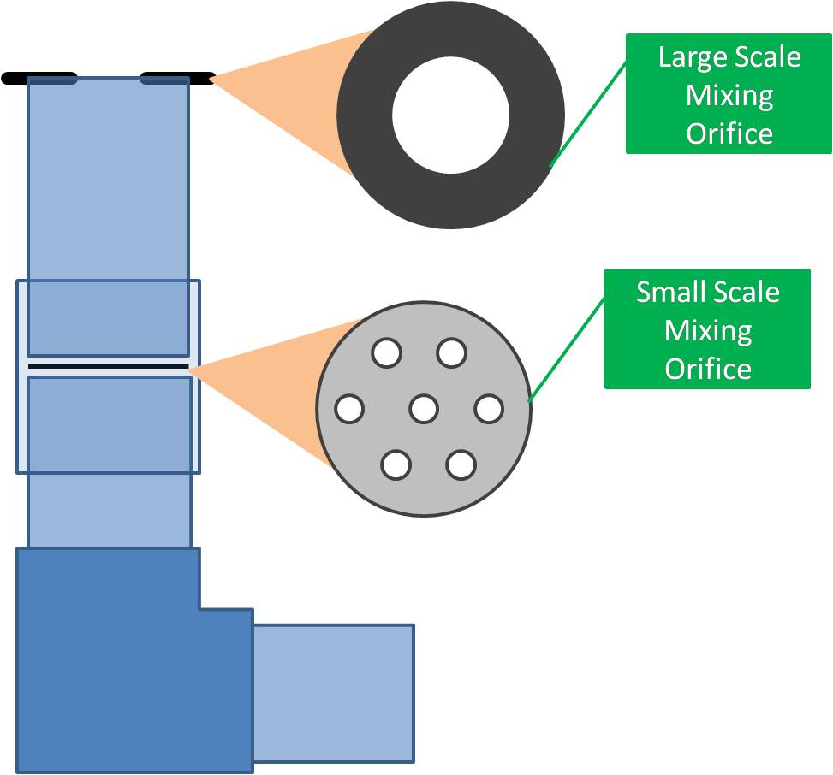
Rapid Mix Tube Design
Problems were occurring with the old design:
  Submerged rapid mix orifice made it difficult to clean when clogged
New design provides a large scale rapid mixing orifice
Makes cleaning much easier: small and large scale orifices can be removed easily
Simple system: easy to build and take apart
Notes:
Kayti

Slide 16
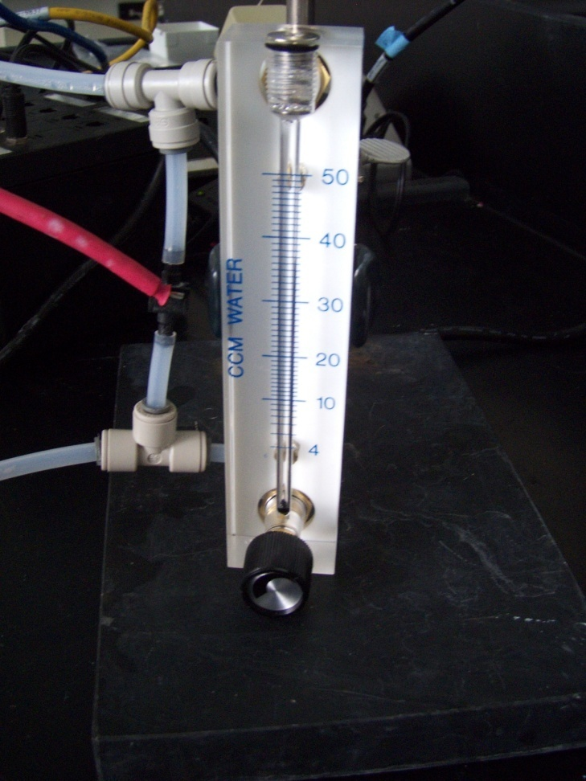
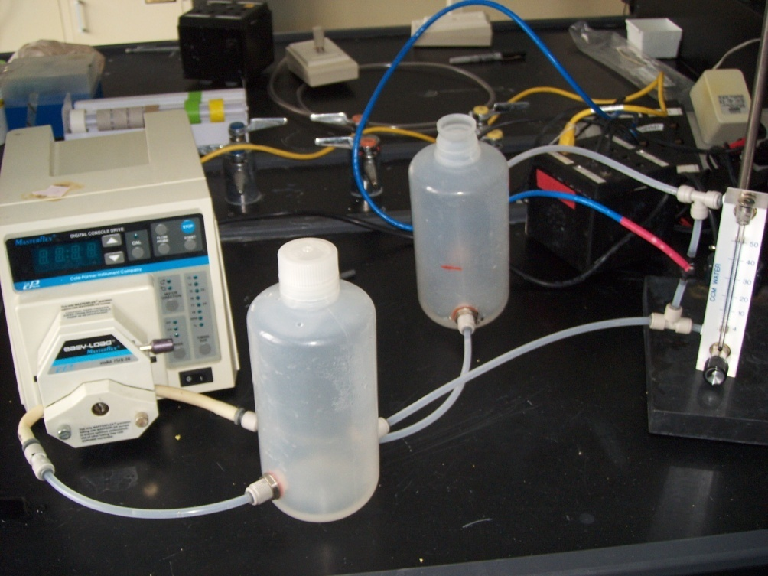
Rotameter Experiment
Measuring headloss
Verifying relationship between Q and h

Slide 17
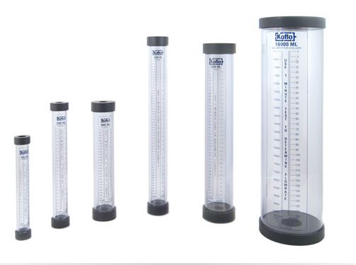
Calibration column to measure flow
Advantages:
Simple
Less chance of clogging
Cheaper
No head loss being introduced

Slide 18

EPA P3 Competition: People, Prosperity and the Planet Student Design Competition for Sustainability
Phase I (Spring 2009): $10,000 grants for research and development
Phase II (Spring 2010): Up to $75,000!
Deliverables:
  Written Project Report (Phase I activities and Phase II proposals) due March 23, 2010
  Project presentation at the annual National Sustainable Design Expo at the National Mall in Washington, DC
Notes:
Kayti

Slide 19
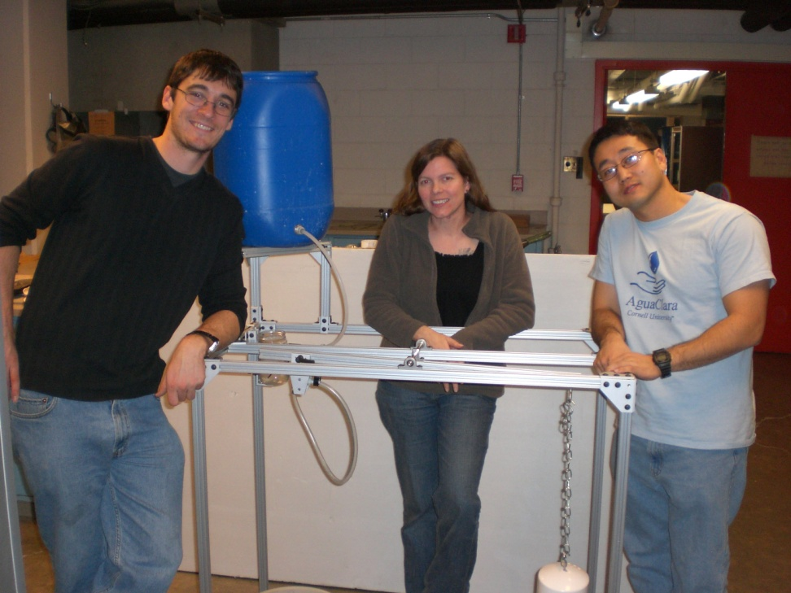
Future Objectives
General Semester Goals
√
Prepare a poster and present at the CEE Research Symposium February 12, 2010
Rebuild the prototype with modifications
Calculate head losses through a rotameter
Create a working display for P3
Write the P3 Report
Perform validation testing
Calibrate the prototype
Prepare a poster and present at the Cornell Engineering Research Conference
Test the rapid mix tube
Special Thanks to Yoon and Monica!
√
Notes:
Karen

Slide 20
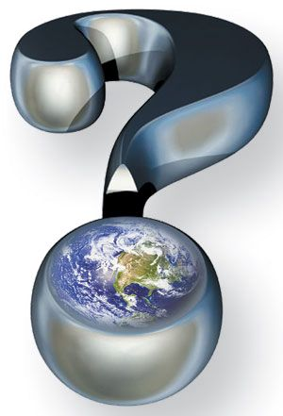
Notes:
Karen

