Slide 1
Chemical Dose Controller
Final Presentation
Karen Swetland
Dale Johnson
Spring 2010
Akta Patel
Harri Ko
Kayti Curtis
Notes:
Harri

Slide 2
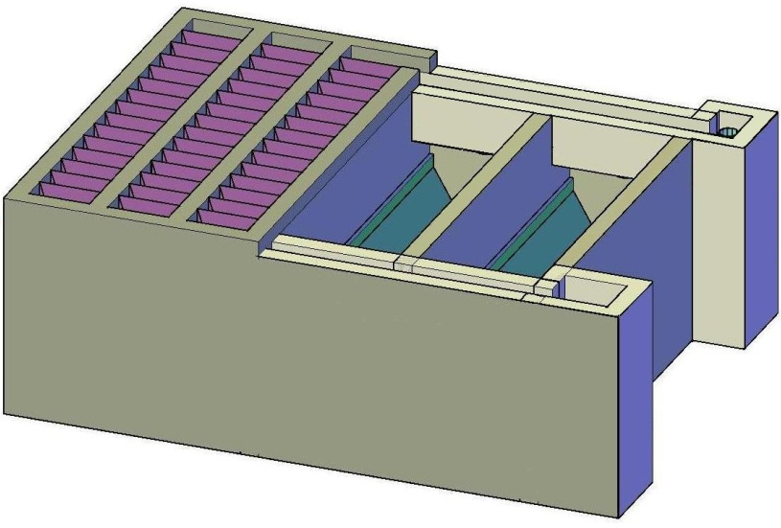
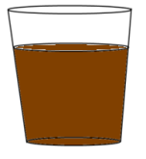
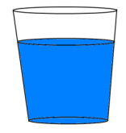
What do we dose?
Alum
Chlorine
dirty water
clean water
AguaClara plant

Slide 3
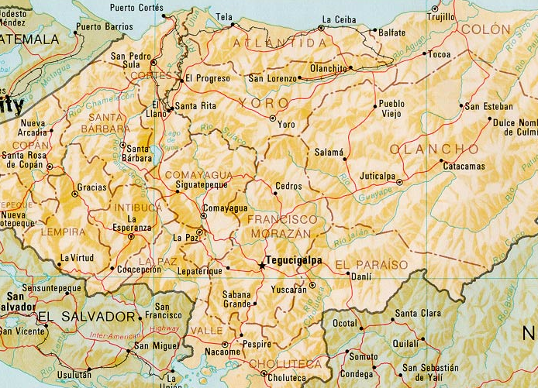
AguaClara plants currently in Honduras
5 plants in operation:
Marcala
Ojojona
Tamara
*Agalteca*
Cuatro
Communidades
Honduras
Agalteca is the first plant to have a nonlinear chemical doser added
Notes:
Harri

Slide 4
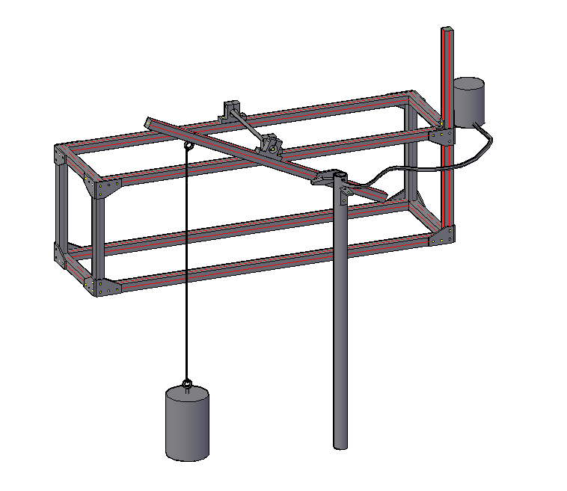
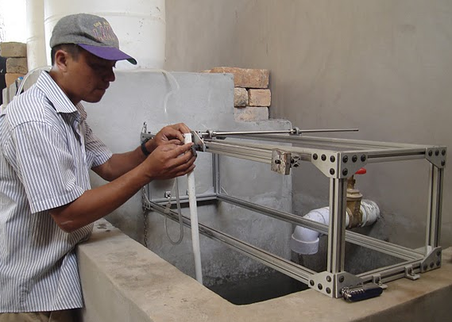
Drawing The Doser
The Agalteca Doser design was drawn in AutoCAD to be used in the automated design tool
This drawing was done based on photographs from the trip
Notes:
Harri

Slide 5
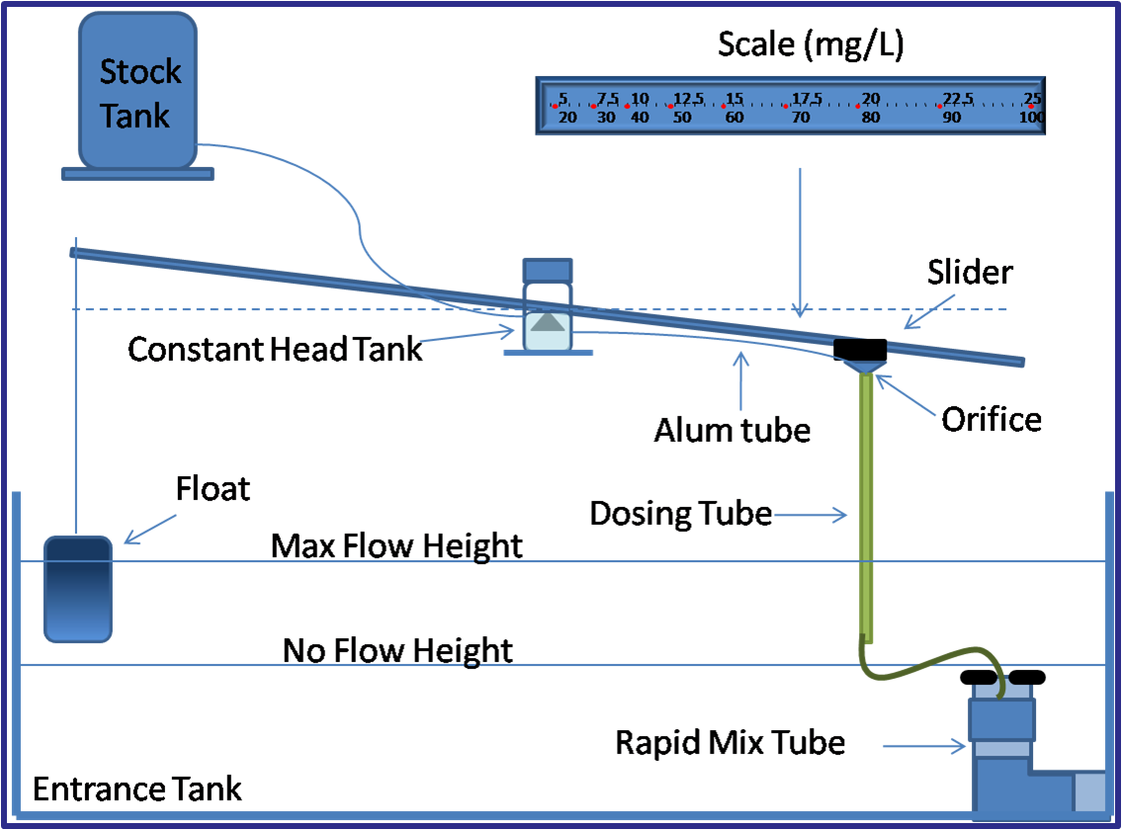
Chemical Dose Controller
Notes:
Harri

Slide 6
Stock Tank
Constant head tank
As the plant flow
increases
Alum flow
increases
Notes:
Harri

Slide 7
What makes the doser nonlinear?
Relationship between Q and h
Compare with linear doser and nonlinear doser
 | Laminar | Turbulent
Linear doser
Orifice doser (nonlinear)
There is the same relationship in turbulent range: CAN SCALE UP
Notes:
Harri

Slide 8
How much do Major head losses matter?
Conclusion: Not much!
We can confidently rely on minor losses (the orifice) to control flow.
Notes:
Harri

Slide 9
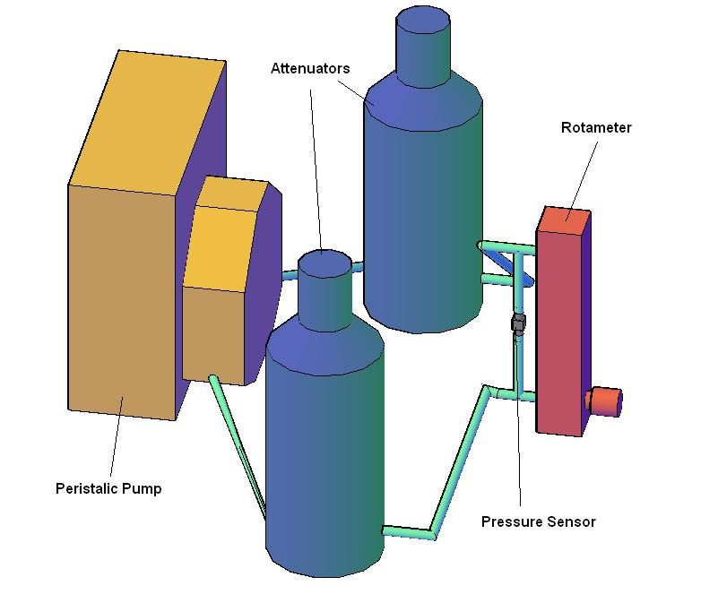
Rotameter Head Loss Experiment
Notes:
Akta

Slide 10
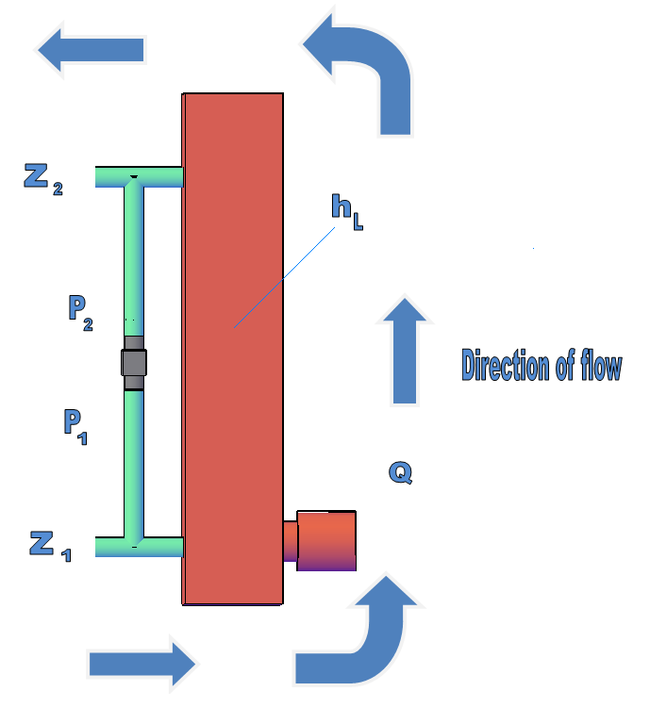
Experiment Setup
The difference in pressure was used to measure the head loss through the rotameter with varying flow rates
The energy equation served as the basis for calculations
Notes:
akta

Slide 11
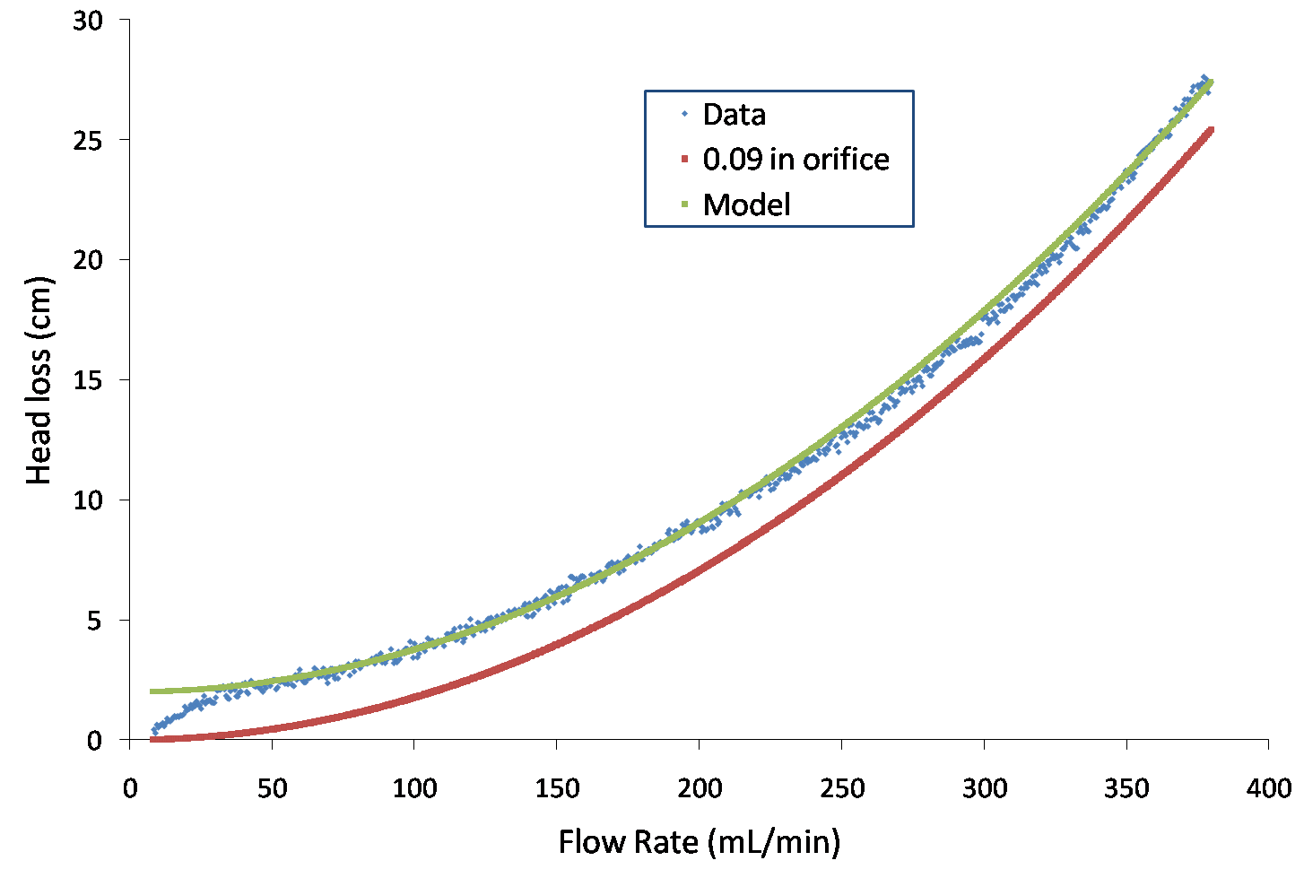
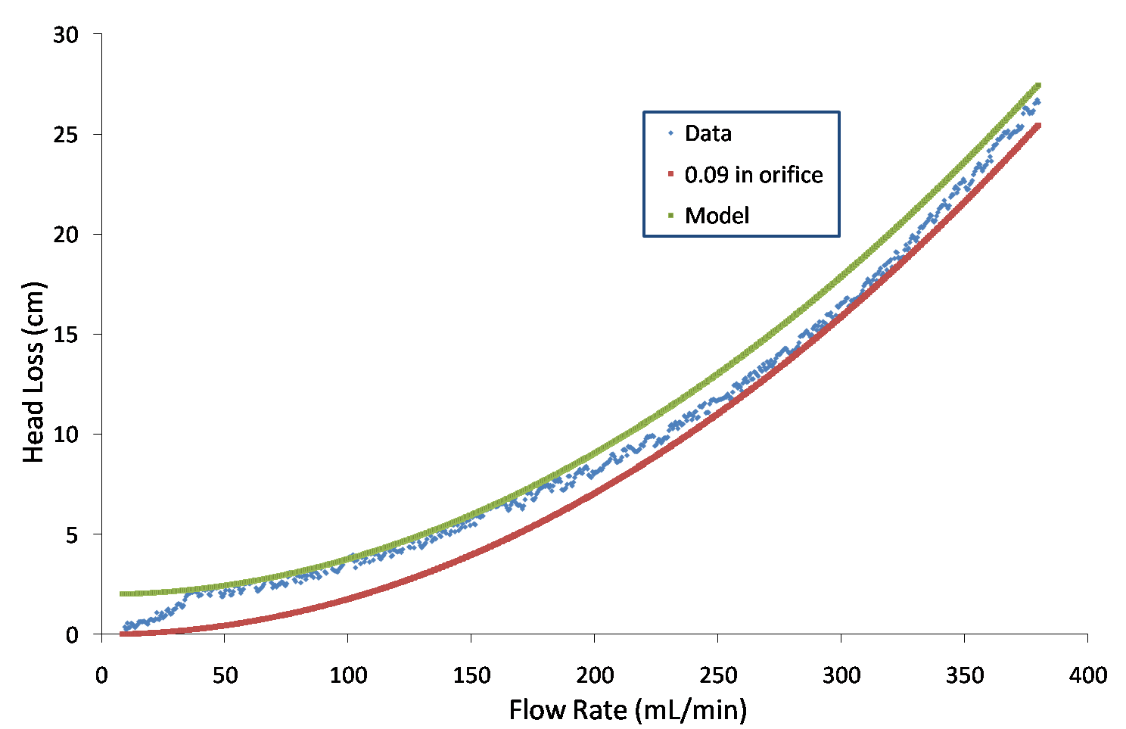
Rotameter Results: Full Flow
Results from test, fit a 0.09 in orifice if we used a 2 cm offset to account for energy needed to lift float.
Data at low flow rates linear and doesn’t fit orifice prediction well.
Full flow experiment #1
Full flow experiment #2
Notes:
Akta

Slide 12
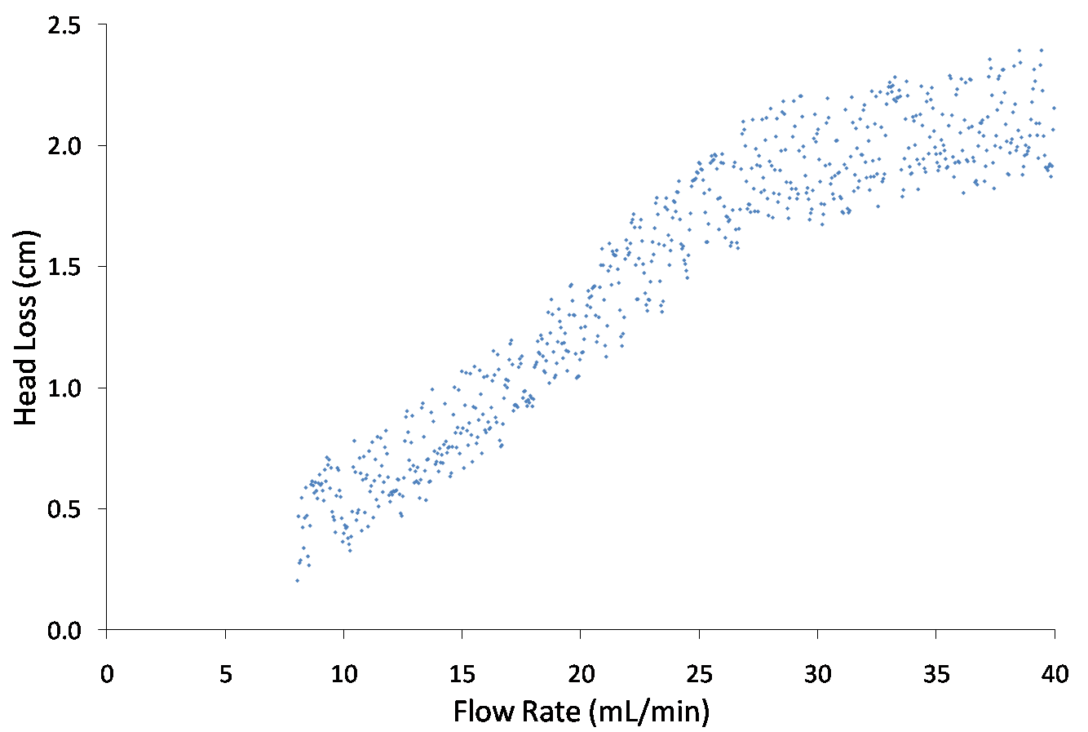
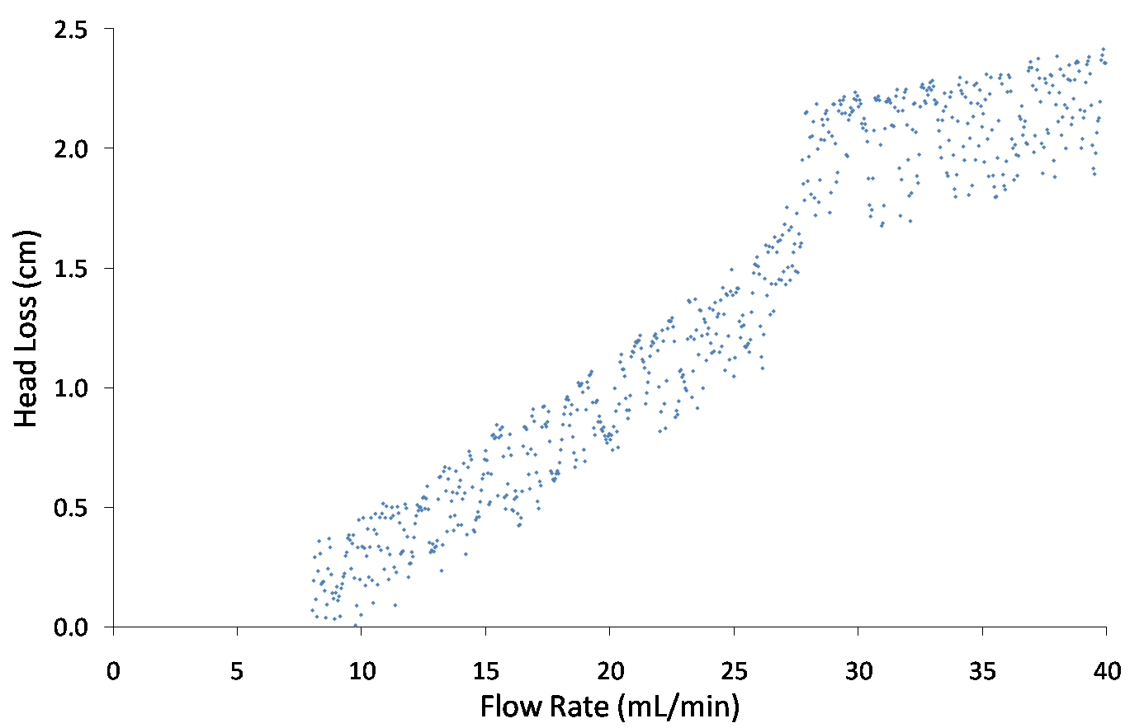
Rotameter Results: Low Flow
Linear relationship at low flow
Can’t use rotameter to measure dosing flow
Low flow experiment #1
Low flow experiment #2
Notes:
Akta

Slide 13
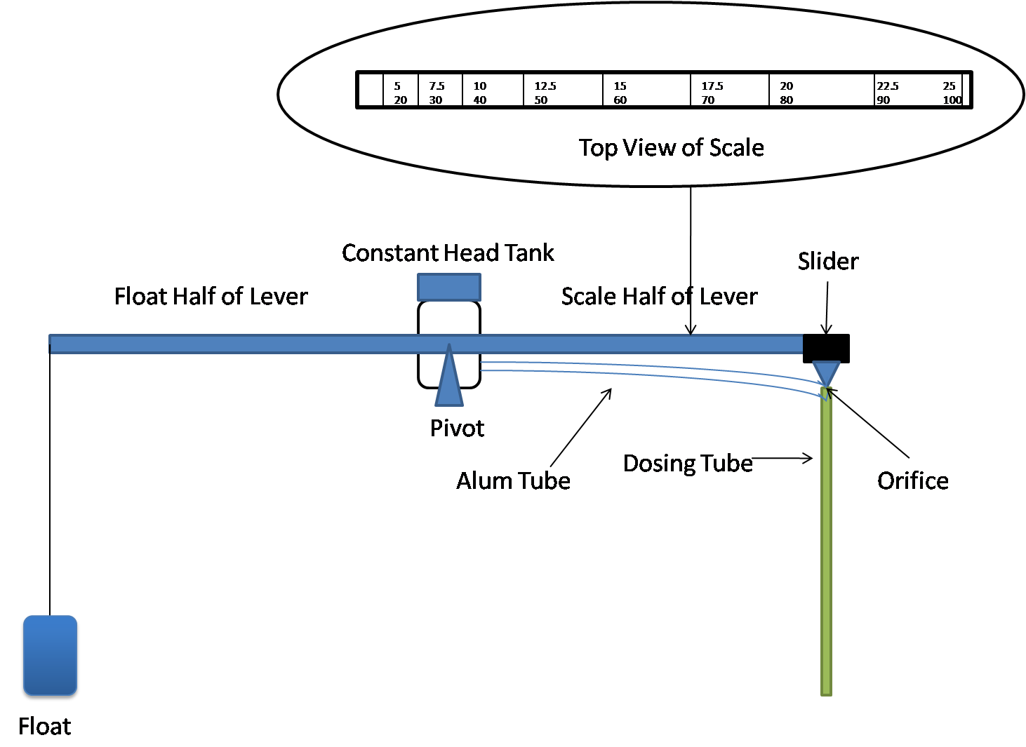
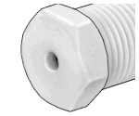
Lever Arm: Dual Scales
Benefits of Dual Scale
Top view of scale
Possible to dose at wider range (5-100mg/L)
More precision at lower doses leads to higher quality effluent
5 7.5 10 12.5 15 17.5 20 22.5 25
20 30 40 50 60 70 80 90 100
mg/l
Orifice size
large
small
Notes:
Akta

Slide 14
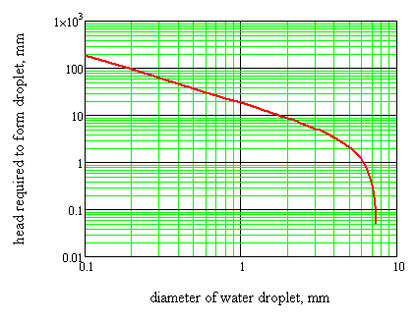
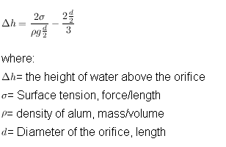
Surface Tension
Can prevent the flow of alum in the dosing system
Can cause large dosing errors
Changes the required head to achieve a certain alum flow
Surface Tension effect
Flow
Head, mm
Droplet forms
No Flow
Orifice diameter, mm
Notes:
Dale

Slide 15
Effect of Surface Tension
No flow point
WITHOUT surface tension
WITH surface tension
Constant head tank
Constant head tank
Zero flow
h
Zero flow
Note: The spot where there is no alum flow is shifted down
Notes:
Dale

Slide 16
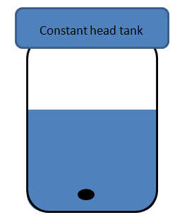
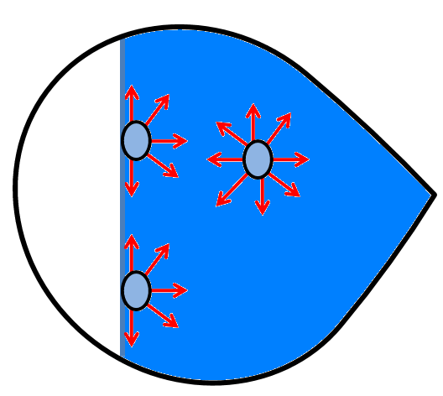
Effect of Surface Tension
No Flow!
h
Particles are more attracted to one another on the surface, causing a cohesive “film” to form on the surface.
Even at some height h, below the water level, surface tension will prevent flow
Notes:
Dale

Slide 17
Two proposed Solutions
Option 1: Submerged orifice
h
No cap orifice
Submerged orifice
A submerged orifice is placed inline between the CHT and the end of the dosing tube
Notes:
Dale

Slide 18
Solutions
Option 1: Submerged orifice
h
Advantages:
Accounts for surface tension and could reduce dosing errors
Disadvantages:
Difficult to see when it clogged
Right now, it’s difficult to remove the insert
The insert might need to be mechanically fabricated
Notes:
Dale

Slide 19



Solutions
Option 2: Nonlinear triple scale
40 48 56 64 72 80 88
mg/l
20 24 28 32 36 40 44
10 12 14 16 18 20 22
Large Medium Small
Scale, cm
6.46
9.29
12.66
16.53
20.92
25.83
31.25
Each of the three scales correspond to three orifice sizes
Has a more narrow range of alum concentrations than dual scale
Can effectively deal with surface tension
Notes:
Dale

Slide 20
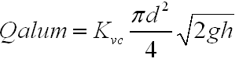
Solutions
Option 2: Nonlinear triple scale
40 48 56 64 72 80 88
mg/l
20 24 28 32 36 40 44
10 12 14 16 18 20 22
Lower concentration ranges
At same diameter this increases h
Surface tension is not as influential
Orifice equation:
Surface Tension Effect, Max Flow
Flow
Head, mm
No Flow
Orifice diameter, mm
Notes:
Dale

Slide 21
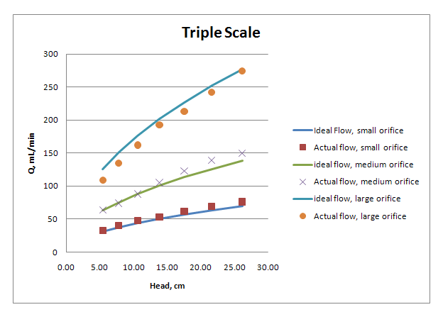
Solutions
On average around 5% error across all scales
Notes:
Dale

Slide 22
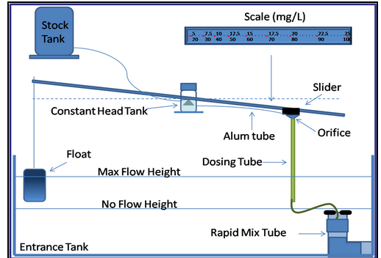
The float
The float connects the changes in plant flow rate to the dosing arm
Notes:
Karen

Slide 23
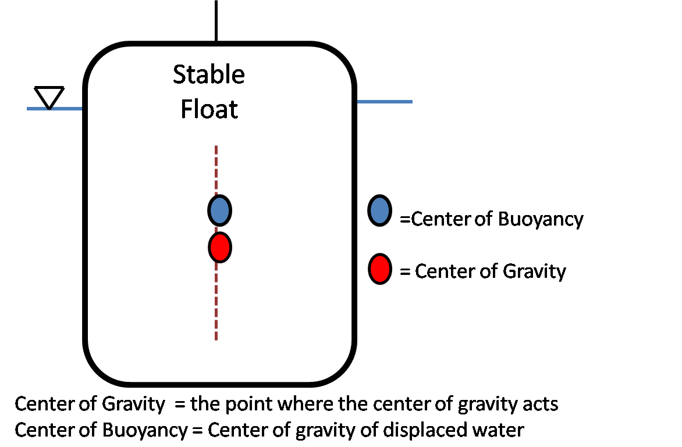
Float parameters
Stable Float
=Center of Buoyancy
= Center of Gravity
Notes:
Karen

Slide 24
Float parameters
Stable Float
=Center of Buoyancy
= Center of Gravity
Sand
As sand is added to the float:
It moves the center of gravity down
It moves the center of buoyancy up
Notes:
Karen

Slide 25
Float parameters
D
=Center of Buoyancy
= Center of Gravity
H
depth
Sand
INPUT:
Percent submerged = 1-(ρ_{water} – ρ_{float} )
Center of Buoyancy = depth/2
Center of Gravity = (mass_{float}*cg_{float}+ m_{sand}*cg_{sand})/ (mass_{float} + mass_{sand})
Where: cg = the distance to the center of gravity from the bottom of the float
OUTPUT: Mass of the sand
Notes:
Karen

Slide 26
Float parameters
D
H
depth
Sand
Conclusion:
Make D wide, to minimize error due to slider.
Mass of sand added: 1.75 lbs – 4.1 lbs
This makes the center of gravity below the center of buoyancy but the float is not fully submerged
Notes:
Karen

Slide 27
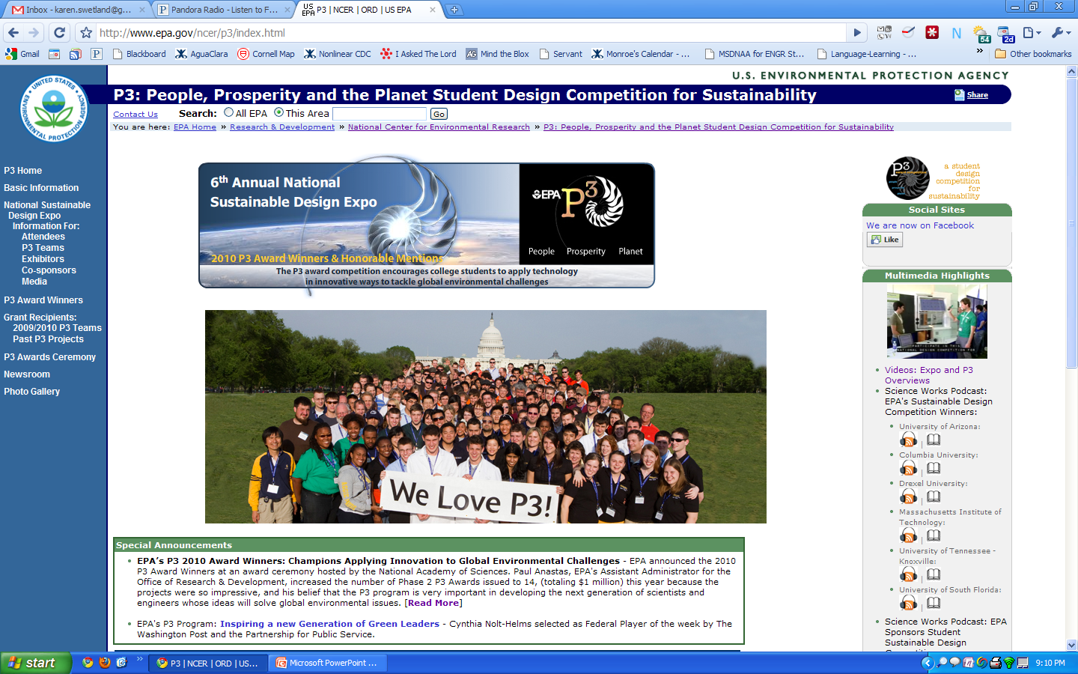
EPA P3:
People, Prosperity & the Plant
Notes:
Akta

Slide 28

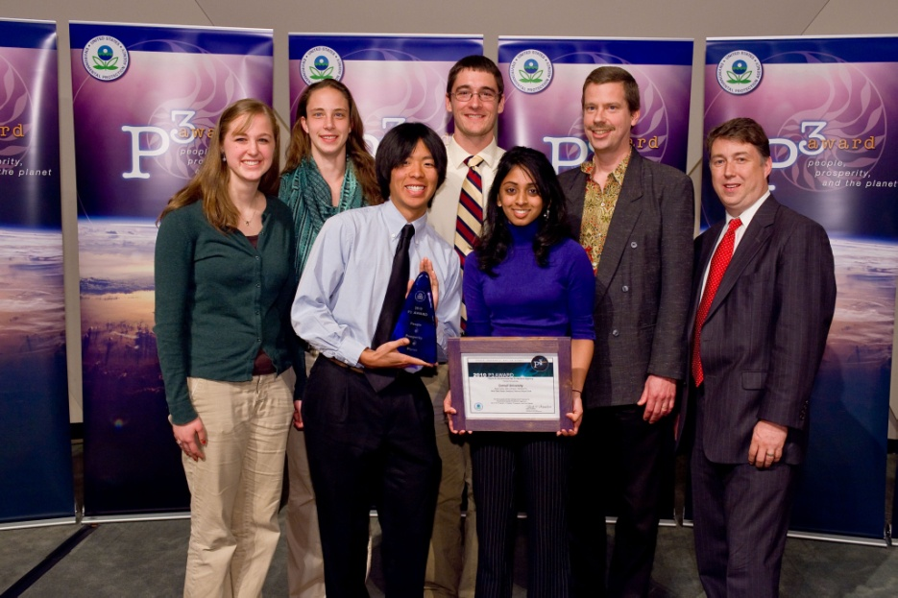
EPA P3 Competition: People, Prosperity and the Planet
Phase I (Spring 2009): $10,000 for research and development
Phase II (Spring 2010): $75,000 for Phase II activities!
Project presentation at the annual National Sustainable Design Expo in Washington, DC
Notes:
Akta

Slide 29
Phase I Activities
Research potential nonlinear doser designs
Write algorithms that calculate relevant parameters
Design a prototype nonlinear dose controller and rapid mix tube
Replicate the prototype doser for installation at the new plant in Agalteca
Document all research and design for the EPA P3 competition
Perform validation testing on the doser
Develop a display and poster for the EPA P3 competition
Phase II Activities
Make
Problem Solve
Experiment
Program
Continue validation testing on the doser
Analyze performance data from the plant at Agalteca
Research and fix failure modes to increase reliability
Document final replicable doser design
Convert doser to locally available materials
Incorporate doser into Automated Design Tool (ADT)
Notes:
Akta

Slide 30
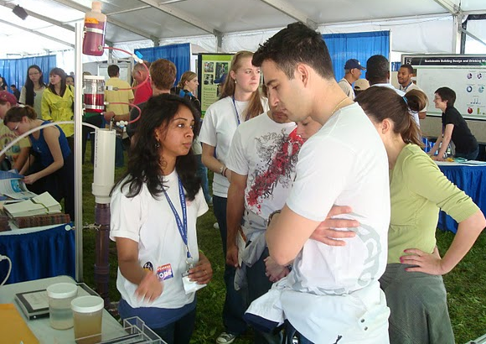
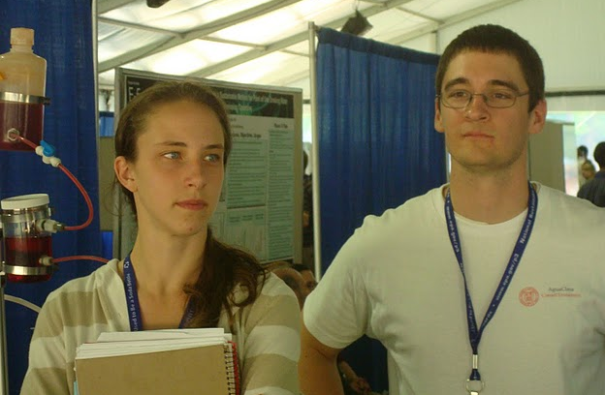
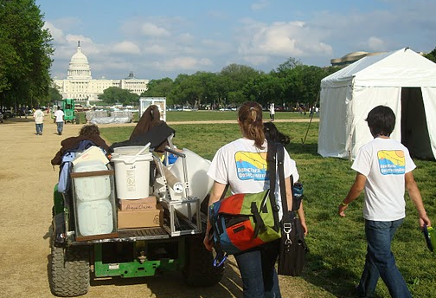
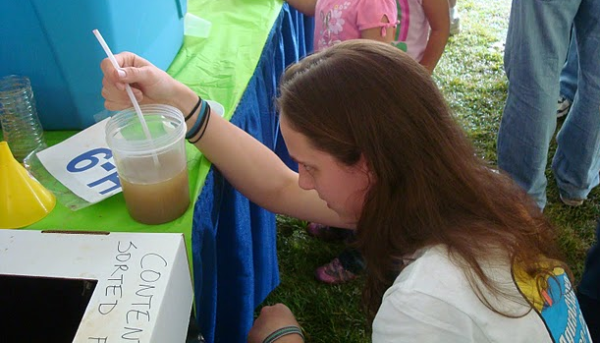
Questions?
Notes:
Kayti

