Slide 1
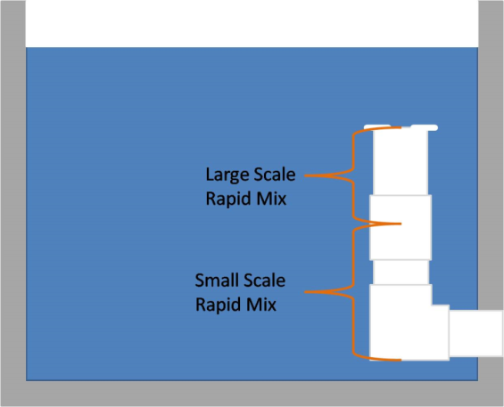
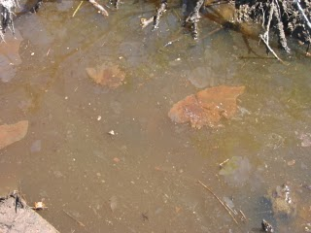
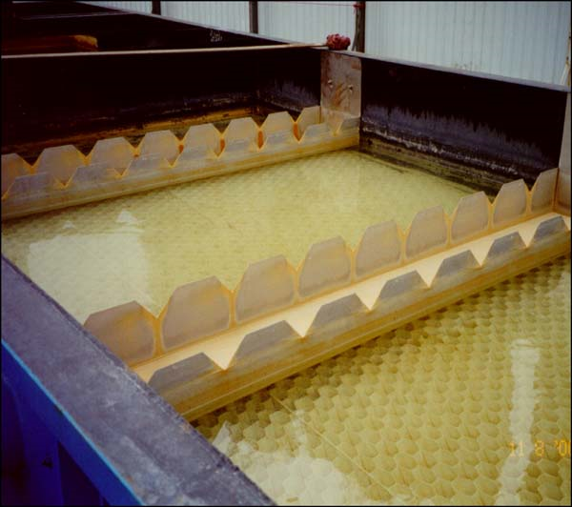
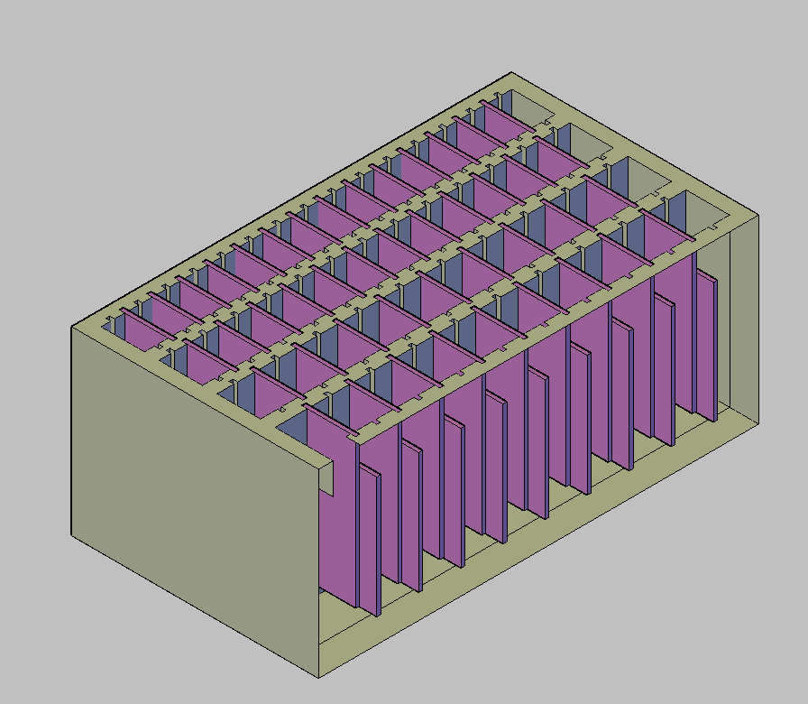

AguaClara Processes: 4 Steps
Step 1: Add Aluminum Sulfate (Alum) –Causes dirt and other impurities to clump together into “flocs”
Step 2: Rapid Mix – Thoroughly blend water and alum, down to the molecular scale
Aluminum
Sulfate
+
Step 3: Flocculation – Water moves around a series of gates or “baffles” which causes the flocs to collide and grow in size
Step 4: Sedimentation – Allows flocs to fall out of suspension
A vertical Flocculator
Baffles
Finally, add chlorine for disinfection and you get…
Clean Drinking Water!

Slide 2
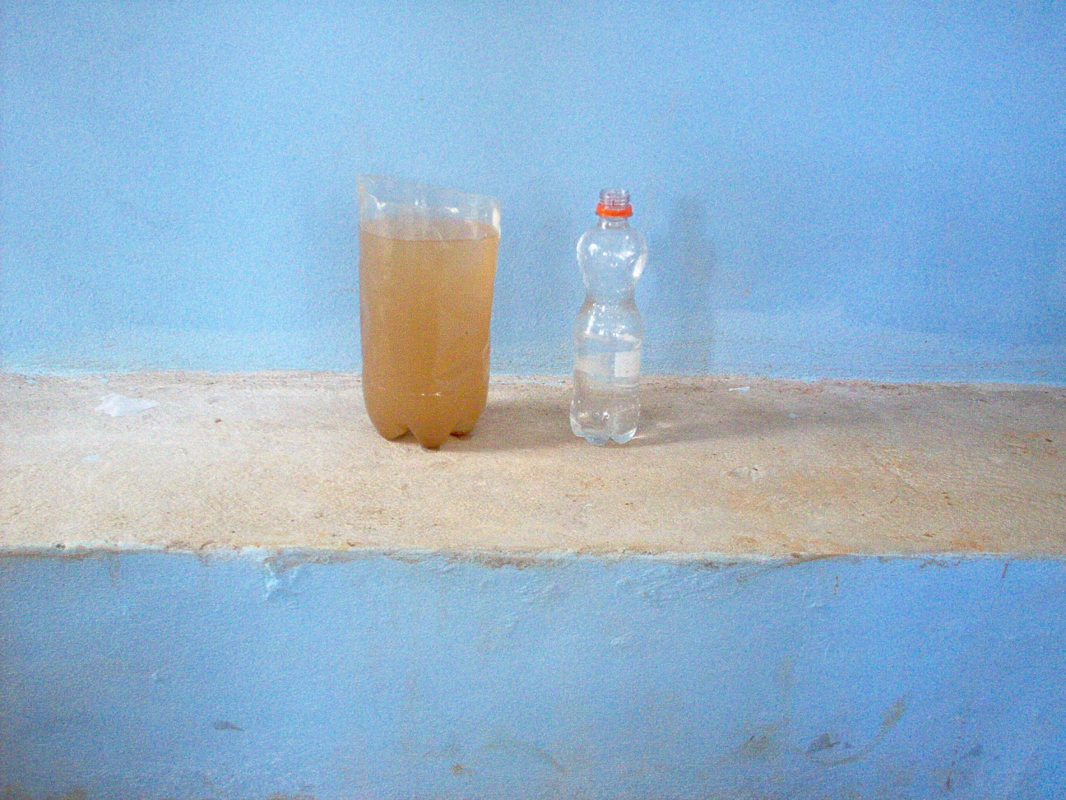
Goal: Reduce Turbidity
Notes:
Turbidity in water reduces the efficacy of disinfection with chlorine.
Remove turbidity in order to make water easier to treat.
Reasons for treating water include diarrhea,…

Slide 3
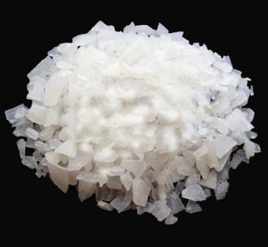
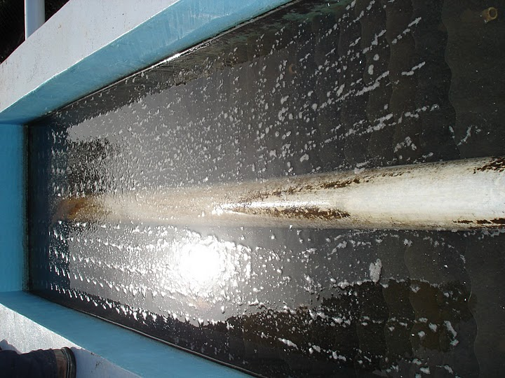
The Four Steps
Notes:
Roadmap slide - meant to be a quick overview of the process.
Step 1: Add Aluminum Sulfate (Alum) –Causes dirt and other impurities to clump together into “flocs”
Step 2: Rapid Mix – Thoroughly blend water and alum, down to the molecular scale
Step 3: Flocculation – Water moves around a series of gates or “baffles” which causes the flocs to collide and grow in size
Step 4: Sedimentation – Allows flocs to fall out of suspension
Finally, add chlorine for disinfection and you get clean water

Slide 4
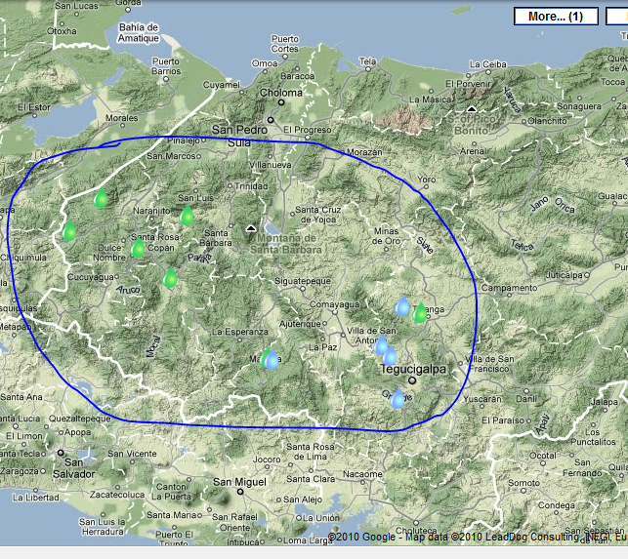

The Source
Notes:
Drawn from turbid local waterways
Community must already have a system for distributing water from the waterway to the community.

Slide 5
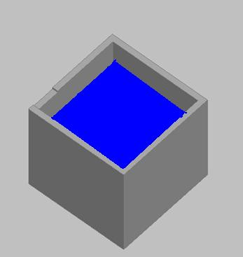
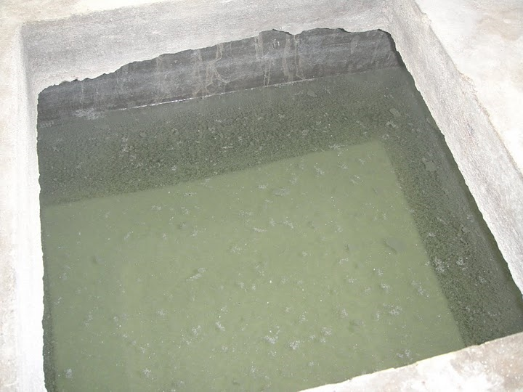
Into the Plant…
Entrance Tank
Chemical Storage Tank
Notes:
Influent water is stored in the entrance tank before treatment
Water level in tank must remain constant in order for the rest of the AguaClara processes to proceed
Alum (the coagulant) kept in the chemical storage tank.

Slide 6


Mixing Alum and Water
To Flocculator
Notes:
Raw influent water and alum are blended in the rapid mixer (down to the molecular scale)

Slide 7
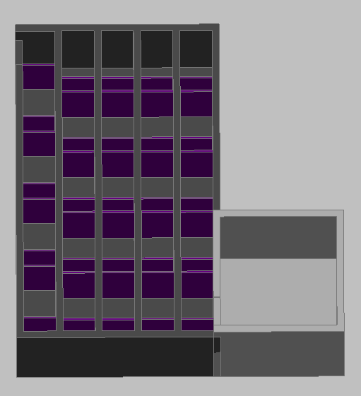
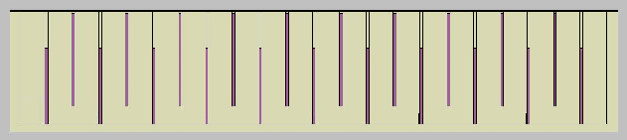
Flocculation
Flocculator Side View
Entrance tank and Flocculator
Notes:
Water moves from the entrance tank into the flocculation tank, as indicated by the yellow arrow:
Once inside the flocculator, water moves through tank, around baffles (shown below in side view of floc tank)
This causes the dirt particles (flocs) to clump together into larger flocs

Slide 8
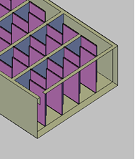
Flocculation (Horizontal)
Notes:
The flocculator can also be horizontal, in which case the water will flow around the baffles as shown here.
Horizontal flocculators typically have higher flow rates and are easier to drain.

Slide 9
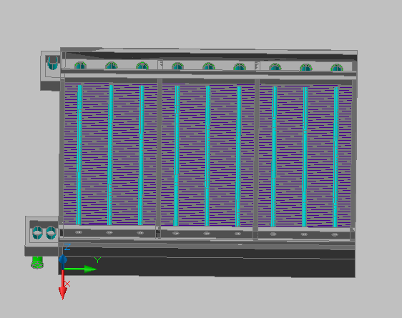
Sedimentation
Notes:
Water moves from the flocculator into the sedimentation tank, where the large flocs settle out of solution.

Slide 10
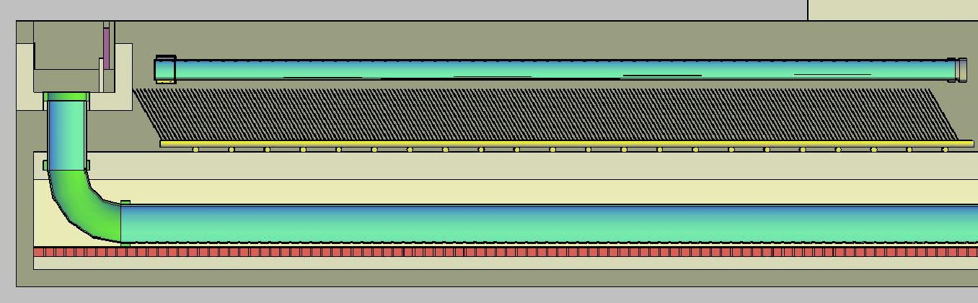
Sedimentation
Notes:
Each of the light blue lines is a “sed plate” (catches flocs as they fall out of solution)

Slide 11
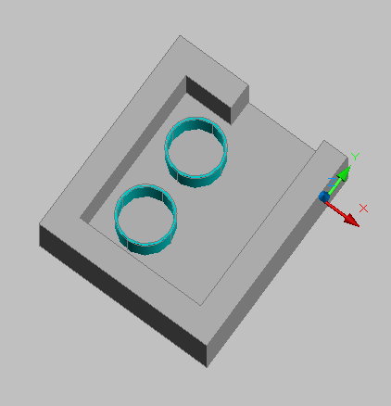
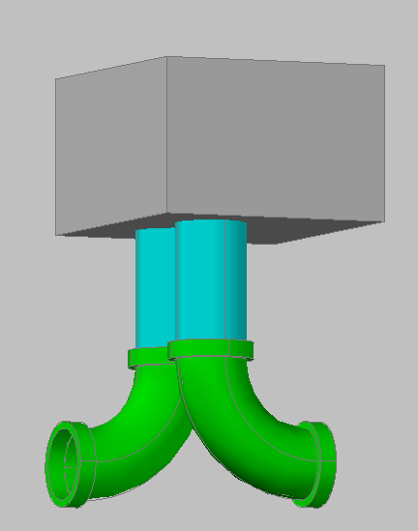
Leaving the Plant
Notes:
Finally, the water is chlorinated and released through the exit channel:
Top view of entrance to exit channel. Water flows into the page, through the light blue pipes.
Side view of the exit channel outlets.

