Slide 1
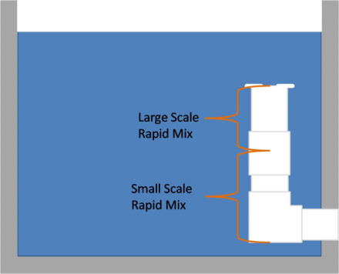
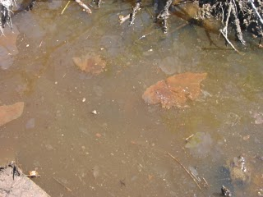
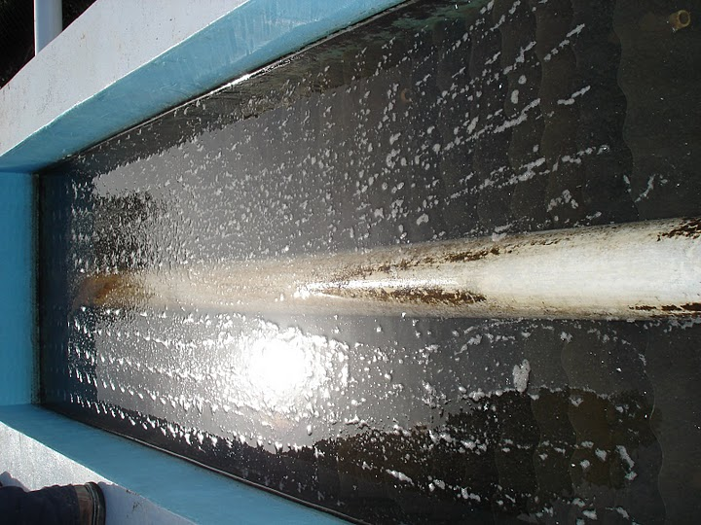
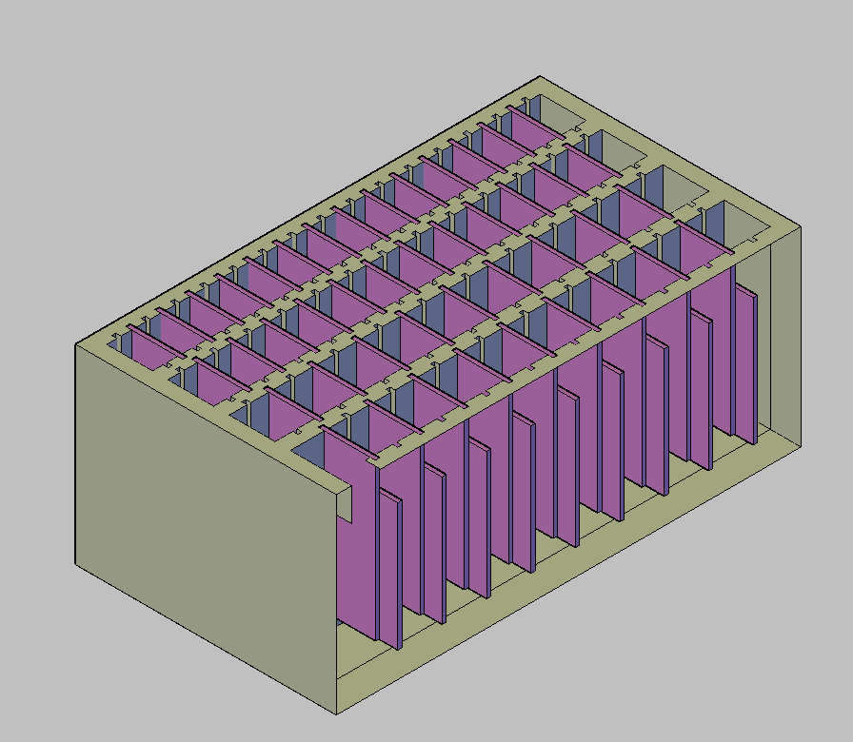

The Aguaclara Process – A Brief Overview
1. Add aluminum sulfate (alum) to influent from local waterways, form flocs (clumps of sediment)
2. Rapid mix - Blend water and alum down to the molecular scale
Alum
+
3. Flocculation – Move water around a series of baffles, make flocs collide & stick together
4. Sedimentation - Remove flocs from solution
A vertical flocculator
Baffles
5. Add chlorine for disinfection, get clean water.

Slide 2
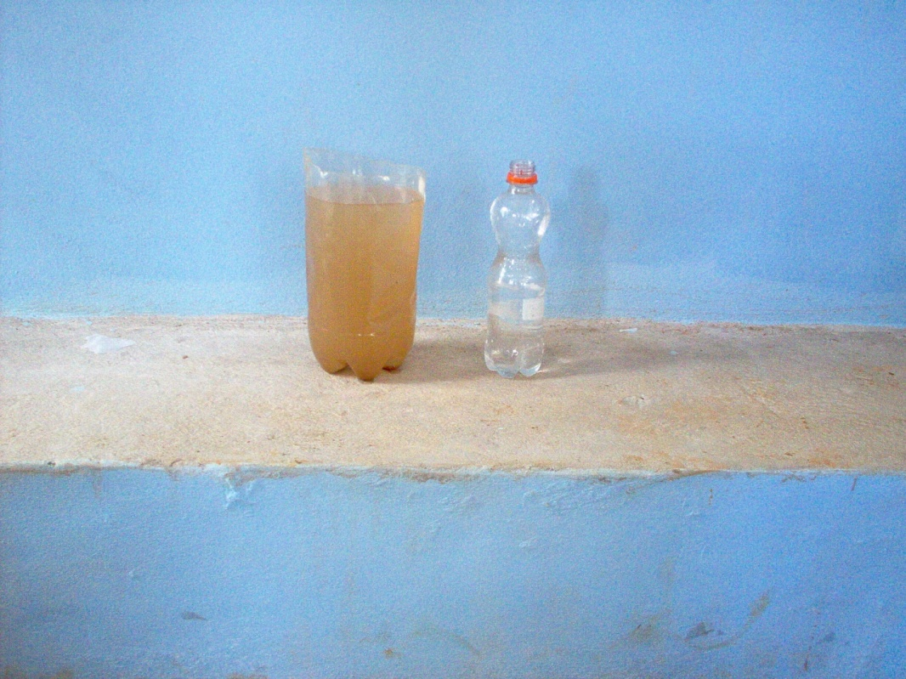
Ultimate Goal: Reduce Turbidity
Turbid water is more difficult to disinfect with chlorine
Remove turbidity in order to make water treatment more effective.
Treated water has more aesthetic appeal and results in fewer instances of diarrhea, bacterial infections, etc.

Slide 3
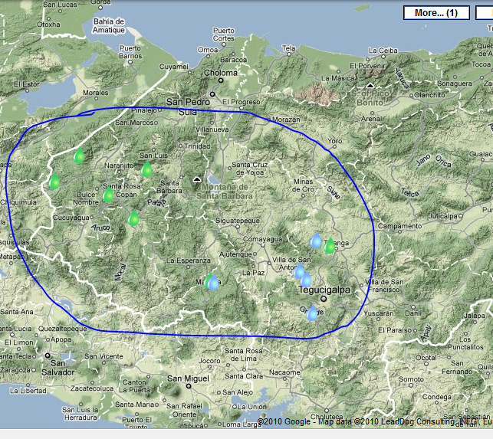
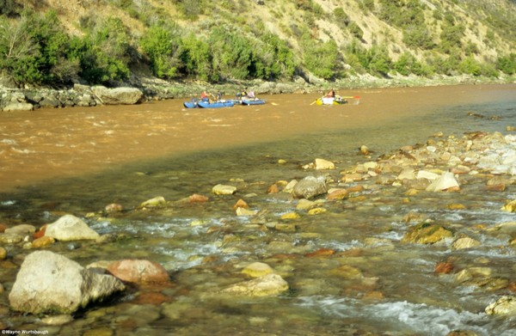
The Source
All influent water for AguaClara plants is drawn from turbid local waterways in interior Honduras.
Note that the local community must already have some type of water distribution system in place.

Slide 4
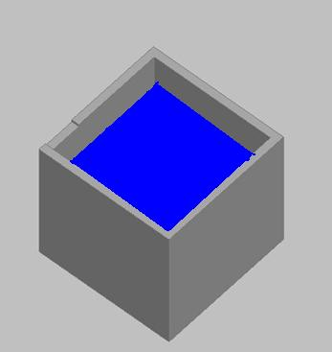
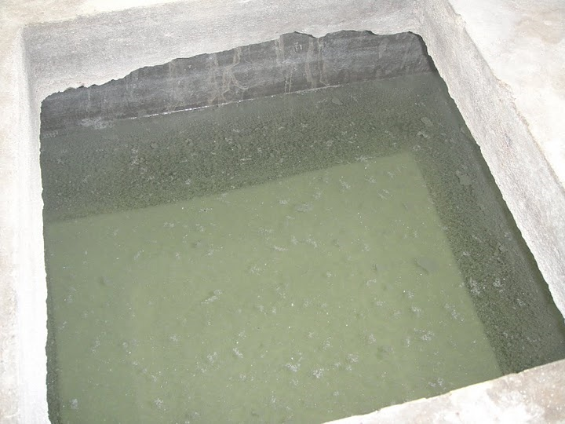
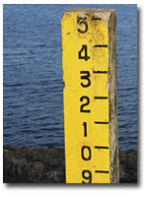
Into the plant…
Influent water stored in the entrance tank before treatment
Aluminum sulfate (alum) kept in the chemical storage tank
Water level in entrance tank must remain constant!
This is necessary to ensure constant flow of chemicals
Function of alum – causes dirt and other impurities to clump together into “flocs”

Slide 5



Mixing Alum and Water
Raw influent water and alum are combined in the rapid mixer (down to the molecular scale)
Alum from chemical storage tank
Water from entrance tank
Effluent to flocculator

Slide 6
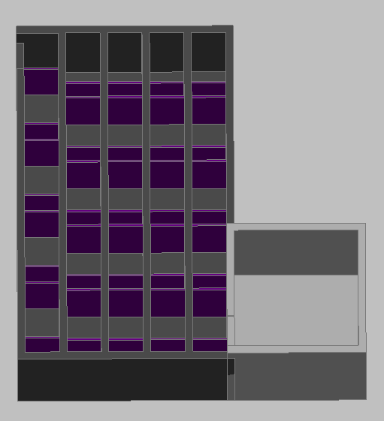
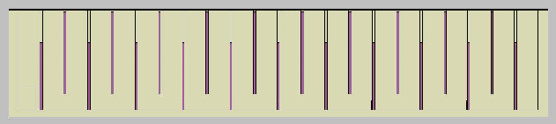
Flocculation (with vertical flocculator)
Water moves from the entrance tank into the flocculation tank, as indicated by the yellow arrow…
Then through the tank, around the baffles, as indicated by the white lines (left) and the red lines (right)
Flocculation tank, side view
This causes the flocs to collide and clump together into larger flocs
Entrance tank (right) and flocculation tank (left), top view

Slide 7
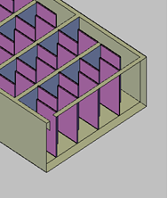
Flocculation (with horizontal flocculator)
The flocculator can also be horizontal, in which case the water will flow around the baffles as shown here.
Horizontal flocculators typically have higher flow rates and are easier to drain.

Slide 8
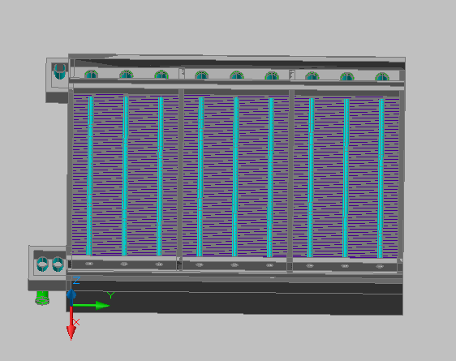
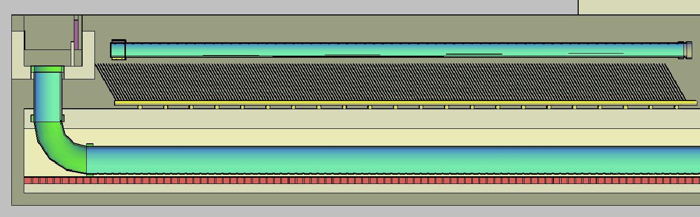
Sedimentation
Water moves from the flocculator into the sedimentation tank, where the large flocs settle out of solution.
The purple lines are “plate settlers” (catch flocs as they fall out of solution.
Arrows show direction of flow in each view
Side view of sedimentation tank
Top view of sedimentation tank (arrow indicates direction of motion)

Slide 9
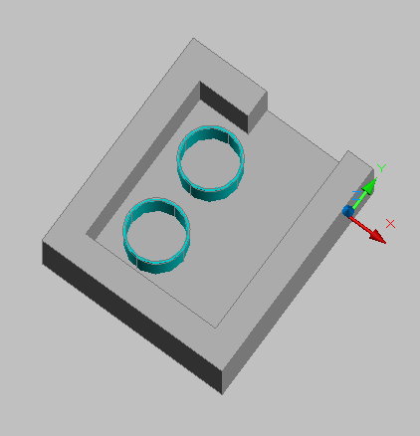
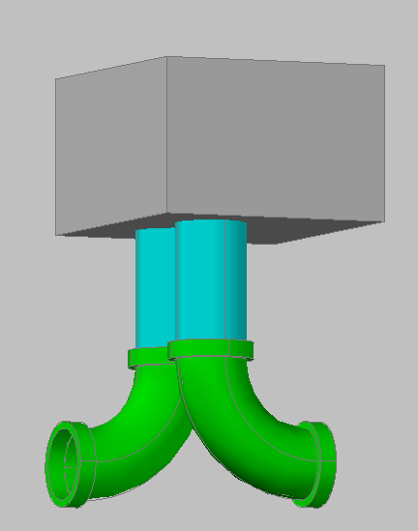
Leaving the plant
Finally, the water is chlorinated and discharged through the exit channel:
Side view of the exit channel outlets.
Top view of entrance to exit channel. Water flows into the page, through the light blue pipes.

